Slide 1
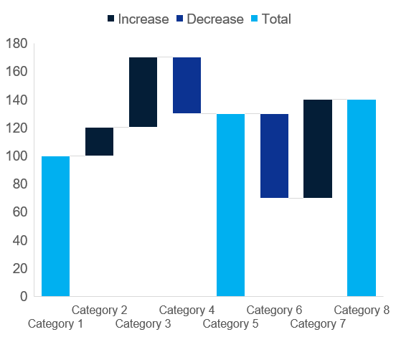
Waterfall / Clustered Column
Click to edit Header text styles
Click to edit Header text styles
Source: Complete if required

