Slide 1
Basics of regression methods

Slide 2

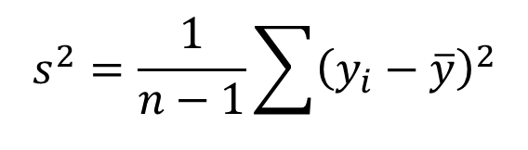
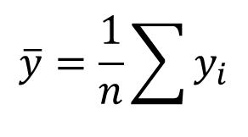

Simple example: mean and variance
$$s^{2}=\frac{1}{n−1}\sum{{\left(y_{i}−\overline{y}\right)}^{2}}$$
$$\overline{y}=\frac{1}{n}\sum{y_{i}}$$
$$y$$
$$x$$

Slide 3



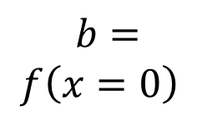

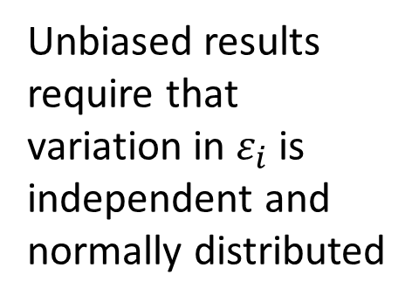
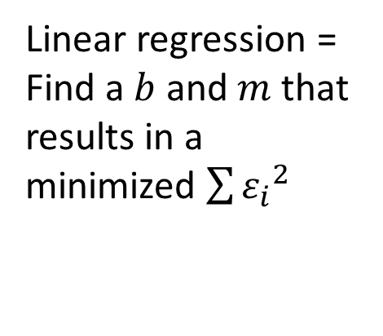
Simple example: linear regression
$$f\left(x\right)=b+mx$$
$$+ ε$$
Linear regression =
Find a $b$ and $m$ that results in a minimized $\sum{{ε_{i}}^{2}}$
$$ε=y−f\left(x\right)$$
$$y$$
$$m=\frac{∆f\left(x\right)}{∆x}$$
Unbiased results require that variation in $ε_{i}$ is independent and normally distributed
$$b= \\ f\left(x=0\right)$$
$$x$$

