Slide 1
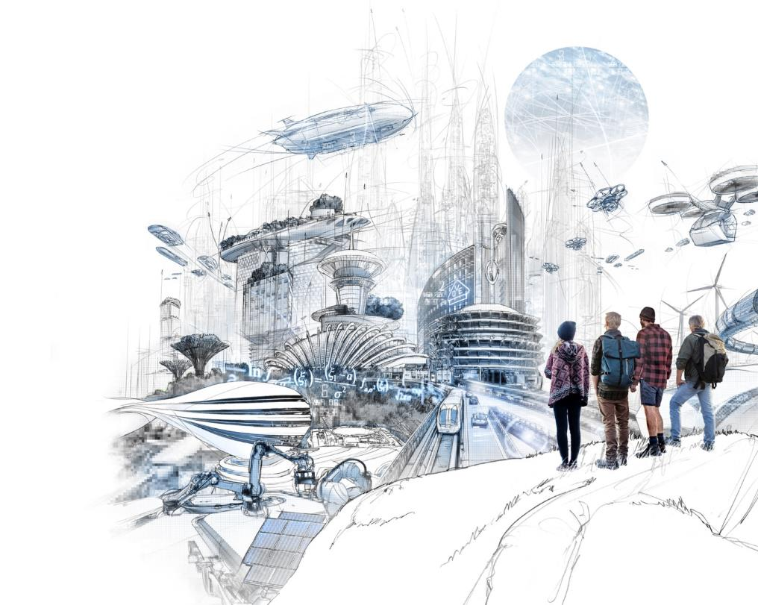

VDE ITG KT2
„Communication Networks and Systems”
9 September 2025

Slide 2



What is VDE ITG – Information Technology Society ?
Who? Association for scientists and engineers in information technology
Purpose? Platform for exchanging scientific knowledge in ICT
Activities? Networking, guidelines, training
connecting knowledge and people (events, global societies)
education and training of young professionals
develops guidelines and recommendations, technology design, societal acceptance
Notes:
Organizes international/national conferences, workshops, and discussions
Develops guidelines and recommendations
Supports scientific publications
Participates in R&D projects
Collaborates with global professional societies
Technology design and societal acceptance
Education and training of young professionals

Slide 3
Working Areas: VDE ITG
Services and Applications
Media technology
Audio technology
Communication technology
  KT 1 “Information and System Theory”
  KT 2 “Communication Networks and Systems”
  KT 3 “Optical Communication Engineering”
  KT 4 “Communication Cable Networks”
  KT 5 “Protection and Automation Technology”
  KT 6 “Internet of Things / Industry 4.0”
Technical computer science
High-frequency technology
Micro- and nanoelectronics

Slide 4
Who's in VDE ITG „KT 2“ ?
“Communication Networks and Systems”

Slide 5
Members
Chairperson
  Prof. Dr. Tobias Hoßfeld, U Würzburg
  Prof. Dr.-Ing. Wolfgang Kellerer, TU München
  Dr.-Ing. Joachim Sachs, Ericsson
Leadership team of the Technical Committee
  About 20 members in the leadership team ("Fachausschuss") of the KT2
  From Academia and Industry (e.g. Ericsson, Nokia, Siemens, Vodafone, Apple)
Members of the Technical Committee
  around 90 members from academia and industry.
  Open for everyone to join !
  Join our mailing list: https://www.listserv.dfn.de/sympa/info/itg-kt2

Slide 6

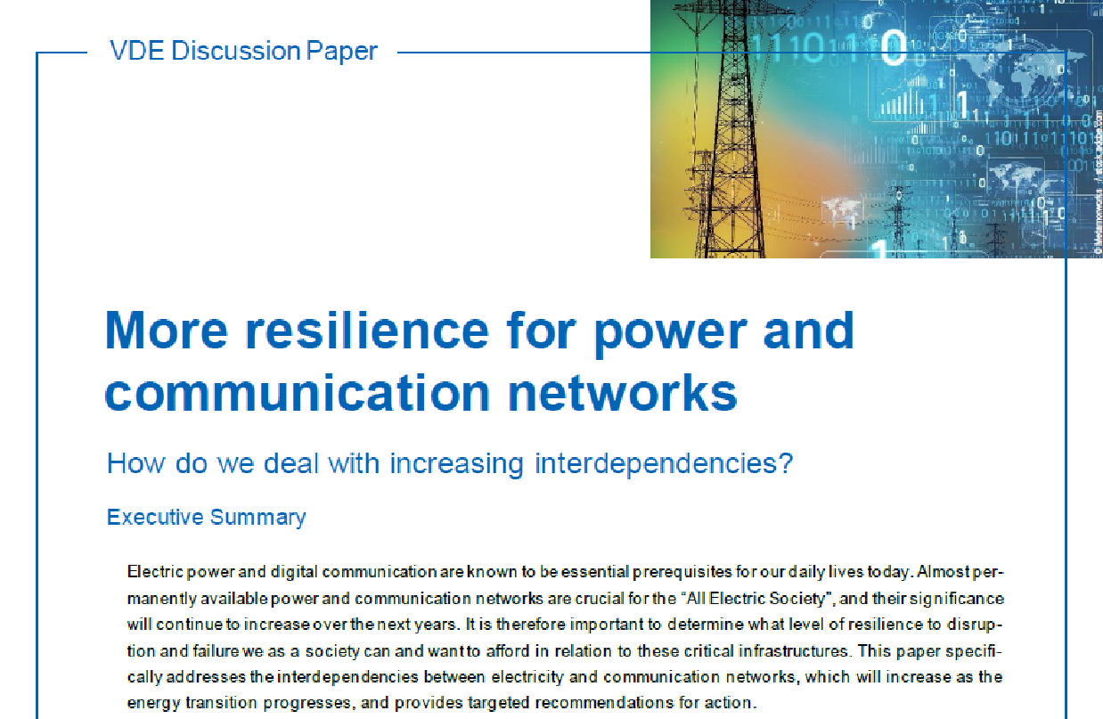
How can you benefit from ITG?

Slide 7
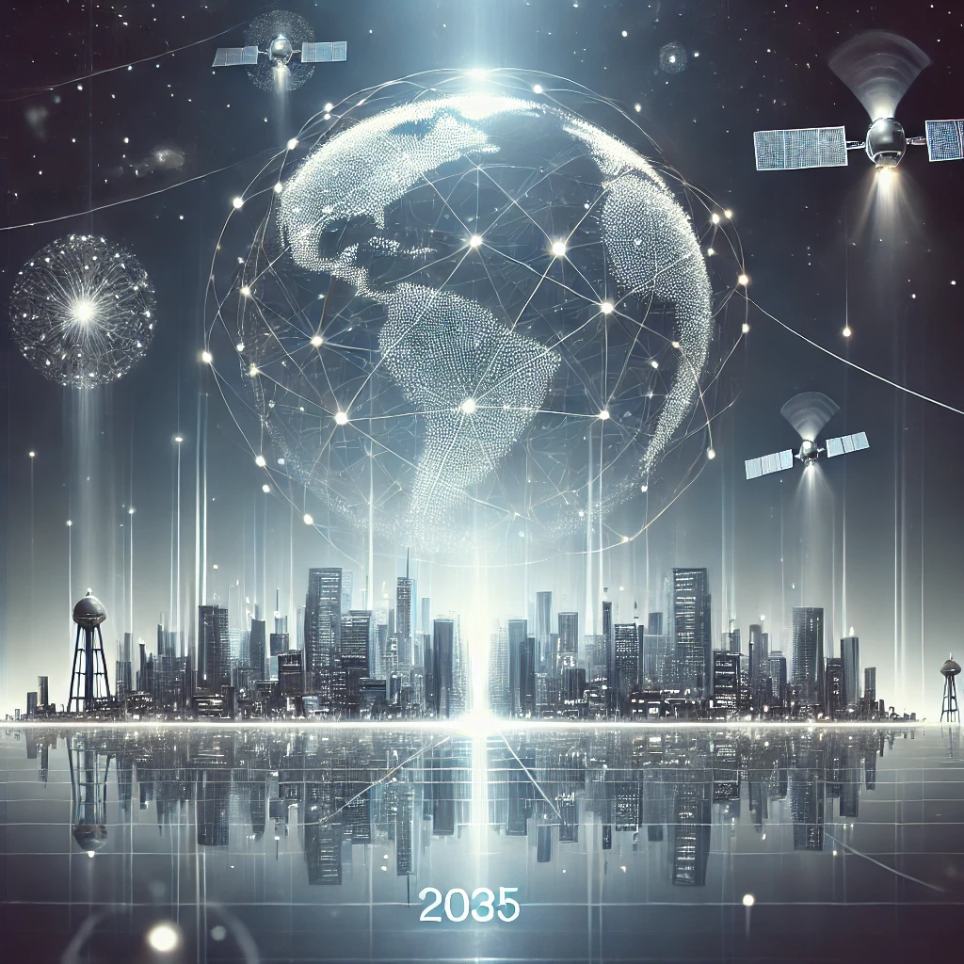
How can you benefit from ITG?
Experts from academia and industry
  get in contact with experts
    technology domain
    scientific methodology
  get feedback for preliminary work
  learn about hot topics
Questions about technology, data, methods, …
  meet and ask the people
Get informed: events, news, mailing list, …
Open for everyone to join !
VDE Positioning Paper
Information Technology
Vision 2035
Notes:
Now is the time to explore and discuss how Information Technology can help achieve and drive societal, economic, and environmental sustainability – and in line with the motto of “the future is on” for our ITG 70 Years Anniversary. We need broad societal awareness of Information Technology options to address the opportunities of the future. Information Technology will continue to have great enabling impact across all sectors of the economy, it has become one of the fundamental pillars of our daily life and a key driver of economic growth. A favorable industry and standardization environment will be a key prerequisite to make it happen.

Slide 8

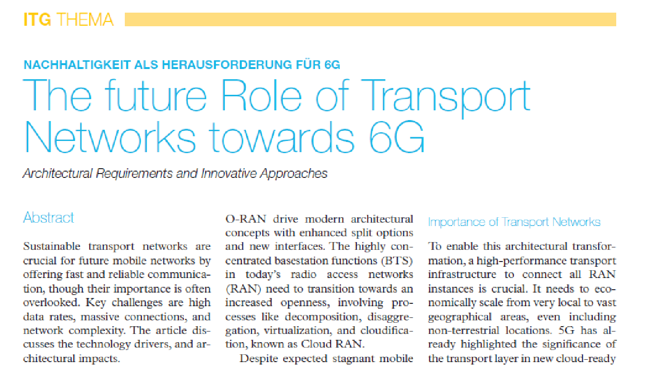
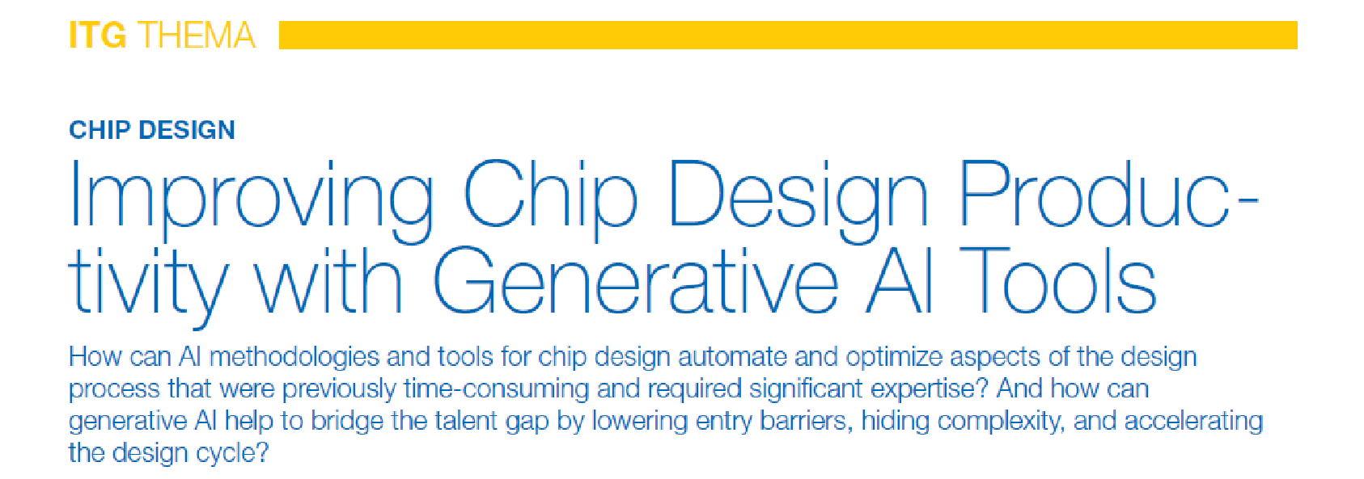
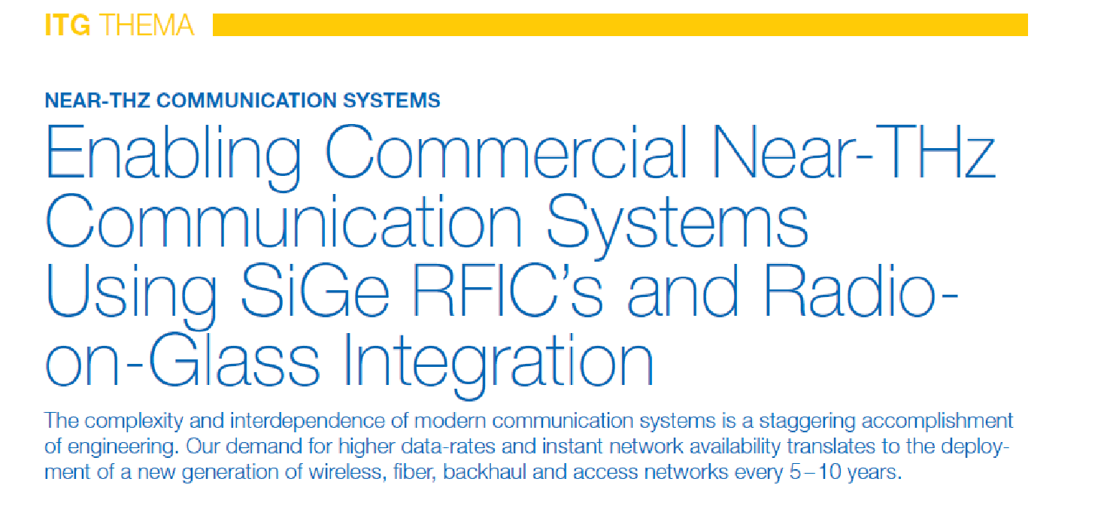

ITG News
https://www.vde.com/itg-news

Slide 9
Events (co-)organized by VDE ITG KT2
Expert Symposium: Future of Networking / Zukunft der Netze (ZdN)
  4. September 2025, Ilmenau, co-located with NetSys 2025
  Website: https://kuvs.de/netsys/2025
WueWoWAS'25 Workshop on 6G Networks
  6 - 8 October 2025, Würzburg
  Website: https://lsinfo3.github.io/WueWoWAS2025/
Interactive Munich'25 workshop "Bringing 6G into Application"
  28 Mai 2025, Nokia Munich
  Website: http://sites.google.com/view/muewowas25
29. Fachtagung Mobilkommunikation
  20 - 21 May 2025, Hochschule Osnabrück
  Website: https://www.hs-osnabrueck.de/fachtagung-mobilkommunikation/
4. KuVS Fachgespräch "Network Softwarization"
  3 - 4 April 2025, Tübingen
  Website: https://ub01.uni-tuebingen.de/xmlui/handle/10900/163069
3. TSN (in 5G/6G) Workshop
  11 - 12 February 2025, Berlin
  Website: https://5g.nrw/3rd-5g-tsn-workshop/

Slide 10
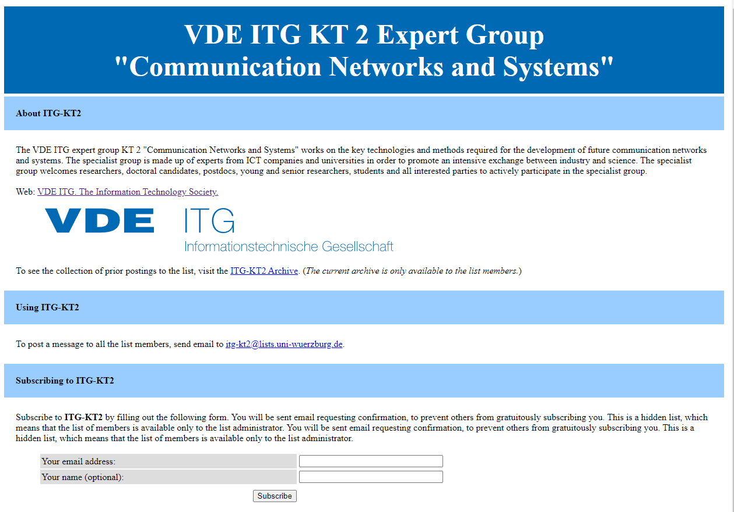
Open for everyone to join !
Just register for the mailing list. (No costs, no membership required)
https://www.listserv.dfn.de/sympa/info/itg-kt2

Slide 11

Free VDE Membership for Young Professionals
Get additional benefits by getting a VDE member
  Free entry year at no costs
  Access to a unique network
  Discounted admission to nationwide VDE events
  Acquisition of soft skills such as project management, communication skills and teamwork through participation in the VDE university groups, the specialist young talent networks or the Young Enineers Panel
  Discounts through corporate benefits
  …
Open for everyone to join !
https://www.vde.com/de/mitgliedschaft/mitgliedschaft-ueberblick/fuer-youngprofessionals
Notes:
Now is the time to explore and discuss how Information Technology can help achieve and drive societal, economic, and environmental sustainability – and in line with the motto of “the future is on” for our ITG 70 Years Anniversary. We need broad societal awareness of Information Technology options to address the opportunities of the future. Information Technology will continue to have great enabling impact across all sectors of the economy, it has become one of the fundamental pillars of our daily life and a key driver of economic growth. A favorable industry and standardization environment will be a key prerequisite to make it happen.

Slide 12
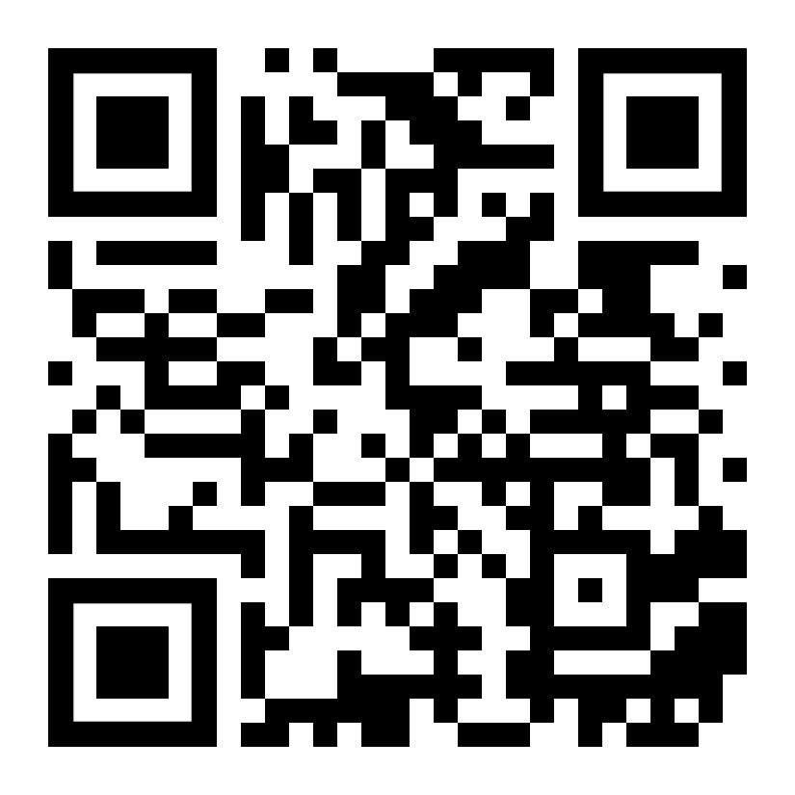
VDE ITG KT2
„Communication Networks and Systems”
Website: https://sites.google.com/view/vde-itg-kt2/
Mailing list: https://www.listserv.dfn.de/sympa/info/itg-kt2

