Slide 1



Herbal Garden
FREE PRESENTATION TEMPLATE

Slide 2

Welcome
Welcome to the world of fantasy! Join us on a journey to explore the mystical creatures, enchanted lands, and magical wonders that exist beyond our reality. Discover the wonders and secrets of this exciting realm and unlock the power of imagination.

Slide 3

Table of Contents
1
4
Introduction
Magic
The Extraordinary Realm
Spellcasting
2
5
Encounters
Adventure
Unicorn Sightings
Happily Ever After
3
6
Wonders
Conclusion
Wishes Granted
Embrace the Fantasy

Slide 4



Introduction
The Fantasy Realm: Uncovering the Secrets of the Imagination and the Magic that Lies Within
EaTemp

Slide 5

The Realm of the Extraordinary
Welcome to the Fantasy World, a realm of wonder and enchantment where anything is possible. Here, dragons breathe fire, unicorns prance through meadows, and rainbows shine brightly. This world is a place where wishes come true, where potions can be cursed and spells are cast. It's a place of treasure and adventure, where the impossible becomes possible. But the greatest treasure of all is the one that lies within.
The world of fantasy is a reflection of our deepest desires, our fondest dreams, and our wildest imaginations. It's a place where we can let go of the constraints of reality and explore the boundless possibilities of the human mind. In this introduction, we will delve into the mysteries of this realm, uncovering the magic and wonder that lies within. So come with us and let's embark on a journey through the Fantasy World.

Slide 6
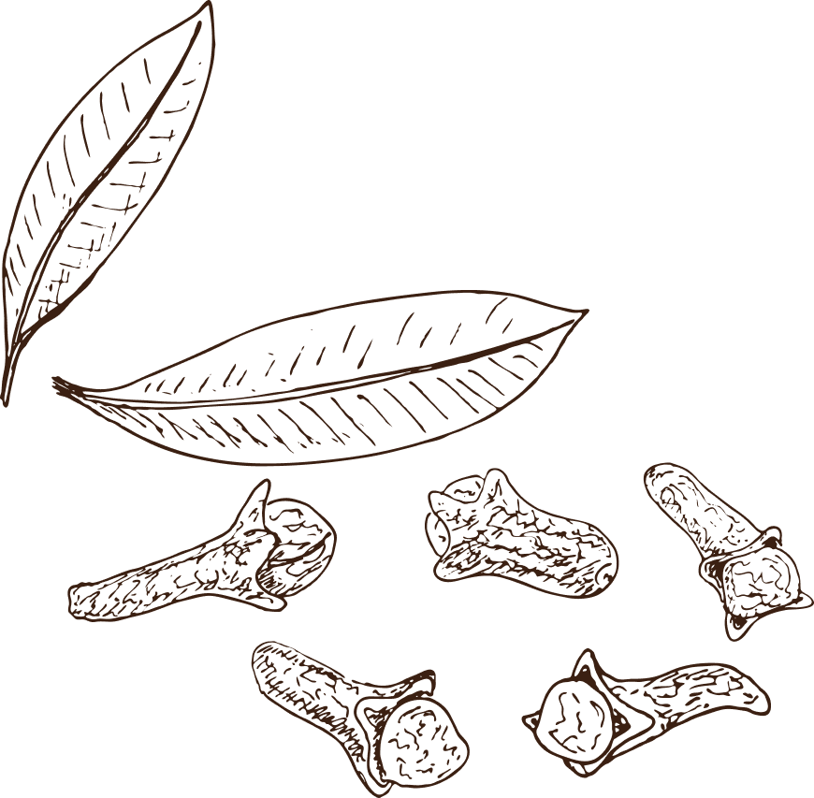
Imagination and Fantasy
  Embark on an adventure filled with magic and wonder
  Tame dragons, see unicorns and experience rainbows every day
  Discover yourself and unlock your imagination through exploration
  Experience the manifestation of your deepest desires and fondest dreams
  Leave reality behind and immerse yourself in a world of endless possibilities

Slide 7



Unicorn Sightings
A record of the number of unicorns spotted in the fantasy realm and the beauty and mystery that surrounds these enchanting creatures.
Dragon Taming
A closer look at the art of taming dragons and the brave adventurers who dare to take on these fearsome creatures.

Slide 8



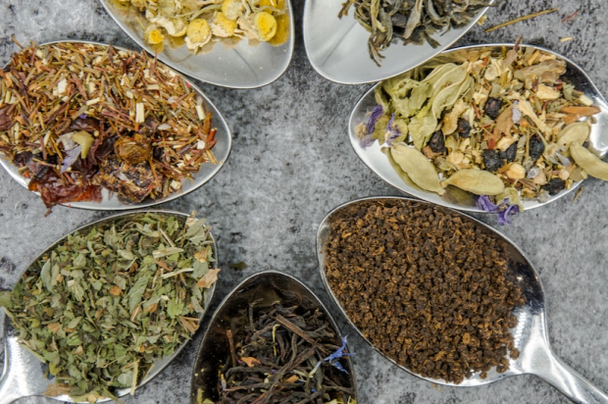

Unicorn Sightings
Dragon Taming
A record of the number of unicorns spotted in the fantasy realm and the beauty and mystery.
A closer look at the art of taming dragons and the brave adventurers who dare to take on these fearsome creatures.

Slide 9



Fantasy is the gateway to the impossible, the land where the ordinary becomes extraordinary, and the impossible becomes possible. It is the realm of the imagination, where anything can happen and everything is possible.
The Dream Weaver

Slide 10


Taming Dragons and Sighting Unicorns: A Guide to the Realm of Magic and Adventure
In the Realm of Magic and Adventure, dragons are no longer fearsome beasts to be feared. They can be tamed and even become loyal companions to those brave enough to venture into the unknown. Similarly, unicorns, long considered to be mythical creatures, can now be sighted in this fantastical realm. The world is filled with endless possibilities and endless adventures.

Slide 11


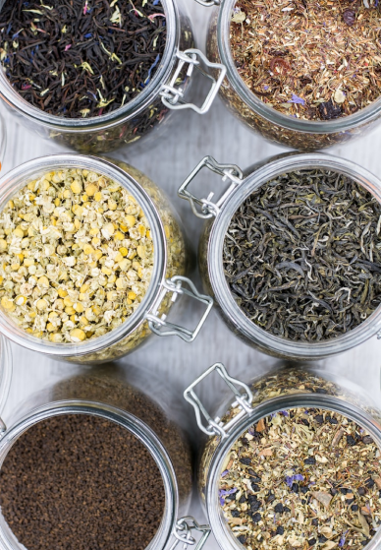

Exploration of the Inner Self:
A Journey of Self-Discovery

Slide 12
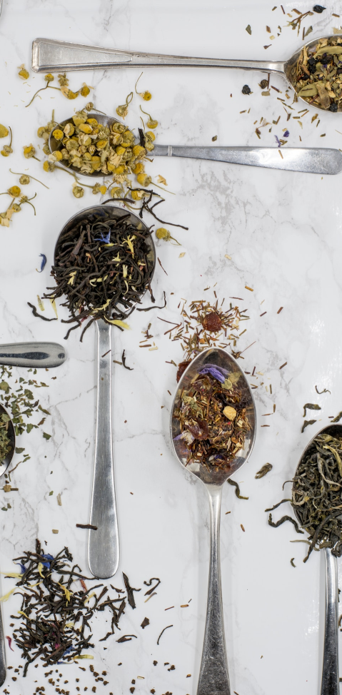




Some Data
75%
Enchanted Creatures
possess the ability to cast spells.
60%
Magic-Wielding Individuals
practice the art of illusions.
90%
Spells Cast
are dark magic, foretelling danger.

Slide 13


234,567
UNICORN SIGHTINGS
A tally of the number of unicorns spotted in the fantasy realm.

Slide 14


233 Coins
85%
Treasure Found
Wishes Granted
456 Minutes
678 Km
Duration og Spell Casting
Journey Distance

Slide 15























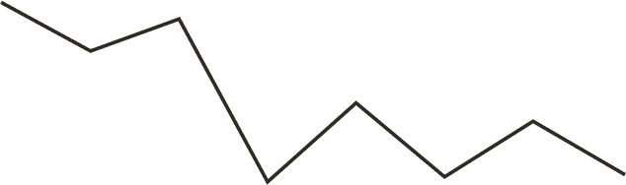
























Some Graph
100
90
80
70
60
50
68%
40
30
20
10
0
1
2
3
4
5
6
7
8
Treasure Found
Spellcasting Progress
A record of the amount of treasure found per month
A record of the number of spells cast per year

Slide 16

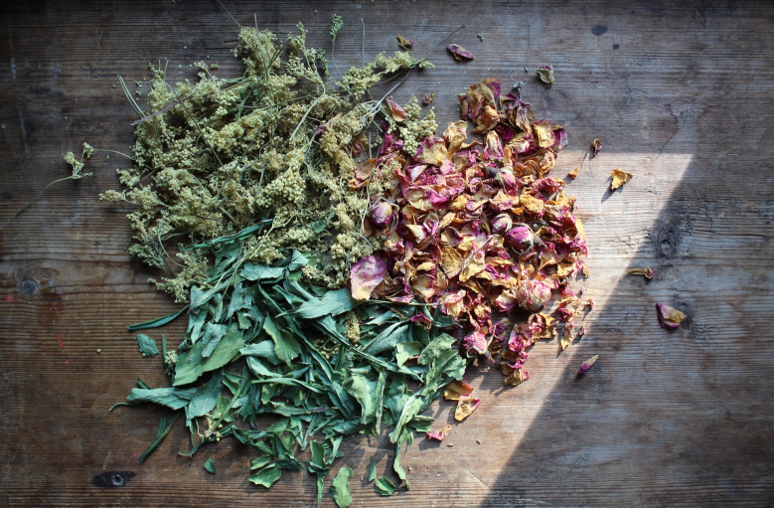

Portal to Adventure
A web application
A web application designed for discovering the world of fantasy

Slide 17

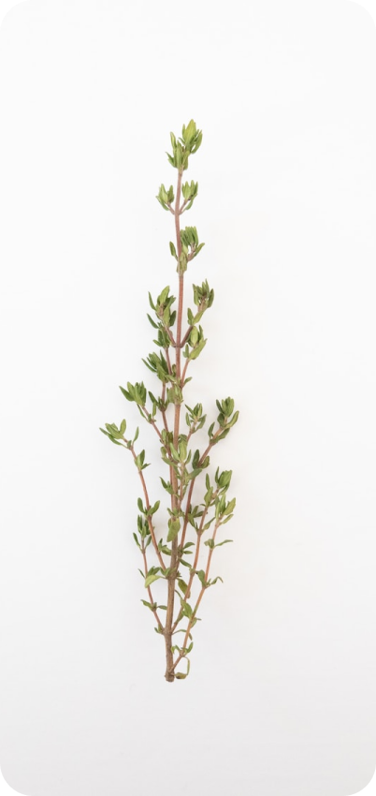

The Future of Fantasy
An mobile app
An app designed for exploring and experiencing the enchanting realm of fantasy
  Explore a magical world
  Experience fantasy firsthand
  Immerse in a realm of magic
  Discover untold wonders
  Live your fantasy dreams
  Unleash imagination.

Slide 18
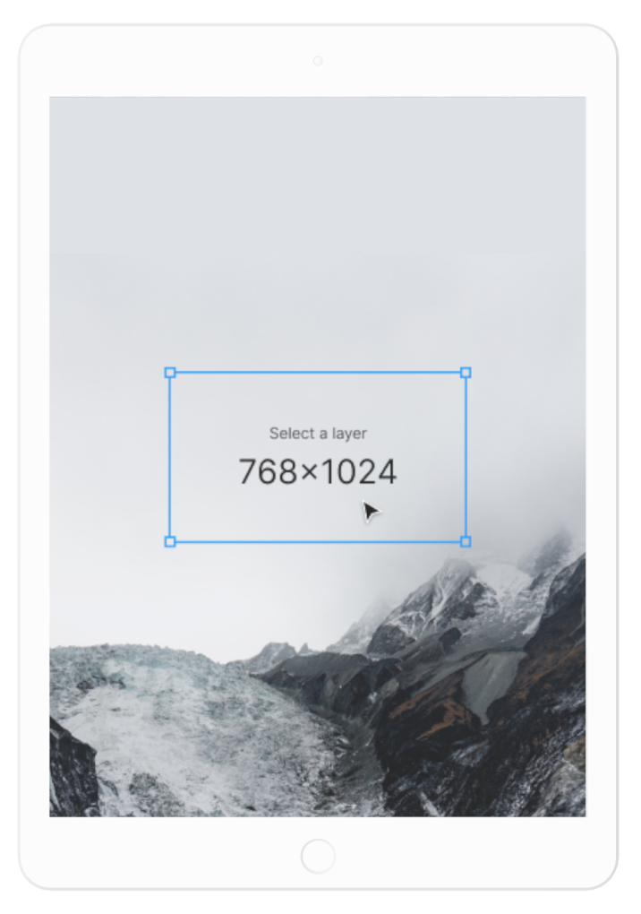
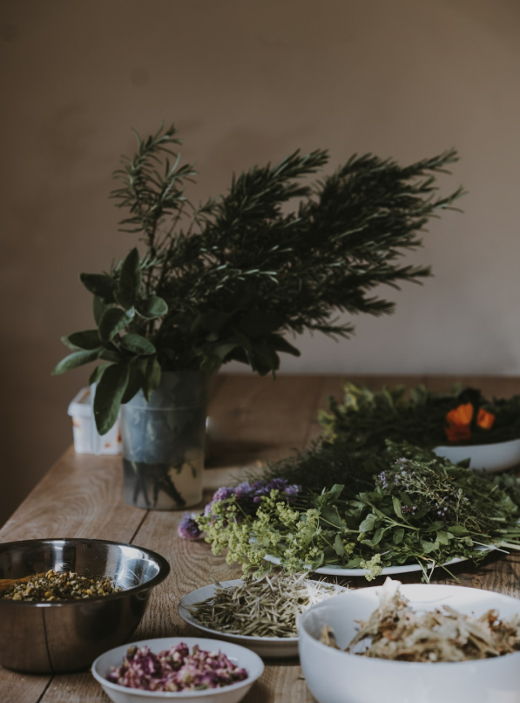
A Gateway to a World of Fantasy and Wonder
  Immerse yourself in the world of magic and mystery
  Explore uncharted territories and fantastical lands
  Meet mythical creatures and legendary beings
  Uncover hidden treasures and secret treasures
A web application
A web application designed for discovering the world of fantasy

Slide 19

The Enchanted Forest
A magical forest filled with talking animals and enchanted creatures.
The Crystal Caves
A network of underground caves filled with precious gems and crystals.
The Dragon's Lair
A dangerous and mysterious place where dragons reside.
Fantasy Realm at a Glance

Slide 20




Our Team
Elementalen
The Guardians of the Four Elements
Lunaria
The Moon Priestess
Eldruin
The Fire Mage

Slide 21

Thank you for choosing EaTemp
We offer free and high-quality slides templates for your presentations. We appreciate you choosing us and hope our templates have been helpful.
As a new website, we rely on your support to grow, so please help us by sharing our site with your friends and colleagues.
Credit | Image: Unsplash

