Slide 1
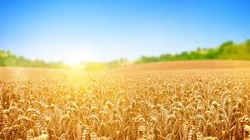
Oh no, the sequence of steps for making bread is out of order. Help the Little Red Hen by putting the steps back in order.
To customize this graphic organizer, change the instructions, replace the background image (or delete it), and change text for the tiles to be arranged.
Care for the wheat
Make the dough
Carry the wheat to the mill
Cut the wheat
Mill the wheat
Eat the bread
Plant the seeds
Bake the bread

