Slide 1
Teacher Preparation and Education Reform: A Behavioral Systems Perspective
Çhair: Ronnie Detrich, Wing Institute
Discussant: Chuck Salzberg, Utah State University
ABAI May 29, 2010
San Antonio, Texas

Slide 2
Context for Session
By almost any standard, many if not most of the nation's 1,450 schools, colleges, and departments of education are doing a mediocre job of preparing teachers for the realities of the 21st century classroom.
Arne Duncan, Secretary of Education

Slide 3
What Teacher Practices Influence Outcomes?
Desired
Discrepancy = Problem
Are We Teaching Effective Practices?
Actual
Student Outcomes
How Are We Supporting
Teachers?

Slide 4
Presentations
What We Know About Effective Teaching
Ronnie Detrich, Wing Institute
200 Years of Teacher Preparation: What Have We Learned?
  Jack States, Wing Institute
Teacher Induction: Where the Rubber Meets the Road
  Randy Keyworth, Wing Institute

Slide 5
A Few Words About the Research
Depends on the best available evidence:
  Not very rigorous.
    Relies on indirect measures of behavior (interviews, surveys, reflective journals).
    Few instances of experimental investigations.
  Much of what we are reporting will serve as baseline for where we are as a profession.

Slide 6
What We Know About Effective
Teaching
Ronnie Detrich
Wing Institute
ABAI, 2010
San Antonio, Texas

Slide 7
Behavioral Systems Perspective
Focus on results (worthy accomplishments)
  Worthy accomplishments: Value of accomplishment exceeds cost of producing it.
  What is valued is socially defined.
  Accomplishments must be precisely defined.
Based on concepts from Tom Gilbert Human Competence: Engineering Worthy Performance

Slide 8
Behavioral Systems Perspective
Measure accomplishments to determine if there is a problem.
    If accomplishments are not acceptable then determine performance that is related to the accomplishment.
      Measure it
    Performance is interesting and important only as it relates to specific accomplishments.
      Context is everything.

Slide 9
Behavioral Systems Perspective
System resources allocated to support important performance.
  Identify important performance that has greatest potential for improvement relative to the cost for producing the improvement.

Slide 10
Where Does Education Stand from Behavioral Systems Perspective?
There is no consensus worthy performance.
  NCLB places great value on reading and math.
  Method for measuring (high stakes testing) has been broadly criticized.
    Standards for acceptable performance by students vary across states.

Slide 11
Where Does Education Stand from Behavioral Systems Perspective?
Abundance of research suggesting teachers are very important in education of students.
  Improving teacher performance likely to have substantial impact on student achievement.
  NCLB emphasizes teacher quality by requiring “highly qualified teacher” in every class.
    Methods for determining “highly qualified” are rarely linked to student performance.
      Vary across states.

Slide 12
Where Does Education Stand from Behavioral Systems Perspective?
No agreement that student outcomes are best measure of effectiveness of teacher.
  Some rely on teacher characteristics and aptitudes as measures of quality teacher.
  Federal Department of Education is advocating a direct link between student outcomes and evaluations of teachers.
    From a functional perspective one has not taught until students have learned.
      Linking teacher quality to student achievement appropriate with caveats.

Slide 13
Applying A Behavioral Systems Perspective to Education
Are our schools achieving worthy accomplishments?
  Since 1980s we have been measuring student performance in standardized way (The Nations Report Card).

Slide 14
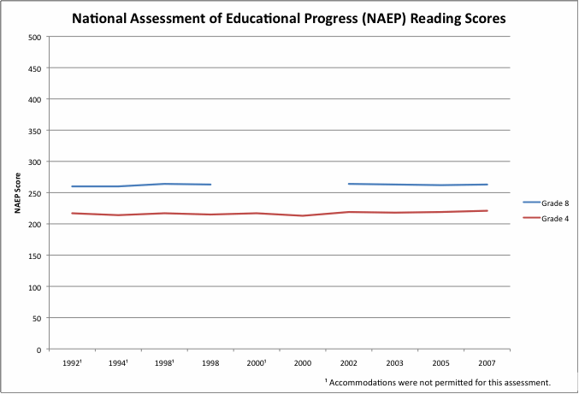
8th Grade Proficiency Standard
4th Grade Proficiency Standard

Slide 15
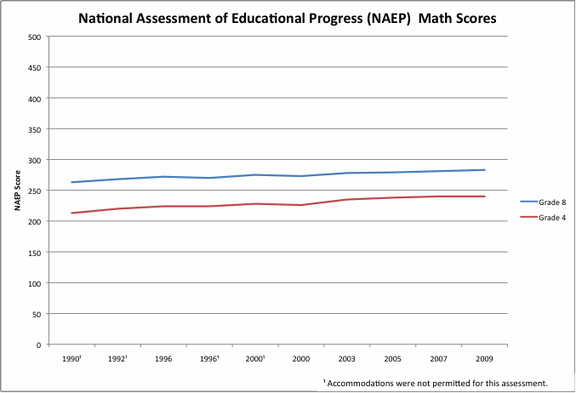
8th Grade Proficiency Standard
4th Grade Proficiency Standard

Slide 16
Applying Behavioral Systems Perspective
Problem is well established.
Teachers contribute significantly to important outcomes.
What do teachers do that influences student achievement?

Slide 17
Teacher Influences on Student Achievement
Classroom Management:
  Maintain active participation by all students.
Student/Teacher Social Interactions:
  Positive response to students.
Classroom Climate:
  Emphasize cooperative goals.
Classroom Instruction:
  Clear and organized direct instruction.
Academic Interactions:
  Frequent calls for substantive oral and written response
Wang, Haertel, & Walberg, 1997

Slide 18
Teacher Influences on Student Achievement
Classroom Assessment:
  Assessment used as a frequent integral component of instruction.
Classroom Implementation and Support:
  Established efficient classroom routines and communicated rules and procedures.

Slide 19
What Do Teachers Do that Influences Student Achievement?
Teacher expectations: believe students can learn and teachers are capable of teaching successfully.
  Teach until material is learned.
  Develop supplemental materials to increase learning.
Exposure to academic content/opportunity to learn.
  Most time allocated to instruction.
Brophy & Good, 1986

Slide 20
What Do Teachers Do that Influences Student Achievement?
Classroom management and organization.
  Effectively organize classrooms as learning environments, minimize transitions, getting organized, and maximize engagement with instructional activities.
Active teaching.
  Spend great deal of time actively instructing students rather than emphasizing time on task.
  More time spent on interactive lessons.
Supportive learning environment.
  Maintain pleasant, friendly classrooms.
  Supportive instructors.
Brophy & Good, 1986

Slide 21
Summary of Research on Critical Skills
Formative Assessment
  Frequent assessment to determine progress
Active Teaching
  Majority of time spent on instruction
  Frequent opportunities to respond
  Directly teach skills

Slide 22
Summary of Research on Critical Skills
Active, positive classroom behavior management
  High rates of positive feedback
  Create classroom culture
Organized, efficient classroom routines
  High level of engagement with instruction
  Clearly communicated expectations

Slide 23
Unanswered Questions
Broad categories rather than specific practices.
  There may be several evidence-based practices that increase opportunities to respond
    Choral responding.
    Student response cards.
  Do we teach specific practices or do we teach principles which inform practices?
    Principles can only be applied in the context of a practice.
    What is the appropriate balance between specific practices and general principles?

Slide 24
Unanswered Questions
What depth of training is required to impact teacher performance and student achievement?

Slide 25
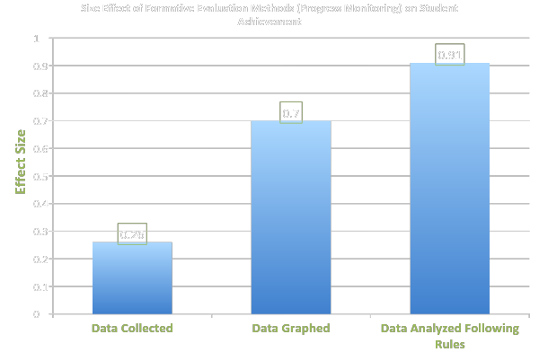
The Value of Increasing
Depth of Instruction
Effects of Systematic Formative Evaluation: A Meta-Analysis, Fuchs & Fuchs, 1986

Slide 26
Caveats
Students will do well when their teachers do well.
Teachers will do well:
  When teacher preparation programs teach the critical skills to be effective.
  When Universities and Districts provide adequate levels of support for teachers during their entire tenure.
    Not just in the first year or two.
Revolutionary change is required.

Slide 27
Thank you
Presentation may be downloaded at
www.winginstitute.org

