Slide 1



Slide 2













SINCE 2009
  GROWN FROM 66 TO 60 K+ AGENTS
  OPENED 170+ OFFICES
  FOUNDED BY PATRICK BET-DAVID
  PROTECTED OVER 1 MILLION FAMILIES
  OUR VISION IS SAVING AMERICA BY BRINGING BACK FREE ENTERPRISE & HOPE TO AMERICAN FAMILIES
  OUR VISION IS 500K AGENTS BY 2029
7
7.1 M + SUBSCRIBERS
#1 CHANNEL FOR ENTREPRENEURS

Slide 3



Slide 4



UNDER $100K
OVER $250K
  PAYCHECK TO PAYCHECK
  LITTLE TO NO SAVINGS
  RENTING
  65+
  401K PLAN
  SOCIAL SECURITY
  INVESTMENTS
  Stocks
  Mutual Funds
  Insurance
  50+
  Own Properties
  Financially Free

Slide 5





3 TYPES OF TRAINING
IN-PERSON TRAINING:
  WEEKDAY 7-9 PM: HOW TO RUN A BUSINESS
  WEEKEND 10-12 PM: HOW MONEY WORKS
FIELD TRAINING:
30 MINUTES DUPLICATING AN EXPERT IS BETTER THAN DOING IT YOURSELF
LICENSING:
A. CLASS
B. Test
C. Fingerprints
D. Licensing Fee
DIFFERS PER STATE

Slide 6



GETTING CLIENTS
WE DON’T DO COLD CALLING, DOOR TO DOOR, OR BUY LEADS
ALL OF OUR CLIENTS COME FROM WORD OF MOUTH, REFERRALS, & SOCIAL MEDIA

Slide 7


GETTING CLIENTS
  AGENT TEACHES CLIENT ABOUT INSURANCE & RETIREMENT.
  AGENT FINDS THE BEST COMPANY FOR THE CLIENT.
  COMPANY COMPENSATES THE AGENT.
CLIENT PAYS $0 FOR OUR SERVICES
NO MARKUPS TO ANY COST

Slide 8


WHAT SEASON OF YOUR LIFE ARE YOU IN?
BUILD A LEGACY FOR YOU & YOUR FAMILY
MAKE EXTRA INCOME

Slide 9


COMPENSATION
PART-TIME
BROKER
RESIDUAL
5 CLIENTS PUT AWAY $200 A MONTH INTO A POLICY:
  $200 X 12 = 2,400 POINTS
  2,400 POINTS X 5 CLIENTS = 12,000
  12,000 POINTS X 50% =
    $6,000 MONTHLY
    $72,000 ANNUALLY
10 LICENSED AGENTS:
  EACH LICENSED AGENT WRITES 5 POLICIES A MONTH
    @ $200 A MONTH PREMIUM
  $200 X 12 = 2,400 POINTS
  2,400 POINTS X 5 POLICIES = 12,000 POINTS/ MONTH
  12,000 POINTS X 10 LICENSED AGENTS = 120,000 POINTS
  AVERAGE BROKER SPREAD (40%) =
    $48,000 MONTHLY
    $576K ANNUALLY
  YOUR PART-TIME AGENTS MAKE $72,000 A YEAR
INCLUDES YOUR PERSONAL
POLICY + TEAM POLICIES
Most Carriers Pay 3%+ in residual
  PERSONAL PAID POINTS: $720,000 X 3% = $21,600
  BASE PAID POINTS (EXCLUDING PERSONAL): $2,945,000 X 40% OVERRIDE = $1,178,000 X 3% =$35,340
  TEAM PAID POINTS (EXCLUDE BASE + PERSONAL): $4,757,000 X 10% OVERRIDE = $475,700 X 3% =$14,271
  TOTAL = $71,211 YEARLY

Slide 10
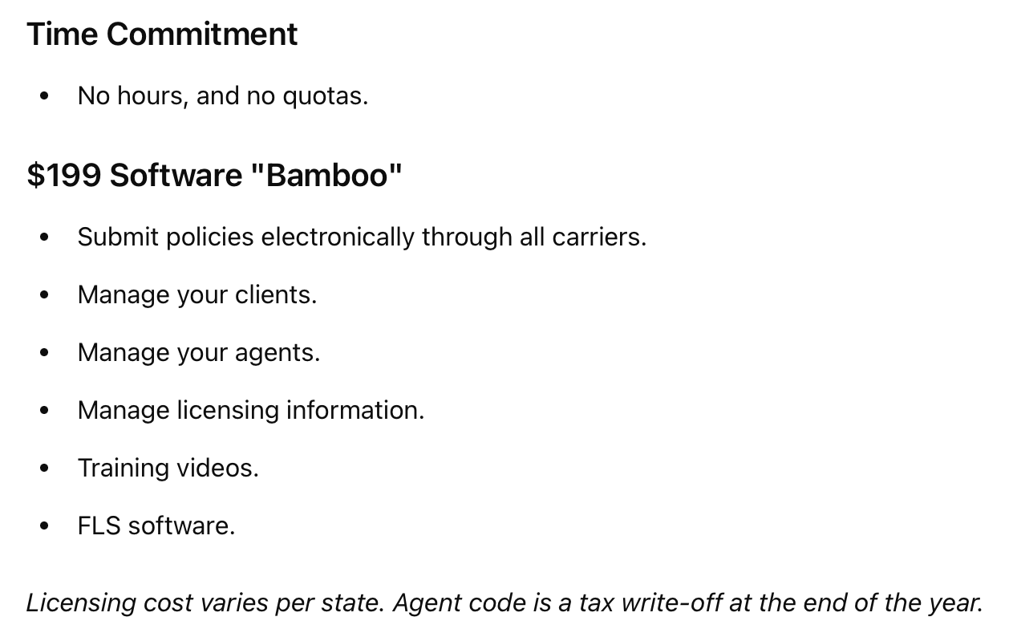



WHAT YOU NEED TO GET STARTED
HOW
URGENT ARE YOU?
BACKGROUND
MISDEMEANORS
FELONIES
TAX LIENS
BANKRUPTCIES

