Slide 1
How to plan for the world of work
This session is aimed at Key Stage Four (recommended for Year 10)

Slide 2
What is FT Flic?
In 2021 the Financial Times newspaper set up a charity, FT Flic (Financial Literacy and Inclusion Campaign).
FT Flicfocuses on building up the financial knowledge and skills of everyone in the UK, especially the people that don’t usually come across this information.

Slide 3
Five ways to ensure we have a respectful learning environment
We will listen to each other respectfully
We will avoid making judgements or assumptions about others
We will comment on what has been said, not the person who has said it
We won’t put anyone on the spot and we have the right to pass
We will not share personal stories or ask personal questions
If there is a question that you do not wish to ask aloud, you can write it on a post-it note which will be collected throughout the session and answered at the end
Notes:
Teacher delivery
Students should be invited to ask questions and they should be provided with an opportunity to ask questions anonymously. It is useful to have a question box or allocated space on the whiteboard for students to share questions.
It is suggested that students are provided with post-its or slips to write their questions on and as the teacher circulates throughout the lesson these questions can be collected and answers throughout the session or using an allocated ‘question time’ at the end of the session.
Students can be invited to respond to questions asked by their peers. If responses to questions are based on personal preference or opinion, the teacher should be clear to preface any answers with this.

Slide 4
Session 1:
Professional services careers

Slide 5
Unit outline
Session 1 | Session 2 | Session 3 | Session 4 | Session 5
Professional services careers | Apprenticeships | Entrepreneurship | Understanding gig work and employment rights | Speaking up at work

Slide 6






Starter: What jobs are these?
What job does each picture represent?
Describe in detail what kind of work each person might do.

Slide 7

Professional services careers: Match up
Personal assistant
1
Investment analyst
2
Auditor
3
Think - Pair - Share
What could these careers involve?
PR manager
5
Marketing manager
4
Underwriter
6
Activity
Using the worksheet Professional services careers, match each career to their brief description
Business development manager
8
Accountant
7
Management consultant
9
Activity 1: Professional services careers
Notes:
Teacher delivery
Assign pairs a number between 1-9, corresponding to the career they will be discussing.
Give students 1-2 minutes to think about what these careers involve. Another 1-2 minutes to discuss their ideas with their partner, before selecting students to share their ideas with the class.
Additional Context
Today we are exploring 9 professional services jobs but there are plenty of others that exist

Slide 8
Job title | Description
Underwriter | Takes a look at an organisation's finances and assesses how much risk a lender will take on if they decide to give the organisation a loan.
 | Checks organisations' financial records and procedures to make sure they are accurate and efficient.
 | Trained experts who solve complex business problems and develop strategies to improve performance.
 | Creates and maintains a favourable public image for their employer or client.
 | Plans how to promote products, services or brands, using advertisements, email campaigns, social media and events.
 | Helps businesses make critical financial decisions by collecting, tracking and correcting the company's finances.
 | Builds relationships with customers, suppliers and partners to help businesses grow and improve.
 | Helps stock market traders, stockbrokers and fund managers make decisions about investments.
 | Carries out support activities for individuals and managers including administration, diary management and event planning.
Answers
Auditor
Management consultant
PR manager
Marketing manager
Accountant
Business development manager
Investment analyst
Personal assistant

Slide 9
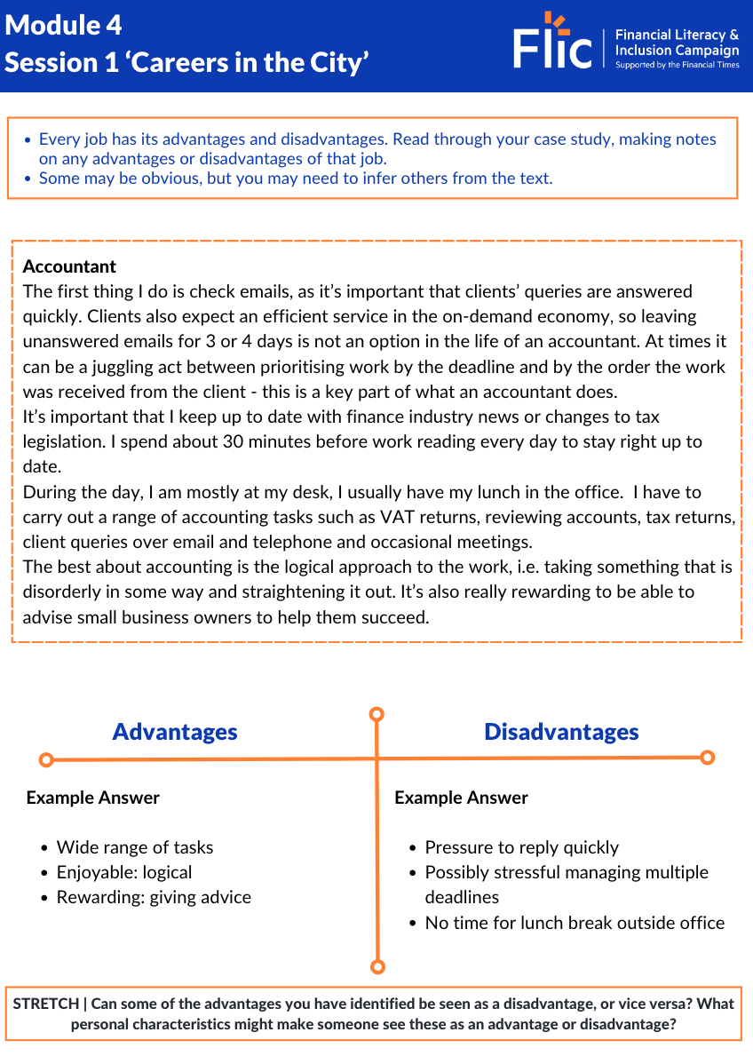
Case Studies
Example:
Every job has its advantages and disadvantages.
Read through the example role (Accountant)
The advantages and disadvantages are completed underneath
Your turn:
Read the description of the Marketing Manager role
Fill in the advantages and disadvantages

Slide 10


Reflection: Is a career in professional services for you?
Would you consider any of the careers that you have researched today?
Do you know which course you should consider as an entry route to any careers of interest?

Slide 11
4
Session 2:
Apprenticeships

Slide 12
Unit outline
Session 1 | Session 2 | Session 3 | Session 4 | Session 5
Professional services careers | Apprenticeships | Entrepreneurship | Understanding gig work and employment rights | Speaking up at work

Slide 13






Starter: Apprenticeships discussion
What do you know about apprenticeships?
Write down a list of things that you know about apprenticeships.
Use the pointers below for some guidance.
Age
Levels
Fee
Income
Training
Time
Qualifications
Notes:
Teacher delivery
Allow 2 minutes for students to write down bullet points of things they know about apprenticeships.
Gather feedback from a handful of students.
The lesson will address each of the pointers.

Slide 14

What are apprenticeships?
Questions
What three things will you do simultaneously (at the same time) on an apprenticeship?
Do apprenticeships result in a qualification?
What is a degree apprenticeship?
What are the benefits of apprenticeships to employers?
Video (watch to 01:45) - Apprenticeships vs university: which is best? | FT Schools
Notes:
Teacher delivery
Video to stop at 01:45.
Allow a further 5 mins to answer questions

Slide 15
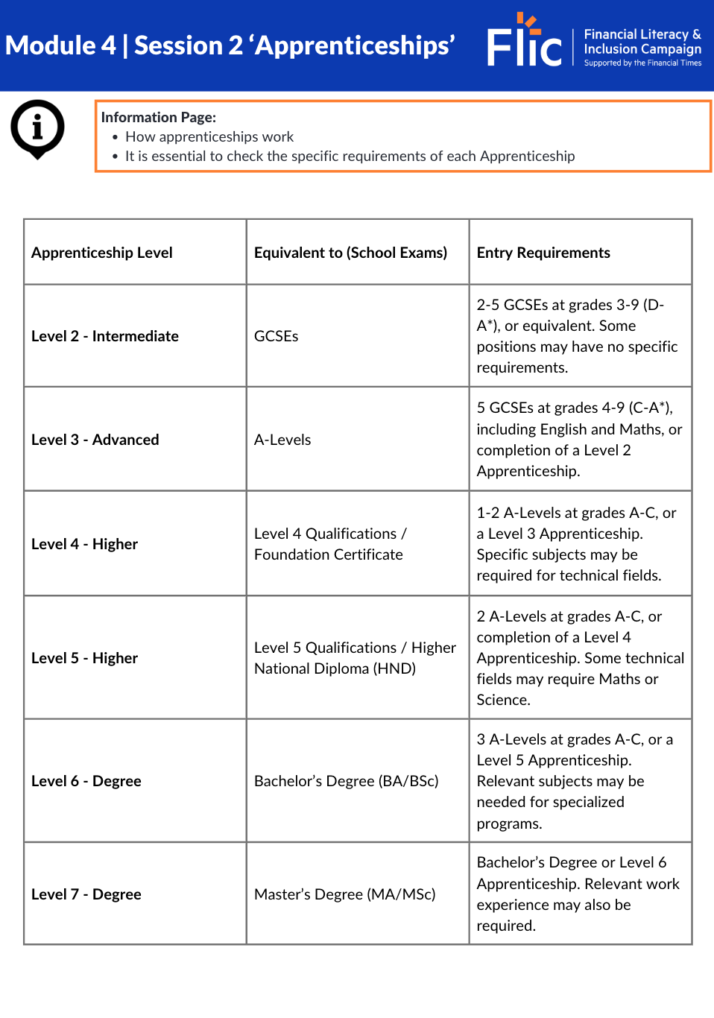
Apprenticeship levels explained
In your workbook:
Refer to your workbook to see an explanation of each apprenticeship level

Slide 16
Becoming a Solicitor
Why might someone choose Route 1?
Why might someone choose Route 2?
Route 1
Route 2
Complete A levels
Gain a Bachelor in Law qualification
Study law at university
Complete a Level 7
Solicitor Apprenticeship
Maths Moment - stretch
Assuming a law degree costs £9,000 per year for three years and the SQE exams costs £3,980, whilst the Level 7 solicitor apprenticeship annual salary is £24,000, what’s the difference in the amount of money earned or owed after 3 years if the person took Route 2 instead of Route 1?
Given this, why might somebody still choose Route 1?
Required to complete the next stage. Can be done through placements at university
Gain 24 months work experience
Gains a Bachelor in Law qualification, as well as solicitors qualification exams. Lasts 6 years, in which 4 days a week are spent working, and 1 day is spent studying
Tests legal knowledge and practical legal skills
Complete the
Solicitors Qualifying Examinations (SQE)
Apply to be a solicitor
Notes:
Teacher delivery
The first two questions are to get students to start thinking about the advantages and disadvantages of the various post 16 options. Students should be able to identify personal preferences that make one option more appealing than others. Gather student’s answers in a whole class discussion.
Maths moments - stretch
Students can then complete the maths moment individually.
Answer: The apprentices will earn £72,000 over the three years of the apprenticeship whilst the university student will pay a total of £30,980. In total, the apprentice would be £102,980 better off.
Answer: University offers the chance to pursue a broader range of careers later in life; it might also offer the potential to earn more money in a career
This is a useful time to assess some further advantages and disadvantages of post 16 routes. In this case, whilst both can lead to the same career, route 2 may take twice as long, especially if university students manage to gain work experience whilst studying.

Slide 17
Becoming a Marketing executive
Route 1
Route 2
Complete GCSEs
What challenges might someone face if they started on Route 1, but decided they no longer wanted a career in digital marketing?
Would these challenges be the same for someone who started on Route 2?
Complete a Level 3 Apprenticeship in Digital Marketing
Study for
A Levels
Specific A levels won't necessarily be required for a career in digital marketing
Complete a Level 5 Marketing Executive Apprenticeship
Complete a university degree
A range of degrees could be useful for a position in digital marketing
Apply to become a
marketing executive
Notes:
Teacher delivery
The first two questions are to get students to start thinking about the advantages and disadvantages of the various post 16 options. Students should be able to identify personal preferences that make one option more appealing than others. Gather student’s answers in a whole class discussion.
This is a useful time to assess some further advantages and disadvantages of post 16 routes. In this case, whilst both can lead to the same career, route 2 may take twice as long, especially if university students manage to gain work experience whilst studying.

Slide 18

Higher (L6 and 7) Apprenticeships vs University
What are the advantages and disadvantages of taking Level 6 and 7 apprenticeships?
Advantages of doing a Degree Apprenticeship | Disadvantages of doing a Degree Apprenticeship
Start earning an income at least three years earlier than studying for a degree Gain valuable work experience Have the opportunity to progress through a career while peers are studying No tuition fees All of the advantages of the previous slide, plus Could come out with the same degree as going down the university route, only with no student debt | Not all degrees are available through a degree apprenticeship May miss out on aspects of university life despite acquiring a degree

Slide 19
Reflection
Would you consider an apprenticeship?

Slide 20
Session 3:
Entrepreneurship

Slide 21
Unit outline
Session 1 | Session 2 | Session 3 | Session 4 | Session 5
Professional services careers | Apprenticeships | Entrepreneurship | Understanding gig work and employment rights | Speaking up at work

Slide 22
What comes to mind when you hear the word?
Keywords relating to entrepreneurship:
Vision
Risk
Innovation
Leadership
Resilience
Strategy
Growth
Adaptability
Opportunity
Passion
Entrepreneur
Notes:
Delivery Instruction
Ask students to create a mindmap of words and phrases that come to mind when they hear the word entrepreneur.
Gather feedback from students
Teacher Explanation
Expected Student Feedback: Students are likely to suggest words and phrases associated with wealthy entrepreneurs seen on tv. Prompt students by asking whether all entrepreneurs fit this criteria.

Slide 23

Meet an entrepreneur
Notes:
Video link: https://www.youtube.com/watch?v=lZNyQSdgujw

Slide 24
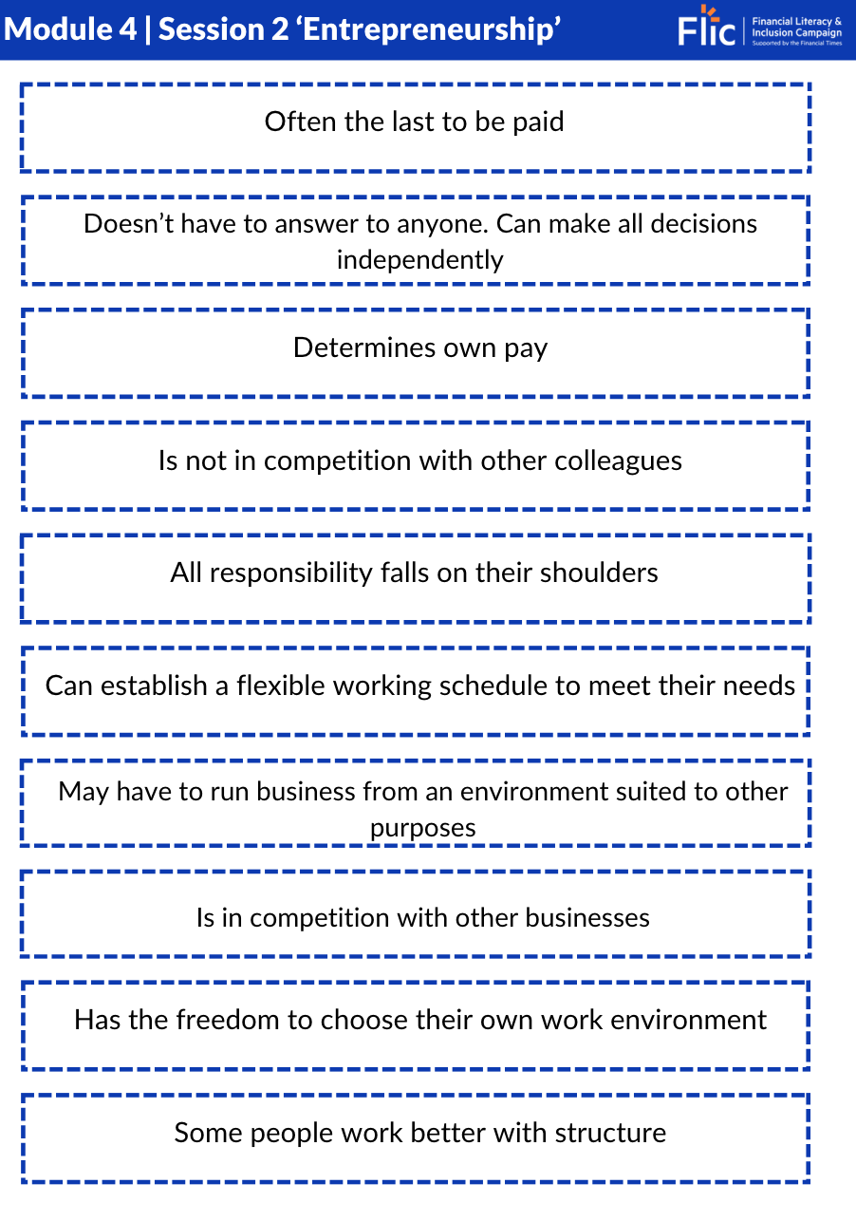
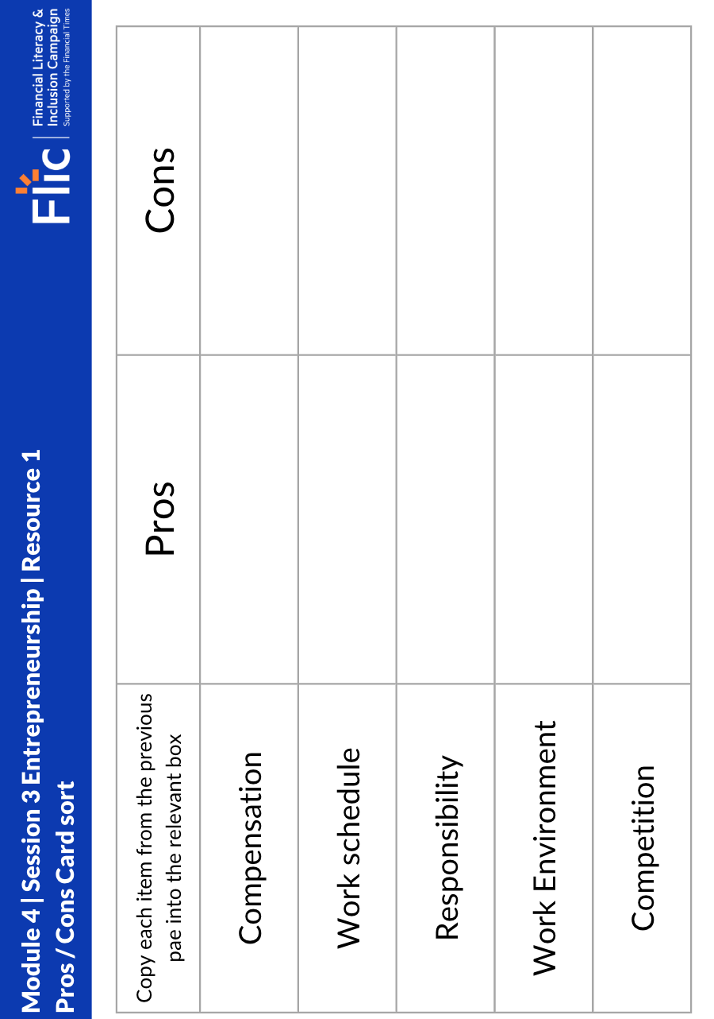
You choose: pros and cons of entrepreneurship
In your workbook:
Read through the ten aspects of work described (Sheet 1)
Copy them into the table on Sheet 2, sorting them into advantages and disadvantages for each category
Sheet 1
Sheet 2

Slide 25
Pros and Cons of Entrepreneurship
 | Pros | Cons
Compensation | Determines own pay | Often the last to be paid
Work schedule | Can establish a flexible working schedule to meet their needs | Some people work better with structure
Responsibility | Doesn’t have to answer to anyone. Can make all decisions independently | All responsibility falls on their shoulders
Work environment | Has the freedom to choose their own work environment | May have to run business from an environment suited to other purposes
Competition | Is not in competition with other colleagues | Is in competition with other businesses
Stretch:
Looking at the statements in bold, can you identify how each pro/con may be seen the other way?
Notes:
Additional Context
The context below is in reference to the alternative pros and cons that students are asked to identify through the task on the slide.
Pro 1: Whilst entrepreneurs may be last to be paid, they determine how much they get paid. This is especially useful when businesses are very profitable.
Con 1: Some may find it very appealing to be in complete control of their working schedule, but others prefer a level of structure to be imposed upon them
Pro 2: Entrepreneurs have autonomy over the direction of their business, so even though all responsibility falls on them, it may be worth it considering they can take the business in whatever direction they choose.
Con 2: Although entrepreneurs don’t have to work from an office, and can in theory work from wherever they like, they may be forced to work in environments that are not conducive to working productively. This is particularly true for startups and young businesses, where entrepreneurs may work from their kitchen, bedroom, or basement. Common examples of this are amazon, which started in Jeff Bezos’ garage, and Facebook, which started in Mark Zuckerberg’s dorm room. In actual fact, garages play a crucial role in the history of Amazon, Google, and Apple
Con 3: Whilst entrepreneurs do not compete with other colleagues (as there often aren’t any, and if there are, the entrepreneur has a higher standing) entrepreneurs must compete with external competition. This can often be more difficult, as the stakes tend to be higher (loss of revenue, survival of business).

Slide 26
Reflection
Would you consider starting your own business?

Slide 27
Session 3:
Understanding gig work and your rights

Slide 28
Unit outline
Session 1 | Session 2 | Session 3 | Session 4 | Session 5
Professional services careers | Apprenticeships | Entrepreneurship | Understanding gig work and employment rights | Speaking up at work

Slide 29

Workers are usually independent contractors or freelancers
Labour is provided through online digital platforms
The gig economy: characteristics
Work is allocated on a temporary basis
This structure often allows companies to provide services at lower cost
Workers gain an element of flexibility and independence

Slide 30

Cleaner
Amazon delivery driver
Actor
Uber/Deliveroo/UberEats driver
Can you think of some gig economy jobs/work?
Online tutor
Photographer
Graphic designer
Personal trainer
Freelance writer
Musician

Slide 31
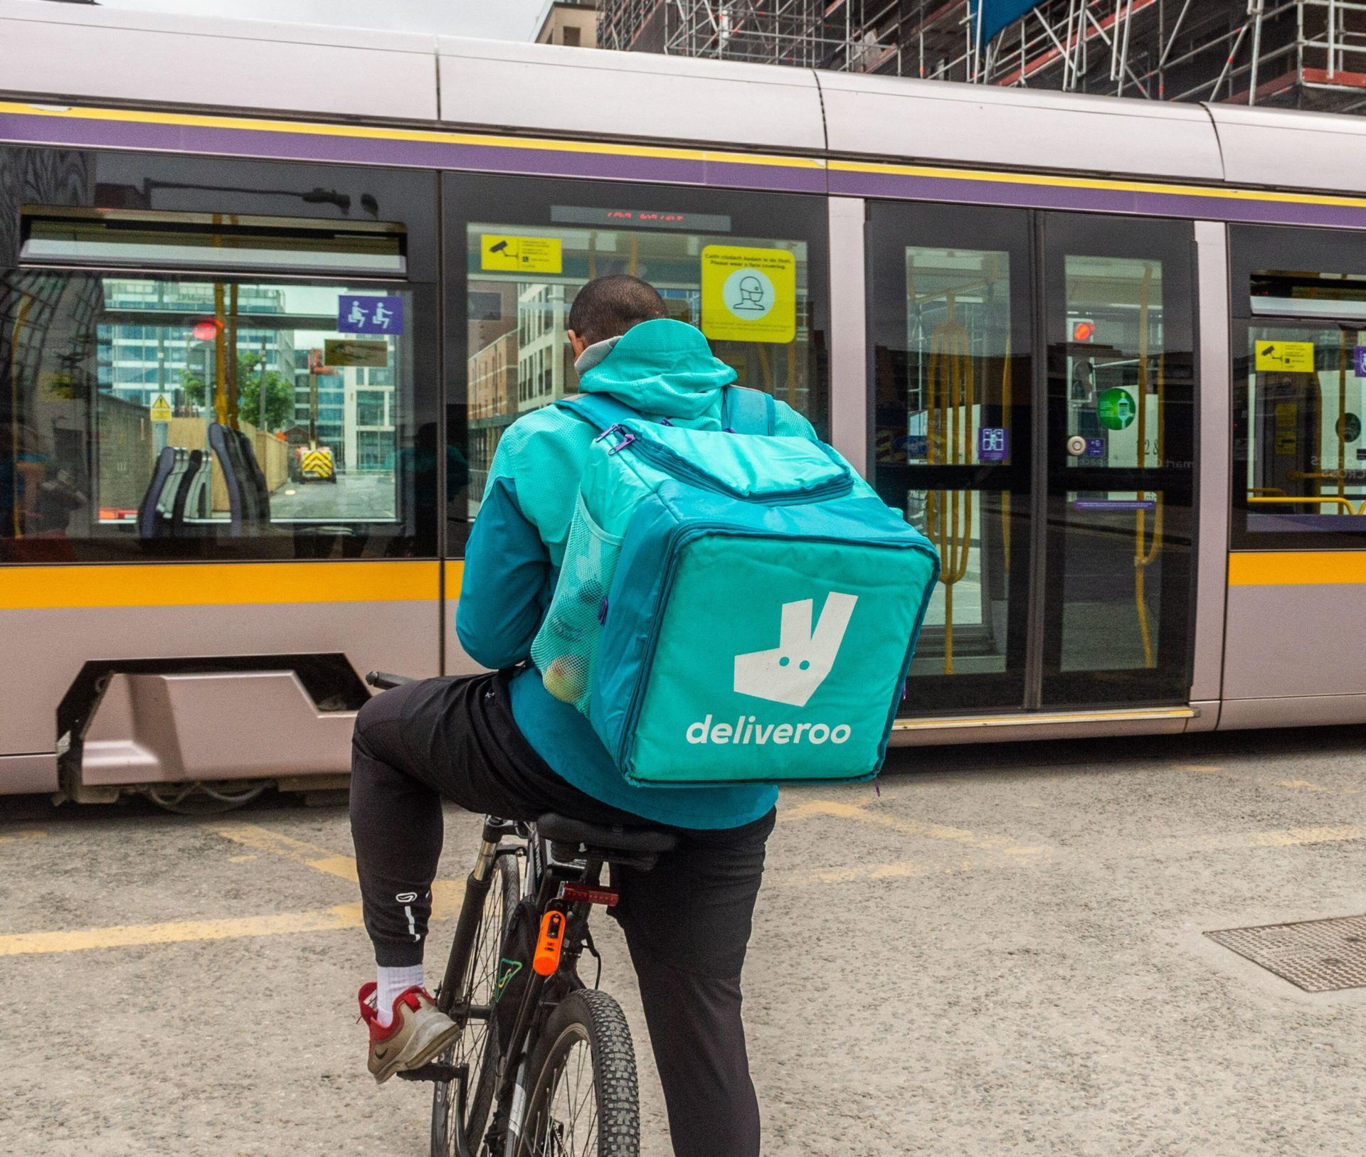
1: Read Dave’s Story
Dave works as a delivery driver for Deliveroo. He likes that he can choose his own hours and work extra shifts when he wants to earn more money.
Dave is about to have a baby so he’s been trying to save as much as he can.
However, his back has been seriously hurting again from an old injury, and he’s worried about taking time off to rest and recover.

Slide 32

2: Dave’s Story - Questions
Dave works as a delivery rider for Deliveroo. He likes that he can choose his own hours and work extra shifts when he wants to earn more money.
Dave is about to have a baby so he’s been trying to save as much as he can.
However, his back has been seriously hurting again from an old injury, and he’s worried about taking time off to rest and recover.
Questions to consider:
How might being a delivery rider be beneficial for Dave’s situation?
What are the challenges of being a delivery rider?
If Dave takes a day off sick, what happens to his income?
Will any of the highlighted points impact on his pay?
Would you like to work in a gig job like Dave’s? Why or why not?
Notes:
1. How might being a delivery rider be beneficial for Dave’s situation?
Can choose when to work: flexible hours.
Can take on extra shifts to earn more.
Can plan work around family or personal life.
2. What are the challenges of being a delivery rider?
No guaranteed income.
No sick pay or holiday pay.
Physically demanding: his back pain affects earning ability.
3. If Dave takes a day off sick, what happens to his income?
He won’t earn money for that day.
No employer to cover sick pay.
May fall behind on savings goals.
4. Will any of the highlighted points impact on his pay?
Yes: taking time off or working fewer hours reduces pay (refer to previous teaching on gig economy)
Extra hours or busy times can increase income.
Income depends on how much and when he works.
5. Would you like to work in a gig job like Dave’s? Why or why not?
Discuss trade-offs: freedom vs. security.
Explore opposing views

Slide 33
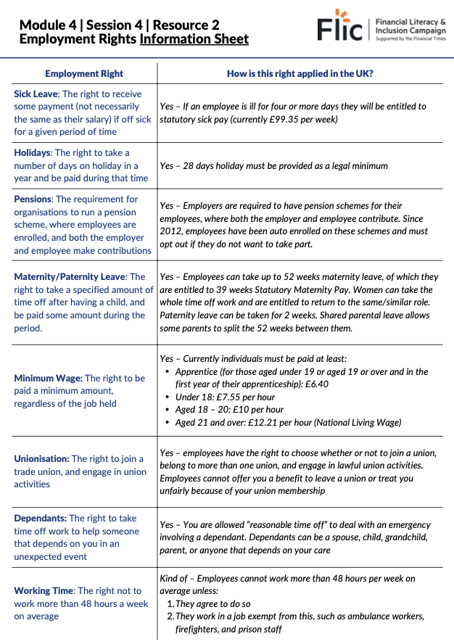




Employment Rights
Read the information sheet which explains how each employment right works in the UK.
Should Dave get a full-time job?
Resource 2: Employment Rights

Slide 34
Reflection
Which rights are most important to young people starting their career journey?

Slide 35
Session 5:
Speaking up at work

Slide 36
Unit outline
Session 1 | Session 2 | Session 3 | Session 4 | Session 5
Professional services careers | Apprenticeships | Entrepreneurship | Understanding gig work and employment rights | Speaking up at work

Slide 37

Top tips when asking for a pay rise
Employees should…
Be specific when it comes to the value of their work, both in terms of what they have achieved and how they have achieved results
Demonstrate the value they will bring to the employer in the future
Discuss their soft skills and how they add value internally to the company e.g. organising a volunteers’ day, or supported colleagues through problems?
Use facts where possible e.g. “Outcomes of the project led to a 10% increase in sales last year”
Prepare key points before booking a meeting with the manager
Use clear and concise language

Slide 38

Making your case
Meet Naomi
What should Naomi say to her boss?
Can you identify the key points for her pay rise pitch?
Naomi works in the marketing department at a large fashion brand. At the start of the year she was involved in a big project that led to a £200,000 increase in the company’s profit. But she hasn’t had a pay rise since she started working there three years ago. Furthermore, two members of the team left and were not replaced, so Naomi has picked up their work too, working over her contracted hours at least a couple of days a week.
At the same time, over the past year inflation has risen to 10% meaning a lot of her costs and the things she buys have become much more expensive. She’s noticed the cost of petrol, her weekly food shop and heating bills have risen a lot!
Notes:
Prompt Questions
Consider the reasons why someone might ask for a pay rise that we saw two slides ago. Can you identify any of these factors here?

Slide 39
Making your case - points to consider
Meet Naomi
What should Naomi say to her boss?
After five minutes of writing, pitch to one another…
Naomi works in the marketing department at a large fashion brand. At the start of the year she was involved in a big project that led to a £200,000 increase in the company’s profit. But she hasn’t had a pay rise since she started working there three years ago. Furthermore, two members of the team left and were not replaced, so Naomi has picked up their work too, working over her contracted hours at least a couple of days a week.
At the same time, over the past year inflation has risen to 10% meaning a lot of her costs and the things she buys have become much more expensive. She’s noticed the cost of petrol, her weekly food shop and heating bill rise a lot!
Notes:
Prompt Questions
Consider the reasons why someone might ask for a pay rise that we saw two slides ago. Can you identify any of these factors here?

Slide 40
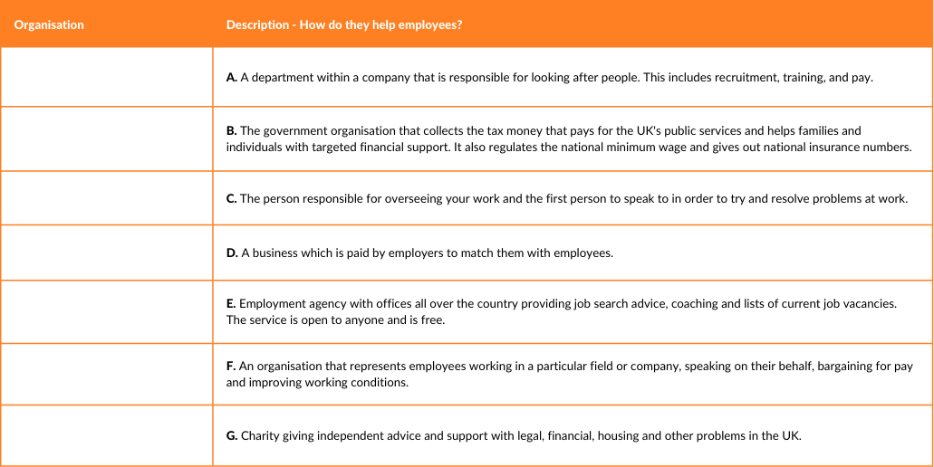
Resolving work issues
People or organisations you should get to know.
Match the definition to the organisation:
Resource 1 - Resolving work issues

Slide 41
Reflection
How easy is it for an employee to ask for a pay rise?

