Slide 1
CARBOHYDRATES & RELATED COMPOUNDS
OKPAKO, Eseoghene

Slide 2
CONCEPT
Consists of carbon, hydrogen and oxygen
First product of photosynthesis
Pharmacognostic Importance of CHO
Unites with other compounds = glycosides
Mucillages e.g marhmallow root, psyllum seeds
Gums as a result of stress /injury (2&3 made up of uronic and sugar units)
Cell walls of brown seaweeds& middle lamella of higher plant tissue; they consist of polysaccharides made up of uronic compounds
50% of the carbon in organic compounds is found in CHO
A large class of naturally occurring polyhydroxy aldehydes and ketones

Slide 3
CLASSIFICATION
MONOSACCHARIDES
Contain 3-7 carbon atoms
Colourless, water soluble, crystalline solids
E.g. glucose, fructose, galactose, xylose, ribose
Structure and Types
Aldoses:- aldehyde sugars e.g. glucose
Ketoses:- ketone sugars e.g. fructose
Classification
Classifed according to the number of carbon atoms in the sugar and number of sugar units
Triose – 3 carbon atoms
Tetrose – 4 carbon atoms
Pentoses – 5 carbon atoms
Hexoses – 6 carbon atoms

Slide 4

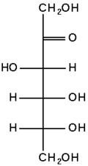
Structure of monosaccharides
(linear/ Fischer structure)
glucose
fructose

Slide 5
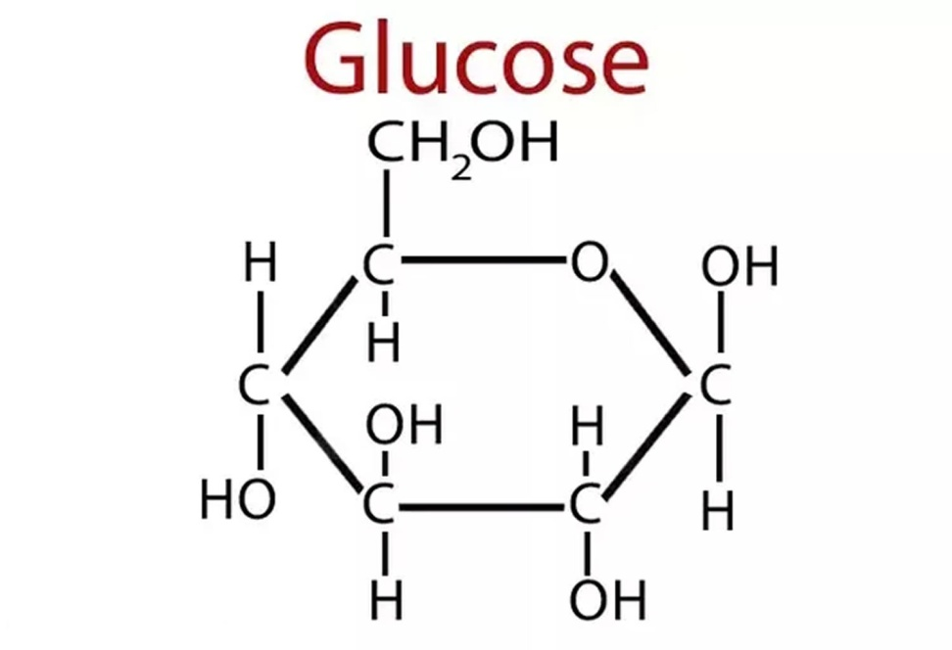
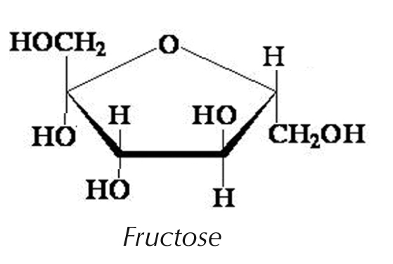
Structure of monosaccharides
(Haworth structure)
Pyranose ring
Furanose ring

Slide 6
OLIGOSACCHARIDES
Formed from 2 or 10 monosaccharide units covalently bonded by glycosidic bonds
DISACCHARIDES
Consist of 2 monosaccharide units
They are crystalline, water soluble and sweet to taste
Types
Reducing disaccharides:- they are with a free aldehyde or keto group e.g maltose, lactose
Non-reducing disaccharides:- they are with no free aldehyde or keto group e. g sucrose, trehalose

Slide 7
TRISACCHARIDES
They are oligosaccharides formed from 3 monosaccharide units e.g maltotriose, glycosides of psyllum
TETRASACCHARIDES
They are formed from 4 monosaccharide units e.g glycosides of Digitalis
POLYSACCHARIDES
Formed from more than 10 monosaccharides
They can be branched or linear
Types
Homopolysaccharides:- contain only monosaccharide units e. g starches, glycogen,cellulose, inulin,
Heteropolysaccharides:- polysaccharide complexes containing uronic acid or other units e.g pectins, algin/alginic acid, chitin, gums and mucillages
Mucopolysaccharides (proteoglycans) e.g heparin, hyaluronic acid
GLYCOPROTEINS
Proteins to which oligosaccharides are covalently attached e.g. antigens, enzymes and some hormones

Slide 8
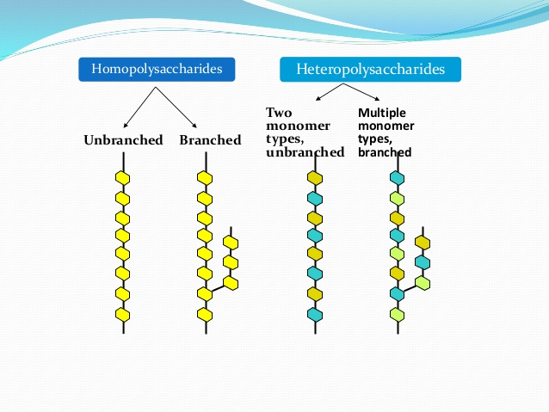
Diagramatic representation of polysaccharides

Slide 9
Differences between proteoglycan and glycoprotein
Proteoglycan
Glycoprotein
Covalently attached to a protein (95% sugar)
Sugar chains are longer (100 or more sugar units)
Linear
Disaccharides repeat
Primarily of protein with small amount of sugar
Short oligosaccharide chains (20 or more)
Highly branched
Do not have repeat sequence

Slide 10
BIOSYNTHETIC ORIGIN
Produced initially in plants via photosynthesis
PHOTOSYNTHESIS
which is a process used by plants, algae and certain bacteria to harness energy from sunlight and turn it into chemical energy
Types
Oxygenic :- oxygen is produced alongside CHO
Anoxygenic:- does not produce oxygen; it occurs in bacteria
Cellular components essential for photosynthesis include the following:-Pigments, carotenoids, phycoblins, plastids, antennae and reaction centres
The photosynthetic can be divided into two:
Light dependent reaction (light reaction)
Dark reactions (calvin reaction):- it is made up of carbon fixation, reduction and regeneration using water as catalysts

Slide 11
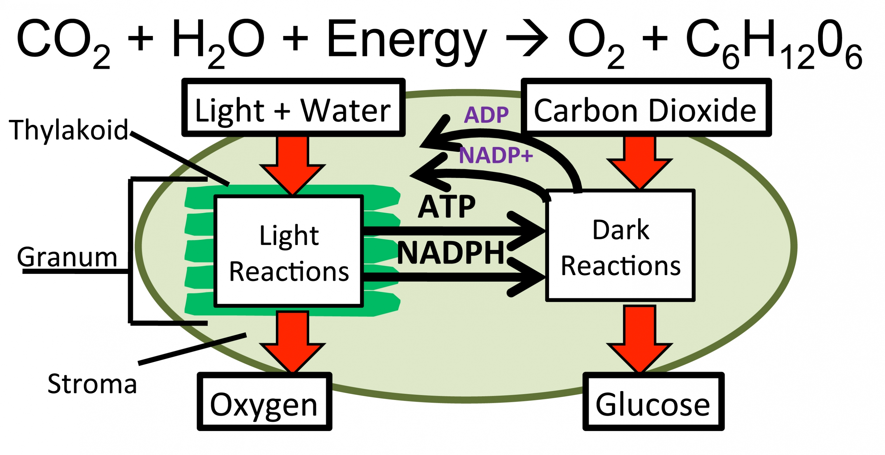

Slide 12
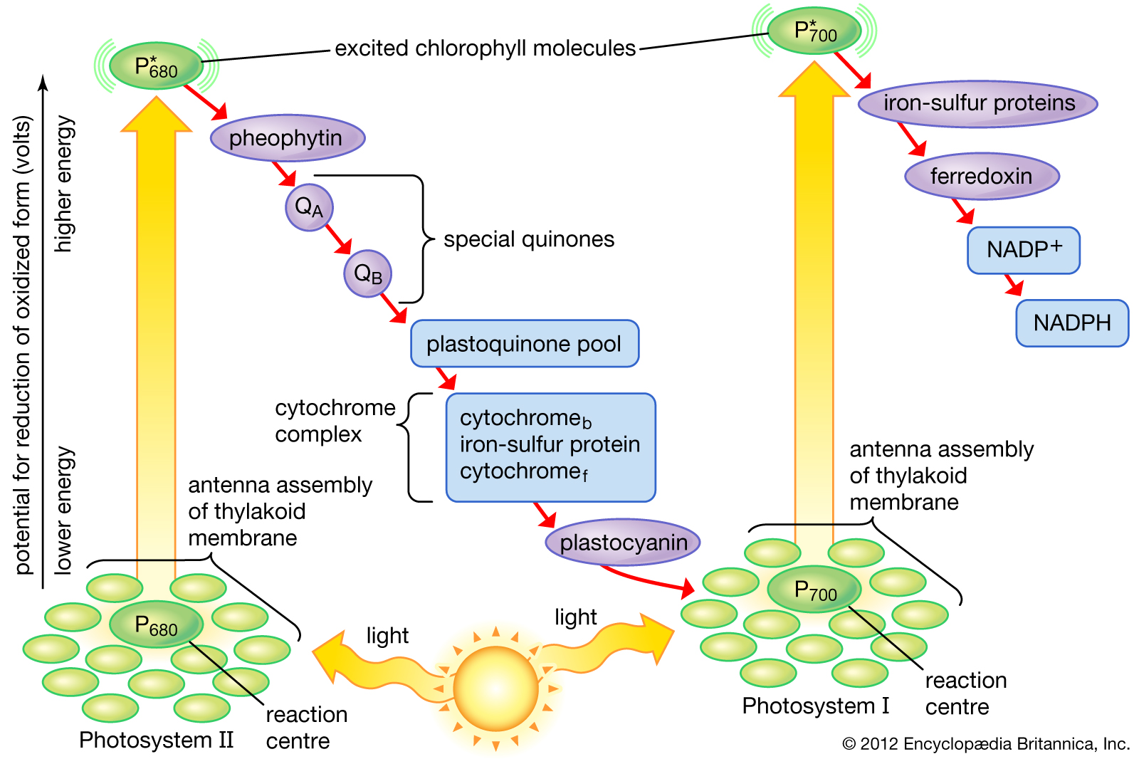
Photosynthesis light reaction diagram

Slide 13
Bioynthesis of Monosaccharides
They arise from the photosynthetic cycle
Free sugars may accumulate as a result of hydrolysis of phosphorylated sugar like D-fructose-6-phosphate and D-glucose-6-phosphate which are universal in occurance
Or used in respiration converted to sugar nucleotides (e.g uridine-diphosphoglucose-UDPG) or by the action of various epimerases give rise to other monosaccharides (e.g. galactose)

Slide 14
Biosynthesis of Disaccharides
Formed in photosynthesis by the reaction of UDPG with fructose-6-phosphate
Control mechanisms for the build up in leaves and its breakdown for its transport to storage organs are achieved by metabolic effector control of the appropriate enzymes

Slide 15
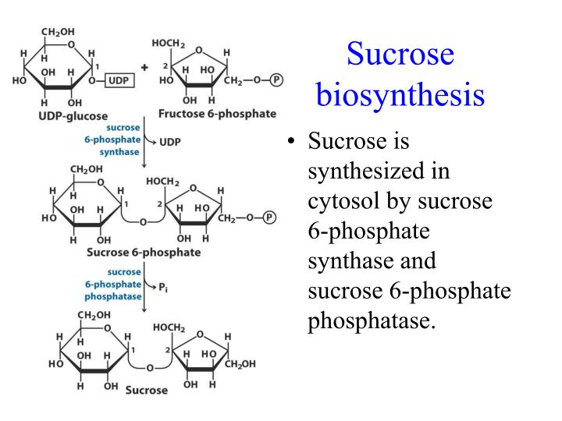

Slide 16
Biosynthesis of polysaccharides
Nucleoside diphosphate sugars play a central role
It is not a direct reversal of catabolism
During the synthesis of glycogen and starch in bacteria and protist ADP-glucose is from glucose-1-phosphate and ATP
It then donates glucose to the end of growing glycogen and starch
ATP + glucose-1-phosphate → ADP-glucose +PPi
(glucose)n + ADP- glucose → (glucose)n+1

Slide 17
Gluconeogenesis
(metabolism of glucose)
Synthesis of glucose from non-CHO precursor
It shares 6 enzymes with the Embden-Meyerhof pathway (EMP)
4 reactions are catalysed by enzymes specific for gluconeogenesis
The enzymes catalysing irreversible reactions are different from those found in EMP.
This pathway is used by many micro-organisms

Slide 18
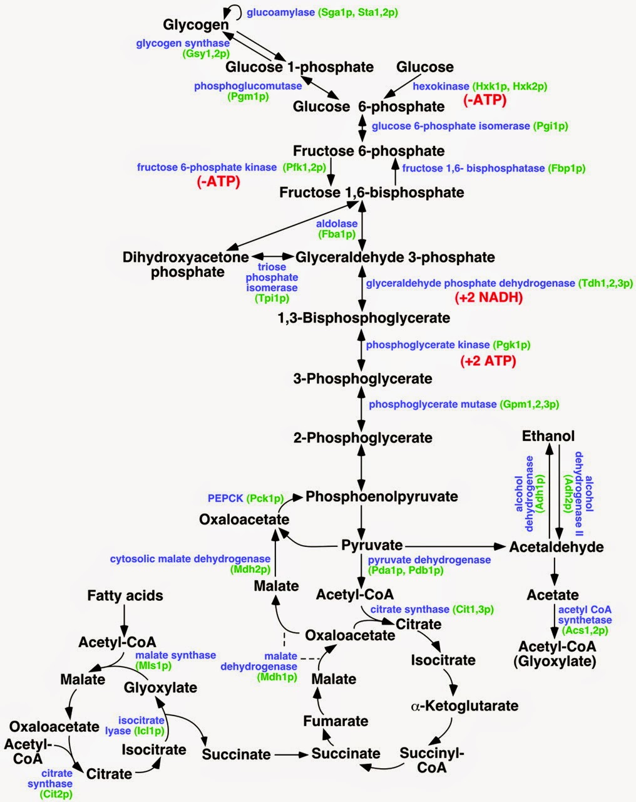
Schematic diagram for gluconeogenesis

Slide 19
PROPERTIES
PHYSICAL
Stereoisomerism e.g glucose has 2 isomers D and L- glucose
Optical activity : rotation in plan polarised light
Diasteroisomers e.g mannose and galactose
Annomerism; spatial configuration with respect to the first carbon atom
Monosaccharides and disaccharides are crystalline, soluble in water and sweet to taste
Polysaccharides are amorphous compounds, not soluble in water, not sweet to taste and they form colloidal suspensions instead of solution

Slide 20
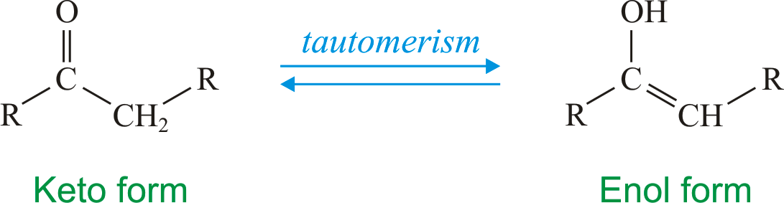
CHEMICAL
Reactions for monosaccharides
tautomerization: process of shifting one carbon atom to another to form enediols (strong reducing agents in alkaline medium); as seen with CHO that have a free sugar group, they will form enediols where two hydroxyl group are attached to the double bonded atoms. When oxidising agents like cupric ions are present sugars form a mixture of carboxylic acid by breaking at the double bonds

Slide 21
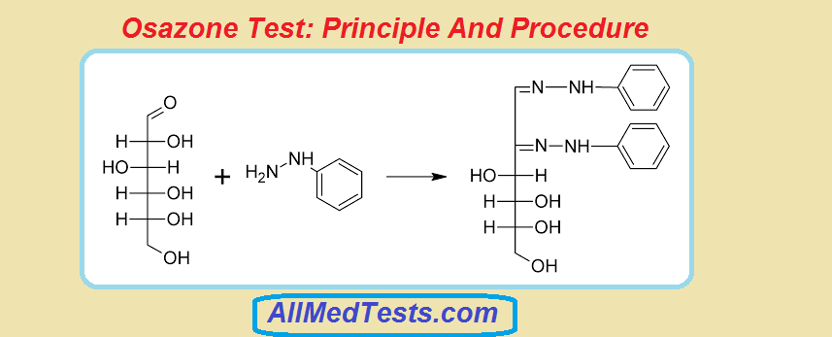
Chemical properties of s
2. osazone formation: all reducing sugars will form osazones with excess of phenylhydrazine when kept at boiling temperature. osazones are soluble and of their respective sugars have a characteristic crystal form

Slide 22
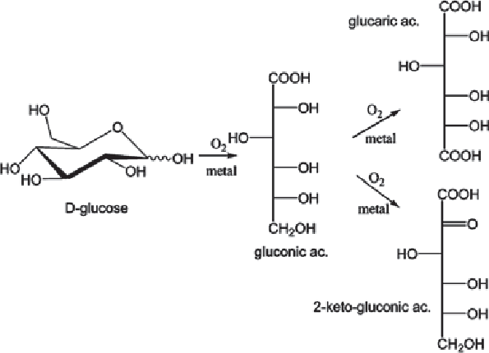
3. Oxidation of Sugars:- mild oxidation conditions e.g. hydrobromous acid , the aldehyde is oxidised to carboxyl groups to produce aldonic acid. When the aldehyde group is protected and the molecule is oxidized especially in the body, the last C is oxidized to COOH producing uronic acid. Under strong oxidation conditions (e.g. strong acid). Both groups are oxidised to produce dicarboxylic acid called saccharic acids

Slide 23
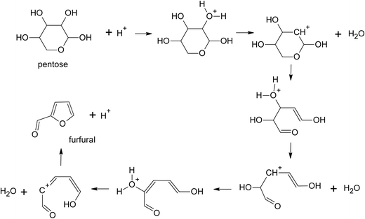
4. Furfural formation: when treated with concentrated sulphuric acid it undergoes dehydration with removal of 3 molecules of water. Hexoses give hydroxymethylfurfural while pentoses give furfural. They condense with phenolic compounds to give various colours. E.g. Molisch test, rapid furfural & Seliwanoff’s test, test for the presence of keto group.

Slide 24
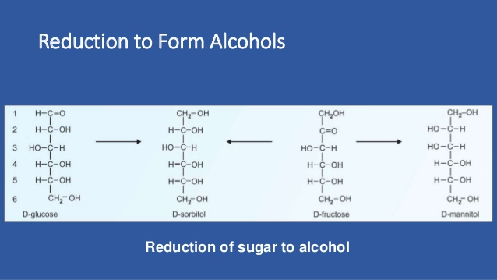
5. Reduction to form alcohols: when heated with reducing agents such as sodium amalgam hydrogen aldose yields a corresponding alcohol while ketoses form 2 alcohols because of appearance of new assymetric carbon in this process

Slide 25
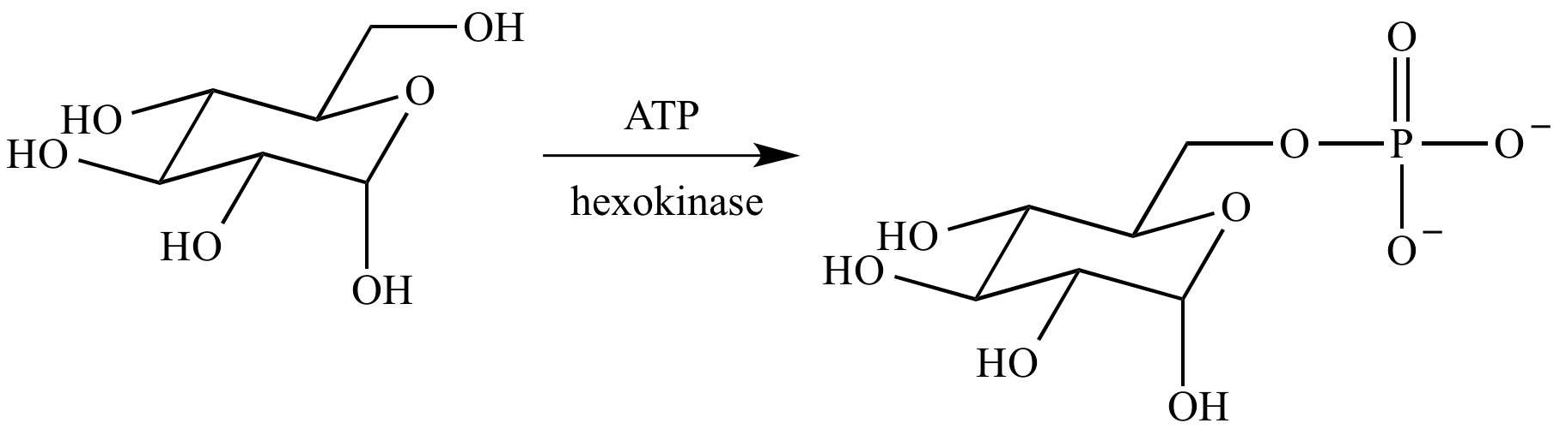
6. Formation of esters:- hydroxyl groups of sugars can be esterified to form acetates, propionates and benzoates.

Slide 26
Chemical properties of Dissacharides
It is non-reducing
Forms no osazones
Chemical properties of deoxy sugars
E.g 2-deoxy-Dribofuranose
They are non- reducing
They do not form osazones
Chemical properties of Starches
Solubility in water: when starch is treated with boiling water 10-20% is solubilized due to amylose. The insoluble part amylopectin causes it to absorb water and form a paste-like gel
Hydrolysis of starch: it will form a blue coloured cplx with iodine the colour disappears on heating and reappears when cooled. When starch is hydrolysed by mild acid smaller and smaller fragments are produced . Thse hydrolysis for a short time produces amylodextrin (violet colour with iodine and non-reducing).Further hydrolysis:
Amylodex → erythrodex → actrodextrin → maltose
Violet red no colour no colour
Non-reducing Non-reducing reducing reducing

Slide 27
Chemical properties of amino sugars
Amino groups may be substituted for hydroxyl groups of sugars to give rise to amino-sugar; it is added to the second C of hexoses
They are non-reducing and do not form osazones they are found in GAGs, glycoproteins & proteoglycans

Slide 28
PHARMACEUTICAL IMPORTANCE OF CHOs
They are used as binding agents in drugs e.g starches, sucrose, lactose, CMC, cellulose
Excipient e.g starches, mannitol in chewable tablets
Diluents e.g starches, lactose, mannitol, sorbitol in chewable tablets, CMC, cellulose
Disintegrants e.g. starches, CMC,
As sweeteners e.g. glucose, sweetener
bulking agent e.g sucrose,
Granulating and coating agent e.g. glucose, sucrose
Stabilizer for drugs e. g. sorbitol
Fillers e.g. lactose, cellulose
Plasticizer e.g. mannitol
Identify bacteria colonies e.g. mannitol, sorbitol
As lubricants e.g. cellulose, hyaluronic acid

Slide 29
PHARMACEUTICAL IMPORTANCE OF CHOs
Suspending agent e.g. CMC, cellulose
powder base in powder dosage forms e.g cellulose
thickening agent e.g hydroxyl propylcellulose
Transdermal patches e.g hydroxyl propylcellulose
Opthalmic preparations e.g hydroxyl propylcellulose
Cosmetics e.g hydroxyl propylcellulose
Preparation of snake and insect venoms e.g hyaluronic acid
Manufacture of salts e.g algin/ alginic acid
Manufacture of fibres e.g algin/ alginic acid
Used in the preparation of food products e.g hydroxyl propylcellulose
Used to measure GFR e.g inulin
Used to reduce sedimentation rate e.g cellulose
Used for electrophoresis e.g. nitrocellulose and acetate cellulose membranes, electrophoresis
Diagnostic agent for kidney function e.g. mannitol

Slide 30
AND IT IS A WRAP

