Slide 1

What Do We Mean by Evidence-based?
Ronnie Detrich
Wing Institute

Slide 2
Review of Survey Data About Evidence
Review of suggested that definition about evidence sorted into two categories:
Functions of evidence
Characteristics of evidence
Categories were generated through inductive approach.
↑ Responses grouped by “themes” that emerged from responses.

Slide 3
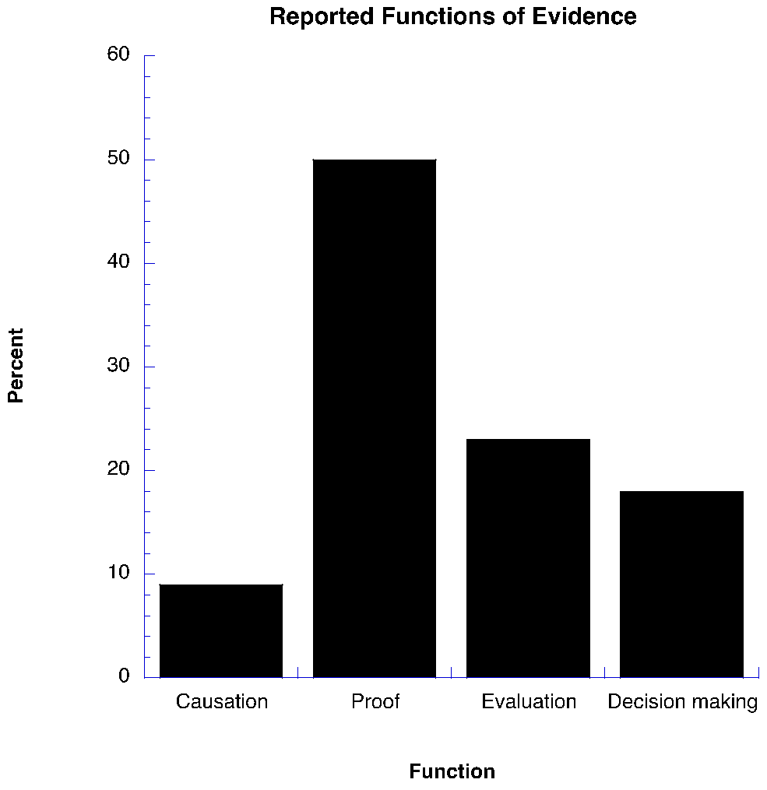

Slide 4
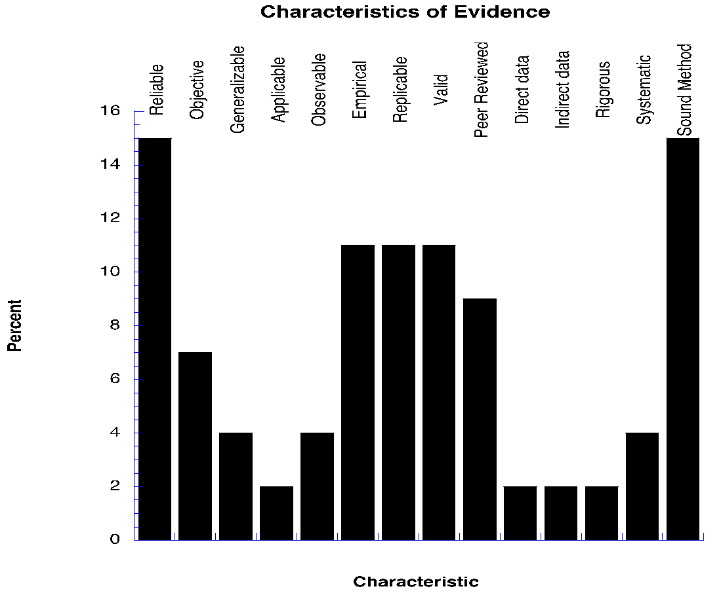

Slide 5
Levels of Evidence
We use evidence in different ways to answer different questions.
There are three broad levels of questions:
What is the impact of an intervention on an individual student?
Addresses function of evaluation.
Usually answered by some type of single subject designs.
Will a particular intervention produce benefits for a defined population of students?
Is there sufficient accumulated evidence to make statements about an intervention being evidence-based?

Slide 6
Levels of Evidence
↑Will a particular intervention produce benefits for a defined population of students?
Addresses function of selecting interventions/decision
making.
 Answered by some type of experimental designs, usually group designs.
Is there sufficient accumulated evidence to make statements about an intervention being evidence-based?

Slide 7
Levels of Evidence
Is there sufficient accumulated evidence to make statements about an intervention being evidence-based?
Addresses function of selecting interventions/decision-making.
Usually answered by some type of research review/synthesis. Criteria for inclusion of including particular studies should be clearly stated so the conclusions drawn from the review can be adequately evaluated.

Slide 8
Approaches to Determining Interventions are Evidence-based
Threshold Approach
Establishes criteria by defining the quantity of data and the quality of data required to demonstrate an intervention is evidence-based.
Criteria most often require multiple randomized clinical trials.
If criteria are not met, then it is determined that no evidence exists to support claims of evidence-based.
Concern is if threshold is set too high then no evidence will be available to guide decisions. Most, if not all, evidence will be excluded.

Slide 9
Approaches to Determining Interventions are Evidence-based
Continuum Approach
Relies on best available evidence to make decisions about which interventions to use.
The benefit is that decision makers have evidence available when they need to make decisions.
The risk of this approach is that ineffective interventions will be implemented on the basis of flawed evidence.

