Slide 1














Social Media
Free Presentation Template

Slide 2



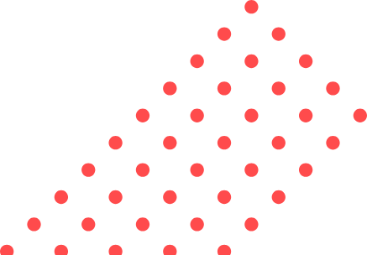
Welcome
  Social media is a collection of online platforms that enable users to create and share content, network, and communicate.
  It's important because it's transformed how we connect and share information.
  Social media has benefits for individuals and businesses, but also has risks such as privacy concerns and cyberbullying.
  This presentation will explore different social media platforms, their pros and cons, and best practices for using social media safely and effectively.

Slide 3





Table of Contents
01
Introduction
02
What is Social Media?
03
Pros and Cons of Social Media
04
Tips for Using Social Media Safely
05
Overview of Popular Social Media Platforms
06
Conclusion

Slide 4





Introduction
Essential Part of Daily Life
Transformation of Communication
Social media has become an essential part of our daily lives, with billions of people using social media.
It has transformed the way we communicate, interact, and access information.

Slide 5






What is
Social Media?
  Social media is an online platform that allows users to create and share content, engage in social networking, and communicate with others.
  Its purpose is to connect people, share information and ideas, and provide a platform for individuals and businesses to engage with their audience.

Slide 6






Benefits
Staying Connected
Entertainment
Social media allows us to stay connected with friends and family. It enables us to communicate with them, share updates.
Social media offers a variety of entertainment options, including videos, games, and memes, that help us relax and unwind.
Accessing Information
Social media platforms provide access to a wealth of information on a wide range of topics. We can learn about news, events,.

Slide 7


4.9 billion
ACTIVE SOCIAL MEDIA USERS WORLDWIDE
Which is 63.2% of the global population.

Slide 8





  Young adults aged 16-24 are the most active social media users, with 82% using social media.
  They use social media to stay connected, share experiences, and consume entertainment.
  Popular social media platforms among young adults include Instagram, Snapchat, and TikTok.
  Social media is an integral part of their social lives and communication.
  Younger generations will continue to shape the direction and trends of social media.
young adults using social media.
82%

Slide 9



Types of social media
social networking
blogging
video sharing

Slide 10



Pros of Social Media
Creating and Sharing
Networking
Building
Social media platforms enable users to create and share a variety of content, including photos, videos, blog posts, and status updates. This makes it easy for individuals and businesses to share their ideas and express themselves online.
Opportunities for individuals and businesses to connect with others, network, and build relationships. This can be particularly useful for professionals looking to expand their reach or for businesses looking to grow their customer base.
Social media offers a way for individuals and businesses to build an online presence and establish their brand. By sharing content and engaging with followers, they can create a loyal following and build their reputation online.

Slide 11










Cyberbullying
Addiction
Social media can be a breeding ground for cyberbullying, which can have serious consequences for the mental health and wellbeing of those involved.
Social media can be addictive, leading to excessive use and negative impacts on productivity and mental health.
Privacy Concerns
Spread of Misinformation
Social media platforms collect and store user data, raising concerns about privacy and data protection. This data can also be used for targeted advertising.
Social media can be a source of misinformation and fake news, which can have negative impacts on society and public discourse.

Slide 12




Mental Health
Studies have shown that excessive social media use can lead to negative impacts on mental health, including anxiety and depression.
Politics
Social media has transformed the political landscape, enabling people to engage with political issues and campaigns in new ways.
How social media impacts society

Slide 13

Protect your information
Avoid cyberbullying
Be cautious about sharing personal information online, such as your home address, phone number, or social security number.
Don't engage in or tolerate cyberbullying. If you see it happening, report it to the platform or a trusted authority.
Be mindful of your online presence
Educate yourself
Your online activity can have an impact on your real-life reputation and future opportunities. Be aware of what you post.
Stay informed about the latest trends and risks related to social media, and educate yourself on how to protect yourself and others.
Tips for Using Social Media Safely

Slide 14
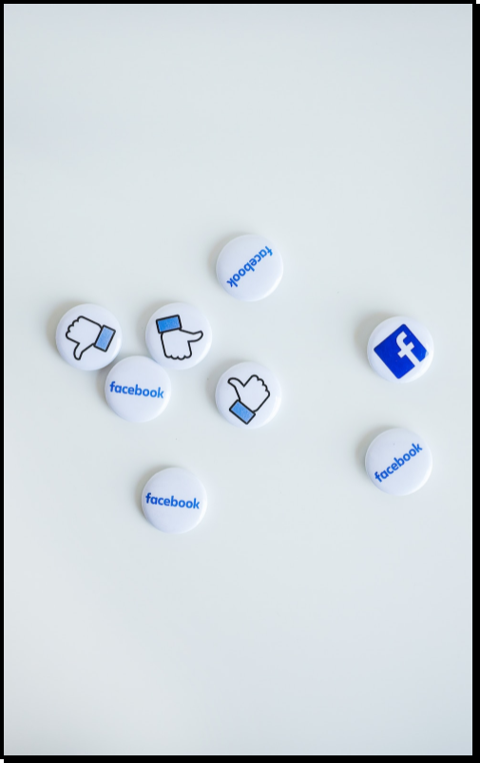

Facebook
2.9 billion
Monthly active users
1.8 billion
Daily active users

Slide 15


YouTube
1 billion hours
Watch time every day
30 billion
Daily active users

Slide 16



TikTok
16-24 years old
Large proportion of users
52 minutes per day
On the app

Slide 17















Thank you for choosing EaTemp
We offer free and high-quality slides templates for your presentations. We appreciate you choosing us and hope our templates have been helpful.
As a new website, we rely on your support to grow, so please help us by sharing our site with your friends and colleagues.
eatemp._
@eatemp
eatempofficial
@eatemp.official
EaTemp

