Slide 1
Developing and Implementing a Quality RtI Process
Edward Daly, Ph.D.
University of Nebraska-Lincoln

Slide 2
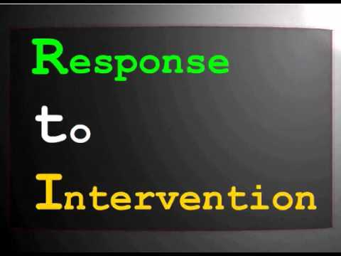
Taking RtI “to Scale”…

Slide 3

And then I looked out my window…

Slide 4

= 1

Slide 5
Is This Really Something New?
No!
Previous versions of IDEA have required…
“Prereferral” intervention
The need to rule out lack of instruction in reading or math or limited English proficiency
Gathering relevant functional and developmental information and information related to enabling the child to be involved in and progress in the general curriculum…
The conceptual basis for intervention design has existed for more than 30 years (Bijou, 1970; Bijou, Peterson, & Ault, 1968).
National Academy of Sciences 1982 report on overrepresentation of minorities (Heller, Holtzman, & Messick, 1982)

Slide 6
So, What is New?
Intervention data can now be used to make eligibility decisions
Includes child study assessment information
Functional assessments
Direct assessment and behavioral observations

Slide 7
Why is RtI Important to Both General and Special Education?
The Paradox of Special Education
Skrtic (1991)
“Structurally, special education is a non-rational system, an organizational artifact that functions as a legitimizing device. Culturally, it distorts the anomaly of school failure and thus preserves the prevailing paradigm of school organization, which ultimately reinforces the presuppositions of organizational rationality and human pathology in the profession and institution of education in society.” (p. 182)

Slide 8
Why is RtI Important to Both General and Special Education?
RtI presents a unique opportunity for educators to get it right…
Transdisciplinary integration of services for students across a continuum that meets all students’ needs

Slide 9
Implementing RtI: Technical Adequacy
Focus on Reliability and Validity of Decisions
Standards for Educational and Psychological Testing: “It is the user who must take responsibility for determining whether or not scores are sufficiently trustworthy to justify anticipated uses and interpretations.” (p.31)
Barnett, Lentz, & Macmann (2000): “Although psychometric variables such as reliability and validity have been traditionally seen as quality of assessment instruments… practitioners must consider the psychometric qualities of their decisions across the sequence of problem solving.” (p. 356)
Problem Solving as a Continuous Evaluation Cycle

Slide 10
Problem Solving as a Continuous Evaluation Cycle
Problem Identification
Plan Evaluation
“Did it work? What do we do next?”
“Is there a discrepancy between current and expected performance?”
The Problem Solving Model
“What will be done to resolve the problem?”
Why is there a problem?
Plan Implementation
“By how much should the student grow?”
Problem Analysis
Goal Setting

Slide 11
Implementing RtI: Technical Adequacy
Reliability and Validity of Decisions
Problem Solving as a Continuous Evaluation Cycle
Local Validation!

Slide 12
Implementing RtI: Technical Adequacy
Validating Practice…Easier said than done…
Reading research has not been readily translated into practice.
Generalizability to actual classroom conditions
Weak generalization of treatment effects
(Lyon & Moats, 1997)
Practitioners need methods that guide them in investigating interventions directly for their students.

Slide 13
Empirical Validation Versus Local Validation
Scientifically supported interventions are not enough!
NASDSE: “Selection and implementation of scientifically based instruction/intervention markedly increases the probability of, but does not guarantee, positive individual response. Therefore, individual response is assessed in RtI and the modifications to instruction/intervention or goals are made depending on results with individual students.”
Batsche, Elliot, Graden, Grimes, Kovaleski, Prasse, Reschly, Schrag, & Tilly (2005)

Slide 14
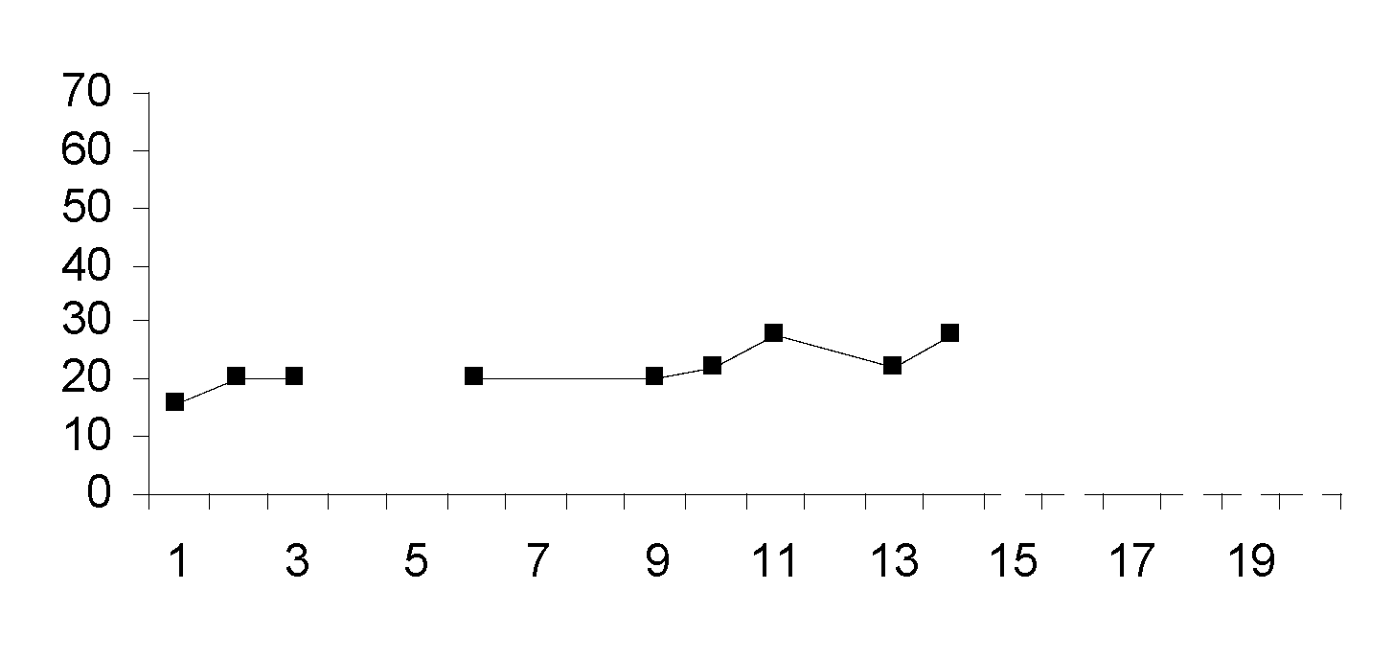
May Have Great Scientific Support, But Not A Valid Intervention for This Student!
Baseline Planned Intervention
Correct Read Words and Errors Per Minute
Ongoing Progress Monitoring
Time

Slide 15
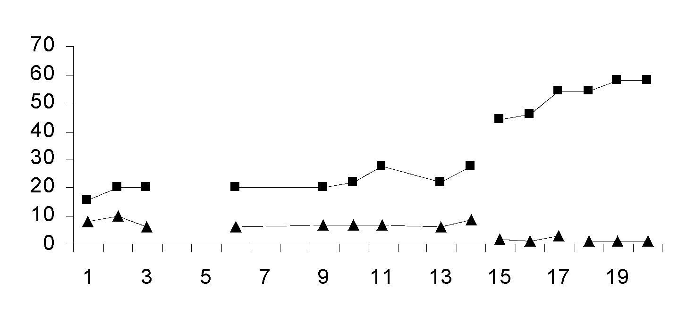
This One is Valid for This Student!
Baseline Planned Intervention 1 Intervention 2
Correct Read Words and Errors Per Minute
Time

Slide 16
Technical Adequacy of RtI: Local Validation
We have to prove it works for students.
If it does not work, we have not finished our job.
We are actually testing the treatments and not the student!

Slide 17
Developing a Valid RtI Process for Students
Quality Indicators
Developmental Progression of Implementation
Strong Operational Model for Continuum of RtI Service Delivery
Evaluation Plan: Validating the Model
Procedural Integrity
Child Outcomes
Refinements and Ongoing Evaluation

Slide 18
Quality Indicators in Nebraska: Implementing RtI in Schools
Parent Involvement
Universal Screening and Assessment
Individual Progress Monitoring
Planned Service Delivery Rules
Scientifically Supported Instruction
Intervention Delivery
SLD Verification

Slide 19
Quality Indicators in Nebraska: Organizational Capacity
School-wide buy-in and implementation plan
Team leadership
Integration of Services
Implementation Infrastructure

Slide 20
Developmental Progression Toward Full Scale Implementation of RTI
Application of
Problem Solving
Data to LD Eligibility
Coordinated Intervention Delivery
Universal Screening to Identify Students At-Risk for Academic Difficulties
Problem Solving Team Engages in
Data Based Problem Solving

Slide 21
Integrating RtI With Existing Practices
School Improvement Plan
Pre-referral Intervention teams
Title I Services
Professional Learning Communities

Slide 22
Implementing RtI: Procedural Integrity
PROCEDURAL CHECKLIST as an operational definition of RtI
Accountability
Formative evaluation and program improvement

Slide 23
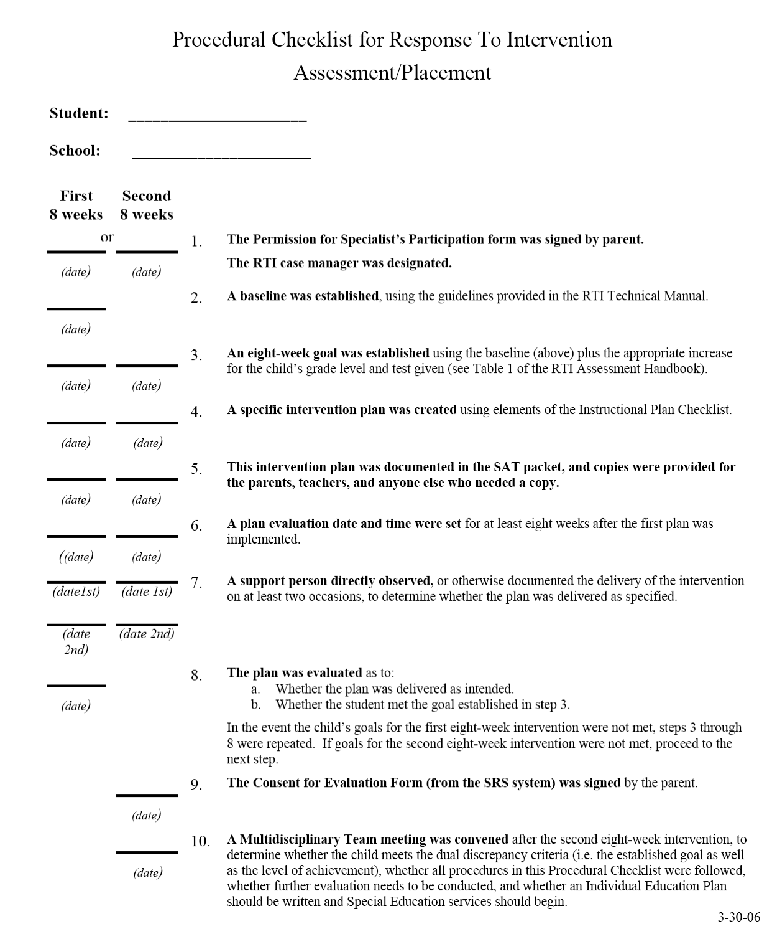

Slide 24
Implementing RtI: Procedural Integrity
PROCEDURAL CHECKLIST as an operational definition of RtI
Accountability
Formative evaluation and program improvement

Slide 25
Procedural Checklist Outcome Example
 | Procedural Checklist
 | 04-05 | 05-06 | Change
N | 64 | 229 | +165
Mean (% steps completed) | 80% | 93% | +13%
SD (% steps completed) | 19% | 9%

Slide 26
Procedural Checklist Outcome Example
Differences across 04-05 and 05-06 school years:
Approximately 250% more students served in the RtI process
A 13% increase in the percentage of procedural steps completed
Less variability in percentage of steps completed among cases

Slide 27
Procedural Checklist Outcome Example
Despite vast increase in number of students served in RtI process in 2nd year, higher procedural fidelity was obtained!!
Possible influences:
Increased organization, comfort and familiarity with process
More training for pilot school psychologists
Increased streamlining of services within buildings

Slide 28
Descriptive Evaluation of Individual Child Study Cases
Produces a quantitative synthesis across outcome metrics
Procedural Integrity (Procedural Checklist)
Effect Sizes & Percentage of Nonoverlapping Data
Graphic Analysis Worksheet
Goal Attainment Scaling
Significance According to “Structured Criteria for Visual Inspection of Data”
Treatment integrity
Social validity

Slide 29
“The significant problems we face cannot be solved by the same level of thinking that created them.”
Albert Einstein

Slide 30
Real Change in Schools
Fullan (1991)
“innovations can be adopted for symbolic political or personal reasons: to appease community pressure, to appear innovative, to gain more resources. All of these forms represent symbolic rather than real change.” (p. 28)
“Even good ideas may represent poor investments on a large scale if the ideas have not been well developed or if the resources to support implementation are unavailable.” (p. 28)

Slide 31
Conclusions
Building a Reliable and Valid Model for RtI
Quality Indicators
Procedural Integrity
Local Validation Through Databased Problem Solving
Strategic and Sequential Development and Refinement

Slide 32
References
American Educational Research Association, American Psychological Association, & the National Council on Measurement in Education (1999). Standards for educational and psychological testing. Washington, DC: American Psychological Association.
Barnett, D. W., Lentz, F. E., Jr., & Macmann, G. (2000). Psychometric qualities of professional practice. In E. S. Shapiro & T. R. Kratochwill (Eds.), Behavioral assessment in schools: Theory, research, and clinical foundations. (2nd ed., pp. 355-386). New York, NY: Guilford Publications.
Bijou, S. W. (1970). What psychology has to offer education--now. Journal of Applied Behavior Analysis, 3, 65-71.
Bijou, S. W., Peterson, R. F., & Ault, M. H. (1968). A method to integrate descriptive and experimental field studies at the level of data and empirical concepts. Journal of Applied Behavior Analysis, 1, 175-191.
Fuchs, L. S., & Fuchs, D. (1998). Treatment validity: A unifying concept for reconceptualizing the identification of learning disabilities. Learning Disabilities Research and Practice, 13, 204-219.

Slide 33
References Continued
Fisher, W. W., Kelley, M. E., & Lomas, J. E. (2003). Visual aids and structured criteria for improving visual inspection and interpretation of single-case designs. Journal of Applied Behavior Analysis, 36, 387-406.
Fullan, M. G. (1991). The new meaning of educational change (2nd ed.). New York, NY: Teachers College Press.
Heller, K. A., Holtzman, W. H., & Messick, S. (Eds.). (1982). Placing children in special education: A strategy for equity. Washington, DC: National Academy Press.
Lyon, G. R., & Moats, L. C. (1997). Critical conceptual and methodological considerations in reading intervention research. Journal of Learning Disabilities, 30, 578-588.
President’s Commission on Excellence in Special Education. (2002). A new era: Revitalizing special education for children and their families. Available on-line: http://www.ed.gov/inits/commissionsboards/whspecialeducation
Skrtic, T. M. (1991). Behind special education: A critical analysis of professional culture and school organization. Denver, CO: Love Publishing Co.

