Slide 1

A ministry of the Mosaic Mennonite Conference
Notes:
Good morning. My name is xxxx xxxx and I am a volunteer for The Worm Project. I’m going to spend the next few minutes telling you about The Worm Project.
‹#›

Slide 2
What is The Worm Project?
A ministry dedicated to preventing malnutrition in children by providing medicine to eliminate parasitic worms
  We purchase deworming medicine in large quantities of 1 million tablets or more
  We donate this medicine to our partners working in over 40 countries
  All volunteers (no paid staff)
Notes:
Read slide
‹#›

Slide 3
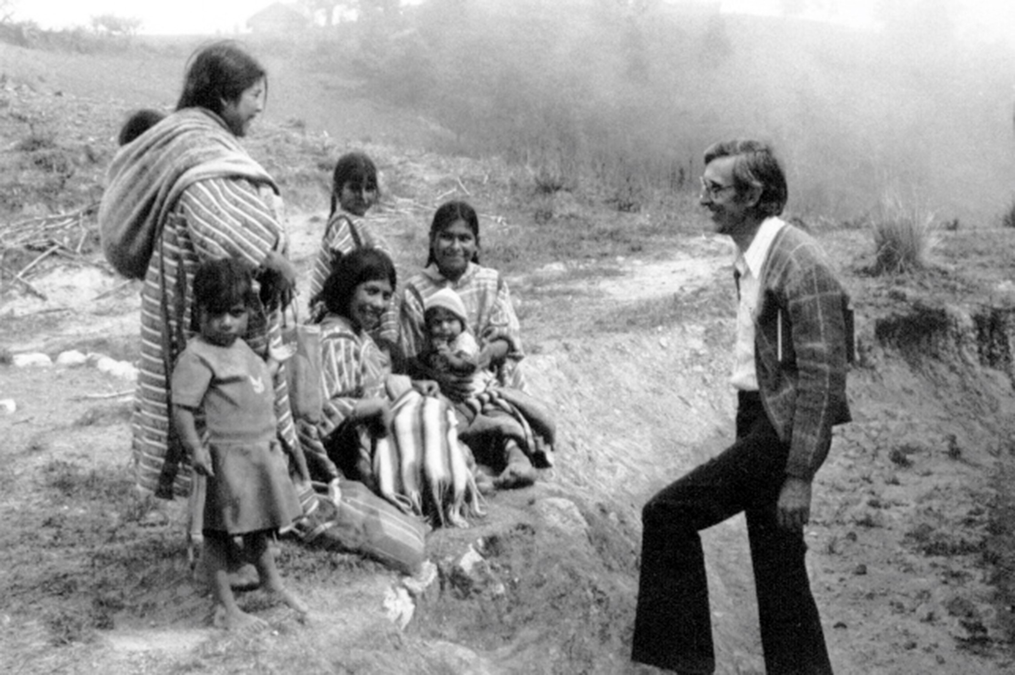
Claude Good, missionary & founder of The Worm Project with indigenous Triquis in Mexico
Notes:
Claude Good, a missionary living with his family in a remote region of Mexico, started The Worm Project after seeing the positive impact of deworming on the health of children in the village there.
‹#›

Slide 4
What is the Problem?
900 million children (ages 1 thru 14) need treatment for parasitic worms each year
  Only 55% of these children received treatment
  Only 38% of children age 1 – 4 years received treatment
Source: World Health Organization 2022 data
Notes:
Read slide
‹#›

Slide 5
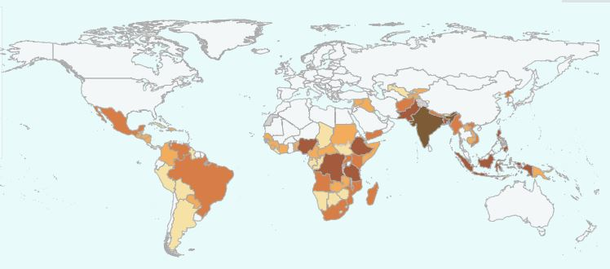
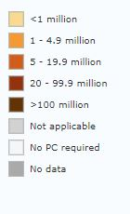
One Quarter of World’s Population Need Treatment for Parasitic Worms
Most live in Tropical & Subtropical Regions
Notes:
Read slide
‹#›

Slide 6
Lack of proper toilets and sanitation are a major issue
Adult female worms inside a person can lay thousands of eggs which are passed out through a child’s feces
Children are infected by swallowing eggs found in contaminated water and dirt they play in
Notes:
Read slide
‹#›

Slide 7
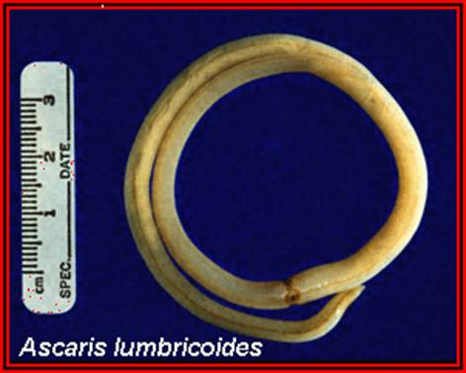
Roundworm, hookworm, whipworm are main types
Roundworms (Ascaris) can rob a child of up to 30% of their daily nutrition
Notes:
Read slide
Worms contribute to malnutrition by stealing the nutrients a child ingests. Children suffering from malnutrition are more susceptible to infection and disease. Deworming a child improves their ability to survive and thrive.
‹#›

Slide 8
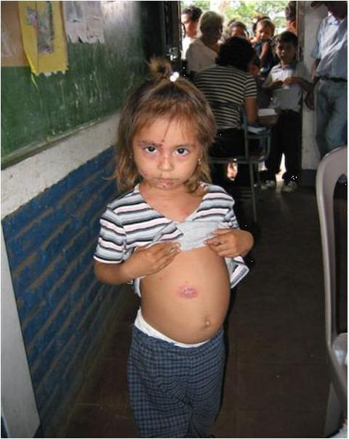
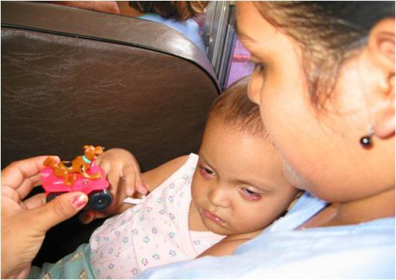
Parasitic worms cause physical and cognitive impairment in children due to malnutrition
Notes:
‹#›

Slide 9
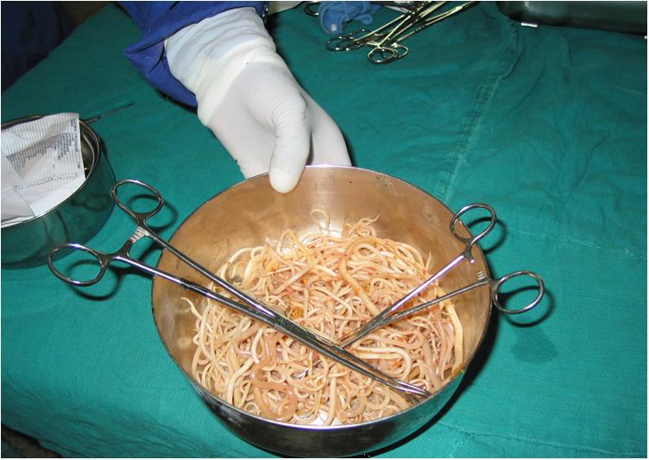
More than a hundred parasitic worms can be growing in one child
Roundworms removed from intestine of child in Kenya
Notes:
‹#›

Slide 10
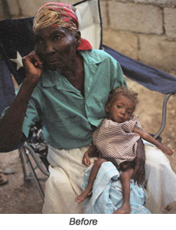
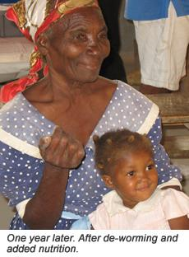
The impact of deworming children can be amazing!
Notes:
These two pictures show a child with her grandmother.
The picture on the left shows the child suffering from extreme malnutrition and parasitic worms when arriving at the clinic of one of our partners in Haiti.
The picture on the right shows the same child one year later after deworming and proper nutrition. The difference is amazing!
‹#›

Slide 11
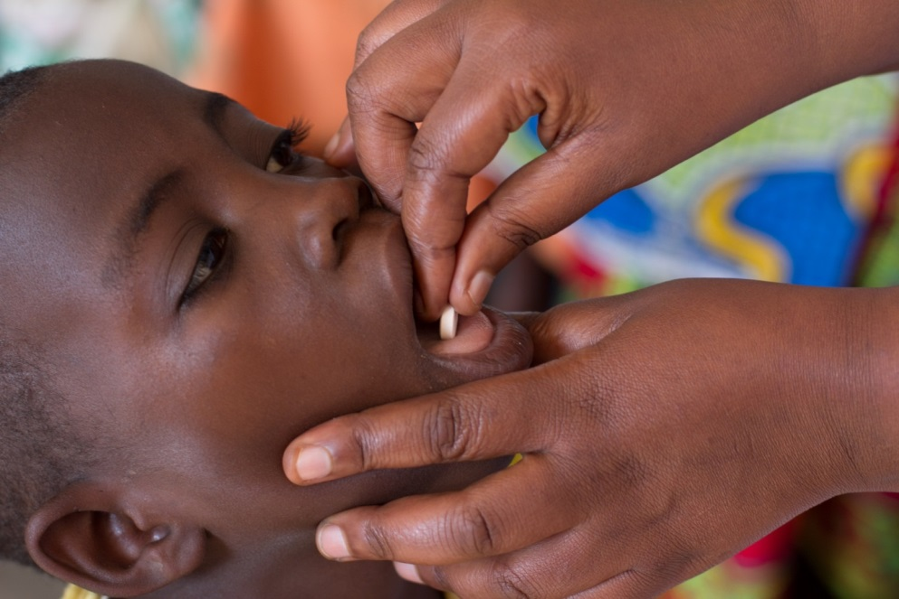
In 2023, we donated medicine to treat over 10 million children !
One deworming tablet costs just a few pennies!
  Recommended treatment is one tablet every 6 months
Notes:
Read slide
‹#›

Slide 12
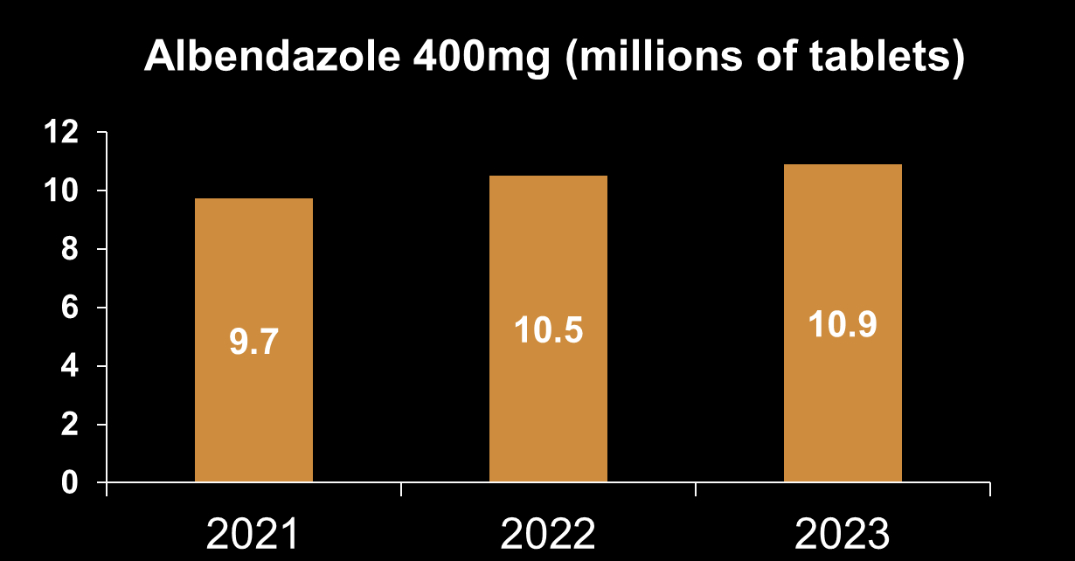
Worm Project – Medicine Donations
One Tablet Treats One Child
Notes:
‹#›

Slide 13
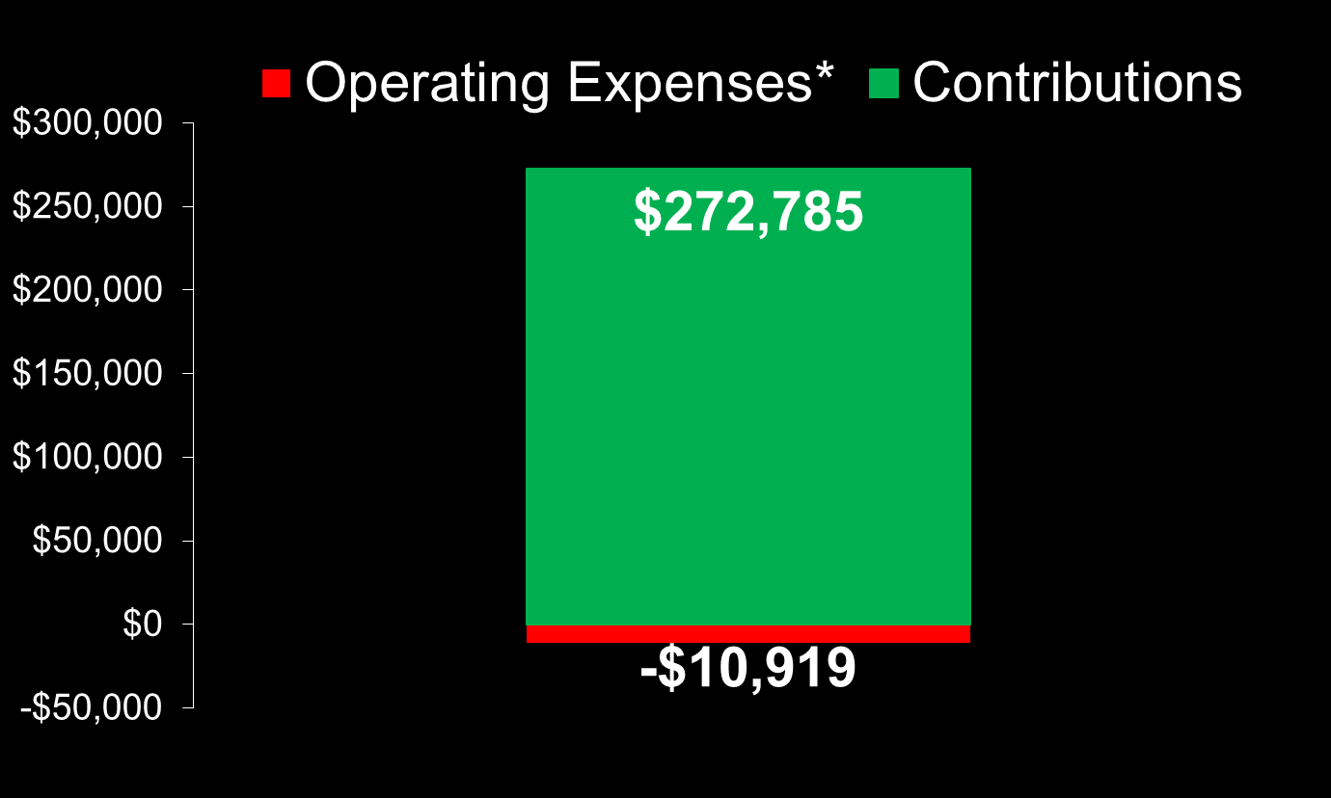
2023 Donations vs. Expenses (4%)
* Operating Expenses exclude Medicine Purchases, donated Labor & O/H
Notes:
Operating Expenses were only 4% of Contributions in 2023
‹#›

Slide 14

  “…Whatever you did for one of the least of these brothers and sisters of mine, you did for me.” Matthew 25:40
Visit our website:
wormproject.org
Notes:
The Worm Project believes no child should suffer from parasitic worms. We are so thankful for donors who help provide deworming medicine to God's precious children in the neediest countries around the world.
Please donate.
I will stay after the service if you have any questions or would like to volunteer to help us.
‹#›

