Slide 1
CTI Integration
- Admin Guide -
December, 2023

Slide 2
Release Notes (December 2023)
Item | Slide No. | Change Description
Admin Tools | 53 | Added Pre Call application to the admin tools
Admin Tools | 55 | Added details on the activated devices
Admin Tools | 57 | Added details in the application features
Admin Tools | 65 | Rename Permission tab to Access Control
Admin Tools | 64 | Added Callback feature

Slide 3
Introduction
Overview
Prerequisite
Setup Guide

Slide 4
Introduction

Slide 5
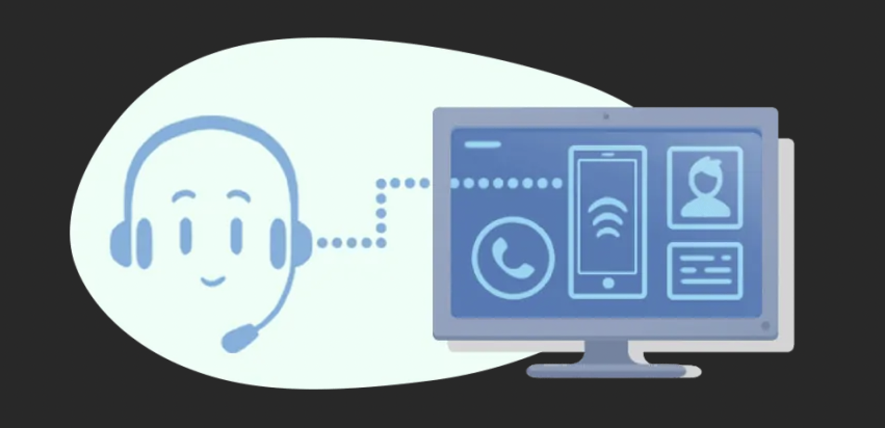
CTI <Overview>
Computer Telephony Integration (CTI) technology allows computers and telephones to interact and exchange information. With auto-identification of the callers from CRM, the agents can answer them better by checking the basic customer details. Computer Telephony Integrations solution is prominently used in call centers to manage inbound and outbound calls to increase human agents’ productivity.

Slide 6
CTI <Prerequisites>
CPAAS |  |  |  |  | FRESHDESK/ZENDESK
Type | License |  | Mandatory | Optional
Base | Phone System |  | ✅ |  | Your Freshdesk account must have administrator privileges so you can access Freshwork Developer Console
 | Auto Attendant |  | ✅
 | Number |  | ✅
Add-on | CTI | Developer License | ✅
 | IP Phone | Developer Concurrent Call License |  | ✅
 | Contact Centre Supervisor/Agent | Team Chat License |  | ✅
 | Web Phone | Call Recording |  | ✅
 | Desktop | Concurrent Call License |  | ✅

Slide 7
Setup Guide

Slide 8
Setup Guide <Overview>
Step 1: Provision CPaaS Licenses on CPaaS portal
Step 2: Create the Auto Attendant Flow
Step 3: Create the Queue for Contact Center
Step 4: Create the Programmable Flow
Step 5: Configure general settings for CPaaS users
Step 6: Create a new custom application in Zendesk portal / Freshdesk portal
Step 7: Start using

Slide 9
Step 1: Provision CPaaS License on CPaaS Portal

Slide 10
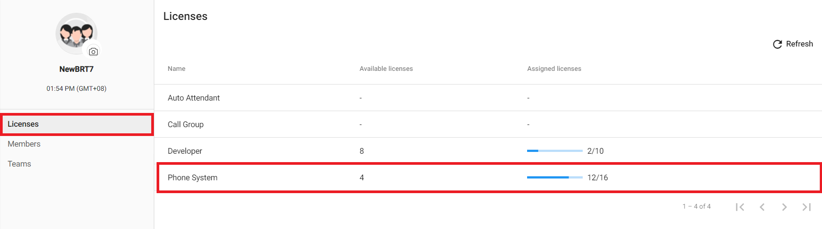
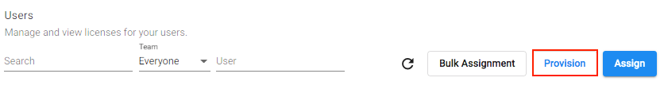
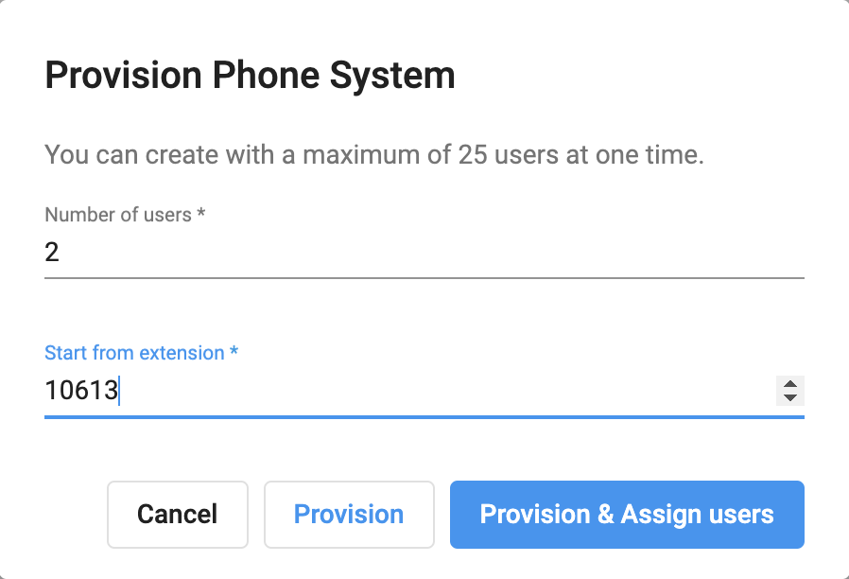
Setup Guide <Provision CPaaS License on CPaaS Portal>
Phone System
A. Manual Configuration
Step 1: Provision Phone System Base License
Go to Manage Organization
Select Licenses > Phone System
Choose Provision
Key-in
Number of User
Extension Number
Provision & Assign users

Slide 11
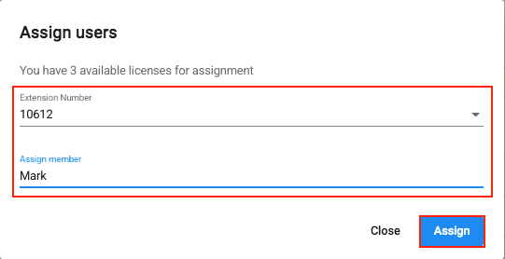
Setup Guide <Provision CPaaS License on CPaaS Portal>
Phone System
A. Manual Configuration
Step 2: Assign User
Select:
Extension Number
Assigned Member
Assign

Slide 12
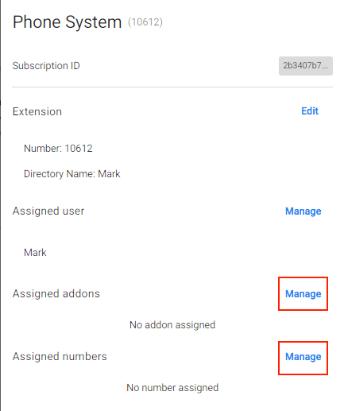
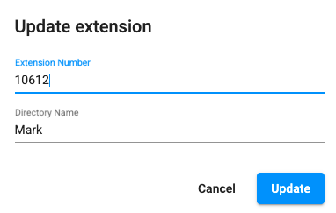
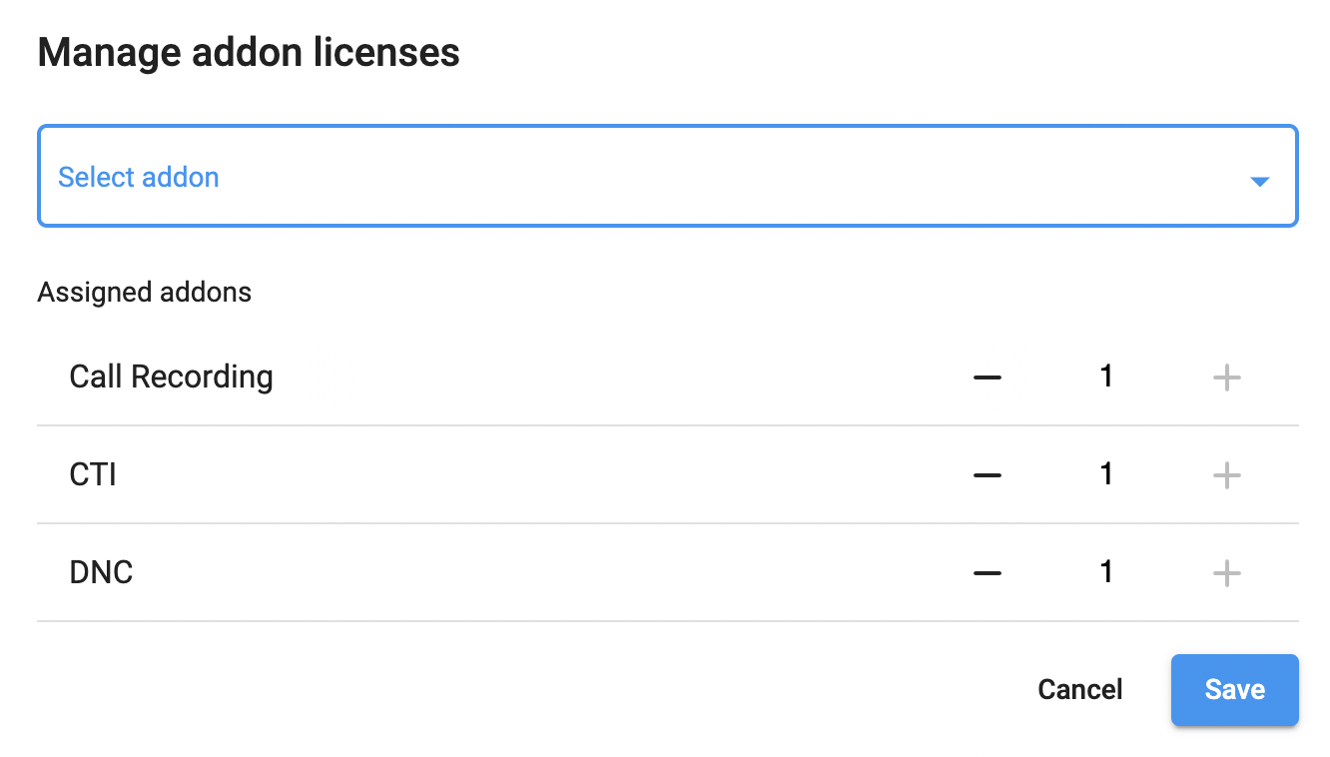
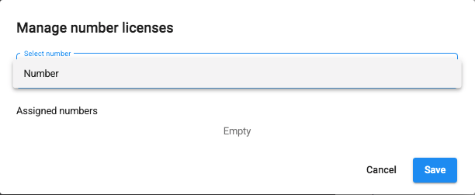
Setup Guide <Provision CPaaS License on CPaaS Portal>
Phone System
A. Manual Configuration
Step 3: Assign Add-on Licenses
Choose the extension that you would like to assign Addon licenses:
At Assigned addons and number, click Manage
Choose Addon Licenses
Choose Numbers
Save

Slide 13
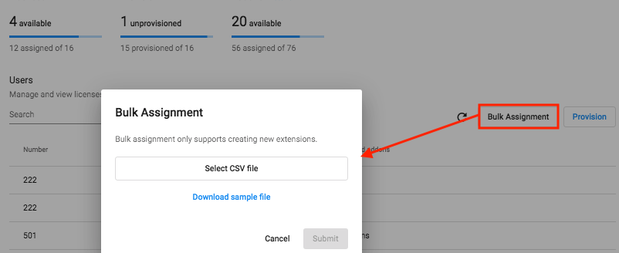
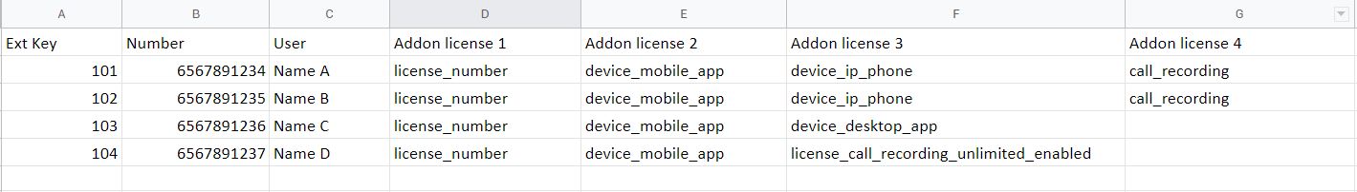
Setup Guide <Provision CPaaS License on CPaaS Portal>
Phone System
B. Bulk Configuration
Click Bulk Assignment > Download sample file > Fill in the required information properly:
Ext key: the key of the extension.
Number: the number (DID) assigned to the extension.
User: the user to assign the extension and add-ons to.
Addon license: the features that a user can use. Insert more columns if the user is assigned to more than 2 features. Use the LICENSE CODES in the next slide for the Addon License column.

Slide 14
Setup Guide <Provision CPaaS License on CPaaS Portal>
Phone System
B. Bulk Configuration
Add-on | Add-on License Code
Number | license_number
CTI | license_cti
Contact Center | license_call_center_enabled
Call Recording | call_recording
Team Chat | team_chat

Slide 15
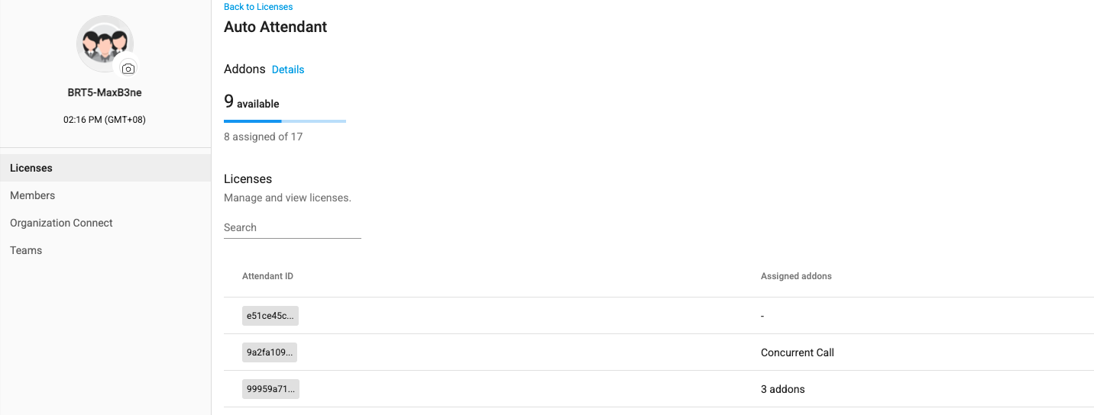
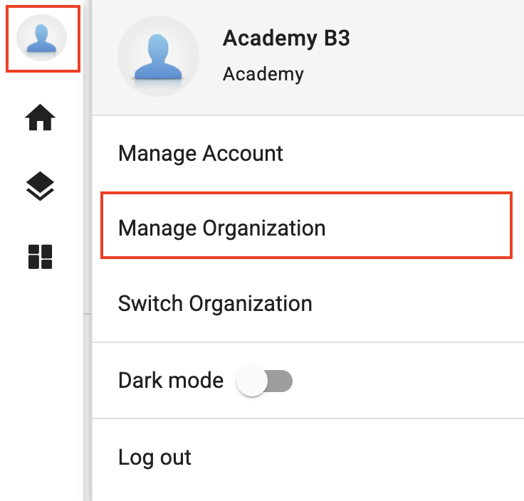
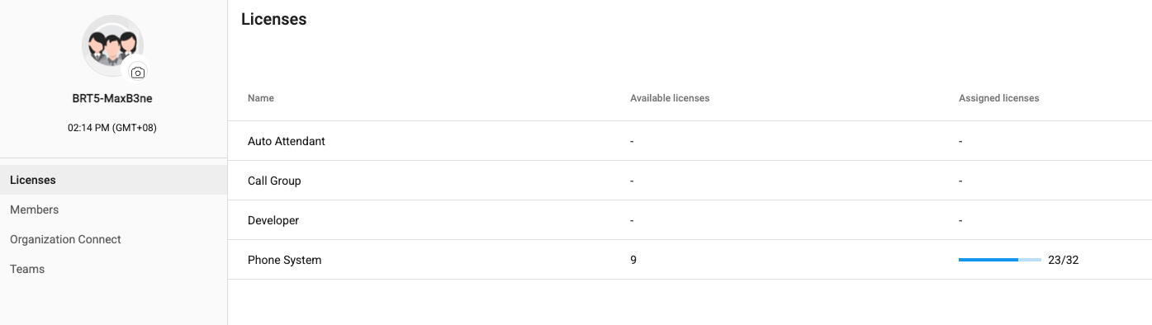

Setup Guide <Provision CPaaS License on CPaaS Portal>
Auto Attendant
In order to have a basic Auto-attendant solution, the following licenses are required:
Auto Attendant Base License
Number Add-on License
Concurrent Call Add-on Licenses (according to the number of channels required)

Slide 16
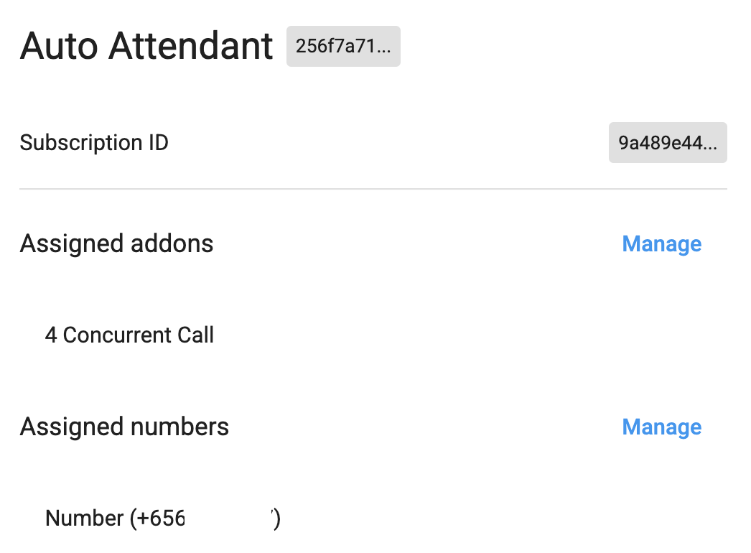
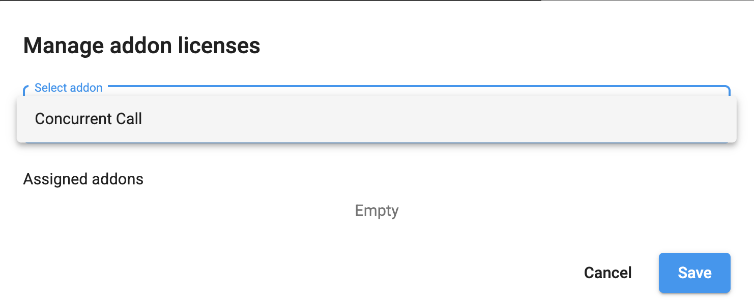
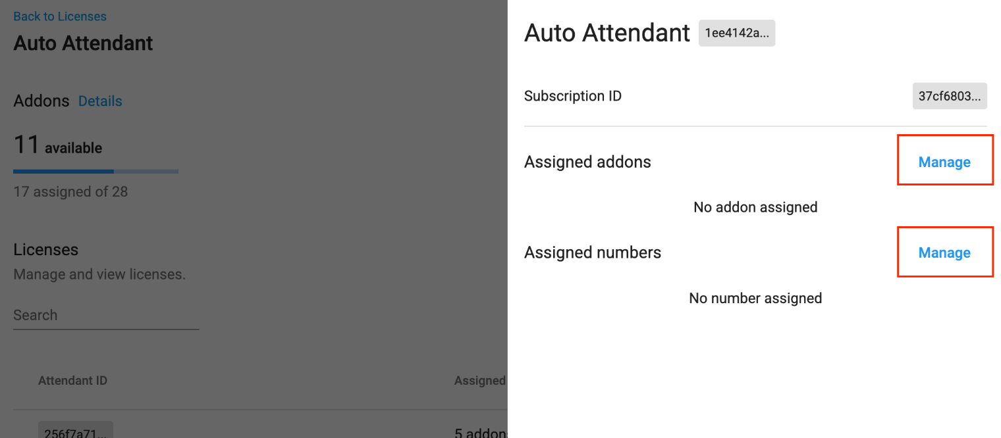
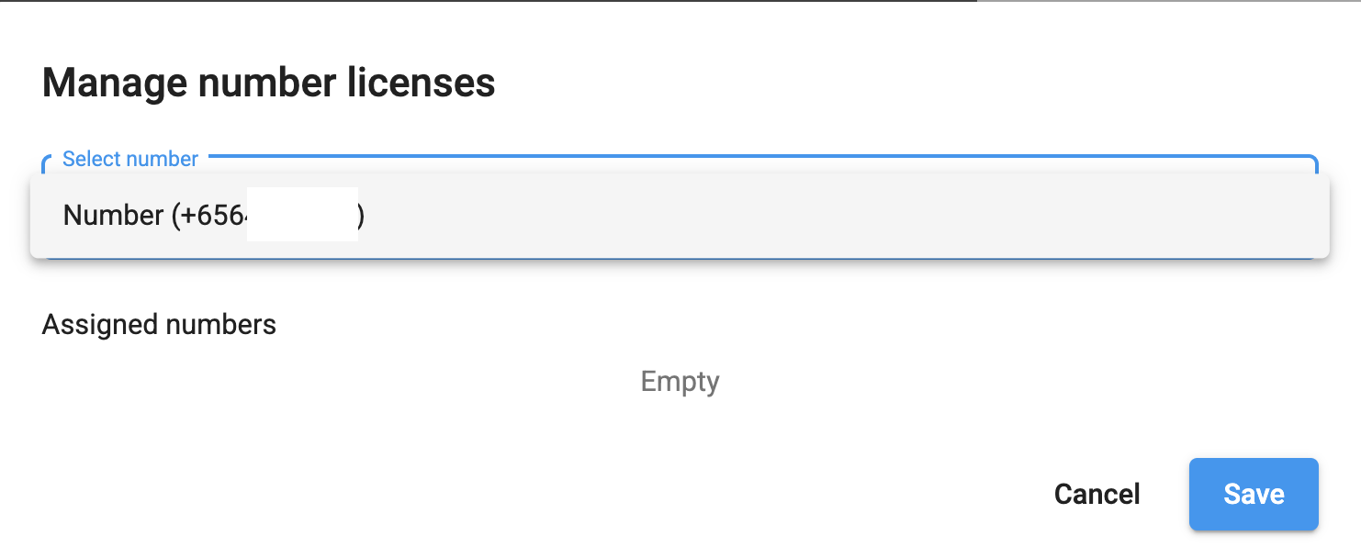
Setup Guide <Provision CPaaS License on CPaaS Portal>
Auto Attendant
How to assign:
Go to Licenses > Select the purchased Auto Attendant Base License
Click Manage > Select an available Number & Concurrent Call Licenses > Save

Slide 17
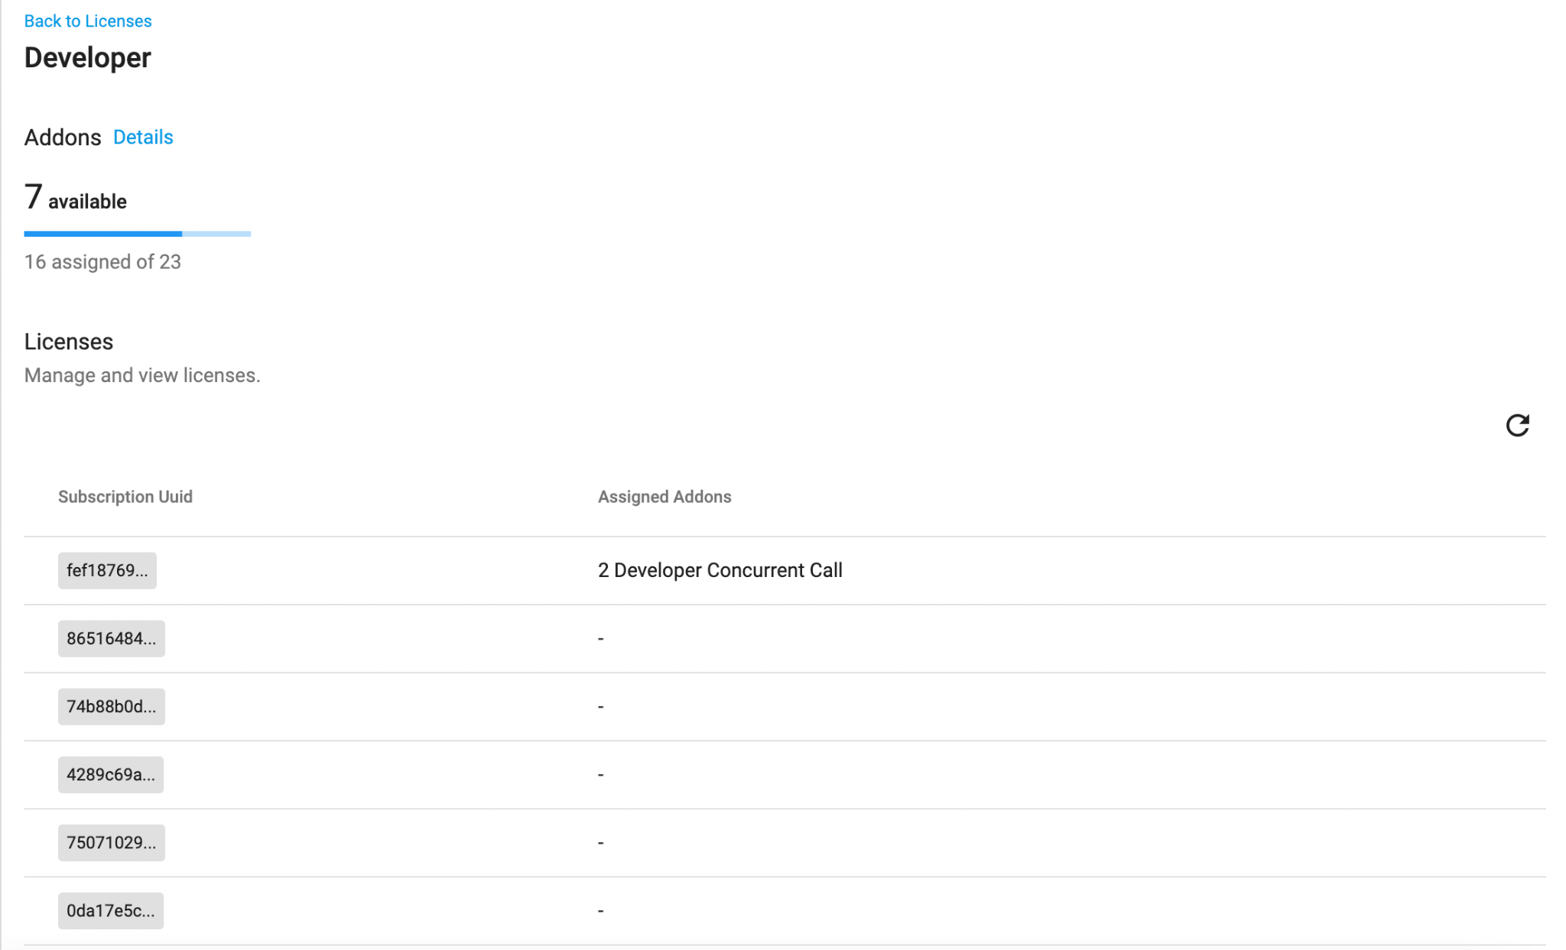
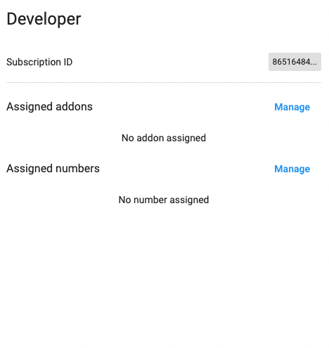
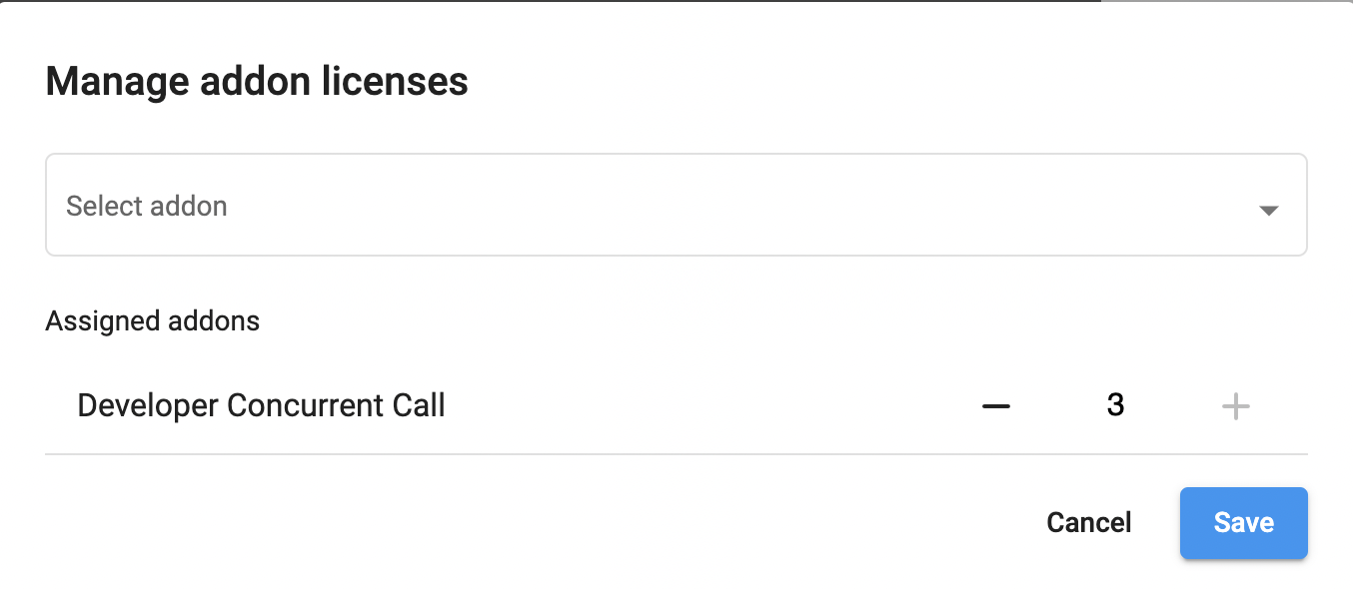
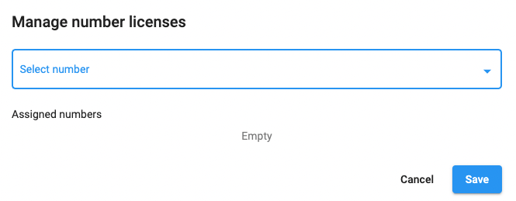
Setup Guide <Provision CPaaS License on CPaaS Portal>
Developer
Once the Developer License has been purchased successfully, you can assign the add on licenses by following steps below:
Choose the License tab
Select the Developer Base License
Choose the specific base to configure
Click the Manage button at the respective section to assign.
Develop Concurrent Call add on license
Number Add on License
Save

Slide 18
Step 2: Create the Auto Attendant Flow

Slide 19

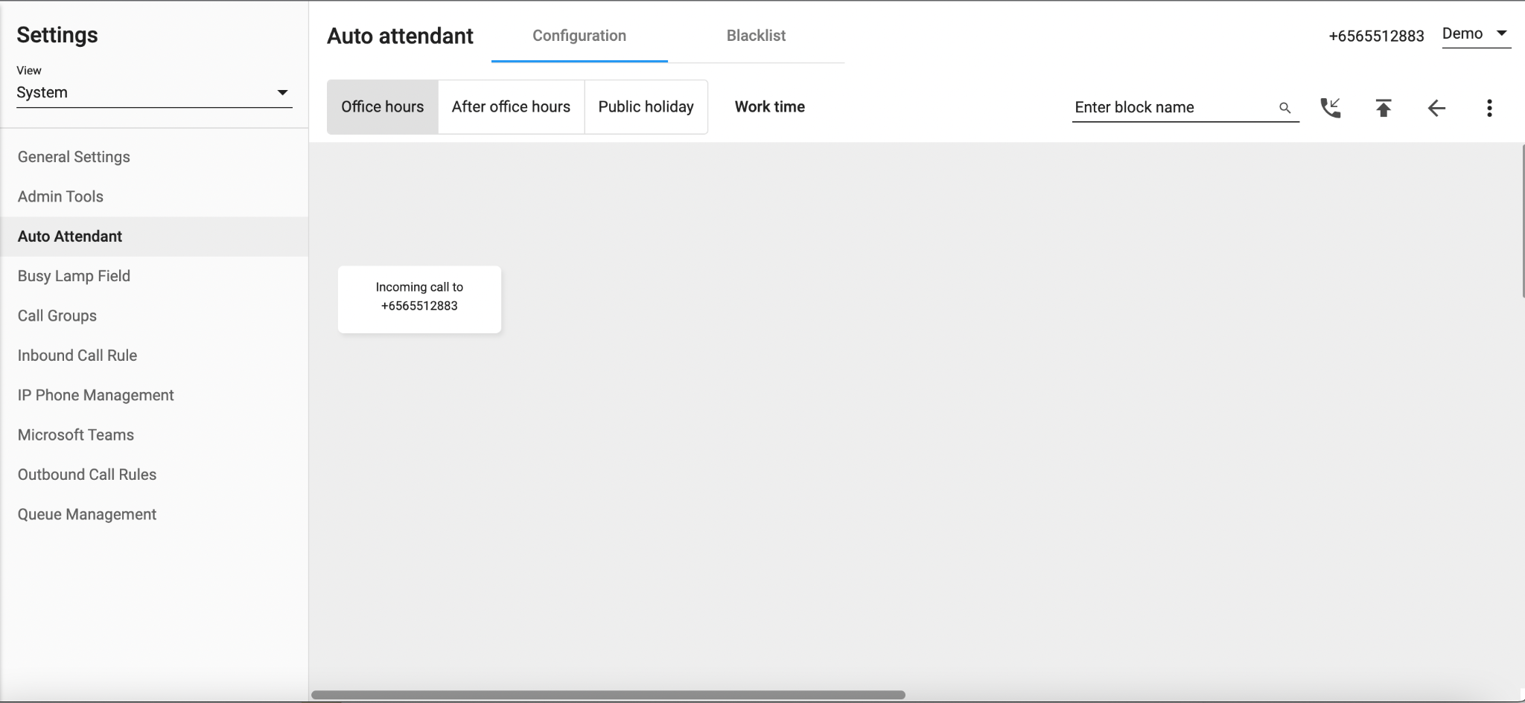
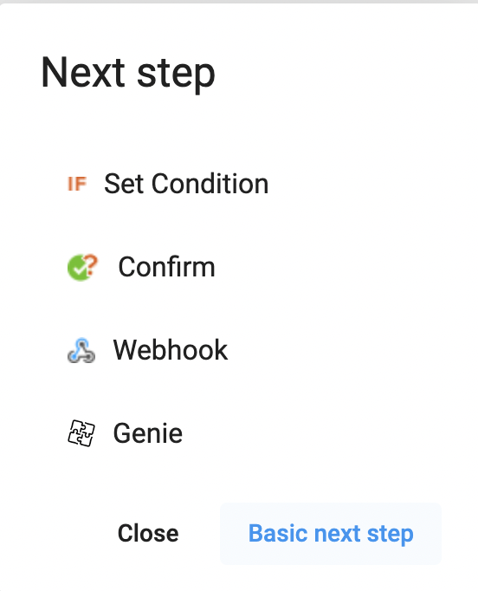
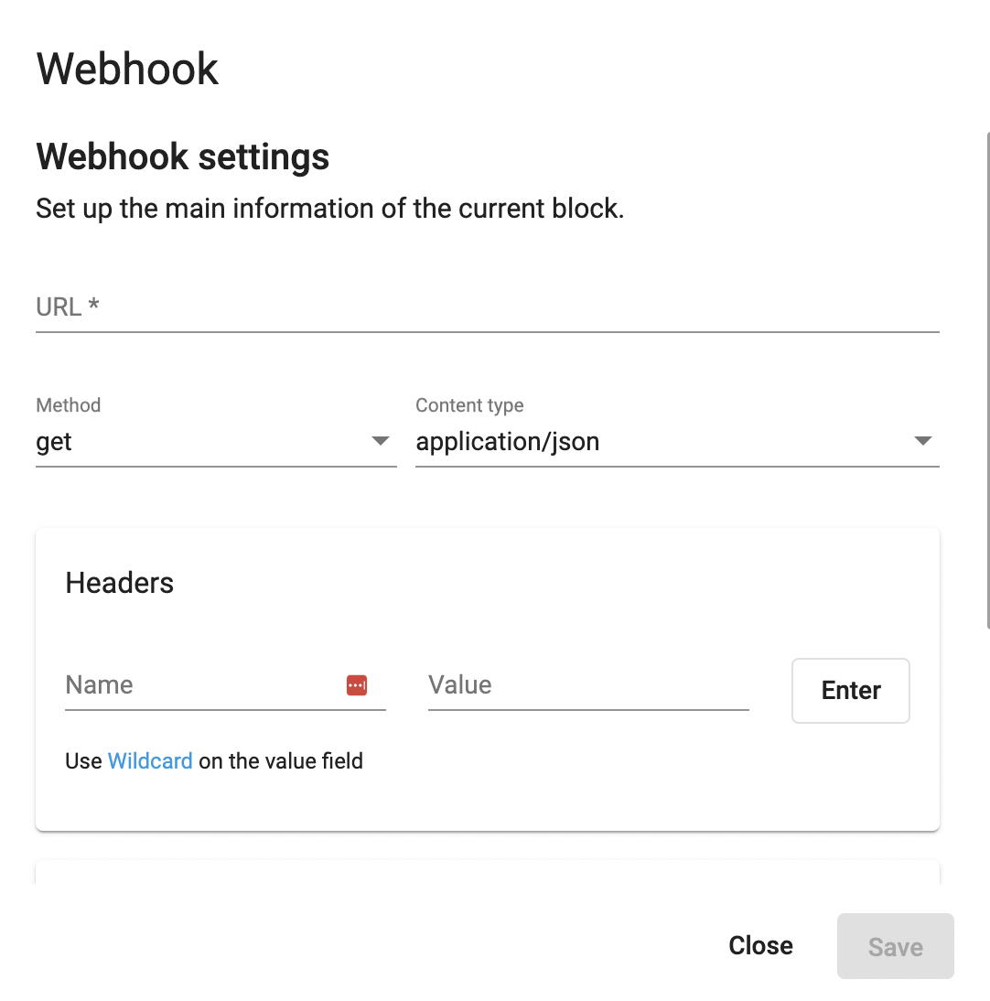
Setup Guide <Create the Auto Attendant Flow>
Go to Setting > View: System > Auto Attendant
Click on Config Workflow > Config Page
Choose Working Hours > Edit
Click on the first block > Choose Webook (or any other Next Step option to begin creating your flow)
Click on the latest block (Webhook) > Next Step > Transfer Call
Transfer to Extension > Select Type: Extension > Select an Extension
Transfer to Call Centre > Select a Queue

Slide 20
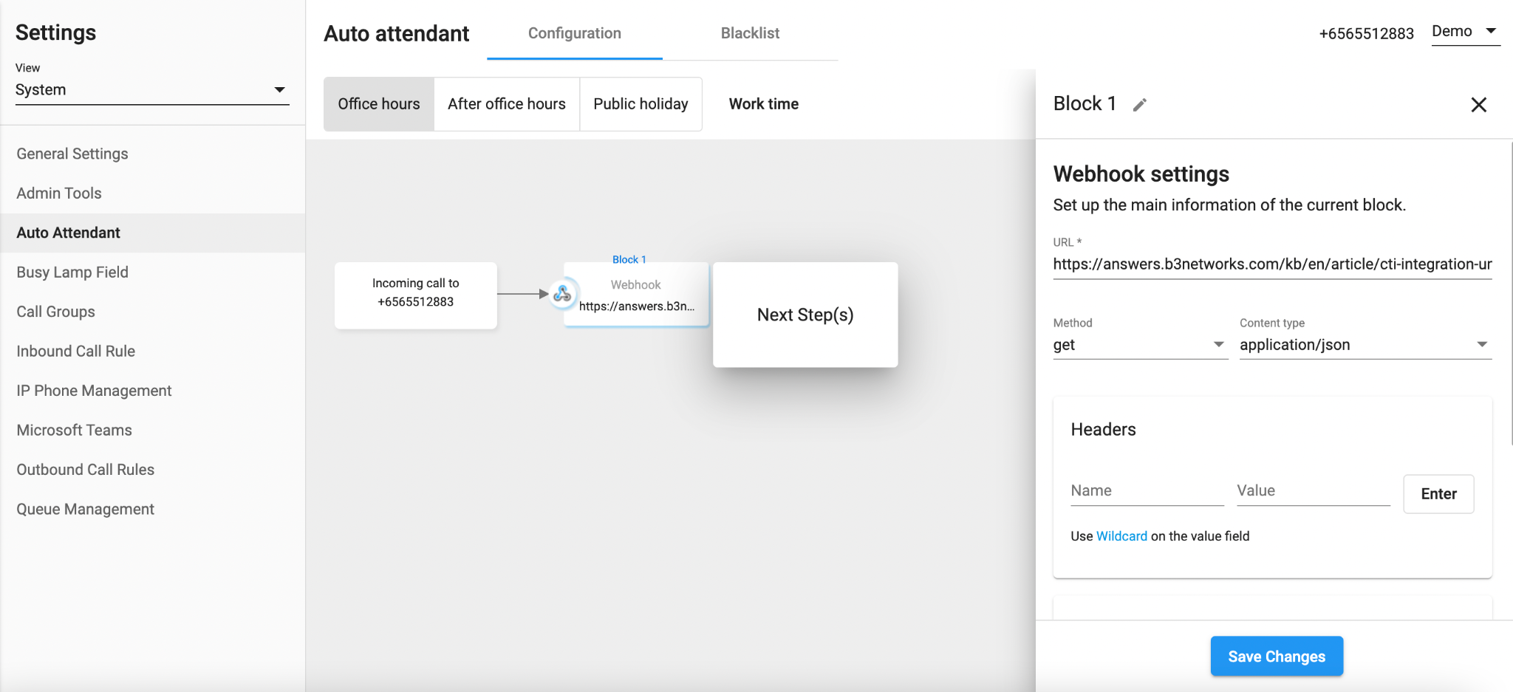
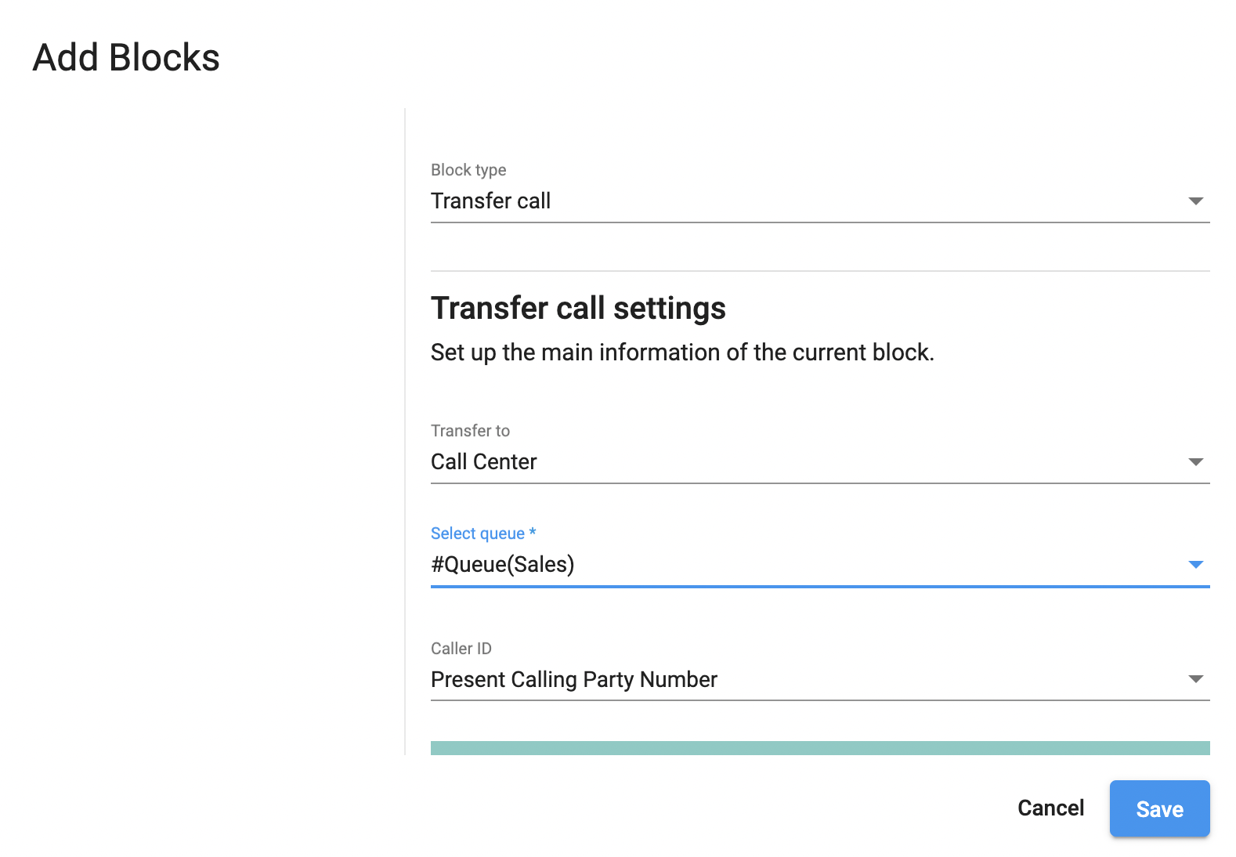
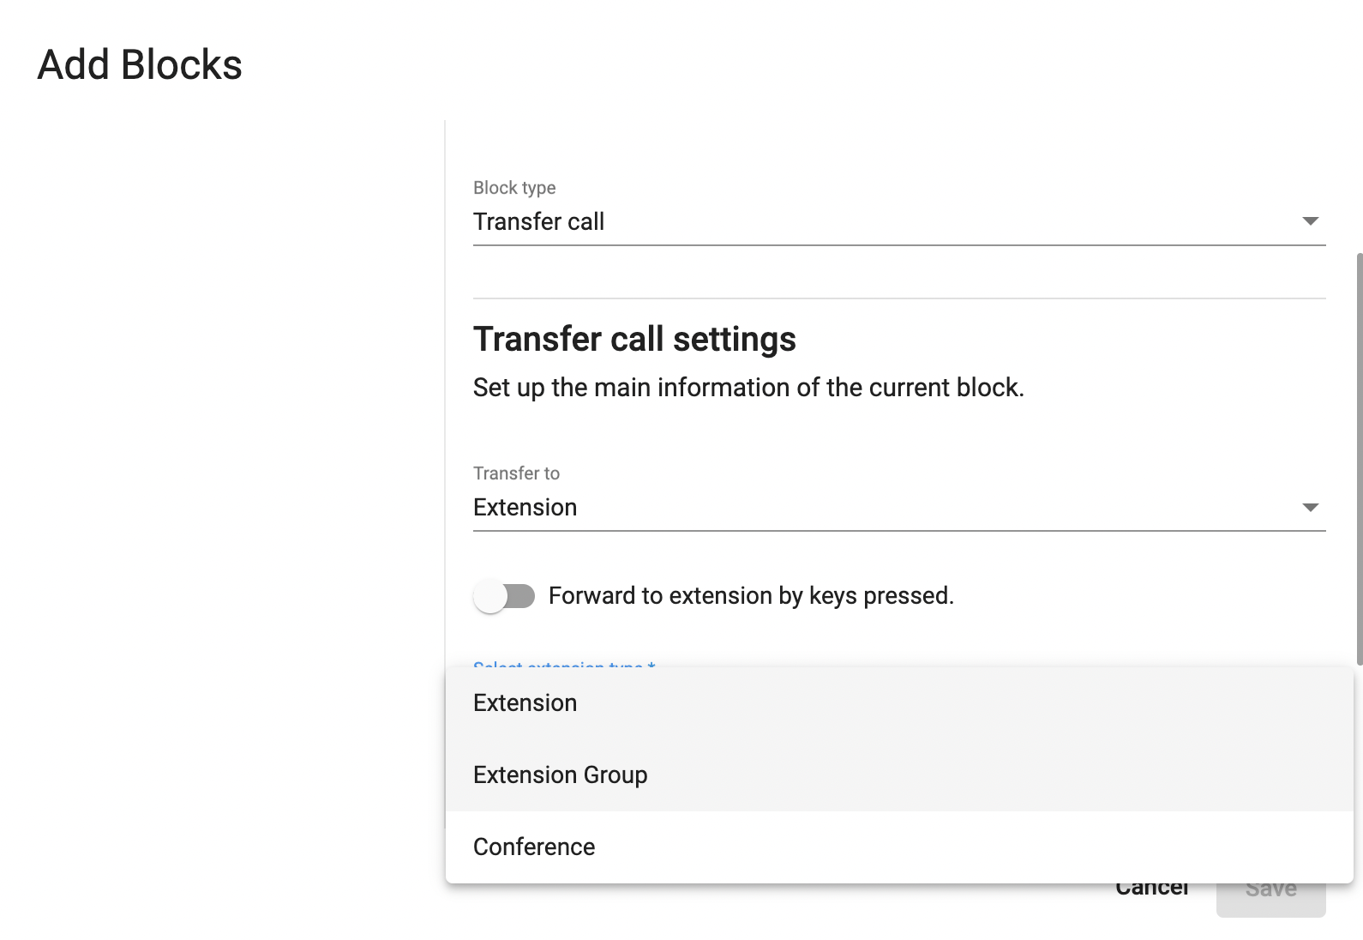
Setup Guide <Create the Auto Attendant Flow>
Go to Setting > View: System > Auto Attendant
Click on Config Workflow > Config Page
Choose Working Hours > Edit
Click on the first block > Choose Webook (or any other Next Step option to begin creating your flow)
Click on the latest block (Webhook) > Next Step > Transfer Call
Transfer to Extension > Select Type: Extension > Select an Extension
Transfer to Call Centre > Select a Queue

Slide 21
Step 3: Create the Inbox for Omni Channel

Slide 22
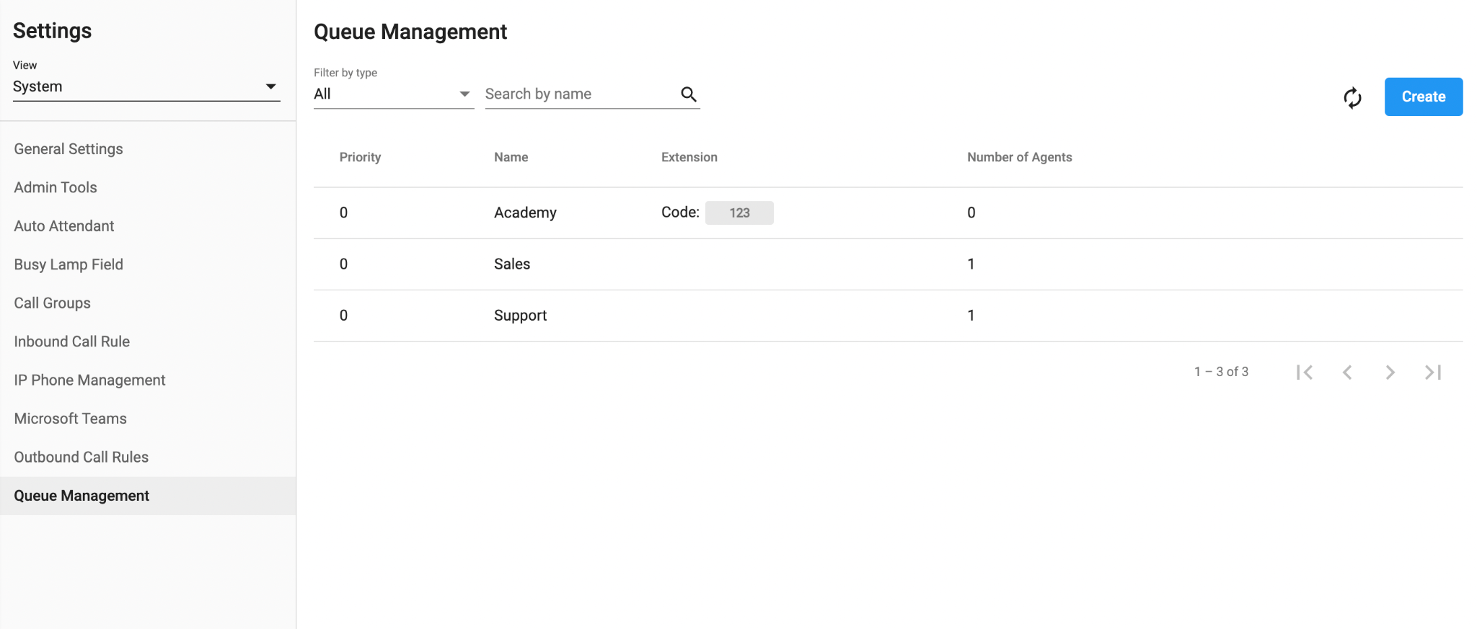
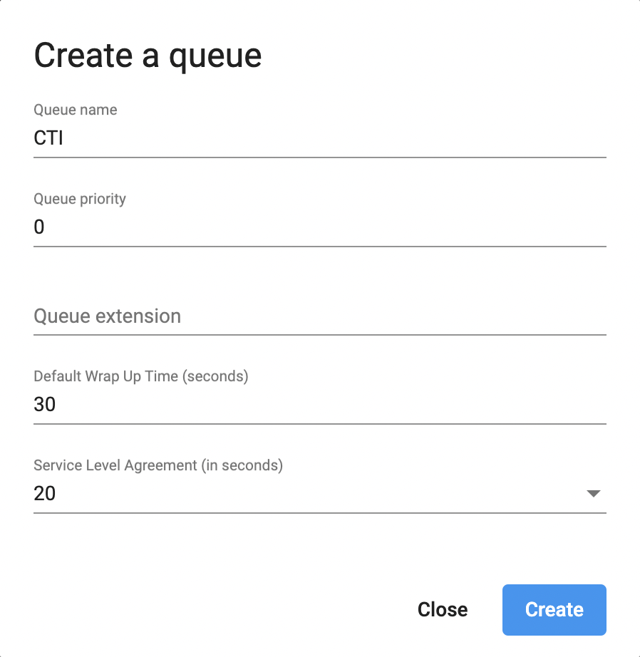
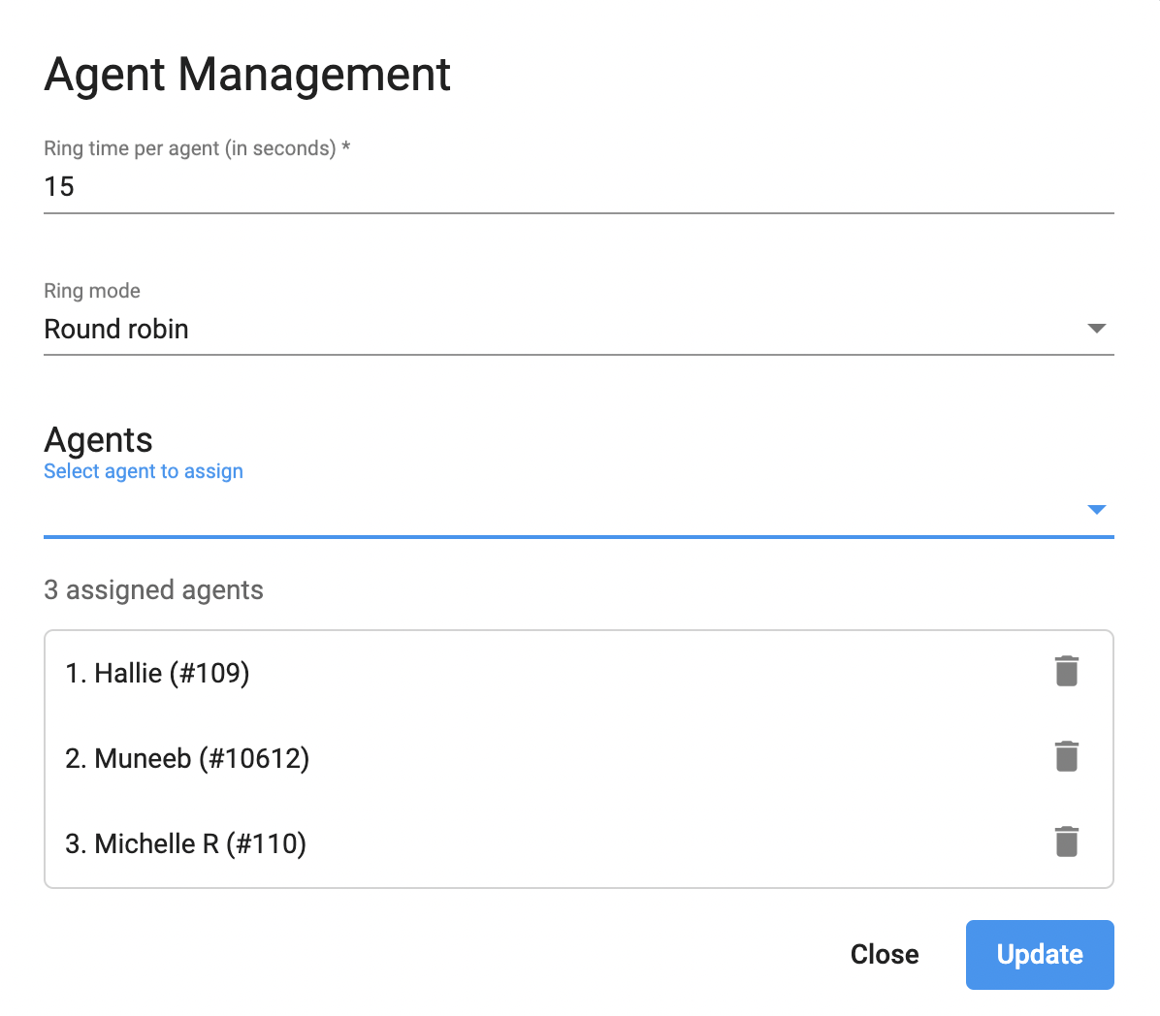
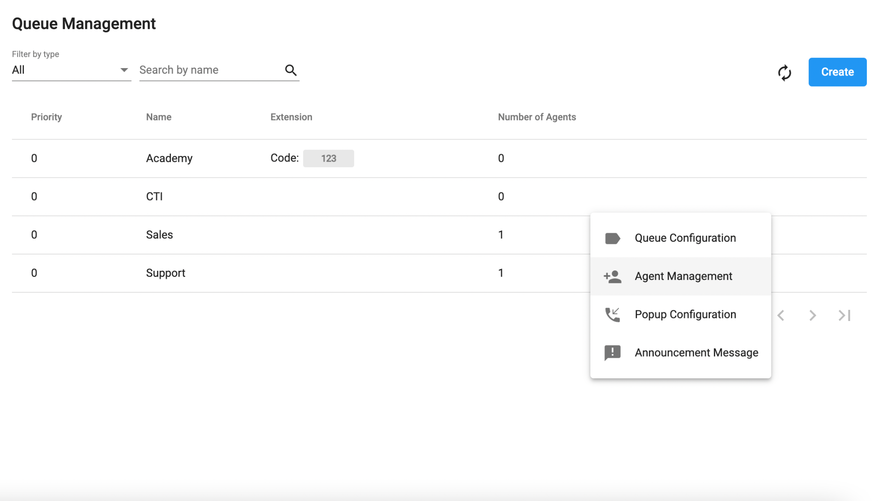
Setup Guide <Create the Queue for Contact Center>
Go to Setting > View: System > Queue Management
Click on Create Button > Enter the Queue Name > Create
Click on the Three dot icon next to the created queue > Go to the Agent Management > Select agents to assign > Update

Slide 23
Step 4: Create the Programmable Flow

Slide 24
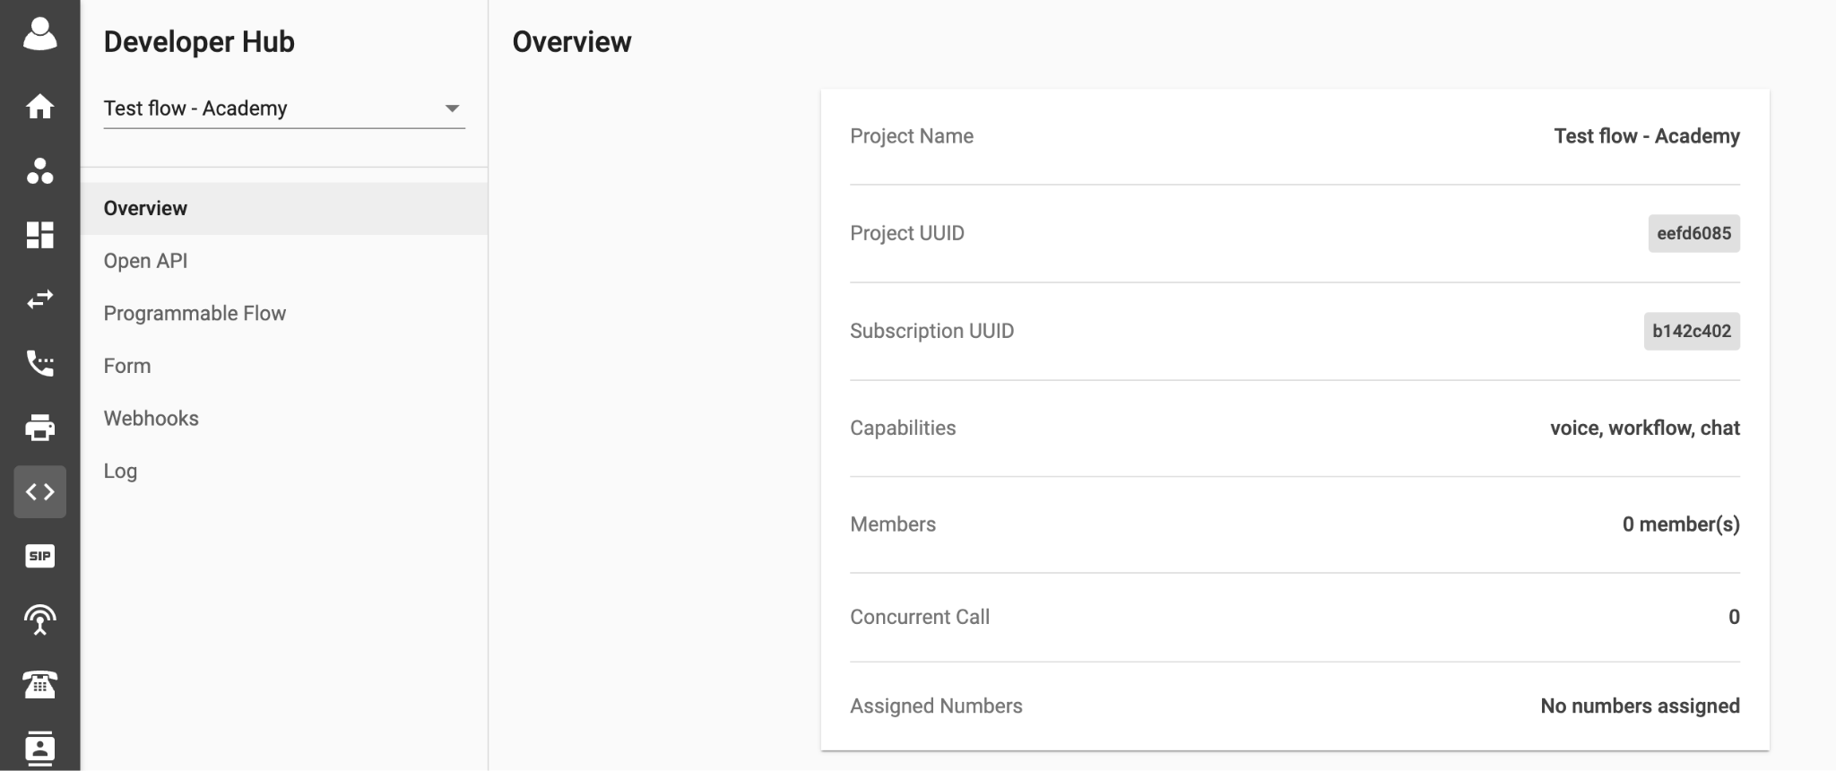
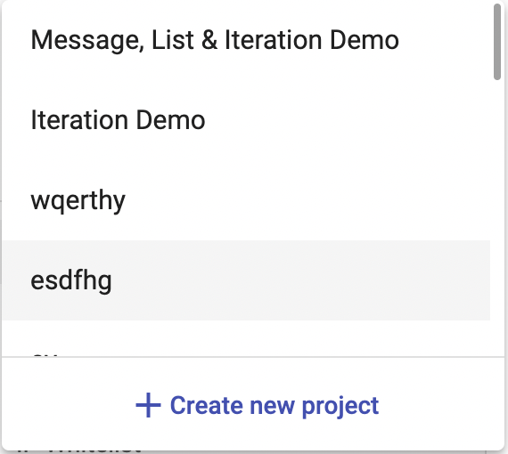
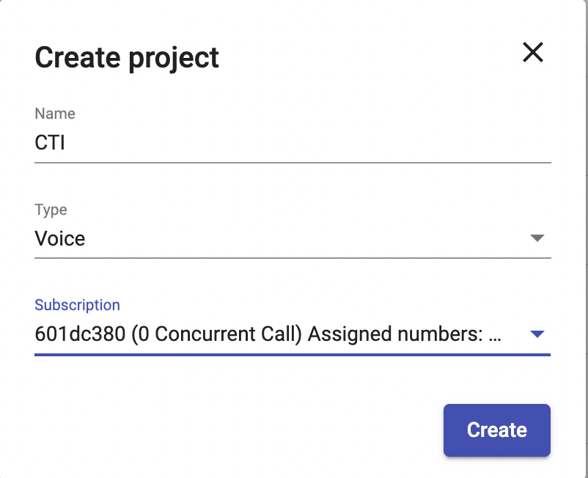
Setup Guide <Create the Programmable Flow>
Step 1. Create Project
Go to Developer Hub > Click on the Triangle Icon > Create New Project
Give a Project Name > In Type option choose Voice
For Subscription option, choose Select UUID
Press Create to start the Project

Slide 25
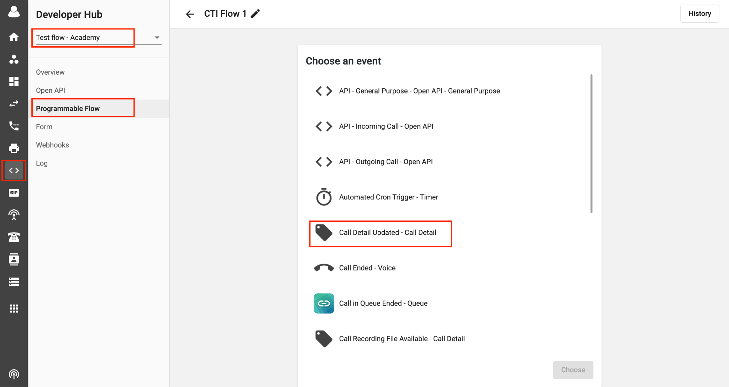
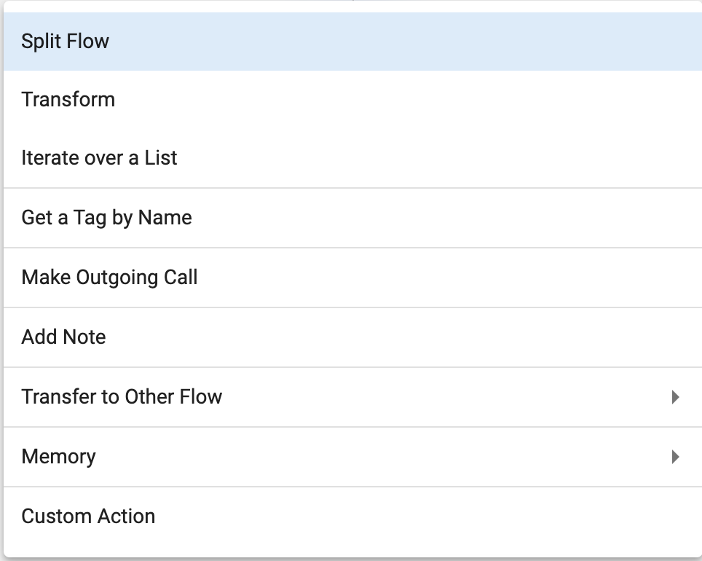
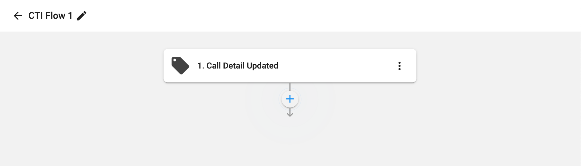
Setup Guide <Create Flow in the Programmable Flow>
Step 2. Create flow in the Programmable Flow
In the created Project, press Create Flow to begin > Choose an event: Call Detail Updated > Click + and select Split Flow

Slide 26
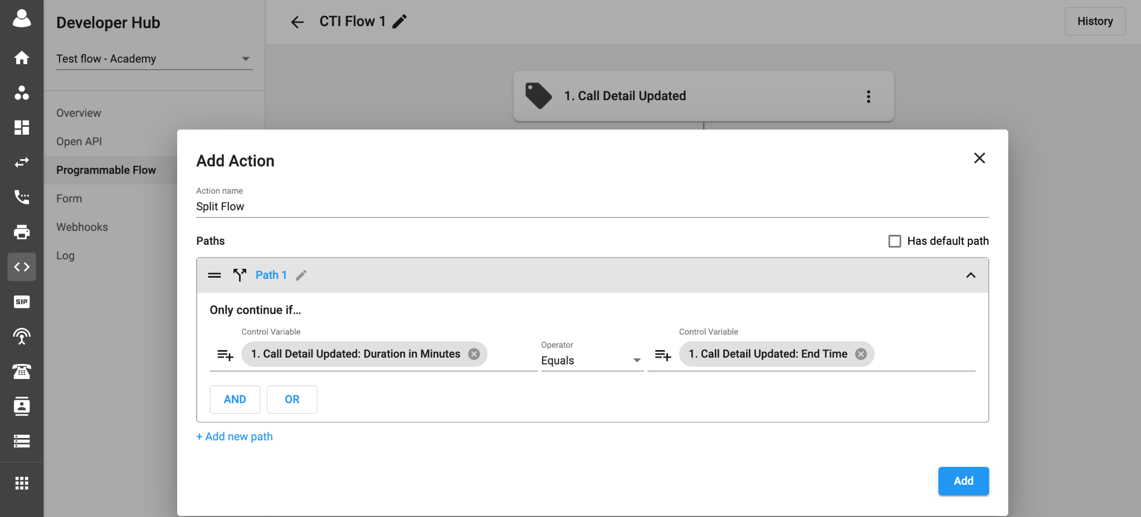
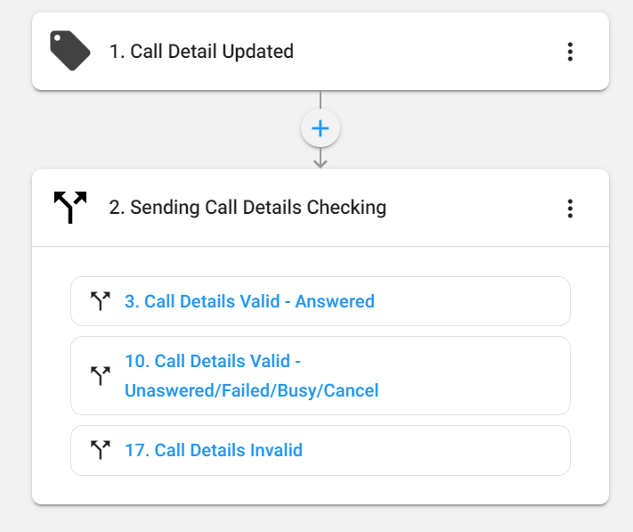
Setup Guide <Create Flow in the Programmable Flow>
Step 2. Create flow in the Programmable Flow
2. Enter Data for Split Flow
Call Details Updated (Answered)
Call Detail Valid (Unanswered/Failed/Busy/Cancel)
Call Detail Invalid

Slide 27
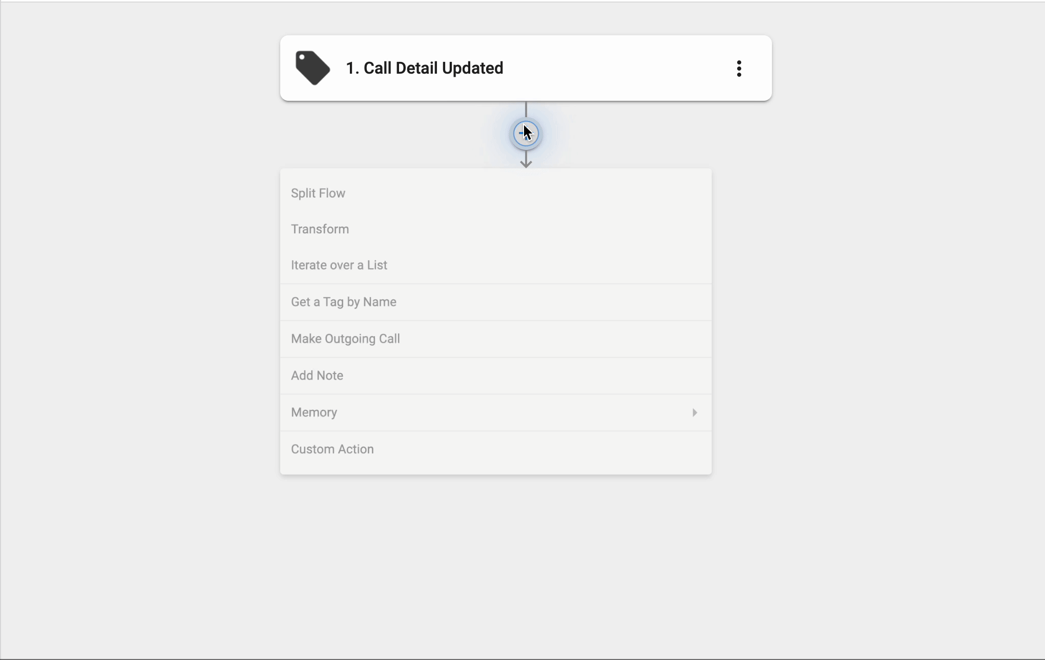
Setup Guide <Create Flow in the Programmable Flow>
Step 2. Create flow in the Programmable Flow
2. Enter Data for Split Flow
Call Details Updated (Answered)
To create custom path in Split Flow action, follow the below steps:
Fill in the Add Action box with the necessary details, such as in Action name, add Sending Call Details Checking > In Path name, add Call Details Valid - Answered > For Control Variable, choose Call Detail Updated: Recording URL > In Operator, select Contains > For Control Variable, add https://

Slide 28
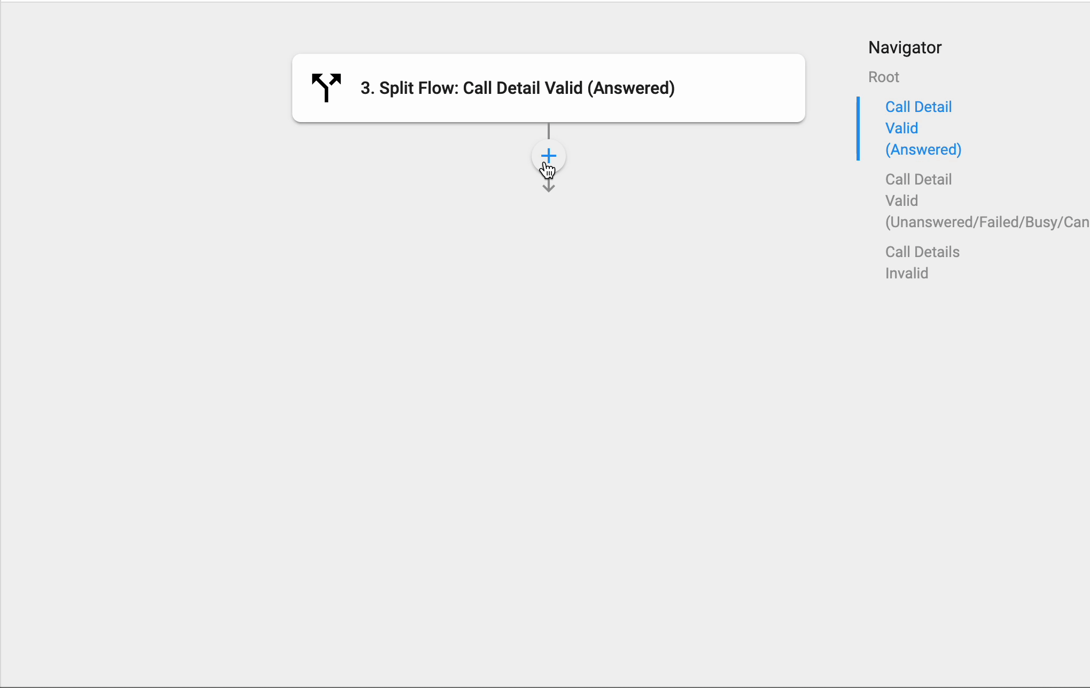
Setup Guide <Create Flow in the Programmable Flow>
Step 2. Create flow in the Programmable Flow
2. Enter Data for Split Flow
Call Details Updated (Answered)
2. Choose Get from Memory > Enter the data:
For Action Name, add Get From Memory *default* > Make Key set in flow to New Flow 2 *default* > For Key name, fill in Call Detail Updated : Call Transaction UUID.

Slide 29
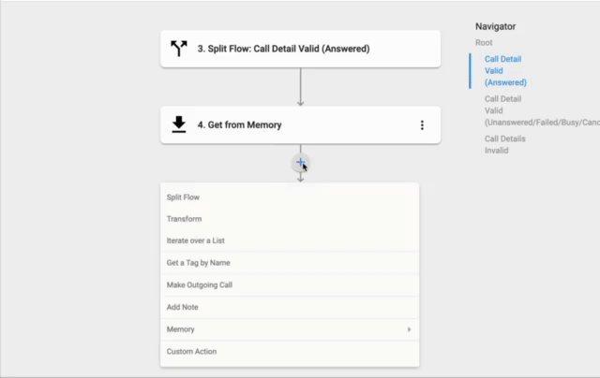
Setup Guide <Create Flow in the Programmable Flow>
Step 2. Create flow in the Programmable Flow
2. Enter Data for Split Flow
Call Details Updated (Answered)
3. Choose Split Flow:
TXN UUID Available:
Choose Split Flow > Rename Action name to Validate TXN UUID > Rename path to TXN UUID Available
For Control Variable, select Get from Memory: Value > For Operator, select Contains > For Control Variable, add in False > Press Add

Slide 30
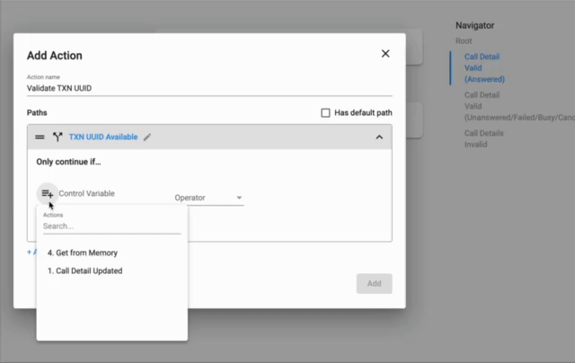
Setup Guide <Create Flow in the Programmable Flow>
Step 2. Create flow in the Programmable Flow
2. Enter Data for Split Flow
Call Details Updated (Answered)
3. Choose Split Flow:
TXN UUID Available:
Choose Split Flow > Rename Action name to Validate TXN UUID > Rename path to TXN UUID Available
For Control Variable, select Get from Memory: Value > For Operator, select Contains > For Control Variable, add in False > Press Add

Slide 31
Setup Guide <Create Flow in the Programmable Flow>
Step 2. Create flow in the Programmable Flow
2. Enter Data for Split Flow
Call Details Updated (Answered)
3. Choose Split Flow:
TXN UUID Not Available
Choose Custom Action > Rename it to Sending Call Details > Choose Method as Post
Fill in the URL: https://openapi.extensionapps.com/prod/api/v1/service-report/callback/call-detail?secret=afe7cb8a00154d85be106bade79b799b
Fill in Body:
"type":﻿1. Call Detail Updated: Call Type﻿,
"status":﻿1. Call Detail Updated: Status﻿,
"txnUuid":﻿1. Call Detail Updated: Call Transaction UUID﻿,
"endTime":﻿1. Call Detail Updated: End Time﻿,
"startTime":﻿1. Call Detail Updated: Start Time﻿,
"answeredTime":﻿1. Call Detail Updated: Answer Time﻿,
"recordingUrl":﻿1. Call Detail Updated: Recording URL﻿,
"recordingExpected":﻿1. Call Detail Updated: Recording Expected﻿,
"toKey":﻿1. Call Detail Updated: To Key﻿,
"toLabel":﻿1. Call Detail Updated: To Label﻿,
"fromKey":﻿1. Call Detail Updated: From Key﻿,
"fromLabel":﻿1. Call Detail Updated: From Label﻿,
"toNumber":﻿1. Call Detail Updated: To Number﻿,
"fromNumber":﻿1. Call Detail Updated: From Number﻿,
"orgUuid":1. Call Detail Updated: Organization UUID﻿,
"durationInSeconds":﻿1. Call Detail Updated: Duration in Seconds﻿,
"durationInMinutes":﻿1. Call Detail Updated: Duration in Minutes﻿
Add sample response content as {"success" : true} to extract properties for the action

Slide 32
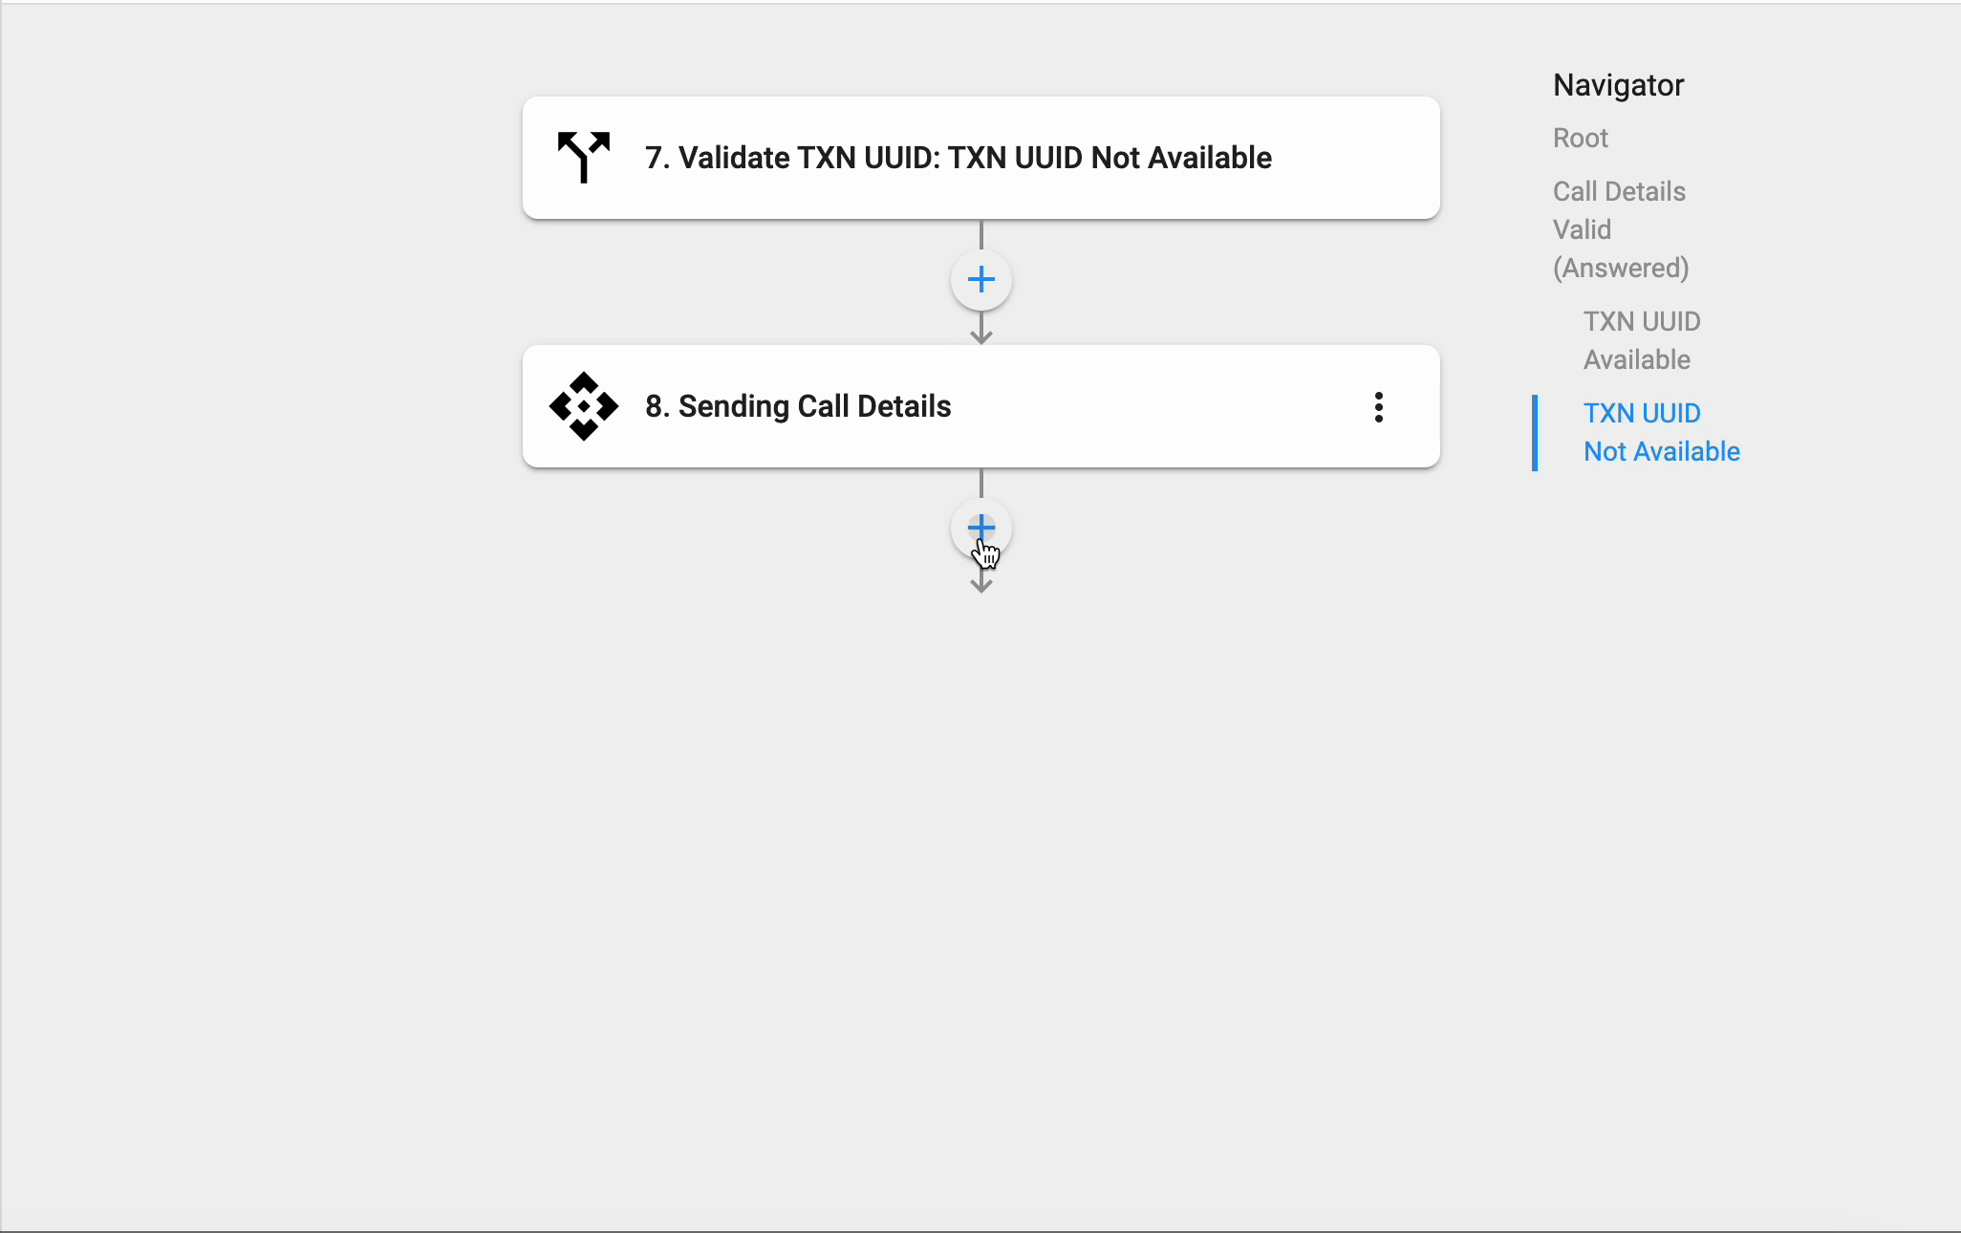
Setup Guide <Create Flow in the Programmable Flow>
Step 2. Create flow in the Programmable Flow
2. Enter Data for Split Flow
Call Details Updated (Answered)
3. Choose Split Flow:
TXN UUID Not Available
Choose Save to Memory:
Click + to add new action > Choose Save to Memory > For Key Name, fill in Call Detail Updated : Call Transaction UUID > Add Value as False > For Time to live, key in 5 minutes
4. Finish

Slide 33
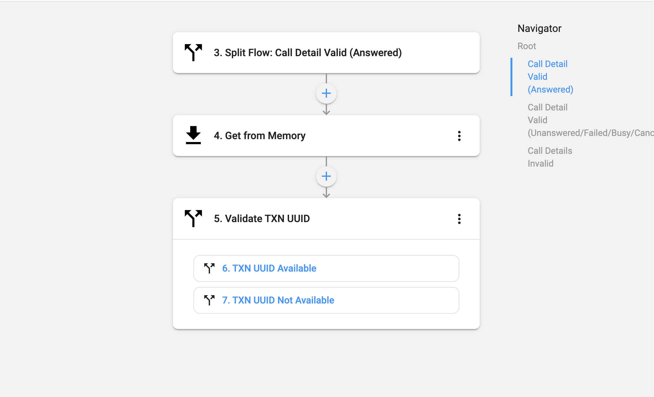
Setup Guide <Create Flow in the Programmable Flow>
Step 2. Create flow in the Programmable Flow
2. Enter Data for Split Flow
Call Details Updated (Answered)
3. Choose Split Flow:
TXN UUID Not Available
Choose Save to Memory:
Click + to add new action > Choose Save to Memory > For Key Name, fill in Call Detail Updated : Call Transaction UUID > Add Value as False > For Time to live, key in 5 minutes
4. Finish

Slide 34
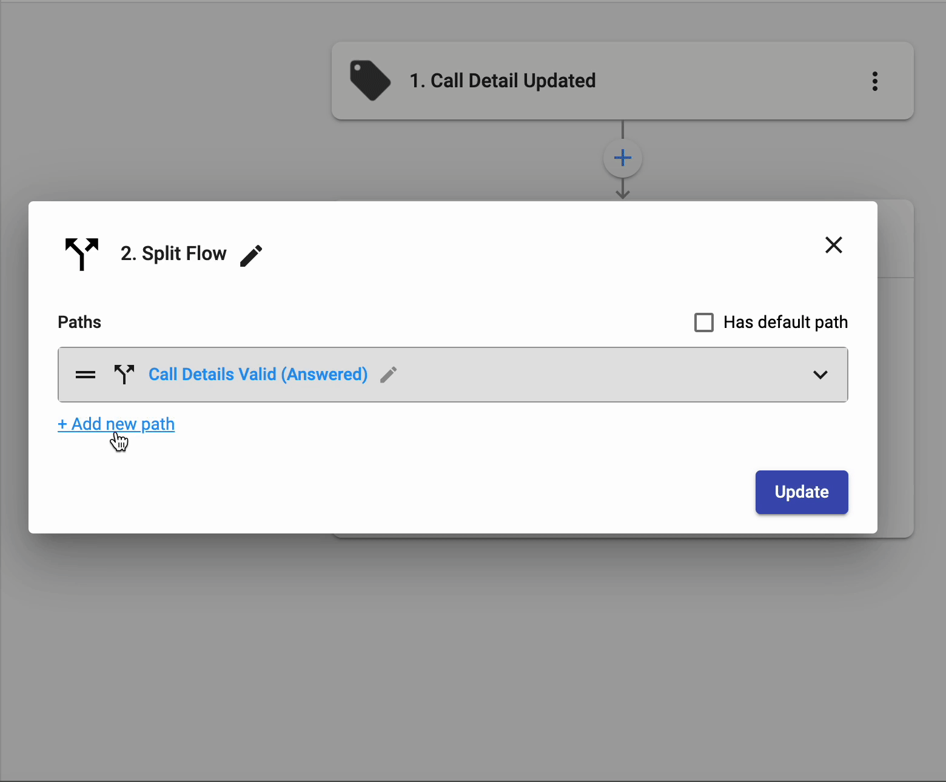
Setup Guide <Create Flow in the Programmable Flow>
Step 2. Create flow in the Programmable Flow
2. Enter Data for Split Flow
b. Call Detail Valid (Unanswered/Failed/Busy/Cancel)
In Path name, add Call Details Valid (Unanswered/Failed/Busy/Cancel) > For Control Variable, choose Call Detail Updated: Recording Expected > In Operator, select Is False
Choose Get from Memory > Enter the data
For Action Name, add Get From Memory *default* > Make Key set in flow to New Flow 2 *default* > For Key name, fill in Call Detail Updated : Call Transaction UUID
Choose Split Flow > Enter data
Transaction UUID available
Choose Split Flow > Rename Action name to Validate TXN UUID > Rename path to TXN UUID Available > For Control Variable, select Get from Memory: Value > For Operator, select Contains > For Control Variable, add in False > Press Add
Transaction UUID not available
Finish

Slide 35
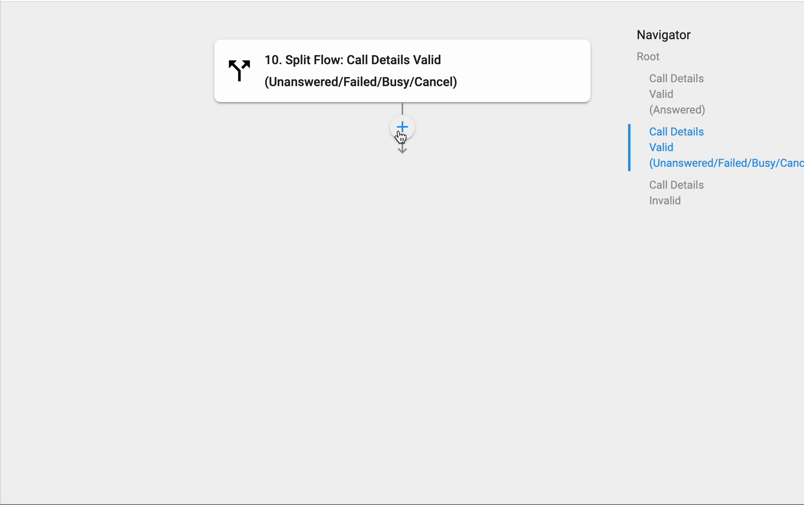
Setup Guide <Create Flow in the Programmable Flow>
Step 2. Create flow in the Programmable Flow
2. Enter Data for Split Flow
b. Call Detail Valid (Unanswered/Failed/Busy/Cancel)
In Path name, add Call Details Valid (Unanswered/Failed/Busy/Cancel) > For Control Variable, choose Call Detail Updated: Recording Expected > In Operator, select Is False
Choose Get from Memory > Enter the data
For Action Name, add Get From Memory *default* > Make Key set in flow to New Flow 2 *default* > For Key name, fill in Call Detail Updated : Call Transaction UUID
Choose Split Flow > Enter data
Transaction UUID available
Choose Split Flow > Rename Action name to Validate TXN UUID > Rename path to TXN UUID Available > For Control Variable, select Get from Memory: Value > For Operator, select Contains > For Control Variable, add in False > Press Add
Transaction UUID not available
Finish

Slide 36
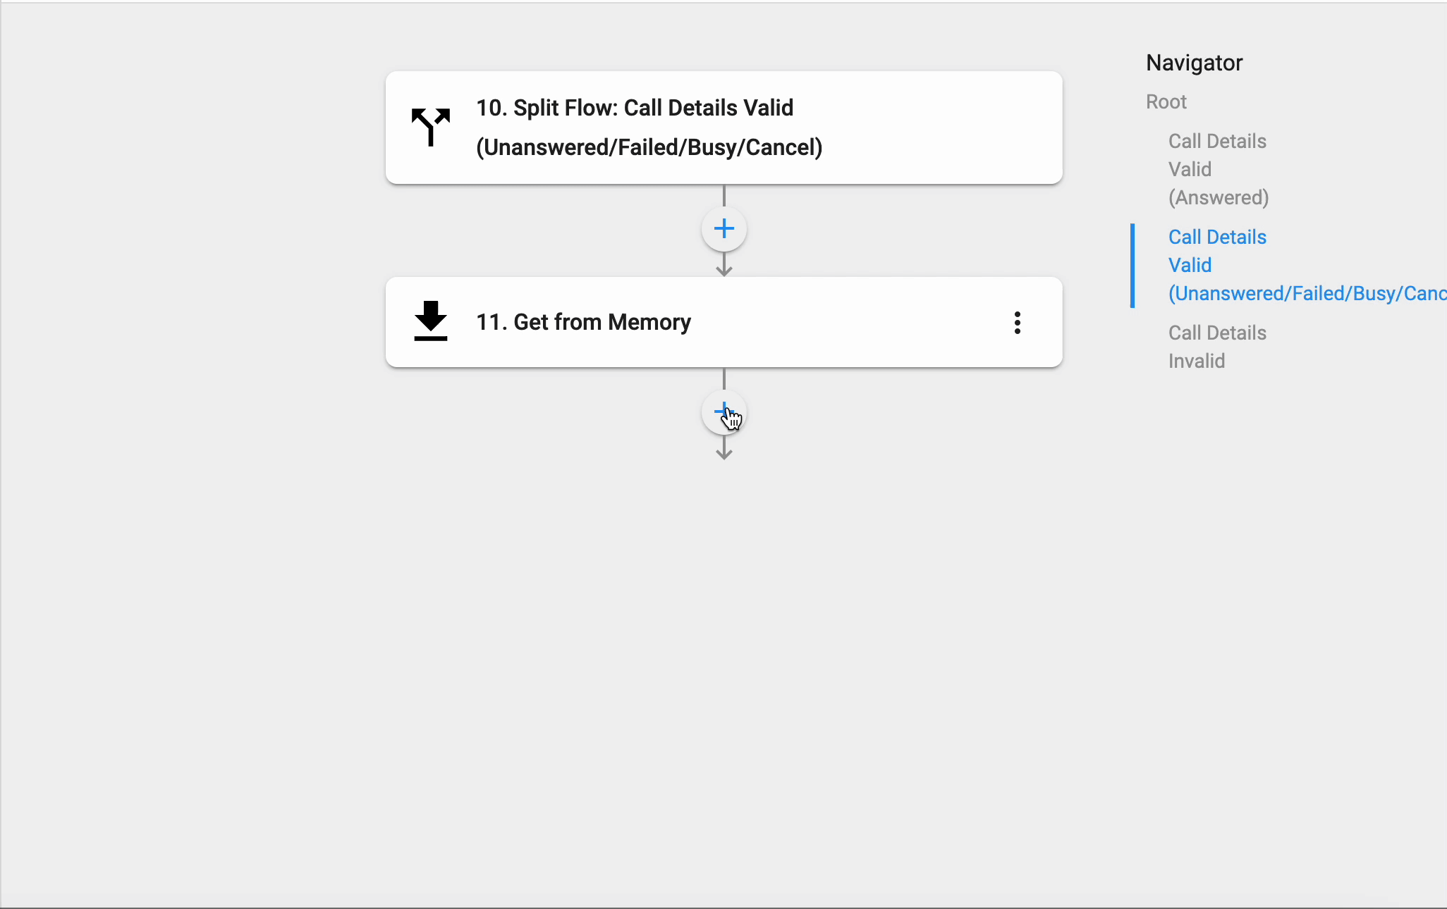
Setup Guide <Create Flow in the Programmable Flow>
Step 2. Create flow in the Programmable Flow
2. Enter Data for Split Flow
b. Call Detail Valid (Unanswered/Failed/Busy/Cancel)
In Path name, add Call Details Valid (Unanswered/Failed/Busy/Cancel) > For Control Variable, choose Call Detail Updated: Recording Expected > In Operator, select Is False
Choose Get from Memory > Enter the data
For Action Name, add Get From Memory *default* > Make Key set in flow to New Flow 2 *default* > For Key name, fill in Call Detail Updated : Call Transaction UUID
Choose Split Flow > Enter data
Transaction UUID available
Choose Split Flow > Rename Action name to Validate TXN UUID > Rename path to TXN UUID Available > For Control Variable, select Get from Memory: Value > For Operator, select Contains > For Control Variable, add in False > Press Add
Transaction UUID not available
Finish

Slide 37
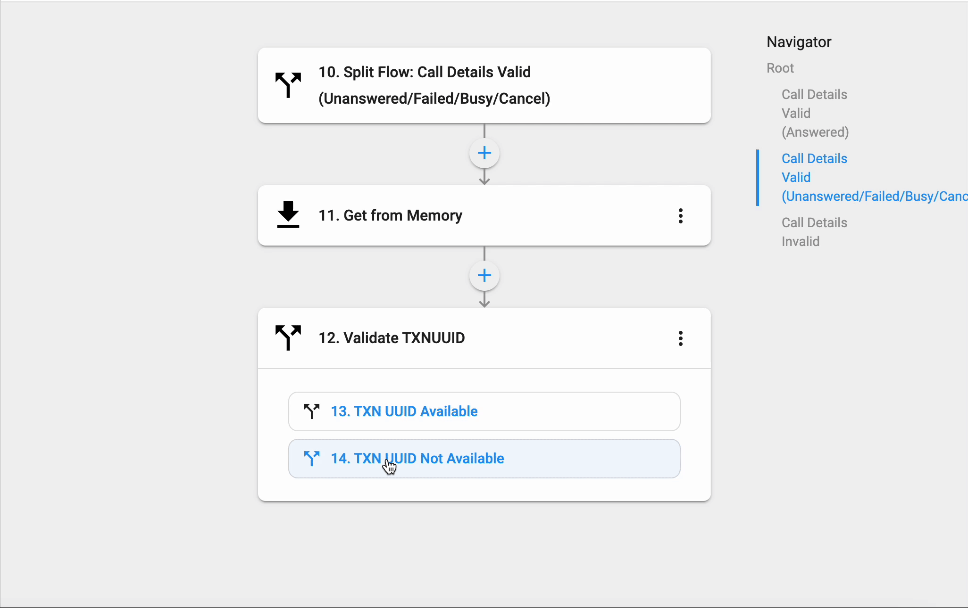
Setup Guide <Create Flow in the Programmable Flow>
Step 2. Create flow in the Programmable Flow
2. Enter Data for Split Flow
b. Call Detail Valid (Unanswered/Failed/Busy/Cancel)
3. Choose Split Flow > Enter data
b. Transaction UUID not available
Choose Custom Action > Rename it to Sending Call Details > Choose Method as Post
Fill in the URL: https://openapi.extensionapps.com/prod/api/v1/service-report/callback/call-detail?secret=afe7cb8a00154d85be106bade79b799b
Fill in Body:
"type":﻿1. Call Detail Updated: Call Type﻿,
"status":﻿1. Call Detail Updated: Status﻿,
"txnUuid":﻿1. Call Detail Updated: Call Transaction UUID﻿,
"endTime":﻿1. Call Detail Updated: End Time﻿,
"startTime":﻿1. Call Detail Updated: Start Time﻿,
"answeredTime":﻿1. Call Detail Updated: Answer Time﻿,
"recordingUrl":﻿1. Call Detail Updated: Recording URL﻿,
"recordingExpected":﻿1. Call Detail Updated: Recording Expected﻿,
"toKey":﻿1. Call Detail Updated: To Key﻿,
"toLabel":﻿1. Call Detail Updated: To Label﻿,
"fromKey":﻿1. Call Detail Updated: From Key﻿,
"fromLabel":﻿1. Call Detail Updated: From Label﻿,
"toNumber":﻿1. Call Detail Updated: To Number﻿,
"fromNumber":﻿1. Call Detail Updated: From Number﻿,
"orgUuid":1. Call Detail Updated: Organization UUID﻿,
"durationInSeconds":﻿1. Call Detail Updated: Duration in Seconds﻿,
"durationInMinutes":﻿1. Call Detail Updated: Duration in Minutes﻿
Add sample response content as {"success" : true } to extract properties for the action
Choose Save to Memory

Slide 38

Setup Guide <Create Flow in the Programmable Flow>
Step 2. Create flow in the Programmable Flow
2. Enter Data for Split Flow
b. Call Detail Valid (Unanswered/Failed/Busy/Cancel)
3. Choose Split Flow > Enter data (cont)
Choose Save to Memory
Click + to add new action > Choose Save to Memory > For Key Name, fill in Call Detail Updated : Call Transaction UUID > Add Value as False > For Time to live, key in 5 minutes
4. Finish

Slide 39

Setup Guide <Create Flow in the Programmable Flow>
Step 2. Create flow in the Programmable Flow
2. Enter Data for Split Flow
b. Call Detail Valid (Unanswered/Failed/Busy/Cancel)
3. Choose Split Flow > Enter data (cont)
Choose Save to Memory
Click + to add new action > Choose Save to Memory > For Key Name, fill in Call Detail Updated : Call Transaction UUID > Add Value as False > For Time to live, key in 5 minutes
4. Finish

Slide 40

Setup Guide <Create Flow in the Programmable Flow>
Step 2. Create flow in the Programmable Flow
2. Enter Data for Split Flow
c. Call Details Invalid
To create this path, checklist the Has default path > rename Path Name to Call Details Invalid
The control variable for this path will automatically be updated to When all else fails
Finish

Slide 41
Setup Guide <Create Flow in the Programmable Flow>
Step 2. Create flow in the Programmable Flow
2. Enter Data for Split Flow
c. Call Details Invalid
To create this path, checklist the Has default path > rename Path Name to Call Details Invalid
The control variable for this path will automatically be updated to When all else fails
Finish

Slide 42

Setup Guide <Create Flow in the Programmable Flow>
Step 3. Once flow is created, click Deploy and Confirm to deploy the flow

Slide 43
Step 5: Configuring CPaaS General Settings for User

Slide 44


Setup Guide <Configuring the CPaaS General Settings>
To maximize the ability of the service, you will need to configure the below settings:
System Setting
General Settings
Admin Tools (Compulsory)
Inbound Call Rule (Optional)
Outbound Call Rule (Compulsory)

Slide 45

Setup Guide <Configuring the CPaaS General Settings>
To maximize the ability of the service, you will need to configure the below settings:
User Setting
Overview
Call History
Change User’s Status (Compulsory)
Call Forwarding (Optional)
Call Recording (Optional)
Delegate (Optional)
Devices (Compulsory)
Inbound Call (Compulsory)
Inbound Call Filter (Optional)
Inbound Missed Calls (Compulsory)
Music on Hold (Optional)
Outbound Call (Compulsory)
Working Hours (Compulsory)

Slide 46


System Configuration <General Settings>
General Settings is where the Owner/Admins configure the below information for the Organization:
Call Pickup
Call Parking
Default rules
Inbound Call Rule
Outbound Call Rule
Public Holiday
Custom Holiday
Busy Remarks

Slide 47


System Configuration <General Settings> (Optional)
Call Pickup
Owner/Admins can create a pickup prefix for the organization so that users can pick up calls of any other extensions.
To directly pick up the call of any extension, press: Pickup prefix + user key + #
Example:
The pickup prefix is *10
Pick up the call that is ringing at Ext 201, press *10201#
To pick up the call of another extension in the same group, press: Pickup prefix + #
Example:
The pickup prefix is *10
Ext 202 & Ext 203 are in the same Group
Ext 202 wants to pick up the call ringing at Ext 201, press *10#

Slide 48


System Configuration <General Settings> (Optional)
Call Parking
Call Park is a feature that allows users to:
Place an incoming call on hold at a specific parking location (a fictional extension)
Pick up the call on a different phone.
Let another person can pick it up on a different phone
To park or retrieve a call, press: *Parking Prefix + channel number + #
Example:
The parking prefix is *10
Ext 202 parks the call at Channel 1
Ext 203 wants to retrieve the call, press *101#
During the Parking time, the caller will hear the on-hold music.
*Channel Number:
It is a fictional extension that allows you to park the call.
The range will be from 1 to 99.
The system allows you to park 99 calls at the same time. However, each channel only can handle 1 call at a time.
If the user tries to park the caller in a busy room (which have another caller), then the system will play an announcement to the user: "This room is unavailable, please try another room."

Slide 49



System Configuration <General Settings>
(Compulsory)
Default Rules
Besides setting a particular Outbound Rule for each team, you can set a default Outbound Rule for the whole organization in this section.
To do so, please follow the steps below:
Go to Settings, choose View - System
Select the General Settings tab
In the Default rules section, select the Pencil icon:
Add the required fields:
Dial Plan
Country Whitelist
* You can disable the Default if isn’t necessary. The system will follow the particular rules that you set in Outbound Call Rules.

Slide 50



System Configuration <General Settings>
(Compulsory)
Public Holiday
Besides setting the Public Holidays for each user, the Admin can set a default Public Holiday for the whole account.
To set it, click Edit and select a specific Country in the available list.

Slide 51



System Configuration <General Settings> (Optional)
Custom Holiday
The Admin can set custom holiday for the whole account. This settings will apply to all the users under the same organization. To set it, please follow steps below:
Click Edit
Enable custom holiday
Add your custom holidays > Update

Slide 52


System Configuration <General Settings> (Optional)
Remark
This is the section that allows you to define the Busy remark for Call Center Agents. By default, the system will have 2 main breaks - Toilet and Lunch breaks.
You can add more remarks in this setting.
*Drag and Drop to change the Position.

Slide 53


System Configuration <Admin Tools>
(Cumpolsary)
Admin Tools page is where Owner/Admins can manage the user’s configurations:
Manual Configuration
Activated Devices
Application
Caller ID
Caller ID When Forwarding
Caller ID when Transferring
Private Caller ID
Auto Attendant Numbers
Call rules
Inbound Call Rule - Users have the option to choose “None” as their inbound call rule.
Outbound Call Rule
Passcode
Features (Call Waiting, Callback, Debug Mode, Android Background)
Organization Connects
Access Control (Call Recording, DNC)
Public Holiday

Slide 54

System Configuration <Admin Tools>
Activated Devices:
TLS:
Secure SIP protects SIP messages by encrypting them over a TLS (Transport Layer Security) channel using a security certificate. Secure RTP (Real-time Transport Protocol) provides encryption, message authentication, integrity, and attack protection to the RTP data stream.
STUN:
A STUN (Session Traversal of User Datagram Protocol [UDP] through Network Address Translators [NATs]) server allows NAT clients (i.e. IP Phones behind a firewall) to set up phone calls to a VoIP provider hosted outside of the local network.
The STUN server allows clients to find out their public address, the type of NAT they are behind and the Internet side port associated by the NAT with a particular local port. This information is used to set up UDP communication between the client and the VoIP provider to establish a call.
IPV6 (applicable for Desktop, Mobile):
Internet Protocol version 6 (IPv6) is the most recent version of the Internet Protocol (IP), the communications protocol that provides an identification and location system for computers on networks and routes traffic across the Internet.
Most of our clients will use IPV4, however, if you utilize IPV6 (check with your internet provider for this information), please enable IPV6 for your Desktop and Mobile devices to make it work.
*Note: If the user has multiple mobile or desktop devices, a change will be applied to all of the devices that have the same type.
IP Phone - View SIP Credentials:
Owner/Admins can use this feature to view SIP Credentials and manually connect SIP with users’ IP Phones.
If users use these brands, Owner/Admins can also use the auto-provisioning functionality to connect SIP with users’ devices.

Slide 55




System Configuration <Admin Tools>
Activated Devices
IP Phone - SIP Password:
For the IP Phone, our system will auto-generate the password and the end-user CANNOT input the password anymore.
The system will generate the password 1 time only when the user presses Reset.
Afterwards the users have to copy and self-manage the password at their side, as the users will NOT be able to view the password on the Webportal.
Whenever there is a change in the SIP domain of the SIP account, the user must go to the portal and create a new password again.

Slide 56


System Configuration <Admin Tools>
Activated Devices:
Codecs:
Standards that encode and decode sound into data streams for transmission in the internet environment.
Users can now update codecs for each device
Codec list includes:
G711A
G711U
Opus
*Note: If the user has multiple mobile or desktop devices, a change will be applied to all of the devices that have the same type.
IP Phone - View SIP Credentials:
Owner/Admins can use this feature to view SIP Credentials and manually connect SIP with users’ IP Phones.
If users use these brands, Owner/Admins can also use the auto-provisioning functionality to connect SIP with users’ devices.
Note: (OPUS minimum requirement)

Slide 57


System Configuration <Admin Tools>
Application:
This feature allows Owner and PS Admins to set up multiple Extensions at 1 time.

Slide 58

System Configuration <Admin Tools>
Caller ID when Forwarding:
Owner/Admins can determine which Caller ID will be displayed on the transferred/forwarded destination for the users.
For external transfer Caller ID:
Assigned Number: extension assigned Caller ID.
Caller Number: original caller number.

Slide 59

System Configuration <Admin Tools>
Caller ID when Transferring:
Owner/Admins can determine which Caller ID will be displayed on the transferred destination for the users.
For external transfer Caller ID:
Assigned Number: extension assigned Caller ID.
Caller Number: original caller number.

Slide 60

System Configuration <Admin Tools>
Private Caller ID:
Allow users to choose Private as their Caller ID when making Outbound Calls

Slide 61

System Configuration <Admin Tools>
Auto Attendant Numbers:
Allow users to choose the assigned auto-attendant numbers as their caller ID when making outbound calls.

Slide 62

System Configuration <Admin Tools> (Compulsory)
Call Rules
Owner/Admins can assign created Inbound Call Rule & Outbound Call Rule to users.
Inbound Call Rule
Users have the option to choose “None” as their inbound call rule
Outbound Call Rule
Passcode
A chain of digits that users have to press when the call to a specific destination.

Slide 63

System Configuration <Admin Tools>
Features:
Call Waiting:
This feature helps users to be notified that another caller is trying to get through their line while they are currently engaged on a call.
Users are able to choose whether to accept/reject the new call or keep talking on the line.
When there are incoming calls ringing directly to the Extension’s devices, the system will check the followings:
Call States:
Free
Others: Dialing, Talking, Holding
Call Waiting:
Disabled: 1 Concurrent Call
Enabled: 2 Concurrent Calls
In case the incoming call reaches the Concurrent call limit of the Extension (3rd call), the call will drop and show status as “Failed”.

Slide 64
System Configuration <Admin Tools>
Features:
Call Back:
This feature supports Auto Callback feature for 1 specific use case when a user is busy on another line so that every call will be handled.
Call flow:
Direct incoming call to Phone System Extension, who is talking with another
This extension enabled the callback feature.
For the incoming call to that extension that cannot be handled, the caller will hear a message: “Hi, I'm currently busy. Please press 1 to request a call back, or press 2 to end the call. Thank you.”
Press 1 or 2 to request a callback or end the call.
1 = After the extension is free → The System will trigger a Call back.
2 = The call will end as a Missed Call
Note:
Phone system extension can only enable either call waiting or call back. These two features cannot work at the same time.

Slide 65
System Configuration <Admin Tools>
Features:
Debug Mode:
If this mode is turned on, users using Mobile and Desktop App will be able to submit app logs whenever they face problems with the apps. This will help our technical team identify the issue faster.
Android Background:
This option allows the Admin/Owner to hide the android background icon on the mobile app.
For existing users its enabled by default.
For new users its disabled by default.
Please note that the user must refresh the app after enabling/disabling android background. .

Slide 66

System Configuration <Admin Tools>
Organization connects:
Grant permission for users to view contacts belonging to the connected organizations.

Slide 67

System Configuration <Admin Tools>
Access Control:
Call Recording:
Allow users to configure the Call Recording settings by themselves.
Allow users to access their own Call Recording files..
Do-Not-Call:
Allow users to configure the DNC settings by themselves.

Slide 68

System Configuration <Admin Tools>
Public Holiday:
Allow User to select Public Holiday at User level & Organization level:
No Holiday: Not follow any Public and Customized Holidays If users choose this option, they won’t have any Public Holidays to follow.
Follow the Organization’s Holiday: Applicable for both Public and Customized Holidays.This extension will follow Organization's Public Holiday
Follow the Personal Holiday: Select a Public Holiday by Country If users choose this option, they are allowed to select the Public Holiday of a specific country.

Slide 69


System Configuration <Admin Tools> (Compulsory)
Bulk Configuration
Owner/Admins can do bulk configuration for the users:
Click Bulk Configuration > Download sample file > Fill in the information > Select the file > Upload

Slide 70







System Configuration <Inbound Call Rule> (Optional)
As a default, the system will display this standard Caller ID on the recipient's side when users make outgoing calls:
<country code> + <area code> + <destination>
It is possible for Owner/Admins to create an Inbound Call Rule that will override the way the recipients see the Caller ID.
To create an Inbound Call Rule, follow the steps below:
Go to Application Settings
View System > Inbound Call Rule
Click Create
Give the rule a name > Create
Click on the pencil icon next to the created rule > click New plan
At the plan as you wish > Update

Slide 71







System Configuration <Inbound Call Rule> (Optional)
To assign an Inbound Call Rule for a user, follow these steps:
Go to Settings > View System > Admin Tools
Choose the User that you would like to assign the rule.
At the Call Rules section, select the appropriate Inbound Call Rule.
Apply

Slide 72




System Configuration <Outbound Call Rule> (Compulsory)
Users need to be assigned to an Outbound Call Rule in order to make outbound calls.
To create an Outbound Call Rule, follow the steps below:
Go to Settings
View System > Outbound Call Rule
Click Create
Give the rule a name > Create
Click on the pencil icon next to the created rule
At the plan as you wish > Update

Slide 73




System Configuration <Outbound Call Rule> (Compulsory)
Outbound Call Rule is composed of the rules for:
Dial plan: By default, if users want to make an outbound call from our system, they will need to follow this standard:
<country code> + <area code> + <destination>
However, to reduce the steps, owner/admins can set up a dial plan for users’ calls. By setting this up, users will not have to key in the country code every time they call out.
Country whitelist: the list of countries users can call to.

Slide 74




System Configuration <Outbound Call Rule> (Compulsory)
Outbound Rules are composed of the rules for:
Dial plan: By default, if users want to make an outbound call from our system, they will need to follow this standard:
<country code> + <area code> + <destination>
However, to reduce the steps, owner/admins can set up a dial plan for users’ calls. By setting this up, users will not have to key in the country code every time they call out.
Country whitelist: the list of countries users can call to.
Passcode required: users need to key in their passcode in order to call to these countries.

Slide 75



System Configuration <Outbound Call Rule> (Compulsory)
Outbound Rules are composed of the rules for:
Country whitelist: the list of countries users can call to.
Passcode required: users need to key in their passcode in order to call to these countries.
Organization Connect: After the 2 organizations are connected, they need to define a Prefix to call the other side.
The code is per direction per connection
Limit 3 digits
*Note: Make sure the Matching Rules do not conflict with the Dial Plan
Inter-organization Call: Prefix + Ext Number

Slide 76
System Configuration <Outbound Call Rule> (Compulsory)
To assign an Outbound Call Rule for a user, follow these steps:
Go to Settings
View System > Admin Tools
Choose the User that you would like to assign the rule.
At the Call Rules section, select the appropriate Outbound Call Rule.
Apply

Slide 77
User Configuration

Slide 78

Settings <Overview>
The Overview tab provides the basic information of the current Users’ settings as well as their status.
Directory Name, Extension Number & Assigned Numbers are managed in the Licenses tab by the Owner/Admins.
Current user status is changed by the End user in Homepage.
Current work status is displayed based on Users’ Working Hours.
Current inbound call actions is displayed based on Users’ Inbound Call.

Slide 79


Settings <Overview> (Compulsory)
Users can manually change their status by going to Homepage > Click on a User’s current status > change to Available / Busy / Away / Offline.
If the users log out their account or do not access the portal, their status will be automatically changed to Offline. Once they login again, the system will restore their last status.
Apart from Offline, other statuses will not be changed unless the users take an action.

Slide 80



Settings <Call Forwarding> (Optional)
Go to Call Forwarding to manage Users’ Forward List.
Ring Mode:
Ring All: All available numbers/extensions in the Forward List are rung simultaneously.
Total Ring Time: from 5 to 60 seconds.
Sequential: Each number/extension is rung in order, one after the other, starting from the first extension in the list each time.
Ring time per forwarding number: from 15 to 90 seconds.

Slide 81


Settings <Call Recordings> (Optional)
Call Recordings page is where Owner/Admins can configure Call Recording settings for users who have Call Recording License.
Toggle on/off to choose either record incoming/outgoing calls or both.
For outgoing calls, owner/admins can choose one of the following actions:
Record all: Automatically records all outgoing calls.
Ask to record: Before initiating the call, user is asked which call they wish to record.
Message: “Please press 0 to disable call recording, press 1 to apply call recording.”

Slide 82


Settings <Delegate (Boss-Secretary)> (Optional)
This function allows other people to answer and make calls on User’s behalf. Calls can be automatically forwarded to User’s delegates (setting up in Inbound Call page). Delegates can transfer back to their Boss by using Transfer function on their devices.
***Notes:
Only users within the organization can be added to the Delegation List
A user cannot be delegated if they are delegating to others.
A user cannot delegate or be delegated when being in a Call Group.
In the case of Delegation List:
If any of the extensions miss the call, it will not trigger its own Unanswered or Busy Flow and the call will be simply dropped.
The working hour of the delegates in the list will be ignored.
Ring Mode:
Ring All: All available delegates in the Delegation List are rung simultaneously.
Sequential: Each delegate is rung in order, one after the other, starting from the first delegate in the list each time.

Slide 83

Settings <Delegate (Boss-Secretary)> (Optional)
The Delegate tab also shows the information of the Boss and his/her status in case the Secretary would like to transfer the call to the Boss
***Notes:
Call History on the portal:
Boss will see that the call is delegated.
Secretary will see the call as a normal incoming call.
Admin Tools:
Show SIP credential for Delegate to:
Register on IP Phone
Receive and make calls using the Boss's Caller ID
Secretary’s Mobile App View:
If the Boss diverts all his/her incoming calls to the Secretary, when there is an incoming call to the Boss:
The system will display the Caller ID of the caller (not her Boss's Caller ID) on the Secretary's device. Besides, if the Secretary uses mobile app, the Boss's extension number will be displayed on the screen so the Secretary knows that this call is diverted from the Boss.
Secretary
Boss’s status

Slide 84


Settings <Devices>
In case users have multiple activated devices, Owner/Admins can decide which devices to be rung when calls come in by going to Devices tab. Users can also select Primary Device (for Contact Center users).
Primary Device
Users can choose a Primary Device from the drop-down menu.
Primary Device is the only device that will be rung for Contact Center extension.
Ring Mode:
Ring All: All ticked devices are rung simultaneously.
Total ring time (second) at all devices.
Sequential: Each device is rung in order, one after the other, starting from the first extension in the list each time.
Ring time (second) per device.
Please note:
The current supported devices include:
IP Phone
Mobile app (IOS and Android)
Desktop (Mac and Windows)
MS Teams
CTI

Slide 85






Settings <Inbound Call> (Compulsory)
Owner/Admins can configure Inbound Call settings for the users for different scenarios.
Working Hours - Available:
The following options can be configured:
Ring Devices: ring users’ available devices
You can set up the ring time (per second) in Devices tab.
Ring Delegates: forward all incoming calls to users’ delegates
Ring Forwarding List: forward all incoming calls to users’ forwarding list

Slide 86



Settings <Inbound Call> (Compulsory)
Working Hours - Busy/Away/Offline:
Owner/Admins can trigger the below actions:
Simply Hang Up the incoming call
Ring Devices
Ring Delegates
Ring Forwarding List to the Forward List
Play Message
Supports TTS (text-to-speech) or MP3 file upload.
The message box is currently limited to 450 characters.
Multiple language and accent options to choose from.
Customizable pitch: the degree of highness or lowness of a tone; from 0 (lowest) to 9 (highest).
Customizable speech rate: the speed; from 0 (slowest) to 9 (fastest).
Gender of the voice options.
Record Voicemail
Limitation: 1 minute/voicemail

Slide 87

Settings <Inbound Call> (Compulsory)
Non-Working Hours:
Owner/Admins can trigger the below actions:
Simply Hang Up the incoming call
Ring Devices
Ring Delegates
Ring Forwarding List to the Forward List
Play Message
Supports TTS (text-to-speech) or MP3 file upload.
The message box is currently limited to 450 characters.
Multiple language and accent options to choose from.
Customizable pitch: the degree of highness or lowness of a tone; from 0 (lowest) to 9 (highest).
Customizable speech rate: the speed; from 0 (slowest) to 9 (fastest).
Gender of the voice options.
Record Voicemail
Limitation: 1 minute/voicemail

Slide 88

Settings <Inbound Call> (Compulsory)
Public Holidays:
Owner/Admins can trigger the below actions:
Simply Hang Up the incoming call
Ring Devices
Ring Delegates
Ring Forwarding List to the Forward List
Play Message
Supports TTS (text-to-speech) or MP3 file upload.
The message box is currently limited to 450 characters.
Multiple language and accent options to choose from.
Customizable pitch: the degree of highness or lowness of a tone; from 0 (lowest) to 9 (highest).
Customizable speech rate: the speed; from 0 (slowest) to 9 (fastest).
Gender of the voice options.
Record Voicemail
Limitation: 1 minute/voicemail

Slide 89


Configuration <Inbound Call Filter> (Optional)
This function defines what action will be taken when an incoming call is made to the User's assigned number according to the Caller ID.
First Rules: By default, the Inbound Call Filter comes with two default rules that can be adjusted but cannot be removed:
Internal Direct Ring Device: If this option is disabled, internal calls will follow User’s Inbound Call settings and Working Hours. If enabled, all internal calls will go directly to the User’s devices regardless of their Inbound Call settings and Working Hours.
Block Anonymous Call

Slide 90





Configuration <Inbound Call Filter>
(Optional)
This function defines what action will be taken when an incoming call is made to the User's assigned number according to the Caller ID.
Custom Inbound Call Filter: in order to add a custom inbound call filter rule, follow the steps below:
Go to Inbound Call Filter > click Add
Choose Match Pattern type:
Starts with
Exact match
Add a number > choose Action:
Block Call
Ring Delegates
Ring Forwarding List
Ring Devices
*Note: Filtering is done by the FIRST match. The system will stop checking the remaining rules if the Caller ID matches the first rule.

Slide 91

Configuration <Inbound Missed Calls> (Compulsory)
Owner/Admins can configure Inbound Missed Call settings for the users for different scenarios.
Reject
Unanswered
Owner/Admins can trigger the below actions:
Ring Delegates
Ring Forwarding List to the Forward List
Play Message
Record Voicemail
Simply Hang Up the incoming call

Slide 92


Configuration <Music On Hold> (Optional)
Owner/Admins can configure default music on hold for users in this tab.

Slide 93


Settings <Outbound Call> (Compulsory)
Outbound Call is where the owner/admins can configure Caller ID, DNC Checking and Speed Dial for the users.
Users can also change Caller ID from their devices. Caller ID can be:
Private (if Admins allow to use)
Identity:
Users’ assigned numbers
Users’ registered numbers
Delegation: Their Boss’s numbers
Organization: Auto-Attendant numbers
Call Group: numbers of the groups that users are in.

Slide 94
Settings <Outbound Call> (Compulsory)
DNC and Consent checking actions (only available if users have DNC license):
Allow (Bypass)
Block
Prompt (Check and ask)
Speed Dial: allows users to place a call by pressing a reduced number of keys.
This function is particularly useful for phone users who dial certain numbers on a regular basis.
Key requires from 1 to 2 digits
Phone number requires the E.164 standard format

Slide 95



Settings <Working Hours> (Compulsory)
In this section, admins can set their Working Hours appropriately for each user.
The available actions to trigger when calls come in during non-working hours can be configured in Inbound Call tab.
Inbound Call - Non-Working Hours tab

Slide 96



Homepage <Call History>
All incoming, outgoing, missed calls coming to the users will be captured in the Homepage with complete details and can be retrieved for up to 1 year.
This place will display all the call history based on Contact Numbers.
Call Recording/Voicemail (if any) can be listened and downloaded here.

Slide 97






Communication Hub <Call History>
The Call History in Communication Hub is a place where keeps the records of all call transactions within the Organization. It will provide:
Basic details - Call Directions (Incoming/Outgoing calls), Phone Numbers, Extension Numbers, Date & Time, etc.
Advanced details - Call Result, Call Metadata, Call Journey, Call Recording, Voicemail, etc.
Data in Call History will be stored up to 1 year since the date the call is created.
It takes a few mins (max: 5 mins) for the data to appear on the portal after the call ends. Longer call duration will require longer processing time.
The SLA of call recording uploading on Unified History is 24 hours.

Slide 98

Communication Hub <Call History>
Call History Design:
The call transaction is divided into 2 levels:
Main Call Transaction
Call Leg Transaction
Main Call Transaction
It contains every basic information about a call that a user with minimum experience about call flows can still understand, including:
TXN UUID: TXN UUID stands for the Universal Unique Identifier of the Transaction.
It is copyable
It is capable to search in the searching box.
Type
Time
Caller
To
Talk / Total Duration
Result

Slide 99

Communication Hub <Call History>
Call History Design:
The call transaction is divided into 2 levels:
Main Call Transaction
Call Leg Transaction
Main Call Transaction
It contains every basic information about a call that a user with minimum experience about call flows can still understand, including:
TXN UUID
Type: Type of the call, can be:
Incoming: Calls come from outside B3 system
Outgoing: Calls are initialized inside B3 system
Forwarding: Calls come from outside B3 then are forwarded to another endpoint
Time
Caller
To
Talk / Total Duration
Result

Slide 100

Communication Hub <Call History>
Call History Design:
The call transaction is divided into 2 levels:
Main Call Transaction
Call Leg Transaction
Main Call Transaction
It contains every basic information about a call that a user with minimum experience about call flows can still understand, including:
TXN UUID
Type
Time: The time when the call started.
Caller
To
Talk / Total Duration
Result

Slide 101

Communication Hub <Call History>
Main Call Transaction
It contains every basic information about a call that a user with minimum experience about call flows can still understand, including:
TXN UUID
Type
Time
Caller: The party who initializes the call, it can be from:
Phone Number (External Call)
Extension (Internal Call), including:
Extension Key
Extension Label
Extension Device
IP Phone
Mobile
Desktop
Web Phone
To
Talk / Total Duration
Result
Call History Design:
The call transaction is divided into 2 levels:
Main Call Transaction
Call Leg Transaction

Slide 102

Communication Hub <Call History>
Main Call Transaction
It contains every basic information about a call that a user with minimum experience about call flows can still understand, including:
TXN UUID
Type
Time
Caller
To: The party who FIRST answers the call. As 1 call can have lots of participants who join to answer the caller, the system will pick the first participant who answered the call to display in the To column.
It can be to:
Phone Number (Called Party Number)
Extension
Extension Key
Extension Label
Extension Device
IP Phone
Mobile
Desktop
Web Phone
MSISDN/SIM
Sip Username
User Origin Inputs (Outbound Only) - The digits input by user when making outbound call.
Talk / Total Duration
Result
Call History Design:
The call transaction is divided into 2 levels:
Main Call Transaction
Call Leg Transaction

Slide 103

Communication Hub <Call History>
Main Call Transaction
It contains every basic information about a call that a user with minimum experience about call flows can still understand, including:
TXN UUID
Type
Time
Caller
To
Talk / Total Duration
Total Duration = Call End Time - Call Start Time
Total Duration = Call End Time - First Answer Time (Detected by the Leg Transaction)
Result
Call History Design:
The call transaction is divided into 2 levels:
Main Call Transaction
Call Leg Transaction

Slide 104

Communication Hub <Call History>
Main Call Transaction
It contains every basic information about a call that a user with minimum experience about call flows can still understand, including:
TXN UUID
Type
Time
Caller
To
Talk / Total Duration
Result: Results of the call, values list:
Answered
Unanswered
Busy
Cancel
Blocked
Failed
Call History Design:
The call transaction is divided into 2 levels:
Main Call Transaction
Call Leg Transaction

Slide 105
Communication Hub <Call History>
Result | Call Type | Determination Method
Answered | Incoming | The incoming call was successfully connected to destination party such as: An Auto-Attendant tree An automation bot User’s devices (IP Phone, mobile, desktop, etc…) and the party picked up
 | Outgoing | The outgoing call was successfully connected to the destination
 | Forwarding | The incoming call was successfully forwarded to the external destination
Unanswered | Incoming | The incoming call was successfully connected to the user’s devices (IP Phone, mobile, desktop, etc…). Caller waited until reaching the total ring time configured by the user => the call was hung up by the system.
 | Outgoing | The caller was successfully connected to the system and the destination party did not pick up the call
 | Forwarding | The caller was successfully connected to the system and the forwarded destination party did not pick up the call
Busy | Incoming | The destination party of the incoming call was on the another call or rejected it
 | Outgoing | The destination party of the outgoing call was on the another call or rejected it
 | Forwarding | The destination party of the forwarding call was on the another call or rejected it

Slide 106
Communication Hub <Call History>
Result | Call Type | Determination Method
Cancel | Incoming | The incoming call was successfully connected to the destination, but hung up before the user picked up The incoming call was successfully connected to the destination but then the system received cancel request from user’s device, telco provider,... before the user picked up Non-working hour/Public Holiday, predefined Action = Hang Up.
 | Forwarding | The incoming call was successfully forwarded to the external destination but hung up before the forwarded destination picked up The incoming call successfully forwarded to the external destination but then the system received cancel request from user’s app, telco provider,... before the user picked up
 | Outgoing | The caller of the outgoing call cancelled the call before the destination picked up
Blocked | Incoming | The incoming call was blocked to connect to destination party by consent (DNC) or organization’s dial plan
 | Outgoing | The outgoing call was blocked to connect to destination party by consent (DNC) or organization’s dial plan
Failed | Incoming | System failed to connect the destination party of the incoming call
 | Outgoing | System failed to connect the destination party of the outgoing call There are some edge case for Outgoing call to be marked as Failed, such as: No Outbound Rule
 | Forwarding | System failed to forward the incoming call to the destination party

Slide 107
Communication Hub <Call History>
Priority Order | Result
#1 | Answered
#2 | Unanswered
#3 | Busy
#4 | Cancel
#5 | Blocked
#6 | Failed
Call Status Favored Order for Main Call Transaction
When to apply this:
In call flows where the destination has multiple active devices (Mobile, Desktop, IP Phone…)
In call flows where there are multiple destinations

Slide 108

Communication Hub <Call History>
Leg Transaction Level
Contains detailed information about every participant who has ever joined a call.
Leg UUID: Leg UUID stands for the Universal Unique Identifier of the Call Leg Transaction
It is copyable
It is capable to search in the searching box.
Type
Start Time
End Time
Caller ID
Participant
Result
Call Recording / Voicemail

Slide 109

Communication Hub <Call History>
Leg Transaction Level
Contains detailed information about every participant who has ever joined a call.
Leg UUID
Type:
The type of the call can be:
Incoming: Calls come from outside the B3 system
Outgoing: Calls initialized inside the B3 system
Forwarding: Calls come from outside B3 then are forwarded to another endpoint.
Start Time
End Time
Caller ID
Participant
Result
Call Recording / Voicemail

Slide 110

Communication Hub <Call History>
Leg Transaction Level
Contains detailed information about every participant who has ever joined a call.
Leg UUID
Type
Start Time: Begin time mark of the Call Leg
End Time
Caller ID
Participant
Result
Call Recording / Voicemail

Slide 111

Communication Hub <Call History>
Leg Transaction Level
Contains detailed information about every participant who has ever joined a call.
Leg UUID
Type
Start Time
End Time: End time mark of the Call Leg
Caller ID
Participant
Result
Call Recording / Voicemail

Slide 112

Communication Hub <Call History>
Leg Transaction Level
Contains detailed information about every participant who has ever joined a call.
Leg UUID
Type
Start Time
End Time
Caller ID: The Caller ID that is displayed on participant devices.
Participant
Result
Call Recording / Voicemail

Slide 113

Communication Hub <Call History>
Leg Transaction Level
Contains detailed information about every participant who has ever joined a call.
Leg UUID
Type
Start Time
End Time
Caller ID
Participant: The Participant Endpoint information:
It can be to:
Phone Number (Called Party Number)
Extension
Extension Key
Extension Label
Extension Device
IP Phone
Mobile
Desktop
Web Phone
MSISDN/SIM
Sip Username
Result
Call Recording / Voicemail

Slide 114

Communication Hub <Call History>
Leg Transaction Level
Contains detailed information about every participant who has ever joined a call.
Leg UUID
Type
Start Time
End Time
Caller ID
Participant
Result: Results of the call, values list:
Answered
Unanswered
Busy
Cancel
Blocked
Failed
Delegated: The call is delegated to someone else
Call Recording / Voicemail

Slide 115

Communication Hub <Call History>
Leg Transaction Level
Contains detailed information about every participant who has ever joined a call.
Leg UUID
Type
Start Time
End Time
Caller ID
Participant
Result
Call Recording / Voicemail
Tied to the Call Leg transaction
Played directly on Call History
Downloaded
*Note: Maximum duration of VoiceMail = 1 minute
Play
Download

Slide 116


Communication Hub <Call History>
Call Metadata
Call Metadata is a place to display the advanced information related to call transactions.
Compliance: PDPC Information:
Bypass Reason
PDPC ID
Action:
Block
Go through
Original Called Number
Auto Attendant
Contact Center
Flow
Participants

Slide 117

Communication Hub <Call History>
Call Metadata
Call Metadata is a place to display the advanced information related to call transactions.
Compliance
Original Called Number: The First Phone Number received the call when it reached the system.
Auto Attendant
Contact Center
Flow
Participants

Slide 118

Communication Hub <Call History>
Call Metadata
Call Metadata is a place to display the advanced information related to call transactions.
Compliance
Original Called Number
Auto Attendant: Call Journey Information:
Auto Attendant Workflow Name
Auto Attendant Call Journey
Contact Center
Flow
Participants

Slide 119

Communication Hub <Call History>
Call Metadata
Call Metadata is a place to display the advanced information related to call transactions.
Compliance
Original Called Number
Auto Attendant
Contact Center: Queue Name
Flow
Participants

Slide 120

Communication Hub <Call History>
Call Metadata
Call Metadata is a place to display the advanced information related to call transactions.
Compliance
Original Called Number
Auto Attendant
Contact Center
Flow: Execution Information:
Flow UUID
Flow Execution UUID
Execution Time
Participants

Slide 121

Communication Hub <Call History>
Call Metadata
Call Metadata is a place to display the advanced information related to call transactions.
Compliance
Original Called Number
Auto Attendant
Contact Center
Flow
Participants: (For Contact Center)
Agent Information:
Extension Key
Extension Label
Agent Status:
Available
Busy
Away
Offline
Agent Actions:
Ring Devices
Ring Delegates
Forward Calls
Play Message
Record Voicemail
Hangup
Ex:
#101 - Academy - Available - Ring Devices
#102 - B3networks - Busy - Hangup

Slide 122

Communication Hub <Call History>
Access Control
According to the privilege of the Admins, they can see the history as follow:
Personal View (Me): Personal View displays:
Call Leg Transactions that tied to their identity UUID
Recording Files that tied to their call leg transactions
Team View
Organization View (Everyone)

Slide 123

Communication Hub <Call History>
Access Control
According to the privilege of the Admins, they can see the history as follow:
Personal View (Me)
Team View: Team View displays:
Call Transactions that tied to the Members of the Team
Call Leg Transactions that tied to the Members of the Team
Call Recording Files and Voicemails that tied to the Members of the Team
Organization View (Everyone)

Slide 124

Communication Hub <Call History>
Access Control
According to the privilege of the Admins, they can see the history as follow:
Personal View (Me)
Team View
Organization View (Everyone): Organization View displays:
Call Transactions of the Organization
Call Leg Transactions of the Organization
Call Recording Files and Voicemails of the Organization

Slide 125
Step 6: Create a new customer application in Zendesk Portal

Slide 126



Setup Guide <Create a New Customer Application in Zendesk Portal>
For CTI Integration under Zendesk Portal, you'll have to follow the following steps:
Install App
Go to the menu Admin Center> redirect to Admin Center page > Choose menu Apps and Integrations.
In the Menu Apps and Integration, click Upload private app > Enter the data and upload application
In App Name, add CTI Test *custom* and in File App, add the following link: https://openapi.extensionapps.com/assets/download/zendesk/Dev/V1/Dev-Zendesk_V1_2_6.zip
Directly click Install without checklist
On the apps image, go to Settings and Enable app
Go back to Zendesk Portal > Enable "Allow" and register users by Request at Gitlab
Get API Key Application Account
Add Users

Slide 127


Setup Guide <Create a New Customer Application in Zendesk Portal>
For CTI Integration under Zendesk Portal, you'll have to follow the following steps:
Install App
Go to the menu Admin Center> redirect to Admin Center page > Choose menu Apps and Integrations.
In the Menu Apps and Integration, click Upload private app > Enter the data and upload application
In App Name, add CTI Test *custom* and in File App, add the following link: https://openapi.extensionapps.com/assets/download/zendesk/Dev/V1/Dev-Zendesk_V1_2_6.zip
Directly click Install without checklist
On the apps image, go to Settings and Enable app
Go back to Zendesk Portal > Enable "Allow" and register users by Request at Gitlab
Get API Key Application Account
Add Users

Slide 128


Setup Guide <Create a New Customer Application in Zendesk Portal>
For CTI Integration under Zendesk Portal, you'll have to follow the following steps:
Install App
Go to the menu Admin Center> redirect to Admin Center page > Choose menu Apps and Integrations.
In the Menu Apps and Integration, click Upload private app > Enter the data and upload application
In App Name, add CTI Test *custom* and in File App, add the following link: https://openapi.extensionapps.com/assets/download/zendesk/Dev/V1/Dev-Zendesk_V1_2_6.zip
Directly click Install without checklist
On the apps image, go to Settings and Enable app
Go back to Zendesk Portal > Enable "Allow" and register users by Request at Gitlab
Get API Key Application Account
Add Users

Slide 129


Setup Guide <Create a New Customer Application in Zendesk Portal>
For CTI Integration under Zendesk Portal, you'll have to follow the following steps:
Install App
Get API Key Application Account
Go to the menu Zendesk API > click Get Started
Go to menu Settings > Enable Password Access > Disabled Token Access > Click Save
Add Users

Slide 130


Setup Guide <Create a New Customer Application in Zendesk Portal>
For CTI Integration under Zendesk Portal, you'll have to follow the following steps:
Install App
Get API Key Application Account
Add Users
Go to menu People > Choose Add User > Enter data for user.
Data for user can be added such as for Name and Email address, add *custom* > For User Type, add either Staff Member/End User > For Role, add Administrator/Member.
Start Using
As soon as CTI integration is completed, your Phone app starts appearing on your ZenDesk and its operational to directly make calls from your ZenDesk portal.

Slide 131
Step 6: Create a new customer application in Freshdesk Portal

Slide 132


Setup Guide <Create a New Customer Application in Freshdesk Portal>
For CTI Integration under Freshdesk Portal, you'll have to follow the following steps:
Install App
Go to the menu “Admin"> search and choose Apps
Click Custom Apps > choose Go to Developer Portal
Once redirected to the All Apps page, click New App
Proceed the application by entering data on the Create New Application page
Fill in App Name with CTI Test *custom* > In Type Apps, choose Custom App > Fill File App with the following link: https://openapi.extensionapps.com/assets/download/freshdesk/Dev/V3/freshdesk_webphone_V3.0.0.zip
Enter the required Information Data *custom*> Save and publish
Data Required *custom*:
App Name
App Overview
App Description
Support Email
Go to All Apps page > check the status of app whether it is Published
Once "Published", return to the Admin page of the domain portal to ensure it is published
Click Install > Once installed, the web phone menu will automatically appear

Slide 133


Setup Guide <Create a New Customer Application in Freshdesk Portal>
For CTI Integration under Freshdesk Portal, you'll have to follow the following steps:
Install App
Go to the menu “Admin"> search and choose Apps
Click Custom Apps > choose Go to Developer Portal
Once redirected to the All Apps page, click New App
Proceed the application by entering data on the Create New Application page
Fill in App Name with CTI Test *custom* > In Type Apps, choose Custom App > Fill File App with the following link: https://openapi.extensionapps.com/assets/download/freshdesk/Dev/V3/freshdesk_webphone_V3.0.0.zip
Enter the required Information Data *custom*> Save and publish
Data Required *custom*:
App Name
App Overview
App Description
Support Email
Go to All Apps page > check the status of app whether it is Published
Once "Published", return to the Admin page of the domain portal to ensure it is published
Click Install > Once installed, the web phone menu will automatically appear

Slide 134



Setup Guide <Create a New Customer Application in Freshdesk Portal>
For CTI Integration under Freshdesk Portal, you'll have to follow the following steps:
Install App
Go to the menu “Admin"> search and choose Apps
Click Custom Apps > choose Go to Developer Portal
Once redirected to the All Apps page, click New App
Proceed the application by entering data on the Create New Application page
Fill in App Name with CTI Test *custom* > In Type Apps, choose Custom App > Fill File App with the following link: https://openapi.extensionapps.com/assets/download/freshdesk/Dev/V3/freshdesk_webphone_V3.0.0.zip
Enter the required Information Data *custom*> Save and publish
Data Required *custom*:
App Name
App Overview
App Description
Support Email
Go to All Apps page > check the status of app whether it is Published
Once "Published", return to the Admin page of the domain portal to ensure it is published
Click Install > Once installed, the web phone menu will automatically appear

Slide 135


Setup Guide <Create a New Customer Application in Freshdesk Portal>
For CTI Integration under Freshdesk Portal, you'll have to follow the following steps:
Install App
Check API Key
Click Profile > Choose Profile Settings
Your api key code shows on the top right of the screen
Add Users

Slide 136



Setup Guide <Create a New Customer Application in Freshdesk Portal>
For CTI Integration under Freshdesk Portal, you'll have to follow the following steps:
Install App
Check API Key
Add Users
Go to the menu Admin > Search and choose Agents
Click New agent > Add a new agent by entering the following data data on the new agent page
Agent Type > Support Agent
Duration > Full Time *Custom*
Email
Time Zone
Language > English
Scope > Global Access
Role > Administrator

Slide 137

Setup Guide <Create a New Customer Application in Freshdesk Portal>
Start Using
As soon as CTI integration is completed, your Phone app starts appearing on your FreshDesk and its operational to directly make calls from your FreshDesk portal.

