Slide 1

Towers of Hanoi
Notes:
Image: https://pixabay.com/illustrations/pagoda-striking-multi-storey-255595/
By stux

Slide 2
Towers of Hanoi
✅
Object of the game is to move all the disks over to Tower 3.
But you cannot place a larger disk onto a smaller disk.
❌
What is the minimum number of moves needed?

Slide 3
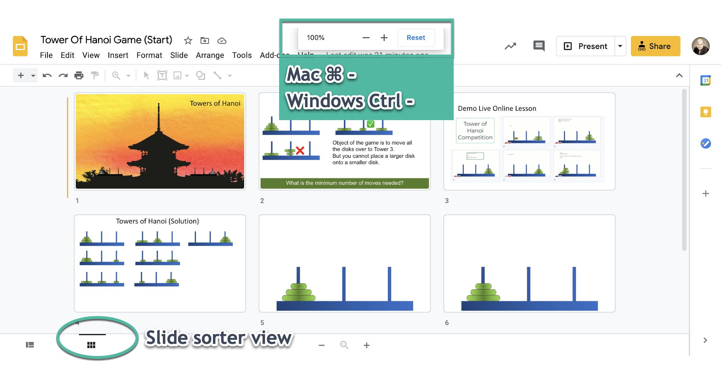
Track all your students

Slide 4
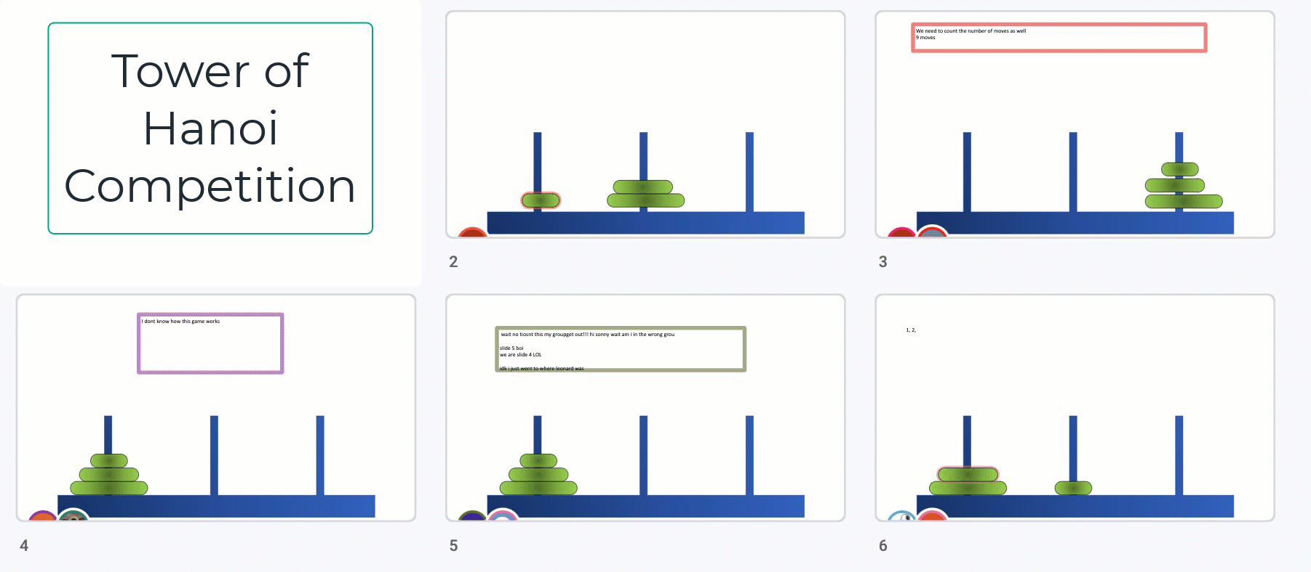
Demo Live Online Lesson

Slide 5
Towers of Hanoi (Solution)

