Slide 1



Finance
FREE PRESENTATION TEMPLATE

Slide 2

Table of Contents
01
Introduction
02
Summary
The Extraordinary Realm
The Extraordinary Realm
03
Analysis
04
Investment
The Extraordinary Realm
The Extraordinary Realm
05
Case Studies
06
Conclusion
The Extraordinary Realm
The Extraordinary Realm

Slide 3




Introduction
Unicorn Sightings
A record of the number of unicorns spotted in the fantasy realm and the beauty and mystery that surrounds these enchanting creatures.
Goblin Gatherings
Unveil the truth about the often-misunderstood goblin race and their role in the fantasy world through a comprehensive record.

Slide 4



Summary
Crystal Caves
A network of underground caves filled with precious gems and crystals.
Enchanted Forest
Dragon's Lair
A magical forest filled with talking animal.
A dangerous and mysterious place where dragons reside.

Slide 5







Lost Magic
A decline in the availability and use of magic has led to a lack of experienced wizards and witches in the world,.
Analysis
Dark Enchantments
A growing number of dark magic practitioners are causing harm and destruction across the land,

Slide 6





Analysis
Crystal Caves
A network of underground caves filled with precious gems and crystals.
Dragon Taming
Enchanted Forest
A magical forest filled with talking animal.
Unicorn
Dragon's Lair
A dangerous and mysterious place where dragons reside.

Slide 7







Analysis
Elemental Binding
Charm of Abundance
Gates of Protection
Illumination Spell

Slide 8




Solution
Binding
Protection
Spell
A powerful spell that can control and harness the elemental forces of nature
An enchantment that creates an impenetrable barrier around an area.
A spell that creates a bright, steady light, providing a solution to problems.

Slide 9



Product
A complete and effective solution for your most pressing concerns, offering an innovative blend of fantasy and practicality for maximum impact.
Elemental Enchantment
Mythical Menagerie
Wings of the Phoenix
A powerful spellcasting tool.
A magical tome contain secrets.
A set of wings allow to fly.

Slide 10



Product
A magical tool to harness the power of fire for your every need.
32%
54%
14%

Slide 11
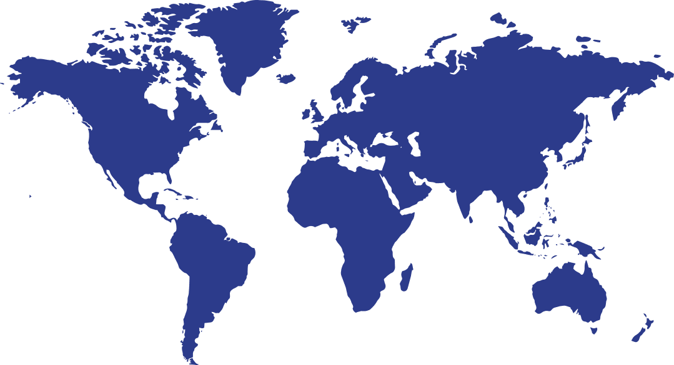
Market
Enchanted Forest
A magical forest filled with talking animals and enchanted creatures.
Crystal Caves
A network of underground caves filled with precious gems and crystals.
Dragon's Lair
A dangerous and mysterious place where dragons reside.

Slide 12

Market
Forest
Caves
City

Slide 13



Enchanted Creatures
Competition
Tracking the mystical animals of the fantasy world
Mystical Landscapes
Discovering the stunning landscapes and hidden wonders
Legendary Artifacts
Uncovering powerful and mysterious artifacts in the fantasy world

Slide 14




Investment
Mystery
Unveil secrets and track progress.
Enchantment
Explore the allure of mythical creatures.
A record of the number of unicorns spotted in the fantasy realm and the beauty and mystery that surrounds these enchanting creatures.
Fantasy
Measure the influence of magic and wonders.

Slide 15





Investment
Basic
Elite
Legendary
  Access to the entry-level dungeons.
  A limited number of quests and battles.
  Ability to form a small party.
  Access to the intermediate dungeons.
  A greater number of quests and battles
  Ability to form larger parties.
  Access to the most challenging dungeons.
  Unlimited quests and battles per month.
  The ability to form the largest.
$10/month
$50/month
$100/month

Slide 16



Shadow Haven
01
Find refuge and protection in the shadows of this mystical safe haven.
Case Studies
Mystical Wonder
02
Uncover the secrets and marvels of a mystical world.
Access to the most challenging dungeons.

Slide 17







Meat our Team
Eldruin
Nephilim
Wyrm
The Fire Mage
The Sky Guardian
The Ancient Serpent

Slide 18





conclusion
Enchanted Forest
Divine Blessings
A magical woodland filled with mystical creatures.
A ritual that imbues a person with divine powers.
Charmed Weapons
Arcane Studies
A range of enchanted weapons.
A course of study that teaches the secrets of magic.

Slide 19




conclusion
Forgotten Lore
Ancient and powerful magic has been lost over time.
Unstable Elements
Magic is tied to the elemental forces of the world.
Mage Uprising
A rising number of rogue mages are using their powers for personal gain/

Slide 20


Thank you for choosing EaTemp
We offer free and high-quality slides templates for your presentations. We appreciate you choosing us and hope our templates have been helpful.
As a new website, we rely on your support to grow, so please help us by sharing our site with your friends and colleagues.

