Slide 1

How to prepare for your financial future
This session is aimed at Key Stage 4 & 5 (recommended for Year 12 and above)

Slide 2
Having a respectful learning environment
We will listen to each other respectfully
We will avoid making judgements or assumptions about others
We will comment on what has been said, not the person who has said it
We won’t put anyone on the spot and we have the right to pass
We will not share personal stories or ask personal questions
If there is a question that you do not wish to ask aloud, you can write it on a Post-it Note which will be collected throughout the session and answered at the end
Notes:
Teacher delivery
Students should be invited to ask questions and they should be provided with an opportunity to ask questions anonymously. It is useful to have a question box or allocated space on the whiteboard for students to share questions.
It is suggested that students are provided with post-its or slips to write their questions on and as the teacher circulates throughout the lesson these questions can be collected and answers throughout the session or using an allocated ‘question time’ at the end of the session.
Students can be invited to respond to questions asked by their peers. If responses to questions are based on personal preference or opinion, the teacher should be clear to preface any answers with this.

Slide 3
Unit outline
Session 1 | Session 2 | Session 3 | Session 4 | Session 5 | Session 6
How the economy works | Mortgages | Credit cards | Pensions | ISAs | Financial decisions

Slide 4
Session 5:
Individual Savings Accounts (ISAs)

Slide 5
By the end of the session, I will be able to:
Explain what ISAs are and how they work
Describe different types of ISAs
Identify best ISA options for different people’s financial goals

Slide 6

Starter
Credit cards and saving money can both help you buy something. But how are they different? Tick the relevant box for each scenario. The first is done for you.
 | Benefits of saving | Drawbacks of saving | Benefits of using credit | Drawbacks of using credit
Using a credit card lets you buy something new
Saving for something means you have to wait to buy it
Using a savings account earns interest on money
Getting into debt can have a negative effect on credit score
If a credit card is used and not all the money is paid back each month, interest will be paid on the amount spent
Having money saved and set aside reduces stress if an unexpected event happens
Resource 1 - Starter. Activity adapted from Barclays Life Skills
Notes:
Delivery instructions
Teacher introduces the statement, reminding students that they have covered this material in previous sessions.
Students can discuss their answers in pairs, explaining the reasons for their responses.
Stretch: Students consider which other factors may be significant to consider here.
Teacher then invites students to share their responses and gauges prior student knowledge of the topic.

Slide 7
Starter | ANSWERS
 | Benefits of saving | Drawbacks of saving | Benefits of using credit | Drawbacks of using credit
Using a credit card lets you buy something new
Saving for something means you have to wait to buy it
Using a savings account earns interest on money
Getting into debt can have a negative effect on credit score
If a credit card is used and not all the money is paid back each month, interest will be paid on the amount spent
Having money saved and set aside reduces stress if an unexpected event happens
Adapted from Barclays Life Skills: https://barclayslifeskills.com/help-others/lessons/money-skills-lesson-three-next-steps-in-your-financial-journey/
Notes:
Teacher delivery
Teacher introduces the statement, reminding students that this is what they learnt a few lessons ago.
Teacher instructions
Students can discuss their answers in pairs, explaining the reasons for their responses
Stretch: Students consider which other factors may be significant to consider here.
Teacher then invites students to share their responses and gauges prior knowledge of the class/students on the topic

Slide 8
What is an Individual Savings Account (ISA)?
On post-it notes, write down:
1 thing you know about ISAs
1 thing you would like to know about ISAs
Notes:
Teacher explanation
Use this as a baseline assessment
Teacher delivery
Students should listen to the clip and note down their responses to the 4 questions
Teacher then invites students to share their responses and discuss

Slide 9
What is an Individual Savings Account (ISA)?
ISAs are simply accounts for people’s savings or investments where the amount earned within the account is tax-free forever.
Notes:
Teacher explanation
Teacher advises that this session will be looking at a way to save money, unlike credit cards which are a form of borrowing money. They will mention that there are many ways to borrow money and that ISAs are just one way.
Teacher delivery
Students should listen to the clip and note down their responses to the 4 questions
Teacher then invites students to share their responses and discuss

Slide 10
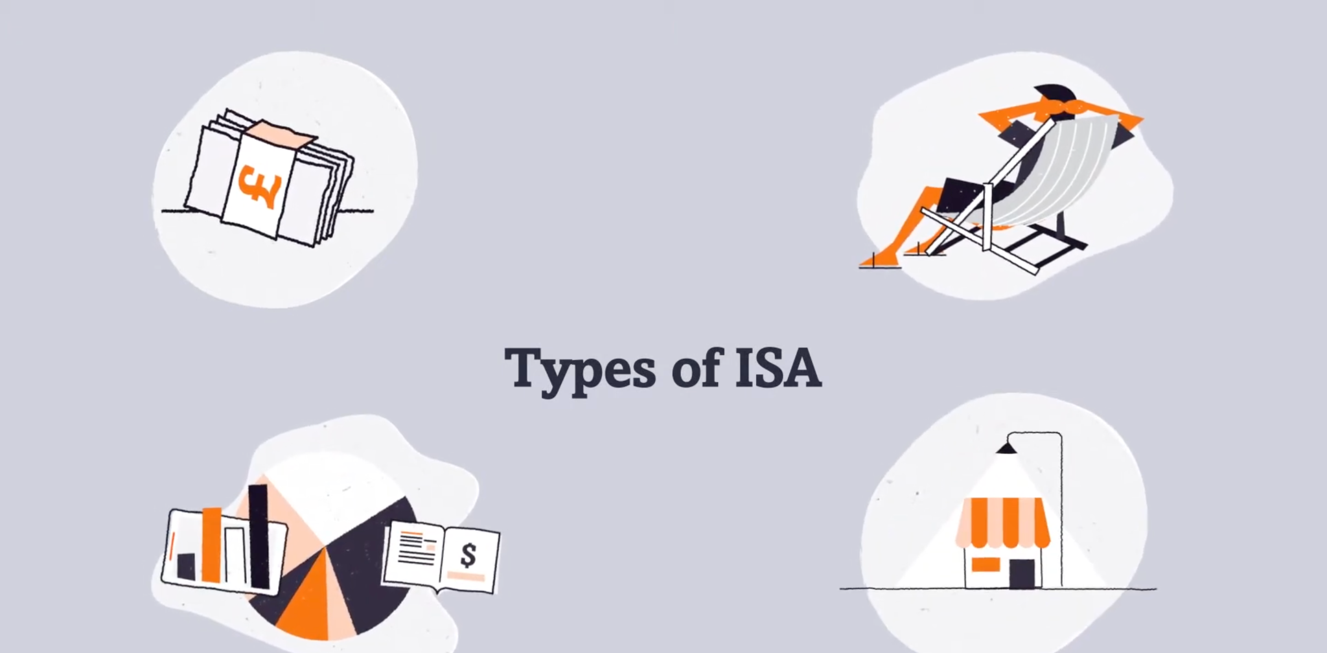
And how do ISAs work?
ISAs explained
Watch the video and respond to the following questions.
Questions:
What are ISAs?
Why might ISAs be known as tax wrappers?
How much is the annual ISA allowance?
Video: What is an ISA?
Notes:
Teacher explanation
Teacher advises that this session will be looking at a way to save money, unlike credit cards which are a form of borrowing money. They will mention that there are many ways to borrow money and that ISAs are just one way.
Teacher delivery
Students should listen to the clip and note down their responses to the 4 questions
Teacher then invites students to share their responses and discuss

Slide 11
And how do ISAs work?
ISA stands for an (1)……………………...
ISAs are another way to (2) …….... money and earn (3)…..…. The interest rate that applies to the ISA will help the person opening and investing in the ISA (4)…….. their money.
Essentially ISAs are a way to invest money into a savings account without getting (5)..........(unlike other types of savings). For this reason they are referred to as a (6).………..
You can invest up to a set amount in an ISA every financial year (April to April), this varies depending on the type of (7) …..….There are two ISAs that are commonly referred to: Cash ISAs and Stocks & Shares ISAs. However there are others and they all work slightly differently. You can invest in one or more, up to a maximum of (8)........... combined.
Word bank
ISA
Tax wrapper
Save
Grow
Individual savings account
Taxed
£20,000
Interest
Resource 2 - What is an ISA?
Notes:
Teacher explanation
Teacher now introduces that the information on the slide starts to explain how ISAs work.
Teacher delivery
Students can work in pairs to verbally gap fill using the word bank of the left of the slide. Students also to refer to the clip they have just watched on the previous task too.

Slide 12
And how do ISAs work? | ANSWERS
ISA stands for an (1) individual savings account.
ISAs are another way to (2) save money and earn (3) interest. The interest rate that applies to the ISA will help the person opening and investing in the ISA (4) grow their money.
Essentially ISAs are a way to invest money into a savings account without getting (5) taxed (unlike other types of savings). For this reason they are referred to as a (6) tax wrapper.
You can invest up to a set amount in an ISA every financial year (April to April), this varies depending on the type of (7) ISA. There are two ISAs that are commonly referred to: Cash ISAs and Stocks & Shares ISAs. However, there are others and they all work slightly differently. You can invest in one or more, up to a maximum of (8) £20,000 combined.
Notes:
Teacher delivery
Teacher invites students to share their responses and addresses any questions from the students.

Slide 13
By the end of the session, I will be able to:
Explain what ISAs are and how they work
Describe different types of ISAs
Identify best ISA options for different people’s financial goals

Slide 14
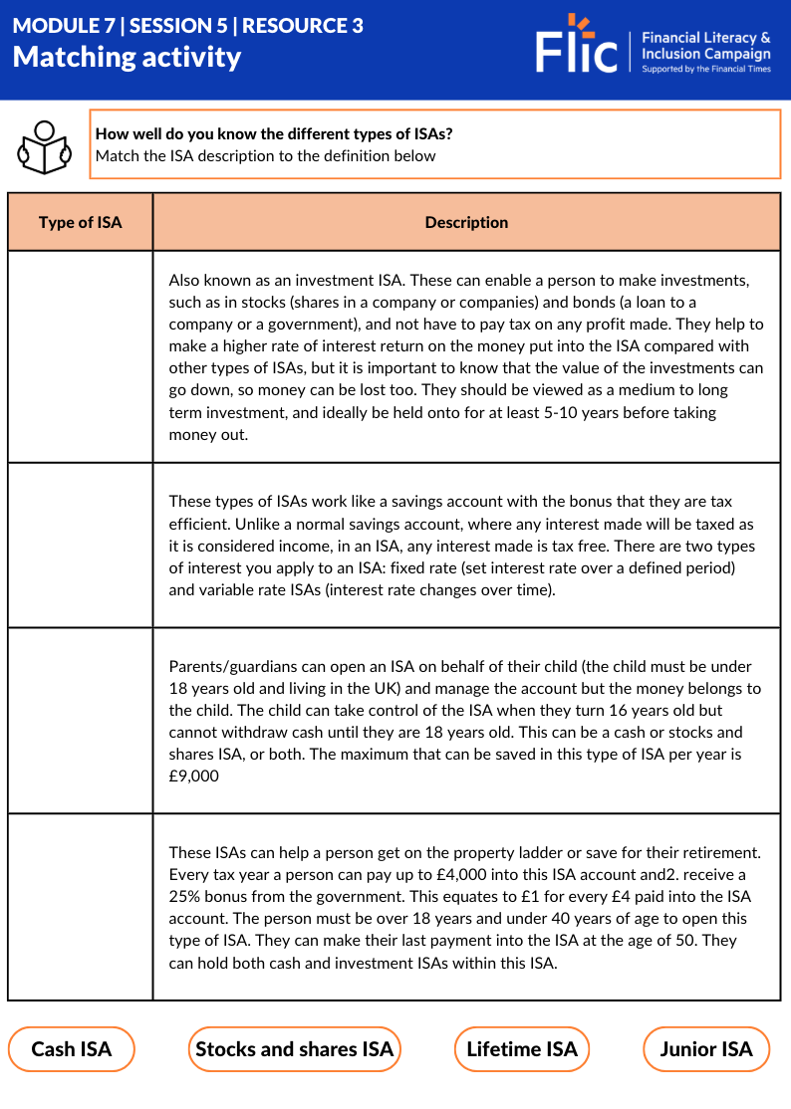
Matching activity
How well do you know the different types of ISAs?
On your worksheet, read the descriptions of the different types of ISA.
The names of ISAs are underneath.
Match each type of ISA to its description.
Electricity bills
Lunch out
Resource 3 | Types of ISAs - Matching activity
Notes:
Teacher delivery
Students can work in pairs to match the definitions to the correct explanation.of the ISAs to the correct type of ISA.
Teacher explanation
Teacher asks students to read the information carefully and use the knowledge they have learnt from the previous tasks as well as looking for clues.

Slide 15
Types of ISAs
Also known as an investment ISA. These can enable a person to make investments, such as in stocks (shares in a company or companies) and bonds (a loan to a company or a government), and not have to pay tax on any profit made. They help to make a higher rate of interest return on the money put into the ISA compared with other types of ISAs, but it is important to know that the value of the investments can go down, so money can be lost too. They should be viewed as a medium to long term investment, and ideally be held onto for at least 5-10 years before taking money out.
Cash ISA
Stocks and shares ISA
Lifetime ISA
Lunch out
Junior ISA
Lunch out
Notes:
Teacher delivery
Teacher to refer to bolded information to prompt students

Slide 16
Types of ISAs
Also known as an investment ISA. These can enable a person to make investments, such as in stocks (shares in a company or companies) and bonds (a loan to a company or a government), and not have to pay tax on any profit made. They help to make a higher rate of interest return on the money put into the ISA compared with other types of ISAs, but it is important to know that the value of the investments can go down, so money can be lost too. They should be viewed as a medium to long term investment, and ideally be held onto for at least 5-10 years before taking money out.
Cash ISA
Stocks and shares ISA
Lifetime ISA
Lunch out
Junior ISA
Lunch out
Notes:
Teacher delivery
Teacher to refer to bolded information to prompt students

Slide 17
Types of ISAs
These types of ISAs work like a savings account with the bonus that they are tax efficient. Unlike a normal savings account, where any interest made will be taxed as it is considered income, in an ISA, any interest made is tax free. There are two types of interest you apply to this type of ISA: fixed rate (set interest rate over a defined period) and variable rate ISAs (interest rate changes over time).
Cash ISA
Stocks and shares ISA
Lifetime ISA
Junior ISA
Notes:
Teacher delivery
Teacher to refer to bolded information to prompt students

Slide 18
Types of ISAs
These types of ISAs work like a savings account with the bonus that they are tax efficient. Unlike a normal savings account, where any interest made will be taxed as it is considered income, in an ISA, any interest made is tax free. There are two types of interest you apply to this type of ISA: fixed rate (set interest rate over a defined period) and variable rate ISAs (interest rate changes over time).
Cash ISA
Stocks and shares ISA
Lifetime ISA
Junior ISA
Notes:
Teacher delivery
Teacher to refer to bolded information to prompt students

Slide 19
Types of ISAs
Parents/guardians can open an ISA on behalf of their child (the child must be under 18 years old and living in the UK) and manage the account but the money belongs to the child. The child can take control of the ISA when they turn 16 years old but cannot withdraw cash until they are 18 years old. This can be a cash or stocks and shares ISA, or both. The maximum that can be saved in this type of ISA per year is £9,000
Cash ISA
Stocks and shares ISA
Lifetime ISA
Junior ISA
Notes:
Teacher delivery
Teacher to refer to bolded information to prompt students

Slide 20
Types of ISAs
Parents/guardians can open an ISA on behalf of their child (the child must be under 18 years old and living in the UK) and manage the account but the money belongs to the child. The child can take control of the ISA when they turn 16 years old but cannot withdraw cash until they are 18 years old. This can be a cash or stocks and shares ISA, or both. The maximum that can be saved in this type of ISA per year is £9,000
Cash ISA
Stocks and shares ISA
Lifetime ISA
Junior ISA
Notes:
Teacher delivery
Teacher to refer to bolded information to prompt students

Slide 21
Types of ISAs
These ISAs can help a person get on the property ladder to buy a home worth up to £450,000 (both inside or outside of London) or save for their retirement. Every tax year a person can pay up to £4,000 into this ISA account and receive a 25% bonus from the government. This equates to £1 for every £4 paid into the ISA account. The person must be over 18 years and under 40 years of age to open this type of ISA. They can make their last payment into the ISA at the age of 50. They can hold both cash and investment ISAs within this ISA.
Cash ISA
Stocks and shares ISA
Lifetime ISA
Junior ISA
Notes:
Teacher delivery
Teacher to refer to bolded information to prompt students

Slide 22
Types of ISAs
These ISAs can help a person get on the property ladder to buy a home worth up to £450,000 (both inside or outside of London) or save for their retirement. Every tax year a person can pay up to £4,000 into this ISA account and receive a 25% bonus from the government. This equates to £1 for every £4 paid into the ISA account. The person must be over 18 years and under 40 years of age to open this type of ISA. They can make their last payment into the ISA at the age of 50. They can hold both cash and investment ISAs within this ISA.
Cash ISA
Stocks and shares ISA
Lifetime ISA
Junior ISA
Notes:
Teacher delivery
Teacher to refer to bolded information to prompt students

Slide 23
By the end of the session, I will be able to:
Explain what ISAs are and how they work
Describe different types of ISAs
Identify best ISA options for different people’s financial goals

Slide 24

Discussion
Read Simon’s scenario. How could he allocate his money to the various ISAs?
 | Age to open | Annual deposit limit | Savings at risk? | Government bonus?
Cash ISA | 16+ | £20,000 | No | No
Stocks and shares ISA | 18+ | £20,000 | Yes | No
Lifetime ISA | 18-39 | £4,000 | Depends | Yes, 25%
Junior ISA | 0-17 | £9,000 | Depends | No
Simon is 40 years old.
He works as a software engineer and has £25,000 in savings. He doesn’t have dependents and is looking to grow his money over the long run, while also having some savings that he can access more easily for some refurbishments.
(Note: Stocks & Shares ISAs are made up of equity & funds)
Adapted from Money Saving Expert
Notes:
Teacher delivery
Students can work in pairs to give their advice to Simon.
Teacher explanation
Students must use the information from the previous exercise and look at the figures carefully- draw students attentions to the ‘Note:Stocks & Shares ISAs are made up of equity & funds’
Teacher feeds back by focusing on the figures mentioned in the task to identify that Simon would not be able to invest £5,000 of the £25,000. (£25,000 - £20,000 maximum annual investment limit into an ISA). He’s likely to put the majority into Stocks and shares ISAs, and some into a Cash ISA.

Slide 25
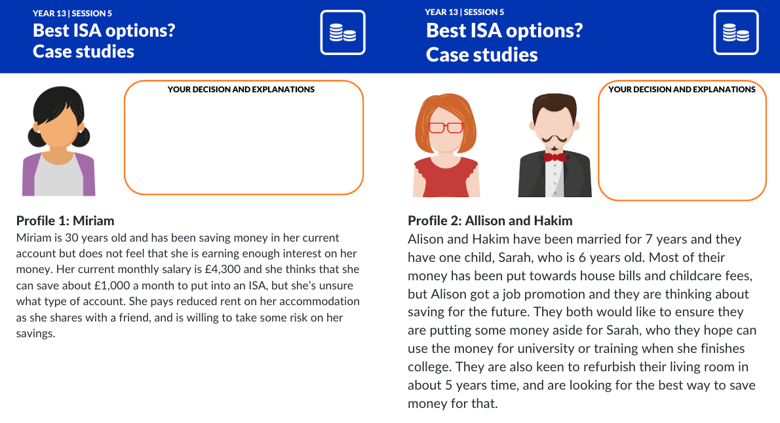
Activity | Case studies
Read each case study and advise on the best ISA for each person’s situation, explaining your reasons.
Then have a go at allocating annual amounts of funds to the ISA or ISAs that you think would best meet the person’s financial goals.
When the answers are shown, relevant personal financial details of scenario will be highlighted in bold.
Resource 4 | Best ISA options?
Notes:
Teacher delivery
Students work in groups of three to read each case study - Resource 2 ‘Best ISA options’ worksheet and analyse the reasons why
Teacher explanation
Students should use the definitions from the previous task and apply here from Resource 3 ‘Types of ISAs’ - Matching activity
Stretch: Students consider whether other ISAs may also be applicable for each case study and analyse why they may not be the best option in comparison to their first choice.
Teacher randomly selects a group for whole class feedback and discussion.

Slide 26

Best ISA options? Allocate amounts
Miriam is 30 years old and has been saving money in her current account but does not feel that she is earning enough interest on her money. Her current monthly salary is £4,300 and she thinks that she can save about £1,000 a month to put into an ISA, but she’s unsure what type of account. She pays reduced rent on her accommodation as she shares with a friend, and is willing to take some risk on her savings.
Notes:
Teacher delivery
Teacher invites feedback from the pairs.
Use whiteboard to illustrate calculations - stocks and shares and CASH. £1,500 x 12 = £18,000. Could distribute e.g. £12,000 into Investment and £6,000 into Cash.

Slide 27
Best ISA options? Allocate amounts
She is likely to go for a Stocks and Shares ISA, but may split that with a Cash ISA so has some money that’s less risky. Overall, she can put away £20,000 in ISAs over the year, where she doesn’t need to pay tax on her returns.
Miriam is 30 years old and has been saving money in her current account but does not feel that she is earning enough interest on her money. Her current monthly salary is £4,300 and she thinks that she can save about £1,000 a month to put into an ISA, but she’s unsure what type of account. She pays reduced rent on her accommodation as she shares with a friend, and is willing to take some risk on her savings.
Notes:
Teacher delivery
Teacher invites feedback from the pairs.
Use whiteboard to illustrate calculations - stocks and shares and CASH. £1,500 x 12 = £18,000. Could distribute e.g. £12,000 into Investment and £6,000 into Cash.
There are also potential tax advantages. For example, if Miriam earns £55,000 a year and puts £1,000 a month into an ISA, then she won’t have to pay the higher rate tax on her money of 40%; instead she’ll be moved to a lower tax band of 20%. See an ISA tax savings calculator here:
https://www.hl.co.uk/partners/search/isa-ppc-calculator?theSource=PCGIL&Override=1&adg=G+ISAL+SAS+EP+FOS&gad=1&gclid=Cj0KCQjw2qKmBhCfARIsAFy8buI5w9eE-t0MVucW9q4D7xbfxfpEW8K29pLM3zZucahUao13EMOdALoaAu_VEALw_wcB

Slide 28
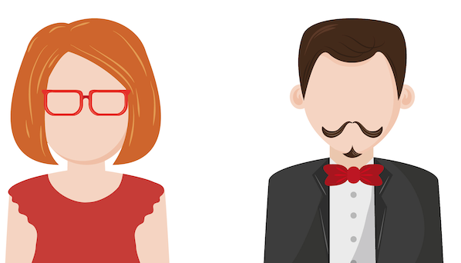
Best ISA options? Allocate amounts
Alison and Hakim have been married for 7 years and they have one child, Sarah, who is 6 years old. Most of their money has been put towards house bills and childcare fees, but Alison got a job promotion which came with higher pay and they are thinking about saving for the future. They both would like to ensure they are putting some money aside for Sarah, who they hope can use the money for university or training when she finishes college. They are also keen to refurbish their living room in about 5 years time, and are looking for the best way to save money for that.
Notes:
Junior and Cash ISas

Slide 29
Best ISA options? Allocate amounts
Alison and Hakim are likely to split the money between a Cash ISA and Junior ISA. We don’t know how much they earn so it’s difficult to put an exact amount on how much. If they can afford it, they may put the full £9,000 into a Junior ISA for Sarah and the rest into a Cash ISA.
Alison and Hakim have been married for 7 years and they have one child, Sarah, who is 6 years old. Most of their money has been put towards house bills and childcare fees, but Alison got a job promotion which came with higher pay and they are thinking about saving for the future. They both would like to ensure they are putting some money aside for Sarah, who they hope can use the money for university or training when she finishes college. They are also keen to refurbish their living room in about 5 years time, and are looking for the best way to save money for that.
Notes:
Junior and Cash ISas

Slide 30

Best ISA options? Allocate amounts
Jenna is 33 years old and has recently been promoted to senior associate director at an architectural firm and is now on a salary of £70,000 per year.
She is eager to start saving money for a deposit to buy her own apartment in the next 5 years. She does not want to pay tax on her savings and hasn’t yet made a savings plan. Jenna would like to save at least £10,000 a year and wants to make a good return.
Notes:
Teacher delivery
Teacher invites feedback from the pairs.
Use whiteboard to illustrate calculations - Lifetime ISA (£4,000) and Investment ISA (£6,000)

Slide 31
Best ISA options? Allocate amounts
Jenna would benefit from putting some of her savings aside into a Lifetime ISA. She can easily put £4,000 a year into this ISA and enjoy the 25% bonus of £1,000 each year from the government.
It’s important to note that she may have to pay a penalty if she removes money from the ISA in the first year, and she can only buy a property worth less than £450,000.
The rest of the money she can put in a Stocks and Shares ISA, with maybe a little bit in a Cash ISA too.
Jenna is 33 years old and has recently been promoted to senior associate director at an architectural firm and is now on a salary of £70,000 per year.
She is eager to start saving money for a deposit to buy her own apartment in the next 5 years. She does not want to pay tax on her savings and hasn’t yet made a savings plan. Jenna would like to save at least £10,000 a year and wants to make a good return.
Notes:
Teacher delivery
Teacher invites feedback from the pairs.
Use whiteboard to illustrate calculations - Lifetime ISA (£4,000) and Investment ISA (£6,000)

Slide 32

Best ISA options? Allocate amounts
Wen is 25 years old. He has been saving £5,000 a year in a traditional savings account and has seen his money slowly grow over the last 3 years. Wen has a steady job as a manager at the local supermarket and earns £30,000. He rents a property close to work, which also helps him to save money on the commute to work. He would like to save his money but is unsure exactly what he would spend it on. He enjoys travelling and would love to go on an all around the world trip but is undecided.
Notes:
Teacher delivery
Teacher invites feedback from the pairs. Cash ISA

Slide 33
Best ISA options? Allocate amounts
Wen is likely to put the majority of his savings into a Cash ISA. This way the money he is already putting into a savings account can grow, and he won’t pay tax on the interest made. This will allow him to safely save for the future, once he knows exactly what he wants to do.
Wen is 25 years old. He has been saving £5,000 a year in a traditional savings account and has seen his money slowly grow over the last 3 years. Wen has a steady job as a manager at the local supermarket and earns £30,000. He rents a property close to work, which also helps him to save money on the commute to work. He would like to save his money but is unsure exactly what he would spend it on. He enjoys travelling and would love to go on an all around the world trip but is undecided.
Notes:
Teacher delivery
Teacher invites feedback from the pairs. Cash ISA

Slide 34
By the end of the session, I will be able to:
Explain what ISAs are and how they work
Describe different types of ISAs
Identify best ISA options for different people’s financial goals

Slide 35
Multiple choice
The annual ISA allowance is:
A | B | C
£25,000 in total | £10,000 per ISA account | £20,000 in total
Notes:
Teacher delivery
Teacher invites feedback from the pairs.
Optional - use mini whiteboards for whole class AfL

Slide 36
Multiple choice
The annual ISA allowance is:
A | B | C
£25,000 in total | £10,000 per ISA account | £20,000 in total
Notes:
Teacher delivery
Teacher invites feedback from the pairs.
Optional - use mini whiteboards for whole class AfL

Slide 37
Multiple choice
2. People will get a new allowance:
A | B | C
On 6 April each year when the next tax year starts | Every 5 years | 1st January every year
Notes:
Teacher delivery
Teacher invites feedback from the pairs.
Optional - use mini whiteboards for whole class AfL

Slide 38
Multiple choice
2. People will get a new allowance:
A | B | C
On 6 April each year when the next tax year starts | Every 5 years | 1st January every year
Notes:
Teacher delivery
Teacher invites feedback from the pairs.
Optional - use mini whiteboards for whole class AfL

Slide 39
Multiple choice
3. If Sally puts £10,000 into a range of ISAs one tax year, she:
A | B | C
Can roll over the remaining £10,000 to be used the following year | Loses the chance to use the remaining £10,000 as it doesn’t roll over | Is mandated to put the remaining £10,000 into an ISA the following year
Notes:
Teacher delivery
Teacher invites feedback from the pairs.
Optional - use mini whiteboards for whole class AfL

Slide 40
Multiple choice
3. If Sally puts £10,000 into a range of ISAs one tax year, she:
A | B | C
Can roll over the remaining £10,000 to be used the following year | Loses the chance to use the remaining £10,000 as it doesn’t roll over | Is mandated to put the remaining £10,000 into an ISA the following year
Notes:
Teacher delivery
Teacher invites feedback from the pairs.
Optional - use mini whiteboards for whole class AfL

Slide 41
Any questions?
?

Slide 42



Services available for people who have concerns about their personal finances
Citizens Advice – Debt and Money – This resource contains links to advice on a number of topics, including financial difficulties, cost of living and communicating with creditors.
https://www.gov.uk/individual-savings-accounts/how-isas-work
https://www.moneyhelper.org.uk/en/savings/types-of-savings/isas-and-other-tax-efficient-ways-to-save-or-invest
At school, you can speak with an adult you trust.
This could be your form tutor, head of year or the school’s safeguarding officer

Slide 43
Links to learn more!
Articles to extend learning
Please visit the FLIC learning hub - https://resources.ftflic.com/ for further resources
Money Helper
Money
What is an Isa? - Which?
Grandparents: give the gift of investment education
A generation locked in the UK’s savings crisis

