Slide 1
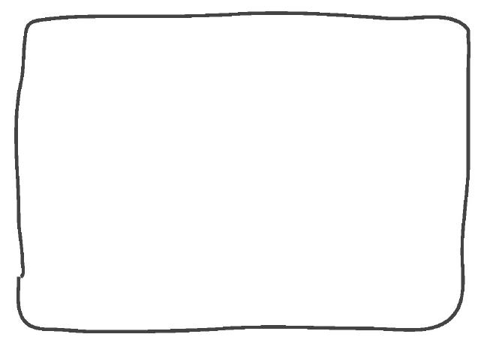

Ice Board Designer
Name: ______________________
The ice board rider is going to take a trip to Lake Baikal! This lake is huge. He needs a new ice board design to get ready for such a big lake. Can you design a new ice board and build a model of it?
1. Read the design goals. Your design must:
include a seat so the ice board rider is comfortable, sitting up, and facing forward
include a sail that won’t fall over when you blow on it (you might have to build something to hold the sail up, too)
fit the cutout of the ice board rider— not too big, and not too small
cost as little as possible
2. Come up with a plan for your model. Explain your plan on the lines below. Draw your plan in the box to the right.
______________________
______________________
______________________
______________________
______________________
______________________
______________________
Forces, Motions, & Magnets | Performance Task

Slide 2
Ice Board Designer
Name: ______________________
3. Build a model of your new ice board. As you build, you may find that you have to change your plan. That’s okay! Be sure to test it to make sure it won’t fall over if you blow on it. If it does fall over, keep improving your design so that it doesn’t. When you are finished go back and make sure you have met all of the design goals!
4. Check your work. When you are done, look back at step 1. Make sure your design meets all of the design goals.
5. Calculate the total cost of your design. Use this table to help you figure out the cost.
Material | How many does your design use? | Multiply to calculate the cost of each type of material
Note card |  | ______ x $5 each = ______________
Paper clip |  | ______ x $5 each = ______________
Tape strip |  | ______ x $10 each = ______________
Total cost of all items (add them up): |  |  | $
6. Improve your design. Think of something creative you can add to your design that will make it even better for the ice board rider. You might add something to make it more comfortable, faster, easier to use, or something else. You might remove certain parts to reduce the cost. Describe what you came up with in the space below. If you have time, you can build it on your actual model.
On my design, I added __________________________________________________________
_____________________________________________________________________________
_____________________________________________________________________________
Forces, Motions, & Magnets | Performance Task

