Slide 1
Clinical Case 06-2019
Here is where your presentation begins

Slide 2
Contents of This Template
Here’s what you’ll find in this GoogleSlides.org template:
A slide structure based on a clinical case presentation, which you can easily adapt to your needs. For more info on how to edit the template, please visit GoogleSlides.org School or read our FAQs.
An assortment of illustrations that are suitable for use in the presentation can be found in the alternative resources slide.
A thanks slide, which you must keep so that proper credits for our design are given.
A resources slide, where you’ll find links to all the elements used in the template.
Instructions for use.
Final slides with:
The fonts and colors used in the template.
More infographic resources, whose size and color can be edited.
Sets of customizable icons of the following themes: general, business, avatar, creative process, education, help & support, medical, nature, performing arts, SEO & marketing, and teamwork.
You can delete this slide when you’re done editing the presentation.

Slide 3
Table of Contents
01
02
03
04
05
About the Patient
Discussion
Diagnosis
Here you could describe the topic of the section
Here you could describe the topic of the section
Here you could describe the topic of the section
Treatment
Patient Monitoring
Here you could describe the topic of the section
Here you could describe the topic of the section

Slide 4
Introduction
Mercury is the closest planet to the Sun and the smallest one in the Solar System—it’s only a bit larger than our Moon. The planet’s name has nothing to do with the liquid metal, since it was named after the Roman messenger god, Mercury

Slide 5
01
About the Patient
You could enter a subtitle here if you need it

Slide 6
Identifying Information
Neptune
Saturn
Mercury
Neptune is the fourth-largest planet by diameter in our Solar System
Saturn is the ringed one. It’s a gas giant, composed mostly of hydrogen and helium
Mercury is the closest planet to the Sun and the smallest one in our Solar System

Slide 7
Identifying Information
Venus
Mercury
Venus has a beautiful name and is the second planet from the Sun. It’s terribly hot—even hotter than Mercury—and its atmosphere is extremely poisonous. It’s the second-brightest natural object in the night sky after the Moon
Mercury is the closest planet to the Sun and the smallest one in the Solar System—it’s only a bit larger than our Moon. The planet’s name has nothing to do with the liquid metal, since it was named after the Roman messenger god

Slide 8
Patient Medical History
Age: 25-35
Gender: female
Allergies: none
Location: Madrid, Spain
Habits: unhealthy eating, sedentary lifestyle
2008
Neptune is the fourth-largest planet by diameter in our Solar System
2013
Saturn is the ringed one. It’s a gas giant, composed mostly of hydrogen and helium
2019
Venus has a beautiful name and is the second planet from the Sun. It’s terribly hot

Slide 9
Review of Systems
01
02
03
04
05
Neptune
Saturn
Neptune is the farthest planet from the Sun
Saturn is composed mostly of hydrogen and helium
Mercury
Jupiter
Mars
Mercury is the smallest planet in our Solar System
This gas giant is the biggest planet in our Solar System
Despite being red, Mars is actually a cold place

Slide 10
Physical Examination
45%
12%
78%
36%
62%
Neptune
Saturn
Mars
Venus
Mercury
To change the size of the graph, click the arc of the circle and drag one of the orange handles
Yes, Saturn is the ringed one. It’s a gas giant, composed mostly of hydrogen and helium
Mars is a cold place full of iron oxide dust, which gives the planet its reddish cast
Venus has a beautiful name and is the second planet from the Sun. It’s terribly hot
Mercury is the closest planet to the Sun and the smallest one our the Solar System

Slide 11
Results
Mercury is the closest planet to the Sun and the smallest one in the Solar System—it’s only a bit larger than our Moon. The planet’s name has nothing to do with the liquid metal, since it was named after the Roman messenger god

Slide 12
4,497,374
Big numbers catch your audience’s attention

Slide 13
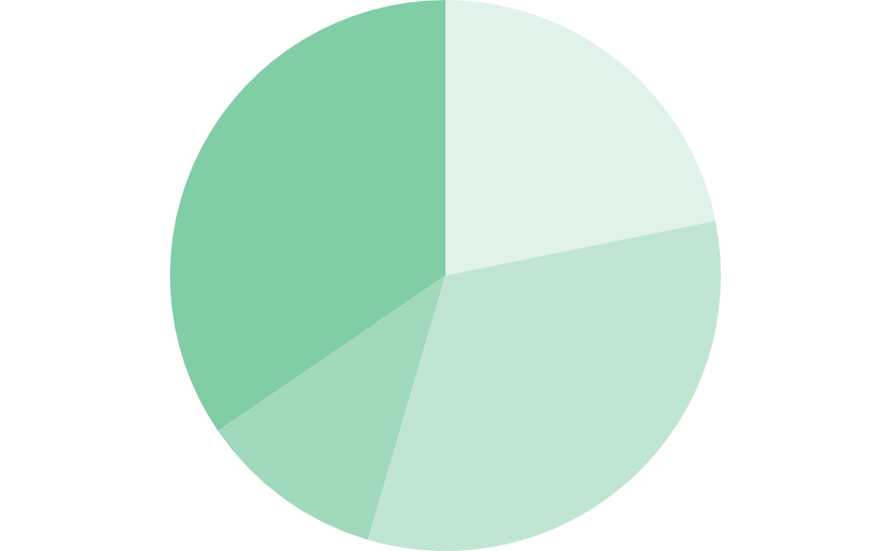
Findings
Evolution
Prevalence
32%
24%
Pluto
Venus
12%
32%
Saturn
Mars
If you want to modify this graph, click on it, follow the link, change the data and replace it
200,000,000
Big number

Slide 14
02
Discussion
You could enter a subtitle here if you need it

Slide 15
Discussions
“Neptune is the farthest planet from the Sun and the fourth-largest in our Solar System’’
Dr. John Doe
“Venus has a beautiful name and is the second planet from the Sun. It’s terribly hot’’
Dr. Jenna James
“Mercury is the closest planet to the Sun and the smallest one in our Solar System’’
Dr. Daniel Patterson

Slide 16
Discussions Summary
01
02
03
Venus has a beautiful name and is the second planet from the Sun. It’s terribly hot and its atmosphere is extremely poisonous
Jupiter is a gas giant and the biggest planet in our Solar System. It’s also the fourth-brightest object in the sky
Mercury is the closest planet to the Sun and also the smallest one in our Solar System. It’s only a bit larger than our Moon

Slide 17
03
Diagnosis
You could enter a subtitle here if you need it

Slide 18
Diagnosis
Neptune
Mercury
Neptune is the fourth-largest planet by diameter in our Solar System
Mercury is the closest planet to the Sun and the smallest one in our Solar System
Saturn
Mars
Saturn is the ringed one. It’s a gas giant, composed mostly of hydrogen and helium
Despite being red, Mars is actually a cold place. It’s full of iron oxide dust
Venus
Jupiter
Venus has a beautiful name and is the second planet from the Sun. It’s terribly hot
It’s the fourth-brightest object in the sky and the biggest planet in our Solar System

Slide 19
Comparison
 | 01 | 02 | 03 | 04
Saturn
Venus
Jupiter
Pluto

Slide 20
04
Treatment
You could enter a subtitle here if you need it

Slide 21
Treatment
Week 1
Mars is full of iron oxide dust, which gives the planet its reddish cast
Saturn is the ringed one. It’s a gas giant, composed of hydrogen and helium
Week 2
Week 3
Venus has a beautiful name and is the second planet from the Sun
Jupiter is a gas giant and the biggest planet in our Solar System
Week 4

Slide 22

A Picture Always Reinforces the Concept

Slide 23

A Picture Is Worth a Thousand Words

Slide 24
05
Patient Monitoring
You could enter a subtitle here if you need it

Slide 25
Patient Monitoring
Week 1
Week 2
Venus has a beautiful name and is the second planet from the Sun
To change the size of the graph, click the circle and drag the colored handle
Venus
Venus
Mars
Saturn
Pluto
Mars
Saturn
Week 3
Venus
Saturn
Mercury is the closest planet to the Sun
Pluto
Mars
Pluto

Slide 26
Contraindications - Indications
Saturn is the ringed one. It’s a gas giant, composed of hydrogen and helium
Despite being red, Mars is actually a cold place. It’s full of iron oxide dust
Jupiter is a gas giant and the fourth-brightest object in the sky
Neptune is the fourth-largest planet in our Solar System
Venus has a beautiful name and is the second planet from the Sun
Pluto is in the Kuiper belt and is considered a dwarf planet since 2006
Mercury is the closest planet to the Sun and the smallest in our Solar System
Ceres is a dwarf planet and the biggest object in the asteroid belt

Slide 27
Post-prevention
Jupiter is a gas giant and the biggest planet in our Solar System
Jupiter
Mercury
Mercury is the smallest planet in our Solar System
Venus is terribly hot and its atmosphere is extremely poisonous
Venus
Mars
Despite being red, Mars is actually a cold place
Neptune is the fourth-largest planet in our Solar System
Neptune
Saturn
It’s a gas giant, composed mostly of hydrogen and helium

Slide 28
Case Timeline
Phase 1
Phase 2
Phase 3
Phase 4
Neptune is the fourth-largest planet in our Solar System
Saturn is the ringed one. It’s a gas giant, composed of hydrogen and helium
Venus has a beautiful name and is the second planet from the Sun
Mars is full of iron oxide dust, which gives the planet its reddish cast

Slide 29
Conclusions
Mercury is the closest planet to the Sun and the smallest one in the Solar System—it’s only a bit larger than our Moon. The planet’s name has nothing to do with the liquid metal, since it was named after the Roman messenger god, Mercury

Slide 30
References
AUTHOR (YEAR). Title of the publication. Publisher
AUTHOR (YEAR). Title of the publication. Publisher
AUTHOR (YEAR). Title of the publication. Publisher
AUTHOR (YEAR). Title of the publication. Publisher
AUTHOR (YEAR). Title of the publication. Publisher
AUTHOR (YEAR). Title of the publication. Publisher

Slide 31
Our Team
Helena James
John Doe
Jenna Patterson
Here you can talk a bit about this person
Here you can talk a bit about this person
Here you can talk a bit about this person

Slide 32
Thanks
Do you have any questions?
youremail@freepik.com
+91 620 421 838
yourcompany.com
Please keep this slide for attribution.

Slide 33
Alternative Resources

Slide 34
Resources
Vectors
Medical equipment icons
Flat nurse team
Flat nurse team
Flat nurse team
Flat nurse team
Flat nurse team
Hand drawn nurse team
Health elements medical tools
Icons
Human anatomy icon pack
Health icon pack
Health care icon pack
Photos
Senior woman looking female nurse wheelchair
Nurse holding checklist

Slide 35
Instructions for use
In order to use this template, you must credit GoogleSlides.org by keeping the Thanks slide.
You are allowed to:
- Modify this template.
- Use it for both personal and commercial projects.
You are not allowed to:
- Sublicense, sell or rent any of GoogleSlides.org Content (or a modified version of GoogleSlides.org Content).
- Distribute GoogleSlides.org Content unless it has been expressly authorized by GoogleSlides.org.
- Include GoogleSlides.org Content in an online or offline database or file.
- Offer GoogleSlides.org templates (or modified versions of GoogleSlides.org templates) for download.
- Acquire the copyright of GoogleSlides.org Content.
For more information about editing slides, please read our FAQs or visit GoogleSlides.org School:
https://GoogleSlides.org and https://GoogleSlides.org/free-templates

