Slide 1
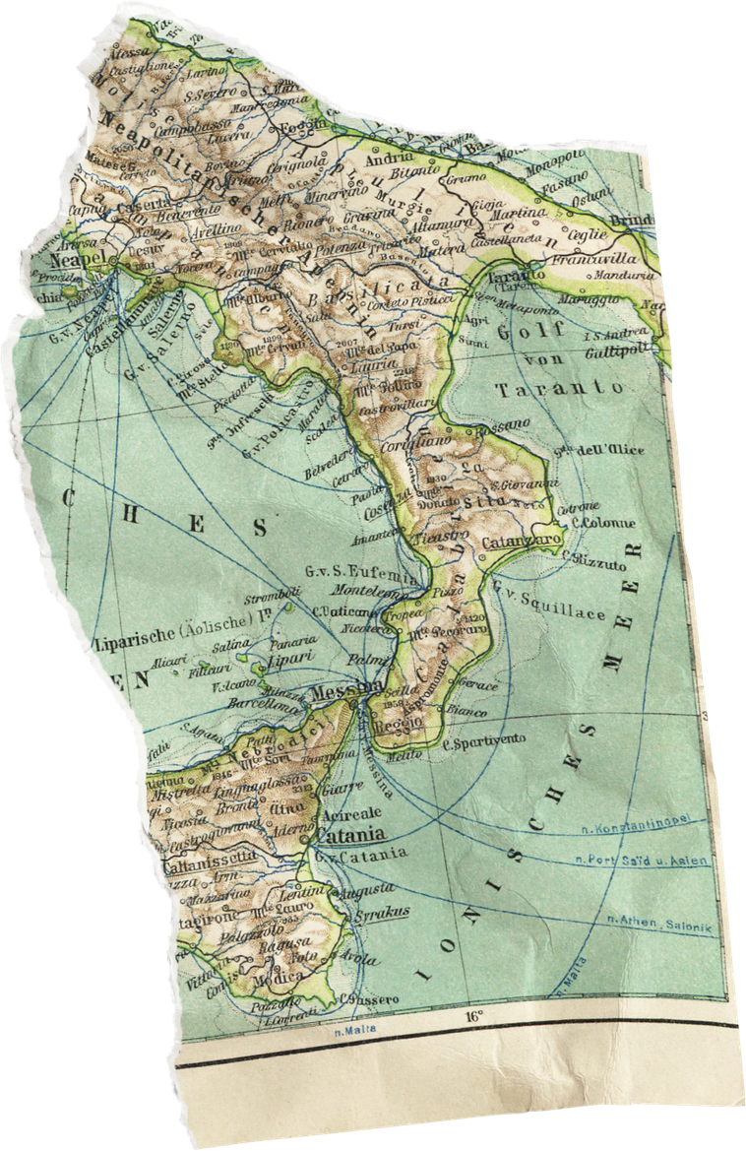
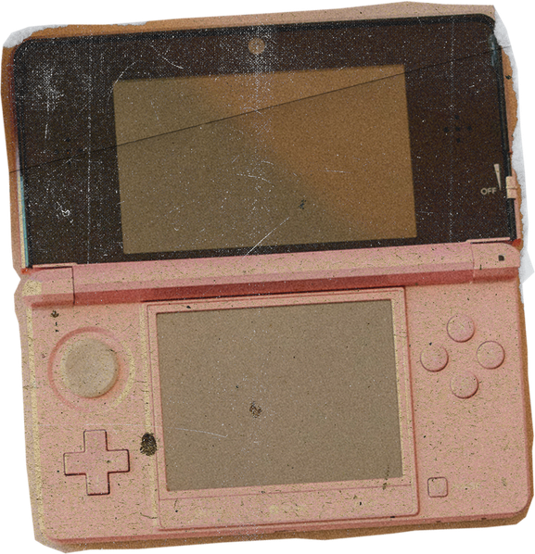

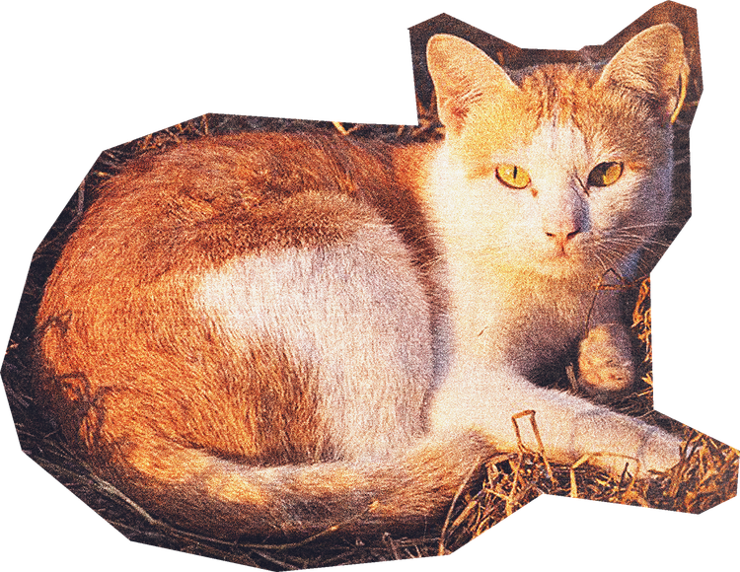
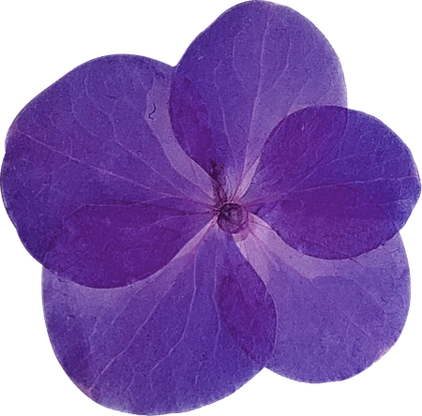








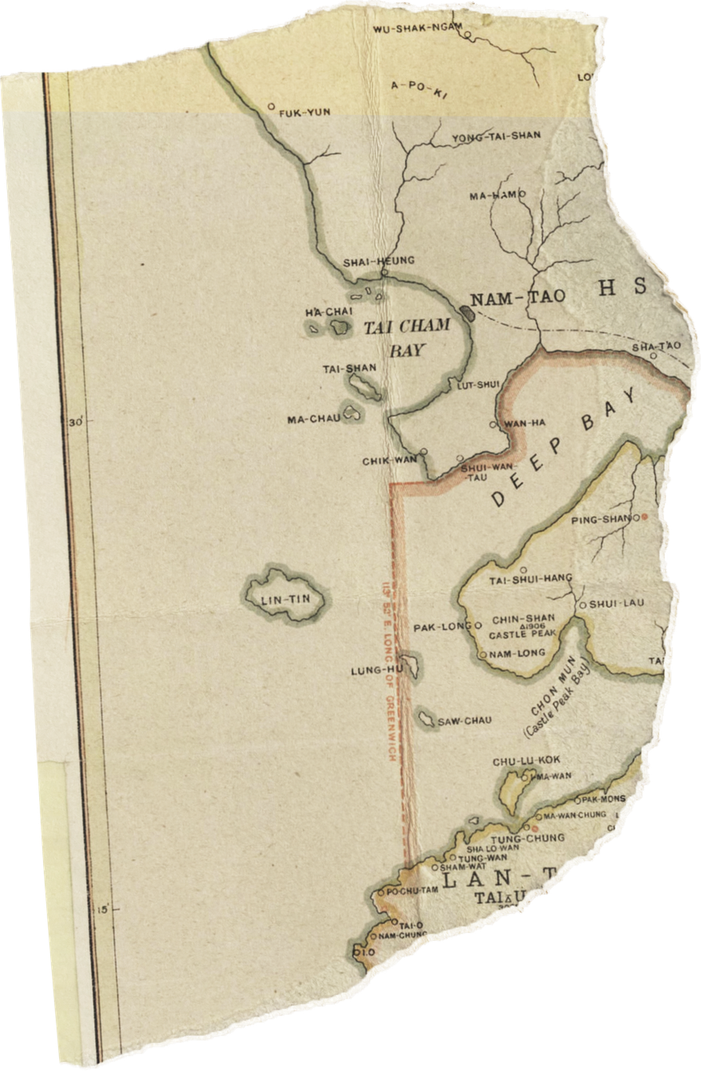



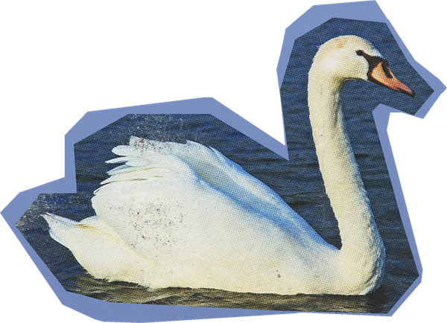
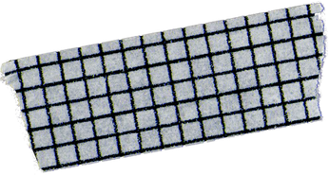
The Art of

Slide 2
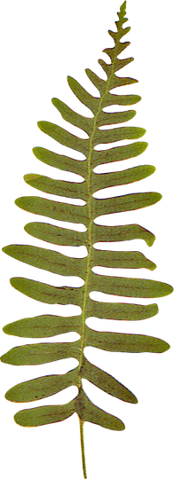

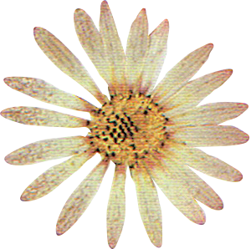
WHAT IS A COLLAGE?
Lesson Outline
WHAT MAKES A GOOD COLLAGE?
HOW TO MAKE A COLLAGE
COLLAGE ACTIVITY

Slide 3
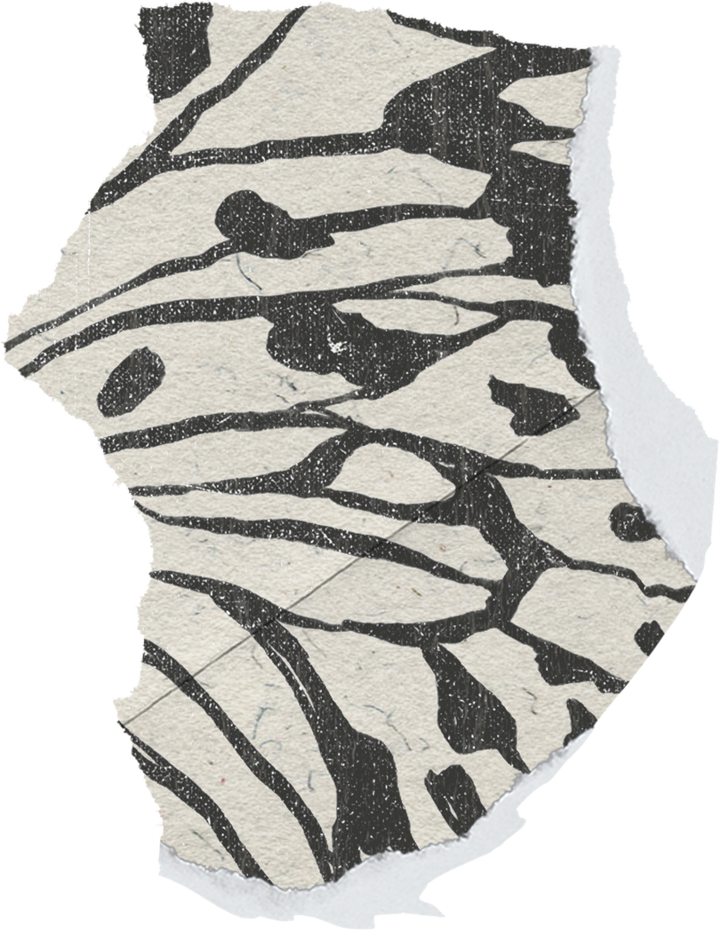
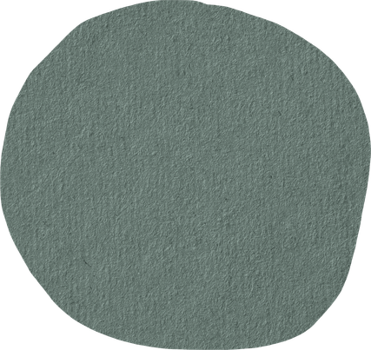

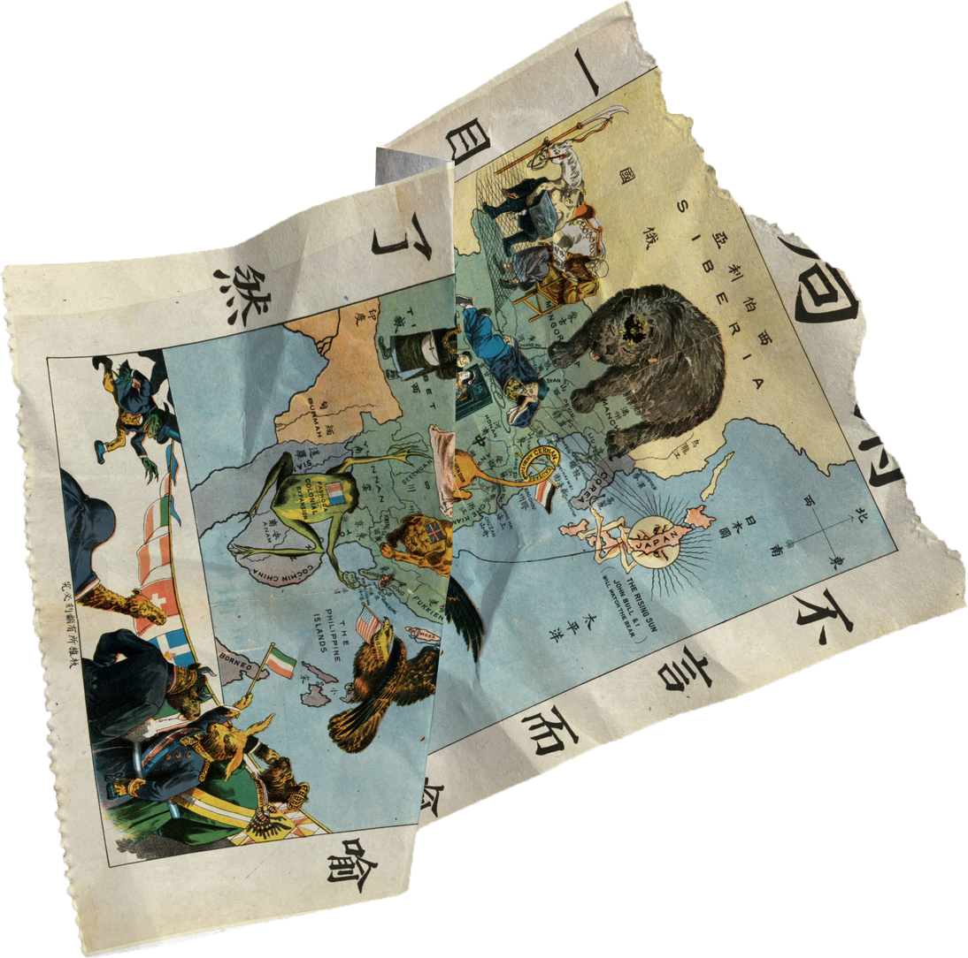
Learning Outcomes
  By the end of this lesson, you should be able to:
  Identify the visual characteristics of a collage
  Understand the process of making a collage

Slide 4
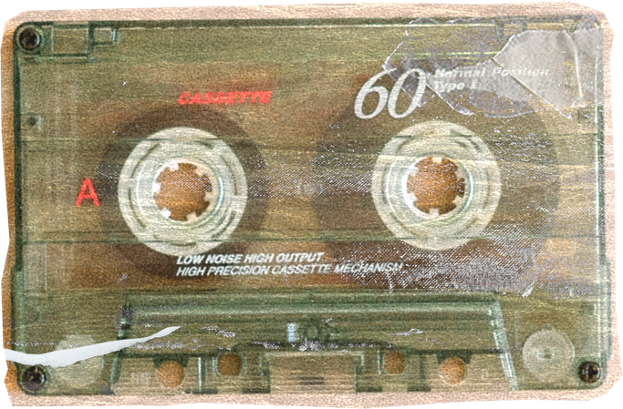
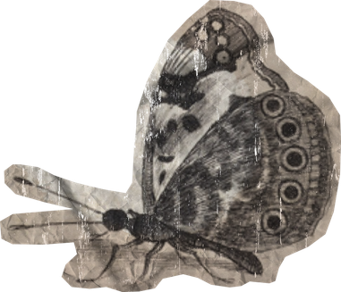
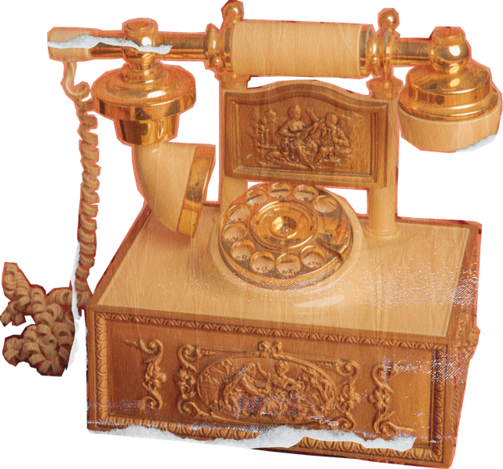
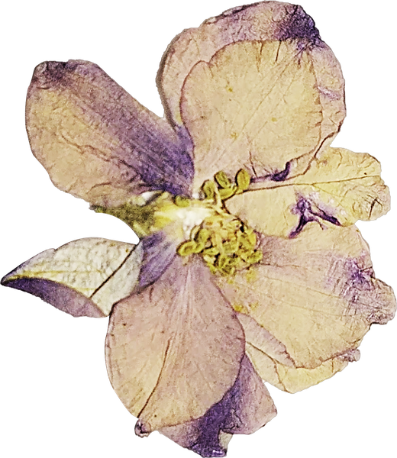
What is a collage?
  Collage is the art of layering different materials by arranging and sticking them onto a supporting surface.
  These materials can include paper, photographs, fabric or found objects like leaves or flowers.

Slide 5

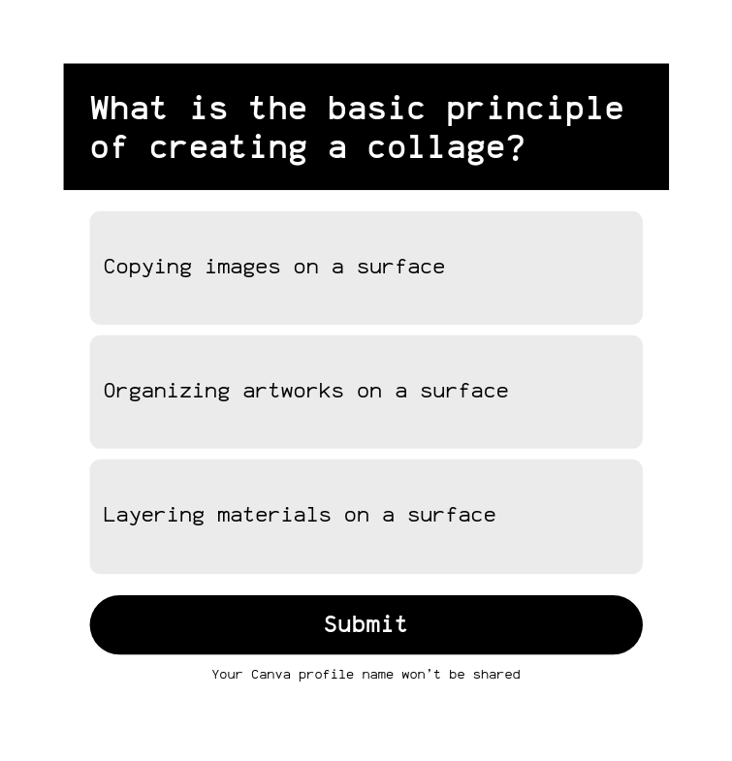
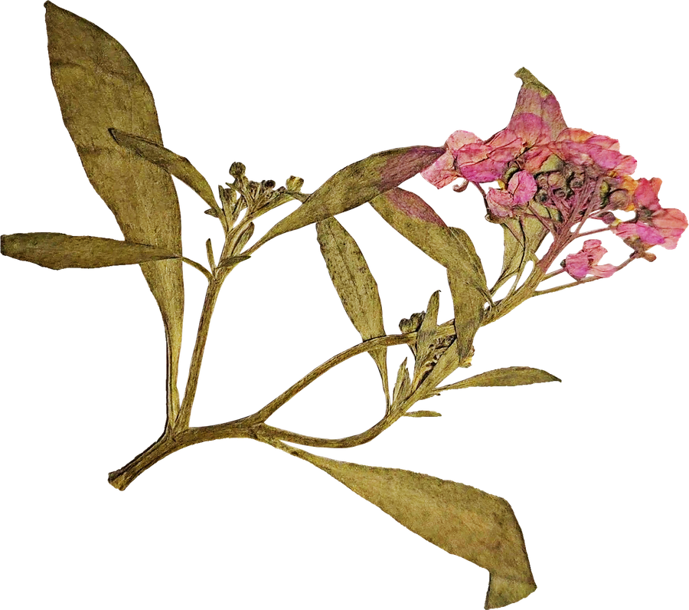
Knowledge Check
Test your understanding
  by answering the quiz
  Teacher Tip: Double-click to customize this poll or quiz, or go to the Elements Tab for more options!

Slide 6
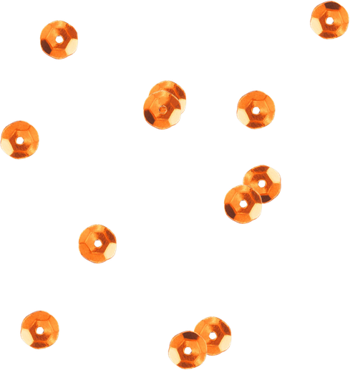
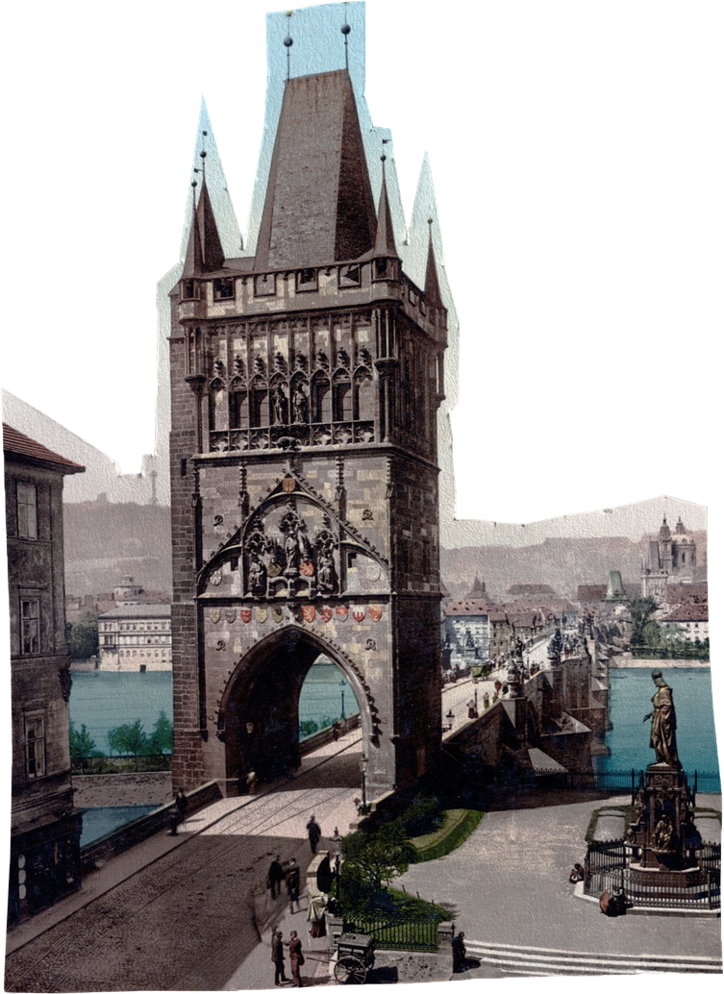

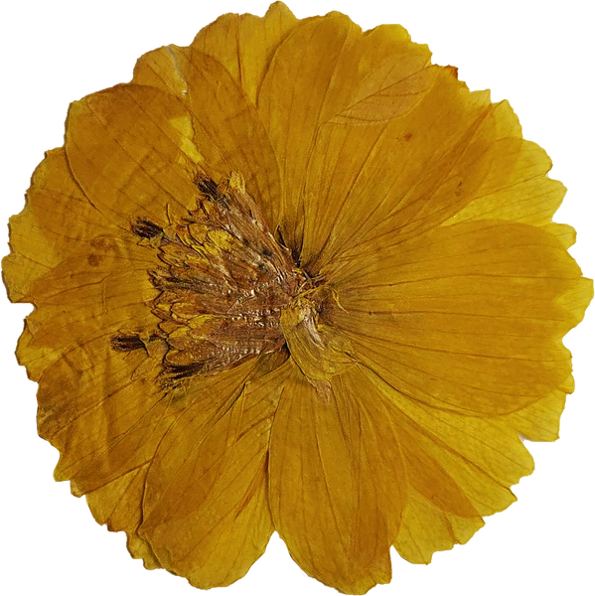
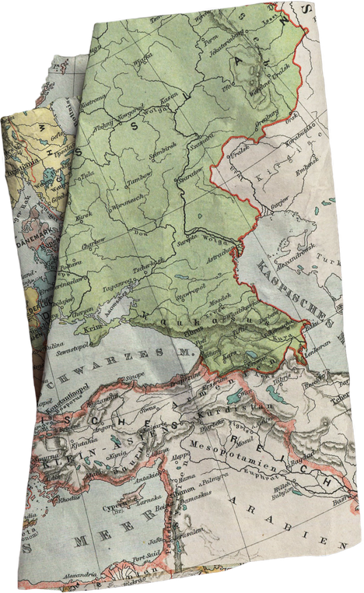



What makes a good collage?
  A successful collage considers its composition. When making a collage, ask yourself, does the collage have:
  Balance
  A focal point
  Negative space

Slide 7


Focal Point
Negative Space
Balance
  Balance refers to how evenly objects are placed.
  Ask yourself:
  Are the colours and shapes spread evenly across a page or are they concentrated?
Focal point refers to where the eye is drawn to in an artwork.
Ask yourself:
  Where is your eye drawn to in the artwork?
Negative space refers to the space around an object.
Ask yourself:
  Is the space empty intentionally or is it filled and busy?

Slide 8




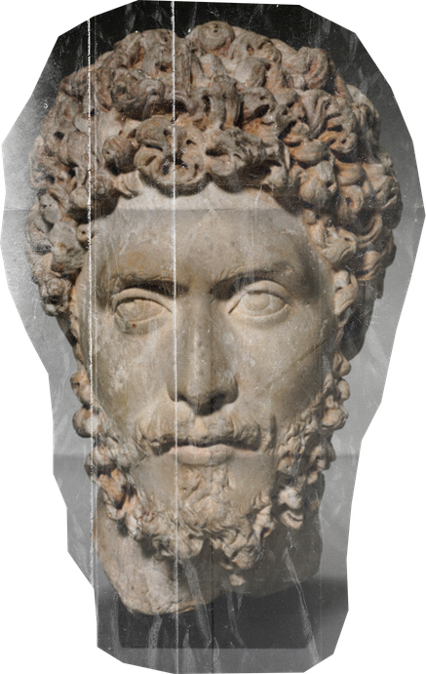
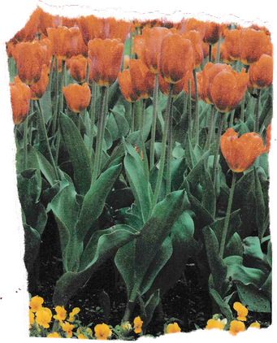
  Class discussion:
  Where can you see balance,focal point and negative space in this collage?

Slide 9
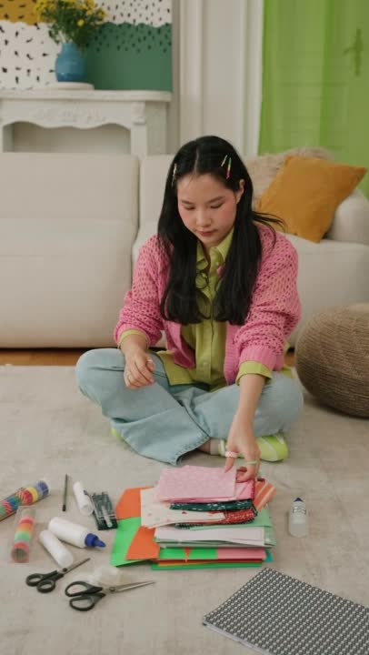


How to make a collage
  Prepare your collage materials:
  Paper
  Pencil/Markers
  Glue

Slide 10
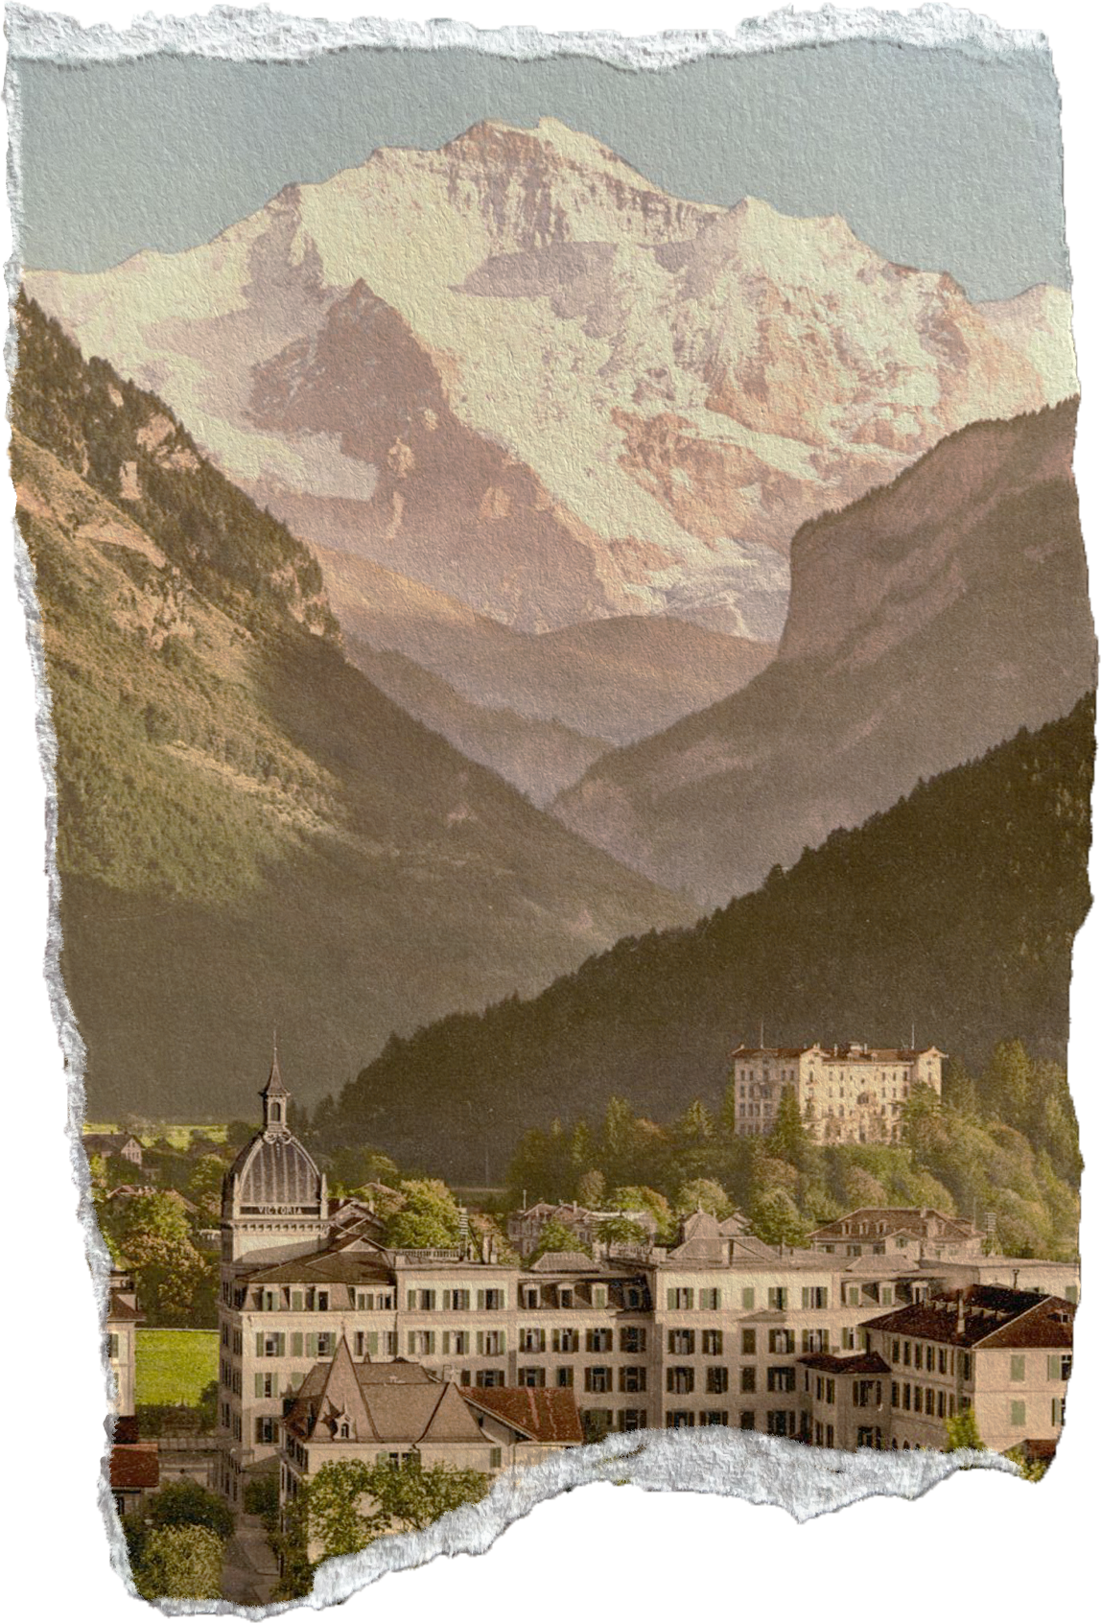

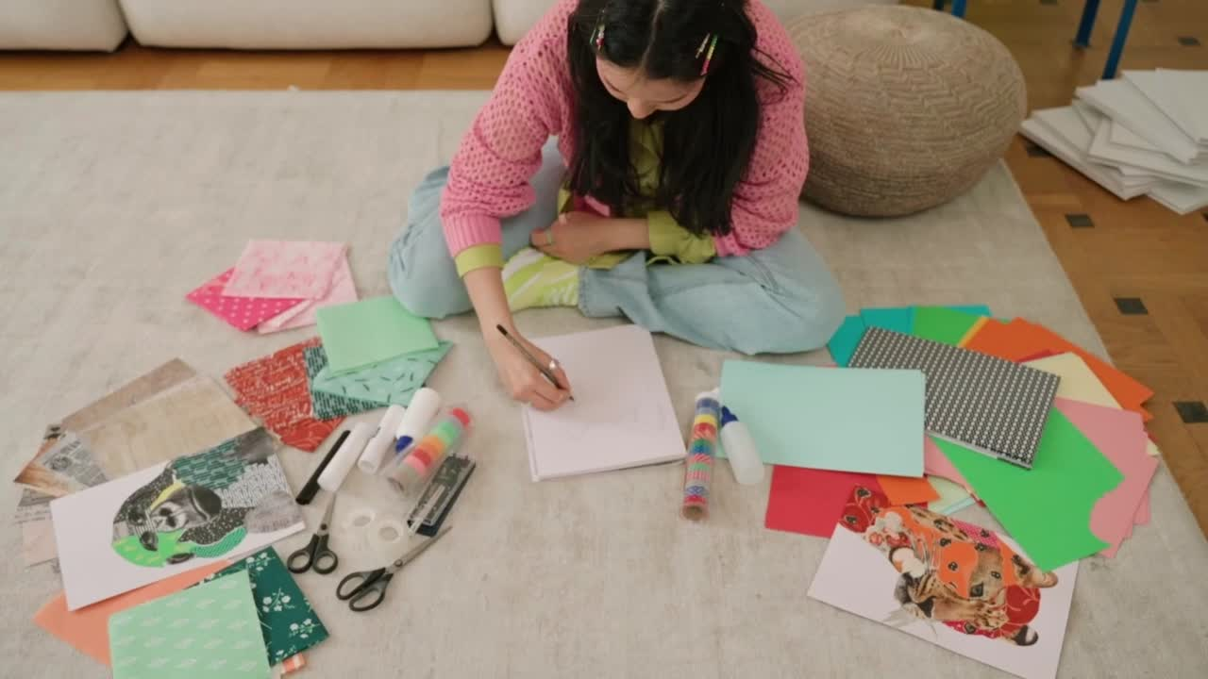
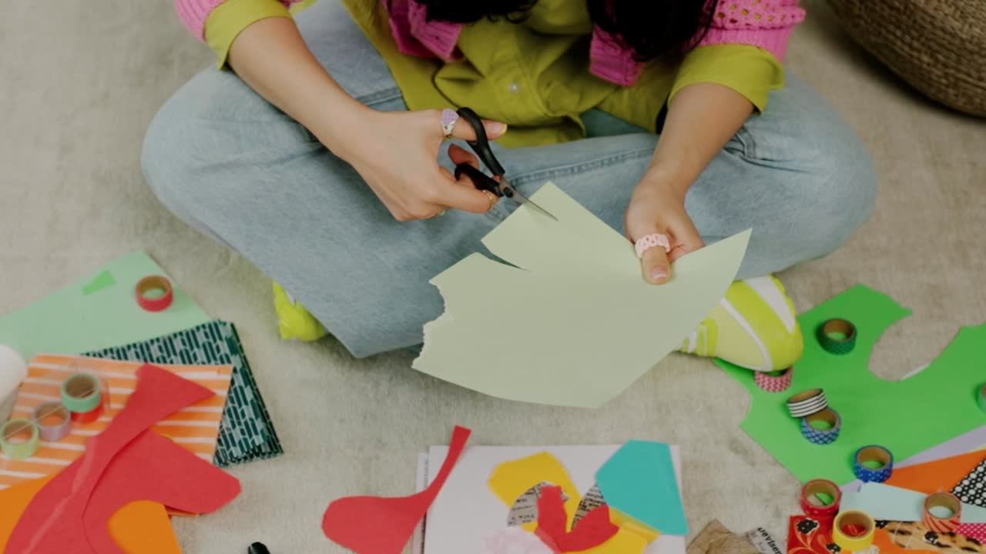

1
2
Plan your collage by drawing out what shapes you want to include on your collage.
  Trace and cut out your shapes on coloured paper.

Slide 11

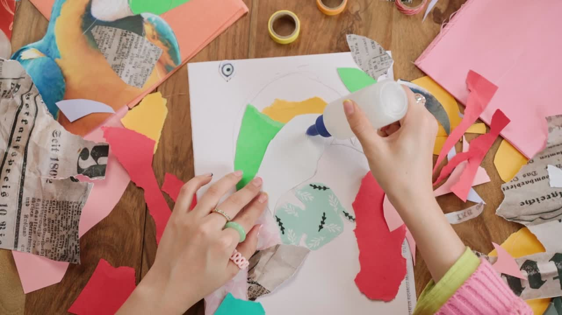
  Arrange your collage shapes onto a piece of background paper.
  TIP 1: Use complementary colours so your shapes stand out on their background.
TIP 2: Remember to consider the following when creating your collage:
  Balance
  A focal point
  Negative space
3

Slide 12
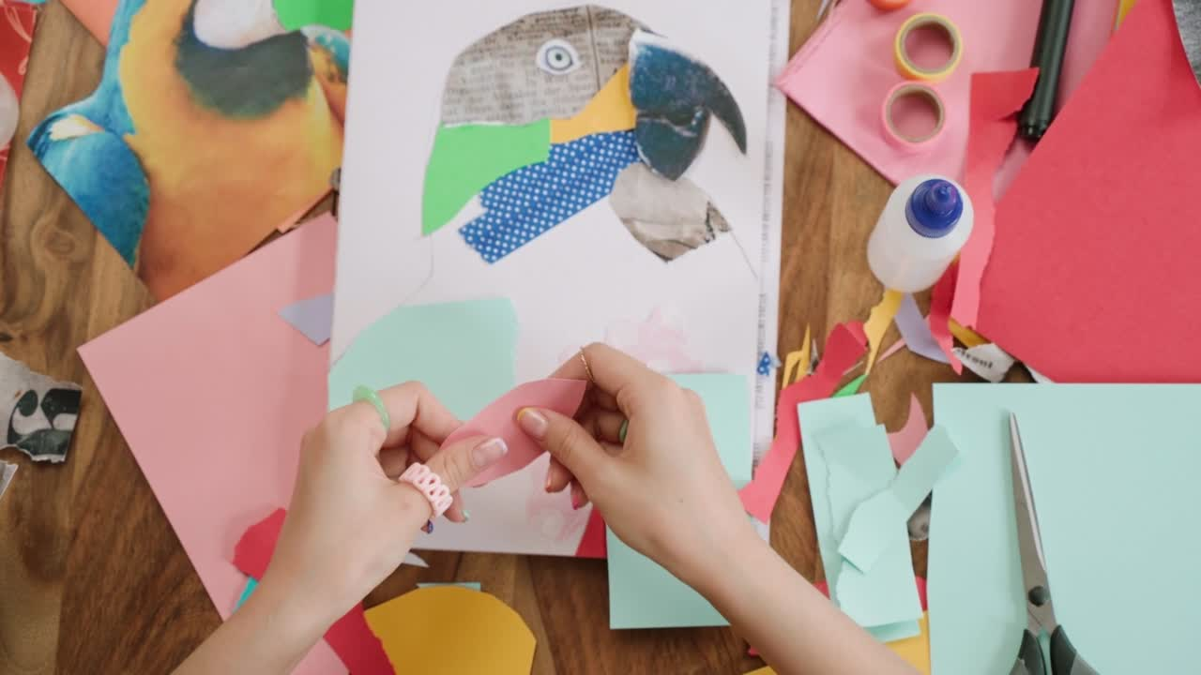
4
Glue down the shapes when you are happy with the arrangement.
You're finished!

Slide 13
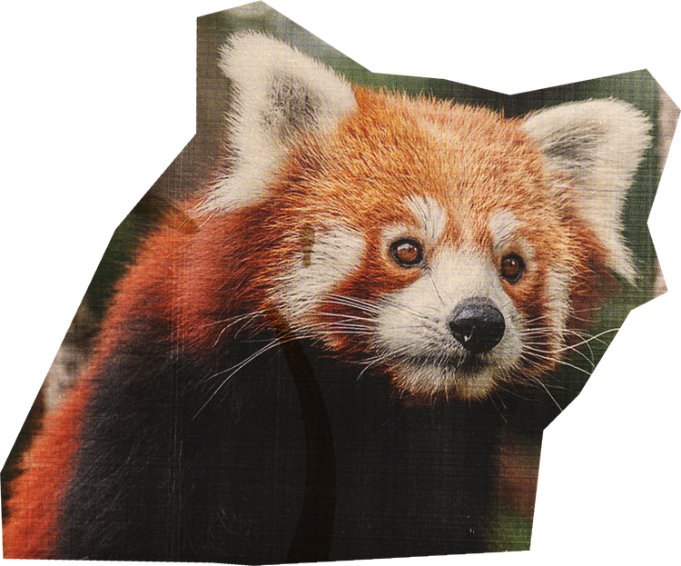
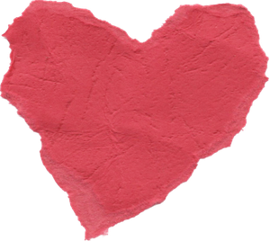
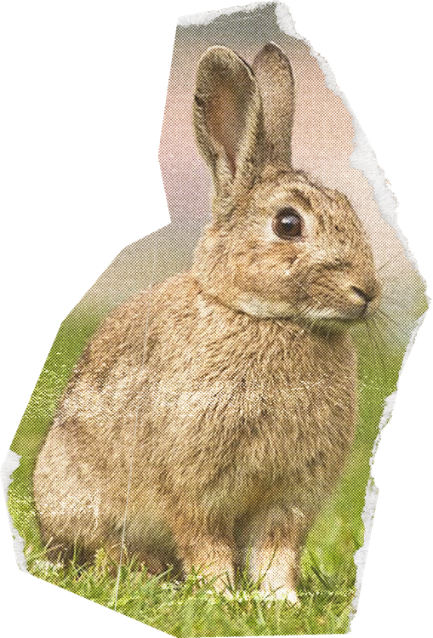
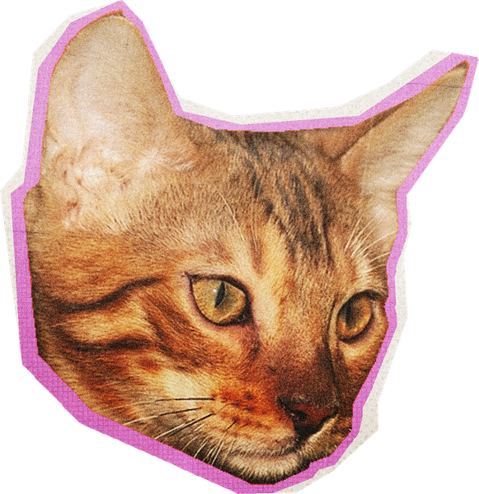
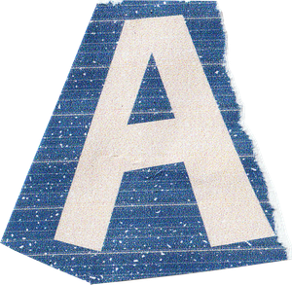
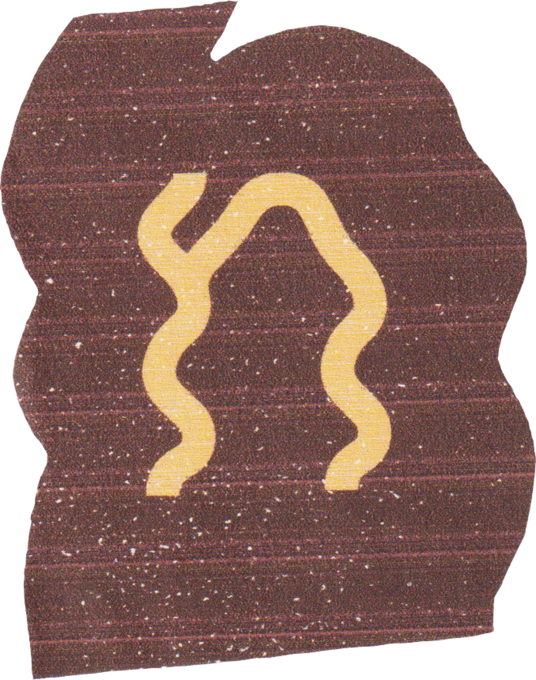


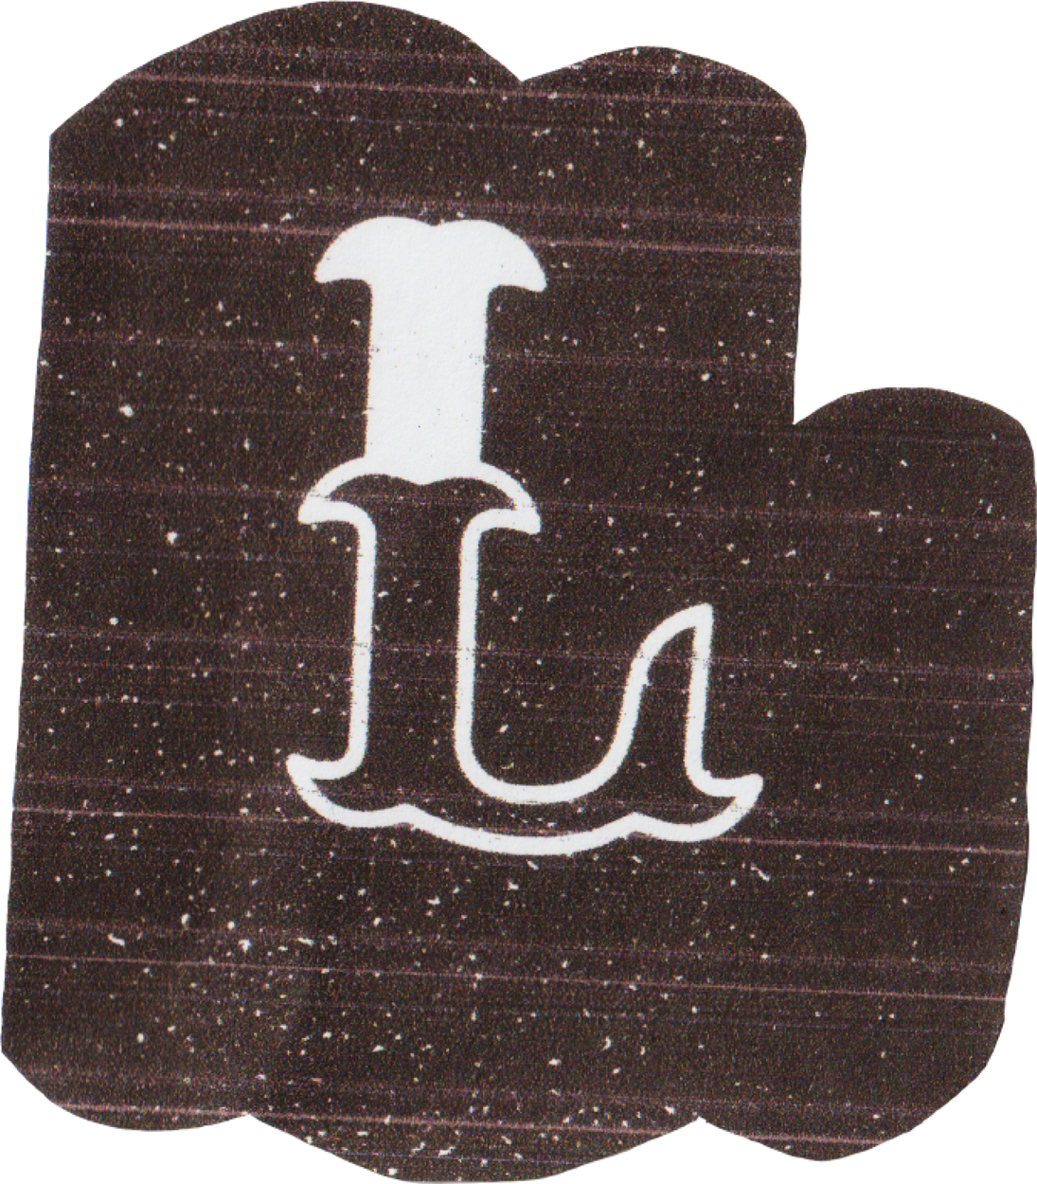
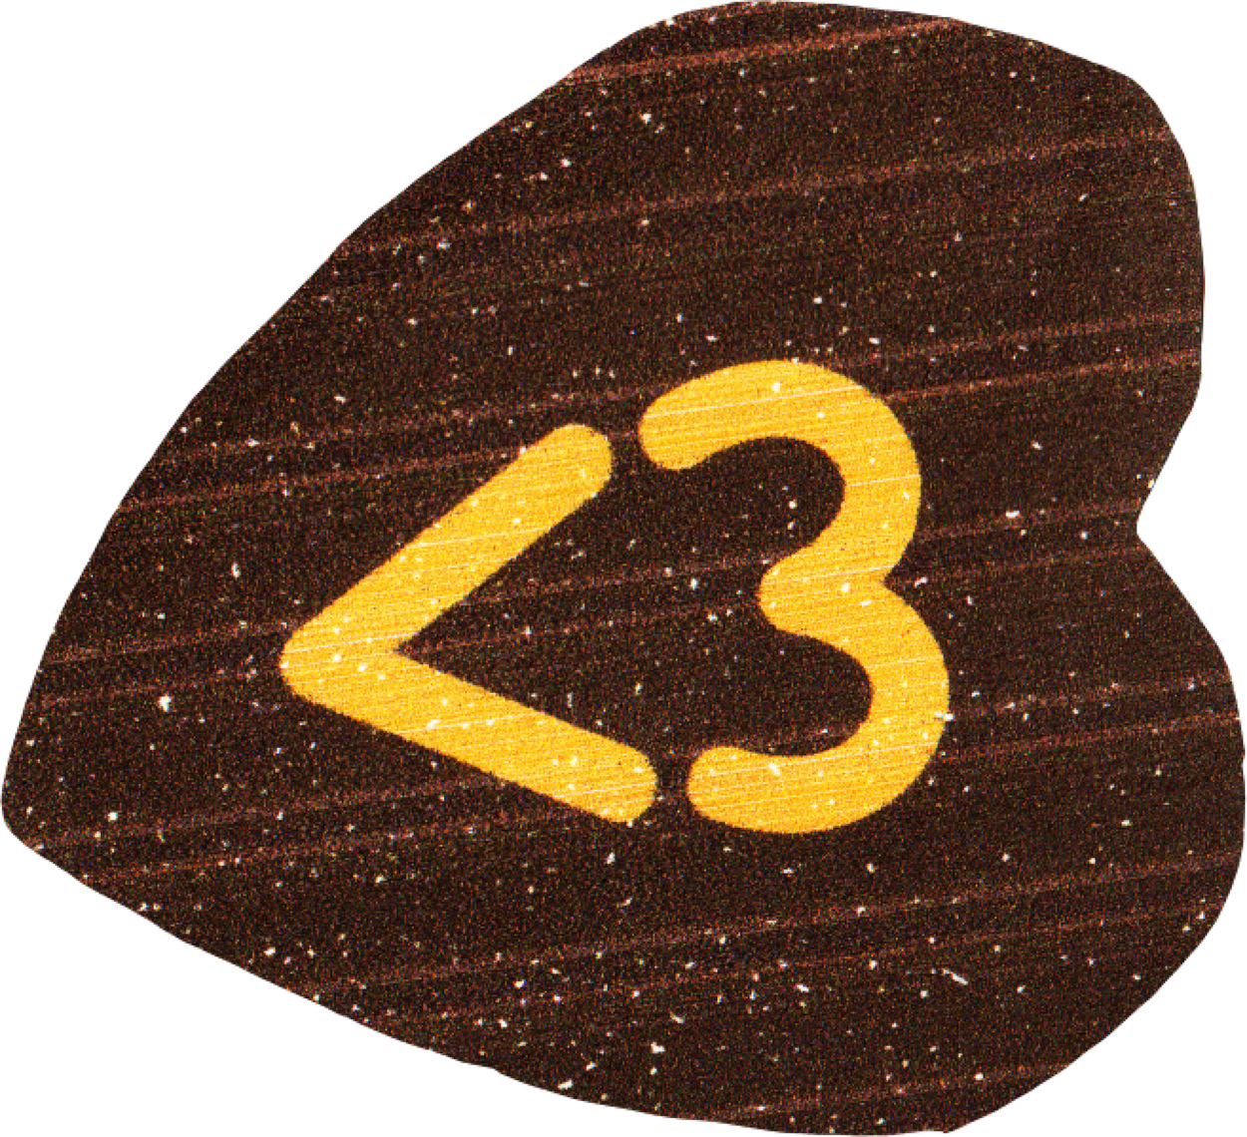
Your turn!
Create a collage of an animal of your choice.
Requirements:
  Use materials including paper, photographs, fabric, found objects, paint or oil pastels in your collage.
  Add text using newspaper or magazine cut outs.

Slide 14
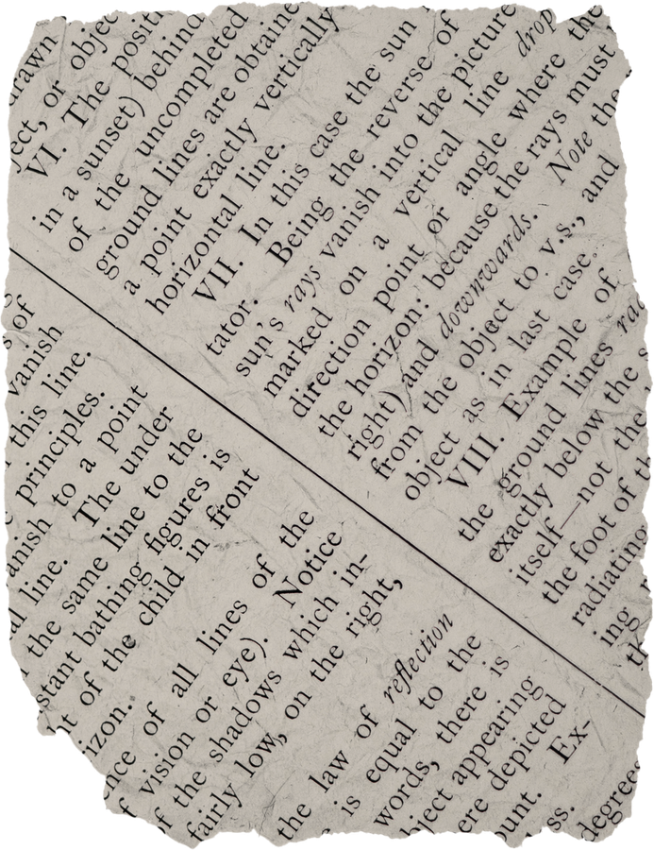
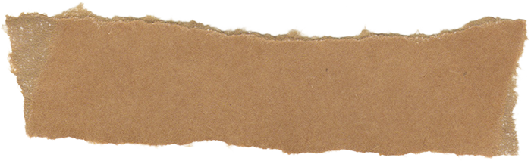
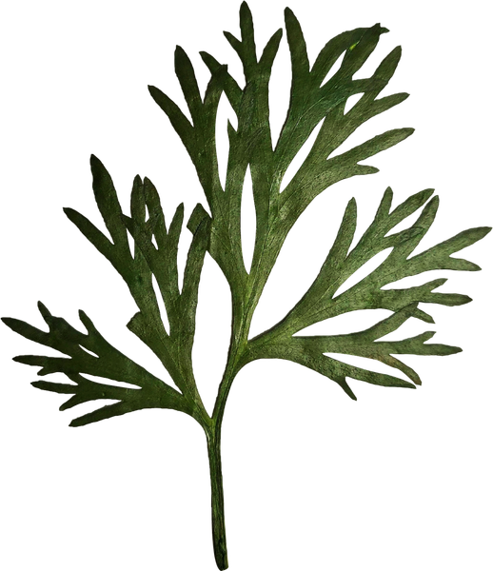
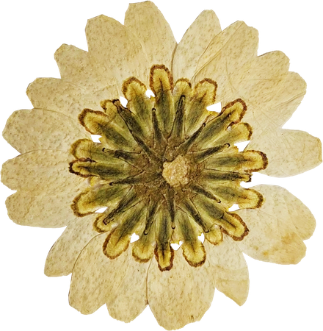
References
Add your references here

Slide 15
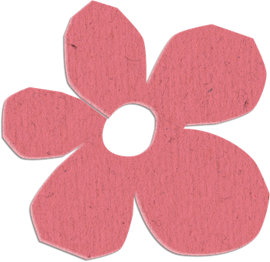
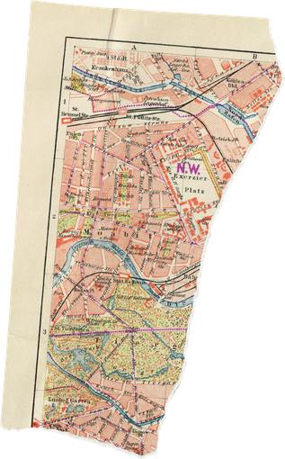
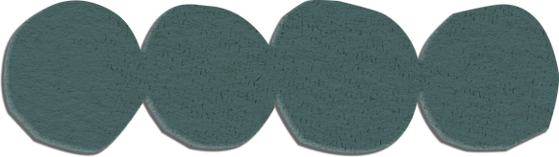


Resource Page
Use these icons and illustrations in your Canva Presentation. Happy designing! Don't forget to delete this page before presenting.
set:nAFG073yTBM
set:nAEkqdcWKXw
set:nAFMR6HoY8s

Slide 16


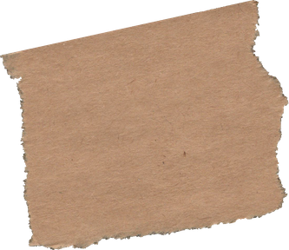
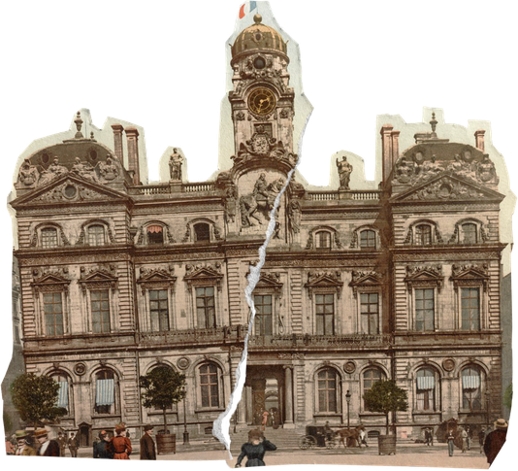


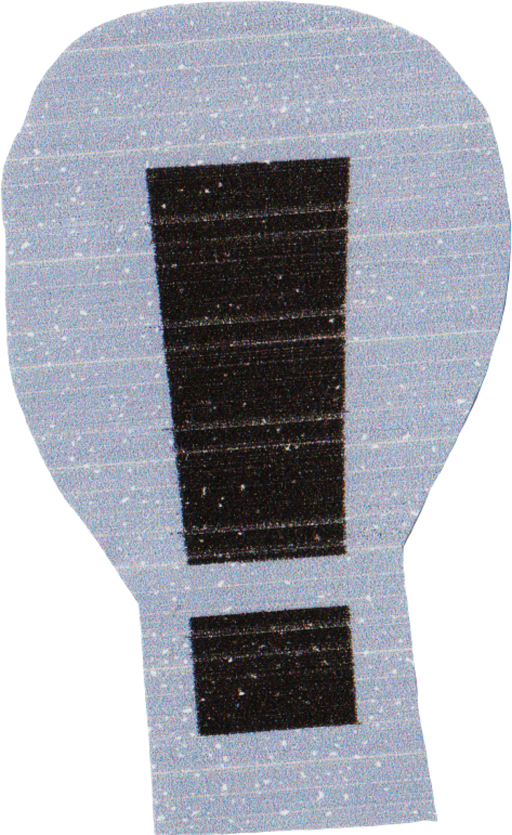



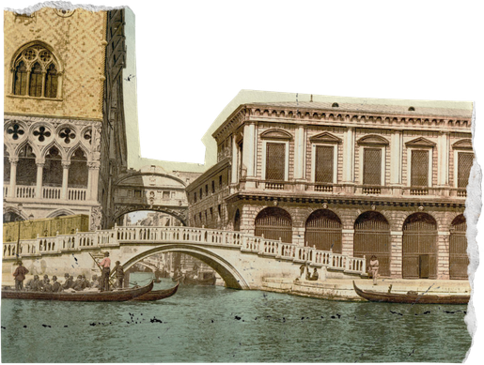

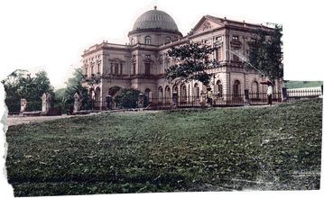
Resource Page
Use these icons and illustrations in your Canva Presentation. Happy designing! Don't forget to delete this page before presenting.
set:nAEx14Evn9k
set:nAFNegY_3-o
set:nAEx14Evn9k

Slide 17






  Try this background for online class.
  *Please delete this section before downloading.

Slide 18
B for blur | C for confetti
D for a drumroll | M for mic drop
O for bubbles | Q for quiet
U for unveil | Any number from 0-9 for a timer
Press these keys while on Present mode!

