Slide 1


Lawyer Presentation Template
www.reallygreatsite.com
law
YER
The law is something that must be enforced, so we are a leading law firm that will always prioritize results and professionalism

Slide 2

intro
duction
A presentation is a formal or informal communication method that involves conveying information, ideas, or a message to an audience. It often employs visual aids such as slides, charts, graphs, or multimedia elements to support and enhance the spoken content.
A presentation is a formal or informal communication method that involves conveying information, ideas, or a message to an audience.
The law is reason, free from passion

Slide 3

areas of
Ignorance of the law excuses no one
Expertise
A presentation is a formal or informal communication method that involves conveying information, ideas, or a message to an audience.
A presentation is a formal or informal communication method that involves conveying information, ideas, or a message to an audience. It often employs visual aids such as slides, charts, graphs, or multimedia elements to support and enhance the spoken content.
A presentation is a formal or informal communication method that involves conveying information, ideas, or a message to an audience.

Slide 4

why
Choose Us
A presentation is a formal or informal communication method that involves conveying information, ideas, or a message to an audience.
A presentation is a formal or informal communication method that involves conveying information, ideas, or a message to an audience. It often employs visual aids such as slides, charts, graphs, or multimedia elements to support and enhance the spoken content.
The first duty of society is justice

Slide 5

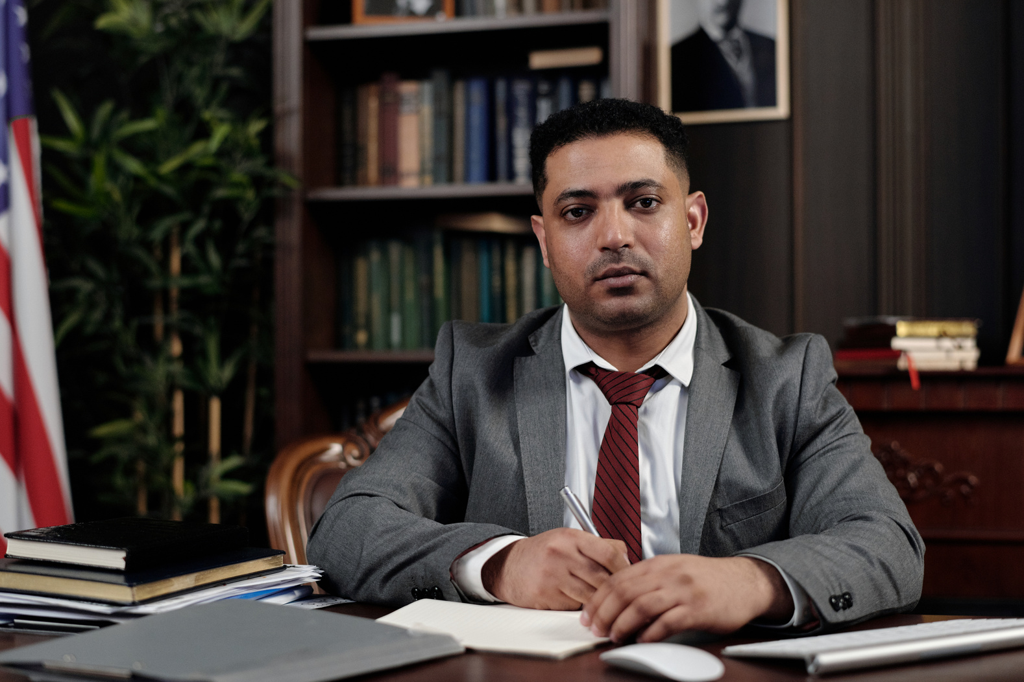

Juliana Silva
Aaron Loeb
Olivia Wilson
Senior Lawyer
Senior Lawyer
Senior Lawyer
our
team
Justice delayed is justice denied

Slide 6
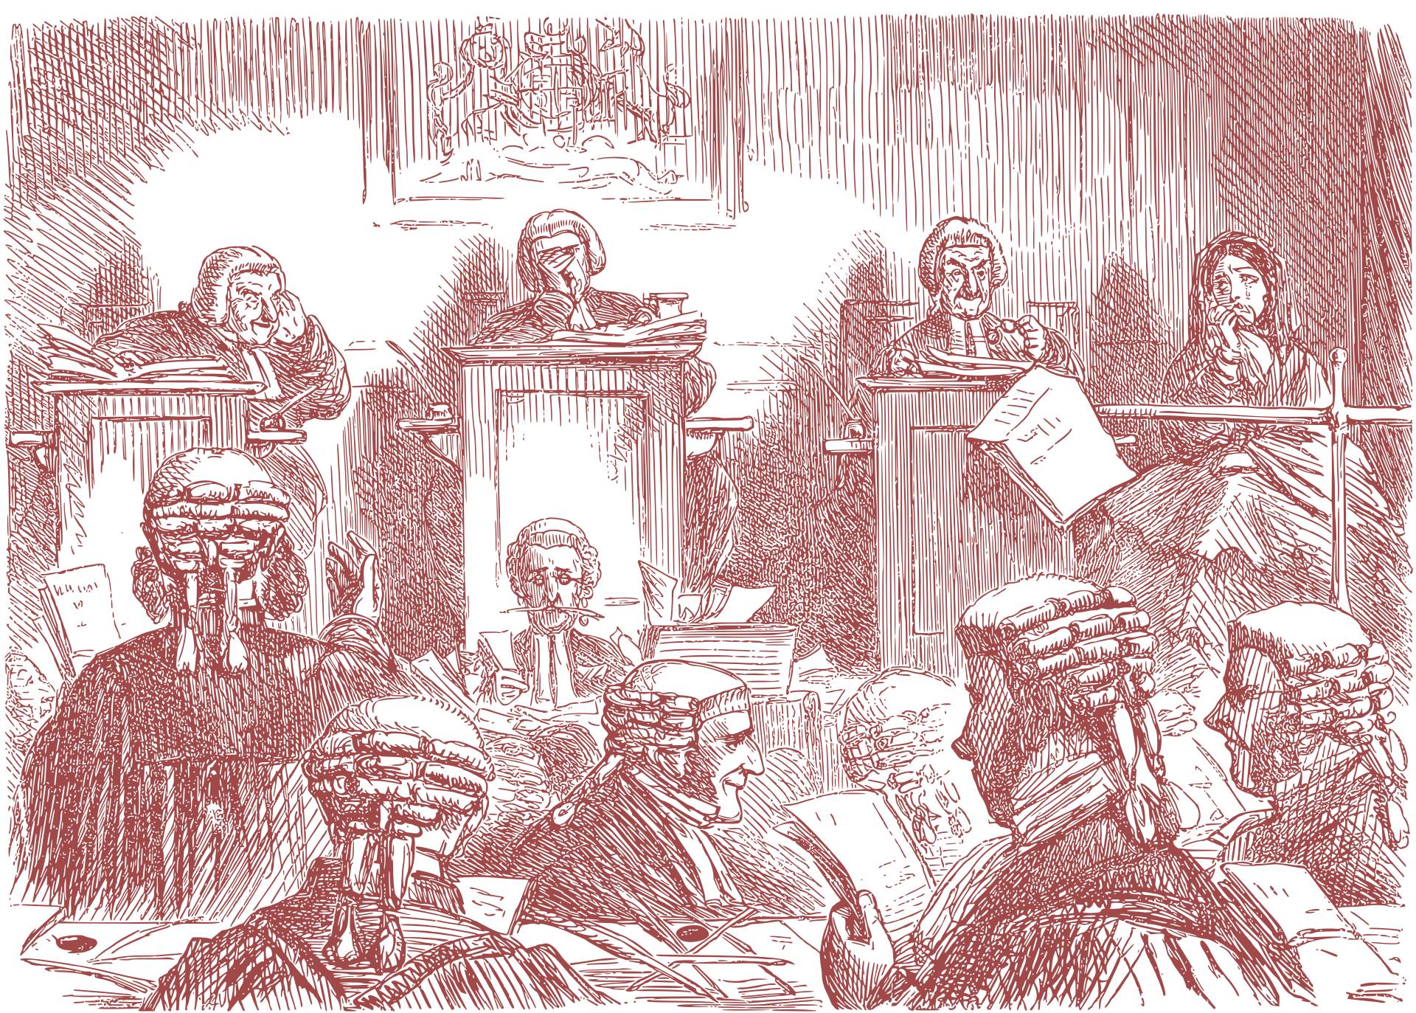
case
Management
A presentation is a formal or informal communication method that involves conveying information, ideas, or a message to an audience. It often employs visual aids such as slides, charts, graphs, or multimedia elements to support and enhance the spoken content.
A presentation is a formal or informal communication method that involves conveying information, ideas, or a message to an audience. It often employs visual aids such as slides, charts, graphs, or multimedia elements to support and enhance the spoken content.

Slide 7

A presentation is a formal or informal communication method that involves conveying information, ideas, or a message to an audience. It often employs visual aids such as slides, charts, graphs, or multimedia elements to support and enhance the spoken content.
client success
Stories
Claudia Alves
CEO of Studio Shodwe

Slide 8

legal
Resources
A presentation is a formal or informal communication method that involves conveying information, ideas, or a message to an audience. It often employs visual aids such as slides, charts, graphs, or multimedia elements to support and enhance the spoken content.
The good of the people is the greatest law

Slide 9
benefits of
Our Services
A presentation is a formal or informal communication method that involves conveying information, ideas, or a message to an audience.
A presentation is a formal or informal communication method that involves conveying information, ideas, or a message to an audience.
A presentation is a formal or informal communication method that involves conveying information, ideas, or a message to an audience.
A presentation is a formal or informal communication method that involves conveying information, ideas, or a message to an audience.

Slide 10

let us
Represent You
The law is reason, free from passion

Slide 11
get in
touch
Justice delayed is justice denied
E-mail
hello@reallygreatsite.com
Website
www.reallygreatsite.com
Phone
+123-456-7890
Address
123 Anywhere St., Any City, ST 12345
THANK YOU FOR YOUR ATTENTION

