Slide 1

DIGITAL MARKETING FOR REAL ESTATE
FREE PRESENTATION TEMPLATE

Slide 2
Welcome to the world of fantasy! Join us on a journey to explore the mystical creatures, enchanted lands, and magical wonders that exist beyond our reality. Discover the wonders and secrets of this exciting realm and unlock the power of imagination.
WELCOME

Slide 3
TABLE OF CONTENTS
01
INTRODUCTION
02
MARKET ANALYSIS
The Extraordinary Realm
Unicorn Sightings
03
TARGET AUDIENCE
04
STRATEGY
Wishes Granted
Spellcasting
05
ANALYTICS
06
CONCLUSION
Happily Ever After
Embrace the Fantasy

Slide 4

INTRODUCTION
The Fantasy Realm: Uncovering the Secrets of the Imagination and the Magic that Lies Within

Slide 5
THE REALM OF THE EXTRAORDINARY
Welcome to the Fantasy World, a realm of wonder and enchantment where anything is possible. Here, dragons breathe fire, unicorns prance through meadows, and rainbows shine brightly. This world is a place where wishes come true, where potions can be cursed and spells are cast. It's a place of treasure and adventure, where the impossible becomes possible. But the greatest treasure of all is the one that lies within.
The world of fantasy is a reflection of our deepest desires, our fondest dreams, and our wildest imaginations. It's a place where we can let go of the constraints of reality and explore the boundless possibilities of the human mind. In this introduction, we will delve into the mysteries of this realm, uncovering the magic and wonder that lies within. So come with us and let's embark on a journey through the Fantasy World.

Slide 6




MARKET ANALYSIS
UNICORN SIGHTINGS
A record of the number of unicorns spotted in the fantasy realm and the beauty and mystery that surrounds these enchanting creatures.
DRAGON TAMING
A closer look at the art of taming dragons and the brave adventurers who dare to take on these fearsome creatures.

Slide 7




UNICORN SIGHTINGS
DRAGON TAMING
A record of the number of unicorns spotted in the fantasy realm and the beauty and mystery.
A closer look at the art of taming dragons and the brave adventurers who dare to take on these creatures.

Slide 8

FANTASY IS THE GATEWAY TO THE IMPOSSIBLE, THE LAND WHERE THE ORDINARY BECOMES EXTRAORDINARY, AND THE IMPOSSIBLE BECOMES POSSIBLE. IT IS THE REALM OF THE IMAGINATION, WHERE ANYTHING CAN HAPPEN AND EVERYTHING IS POSSIBLE.
THE DREAM WEAVER

Slide 9




High Quality
Celestial Plains
Crystal Caves
Mirrored Lake
Low Price
High Price
Lost City
Enchanted Forest
Treasures
Low Quality

Slide 10



THE MAGIC OF DRAGONS:
A RESEARCH
6.7M
"The Art of Archery": Discover the intricacies of the Art of Archery as practiced by the graceful and precise elves.
4.4M
2.3M
"The Music of the Elves": Immerse yourself in the enchanting music of the elves, whose songs have the power to heal.

Slide 11

TARGET AUDIENCE

Slide 12

THE ENCHANTED FOREST
A magical forest filled with talking animals and enchanted creatures.
THE CRYSTAL CAVES
A network of underground caves filled with precious gems and crystals.
THE DRAGON'S LAIR
A dangerous and mysterious place where dragons reside.
AUDIENCE

Slide 13
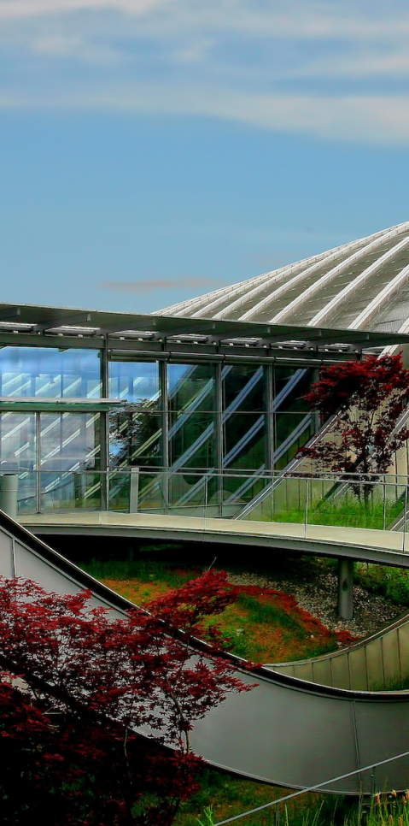

SOME DATA
75%
ENCHANTED CREATURES
possess the ability to cast spells.
MAGIC-WIELDING INDIVIDUALS
60%
practice the art of illusions.
90%
SPELLS CAST
are dark magic, foretelling danger.

Slide 14
234,567
UNICORN SIGHTINGS
A tally of the number of unicorns spotted in the fantasy realm.

Slide 15

STRATEGY

Slide 16


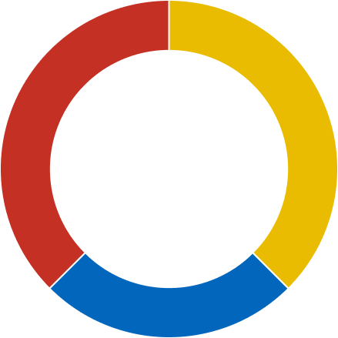


SOME GRAPH
100
90
80
70
60
50
34.574
40
Total
30
20
10
0
1
2
3
4
5
6
7
8
SPELLCASTING PROGRESS
TREASURE FOUND
A record of the number of spells cast per year
A record of the amount of treasure found per month

Slide 17


PORTAL TO ADVENTURE
A WEB APPLICATION
A web application designed for discovering the world of fantasy

Slide 18


THE FUTURE OF FANTASY
AN MOBILE APP
An app designed for exploring and experiencing the enchanting realm of fantasy
  Explore a magical world
  Experience fantasy firsthand
  Immerse in a realm of magic
  Discover untold wonders
  Live your fantasy dreams

Slide 19

ANALYTICS

Slide 20



12
10
A
8
6
B
C
4
2
0
2015
2016
2017
2018
2019
2020
2021

Slide 21

1
DISCOVER THE SECRETS
Explore the lush, vibrant forest and uncover the mysteries that lie within.
2
FIND YOUR OWN PATH
Choose your own path through the forest, and see where it takes you.

Slide 22
2015
2015
2015
2015
ECLIPSE
WAR
OBTAIN
FOUNDATION
A rare eclipse occurs, causing strange and unpredictable magical effects.
An elf helps humans obtain the Crystal of the Unicorn from the Elven Forest.
A volcanic eruption devastates a nearby city, forcing its inhabitants.
The civilization of the Shimmering City is founded by a group of powerful wizards.
A group of adventurers sets out to recover an ancient artifact.
An elf helps humans obtain the Crystal of the Unicorn from the Elven Forest.
An elf helps humans obtain the Crystal of the Unicorn from the Elven Forest.
The civilization of the Shimmering City is founded by a group of powerful wizards.

Slide 23




THE PRICE
BASIC
ELITE
LEGENDARY
  Access to the entry-level dungeons.
  A limited number of quests and battles per month.
  Ability to form a small party with fellow adventurers.
  Access to the intermediate and advanced dungeons.
  A greater number of quests and battles
  Ability to form larger parties with fellow adventurers.
  Access to the most challenging dungeons and encounters.
  Unlimited quests and battles per month.
  The ability to form the largest parties with fellow adventurers.
$10/MONTH
$50/MONTH
$100/MONTH

Slide 24
Welcome to the world of fantasy! Join us on a journey to explore the mystical creatures, enchanted lands, and magical wonders that exist beyond our reality. Discover the wonders and secrets of this exciting realm and unlock the power of imagination.
CONCLUSION

Slide 25





THANK YOU FOR CHOOSING EATEMP
We offer free and high-quality slides templates for your presentations. We appreciate you choosing us and hope our templates have been helpful.
As a new website, we rely on your support to grow, so please help us by sharing our site with your friends and colleagues.
eatemp._
@eatemp
eatempofficial
@eatemp.official

Slide 26
DIGITAL MARKETING FOR REAL ESTATE
FREE PRESENTATION TEMPLATE

Slide 27
Welcome to the world of fantasy! Join us on a journey to explore the mystical creatures, enchanted lands, and magical wonders that exist beyond our reality. Discover the wonders and secrets of this exciting realm and unlock the power of imagination.
WELCOME

Slide 28
TABLE OF CONTENTS
01
INTRODUCTION
02
MARKET ANALYSIS
The Extraordinary Realm
Unicorn Sightings
03
TARGET AUDIENCE
04
STRATEGY
Wishes Granted
Spellcasting
05
ANALYTICS
06
CONCLUSION
Happily Ever After
Embrace the Fantasy

Slide 29
INTRODUCTION
The Fantasy Realm: Uncovering the Secrets of the Imagination and the Magic that Lies Within

Slide 30
THE REALM OF THE EXTRAORDINARY
Welcome to the Fantasy World, a realm of wonder and enchantment where anything is possible. Here, dragons breathe fire, unicorns prance through meadows, and rainbows shine brightly. This world is a place where wishes come true, where potions can be cursed and spells are cast. It's a place of treasure and adventure, where the impossible becomes possible. But the greatest treasure of all is the one that lies within.
The world of fantasy is a reflection of our deepest desires, our fondest dreams, and our wildest imaginations. It's a place where we can let go of the constraints of reality and explore the boundless possibilities of the human mind. In this introduction, we will delve into the mysteries of this realm, uncovering the magic and wonder that lies within. So come with us and let's embark on a journey through the Fantasy World.

Slide 31
MARKET ANALYSIS
UNICORN SIGHTINGS
A record of the number of unicorns spotted in the fantasy realm and the beauty and mystery that surrounds these enchanting creatures.
DRAGON TAMING
A closer look at the art of taming dragons and the brave adventurers who dare to take on these fearsome creatures.

Slide 32
UNICORN SIGHTINGS
DRAGON TAMING
A record of the number of unicorns spotted in the fantasy realm and the beauty and mystery.
A closer look at the art of taming dragons and the brave adventurers who dare to take on these creatures.

Slide 33
FANTASY IS THE GATEWAY TO THE IMPOSSIBLE, THE LAND WHERE THE ORDINARY BECOMES EXTRAORDINARY, AND THE IMPOSSIBLE BECOMES POSSIBLE. IT IS THE REALM OF THE IMAGINATION, WHERE ANYTHING CAN HAPPEN AND EVERYTHING IS POSSIBLE.
THE DREAM WEAVER

Slide 34
High Quality
Celestial Plains
Crystal Caves
Mirrored Lake
Low Price
High Price
Lost City
Enchanted Forest
Treasures
Low Quality

Slide 35
THE MAGIC OF DRAGONS:
A RESEARCH
6.7M
"The Art of Archery": Discover the intricacies of the Art of Archery as practiced by the graceful and precise elves.
4.4M
2.3M
"The Music of the Elves": Immerse yourself in the enchanting music of the elves, whose songs have the power to heal.

Slide 36
TARGET AUDIENCE

Slide 37
THE ENCHANTED FOREST
A magical forest filled with talking animals and enchanted creatures.
THE CRYSTAL CAVES
A network of underground caves filled with precious gems and crystals.
THE DRAGON'S LAIR
A dangerous and mysterious place where dragons reside.
AUDIENCE

Slide 38
SOME DATA
75%
ENCHANTED CREATURES
possess the ability to cast spells.
MAGIC-WIELDING INDIVIDUALS
60%
practice the art of illusions.
90%
SPELLS CAST
are dark magic, foretelling danger.

Slide 39
234,567
UNICORN SIGHTINGS
A tally of the number of unicorns spotted in the fantasy realm.

Slide 40
STRATEGY

Slide 41
SOME GRAPH
100
90
80
70
60
50
34.574
40
Total
30
20
10
0
1
2
3
4
5
6
7
8
SPELLCASTING PROGRESS
TREASURE FOUND
A record of the number of spells cast per year
A record of the amount of treasure found per month

Slide 42
PORTAL TO ADVENTURE
A WEB APPLICATION
A web application designed for discovering the world of fantasy

Slide 43
THE FUTURE OF FANTASY
AN MOBILE APP
An app designed for exploring and experiencing the enchanting realm of fantasy
  Explore a magical world
  Experience fantasy firsthand
  Immerse in a realm of magic
  Discover untold wonders
  Live your fantasy dreams

Slide 44
ANALYTICS

Slide 45
12
10
A
8
6
B
C
4
2
0
2015
2016
2017
2018
2019
2020
2021

Slide 46
1
DISCOVER THE SECRETS
Explore the lush, vibrant forest and uncover the mysteries that lie within.
2
FIND YOUR OWN PATH
Choose your own path through the forest, and see where it takes you.

Slide 47
2015
2015
2015
2015
ECLIPSE
WAR
OBTAIN
FOUNDATION
A rare eclipse occurs, causing strange and unpredictable magical effects.
An elf helps humans obtain the Crystal of the Unicorn from the Elven Forest.
A volcanic eruption devastates a nearby city, forcing its inhabitants.
The civilization of the Shimmering City is founded by a group of powerful wizards.
A group of adventurers sets out to recover an ancient artifact.
An elf helps humans obtain the Crystal of the Unicorn from the Elven Forest.
An elf helps humans obtain the Crystal of the Unicorn from the Elven Forest.
The civilization of the Shimmering City is founded by a group of powerful wizards.

Slide 48
THE PRICE
BASIC
ELITE
LEGENDARY
  Access to the entry-level dungeons.
  A limited number of quests and battles per month.
  Ability to form a small party with fellow adventurers.
  Access to the intermediate and advanced dungeons.
  A greater number of quests and battles
  Ability to form larger parties with fellow adventurers.
  Access to the most challenging dungeons and encounters.
  Unlimited quests and battles per month.
  The ability to form the largest parties with fellow adventurers.
$10/MONTH
$50/MONTH
$100/MONTH

Slide 49
Welcome to the world of fantasy! Join us on a journey to explore the mystical creatures, enchanted lands, and magical wonders that exist beyond our reality. Discover the wonders and secrets of this exciting realm and unlock the power of imagination.
CONCLUSION

Slide 50
THANK YOU FOR CHOOSING EATEMP
We offer free and high-quality slides templates for your presentations. We appreciate you choosing us and hope our templates have been helpful.
As a new website, we rely on your support to grow, so please help us by sharing our site with your friends and colleagues.
eatemp._
@eatemp
eatempofficial
@eatemp.official

