Slide 1
An introduction to dimensional analysis using basic properties of water
Notes:
This unit will review the dimensions and units that are commonly used for quantifying water in the environment. To provide examples of the meaning of these dimensions and the conversion of units, we will also review the properties of water that are critical to the shaping of the landscape and its ecosystems.

Slide 2
Physics of water
Water is matter.
What does this mean?
  Water has mass
  Water occupies space
How do we describe mass and volume objectively?
Notes:
Before we an start describing the unique physical properties of water, we have to establish some basic context for how we think about reality.
We can build from the basics starting with the most fundamental physical properties. Physical properties are broken down into a couple basic categories: Mass-energy and Space-time. Let’s start as simple as we can get, and just think about liquid water in a bucket.
Q: Water can be described as matter. Based on the definition of matter, what are the 2 properties we know the water in this bucket must have?
A: Water has mass and occupies a volume in space.
Mass and volume are things we can measure. Mass is measured as proportional to the gravitational force of the Earth on the water. This force is also known as the water’s weight. Volume can be measured in many ways.
So if we want to be able to talk to each other about how much mass or how much volume is associated with a given amount of water, then we have to make sure we are thinking in the same context. This is where we have to be sure we are thinking in the same reference frame, and properly defining the dimensions for mass and volume variables in that reference frame. This idea is the domain of dimensional analysis.

Slide 3
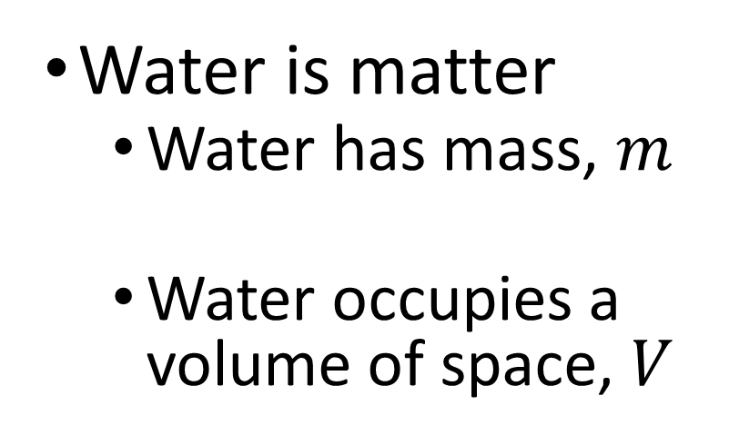
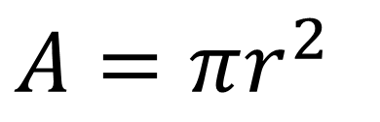
Dimensions of matter (in this case water)
$A=πr^{2}$
Water is matter
  Water has mass, $m$
  Water occupies a volume of space, $V$
Mass [M]
[M]
Notes:
Dimensions of a given amount of water.
We can think about mass and volume in terms of dimensions.
Mass is straightforward, and is a dimension itself usually specified by a capital [M]. Dimensions are usually signified by square brackets.
Volume is a little different. We can break volume down into a simpler dimension in space, length. The length dimension is specified with a capital [L].
For our bucket of water, we can get to the dimensions of volume by thinking about how to calculate volume of a cylinder. The depth of the water in the bucket has dimensions of length. The plan area of the bucket is $πR^{2}$. Since R has dimension of [L], we know the dimensions of area are [L²]. Since the volume is the plan area of the bucket times the depth of water, we get a dimension of volume as [L³].

Slide 4



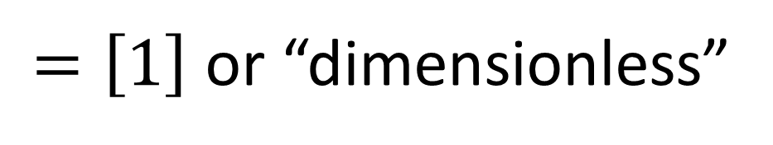


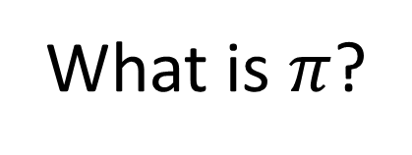
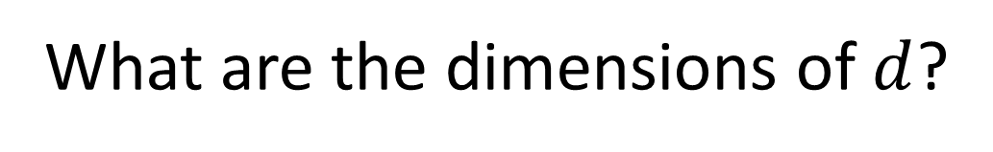


What are the dimensions of $π$?
What is $π$?
(Hint: it is a ratio that has something
to do with the geometry of a circle)
What are the dimensions of $c$?
$$c$$
What are the dimensions of $d$?
$$d$$
$$[L]$$
$$\frac{}{[L]}$$
$$π≡\frac{c}{d}$$
$=\left[1\right]$ or “dimensionless”

Slide 5
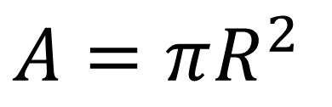
Dimensions of matter (in this case water)
$A=πR^{2}$
[1][?]²
[1][L]²
= [L²]
Water is matter
  Water has mass, $m$
  Water occupies a volume of space, $V$
[L]
Mass [M]
[M]
[L²][L] = [L³]
Notes:
Dimensions of a given amount of water.
We can think about mass and volume in terms of dimensions.
Mass is straightforward, and is a dimension itself usually specified by a capital [M]. Dimensions are usually signified by square brackets.
Volume is a little different. We can break volume down into a simpler dimension in space, length. The length dimension is specified with a capital [L].
For our bucket of water, we can get to the dimensions of volume by thinking about how to calculate volume of a cylinder. The depth of the water in the bucket has dimensions of length. The plan area of the bucket is $πR^{2}$. Since R has dimension of [L], we know the dimensions of area are [L²]. Since the volume is the plan area of the bucket times the depth of water, we get a dimension of volume as [L³].

Slide 6
Units
Variables have dimensions, numbers have units
  Dimensions are abstractions, units provide a specific scale
Units are scaled by an arbitrary standard measurement
  The units tell you what “1” (or unity) means
What are units of [L]?
  US Hydrologists have to be good at converting units
inches, feet, meters, kilometers, etc.
Notes:
Once we have defined the dimensionality of a variable, a value for that variable needs to be characterized on a scale we recognize. That scale is provided by some arbitrary standard measurement for a given dimension. We call that arbitrary standard measurement a “unit” then use it to scale all our measurements by some factor of that unit.
There is an international standard system of units called SI. However, as you are probably already aware, this is not the standard of units used by the US government. Therefore, the majority of jobs involving environmental science in the US are going to require strong skills in unit conversion.

Slide 7
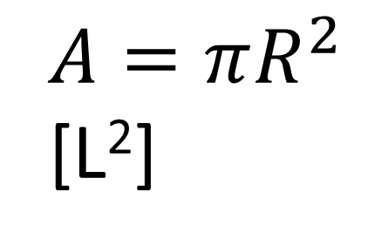
Units example
$A=πR^{2}$
[L²]
:cm²
acre or hectare?
Water is matter
  Water has mass, $m$
  Water occupies a volume of space, $V$
[L]
:cm
Mass [M]
[M]
:kg
:kg
[L³]
:cm³
gal or L?
Notes:
Units for a given amount of water.
Let’s go back to our bucket of water, and we can think about the units we might use to correspond to our dimensions.
We can think about the mass in kilograms. The kilogram is defined by the international prototype, a rod made of platinum iridium.
We can think about length in centimeters or one-hundredth of a meter. A meter is defined as the length travelled by light in a vacuum during a time interval of 1 / 299,792,458 sec.

Slide 8

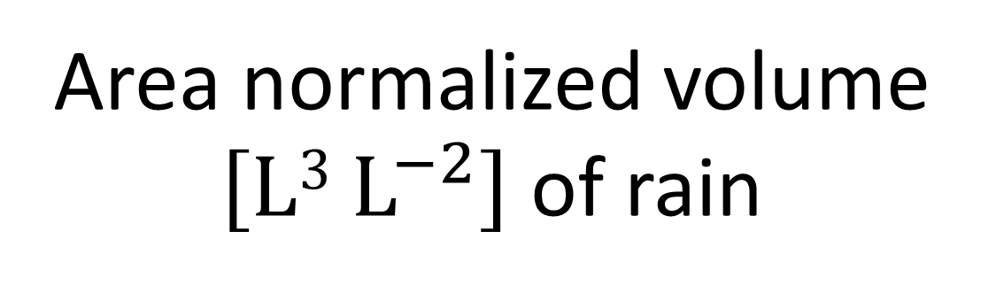
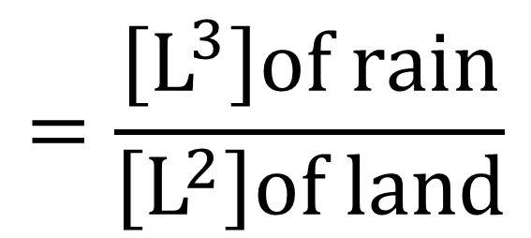
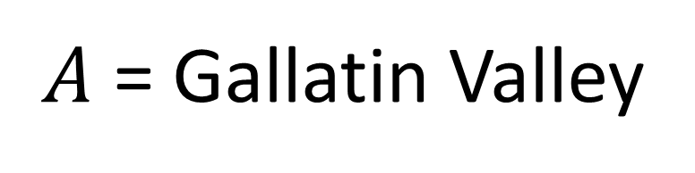
Dimensional thinking: How much rain is an “inch”?
$A$ = Gallatin Valley
$$=\frac{\left[L^{3}\right]of rain}{\left[L^{2}\right]of land}$$
$$\left[L\right]of rain$$
Area normalized volume $\left[L3 L^{−2}\right]$ of rain
Notes:
More about thinking dimensionally.
When you hear rainfall reported on the weather. What are the units? What are the dimensions? What does this amount of rain mean?
The dimensions of rainfall are usually given as a depth. Another way to think about depth is an area normalized volume.
For example, if we get 2 cm of rain on some area of land, you would multiply that area in cm² times the 2 cm of rain to come up with the total volume of water.
Later on, you will find out that we think about area normalized dimensions A LOT in watershed hydrology. Sometimes it is better not to cancel dimensions, even when you can.

Slide 9

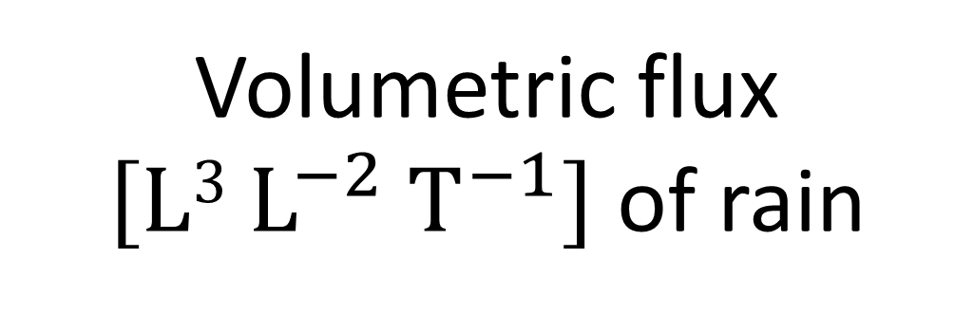
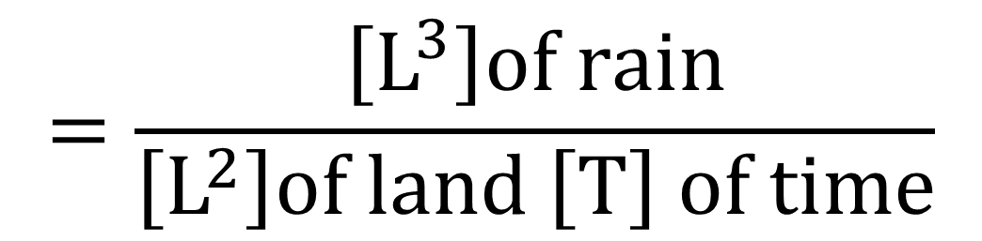
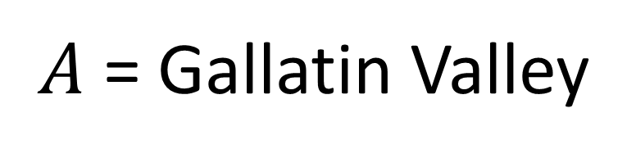
Dimensional thinking: What is an “inch per hour”?
$A$ = Gallatin Valley
$$\left[L T^{−1}\right]of rain$$
$$=\frac{\left[L^{3}\right]of rain}{\left[L^{2}\right]of land \left[T\right] of time}$$
Volumetric flux
$\left[L3 L^{−2} T^{−1}\right]$ of rain
Notes:
More about thinking dimensionally.
When you hear rainfall reported on the weather. What are the units? What are the dimensions? What does this amount of rain mean?
The dimensions of rainfall are usually given as a depth. Another way to think about depth is an area normalized volume.
For example, if we get 2 cm of rain on some area of land, you would multiply that area in cm² times the 2 cm of rain to come up with the total volume of water.
Later on, you will find out that we think about area normalized dimensions A LOT in watershed hydrology. Sometimes it is better not to cancel dimensions, even when you can.

Slide 10
Dimensional analysis: rules for describing a reference frame
Reference frames provide the context for quantifying the real world
A reference frame is described by a collection of dimensions
Measured variables have dimensions
Fundamental dimensions:
  Length [L]
  Time [T]
  Mass [M]
  Temperature [Θ]
Spacetime
Mass-Energy
Notes:
What are dimensions?
Environmental scientists are generally interested in understanding the patterns we observe in our environment. The objective characterization and analysis of these patterns require that we have a way to put numbers on them. This is why scientists are generally obsessed with measuring things. When we start measuring something, we tend to say we are obtaining a value for a “variable”.
The ability to organize how we think about variables requires a reference frame, and it is that reference frame that provides a common context and language that allows us to know what a given variable means when somebody else starts talking about it. A reference frame is described by a collection of “dimensions”, so each dimension represents a part of the reference frame that can (in theory) be measured.
This brings us to the critical overlap between the real world and a variable we have measured within it, and how that overlaps with a given dimension in our conceptual reference frame (or how we think about that real world).
So far, this might sound academic and theoretical. But I hope as we proceed, I can convince you that people who are proficient with dimensions are the people who make the fewest mistakes.

Slide 11
Rules for formatting dimensions
(i.e. grounds for losing points on assignments)
Use capital letters with non-italicized fonts (e.g. [M] not [M] or [m])
Always put in square brackets (i.e. [L] not L or (L))
Use negative exponents rather than fractions
(e.g. a mass flux is [M L⁻² T⁻¹] not [M / L²T])
  Why? Less ambiguous order of operations
    [M/L²T] might be interpreted as [(M/L²)T] or [M/(L²T)]
    [M L⁻² T⁻¹] is unambiguously the same as [M/(L²T)]

Slide 12
Dimensional analysis: more examples of derived dimensions
  = [L T⁻¹]
Velocity
Acceleration
Force [F]
Energy [E]
  = change in distance [L] over time [T]
  = change in velocity [L T⁻¹] over time [T]
  = [L T⁻²]
  = mass [M] times acceleration [L T⁻²]
  = [M L T⁻²]
  = force [M L T⁻²] applied over a distance [L]
  = [M L² T⁻²]

Slide 13
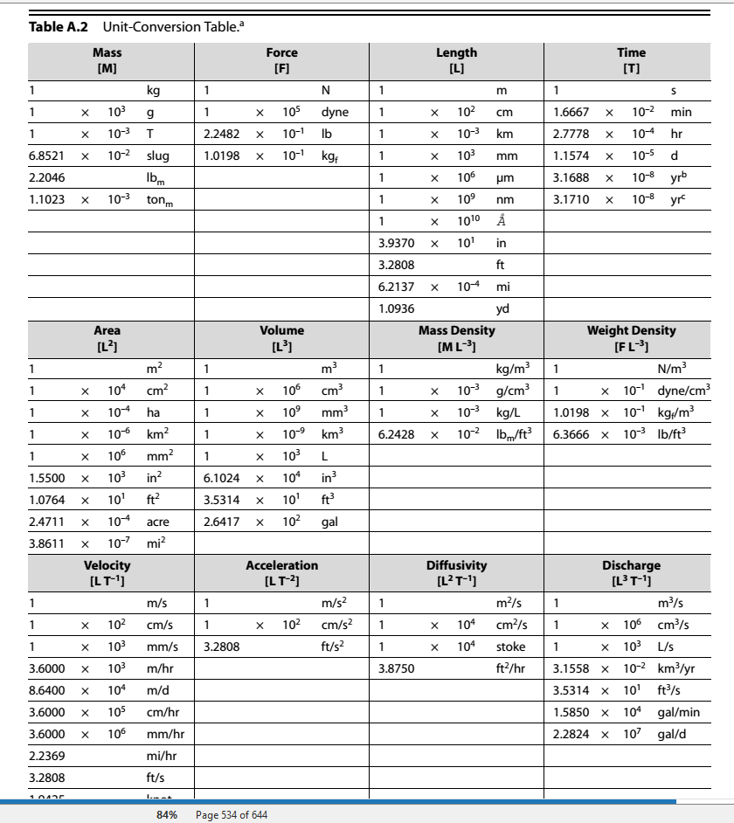
Appendix A in the textbook

Slide 14
Why care about dimensional analysis?
Will vastly improve understanding of applied mathematics
  Most important skill after algebra
Dramatically reduces the potential for mathematical errors
  Calculation error (i.e. carrying units through calculations)
  Derivation error

Slide 15
Using the dimensionality of chemical properties of water to estimate volume
Notes:
This unit will review the dimensions and units that are commonly used for quantifying water in the environment. To provide examples of the meaning of these dimensions and the conversion of units, we will also review the properties of water that are critical to the shaping of the landscape and its ecosystems.

Slide 16
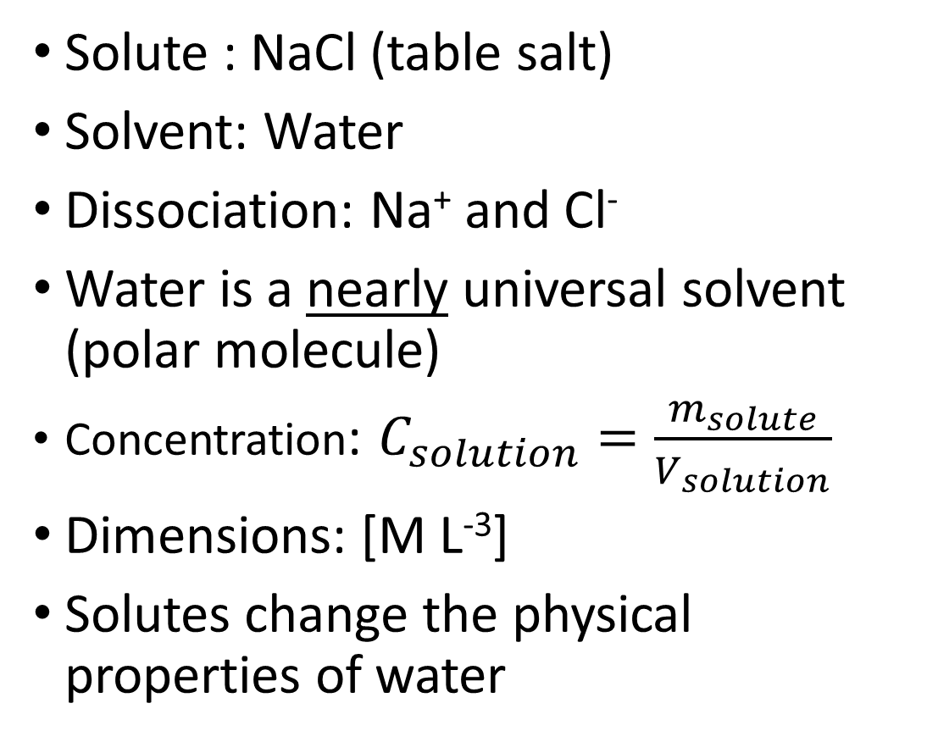
Chemistry of water: Solutions
Solute : NaCl (table salt)
Solvent: Water
Dissociation: Na⁺ and Cl⁻
Water is a nearly universal solvent (polar molecule)
Concentration: $C_{solution}=\frac{m_{solute}}{V_{solution}}$
Dimensions: [M L⁻³]
Solutes change the physical properties of water
NaCl
Notes:
Chemistry: Solutions
Understanding the chemistry of water (also known as “aqueous chemistry”) all starts with understanding solutions and how to quantify them. One of the best indicators of where water has been, and for how long, is determining what is or isn’t dissolved in the water.
There is actually more than one mechanism of dissolution, but lets start with dissociation. Let’s start with a solute (salt), and added to our solvent (water). When you add table salt to water, what happens? What kind of bond is there between sodium and chloride in salt?
As it turns out, this bond is not very hard to break, especially in a polar solvent like water. Therefore NaCl will completely dissociate in water.
Water is particularly good at dissociating ions because of its polar nature. In fact, water can dissolve just about any molecule that has a charge. For this reason, it is sometimes referred to as a “universal” solvent. However, absolutes are almost never true, and this is no exception. Molecules with no charge tend to have little to no attraction to the polarity of water. The fact that they have much more cohesion with molecules of their own type than with water molecules makes them “immiscible” and they will not dissolve in water without additional chemical additives.
Later in the class, we will talk more about the chemical activity that occurs with solutes. But for right now, the important thing to remember is that all of the physical properties of water we have talked about so far CHANGE when solutes are added to the water.
For example, can anyone say why we sometimes put salt on roads or sidewalks in the winter?

Slide 17
Chemistry of water: Solutions
DIMENSIONS DON’T TELL YOU EVERYTHING!
Concentration might be provided in different dimensions (molarity is
[N L⁻³], molality is [N M⁻¹], percent by volume is [1], etc.)
[M L⁻³] is not always concentration. These are also the dimensions of density.
Dimensions are abstract, so CONTEXT IS EVERYTHING!
NaCl
Notes:
Chemistry: Solutions
Understanding the chemistry of water (also known as “aqueous chemistry”) all starts with understanding solutions and how to quantify them. One of the best indicators of where water has been, and for how long, is determining what is or isn’t dissolved in the water.
There is actually more than one mechanism of dissolution, but lets start with dissociation. Let’s start with a solute (salt), and added to our solvent (water). When you add table salt to water, what happens? What kind of bond is there between sodium and chloride in salt?
As it turns out, this bond is not very hard to break, especially in a polar solvent like water. Therefore NaCl will completely dissociate in water.
Water is particularly good at dissociating ions because of its polar nature. In fact, water can dissolve just about any molecule that has a charge. For this reason, it is sometimes referred to as a “universal” solvent. However, absolutes are almost never true, and this is no exception. Molecules with no charge tend to have little to no attraction to the polarity of water. The fact that they have much more cohesion with molecules of their own type than with water molecules makes them “immiscible” and they will not dissolve in water without additional chemical additives.
Later in the class, we will talk more about the chemical activity that occurs with solutes. But for right now, the important thing to remember is that all of the physical properties of water we have talked about so far CHANGE when solutes are added to the water.
For example, can anyone say why we sometimes put salt on roads or sidewalks in the winter?

Slide 18
Physics of water: Electrical conductivity
NaCl
Units: μS cm⁻¹
Varies with dissolved solids and temperature
Temperature-corrected (to 25 °C), or “specific” conductivity normalizes for the effects of temperature
Notes:
Chemistry: Solutions
For our next lab, we are especially interested in how salt affects a physical property we haven’t talked about yet. Electrical Conductivity.
Electrical conductivity is the ability to carry a current of electrons when a given voltage is applied. Particularly in NaCl solutions, the more salt there is, more electrons net movement of electrons through the solution. This is why NaCl is sometimes called an “electrolyte”.

Slide 19
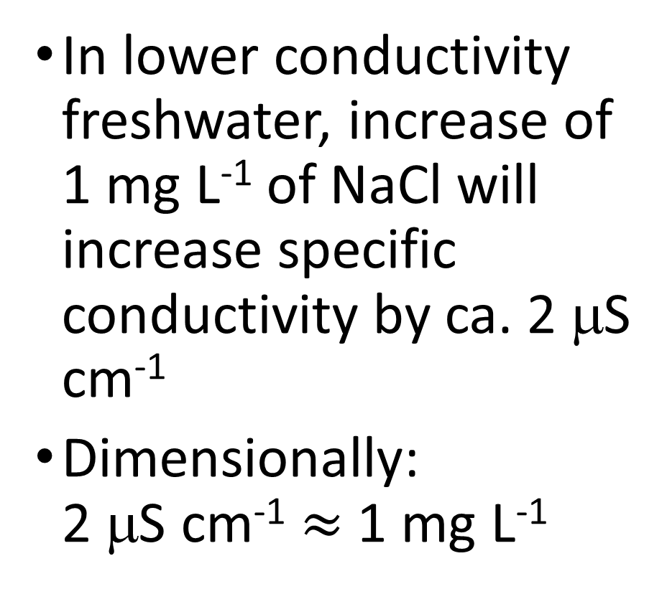
Relating electrical conductivity to solute concentration
NaCl
In lower conductivity freshwater, increase of 1 mg L⁻¹ of NaCl will increase specific conductivity by ca. 2 μS cm⁻¹
Dimensionally:
2 μS cm⁻¹ $≈$ 1 mg L⁻¹
Notes:
Chemistry: Solutions
For our next lab, we are especially interested in how salt affects a physical property we haven’t talked about yet. Electrical Conductivity.
Electrical conductivity is the ability to carry a current of electrons when a given voltage is applied. Particularly in NaCl solutions, the more salt there is, more electrons net movement of electrons through the solution. This is why NaCl is sometimes called an “electrolyte”.

Slide 20
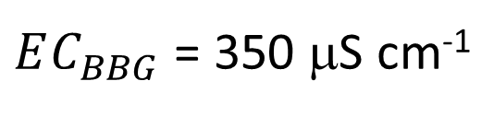
Measuring volume by dilution
$EC_{BBG}$ = 350 μS cm⁻¹
Conductivity
Meter
350 μS cm⁻¹
?
Notes:
Summarizes the calculations necessary to estimate the volume of water in a bucket by adding a known volume of salt to the bucket, dissolving the salt, and measuring the change in electrical conductivity before and after the salt is added.
$EC_{BBG}$ = Background electrical conductivity of water in the bucket (BEFORE adding salt)
$m_{NaCL}$ = Mass of salt added to the bucket
$EC_{BS}$ = Electrical conductivity of water in the bucket AFTER adding salt
$ΔEC$ = The change in EC (in this case increase) due to the addition of the salt to the water in the bucket

Slide 21
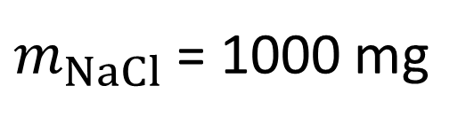
Measuring volume by dilution
$m_{NaCl}$ = 1000 mg
$EC_{BBG}$ = 350 μS cm⁻¹
NaCl
?
Notes:
Summarizes the calculations necessary to estimate the volume of water in a bucket by adding a known volume of salt to the bucket, dissolving the salt, and measuring the change in electrical conductivity before and after the salt is added.
$EC_{BBG}$ = Background electrical conductivity of water in the bucket (BEFORE adding salt)
$m_{NaCL}$ = Mass of salt added to the bucket
$EC_{BS}$ = Electrical conductivity of water in the bucket AFTER adding salt
$ΔEC$ = The change in EC (in this case increase) due to the addition of the salt to the water in the bucket

Slide 22
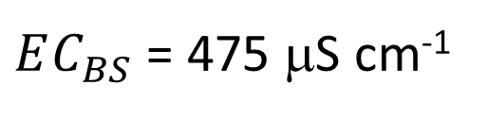
Measuring volume by dilution
$m_{NaCl}$ = 1000 mg
$EC_{BBG}$ = 350 μS cm⁻¹
$EC_{BS}$ = 475 μS cm⁻¹
Conductivity
Meter
475 μS cm⁻¹
?
Notes:
Summarizes the calculations necessary to estimate the volume of water in a bucket by adding a known volume of salt to the bucket, dissolving the salt, and measuring the change in electrical conductivity before and after the salt is added.
$EC_{BBG}$ = Background electrical conductivity of water in the bucket (BEFORE adding salt)
$m_{NaCL}$ = Mass of salt added to the bucket
$EC_{BS}$ = Electrical conductivity of water in the bucket AFTER adding salt
$ΔEC$ = The change in EC (in this case increase) due to the addition of the salt to the water in the bucket

Slide 23
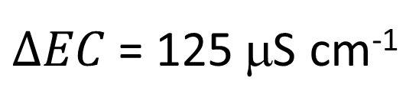
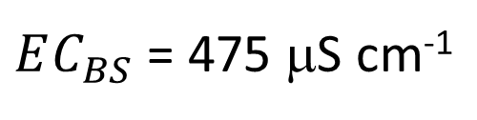
Measuring volume by dilution
$m_{NaCl}$ = 1000 mg
$EC_{BBG}$ = 350 μS cm⁻¹
$EC_{BS}$ = 475 μS cm⁻¹
$ΔEC$ = 125 μS cm⁻¹
Conductivity
Meter
475 μS cm⁻¹
?
Notes:
Summarizes the calculations necessary to estimate the volume of water in a bucket by adding a known volume of salt to the bucket, dissolving the salt, and measuring the change in electrical conductivity before and after the salt is added.
$EC_{BBG}$ = Background electrical conductivity of water in the bucket (BEFORE adding salt)
$m_{NaCL}$ = Mass of salt added to the bucket
$EC_{BS}$ = Electrical conductivity of water in the bucket AFTER adding salt
$ΔEC$ = The change in EC (in this case increase) due to the addition of the salt to the water in the bucket

Slide 24

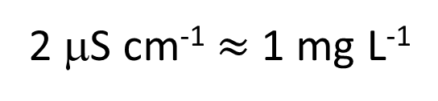
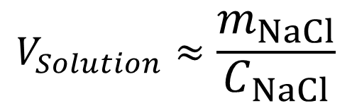
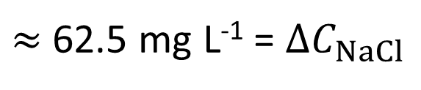
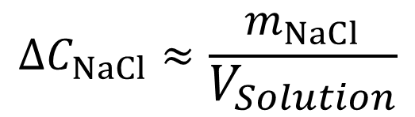
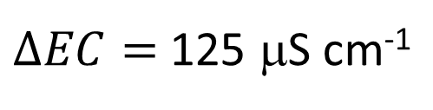
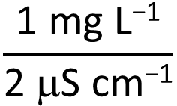
Measuring volume by dilution
$m_{NaCl}$ = 1000 mg
$EC_{BBG}$ = 350 μS cm⁻¹
Assuming salt is “conservative”
$EC_{BS}$ = 475 μS cm⁻¹
2 μS cm⁻¹ $≈$ 1 mg L⁻¹
$ΔEC$ = 125 μS cm⁻¹
$ΔEC=$ 125 μS cm⁻¹
$$\frac{\text{1 }\text{mg} \text{L}\text{−1}}{\text{2 }\text{m}\text{S} \text{cm}\text{−1}}$$
$≈$ 62.5 mg L⁻¹ = $ΔC_{NaCl}$
$$ΔC_{NaCl}≈\frac{m_{NaCl}}{V_{Solution}}$$
?
$$V_{Solution}≈\frac{m_{NaCl}}{C_{NaCl}}$$
$$\text{= }\frac{\text{1000 }\text{mg} }{\text{62.5 }\text{mg} \text{L}\text{−1}}$$
= 16 L
16 L
Assuming solution volume is equal to original water volume (salt adds negligible volume)
Notes:
Summarizes the calculations necessary to estimate the volume of water in a bucket by adding a known volume of salt to the bucket, dissolving the salt, and measuring the change in electrical conductivity before and after the salt is added.
$EC_{BBG}$ = Background electrical conductivity of water in the bucket (BEFORE adding salt)
$m_{NaCL}$ = Mass of salt added to the bucket
$EC_{BS}$ = Electrical conductivity of water in the bucket AFTER adding salt
$ΔEC$ = The change in EC (in this case increase) due to the addition of the salt to the water in the bucket

