Slide 1
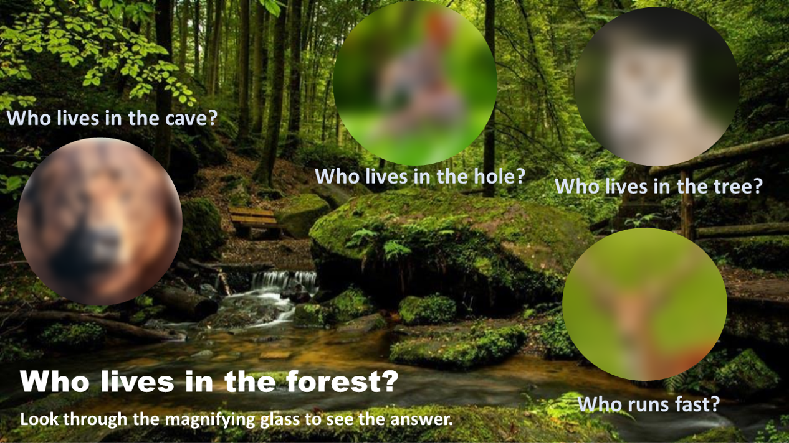
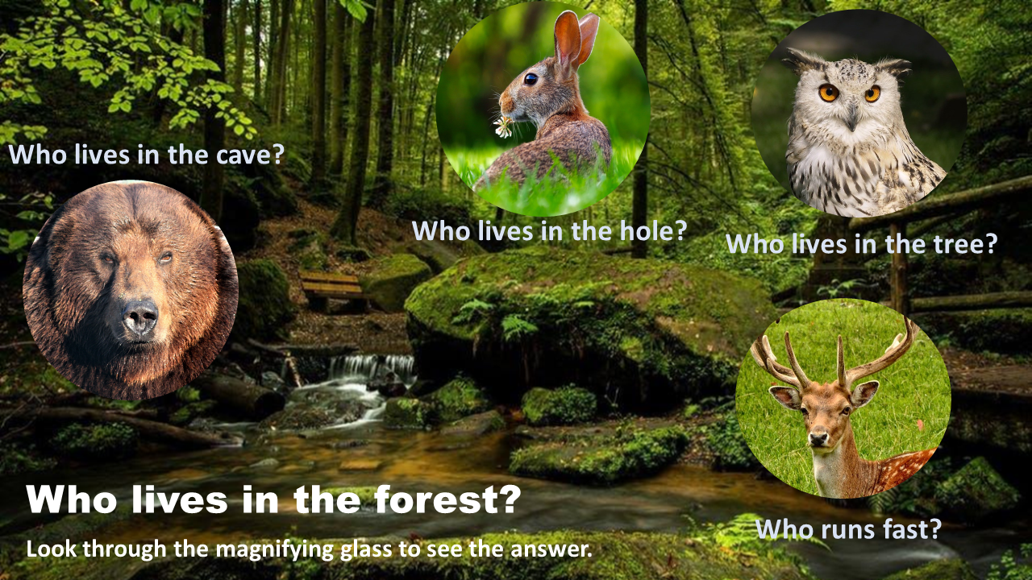

Slide 6

Though it took me many hours to figure this out, I credit Studio 42 and his amazing 5-minute YouTube GlassMorphism video. In the end, it is really quite simple. (https://www.youtube.com/watch?v=4YwbThvJAwQ&t=20s)
This must be done in a new version of PowerPoint, which has MORPH in the TRANSITIONS. It can be converted to Google Docs, but the animation doesn’t move as smoothly.
The Trick – make 2 background images, 1 blurred, 1 not blurred. Format the slide background with the blurred image. At 2:06 in the Studio 42 video, insert the non-blurred image. At 2:36, I changed my shape to a circle with a silver 6pt border. I skipped 2:53-4:00. Duplicate the slide as many times as necessary, moving the circle in the order you want. I added the magnifying glass handle after all of my slides were made. Have Fun! --Debbie--

Slide 7
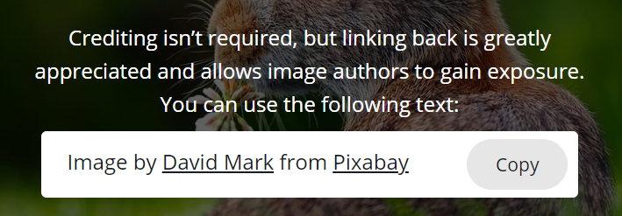


Dear SlidesMania,
I was introduced to you via Matt Miller and Ditch That Textbook. I love all the work you do for we educators. Thank you! I’d like to contribute one that I had fun making, and think will be useful for other teachers. On the previous slide, I noted my inspiration. Below are the photographers. Pixabay.com doesn’t require that we credit them on the slides, but I don’t really know your protocol, so I am listing them here. The background and the bear came from PowerPoint stock images and have no one to credit.
Again, thank you! Debbie
Image by <a href="https://pixabay.com/users/12019-12019/?utm_source=link-attribution&amp;utm_medium=referral&amp;utm_campaign=image&amp;utm_content=1903016">David Mark</a> from <a href="https://pixabay.com/?utm_source=link-attribution&amp;utm_medium=referral&amp;utm_campaign=image&amp;utm_content=1903016">Pixabay</a>
Rabbit
Image by <a href="https://pixabay.com/users/brkarl-304662/?utm_source=link-attribution&amp;utm_medium=referral&amp;utm_campaign=image&amp;utm_content=377192">Bernd-Rainer Karl</a> from <a href="https://pixabay.com/?utm_source=link-attribution&amp;utm_medium=referral&amp;utm_campaign=image&amp;utm_content=377192">Pixabay</a>
Owl
Image by <a href="https://pixabay.com/photos/?utm_source=link-attribution&amp;utm_medium=referral&amp;utm_campaign=image&amp;utm_content=423202">Free-Photos</a> from <a href="https://pixabay.com/?utm_source=link-attribution&amp;utm_medium=referral&amp;utm_campaign=image&amp;utm_content=423202">Pixabay</a>
Deer

