Slide 1

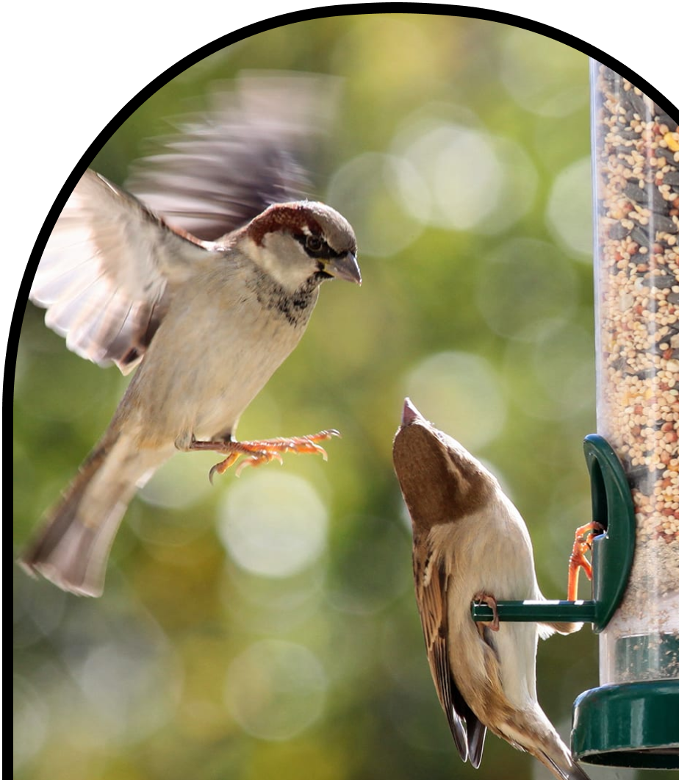
Grade 2
Anchor Layer Teacher Guide
A curriculum companion for Anchor Layer users
Animal Biodiversity & Habitats
Unit Web Link • Pacing Guide • Other Units

Slide 2
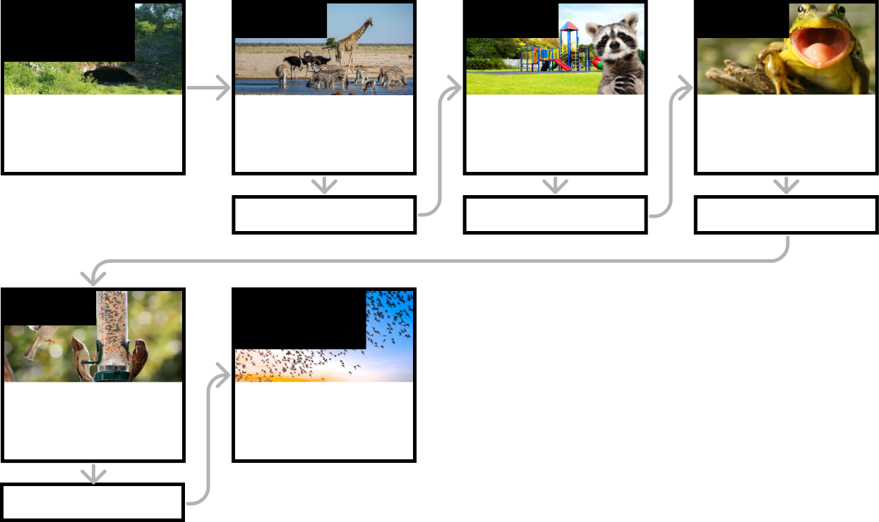
Animal Biodiversity & Habitats • Grade 2
Anchor Layer Teacher Guide
Unit Summary
In this unit, students explore the incredible diversity of animals and habitats! They investigate animal classification and the traits that define each group. Students then explore habitats to discover how the living and non-living aspects of the environment affect the diversity of organisms. They use this information to design a bird feeder that will attract birds with specific food preferences. Assessments
Performance Expectations | Science & Engineering Practices | Disciplinary Core Ideas | Crosscutting Concepts
• 2-LS4-1. Make observations of plants and animals to compare the diversity of life in different habitats. • K-2-ETS1-1. Ask questions, make observations, and gather information about a situation people want to change to define a simple problem that can be solved through the development of a new or improved object or tool. • K-2-ETS1-2. Develop a simple sketch, drawing, or physical model to illustrate how the shape of an object helps it function as needed to solve a given problem. | • Obtaining, Evaluating, and Communicating Information • Analyzing and Interpreting Data • Planning and Carrying Out Investigations • Engaging in Argument from Evidence • Asking Questions and Defining Problems • Constructing Explanations and Designing Solutions • Developing and Using Models | • LS4.D: Biodiversity and Humans | • Patterns • Cause and Effect
Anchor Phenomenon
Lesson 1
Lesson 2
Lesson 3
Animal Biodiversity & Habitats
Life Underground
Biodiversity & Classification
How many different kinds of animals are there?
Habitat Diversity
Why would a wild animal visit a playground?
Biodiversity, Habitats, & Species
Why do frogs say “ribbit”?
Anchor Connection
Anchor Connection
Anchor Connection
Lesson 4
Performance Task
Biodiversity & Engineering How could you get more birds to visit a bird feeder?
Biodiversity, Habitats, & Species
Where else do bats live?
Anchor Connection
‹#›

Slide 3
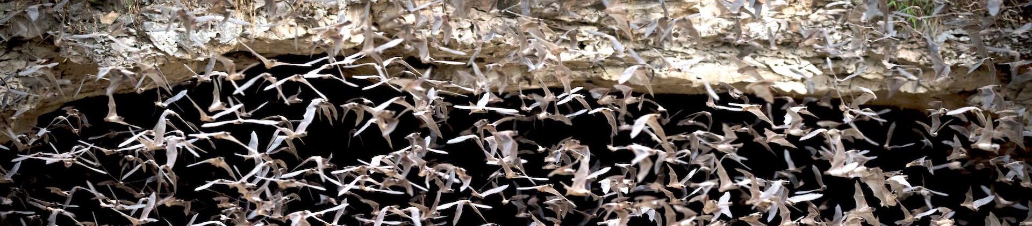
Animal Biodiversity & Habitats • Grade 2
Anchor Layer Teacher Guide
Anchor Phenomenon Background
What type of animal lives in Bracken Cave?
Many children conceive of simple categories of animals at an early age, such as thinking of fish as animals that have scales and swim, while thinking of birds as animals that have feathers and fly. Children recognize patterns in the animals that they learn about, and they use these patterns to develop those mental categories.
As students learn about more and more types of animals, though, they learn about animals that don’t fit into simple categories. Ostriches are birds, but they can’t fly. Penguins are also birds that can’t fly, but they can swim incredibly well. The fact that they swim doesn’t make them a fish, though!
In turn, the bat is an animal that can fly just like a bird and looks a great deal like a bird, but it has fur instead of feathers. This is the first clue that it is a mammal—just like dogs, squirrels, and humans. Bats are truly amazing among the mammals.
In one way, they are extremely rare: they are the only known mammal that can fly. In another way, they are incredibly common:
If you were to list all of the known mammals everywhere on Earth, roughly one out of every four mammals on the list would be a type of bat. They are the most common type of mammal, even though they are the only one that can fly.
Bracken Cave, near San Antonio, Texas, is the site of a particularly incredible colony of bats. In terms of the total number of individuals, it is the single largest gathering of mammals anywhere on Earth. Somewhere between ten and twenty million bats migrate to and from the cave each year in the spring and fall. Female bats give live birth to their young in the cave, which is another reason we know they are not birds: they don’t lay eggs.
Bats are incredibly important to the environments in which they live. Each night, the bats of Bracken Cave fly into the air and eat between 100 and 200 tons of insects that would otherwise be a nuisance to humans and damage crops. When they return to the cave, all of those bats leave a huge amount of poo (known as guano) on the cave floor. This is where the unit begins!
‹#›

Slide 4
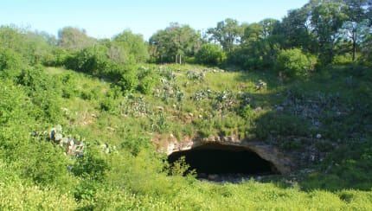
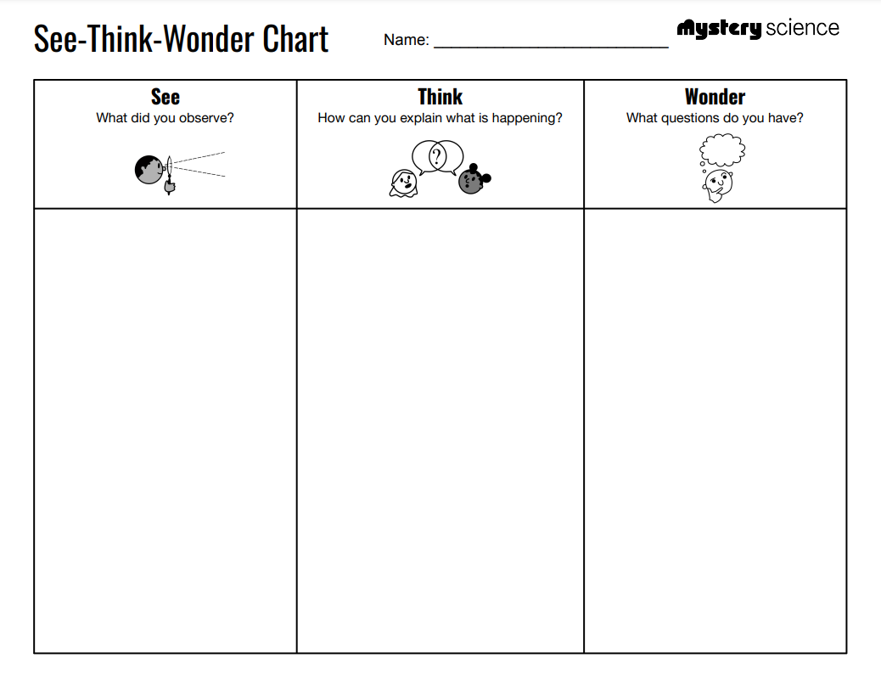
Animal Biodiversity & Habitats • Grade 2
Anchor Layer Teacher Guide
Anchor Phenomenon: Life Underground
Animal Biodiversity & Habitats
Anchor Phenomenon Overview
Note: This lesson is part of this unit’s Anchor Layer. If you have the Anchor Layer turned on, we recommend teaching all lessons in the remainder of this unit in order.
The anchor phenomenon for this unit is a cave north of San Antonio, Texas, that has an unusually large amount of animal poo covering the cave floor. Throughout the unit, students gather details about the mysterious type of animal that lives there.
During the introduction, students generate observations and questions about the phenomenon and create an initial conceptual model to explain the phenomenon. Students will use these initial ideas to track how their understanding grows throughout the unit.
Anchor Phenomenon 15 mins
Guided Inquiry 25 mins
Hands-on Activity 20 mins
Student Work Samples & Notes
Students will gather clues during and after each lesson in this unit to help them improve their understanding and explanations. It is important to encourage students to recognize that even if they don't know the perfect answer yet, they are going to learn a lot throughout the unit and will have an opportunity to revisit the phenomenon over time.
A deep cave in Texas
Poo covering the floor of the cave
Scientists in the cave
It might be a bear that lives in the cave
because it needs to be a big animal to make that much poo
It might be a lot of lizards in the cave
because it would take a lot of them to make that much poo
How many animals live in the cave?
Are the animals big or small?
Why do the animals live in the cave?
‹#›

Slide 5
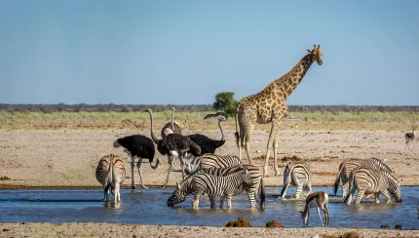
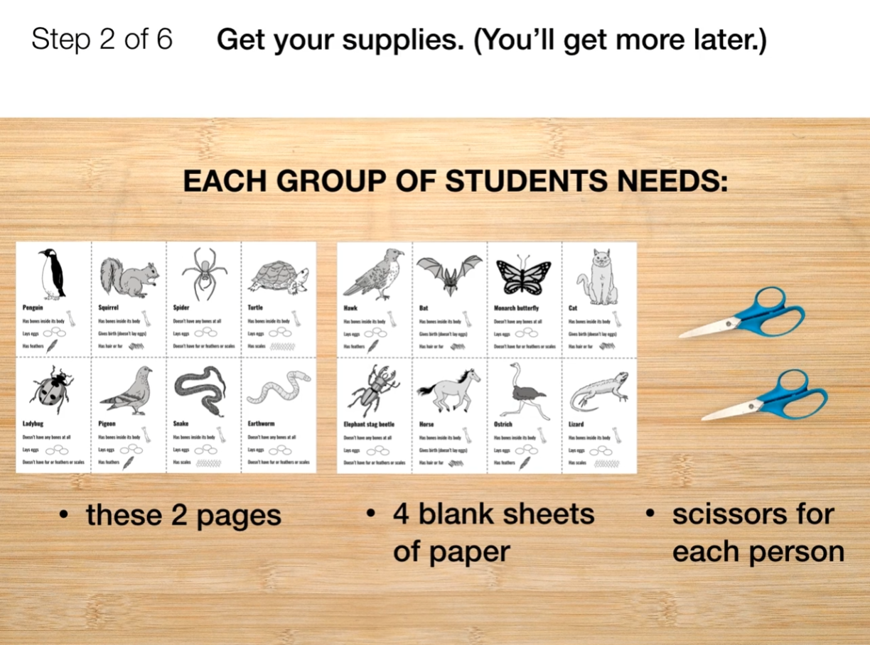
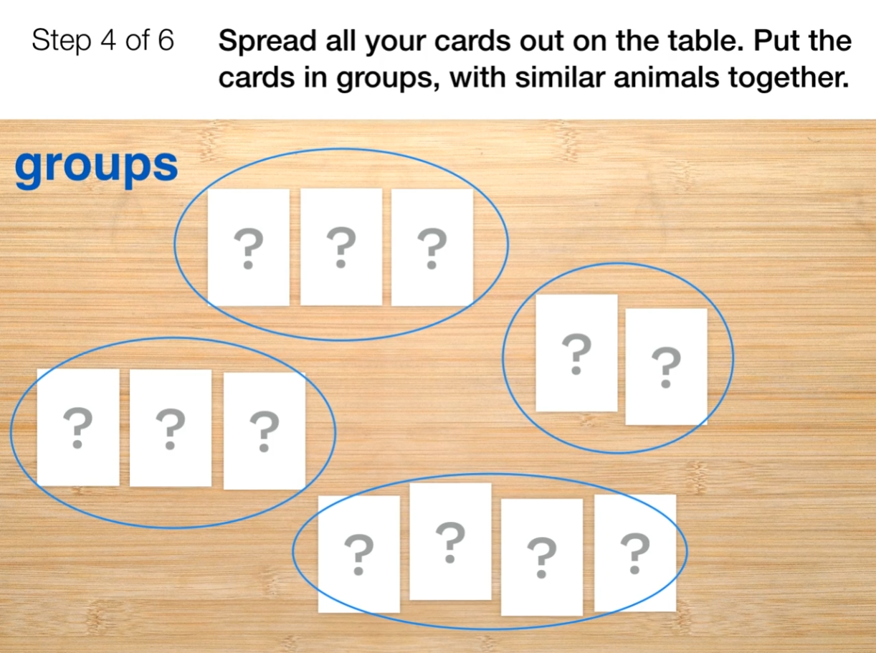
Animal Biodiversity & Habitats • Grade 2
Anchor Layer Teacher Guide
Lesson 1: How many different kinds of animals are there?
Biodiversity & Classification (pg 1 of 2)
Overview
In this lesson, students examine how scientists organize animals into groups based on their characteristics.
In the activity, Animals Sorting Game, students study animal traits and use these traits to sort animal cards into mammals, birds, reptiles, and invertebrates. Students are then challenged to make decisions about animals that don’t fall neatly into any of those categories.
Anchor Connection on Next Page
Exploration 21 mins
Hands-On Activity 30 mins
Wrap-Up 4 mins
Anchor Connection 15 mins
Assessment 20 mins
Activity Notes
We suggest students work in pairs. When you set up your classroom, note that students will need to alternate between doing their work and watching two short videos that are part of the activity.
Each pair of students will need a set of Challenge Cards. Each copy of this printout has two sets of cards, so we recommend you cut these in half prior to class for easy distribution to pairs of students.
‹#›

Slide 6
Animal Biodiversity & Habitats • Grade 2
Anchor Layer Teacher Guide
Lesson 1: How many different kinds of animals are there?
Biodiversity & Classification (pg 2 of 2)
Anchor Connection
After reviewing this lesson, use the email as an opportunity to practice obtaining information from a written source. Read the email together, and ask students to find which parts of the email are most important.
Students revisit their initial drawing, then create a new drawing during this anchor connection. They should understand that the animal in the cave has the characteristics of a mammal. Even though the cave is filled with a huge amount of poo, the mammal inside is very small.
In their second drawing, students need to make sure that the animal they choose is small and is a mammal.
Connecting Storyline Question
Do the animals in the cave always stay in the cave, or do they go to other places?
Exploration 21 mins
Hands-On Activity 30 mins
Wrap-Up 4 mins
Anchor Connection 15 mins
Assessment 20 mins
‹#›

Slide 7
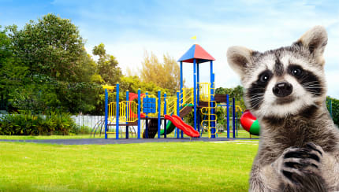
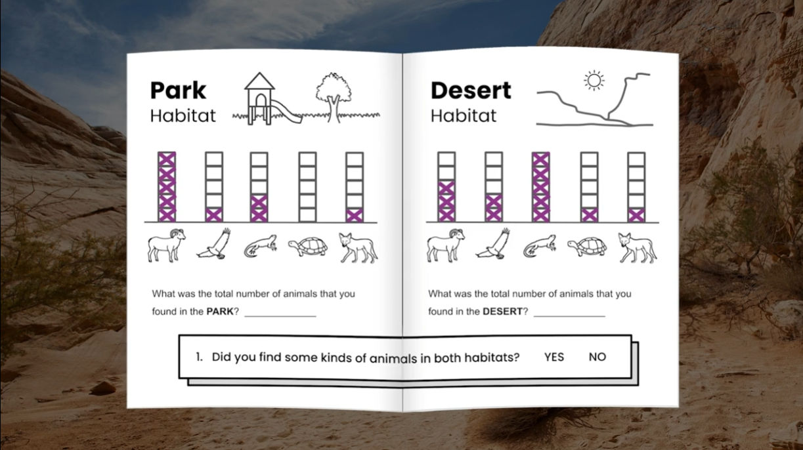
Animal Biodiversity & Habitats • Grade 2
Anchor Layer Teacher Guide
Lesson 2: Why would a wild animal visit a playground?
Habitat Diversity
Overview
In this lesson, students solve the mystery of why a group of wild bighorn sheep would leave their usual desert habitat to visit a second, very different habitat: a local playground.
In the activity, Habitat Scavenger Hunt, students record observations of the diversity of life found in the desert and the playground, as well as the physical characteristics of each location. Students combine these observations to create an understanding of how the living and nonliving parts of a habitat support the animals that live there.
Anchor Connection
The behavior of the bats is the opposite of the bighorn sheep: the goats go to a safe place to sleep at night, while the bats go to a safe place to sleep during the day.
Students revisit their earlier drawings, then create a new drawing during this anchor connection. They should understand that the animal in the cave is a small mammal that sleeps during the day, and hunts at night..
Connecting Storyline Question
What type of small mammal lives in the cave?
Exploration 10 mins
Hands-On Activity 30 mins
Wrap-Up 10 mins
Anchor Connection 15 mins
Assessment 20 mins
Activity Notes
There is no activity prep for this activity. Since there’s so little prep for this lesson, we suggest you consider extending this lesson by having your students perform their own Habitat Scavenger Hunt in two different locations at your school site. Instructions for this extension can be found here.
‹#›

Slide 8
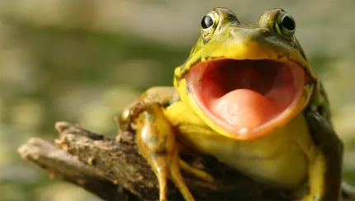
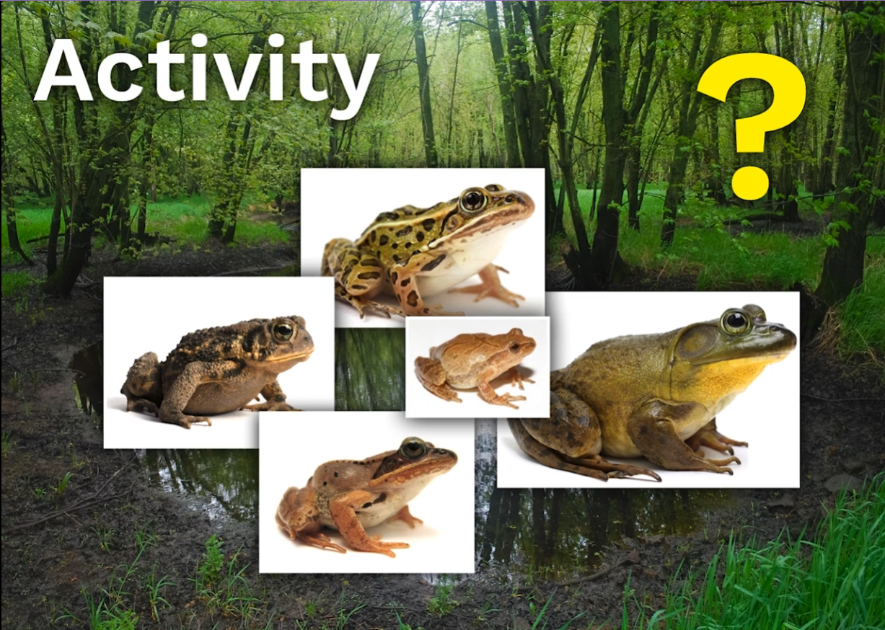
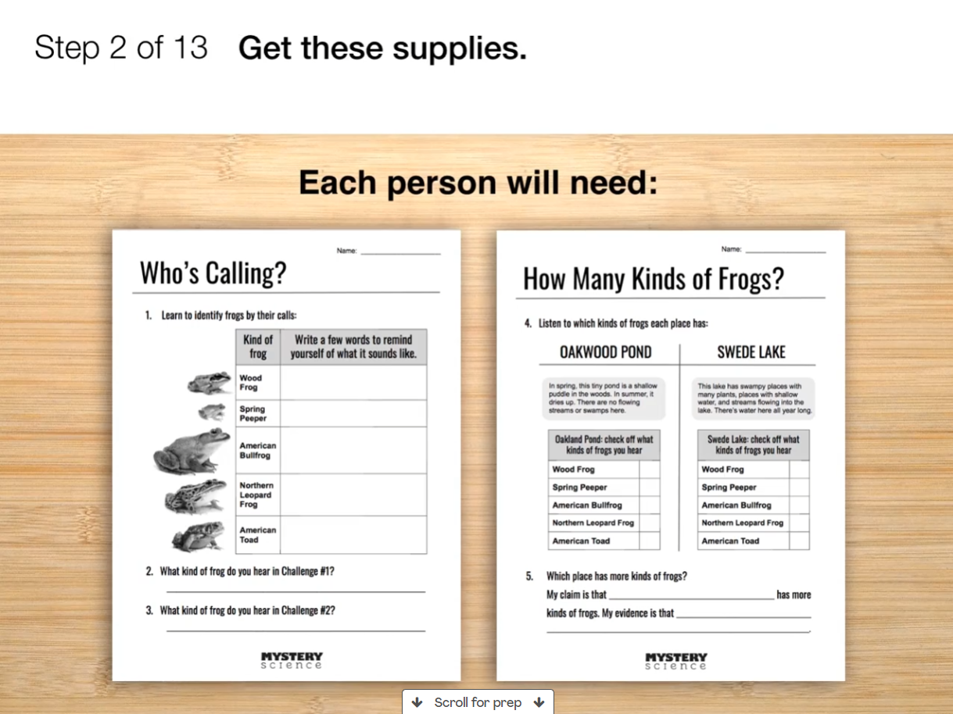
Animal Biodiversity & Habitats • Grade 2
Anchor Layer Teacher Guide
Lesson 3: Why do frogs say “ribbit”?
Biodiversity, Habitats, & Species
Overview
This lesson is a case study in biodiversity using the frogs of North America.
In the activity, Who's Calling?, students learn to identify frogs by their unique calls and investigate which of two locations has a greater variety of frogs. After listening to recordings of frog calls, students create words that will remind them of the sounds, and then use those words to identify frog sounds in different environments.
Anchor Connection
Students will use the listening skills they developed in the lesson to listen closely to the sounds of the bat from Bracken Cave. Once they have identified that it is a bat, they will need to think about where that animal might live in the cave. Students learn that a huge colony of Mexican Free-Tailed Bats lives in the cave.
Students revisit their earlier drawings, then create a new drawing during this anchor connection. They should understand that it is a bat in the cave, but they need to guess where the bats go when they are in the cave.
Connecting Storyline Question
Where do the bats live in the cave?
Exploration 21 mins
Hands-On Activity 35 mins
Wrap-Up 4 mins
Anchor Connection 25 mins
Assessment 20 mins
Activity Notes
We suggest students work in groups of four. Before you begin, let students know they’ll be listening to the sounds of nature as they do this activity.
‹#›

Slide 9
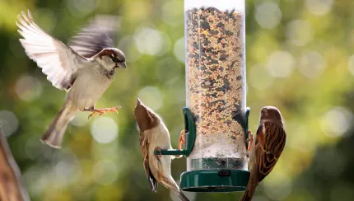
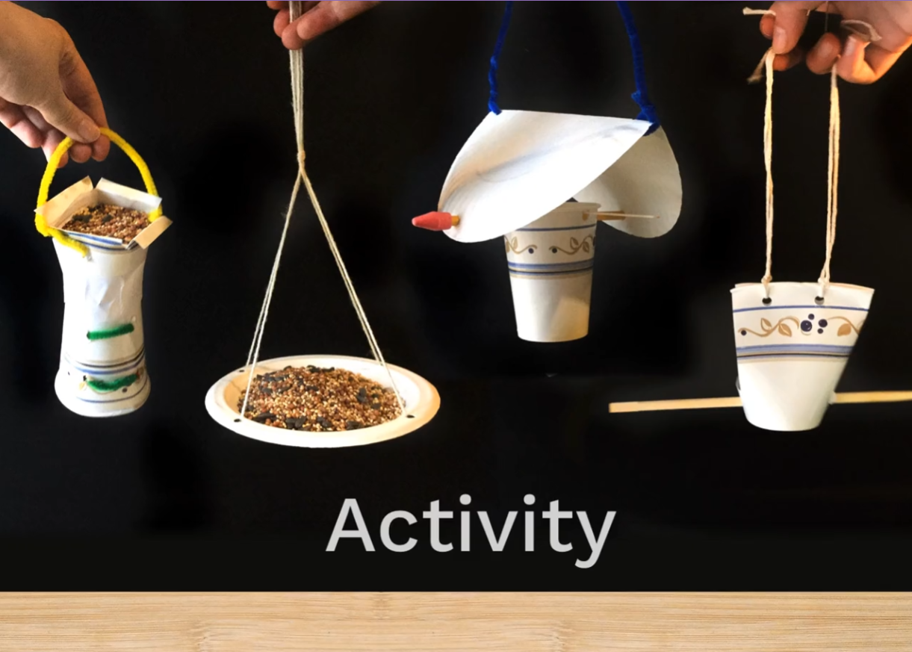
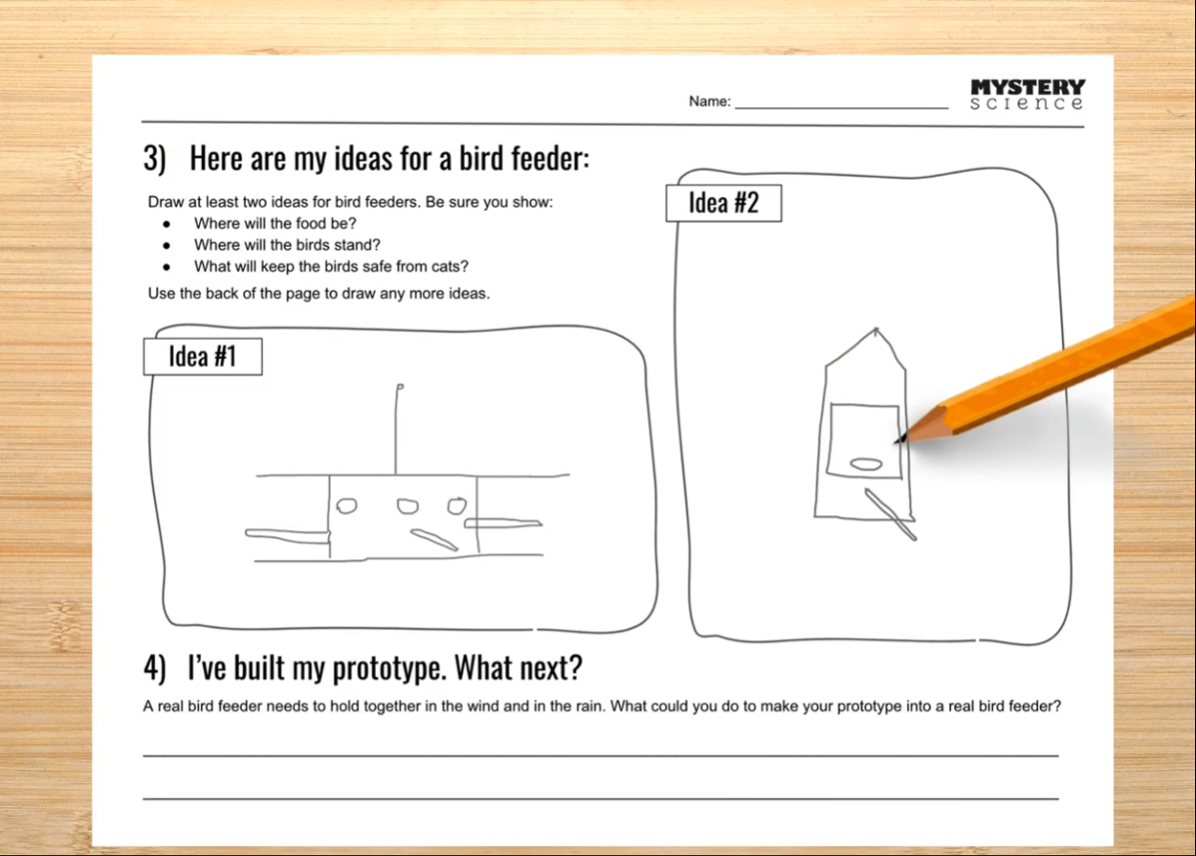
Animal Biodiversity & Habitats • Grade 2
Anchor Layer Teacher Guide
Lesson 4: How could you get more birds to visit a bird feeder?
Biodiversity & Engineering (pg 1 of 2)
Overview
In this lesson, students investigate which kinds of birds are likely to visit a bird feeder based on what they eat.
In the activity, Design a Bird Feeder, students first draw their own bird feeder design to attract a specific type of bird. Then they build a prototype of their bird feeder using available materials.
Anchor Connection on Next Page
Exploration 27 mins
Hands-On Activity 40 mins
Wrap-Up 3 mins
Anchor Connection 25 mins
Assessment 20 mins
Activity Notes
Each student will create their own bird feeder, but we suggest students work in pairs to share ideas.
Part 1 (designing a bird feeder) takes 15 to 20 minutes. Part 2 (building the prototype) can take up to 30 minutes.
You may want to divide this lesson into two sessions, stopping after Part 1 and continuing with Part 2 at a later point. If you plan to do the activity in two sessions, building the bird feeder begins at Step 7.
For detailed activity prep instructions, see our lesson page.
‹#›

Slide 10
Animal Biodiversity & Habitats • Grade 2
Anchor Layer Teacher Guide
Lesson 4: How could you get more birds to visit a bird feeder?
Biodiversity & Engineering (pg 2 of 2)
Anchor Connection
After the lesson review, have students observe the bat attempting to land on the smooth ceiling in the slow-motion video. Have them think about what a bat would need in order to grab hold of something and rest.
Students revisit their earlier drawings, then create a new drawing during this anchor connection. They should understand that the bats hang from the ceiling when they are inside of the cave. Students should write down the names of the materials they would use to build their Bat Rest Stop.
Connecting Storyline Question
What else lives nearby?
Exploration 27 mins
Hands-On Activity 40 mins
Wrap-Up 3 mins
Anchor Connection 25 mins
Assessment 20 mins
‹#›

Slide 11
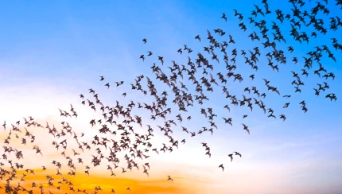
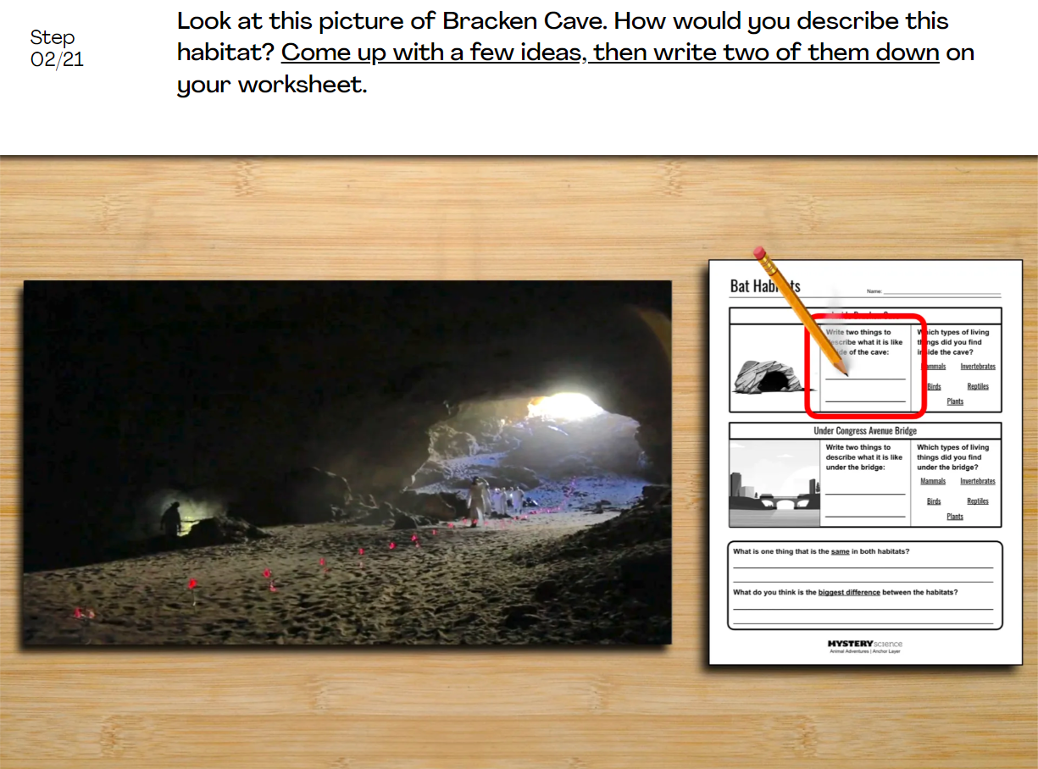
Animal Biodiversity & Habitats • Grade 2
Anchor Layer Teacher Guide
Performance Task: Where else do bats live?
Biodiversity, Habitats, & Species
Overview
In this performance task, students explore and compare two very different places that Mexican free-tailed bats live.
After a review of the Animal Adventures unit, students will learn about a new location where a different colony of bats lives. Then, they compare and contrast the physical environment and the other living things that can be found in each place.
Unit Review 20 mins
Hands-On Activity 50 mins
Performance Task Notes
This is a relatively low-prep activity focused on discussion and comparing new habitats of other living things. Print as many copies of the Bat Habitats worksheet as you will need for your students.
Crosscutting Concepts
Systems: A system is a group of related parts that interact with one another. Bracken Cave and the bridge in Austin, Texas, are both complex systems that involve a variety of living things.
Patterns: Different types of animals exhibit patterns in their body parts and in their behaviors. The bats in both locations are the same type of bat, but almost everything about where they live is completely different
‹#›

