Slide 1




eSports
FREE PRESENTATION TEMPLATE

Slide 2











Welcome to the world of fantasy! Join us on a journey to explore the mystical creatures, enchanted lands, and magical wonders that exist beyond our reality. Discover the wonders and secrets of this exciting realm and unlock the power of imagination.
Welcome

Slide 3



2015
Introduction
The Extraordinary Realm
2015
Encounters
Table of Contents
Unicorn Sightings
2015
Wonders
Wishes Granted
2015
Magic
Spellcasting

Slide 4
The Fantasy Realm: Uncovering the Secrets of the Imagination and the Magic that Lies Within
Introduction

Slide 5



The Realm of the Extraordinary
Welcome to the Fantasy World, a realm of wonder and enchantment where anything is possible. Here, dragons breathe fire, unicorns prance through meadows, and rainbows shine brightly. This world is a place where wishes come true, where potions can be cursed and spells are cast. It's a place of treasure and adventure, where the impossible becomes possible. But the greatest treasure of all is the one that lies within.
The world of fantasy is a reflection of our deepest desires, our fondest dreams, and our wildest imaginations. It's a place where we can let go of the constraints of reality and explore the boundless possibilities of the human mind. In this introduction, we will delve into the mysteries of this realm, uncovering the magic and wonder that lies within. So come with us and let's embark on a journey through the Fantasy World.

Slide 6
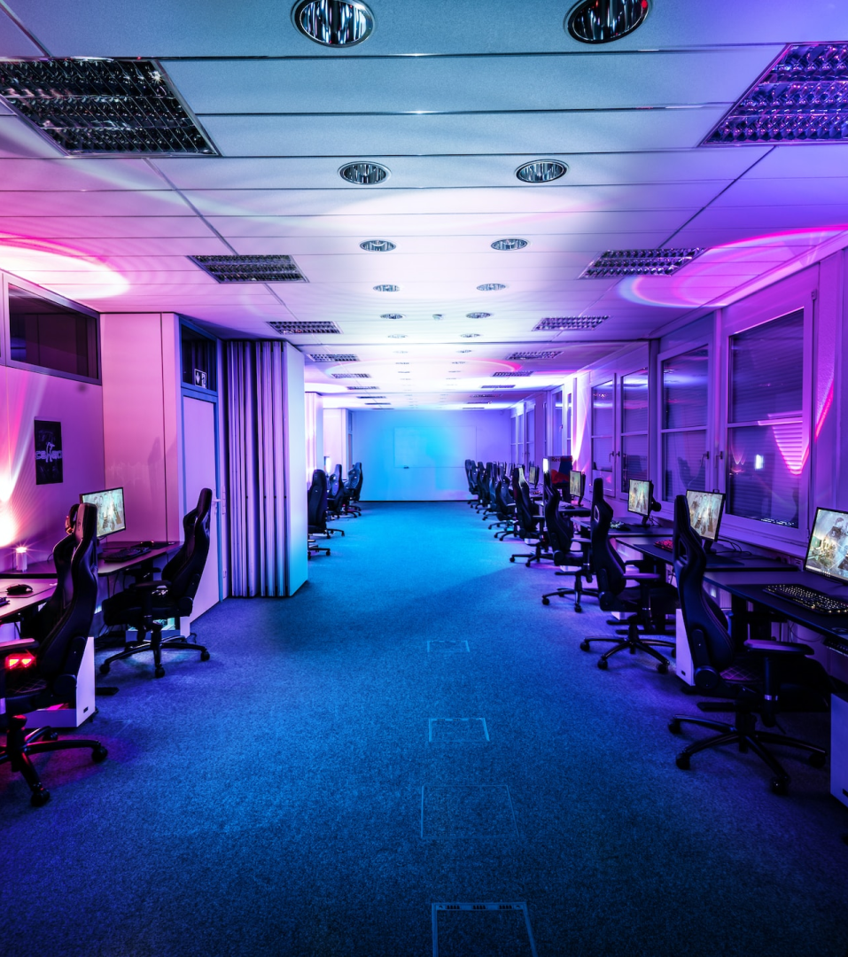







Unicorn Sightings
A record of the number of unicorns spotted in the fantasy realm and the beauty and mystery that surrounds these enchanting creatures.
Dragon Taming
A closer look at the art of taming dragons and the brave adventurers who dare to take on these fearsome creatures.

Slide 7



Dragon Taming
A closer look at the art of taming dragons and the brave adventurers who take on these creatures.
Unicorn Sightings
Unicorn Sightings
A record of the number of unicorns spotted in the fantasy realm and the beauty and mystery.
A record of the number of unicorns spotted in the fantasy realm and the beauty and mystery.

Slide 8


Fantasy is the gateway to the impossible, the land where the ordinary becomes extraordinary, and the impossible becomes possible. It is the realm of the imagination, where anything can happen and everything is possible.
The Dream Weaver

Slide 9





The Art of Unicorn Sighting
Tips and tricks for spotting the elusive unicorns in their natural habitat.
Dragon Taming Technique
A guide to taming and caring for dragons in the realm of magic.

Slide 10





The Magic of Dragons: A Research
Unicorn Sighting
Dragon taming
rainbow seeing
"The Art of Archery": Discover the intricacies of the Art of Archery .
"The Music of the Elves": Immerse yourself in the enchanting music.
"The Life of an Elf": Learn about the customs and daily life of the elves.

Slide 11





Pricing Plan
Basic
Elite
Legendary
Access to the entry-level dungeons.
A limited number of quests and battles per month.
Access to the intermediate and advanced dungeons.
A greater number of quests and battles
Access to the most challenging dungeons and encounters.
Unlimited quests and battles per month.
$10/month
$50/month
$100/month

Slide 12





Strengths
Weaknesses
Rare event causes unpredictable magic.
Rare event causes unpredictable magic.
S
W
O
T
Opportunities
Threats
Rare event causes unpredictable magic.
Rare event causes unpredictable magic.

Slide 13


Some Data
75%
Enchanted Creatures
possess the ability to cast spells.
60%
Magic-Wielding Individuals
practice the art of illusions.
Spells Cast
90%
are dark magic, foretelling danger.

Slide 14


234,567
A tally of the number of unicorns spotted in the fantasy realm.
UNICORN SIGHTINGS

Slide 15







Some Graph
100
90
80
70
60
34.574
50
Total
40
30
20
10
0
1
2
3
4
5
6
7
8
Spellcasting Progress
Treasure Found
A record of the number of spells cast per year
A record of the amount of treasure found per month

Slide 16

A Magic Picture

Slide 17

1
Discover the secrets
Explore the lush, vibrant forest and uncover the mysteries that lie within.
2
Find your own path
Choose your own path through the forest, and see where it takes you.
Meet the creatures
3
Encounter the mythical creatures that call the forest home, from talking animals to fairies.

Slide 18



Fantasy Realm at a Glance
The Enchanted Forest
A magical forest filled with talking animals and enchanted creatures.
The Crystal Caves
A network of underground caves filled with precious gems and crystals.
The Dragon's Lair
A dangerous and mysterious place where dragons reside.

Slide 19




Team A
Team B
Eldruin
Lunaria
The Fire Mage
The Moon Priestess
Elementalen
Eldruin
The Guardian
The Fire Mage

Slide 20

We offer free and high-quality slides templates for your presentations. We appreciate you choosing us and hope our templates have been helpful.
As a new website, we rely on your support to grow, so please help us by sharing our site with your friends and colleagues.
Credit | Image: Unsplash
Thank you for choosing EaTemp

