Slide 1
BUSINESS PROPOSAL
Presentation Templates
Presentation template by GoogleSlides.org

Slide 2

ABOUT US
A complex idea can be conveyed with just a single still image, namely making it possible to absorb large amounts of data quickly.
Easy to change colors, photos and Text. Get a modern PowerPoint Presentation that is beautifully designed.

Slide 3
CONTENTS
01
02
03
04
05
Powerpoint
Web Design
Keynote
Development
Circle

Slide 4

PART
01
Powerpoint
  Team
  Solutions
  Devices
  Design
  Design
  Web
  Solutions

Slide 5

Powerpoint
Check
Easy to change colors, photos and Text. Get a modern PowerPoint Presentation that is beautifully designed.
Opening
Break
Overview
I hope and I believe that this Template will your Time, Money and Reputation.
Cerenomy
Free Time
Devices
I hope and I believe that this Template will your Time, Money and Reputation.
Free Time
Easy to change colors, photos and Text. Get a modern PowerPoint Presentation that is beautifully designed.

Slide 6
Powerpoint
Vision
Easy to change colors, photos and Text. Get a modern PowerPoint Presentation that is beautifully designed.
Mission
A complex idea can be conveyed with just a single still image, namely making it possible to absorb large amounts of data quickly.
Our Values
Easy to change colors, photos and Text. Get a modern PowerPoint Presentation that is beautifully designed.

Slide 7

Powerpoint
About us
You will get a copy of this document on your Google Drive and will be able to edit, add or delete slides.
You will get a copy of this document on your Google Drive and will be able to edit, add or delete slides.
Add or delete slides. You have to be signed in to your Google account. in PowerPoint. Remember to download and install

Slide 8
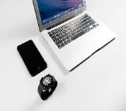
Powerpoint
Pricing
Future
Timeline
Services
Forum
We use well-known development methodologies to create a customized
Is the color of gold, butter and ripe lemons. In the spectrum of visible
We use well-known development methodologies to create a customized
Is the color of gold, butter and ripe lemons. In the spectrum of visible

Slide 9



Powerpoint
Meeting
Feel 'right' for your users. We create a solid user-product relationship, one that's long and fruitful.
What we do?
We press play on your digital story. Using conceptual, digital design, we work with you to build experiences that

Slide 10
Powerpoint
Success
Succes
Simple & Smooth, exactly how purchasing experiences should be. We align with your users need to build and
Split
Transport
Moving from creative ideas to solid strategy and execution, we help your target market resonate fully
Skills
Suggest
Moving from creative ideas to solid strategy and execution, we help your target market resonate fully
Share
Conferences
Simple & Smooth, exactly how purchasing experiences should be. We align with your

Slide 11

Powerpoint
Amplified with the right words. Sometimes it's easier
Your audience relate and absorb information on.
Send
Signature
Amplified with the right words. Sometimes it's easier to go old school, our
Your audience relate and absorb information on

Slide 12

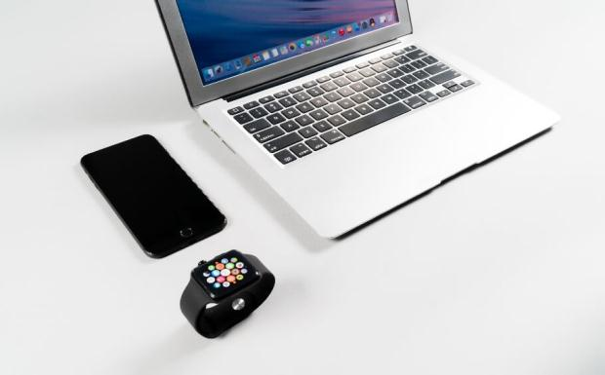
Powerpoint
Lower
Schedule
The user can demonstrate on a projector or computer,
Sometimes it's easier to go old school, our copywriters prefer a
Occupation
Lanage
Sometimes it's easier to go old school, our copywriters prefer a good ball.
The user can demonstrate on a projector or computer, or print
Your audience relate and absorb information on different sensory levels. We know visual stories are amplified with the right words. Sometimes it's easier to go old school, our copywriters prefer a good ball.

Slide 13
Powerpoint
The user can demonstrate on a projector or computer, or print the presentation and make it into a film to be used in a wider field. Using PowerPoint
Enter the comprehensive description of the above chart here, enter the comprehensive description
Your audience relate and absorb information on different sensory levels. We know visual stories are amplified with the right words. Sometimes
The user can make a presentation on a projector or computer, or print out the presentation to make a film. The user can make a presentation on a projector or computer, and can also make a presentation. You can
The user can demonstrate on a projector or computer, or print the presentation and make it into a film to be used in a wider field. Using PowerPoint
Your audience relate and absorb information on different sensory levels. We know visual stories are amplified with the right words. Sometimes it's easier to go old school, our copywriters prefer a good ball.

Slide 14
PART
02
Web Design
  Skills
  Split
  Signature
  Share
  Share
  Skills
  Split

Slide 15
Web Design
It is a very sad thing that nowadays there is so little useless information.
We certainly do not forget you as soon as you forget us. It is, perhaps, our fate rather than our merit.
It is a very sad thing that nowadays there is so little useless information.
Lanage
Schedu
Send
Lanage
Lower
Send
We cannot help ourselves. We live at home, quiet, confined, and our feelings prey upon us.
All the privilege I claim for my own sex (it is not a very enviable one; you need not covet it), is that of
We cannot help ourselves. We live at home, quiet, confined, and our feelings prey upon us.

Slide 16
Web Design
98%
Agenda
85%
I believe that people would be alive today if there were a death penalty. Nancy Reagan
77%
Add
60%
60%
The time is now, the place is here. Stay in the present. You can do nothing to change the past, and the future will never come exactly as you plan or hope for.
Accept
Genius hath electric power which earth can never tame. Lydia M. Child
Advise
I feel very strongly that change is good because it stirs up the system. Ann Richards

Slide 17
Web Design
A large income is the best recipe for happiness I ever heard of. Mansfield Park
I feel very strongly that change is good because it stirs up the system. Ann Richards
Woe be to him that reads but one book. George Herbert
Approve
Bill
Apply
Budget
A large income is the best recipe for happiness I ever heard of. Mansfield Park
Authorize
Brand
I feel very strongly that change is good because it stirs up the system. Ann Richards
Be an encourager, the world has enough critics already. Always give your best never worry for

Slide 18
Web Design
Education is the most powerful weapon which you can use to change the world.
A
B
God sometimes removes people from your life to protect you. Do not run after them.
Always give your best never worry for results.
F
C
Education is the most powerful weapon which you can use to change the world.
God sometimes removes people from your life to protect you. Do not run after them.
E
D
Always give your best never worry for results.

Slide 19


Web Design
Certification
Buy
God sometimes removes people from your life to protect you. Do not run after them.
Education is the most powerful weapon which you can use to change the world.
Cancel
Calculate
Education is the most powerful weapon which you can use to change the world.
God sometimes removes people from your life to protect you. Do not run after them.

Slide 20
Web Design
Enjoy the little things in life, because one day you will look back and realize they were the big things.
Everyone wants, happiness. No one wants pain. But you can’t have a rainbow without a little rain.
Comparison
Competition
Step One
Step Two
Step Three
Step Four
Do you wonder what the difference between ignorance and genius is? A Genius has limits but an ignorant doesn’t have any.
Enjoy the little things in life, because one day you will look back and realize they were the big things.
Commission
Choose

Slide 21
PART
03
Keynote
  Convince
  Confirm
  Complain
  Complete
  Complete
  Complain
  Confirm

Slide 22


Keynote
Decide
Deadline
Convince
Do you wonder what the difference between ignorance and genius is? A Genius has limits but an
Everybody has three chars ; the one is come out ,the one is owned ,the one is
People who touch your heart are always with you.
Date
Customer
Do you wonder what the difference between ignorance and genius is? A Genius has limits but an
You can’t change what’s going on around you until you start changing what’s going on with you.

Slide 23
Keynote
Decision
Do you wonder what the difference between ignorance and genius is? A Genius has limits but an ignorant doesn’t have any. Everybody has three chars ; the one is come out ,the one is owned ,the one is thought to have.
C
B
Description
People who touch your heart are always with you.
People who touch your heart are always with you.
A
A
Department
B
You can’t change what’s going on around you until you start changing what’s going on with you.
Deliver
C
You can’t change what’s going on around you until you start changing what’s going on with you.

Slide 24

Keynote
You can’t change what’s going on around you until you start changing
Dispatch
Develop
You can’t change what’s going on around you until you start changing what’s going on with you.
Everybody has three chars ; the one is come out ,the one is owned ,the one is thought to have.
Dismiss
Difference
Everybody has three chars ; the one is come out ,the one is owned ,the one is thought to have.
You can’t change what’s going on around you until you start changing what’s going on with you.

Slide 25


Keynote
A
B
C
Employ
Education
Distribute
You can’t change what’s going on around you until you start changing what’s going on with you.
Everybody has three chars ; the one is come out ,the one is owned ,the one is thought to have.
People who touch your heart are always with you.
Do you wonder what the difference between ignorance and genius is? A Genius has limits but an ignorant doesn’t have any.Everybody

Slide 26
Keynote
Exchange
Encourage
Experience
Equipment
You can’t change what’s going on around you until you start changing what’s going on with you. People who touch your heart are always with you A torn jacket is soon mended; but hard words bruise the heart of a child. Henry Wadsworth Longfellow.

Slide 27
PART
04
Development
  Explanation
  Facilities
  Feedback
  Explanation
  Facilities

Slide 28
Development
Goal
To see what is in front of one's nose needs a constant struggle. George To see what is in front of one's nose needs a constant struggle. George Orwell
Fund
A torn jacket is soon mended; but hard words bruise the heart of a child. Henry Wadsworth Longfellow
Fix
Be not afraid of going slowly, be afraid only of standing still

Slide 29
Development
Take calculated risks. That is quite different from being rash.
A torn jacket is soon mended; but hard words bruise the heart of a child. Henry Wadsworth
Increase
Growth
1
3
There is only one difference between a madman and me. I am not mad.
To see what is in front of one's nose needs a constant struggle. George Orwell
2
Improve
4
Hearing

Slide 30
Development
7.8
5.3
1.0
3.2
8.8
01.
04.
Inventory
03.
Inform
Take calculated risks. That is quite different from being rash.
Install
Take calculated risks. That is quite different from being rash.
02.
05.
To see what is in front of one's nose needs a constant struggle.
Instructions
Industry
There is only one difference between a madman and me. I am
There is only one difference between a madman and me. I am

Slide 31
Development
To see what is in front of one's nose needs a constant struggle. George Orwell
A torn jacket is soon mended; but hard words bruise the heart of a child.
Take calculated risks. That is quite different from being rash. George S. Patton
To see what is in front of one's nose needs a constant struggle. George Orwell
A torn jacket is soon mended; but hard words bruise the heart of a child.
Take calculated risks. That is quite different from being rash. George S. Patton

Slide 32
Development
Knowledge
There is only one difference between a madman and me. I am not mad.
Invoice
There is only one difference between a madman and me. I am not mad.
Join
I'm convinced that about half of what separates the successful entrepreneurs from the non-successful ones is pure perseverance.

Slide 33


Development
2001
2010
2015
2020
Be an encourager, the world has enough
Woe be to him that reads but one book.
Be an encourager, the world has enough
Woe be to him that reads but one book.

Slide 34
PART
05
Circle
  Fashion
  Startup
  NGO
  Public
  Public

Slide 35
Circle
Finance
Fashion
Arts & Culture
Real Estate
Energy
E-commerce
Comme
Education is the most powerful weapon which you can use to change the world.
Always give your best never worry for results.
God sometimes removes people from your life to protect you. Do not run after them.
Education is the most powerful weapon which you can use to change the world.
Always give your best never worry for results.

Slide 36
Circle
Everyone wants, happiness. No one wants pain. But you can’t have a rainbow without a little rain.
Enjoy the little things in life, because one day you will look back and realize they were the big things. Do you wonder what the difference between ignorance and genius is? A
Briefing
Evaluation
Workshop
Everyone wants, happiness. No one wants pain. But you can’t have a rainbow without a little rain.

Slide 37
Circle
Quality
Design
People who touch your heart are always with you.
Everybody has three chars ; the one is come out ,the one is owned ,the one is thought to have.
Implementation
Assurance
Everybody has three chars ; the one is come out ,the one is owned ,the one is thought to have.
You can’t change what’s going on around you until you start changing what’s going on with you.
Design
Implementation
You can’t change what’s going on around you until you start changing what’s going on with you.
People who touch your heart are always with you.

Slide 38




Circle
Service
Assurance
You can’t change what’s going on around you until you start changing what’s going on with you.
Be not afraid of going slowly, be afraid only of standing still
75%
59%
82%
23%
Powerpoint
Our
Be not afraid of going slowly, be afraid only of standing still
You can’t change what’s going on around you until you start changing what’s going on with you.

Slide 39
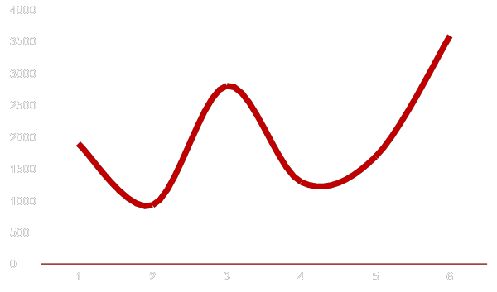
Circle
Web Design
A torn jacket is soon mended; but hard words bruise the heart of a child. Henry Wadsworth Longfellow
192,058,473
Skiing consists of wearing $3,000 worth of clothes and
Keynote

Slide 40
Thank you!
Business Proposal Presentation
Presentation template by GoogleSlides.org

Slide 41
GoogleSlides.org
Google Slides
Select slide and edit your presentation
You can download and share your presentation!
Powerpoint Templates
Free Powerpoint Presentation Template (.pptx)
You can upload Google Slides..
Free Powerpoint Templates: https://googleslides.org/free-templates
Abstract Google Slides: https://googleslides.org/free-templates/abstract-google-slides
Animal and Wildlife Presentation: https://googleslides.org/free-templates/animal-wildlife-presentation-template
Biology Powerpoint Templates: https://googleslides.org/free-templates/biology-presentation-slides
Business & Finance Google Slides: https://googleslides.org/free-templates/business-finance-templates
Chemistry Powerpoint Slides: https://googleslides.org/free-templates/chemistry-google-slides-template
Christmas Google Slides: https://googleslides.org/free-templates/christmas-new-year-templates
Education Google Slides: https://googleslides.org/free-templates/education-google-slides
Flowers Powerpoint Templates: https://googleslides.org/free-templates/flowers-powerpoint-templates
Food and Drinks Slides: https://googleslides.org/free-templates/food-drinks-powerpoint-templates
Games Powerpoint Templates: https://googleslides.org/free-templates/games-powerpoint-templates
Medical Google Slides: https://googleslides.org/free-templates/medical-powerpoint-templates
Nature Powerpoint Templates: https://googleslides.org/free-templates/nature-google-slide-templates
Religious Google Slides: https://googleslides.org/free-templates/religion-powerpoint-templates
Sports Powerpoint Slides: https://googleslides.org/free-templates/sports-presentation-slides
Technology Google Slides: https://googleslides.org/free-templates/technology-powerpoint-templates
Transportation Powerpoint Templates: https://googleslides.org/free-templates/transportation-google-slides

