Slide 1
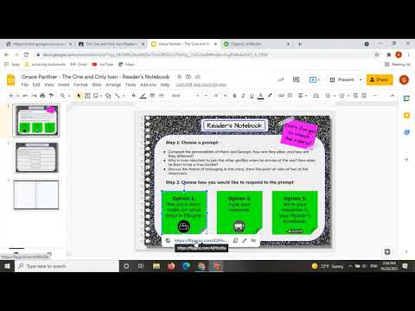

Slide 5


Slide 8


Slide 14
Students complete a short Google Form so you can quickly keep track of student choices in a Google Sheet. Be sure to add a link to your form where it says, “Track your choice here!”. You can make a copy of the form shown below by clicking here (URL to access: bit.ly/rnform7)

Slide 15
Track your choice here!

Slide 16
Track your choice here!

Slide 17
Track your choice here!

