Slide 1

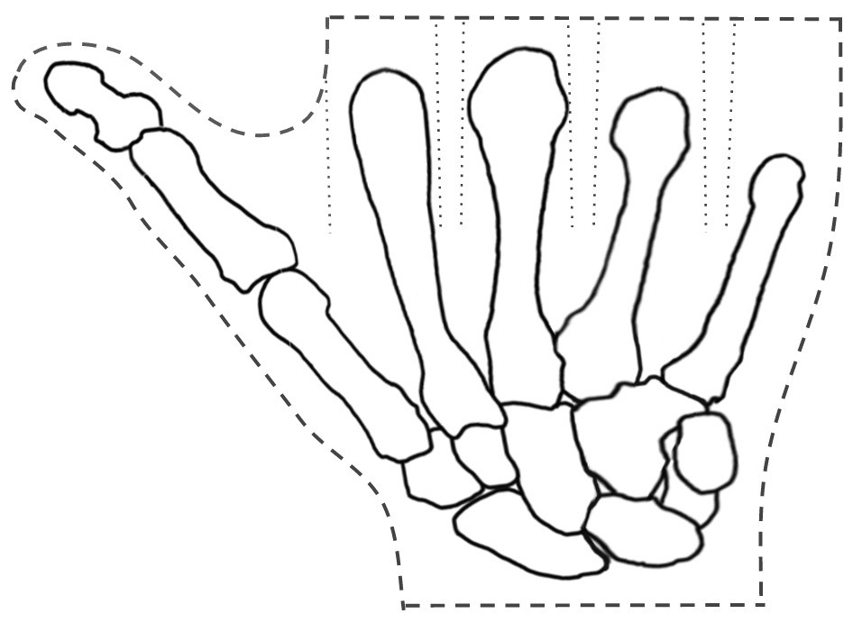
Directions: 1) Get in a group of 4 2) Glue this paper to stiff cardboard 3) Cut on the dashed lines 4) Cut on the dotted lines 5) Slide on 4 robot fingers
Robot Hand Template
Why do your biceps bulge?
Directions: 1) Glue this piece of paper to some stiff cardboard. 2) Cut on the dashed lines. 3) Cut the 7 dotted lines. 4) Slide on 4 robot fingers.
Thumb bones
4
4
4
Palm
bones
4
Wrist
bones

