Slide 1
Skipping the paywall with Open Access and Interlibrary Loan
Joe McArthur - @mcarthur_joe
Joe@openaccessbutton.org
Director, Open Access Button.
Assistant Director, Right to Research Coalition.
SPARC

Slide 2

Get the slides
openaccessbutton.org/uksg
With bonus content, further reading & a handout.

Slide 3
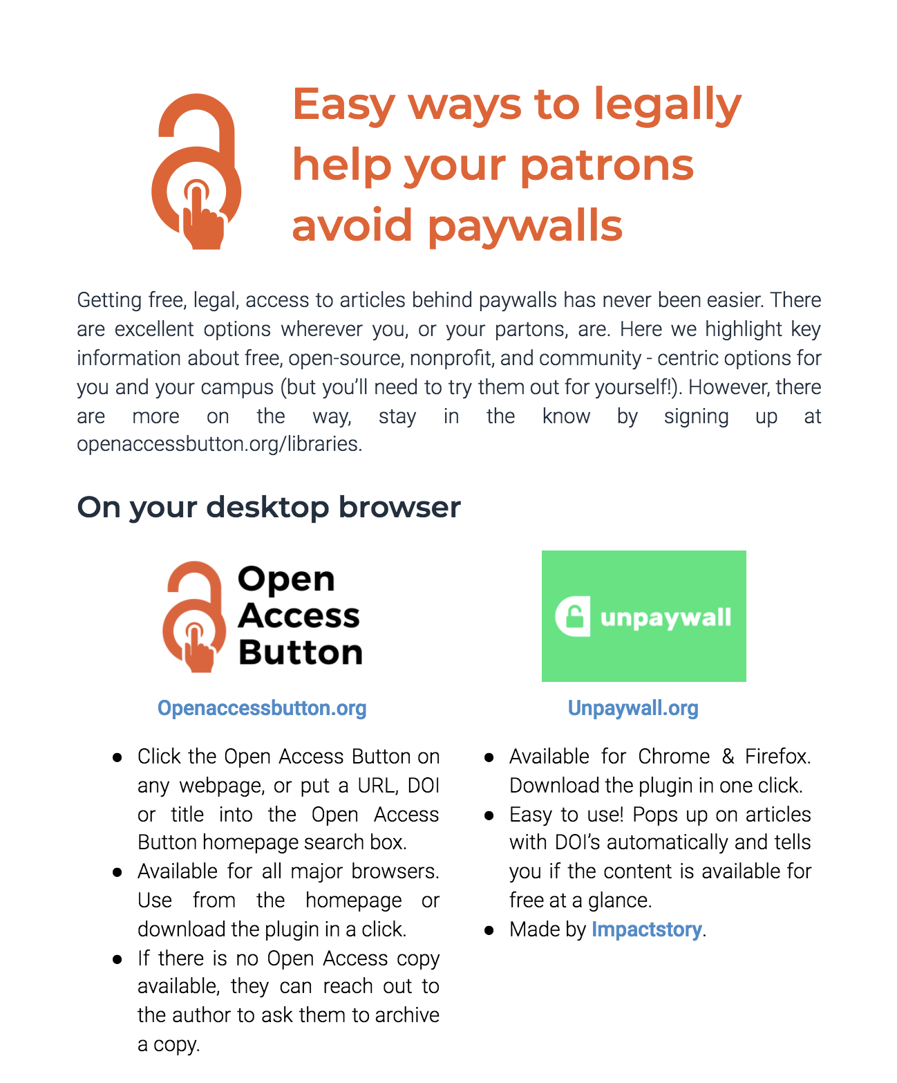
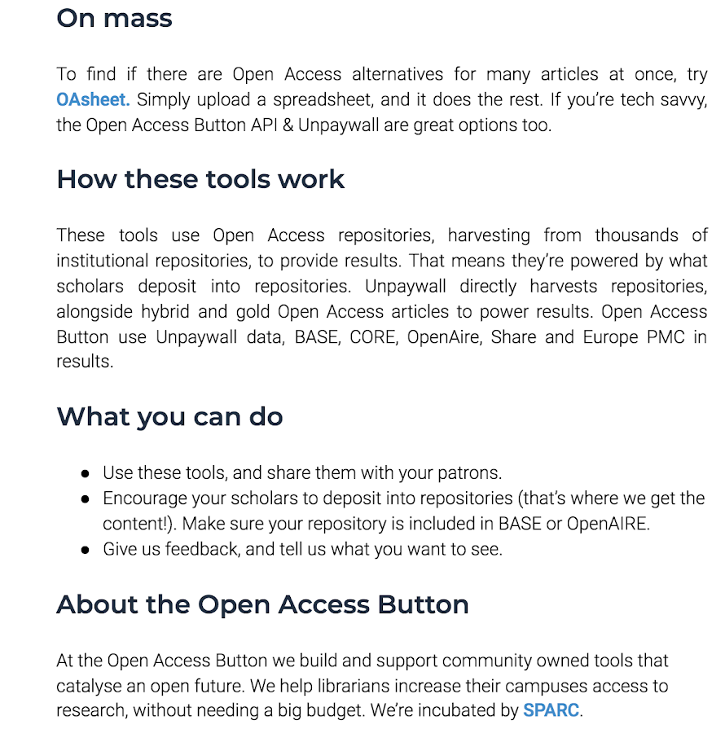
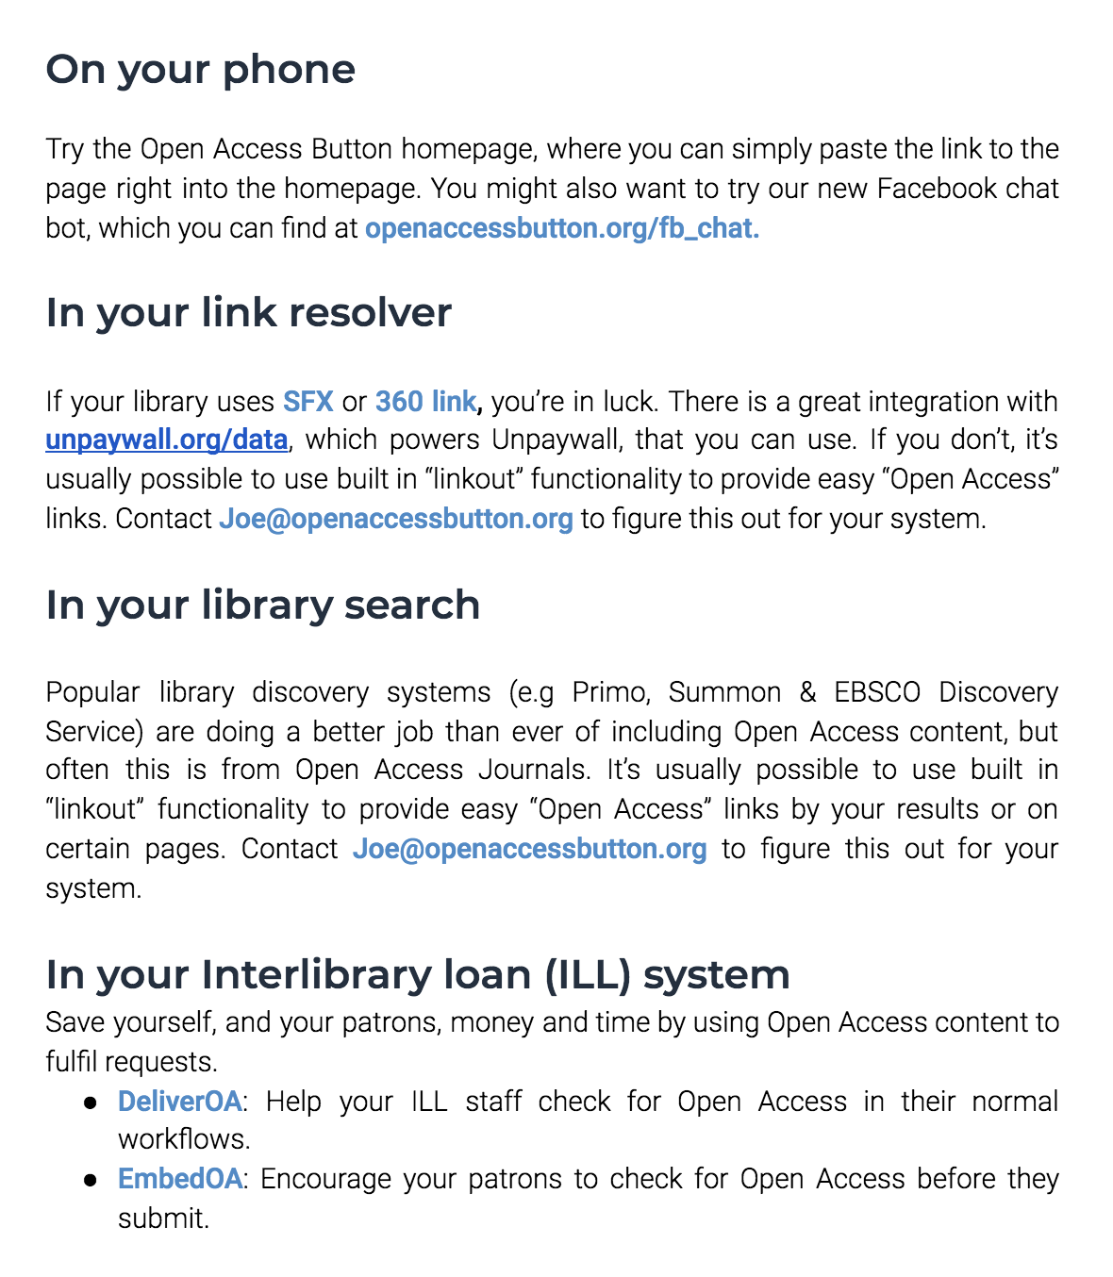
Get the handout

Slide 4
In this talk
Tools for legally avoiding paywalls
Integrating OA into ILL
What’s next?

Slide 5

About me & the Open Access Button
Me:
Started as a student frustrated by paywalls.
Co-founder, Open Access Button. Assistant Director of Right to Research Coalition. Organizer for OpenCon.
Open Access Button:
Building a family of community-owned tools that catalyse an open future since 2014. We help librarians increase their campus’s access to research, without needing a bigger budget.
Non-profit, Open Source, community-owned, Supported by SPARC (a coalition of academic libraries).

Slide 6
Thank you to...
Krystie at Bates University, Sarah at Centennial College, and many at Trinity & EIFL for help with EmbedOA
Renee at University of Virginia, Chris at Huddersfield, and Kenny at York for help with DeliverOA
Imperial College London for the inspiration and support
Our case study institutions
Several dozen of libraries around the world who have given comments & taken my calls
Jisc
SPARC
Cottage Labs
Our team, past & present

Slide 7
A tour of legal, free & fast ways to get around paywalls

Slide 8
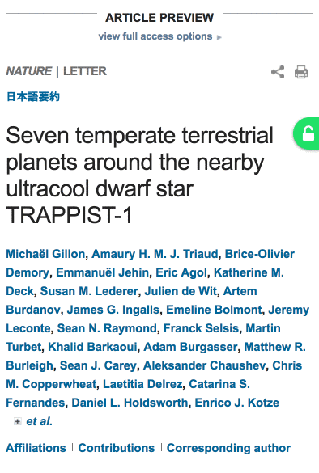
Unpaywall
Easy to use! Pops up on articles with DOI’s.
Available for Chrome & Firefox. Download the plugin in one click.
Made by Impactstory: https://impactstory.org/
Useful for: Your Researchers, your Staff, you!
Get it: http://unpaywall.org

Slide 9
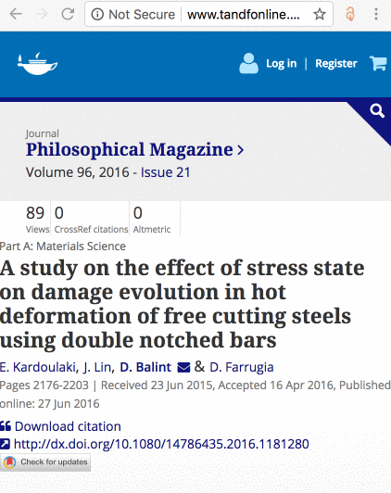
New: Open Access Button:
Article Available
Click on any article, or put a url, doi or title into the homepage search box.
Available for all major browsers. Use from the homepage or download the plugin in a click.
Doesn’t use Researchgate & Academia.edu

Slide 10
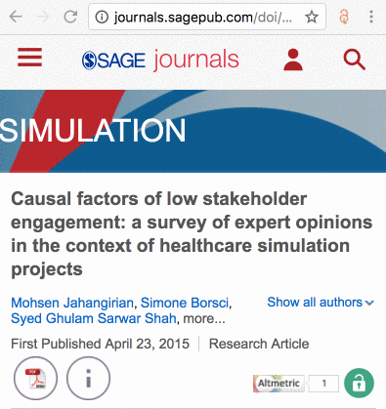
Open Access Button:
Article Not Available
When an article is unavailable, you’re automatically invited to request it from and author.
All you do is say why you want the article and sign in
You’ll get email updates on the progress of your request.
If the author shares it with you, everyone else who needs it will be able to access it.
Successful about 5% of the time, currently.

Slide 11
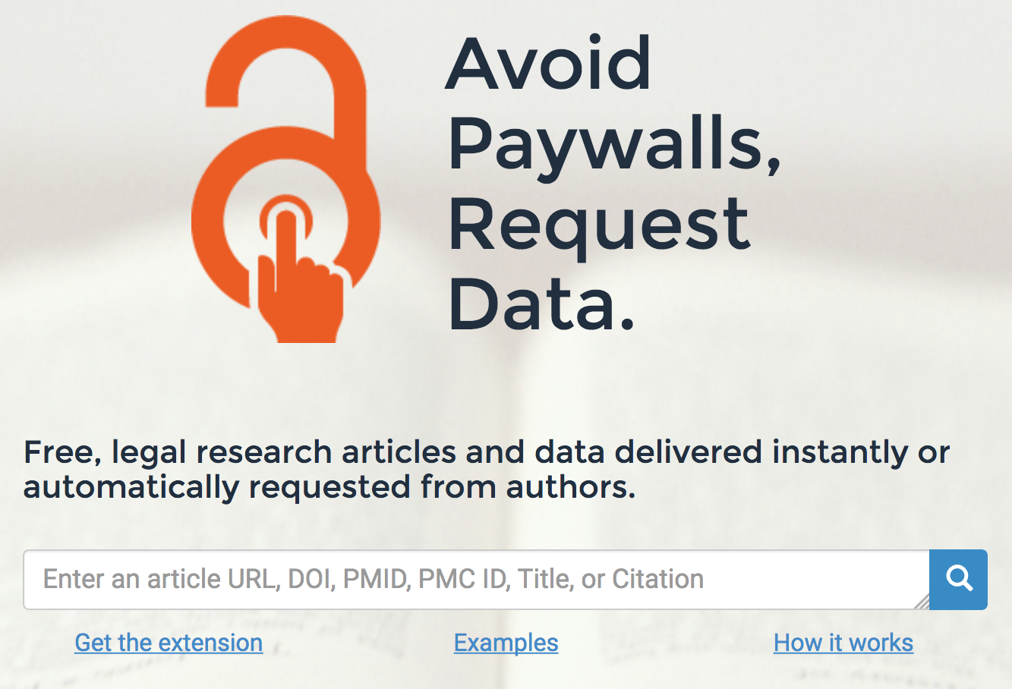
Using the Open Access Button
Use this search box to find articles immediately
(no installation or sign up)

Slide 12
About the content we find
Also known as “green Open Access”, author uploaded manuscripts or self-archived Open Access. Usually found in repositories.
Articles in repositories are often extremely similar to their journal equivalents.
We find “hybrid” articles (free articles in paid-for journals)
Self-archived versions can be hard to find, we make it easy.
We find articles from 5000+ repositories & “hybrid” articles.
We don’t use Researchgate & Academia.edu

Slide 13


Using the (new) Open Access Button
Click here on any scholarly article.
We will either take you to an Open Access version, or start a request to an author for you in a single click.
Try it here:
openaccessbutton.org/plugin_v4

Slide 14
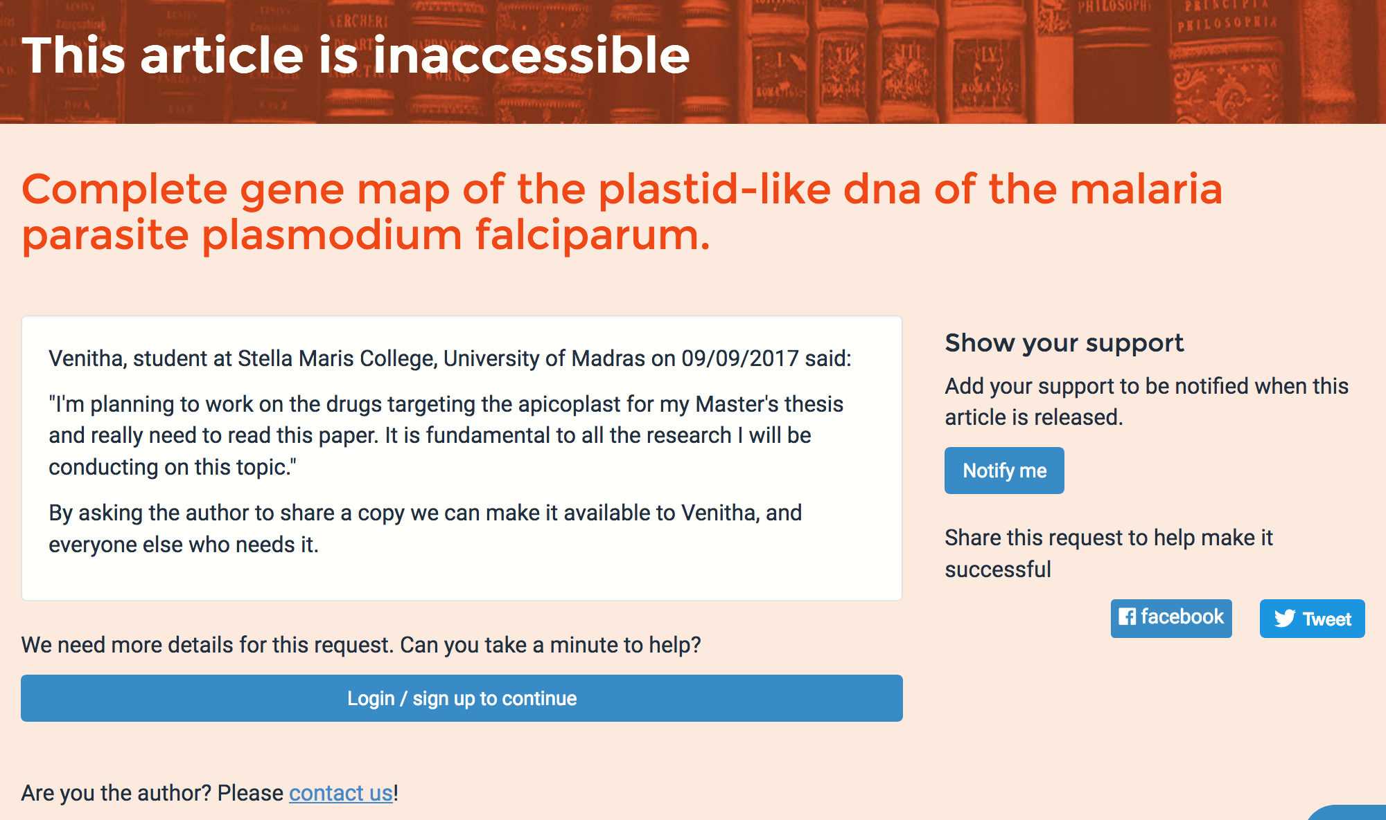
How the Open Access Button contacts authors on your behalf
Checking your story and request (so we don’t send spam)
Finding the author’s up to date email address
Sending authors a friendly message with your name and why you want the article
Guiding the author on providing a legal copy of their work
Putting the article in a repository (Zenodo)
Sharing the article with a user, and anyone else who needs it

Slide 15
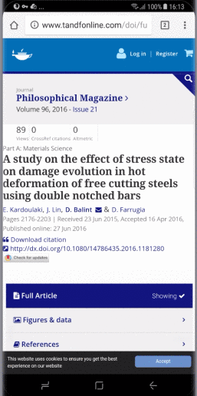
Finding Open Access on your phone:
Open Access Button Website
Paste the an article link or article doi / title into the Open Access Button homepage.
If we can find a free to read copy we’ll show it to you!
Useful for: Your Researchers, your Staff, you!
Use it: https://openaccessbutton.org

Slide 16

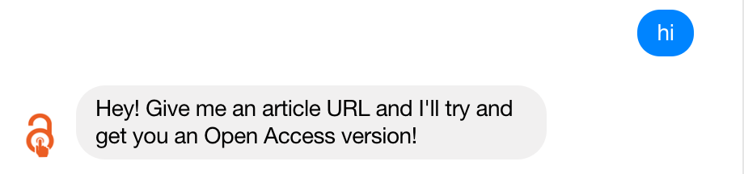
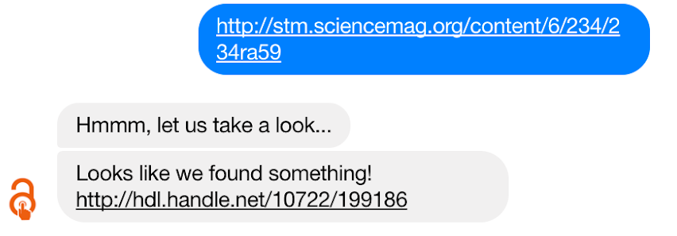
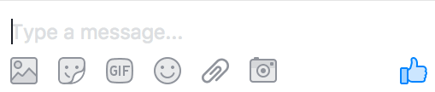
Finding Open Access on your phone:
Facebook Messenger (Coming Soon)
Great for when you’re on your mobile. Simply share the link to Facebook!
Get early access: https://openaccessbutton.org/fb_chat
Notes:
NOTE: Show sharing from a phone

Slide 17
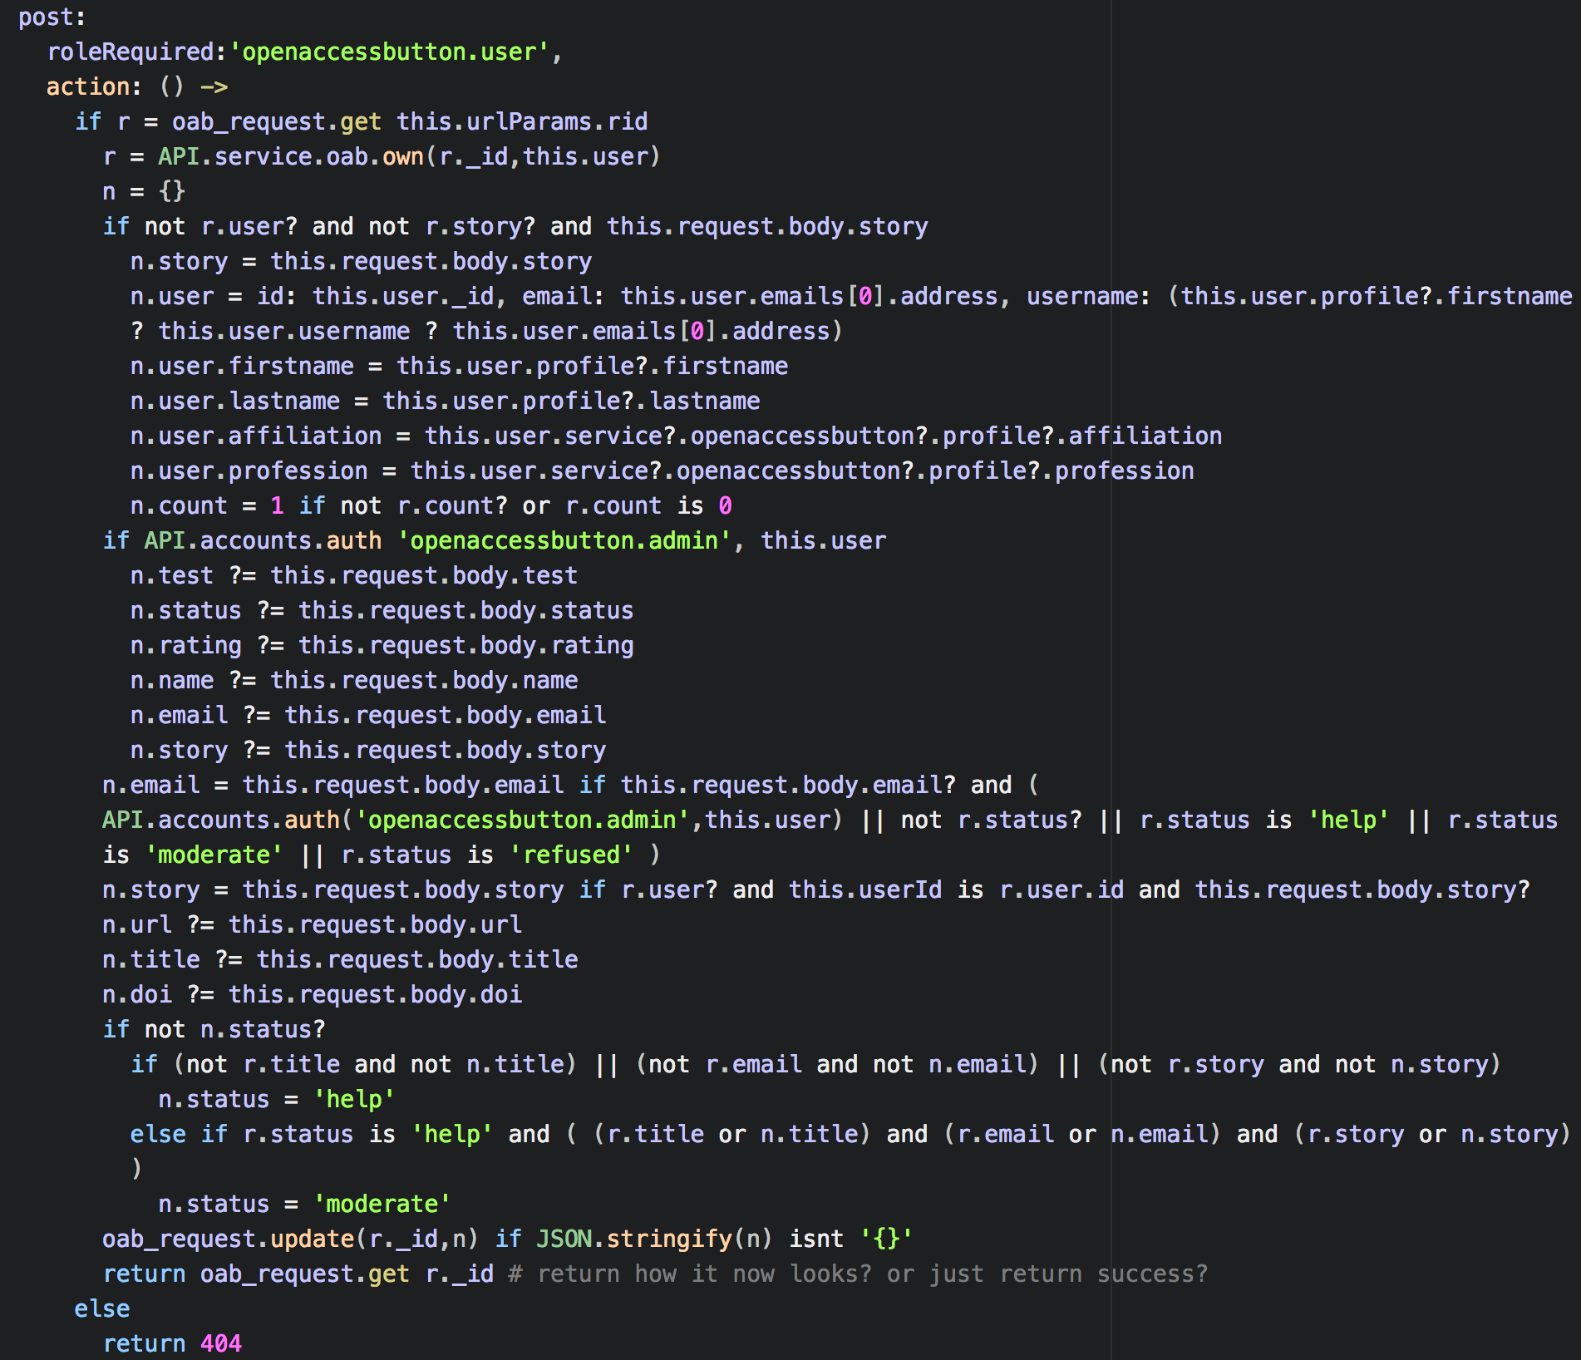
Open Access Button / Unpaywall API
Documented
Free
No sign-up required
Take a peak: openaccessbutton.org/api

Slide 18
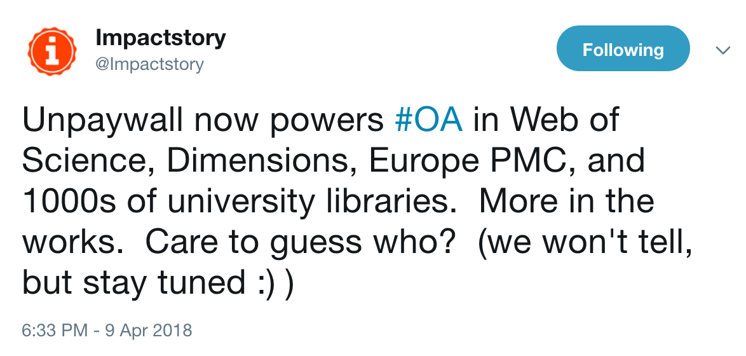
Across the web

Slide 19
Kopernio :/

Slide 20
How we are putting-
-OA in ILL-

Slide 21
Why we are putting-
-OA in ILL-

Slide 22
We believe the power of ILL systems can be leveraged to dramatically accelerate the awareness, use, and creation of Open Access, all while driving down ILL costs and improving the service.

Slide 23
Stay in the know
openaccessbutton.org/libraries
(big announcements on the way)

Slide 24
But... right now
Talking to ~50 universities around the world we found:
Most ILL systems don’t allow easy discovery or delivery of Open Access
Many ILL staff don’t know about Open Access or have to leverage it
Many ILL staff have concerns about how patrons will respond to fulfilling with Open Access
Almost no ILL staff use ILL to drive article deposits
Usually ILL systems are unfriendly (for everyone) to use
Many ILL systems aren’t well integrated on campus
Many campuses suggest their patrons search for an Open Access copy before submitting an ILL - but don’t say how

Slide 25
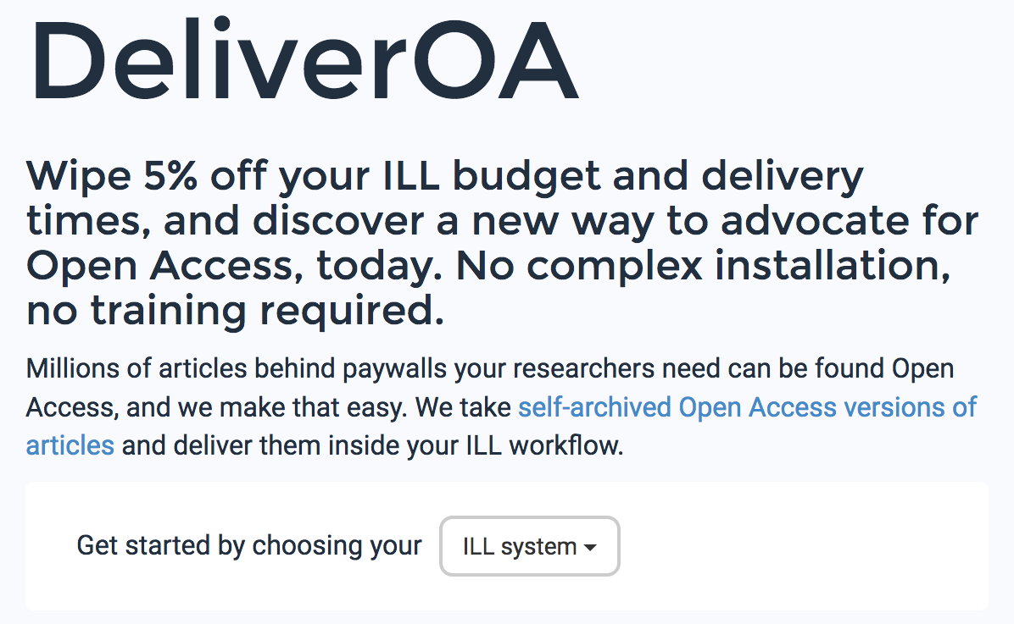
NEW: Finding OA when processing Interlibrary Loans (ILL)
Helps ILL staff check for Open Access without changing their workflows
Provides resources & advice for staff on what to send.
Works on Alma, Clio, ILLiad & email with more on the way
Similar to our website & plugin, but honed for ILL staff

Slide 26
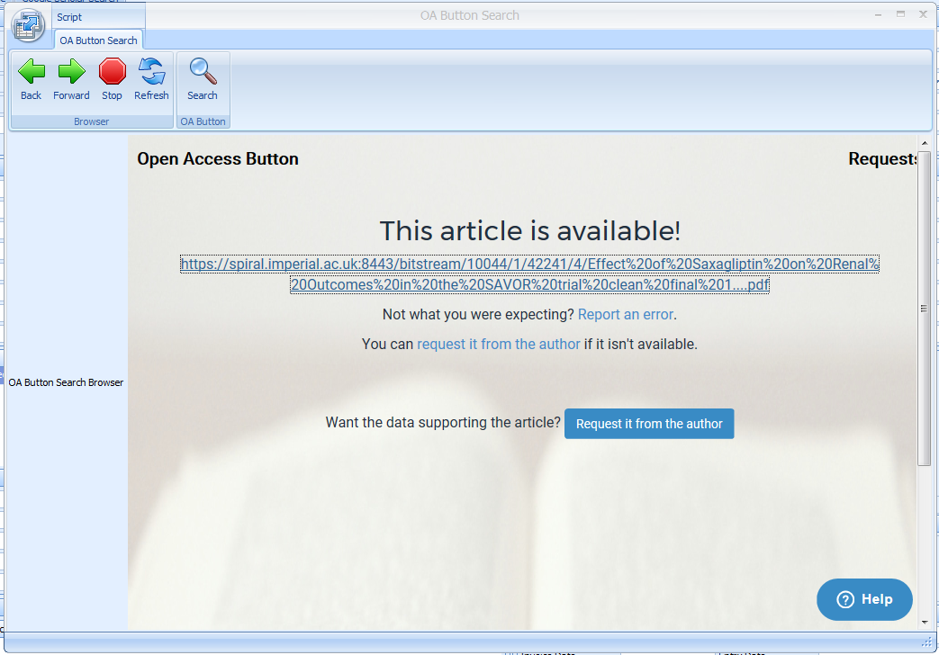
DeliverOA: finding OA in Clio

Slide 27
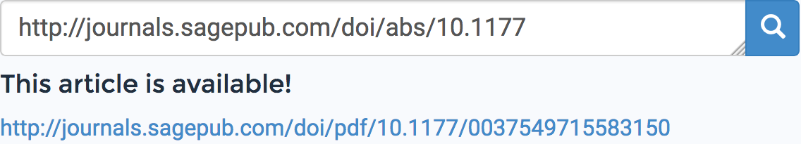
NEW: Add a search bar to your library webpages
Make it easy for your researchers to discover Open Access articles before they make Interlibrary loans or browse your Libguide. No coding skills required.
^ Put an easy to use search bar on any of your libraries pages!
Notes:
NOTE: Could show the box as a standalone, and say put this anywhere

Slide 28
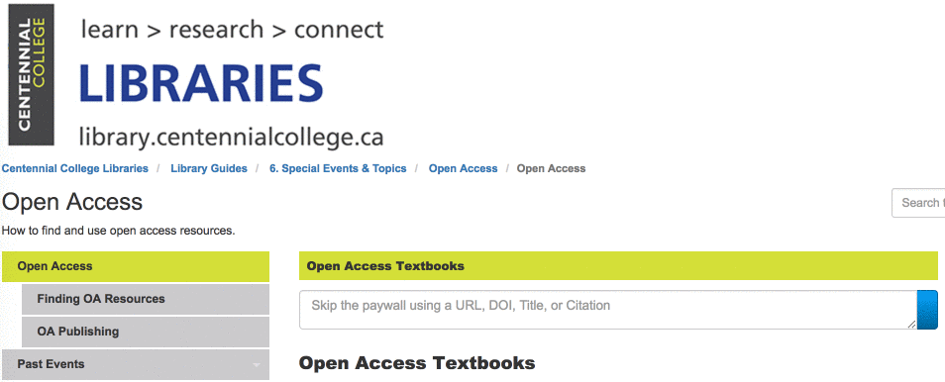
NEW: Add a search bar to your library webpages
Make it easy for your researchers to discover Open Access articles while they make Interlibrary loans or browse your Libguide. No coding skills required.
Notes:
NOTE: Could show the box as a standalone, and say put this anywhere

Slide 29
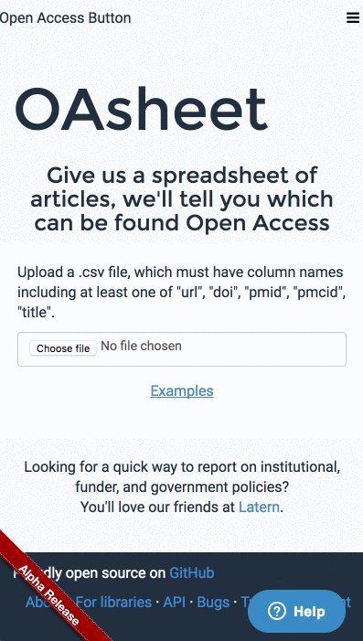
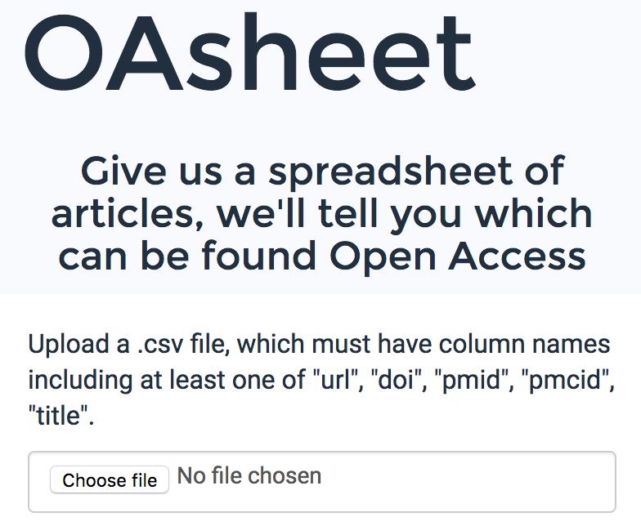
NEW: Finding OA alternatives for lots of articles at once!
Upload a spreadsheet with a list of articles, and it does the rest.
We’ll send you a spreadsheet with a list of article we could find Open Access alternatives for.
Useful to check compliance, find how much of a journal is OA, see how many ILLs you could fill with OA.
If you’re technical: openaccessbutton.org/api or oadoi.org are more powerful.

Slide 30
Working with authors to make their work open as part of ILL
Librarians are happy to have all ILLs start requests to authors to make the work Open Access.
Many happy to have university name associated with requests.
Expected to see a success rate above our usual requests due to the university brand name.
Not managed to implement yet due to logistical difficulties. However, these are slowly being overcome.
Currently rapidly experimenting with different approaches.
Notes:
NOTE: Could show the box as a standalone, and say put this anywhere

Slide 31
Work in progress
*Names, features, plans... all may change*
*Please hold your tweets*

Slide 32
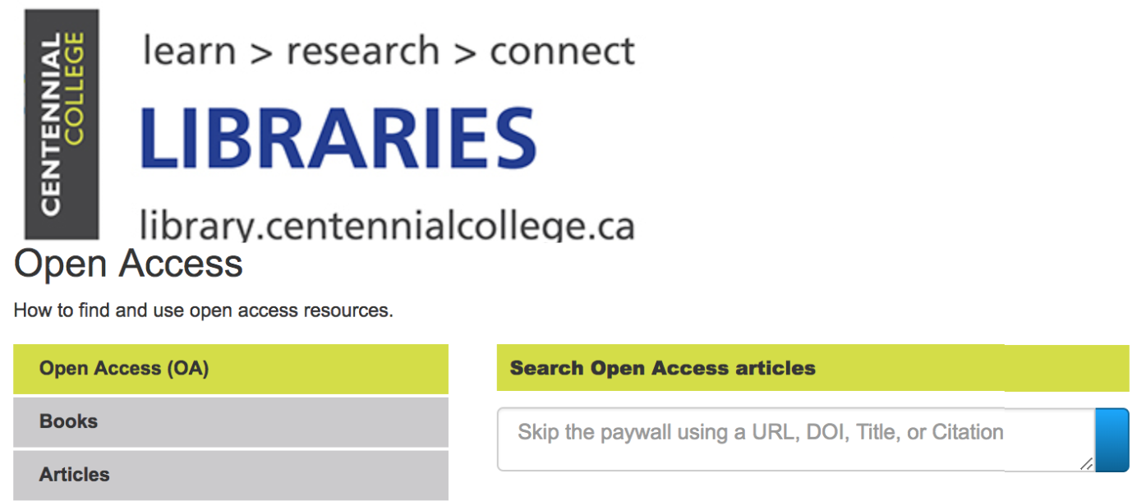
InstantILL: a supercharged ILL form
Subscriptions, Open Access, ILL and other services work to deliver content through your ILL form instantly.
~10-20% of content delivered instantly. All requests checked to save your staff time.
Submits ILLs, already checked against subscriptions & with great Metadata, to your ILL system.
EmbedOA (shown left) sets the scene for this new type of ILL form. Try it today.

Slide 33
GetPDF: All delivery services, one button
Subscriptions, Open Access, ILL and other services all in one button that is always by your patron’s side.
Comes pre-installed on Library PC’s or installed onto a users browser
Prototyped with Imperial College London. Need support from libraries to advance development.
The new Open Access Button (shown right) sets the scene for this move. Use it today.

Slide 34
Stay in the know
openaccessbutton.org/libraries
(big announcements on the way)

Slide 35
Get the slides
openaccessbutton.org/uksg
With bonus content, further reading & a handout.

Slide 36
Questions, feedback?
Contact me @mcarthur_joe or Joe@openaccessbutton.org
or come and chat to me.

