Slide 1



Floral
PRESENTATION
by EaTemp.com

Slide 2

Table of Contents
1
4
Introduction
Magic
The Realm of the Extraordinary
Spellcasting
2
5
Encounters
Adventure
Unicorn Sightings
Happily Ever After
3
6
Wonders
Conclusion
Wishes Granted
Embrace the Fantasy

Slide 3



Introduction
The Fantasy Realm: Uncovering the Secrets of the Imagination and the Magic that Lies Within

Slide 4

The Realm of the Extraordinary
Welcome to the Fantasy World, a realm of wonder and enchantment where anything is possible. Here, dragons breathe fire, unicorns prance through meadows, and rainbows shine brightly. This world is a place where wishes come true, where potions can be cursed and spells are cast. It's a place of treasure and adventure, where the impossible becomes possible. But the greatest treasure of all is the one that lies within.
The world of fantasy is a reflection of our deepest desires, our fondest dreams, and our wildest imaginations. It's a place where we can let go of the constraints of reality and explore the boundless possibilities of the human mind. In this introduction, we will delve into the mysteries of this realm, uncovering the magic and wonder that lies within. So come with us and let's embark on a journey through the Fantasy World and discover the true magic that lies within.

Slide 5

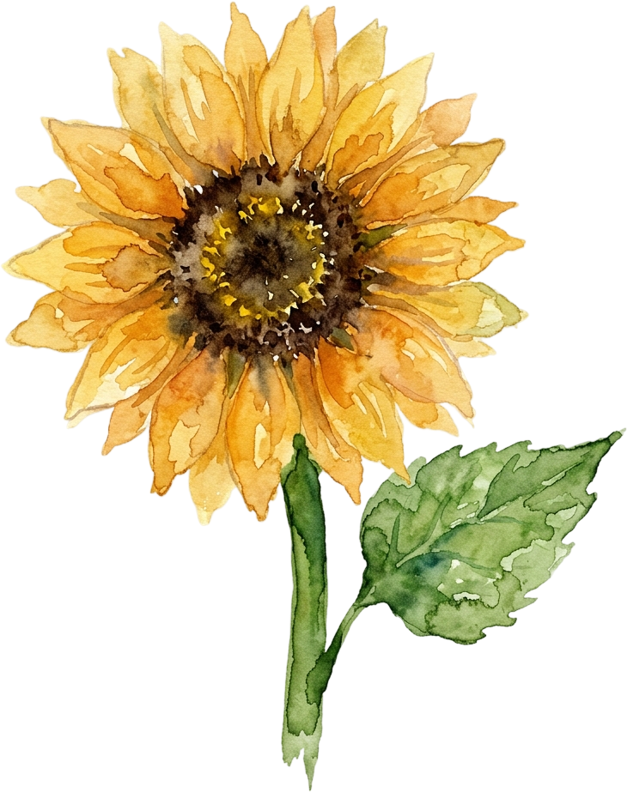
Imagination and Fantasy
A place of endless possibilities and endless adventures
Dragons can be tamed, unicorns can be sighted, and rainbows are a daily occurrence
Not just about the creatures and wonders that populate this realm, but also about the journey of self-discovery and the exploration of the human imagination
A reflection of our deepest desires and our fondest dreams
A place where we can let go of the constraints of reality and explore the boundless possibilities of the mind

Slide 6
Encounters
Encountering the Inhabitants of the Fantasy Realm: From the Enchanting to the Fearsome

Slide 7



Encounters
Unicorn Sightings
Dragon Taming
A record of the number of unicorns spotted in the fantasy realm and the beauty and mystery that surrounds these enchanting creatures.
A closer look at the art of taming dragons and the brave adventurers who dare to take on these fearsome creatures.

Slide 8




Encounters
Rainbow Sightings
Cursed Potions
The significance and beauty of rainbows in the fantasy realm and the magic they bring.
The darker side of magic, and the dangers of cursed potions in the fantasy realm.
Wishes Granted
Magical Encounters
The power and magic of wishes and how they come true in the fantasy realm.
The different magical creatures that can be encountered in the fantasy realm and the wonder.

Slide 9
Wonders
A sense of awe and amazement in the face of something extraordinary or unexpected.

Slide 10


“
Fantasy is the gateway to the impossible, the land where the ordinary becomes extraordinary, and the impossible becomes possible. It is the realm of the imagination, where anything can happen and everything is possible.
The Dream Weaver

Slide 11


The Wizard's Workshop
A Fascinating Peek into the World of Fantasy Magic and Spellcasting, Where the Secrets of the Realm are Revealed

Slide 12
Magic
A world of spellbinding wonders and mythical creatures where magic is the key to unlocking the impossible.

Slide 13

234,567
Unicorn Sightings
A tally of the number of unicorns spotted in the fantasy realm.

Slide 14
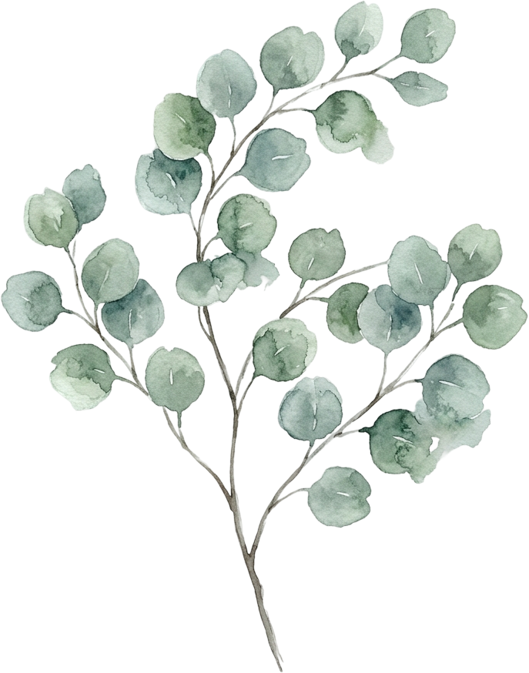
233 Coins
85%
Treasure Found
Wishes Granted
456 Minutes
678 Km
Duration of Spell Casting
Journey Distance

Slide 15












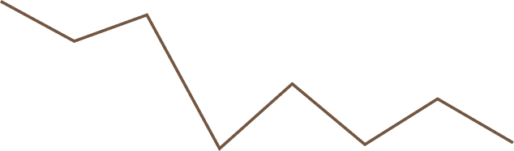




















Fantasy World Data
100
90
80
70
60
50
68%
40
30
20
10
0
1
2
3
4
5
6
7
8
Treasure Found
Spellcasting Progress
A record of the amount of treasure found per month
A record of the number of spells cast per year

Slide 16



Portal to Adventure
A web application designed for discovering the world of fantasy

Slide 17



































































The Future of Fantasy
An app designed for exploring and experiencing the enchanting realm of fantasy

Slide 18


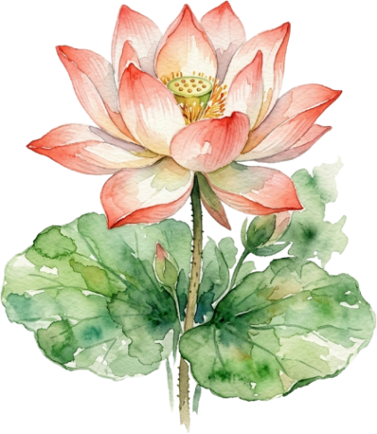
Portal to Adventure
A web application designed for discovering the world of fantasy

Slide 19
Adventure
Embark on daring adventures, face challenging obstacles and discover hidden secrets in a realm full of limitless possibilities.

Slide 20
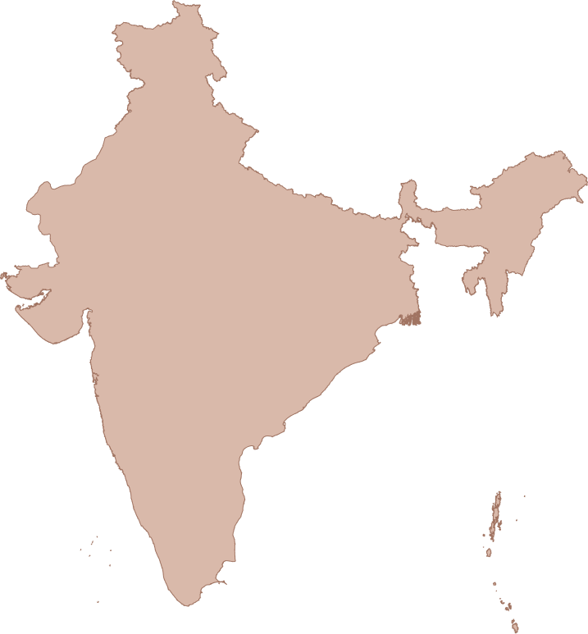

Fantasy Realm at a Glance
The Enchanted Forest
A magical forest filled with talking animals and enchanted creatures.
The Crystal Caves
A network of underground caves filled with precious gems and crystals.
The Dragon's Lair
A dangerous and mysterious place where dragons reside.

Slide 21





The Fantasy Timeline
Dragon Taming
Unicorn Migration
First dragon was successfully tamed
Large herd of unicorns migrated to the realm
Enchanted Pool
Rainbow Sightings
A magical pool with power to grant wishes
Unusually large number of rainbows were sighted

Slide 22

Fantasy Infographic
01
02
03
Spellcasting Competition
Treasure
Hunt
Great
Adventure
A significant event in the history of the fantasy realm, in which the greatest spellcasters of the realm competed in a tournament.
A significant event in the history of the fantasy realm, in which a massive treasure hunt was organized, leading to the discovery.
A notable year in the history of the fantasy realm, in which a large number of adventurers set out to explore and discover new parts of the fantasy realm.

Slide 23
Fantasy Table
QUEST
DIFFICULTY
REWARDS
Searching for the Holy Grail
High
Wealth and Prosperity
Retrieving the Golden Fleece
Medium
Treasure and Ancient Knowledge
Finding the Sorcerer's Stone
Low
Knowledge and Foresight

Slide 24








































Fantasy Graph
25%
35%
Wishes Granted
Medieval-like Worlds
15%
25%
Dragon Appear
Chosen One

Slide 25



Our Team
Full Name
Full Name
Full Name
Title
Title
Title

Slide 26
Conclusion
Experience the magic and thrill of the extraordinary in the realm where anything is possible and every journey is unique.

Slide 27

Fantasy List
Dragons
Fire-breathing creatures that are often powerful and dangerous
Medieval-like Settings
Worlds with castles, knights, and feudal systems
Chosen One Trope
A hero chosen by destiny to save the world
Magic
An integral part of fantasy stories, can take many forms
The Best Curse
A curse that is unique, creative, and fits within the story
Unique Creatures
A variety of fantastical beings that inhabit the world

Slide 28



Fantasy Quest List
The Quest List
Yes
No
Dragon's Treasure
Missing Heir
Ultimate Spell

Slide 29

Thank You
Title Font
Marcellus
Body Font
Avenir
Icon
Ant Design Icon
by EaTemp.com

