Slide 1

Why Hasn’t Evidence-based Practice Had A Greater Impact On Education?
Wing Institute 2014
Summit
Jack States
Notes:
Welcome – looking forward to to this years Summit because of the topic of culture. I have felt vexed with the slow pace of change in education. This is specially frustrating when we see so many pockets of excellence. After 40 years its I have witnessed the development of a robust knowledge base of effective practice, but despite this progress these practices are not being embraced by the mainstream.

Slide 2
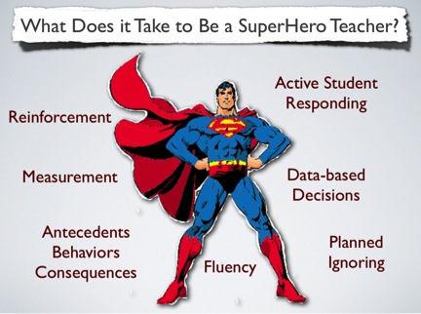
Janet Twyman, 2014
Notes:
- What we know is Teachers and how they teach are the #1 factor in improving student achievement.
- Success is complex requiring change in the behavior – we would all like a magic bullet such: class size reduction, charter schools, or accountability
- Randy and my teaching story
- Last year we identified 4 critical skill area in our Explicit instruction model

Slide 3
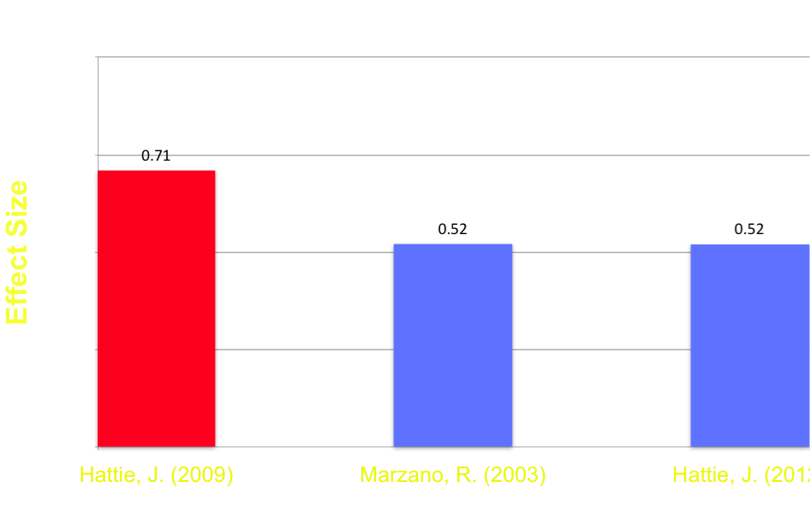
Classroom Management
Appropriate
Behavior
Classroom Management
Notes:
14 practices elements in classroom management in four categories - 1. Pro-active Management 2. Rules and procedures 3. Behavior reduction 4. structured environment

Slide 4
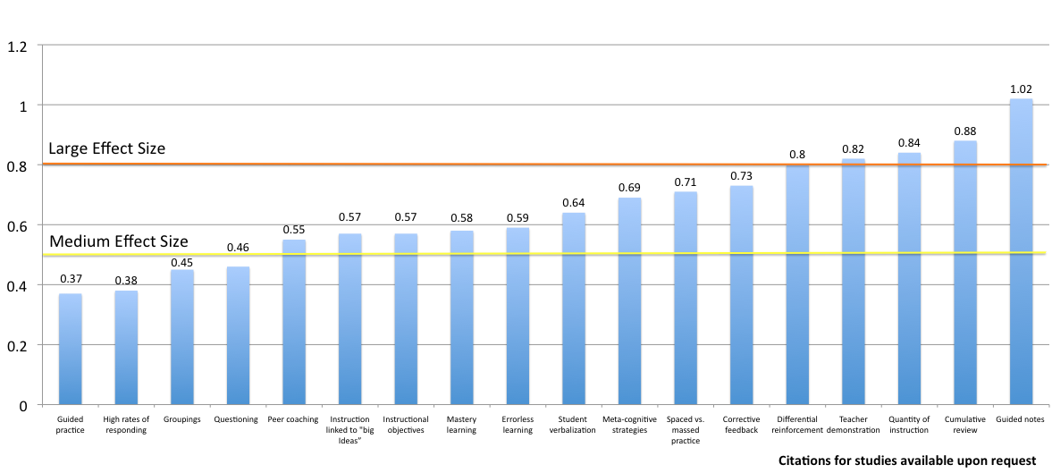
Instructional Delivery
Notes:
25 Instruction delivery elements – highlight: active responding, instructional objectives, mastery learning, quantity of instruction

Slide 5
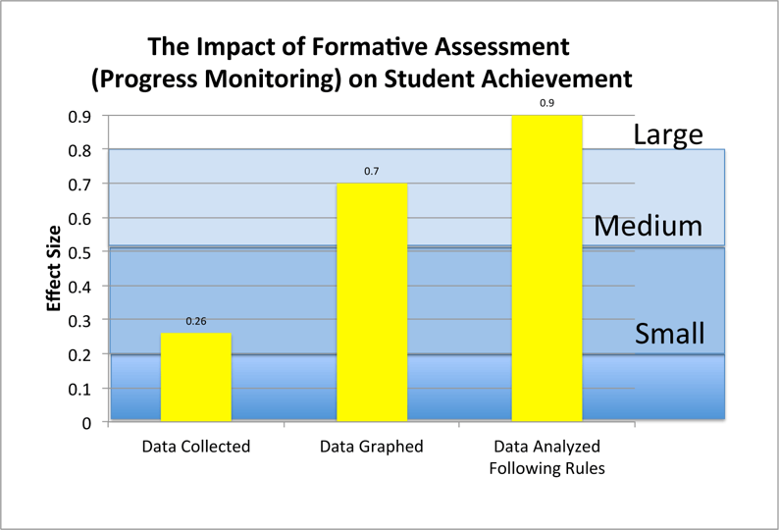
Formative Assessment
Fuchs and Fuchs, 1986

Slide 6
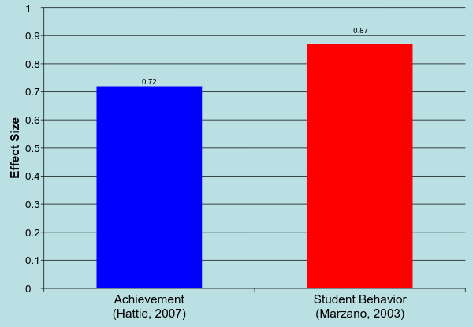
Soft Skills
Teacher – Student Relations
Notes:
Ability to show empathy, warmth, encourage student learning, be adaptable to novel situations, exhibit cultural sensitivity and show respect for students

Slide 7
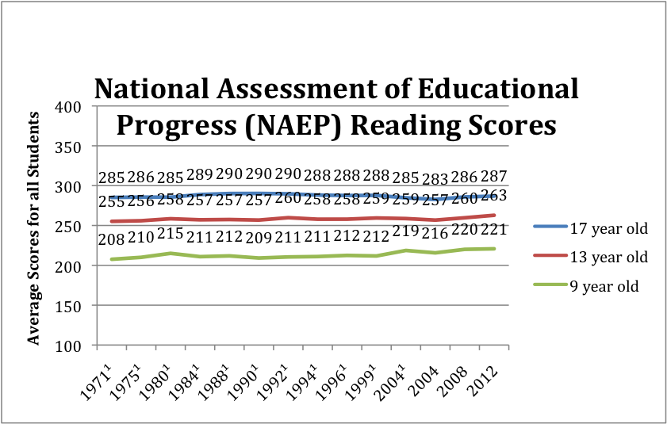

NAEP Scores
Notes:
Despite deep knowledge base explicit practices are not being adopted or sustained

Slide 8
Why Culture Is Important to
Building An Evidence-Based Model?
Americans are ill informed and skeptical of science
To win the hearts and minds of policy makers, educators, and the public
To overcome advantages held by competing educational approaches
To overcome the limitations of large social change delivered one individual at a time

Slide 9

What is Culture?
The arts and other manifestations of human intellectual achievement
Not For Our Purpose
Notes:
No single definition for organizational culture. Studied from a variety of perspectives ranging from disciplines such as anthropology and sociology, to the applied disciplines of organizational behavior, management science, and organizational communication
Organizational culture: Business in 1980’s – Education – adopted in the 1990’s.
In organizational culture 2 strands, functional that emphasizes Behavior, contingencies, and artifacts specific to a group and the other, that focuses beliefs and values. (Riley, 1983)

Slide 10

One View of Culture
…a collection of common verbal and overt behaviors that are learned
and maintained by a set of social and environmental contingencies (i.e. learning history)……
Sugai, O’Keefe and Fallon (2012)

Slide 11
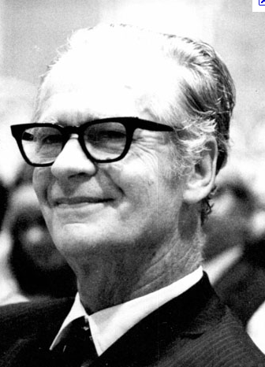
The Role of Culture
“As a set of contingencies of reinforcement maintained by a group…
The group has…
a continuing existence beyond the
lives of members of the group,
a changing pattern as practices are
added, discarded, or modified…
A culture so defined controls the behavior of the members of the group that practice it.”
B.F. Skinner
Notes:
Skinner was quoted in 1971 upon the publishing of his work “Beyond Freedom and Dignity” , “if business would take seriously reinforcement theory within a year, they could become a model of human competence, productivity and happiness. Schools could easily solve most of their problems. Unfortunately, 40 years later we are still waiting for the revolution.

Slide 12
Performance Management and Organizational Behavior Management (OBM)
View of Culture
  Culture Change
    Values
    Policies and Goals
    Behavior
Contingencies
Tom Gilbert
Notes:
Tom Gilbert claimed that behaviorism has been unsuccessful in having a greater impact because it failed to address the issue of Values

Slide 13
Who Is Having The Greatest Impact In The Classroom?
Constructivists
Practitioners of explicit instruction
Notes:
Discovery learning and Direct Instruction

Slide 14
Comparing The Two Dominant Approaches to Teaching
Explicit Instruction | Constructivism
The teacher and student share responsibility for learning | The student is self directed and responsible for their own learning
The role of the teacher is to teach concepts, skills, and knowledge | The role of the teacher is to provide a context and process for students to discover concepts, master skills, and acquire knowledge on their own
The role of the teacher is to provide systematic instruction tied to standards and goals | Students create knowledge of the world through personal experiences not tied to external standards and goals
Teachers master evidence-based teaching skills | Teachers develop their own philosophy of education and personal style of teaching
Formative assessment is key to ensuring student progress | Assessment of student progress is subjective
Higher order thinking is systematically taught and dependent on student mastery of foundation skills | Higher order thinking and foundation skills are learned as required to solve problems
Notes:
Clear distinction between the belief systems – I understand the appeal the emotional power of discovery, but a non systematic approach is akin to medicine before science. You try something until you stumble upon something better. Bloodletting. Can we wait decades for teachers to randomly discover what works? I think not.

Slide 15
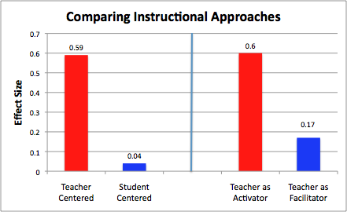
What is the Impact of Education Philosophy on Teaching?
Hattie, 2009
Notes:
Despite constructivist appeal the research supports explicit model

Slide 16
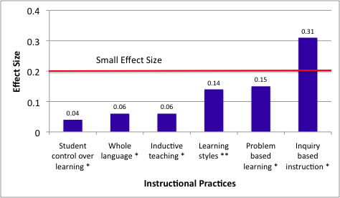
Less Effective
Instructional Practices
* Hattie, 2009 ** Kavale, 1987
Notes:
Practices associated with constructivism do not hold up under scrutiny

Slide 17
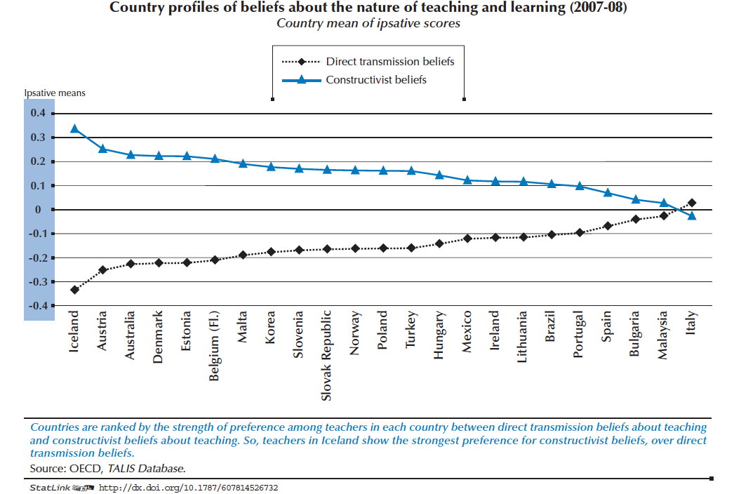
Notes:
Organization for Economic Co‑operation and Development – Teaching and Learning International Survey (TALIS)
Hall K, Harding A (2003) A systematic review of effective literacy teaching in the 4 to 14 age range of mainstream schooling.
Teachers observations were characterized by a balance of constructivist and direct instructional practices

Slide 18
What Do These Terms Describe?
The search for social justice
Authentic learning
Student centered
Learning occurs through discovery
Teaching students how to think, not what to think
Real world learning
Intrinsic motivation
Helping students become caring, responsible problem solvers
Facilitating creativity
Learning is democratic
Systematic skills building
Mastery learning
Component skills to composite
Behavioral cusp
Formative assessment
Contingent praise
Errorless learning
Blooms taxonomy
Notes:
The constructivist descriptors are warm, inviting, appealing to many of our human values. Explicit descriptors come off sounding cold and mechanistic
Video Next - Observe the video for your reaction. What do you observe, How do you feel about what you see

Slide 19


Slide 20
What Was Your Reaction To The Video?
High Rates of Responding (Active Responding)
Classroom Rules
Corrective Feedback
Differential Reinforcement
Structured Environment
Quantity of Instruction
Notes:
I see a well organized classroom with student engaged. I observe these practices in action

Slide 21

“The Culture Divide”
…Watch a group of children respond like trained seals to a teacher clapping. I'm amazed that this is supposed to pass for higher-level thinking. To me, it looks like the creation of little, semi-robotic creatures who will happily fold t-shirts at Walmart for 8 bucks an hour. ….
…the real problem is that this exercise isn't "developmentally" appropriate for these kids -- Having five year olds count to 15, with a clapping/snapping/goonily-smiling teacher, is neither rigorous nor effectively producing college-ready kindergartners.
They stopped the video before the kids get the food pellets!
I think she moonlights at Seaworld....we must have missed the minnow treats.
You should see when the teacher claps twice. All the kids roll over and fetch her the morning newspaper.
(NY Educator, 2013)
#1
Notes:
This video from the New York Educator. We are not successfully framing our practices in a way that educators are embracing. We are losing the culture war. They predominate. They are telling a better story while appealing to peoples emotions. One reason is we haven't thought it was relevant or important (science for science), oh I guess when I talk about relevant or important I am talking about culture values.

Slide 22
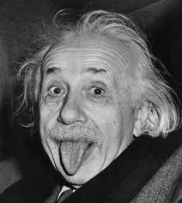
How Do Americans Feel About Science?
#2
Notes:
the National Science Foundation - 90 % of Americans think scientists are "helping to solve challenging problems"
26% of respondents said the sun revolves around the earth (44% for EU) and only 48% percent knew that human beings developed from earlier species of animals.

Slide 23
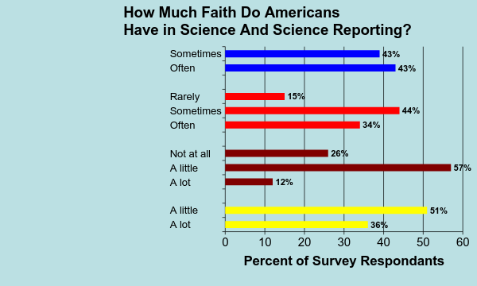
Findings influenced by
companies funding
Results influenced
by politics
Trust science journalists
Trust what scientists report
Huffington Post and YouGov, 2013
Notes:
Companies = 86% --- Politics = 78% ----- journalist 0ver 80% --------- what science reports = 51% #2 The American public is ill informed regarding science and are skeptical about what science is reporting

Slide 24
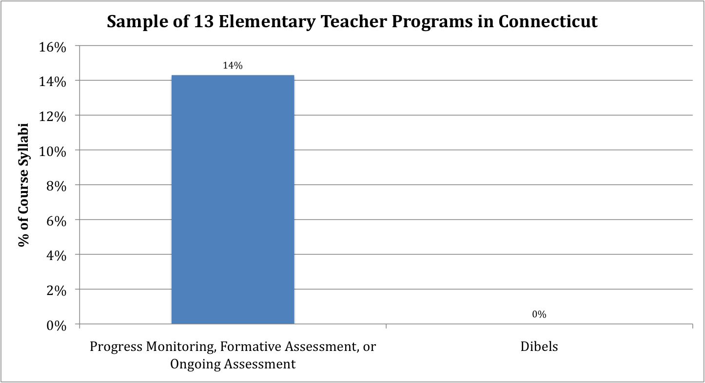
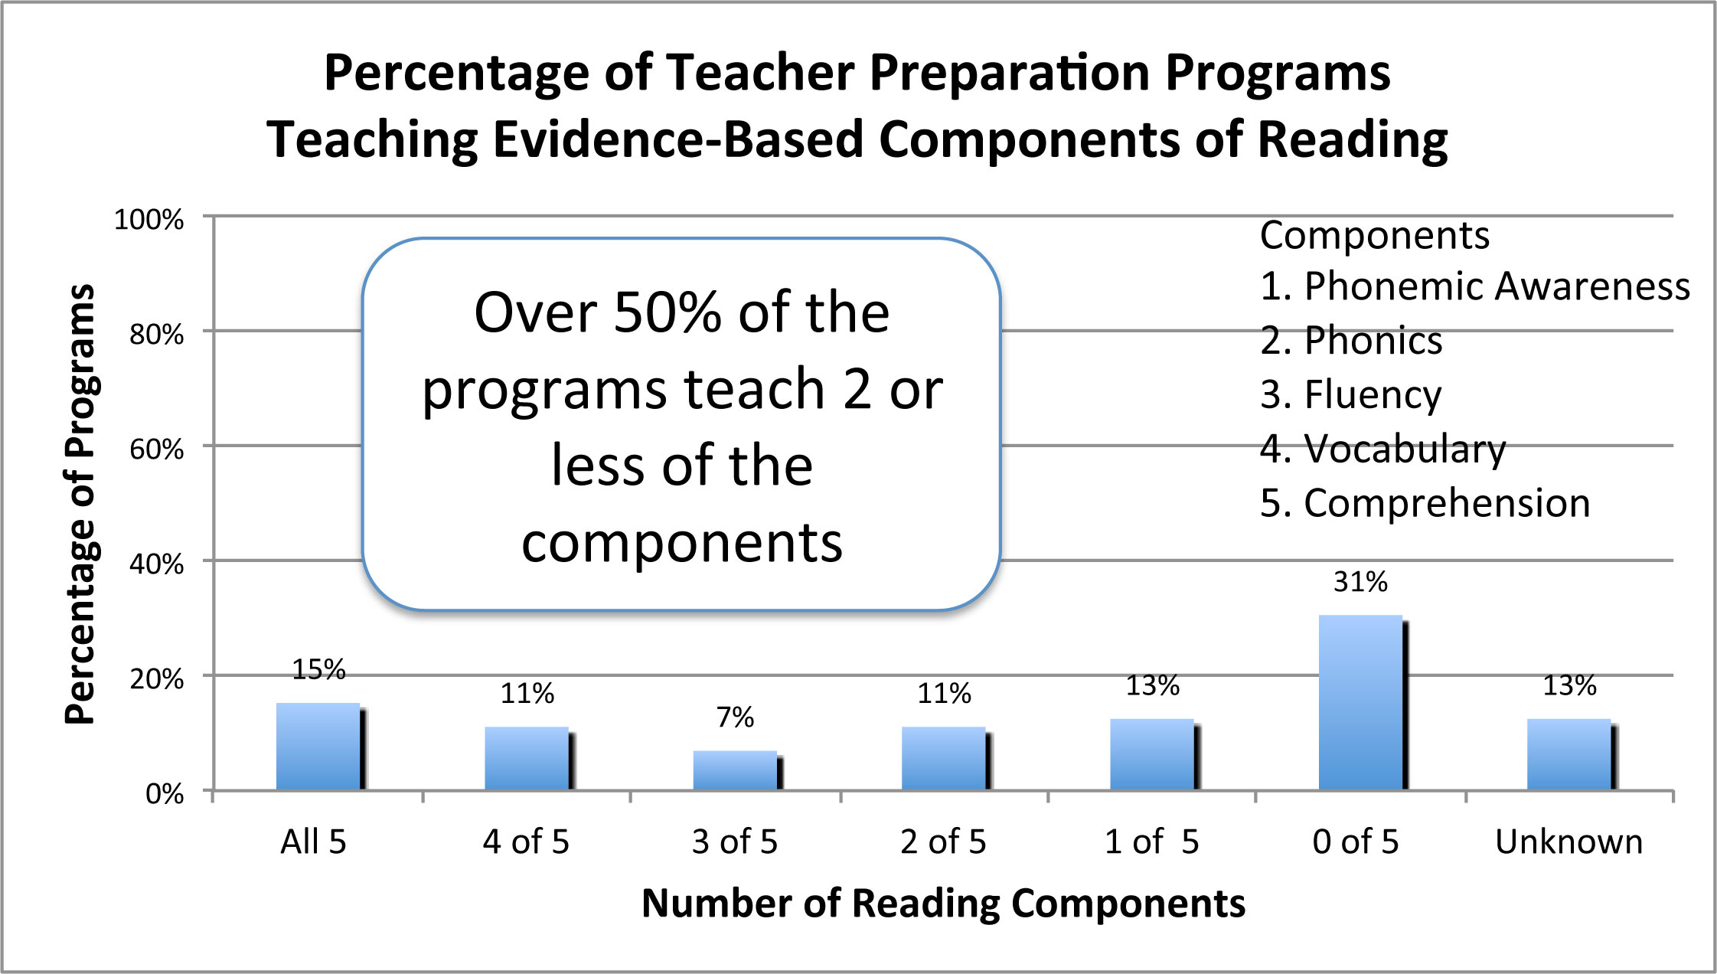
Impact of Teacher Preparation
#3
Spear-Swerling (2008)
Walsh, Glaser, and Wilcox. (2006)
Notes:
Steiner, 2004 - 16 mostly well-regarded colleges of education all emphasized constructivism
National Reading Panel
#3 Constructivism predominates Teacher preparation

Slide 25


Long Term Versus Short Term Contingencies
#4
Notes:
Art vs. Science – Not art if we mean it is beyond analysis – not science because we are interested in more than just describing the world we are interested in changing children
Classroom teacher will make more than 800 - 1,500 educational decisions every school day. - Kauchak & Eggen (2005) Danielson (1996) 3,000
Explicit model teachers must master a set a skills – Trained and coached: This takes time, effort, and money – long term rewards
Constructivist payoff is immediate, can’t be evaluated, easy to implement because you select what you want vs what works
#4 – The contingencies maintaining Constructivism are winning the short term vs long term

Slide 26
Take Away Message?
We have a robust knowledge-base of practices supported by science that work and those that do not
Despite knowing what works, most teachers embrace constructivism
The constructivists are doing a better job of framing the debate
The foundation of explicit instruction, science, is misunderstood by the public
Constructivist control of a majority of teacher preparation programs
In a head to head match constructivism is winning the short term contingency vs the long term contingencies
Notes:
Take Away is Being right is not enough

