Slide 1


To Access Your Editable Presentation Click the “Use Template” button.

Slide 2


Brivity’s Editable
Buyer Presentation
Your Secret Weapon to Winning with Buyers
Brivity.com

Slide 3
Get Buyers to sign with you with buyer presentation developed and used by top-performing agents.
Start using this presentation by following these steps:
Add your branding (logo, images, fonts, colors) to the buyer presentation (pages placeholder).
Review the buyer presentation and update any information that is pertinent to you, such as removing or adding strategies & tools your business does or does not offer.
(Optional) Add a slide in this deck, communicating the value of your vendor partnerships such as your mortgage lender and how through these partnerships you will help them secure the best fees, and reduce costs on their end.
Print pages 4-25 on high-quality paper (in settings, choose letter size and fit to printable area).
Three-hole punch the buyer presentation and put it inside a binder with a branded cover page.
After the appointment, follow up with a handwritten thank you card.
With your buyer presentation branded to you and ready to present, you’ll bring the wow factor to every buyer!
WANT TO LEARN MORE ABOUT BRIVITY? SCHEDULE A DEMO TODAY!

Slide 4


© Powered by Brivity

Slide 5

IT’S ABOUT YOU
Your needs. Your Dreams. Your Questions. Your Timeline. Your WEALTH.
We will work with you to understand your unique lifestyle, needs, and wishes. Buying a home is about more than just your next move. It's about your life.

Slide 6
WELCOME
Thank you for the opportunity to represent you!
As your real estate team, our goal is to make your dream of owning a home a reality so you can build the financial strength and security that homeownership provides. A recent US Census study reported that the average homeowner’s net worth in the United States is 38 times that of a renter.
Your growing net worth can be used to start a new career or business, take care of loved ones, send a child to college, give generously to others, or retire, among other things.
In fact, government incentives from homeownership surpass those of almost any other investment vehicle.
Buying a home is an investment like no other, and part of the ultimate benefit is that your monthly living expenses go right back into building your net worth instead of building someone else’s. Most importantly, the biggest benefit of homeownership is building tax-free wealth. Unlike returns from other investments, the return on homeownership—what economists call “imputed rent”—is excluded from taxable income.
You are in good hands now! Our mission is to deliver your dream of being a homeowner.

Slide 7

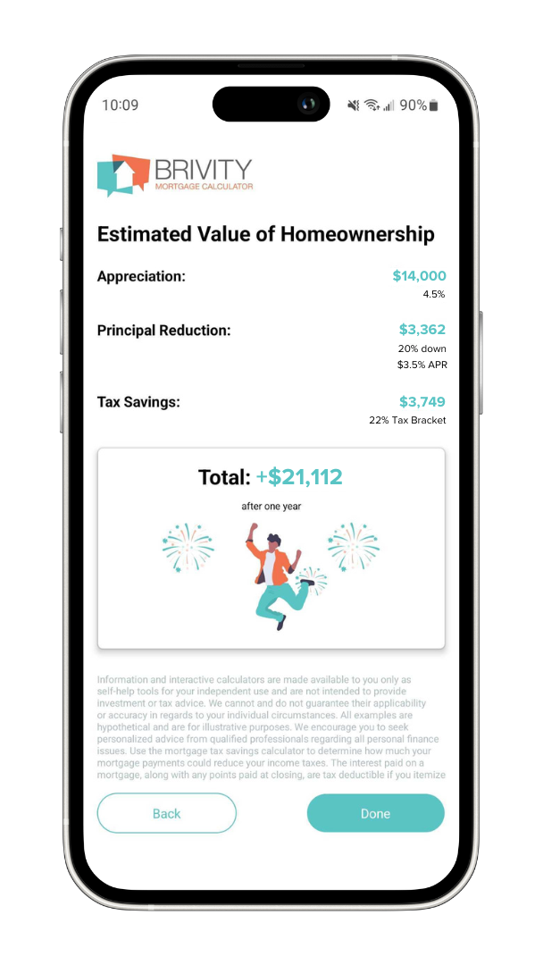
AVERAGE
NET WORTH
RENTER
$10,400
VS
HOMEOWNER
$396,000

Slide 8




HOMEOWNERSHIP BENEFITS
APPRECIATION
Real Estate has appreciated at an average of 4% annually for the past 30 years. This is a national statistic, which means for some areas and some years, the numbers may be more or less.
PRINCIPAL PAYMENTS
A certain percentage of your mortgage payment will be contributed to the principal balance of your loan. This creates more equity in your home each month you make a payment.
TAX BENEFITS
Homeownership can offer many benefits to the taxpayer. These can include the ability to write off and deduct interest paid up to a specific amount* of a mortgage, plus property tax benefits and private mortgage insurance, in many cases.
PROJECTED HOME PRICE
MORTGAGE AMOUNT
TOTAL INTEREST PAID FIRST YEAR
TOTAL SAVINGS
When you add up these 3 financial benefits of homeownership, in just your first year alone, your net worth will have increased by approximately:
AVERAGE APPRECIATION RATE
INTEREST RATE
TERM (YEARS)
TAX BRACKET
ANNUAL APPRECIATION
PRINCIPAL PAID YEAR ONE
TAX SAVINGS
TOTAL
*Speak to your tax professional or lender for information about your specific scenario

Slide 9


NEEDS ANALYSIS
We have a few goals and promises we make to every client to whom we make a commitment:
WHAT ARE YOUR GOALS?
Examples may include: What type of neighborhood? What is the age and style of the home? What is the size of home and size of the lot?
This home buying process will be one of the best decisions and purchases of your life.
We will help you find the perfect home for the best price possible.
We will have constant and clear communication throughout the whole process.
1
2
3
4

Slide 10


SECURING FINANCING
If you are not paying cash, the next step in the buying process is to decide which lender and loan program to use. Having a written pre-approval letter is key in this market to get your competing offer accepted.
Required Documents
Review Loan Programs
You will need to gather two years of tax returns, recent pay stubs, any asset statements like 401(k), and two months of bank statements for all borrowers. In order to get a full approval, all of these items need to be collected in advance.
Loan programs vary based on location and condition of the property, credit scores, available down payment and length of loan.
Down Payment, Terms & Rates
Obtain Pre-Approval Amount
We partner with lenders who offer competitive rates, and specialize in a variety of loan programs.
Many lenders offer a fast, over-the-phone prequalification. This is not the same as a pre-approval. Always get fully pre-approved to make sure you get the best property for the best price.

Slide 11

BUYER BEWARE WHEN BUYING A HOME
01
02
Do not change jobs, become self-employed or quit your job
Do not buy a car, truck or any vehicle
03
04
Do not excessively use credit cards, cancel cards or fall behind on payments
Do not spend money you have set aside for closing
05
06
Do not leave out debt or liabilities from your loan application
Do not buy furniture on credit
07
08
Do not originate any inquiries into your credit
Do not make large deposits or withdrawals without checking with your loan officer
09
10
Do not change bank accounts
Do not cosign a loan for anyone

Slide 12
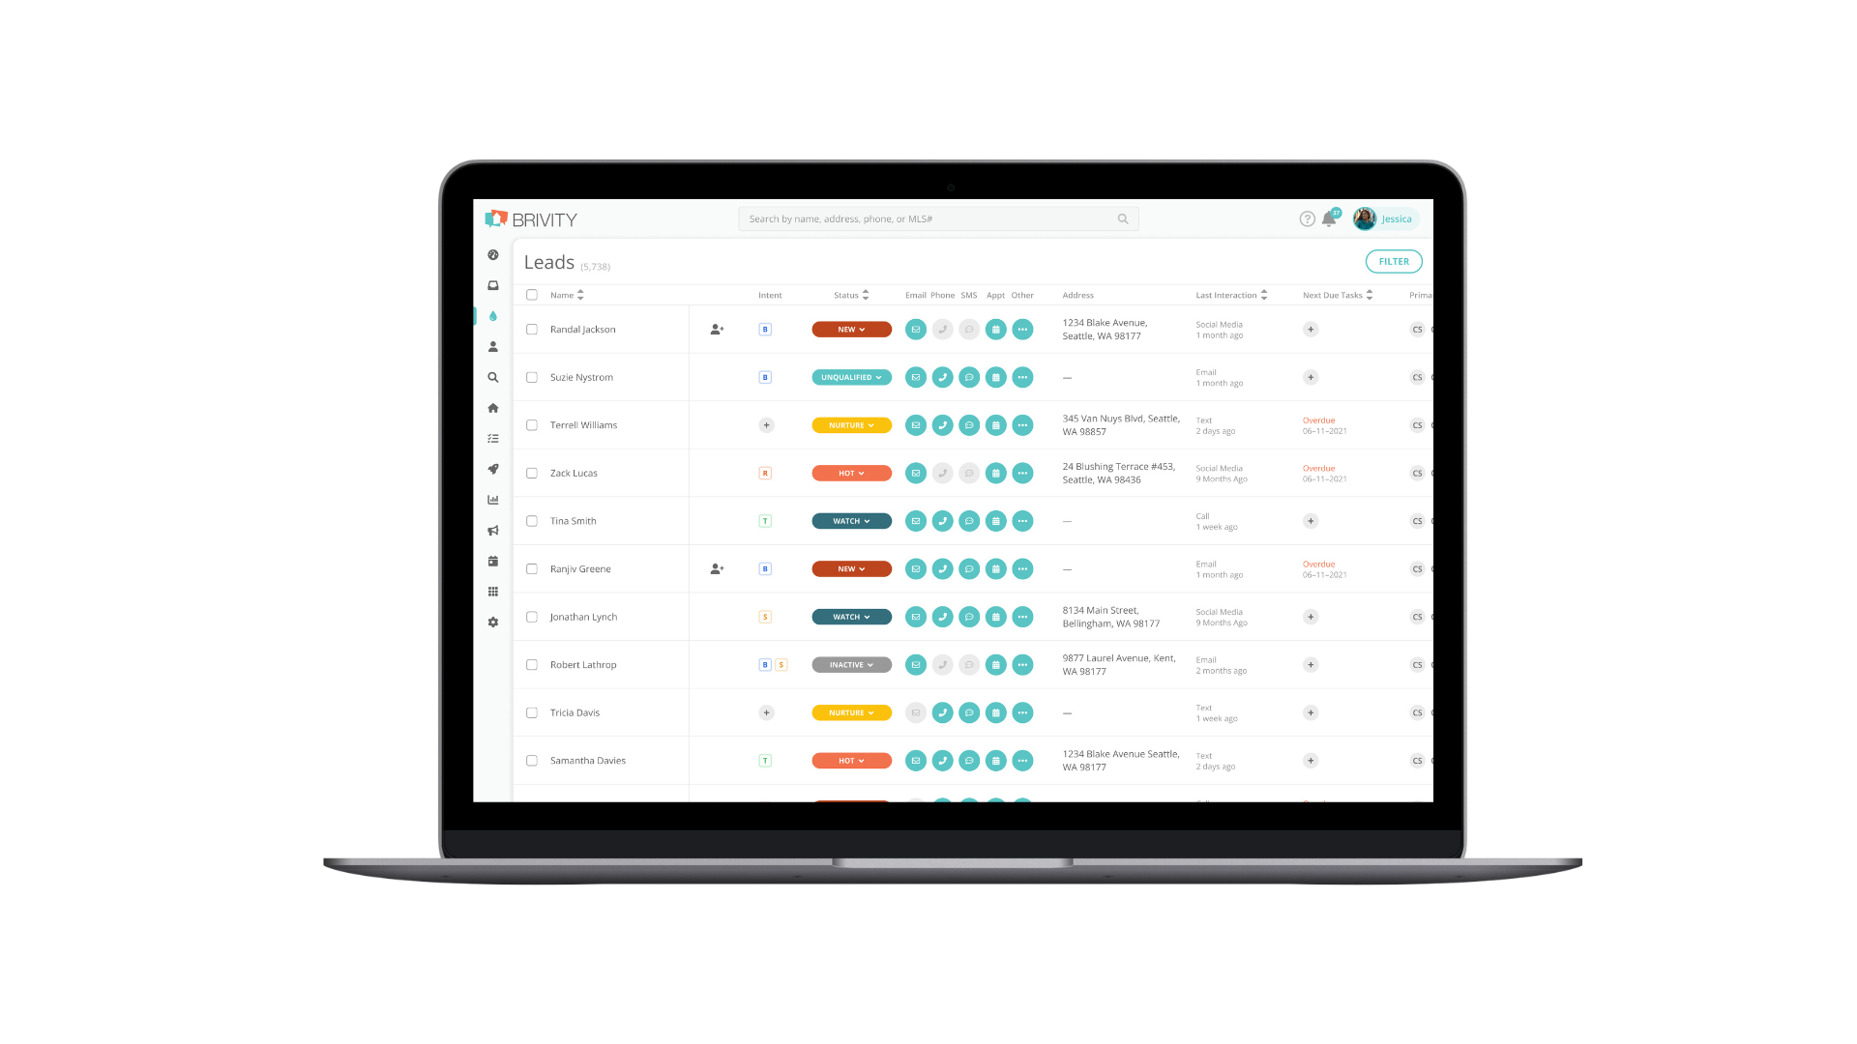
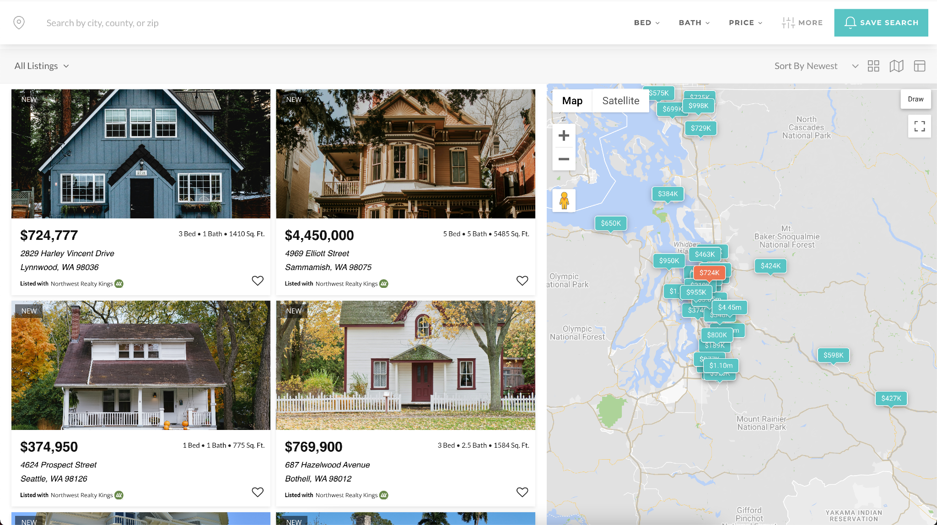
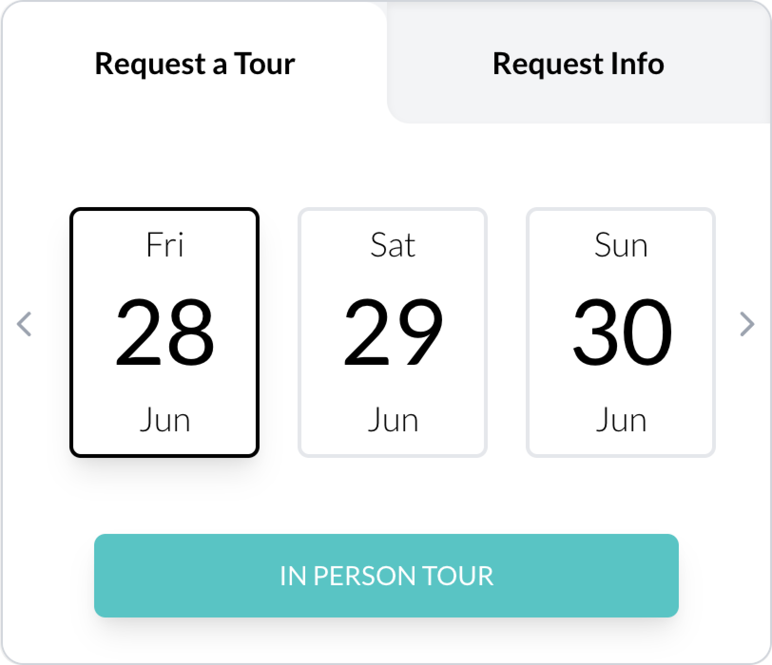
FINDING THE RIGHT HOME
A new approach to finding the perfect property means your perfect home is right around the corner.
Smart home buyers choose a team like ours to work for them in finding the perfect property. We can make sure you have access to the best homes before the competition.

Slide 13

ALL THE WAYS WE HELP YOU FIND THE RIGHT HOME
We offer a variety of tools and features to ensure you have access to all homes that hit the market, from traditional listings to off market homes.
Actively Listed Homes & Open Houses
Our technology gets you first access to all properties that are for sale by any brokerage or agent in the area. We automatically send you new listings up to twice daily.
For Sale by Owners
Our team has access to For Sale By Owner (FSBO) properties. We can schedule an appointment with properties on or off the market. Take caution, as most FSBO properties do not sell because they are overpriced.

Slide 14

ALL THE WAYS WE HELP YOU FIND THE RIGHT HOME
Foreclosures
We are experts at locating and selling HUD homes, Bank Foreclosures and Short Sale properties. If you are interested in bank owned homes, we can provide you with a list of available properties.
Off-Market Homes
Our team knows of some WOULD-sell properties including off-market homes, previously failed sales and motivated sellers who do not want a home publicly advertised.
New Construction
Home builders represent their best interests at all times. You need an advocate to help you save money and not overpay. Let us know in advance if you ever want to visit a new construction property and we will register you as being pre-approved and represent you fully.

Slide 15

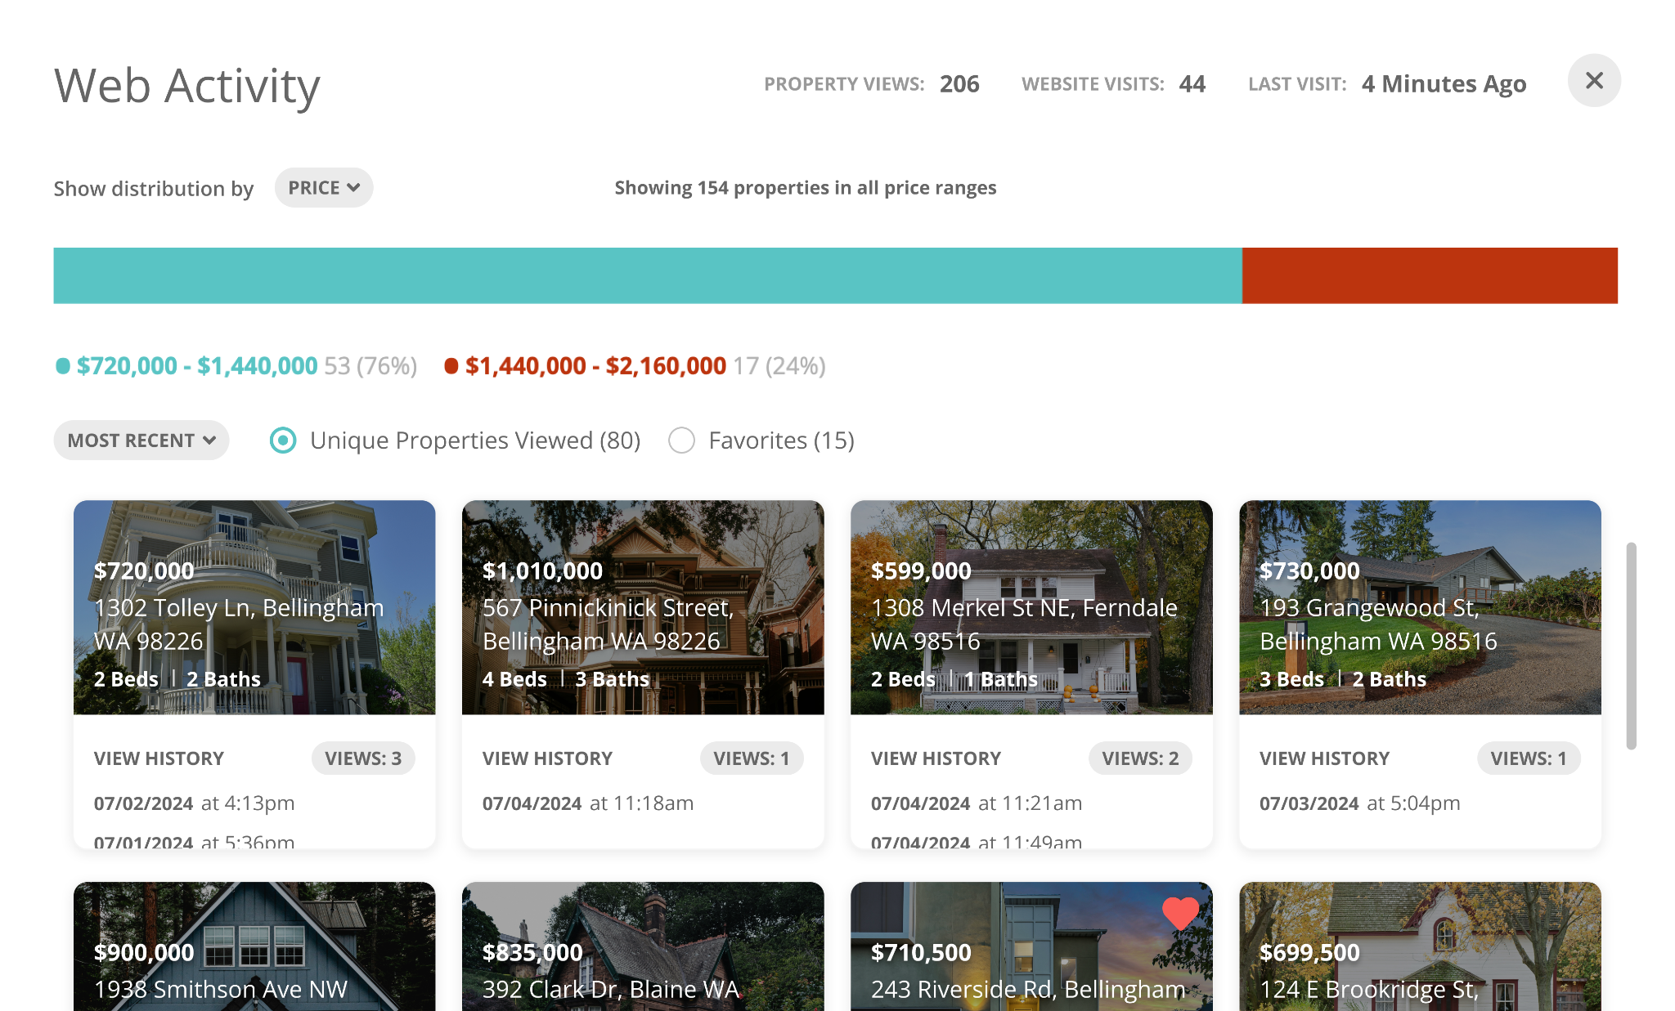
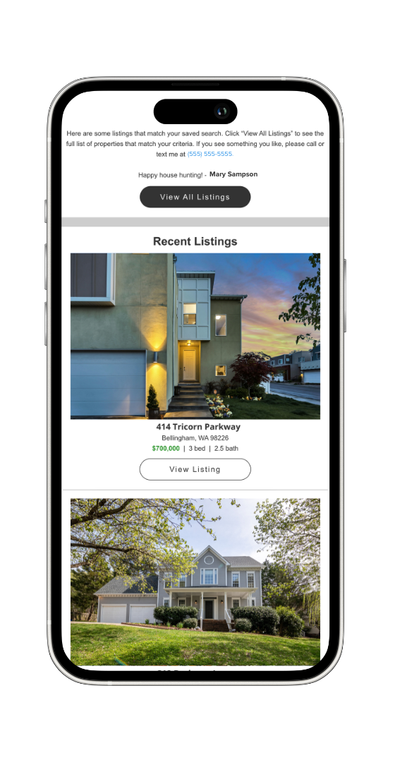
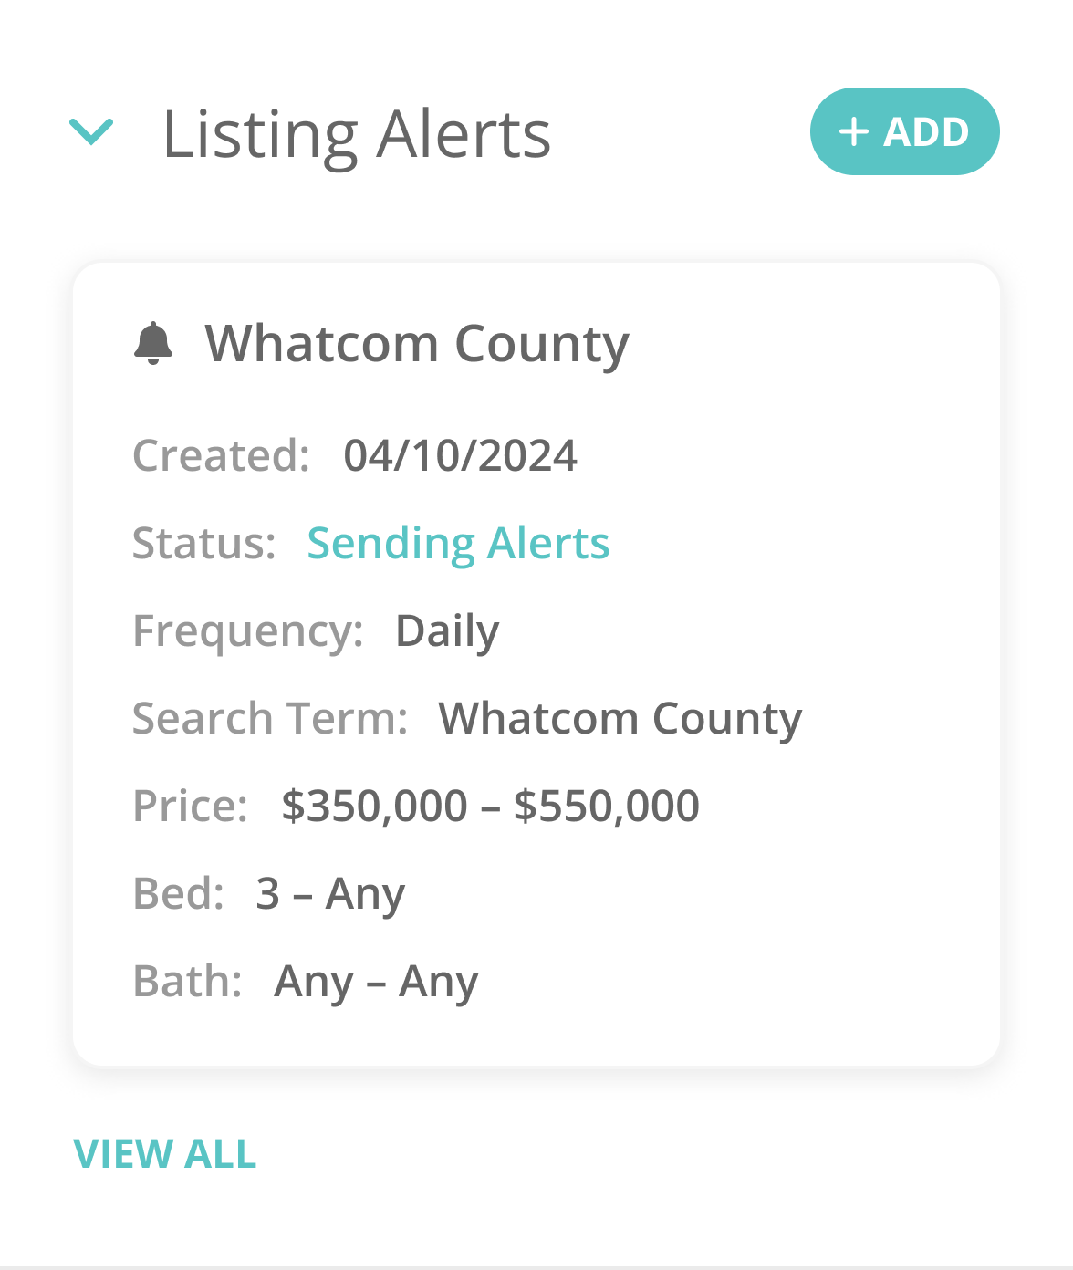
ALWAYS BE THE FIRST TO KNOW
You never have to worry about missing out on new listings that hit the market in the area where you’re looking to buy.
Whether you prefer daily, multiple times a week, bi-weekly, or monthly updates, we’ll ensure you're always notified when a listing that matches your criteria and must-haves hits the market.

Slide 16
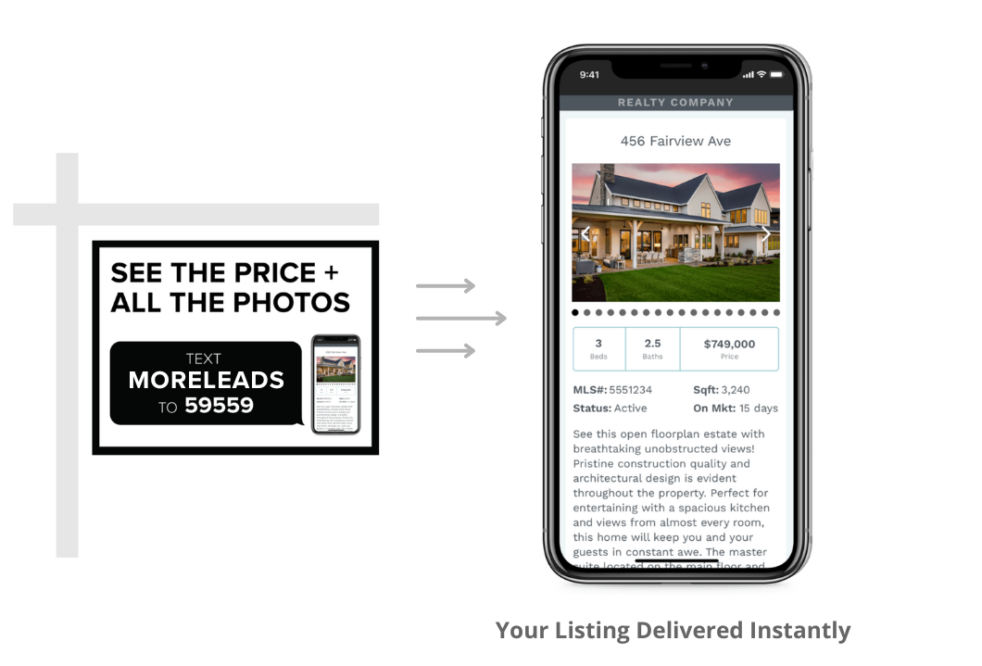
INSTANT PROPERTY INFORMATION VIA TEXT
Our #1 priority is to ensure you have access to the information you need to make the biggest investment of your life, anytime, anywhere.
See a home you love? Simply text a special keyword to immediately receive information about that property you are viewing via text message.

Slide 17
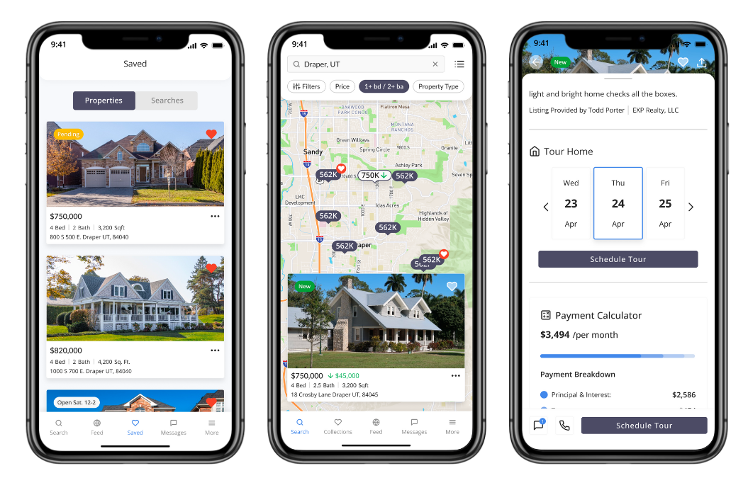
ACCESS YOUR REAL ESTATE TEAM ANYTIME, ANYWHERE
Collaborate with your real estate team through an exclusive app that personalizes your home search to you.
Curate your favorite homes, save your searches and schedule showings all from one place. Plus, chat with us about questions you may have on a property via the app so our team can immediately spring into action, giving you an edge over competing buyers.

Slide 18

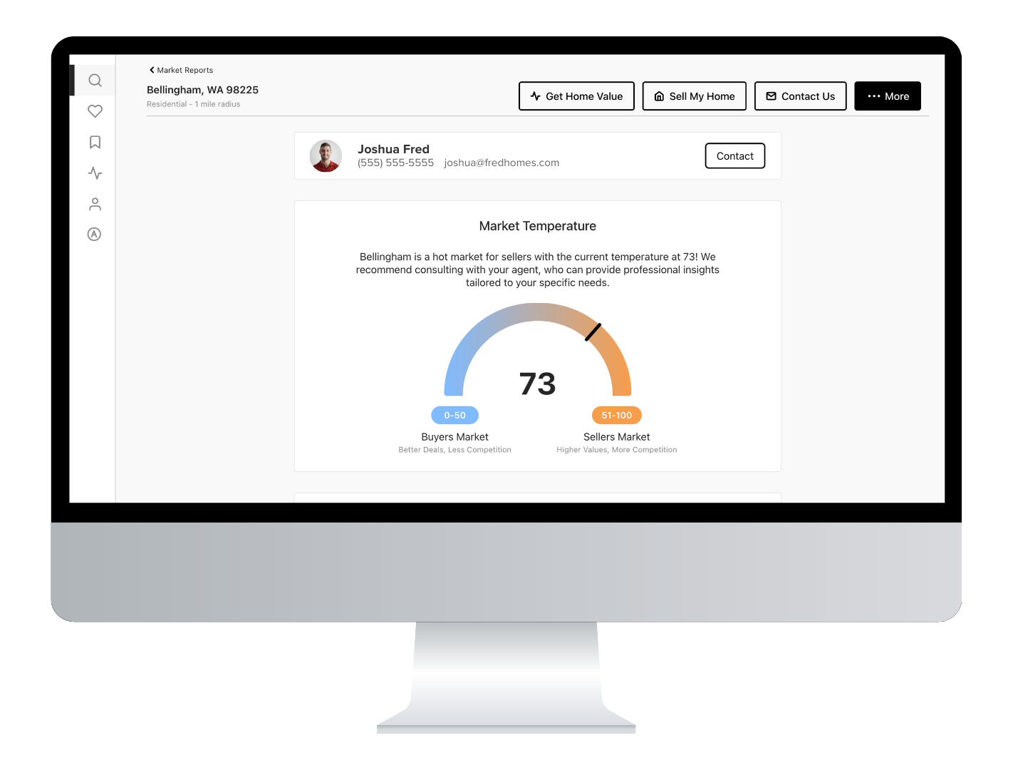
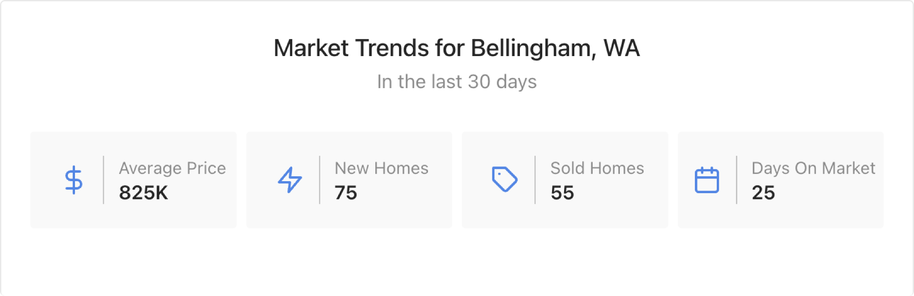
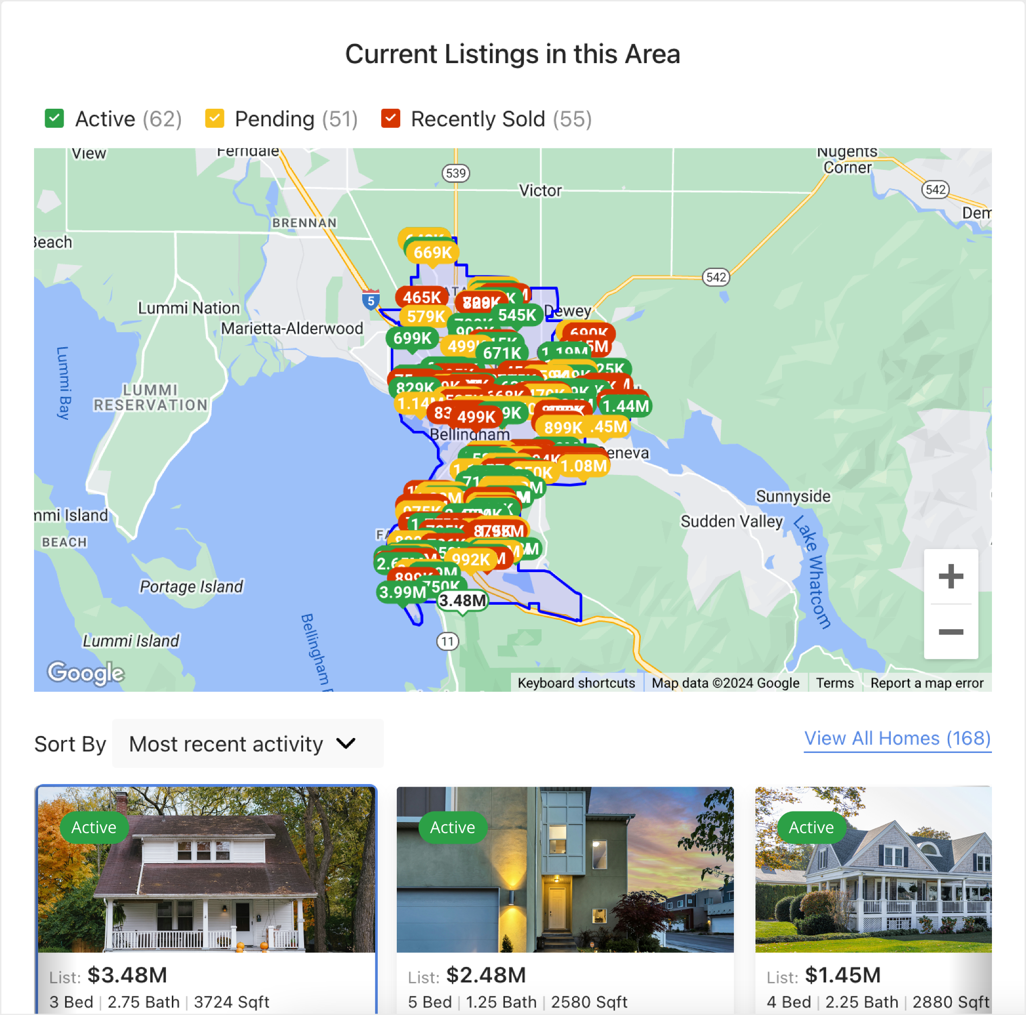
TRUSTED UP-TO-DATE DATA IN YOUR NEIGHBORHOOD
Getting relevant real-time data about the neighborhood you're considering is crucial to making the most informed decision on one of the biggest investments of your life.
By partnering with us, you’ll always receive information such as when a property goes up for sale, pending or off market, and most importantly, community insights. Having accurate and current information ensures that you choose a location that meets your needs and preferences, helping you avoid potential pitfalls.

Slide 19
MAKING AN OFFER
01
MARKET OVERVIEW
02
MONTHS OF INVENTORY
03
LIST PRICE TO SALES PRICE RATIO
04
DAYS ON MARKET
05
COMPARABLES
06
NEGOTIATIONS
5 + 5 + 5
Active
Properties
Pending
Properties
Sold
Properties

Slide 20


FROM OFFER TO CLOSING
01
02
03
04
Making An Offer
Negotiation
Of Terms
Offer Accepted
Loan Process
05
06
07
08
Inspections
& Appraisal
Title, Escrow &
Loan Doc Review
Sign Documents
& Loan Funding
Title Records &
Transaction Closes

Slide 21
COSTS OF BUYING A HOME
01
EARNEST MONEY
02
HOME INSPECTION
Earnest money, also known as a good faith deposit, demonstrates your commitment to buying a home. It's provided by the buyer once there is an accepted offer and later applied towards funds required by buyer at closing. Earnest money can vary in amount, either flat or a percentage of the purchase price.
A general home inspection is recommended on any property that you purchase and the cost can vary in cost depending on the size of the property. The buyer pays inspector at time of inspection. Other specific inspections can be done as well that can incur additional costs.
03
APPRAISAL
04
DOWN PAYMENT
When getting a mortgage, the bank will require an appraisal to confirm the home's value. This fee is most often the financial responsibility of the buyer. The cost of the appraisal varies based on loan type, property type and location.
Down payments can range, on average, from 0% to 25% of the purchase price depending on the loan program. Your lender will be able to go over all of your options to help you determine the best program and down payment options for you.
05
BUYER AGENT COMPENSATION
Buyer agent compensation is deferred until closing. The buyer agent’s compensation is earned through the skilled management of your agent to find the right home, negotiate the purchase, and walk you through the entire closing process. We aim to offset Buyer Agent compensation via Seller-offered commission or concessions. With our market expertise, we do our best to negotiate compensation, and if needed, we discuss options before viewing a home and negotiate any shortfall through Seller Concessions. We’ll also provide a clear financial picture, including out-of-pocket expenses, empowering you to make informed decisions.

Slide 22
CLOSING DAY - MISSION ACCOMPLISHED
01
Review Documents
Prior to your appointment to sign documents, you will have time to review the title report, loan information, seller disclosures and any other related information discovered during the pending process. In some cases, this information can be reviewed in person at closing.
02
Closing Appointments
Prior to closing, a closing appointment with your attorney or escrow officer will be scheduled. Remember - all buyers who are listed on the loan documents will need to be present. Don’t forget to bring photo identification for all parties.
03
Funds
Escrow will help make arrangements for your funds for closing costs and down payment to be wired prior to closing. Make arrangements prior to closing and remember to check the calendar to make sure you allow for enough time around holidays and weekends.
04
Signing of Documents
At your appointment, you will sign loan and closing documents. You will have time to ask questions or get clarifications during your appointment. If you have any concerns, contact your loan officer and your real estate team right away.
05
06
Recording
Once all parties have signed and funds are delivered, we will make sure all documents are delivered to all parties and the ownership transfer is finalized and recorded.
Congratulations
We get the honor of handing you the keys to your new home! Congratulations on becoming a homeowner and continuing your wealth building journey!

Slide 23
OUR AGREEMENT
Important benefits for partnering with us:
In return for these services, you agree to:
We will assist you in securing the best financing program for your specific situation.
We will automatically email you properties that match your buying criteria daily. This will allow you to drive by at your convenience and determine which properties you want to view.
We will arrange a private showing of any property you want to see, including new construction and For Sale By Owner homes (subject to their consent).
When you find a property you like, we will use our experience and discuss a strategy regarding offer price, financing terms, possession date and anything else you want to know.
We will provide any information about the home that will enable you to make an informed decision about purchasing the home (i.e. listing history, public information, taxes, etc.).
We will present the offer on your behalf and then negotiate in your best interest to help you secure the property, at the best possible price and terms.
We will guide you through the necessary steps to purchase including appraisal, inspection, insurance, communication with title company, etc.
We will be available to answer any questions you might have.
Seek pre-approval from a lender (or proof of funds for cash transactions) prior to viewing homes.
Notify us of any listed properties you wish to view and inform all agents, For Sale By Owners or New Home Builders that we are working with you.
Have a member of our team formulate an offer on any home (new or re-sale) through us.
Acknowledge that the Broker is being retained solely as a real estate agent and not as an attorney, tax advisor, lender, appraiser, home inspector, or other professional service provider. Buyer has been advised to seek professional advice concerning the condition of the property and all legal & tax matters.
YOUR NEXT STEPS
Understand and discuss the buyer agency relationship with your agent.
Sign the Buyer Representation Agreement so we can go to work for you.

Slide 24

NOTES

Slide 25
© Powered by Brivity

Slide 26
The resources provided by Brivity, including webinars, templates, and scripts, are for informational purposes only and do not constitute legal or professional advice. Brivity does not warrant the accuracy or completeness of any information, text, graphics, links, or other items contained within resources. Brivity is not liable for any damages arising from their use. Brivity does not guarantee you will achieve any specific results if you follow any advice in the resources. It may be advisable for you to consult with a professional such as a lawyer, accountant, architect, business advisor, or professional engineer to get specific advice that applies to your specific situation.
© Copyright Brivity - All Rights Reserved

