Slide 1




5G TECHNOLOGY SPEED
Presentation Template
www.freepptbackgrounds.net

Slide 2

Contents
01.Solution
02.Content
03.Direction
04.Visual

Slide 3



PART 01.
SOLUTION

Slide 4


TITLE
CLICK TO ADD CAPTION TEXT
We use well-known development methodologies to create a customized approach for each of the projects. This allows us to achieve high quality outcomes and full transparency towards.
We use well-known development methodologies to create a customized approach for each of the projects. This allows us to achieve high quality outcomes and full transparency towards.

Slide 5
TITLE
TITLE
TITLE
TITLE
TITLE
Go ahead and replace it with your own text.
Go ahead and replace it with your own text.
Go ahead and replace it with your own text.
Go ahead and replace it with your own text.

Slide 6

TITLE
DESCRIPTION HERE
71%
TITLE
86%
TITLE
A complex idea can be conveyed with just a single still image, namely making it possible to absorb large amounts of data quickly.
Everyone has their own dreams, I am the same.
Everyone has their own dreams, I am the same.

Slide 7

TITLE
THE POWER
OF THE DREAM
We use well-known development methodologies to create a customized approach for each of the projects. This allows us to achieve high quality outcomes and full transparency towards.

Slide 8
PART 02.
CONTENT

Slide 9


TITLE
DESCRIPTION HERE
A complex idea can be conveyed with just a single still image, namely making it possible to absorb large amounts of data quickly.
DESCRIPTION HERE
A complex idea can be conveyed with just a single still image, namely making it possible to absorb large amounts of data quickly.

Slide 10

TITLE
A complex idea can be conveyed with just a single still image, namely making it possible to absorb large amounts of data quickly.
A complex idea can be conveyed with just a single still image, namely making it possible to absorb large amounts of data quickly.
65
85
Everyone has their own dreams
Everyone has their own dreams

Slide 11

TITLE
CLICK TO ADD CAPTION TEXT
We use well-known development methodologies to create a customized approach for each of the projects. This allows us to achieve high quality outcomes and full transparency towards.

Slide 12

NOTE HERE
We use well-known development methodologies to create a customized approach for each of the projects. This allows us to achieve high quality outcomes and full transparency towards.

Slide 13
PART 03.
DIRECTION

Slide 14

TITLE
CLICK TO ADD CAPTION TEXT
Simple Atmosphere Universal Template
We use well-known development methodologies to create a customized approach for each of the projects. This allows us to achieve high quality outcomes and full transparency towards.

Slide 15


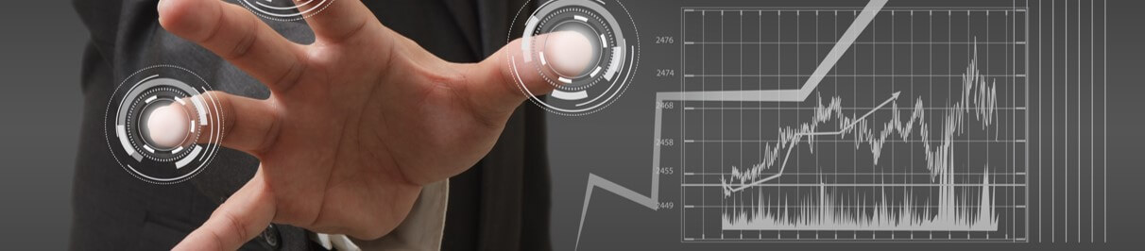
TITLE
NOTE HERE
We use well-known development methodologies to create a customized approach for each of the projects. This allows us to achieve high quality outcomes and full transparency towards.

Slide 16

TITLE
102
92
A complex idea can be conveyed with just a single still image, namely making it possible to absorb large amounts of data quickly.
A complex idea can be conveyed with just a single still image, namely making it possible to absorb large amounts of data quickly.

Slide 17
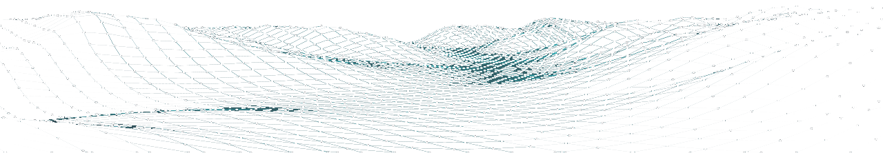
DESCRIPTION HERE
We use well-known development methodologies to create a customized approach for each of the projects. This allows us to achieve high quality outcomes and full transparency towards.

Slide 18
PART 04.
VISUAL

Slide 19
TITLE
NOTE HERE
NOTE HERE
We hope that this template will return to you as a time, money and reputation.
We hope that this template will return to you as a time, money and reputation.
NOTE HERE
NOTE HERE
We hope that this template will return to you as a time, money and reputation.
We hope that this template will return to you as a time, money and reputation.

Slide 20



TITLE
DESCRIPTION HERE
We hope that this template will return to you as a time, money and reputation.
We hope that this template will return to you as a time, money and reputation.
We hope that this template will return to you as a time, money and reputation.

Slide 21
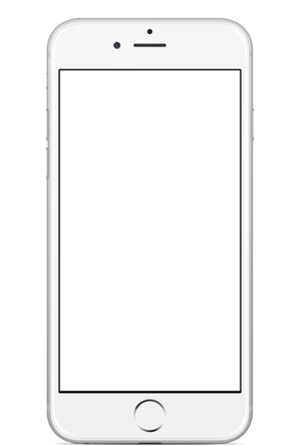
TITLE
We use well-known development methodologies to create a customized approach for each of the projects. This allows us to achieve high quality outcomes and full transparency towards.
96.5
Everyone has their own dreams

Slide 22
THANK YOU !
5G Technology Speed Template
www.freepptbackgrounds.net

