Slide 1



sales deck
FREE PRESENTATION TEMPLATE

Slide 2
Company overview
Enchanted Furnishings Inc. is dedicated to providing high-quality, magical furniture that enhances the lives of our customers. Our team of skilled craftsmen and enchanters combines traditional woodworking techniques with cutting-edge spell-casting abilities to create furniture that is both functional and enchanting.

Slide 3




80%
Enchanted Furnishings Inc. has built a reputation as a trusted provider of exceptional products and services.
Geographic Reach
95%
Customer Satisfaction

Slide 4

154,235
enchanted furniture pieces sold to date, Enchanted Furnishings Inc. has helped customers across the realm and beyond bring a touch of magic and enchantment into their homes and workplaces.

Slide 5
Product
Enchanted Furnishings Inc. offers a diverse range of enchanted furniture that will add a touch of magic and enchantment to any home or workplace. Our products are crafted using traditional woodworking techniques and advanced spell-casting abilities, resulting in unique and beautiful pieces .

Slide 6
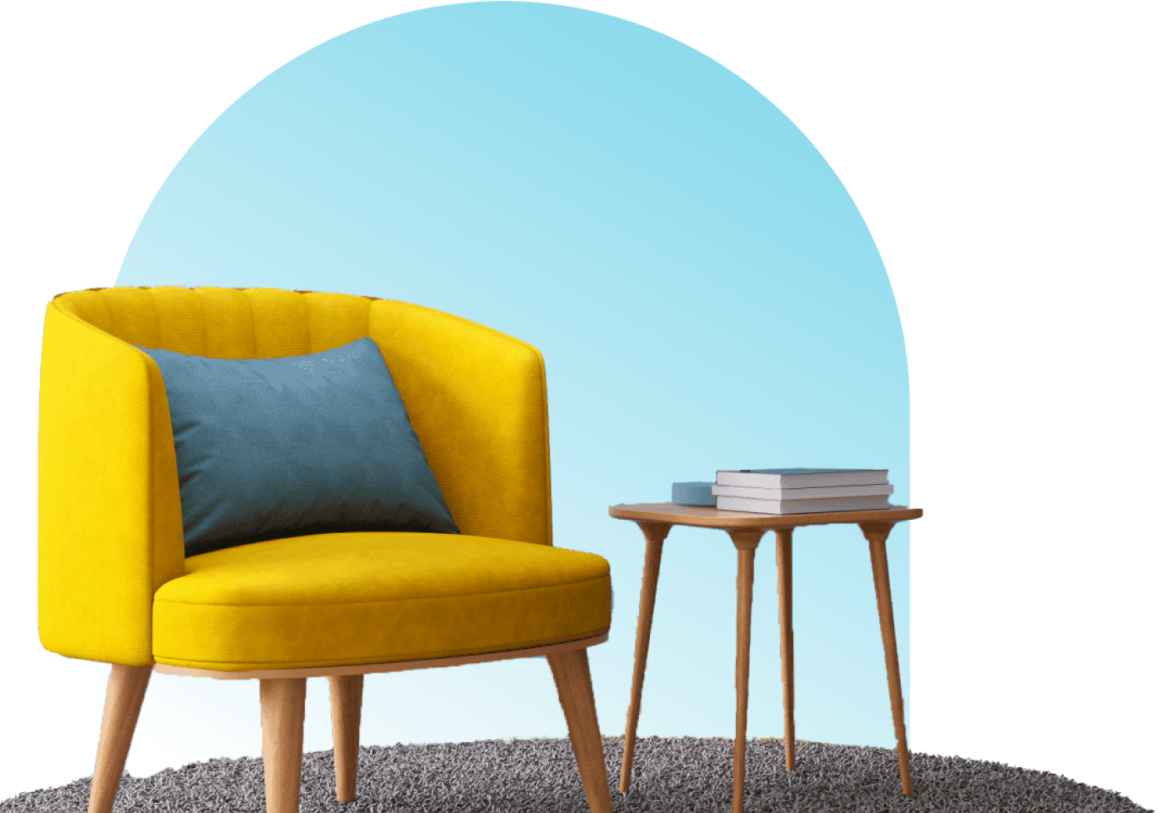



Levitator Chair
Float in comfort with our innovative Levitator Chair, which uses advanced enchantments to suspend you.
Mind-Reader Chair
Our Mind-Reader Chair uses powerful divination spells to intuitively adjust its shape and support to your body's needs.

Slide 7
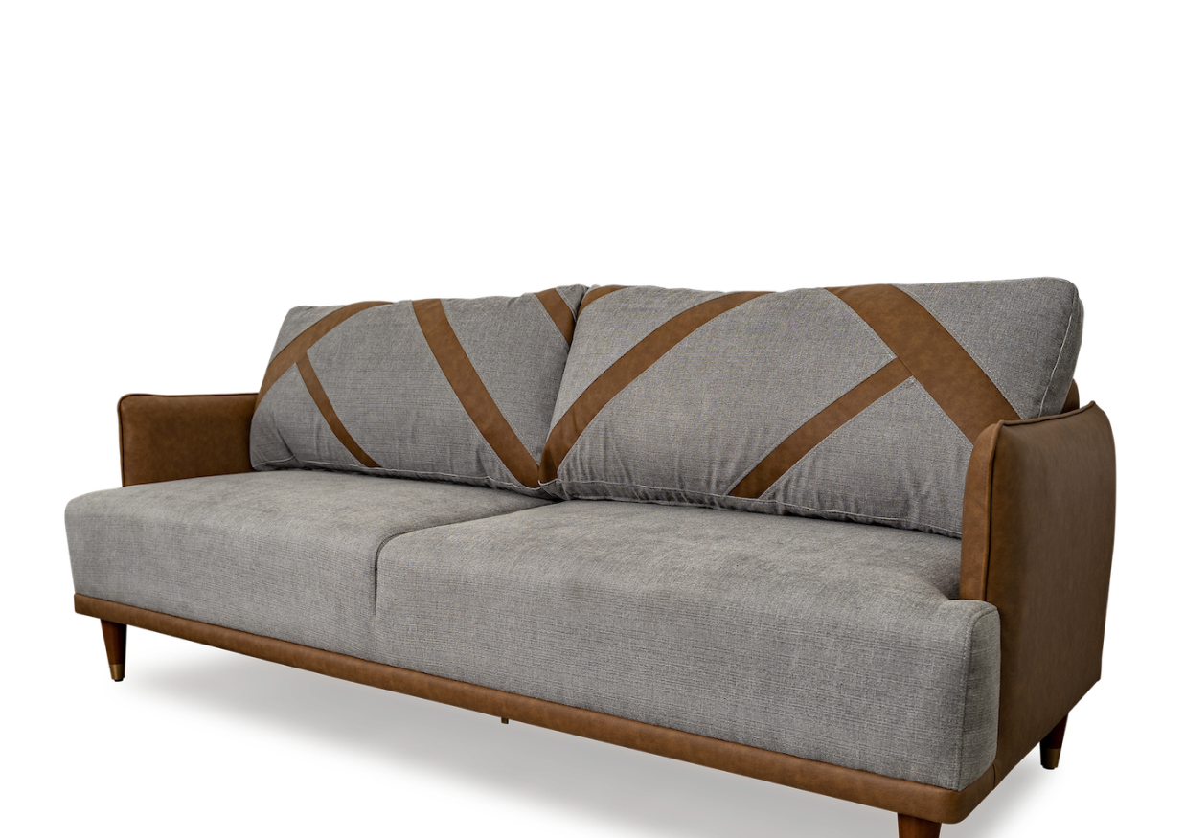



Enchanted
Elemental
Timeless
Our Enchanted Loveseat adds a touch of magic and enchantmen.
Our Elemental Sofa is crafted with magical wood and enchanted with elemental spells.
Our Timeless Sofa uses ancient enchantments to preserve its beauty and durability.

Slide 8
Materials
Enchanted Furnishings Inc. uses only the finest materials in the crafting of our magical furniture. Our wood is enchanted to ensure durability, strength, and beauty, while our fabrics are imbued with protective spells that repel stains and damage.

Slide 9
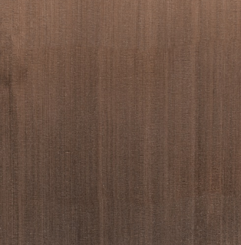
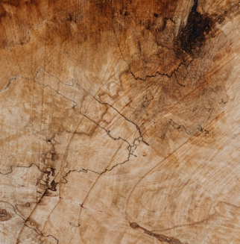
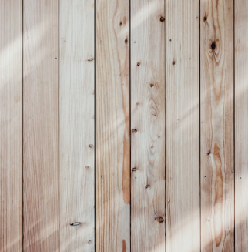
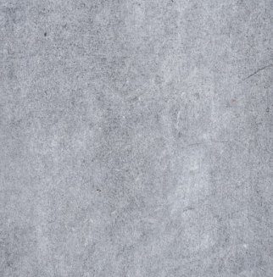
Durability, strength, and beauty
Enchanted Wood
Faerie Oak
Treant Timber
Arcane Ash
Our enchanted wood is sourced from the mystical forests of the realm
Faerie Oak is a rare and coveted type of enchanted wood that is exclusive
Treant Timber is sourced from the ancient treants that roam the forests
Arcane Ash is a type of enchanted wood that is imbued

Slide 10
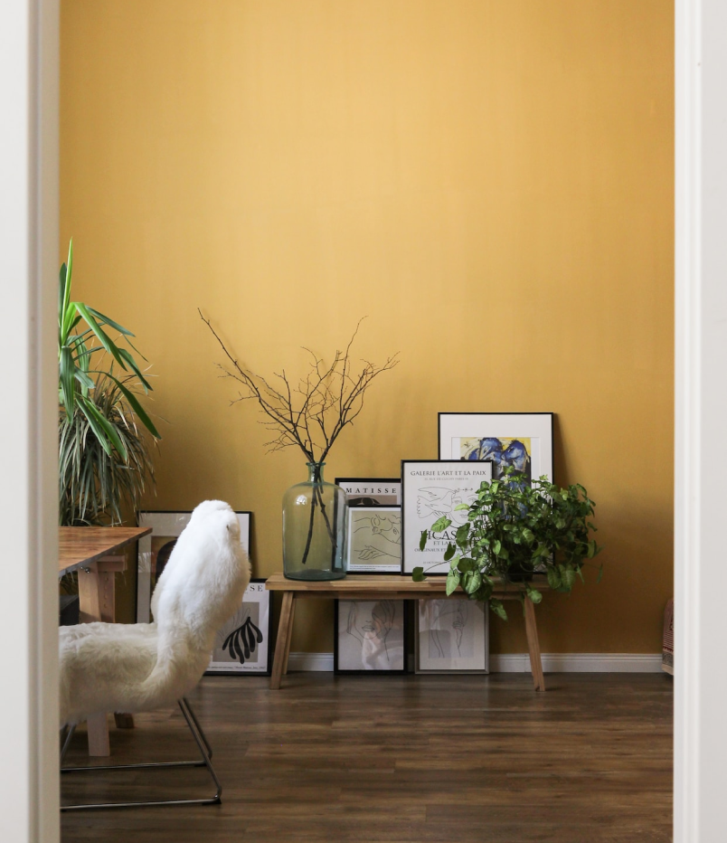





Enchanted Wood
Our enchanted wood is sourced from the mystical forests of the realm
Faerie Oak
Faerie Oak is a rare and coveted type of enchanted wood that is exclusive
Treant Timber
Treant Timber is sourced from the ancient treants that roam the forests
Arcane Ash
Arcane Ash is a type of enchanted wood that is imbued

Slide 11
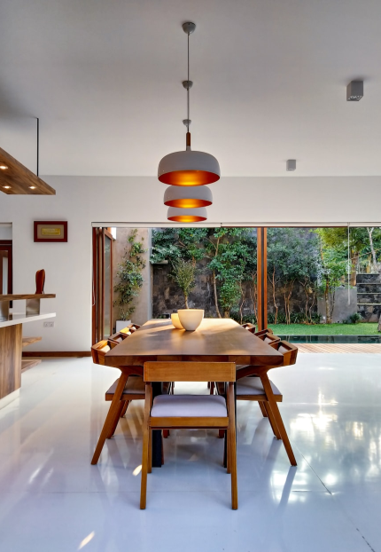
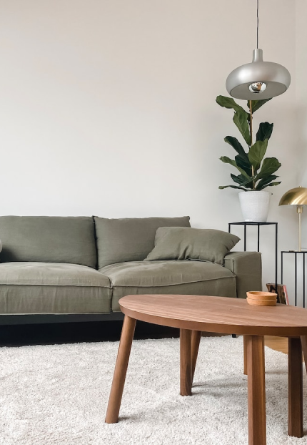
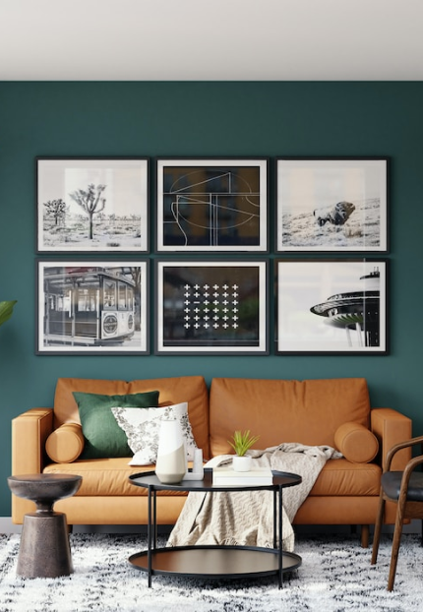
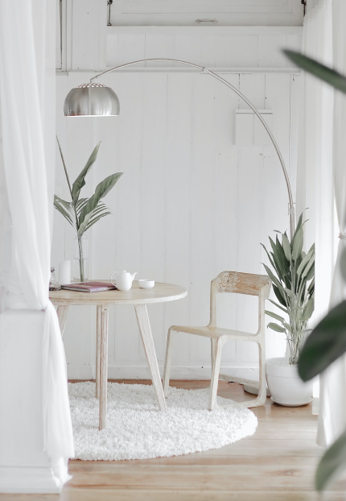
Enchanted Wood
Treant Timber
Faerie Oak
Arcane Ash

Slide 12
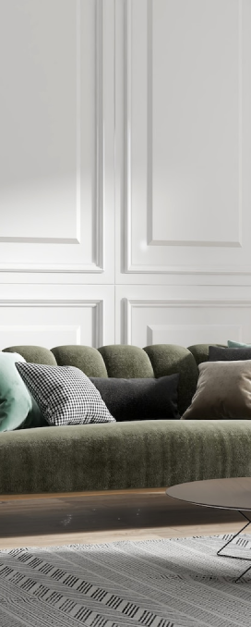

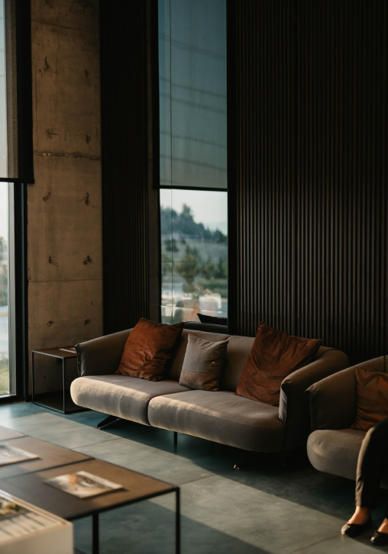
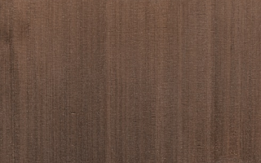
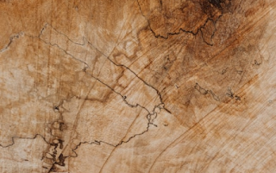
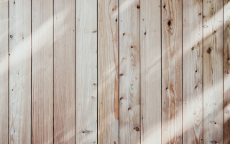
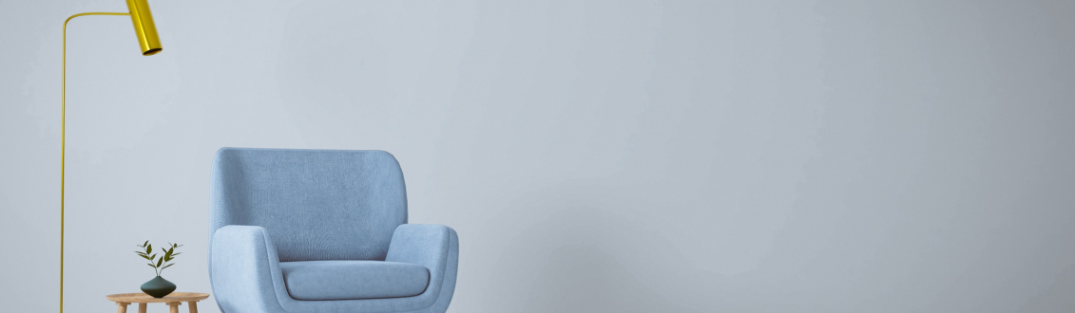
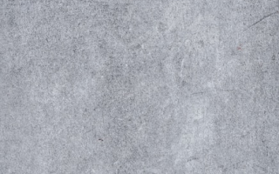

Slide 13



High Quality
32%
54%
14%
Furniture made from Arcane Ash is both beautiful and functional, with the added benefit of protection against magical forces.
Protection
Spell

Slide 14
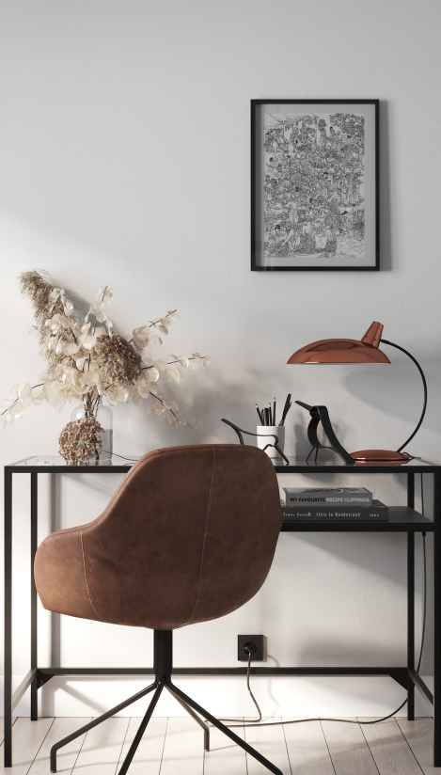
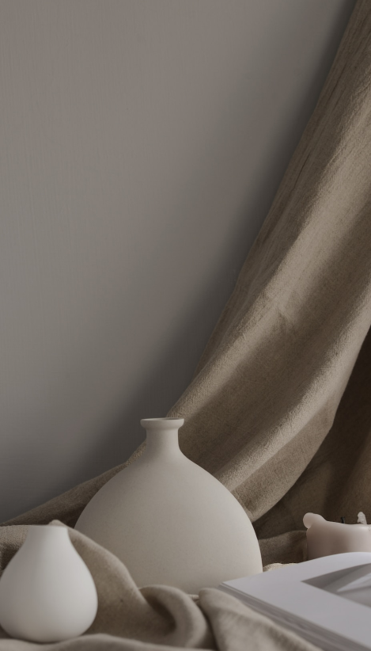
Protection
This enchanted wood is known for its incredible strength and resilience, and is often used to create furniture that is both sturdy and visually stunning.

Slide 15
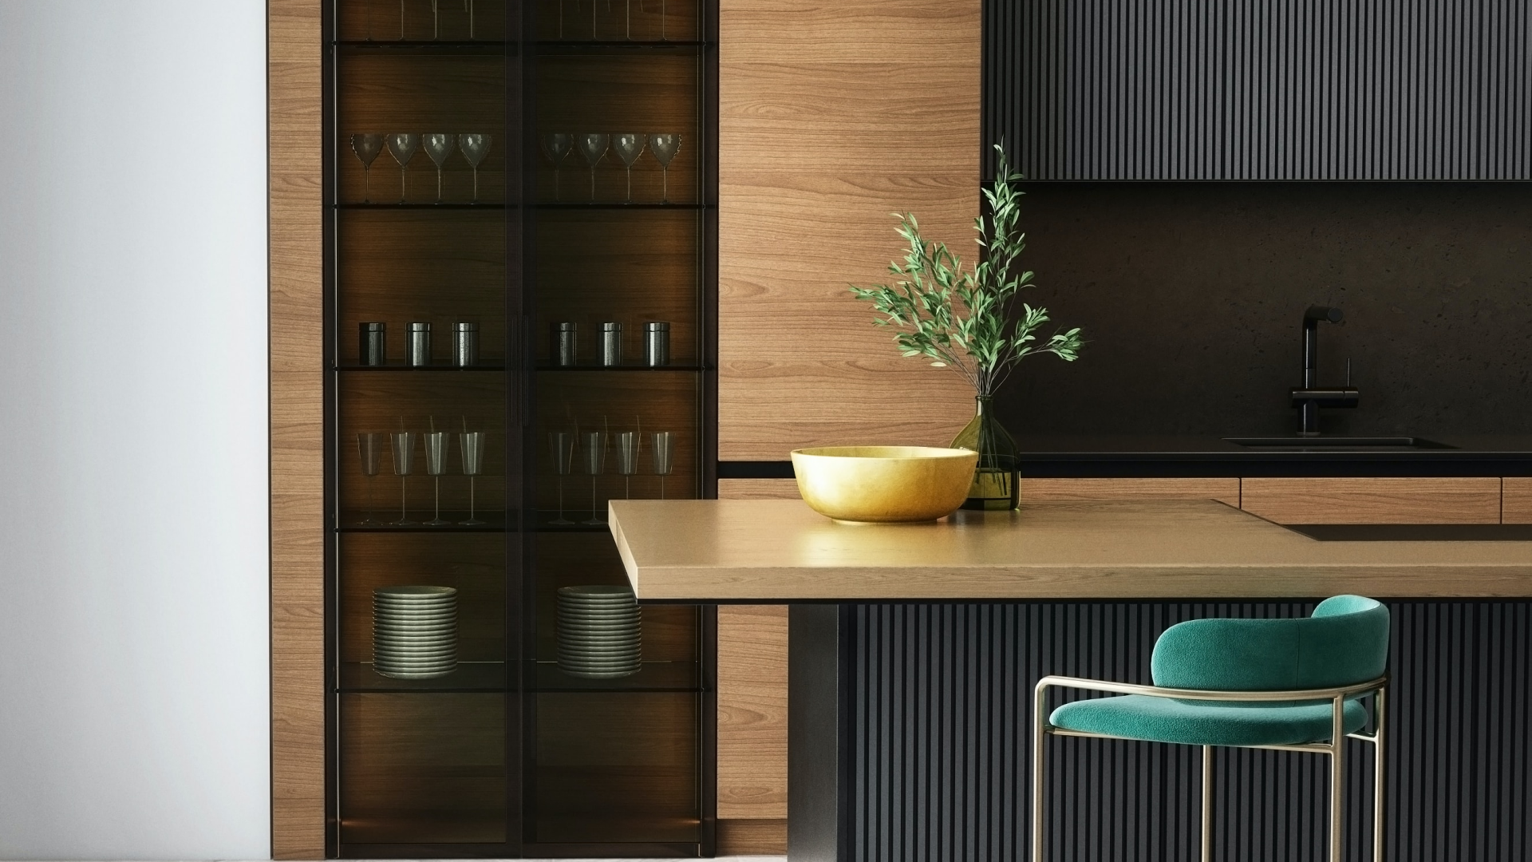
Our magical textiles are made from natural fibers that are imbued with protective spells, making them resistant to stains and damage from magical creatures. Our expert textile artisans use traditional techniques and advanced spell-casting abilities to create soft and comfortable fabrics that are also durable and long-lasting, perfect for upholstery and cushions.

Slide 16
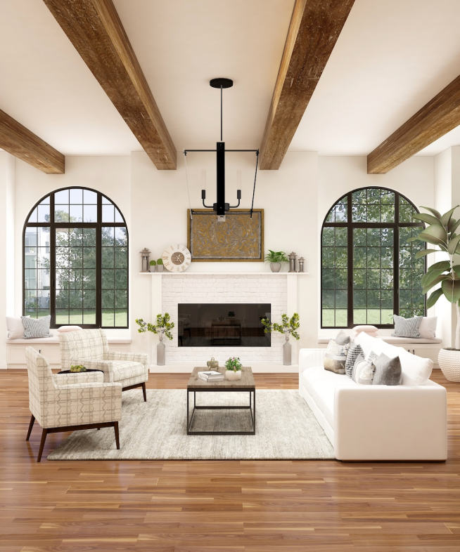
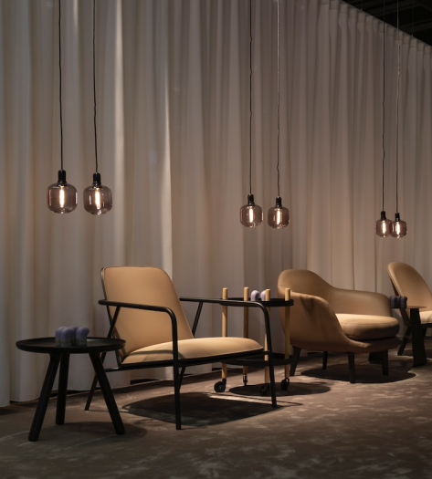
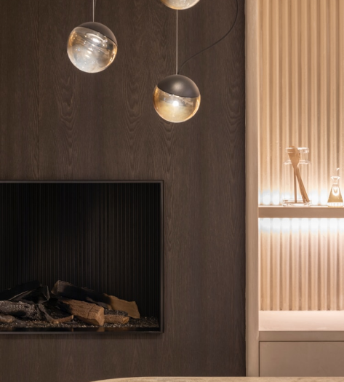
01
Shadow Haven
Find refuge and protection in the shadows of this mystical safe haven.
02
Mystical Wonder
Uncover the secrets and marvels of a mystical world.

Slide 17
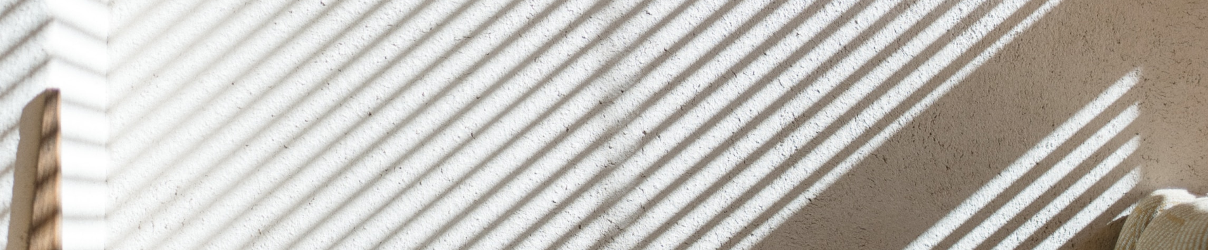



Divine Blessings
Enchanted Forest
A ritual that imbues a person with divine powers.
A magical woodland filled with mystical creatures.

Slide 18
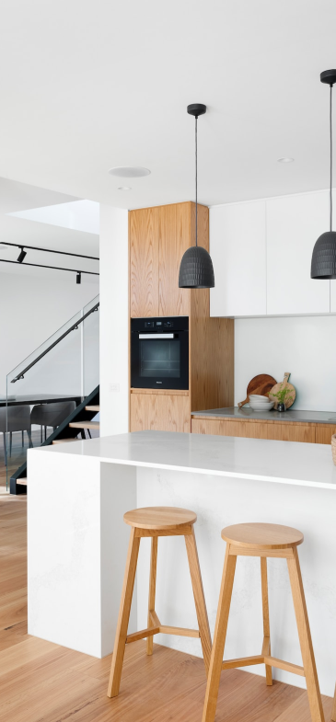
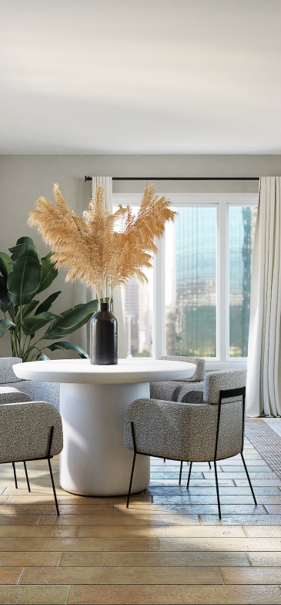
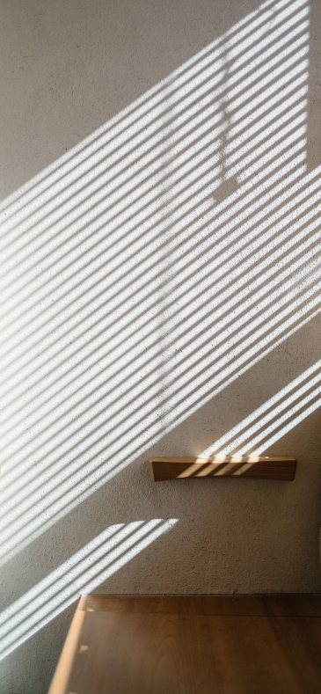


Slide 19
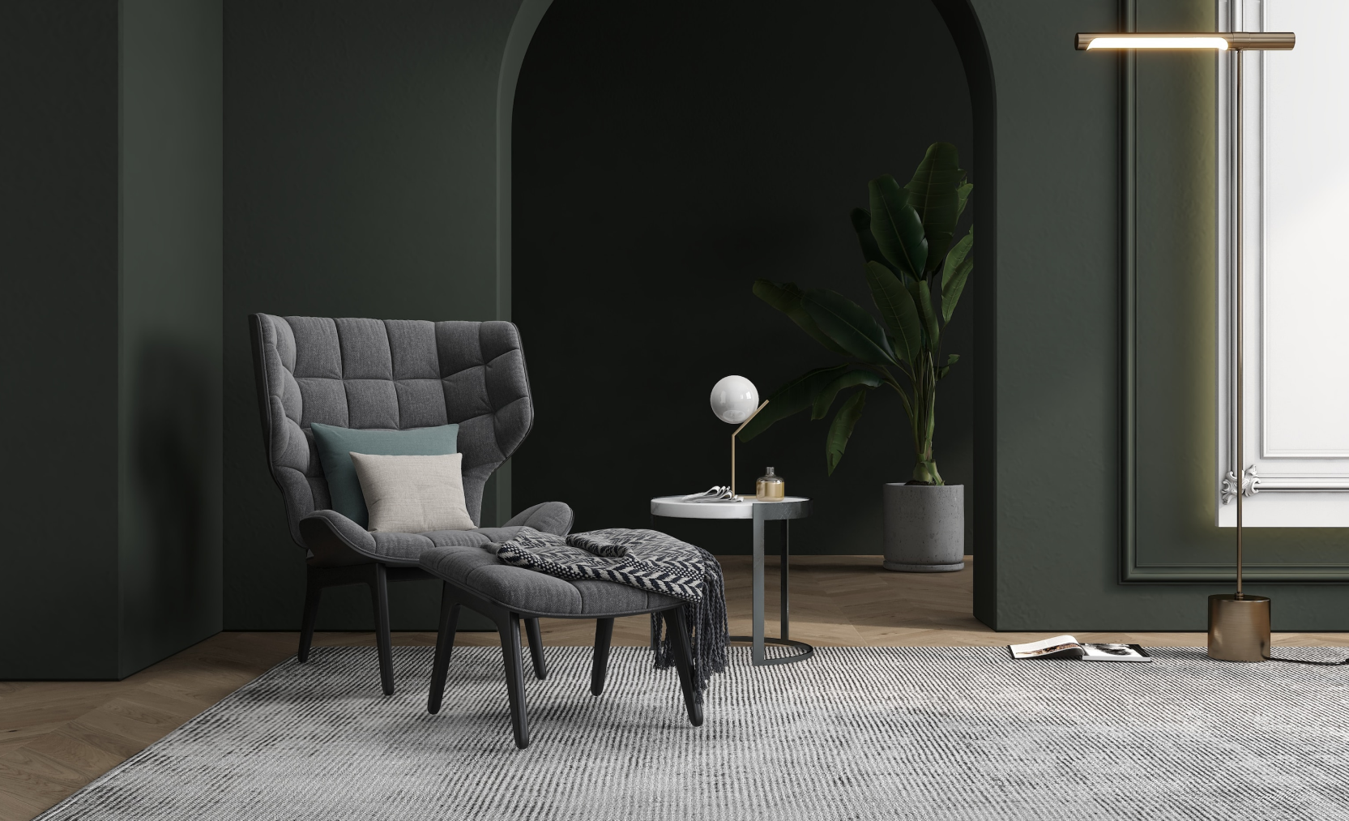
Your furniture will remain beautiful and functional for years to come, no matter what magical forces come your way.

Slide 20
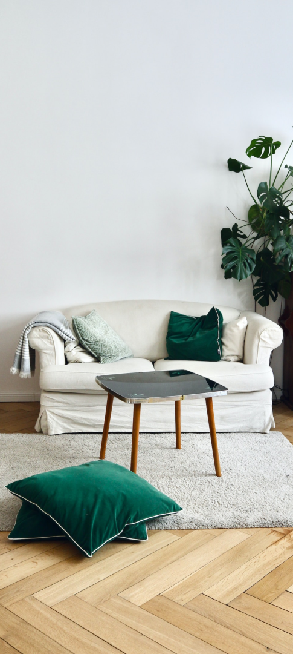

Enchanted Furnishings Inc. is the only company I trust to create furniture that is both functional and magical. Their attention to detail and use of enchanted materials truly sets them apart from the competition.
Lady Cassandra, Enchanted Forest Resident.

Slide 21


thank you

Slide 22





We offer free and high-quality slides templates for your presentations. We appreciate you choosing us and hope our templates have been helpful.
As a new website, we rely on your support to grow, so please help us by sharing our site with your friends and colleagues.
eatemp._
@eatemp
eatempofficial
@eatemp.official
Thank you for choosing EaTemp

