Slide 1
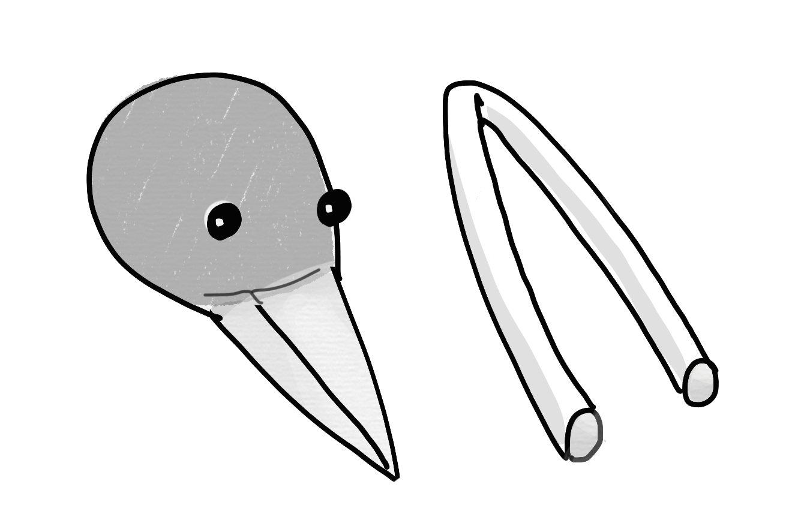
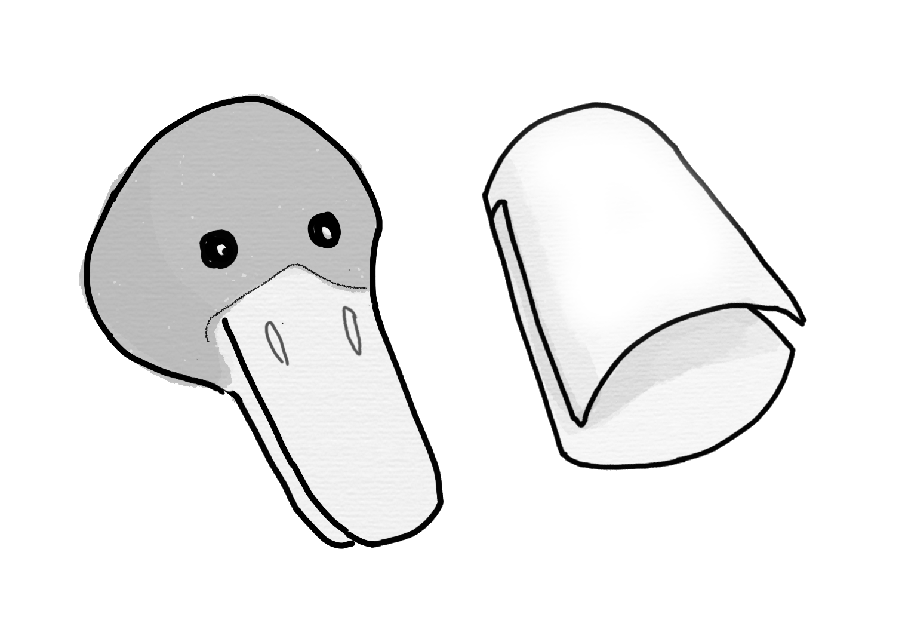
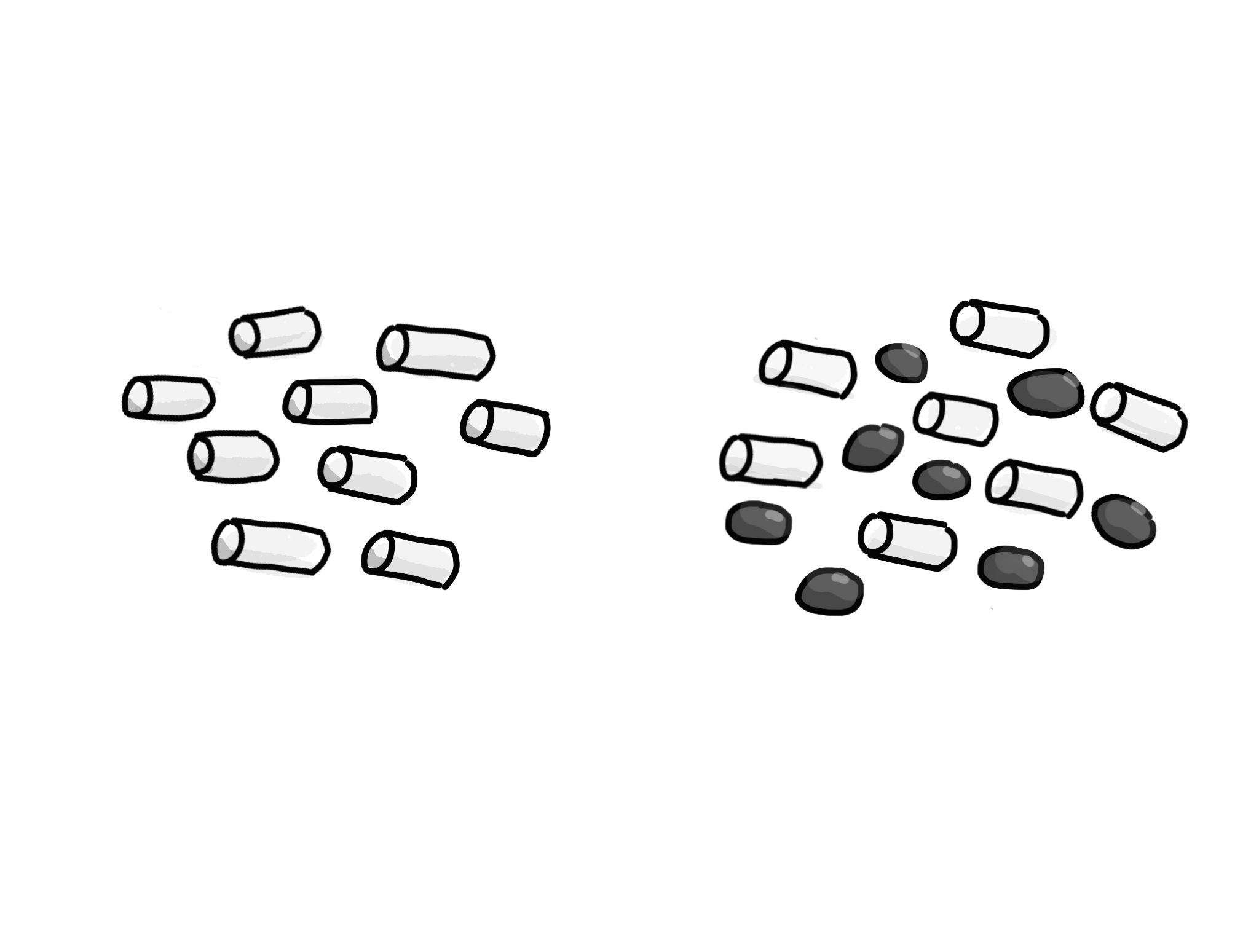
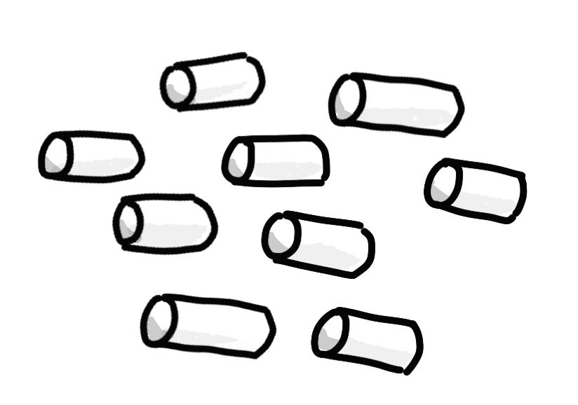
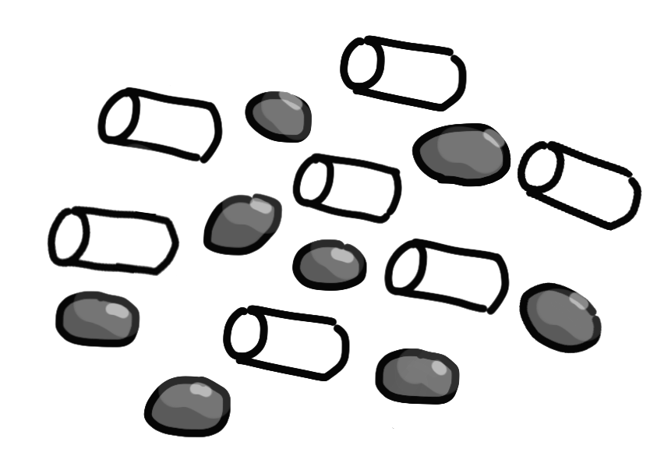

Name:
1. Your bird wants to eat food that is scattered in the rocks. Which beak will you use? Circle it.
2. How many pieces did you get?
3. Draw a line from each beak to the food it’s best at getting.
Why do birds have beaks?

