Slide 1
Looking at Junior Cycle English in our School Online Cluster 2021-2022
“The limits of my language are the limits of my world.”
(Ludwig Wittgenstein)

Slide 2
A glimpse of today’s CPD
Click here to watch the video

Slide 3
Structure of our day
Session 1 9:30 – 12:00
Looking at Junior Cycle English
in our Schools
11:00 – 11:20
Session 2 12:00 – 13:00
Choice of Workshops
13:00 – 14:00
Session 3 14:00 – 15:30
Language and Story in the Junior Cycle English classroom
2

Slide 4
Choice of elective workshops
12:00pm - 1:00pm
Choose a Workshop
Raising the Curtain - Drama and Performance
Level 2 and Level 3 in the JC English classroom
Exploring My Creative Writing
Using Digital Technology to Enhance Learning Experiences
or
or
or

Slide 5
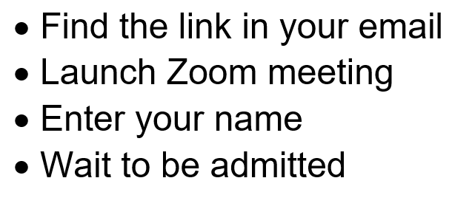
Some ways to make today a success
If you lose connection…
We invite you to leave your camera on for the duration, but especially in Breakout Rooms
Please mute your microphone when not speaking but use the chat anytime
This day is not being recorded

Slide 6
Google Site and Support Booklet
Scan me using your camera or QR scanner

Slide 7
Rationale for our day
Feedback from Teachers to JCT English
Research on the impact of the pandemic on teaching and learning
Recommendations from the publication Looking at English in our School
Rationale
Looking at English in our School
4

Slide 8
Our focus for this session is:
To share recent experiences of teaching and learning in Junior Cycle English
To explore planning for assessment
To collaboratively create a sample assessment focusing on personal writing
3

Slide 9
Four texts for the group task – choose 1
Suffragette
directed by
Sarah Gavron
Julius Caesar
William Shakespeare
Father and Daughter
Aifric Mac Aodha
The 14th Tale
Inua Ellams
3/5/9

Slide 10
Text 1: Julius Caesar
Act 3, Scene 2
Conspirators convince Julius Caesar's ally Brutus to join an assassination plot against him.
After his assassination, Mark Antony speaks, from the heart, giving his personal response to Caesar’s murder.
Click here to watch the video
3

Slide 11
Activity 1 – Breakout Room (8 mins)
Hellos!
Look at the image
Identify the titles from the prescribed text list 2018 - 2023
Number 1 is Of Mice and Men
4

Slide 12
Answers!
Of Mice and Men
Hunt for the Wilderpeople
Sing Street
Animal Farm
Trash
Julius Caesar
This One Summer
The 14th Tale
Blood Brothers
Suffragette
Sense and Sensibility

Slide 13
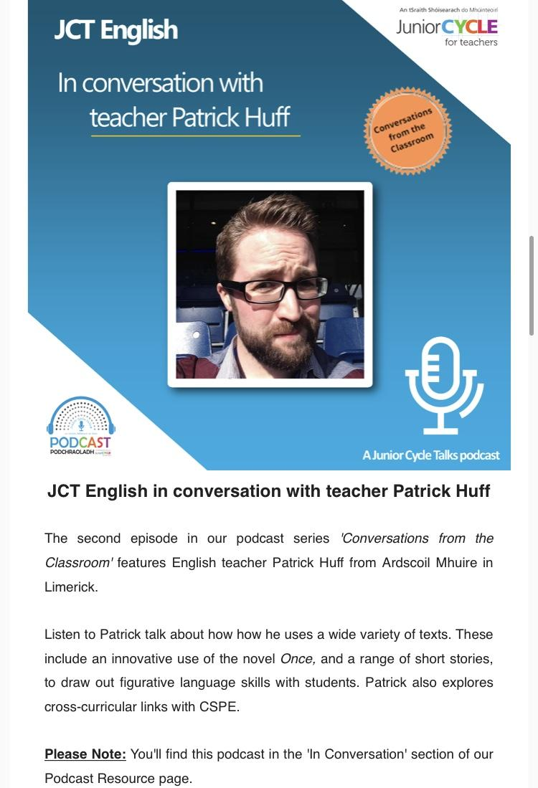
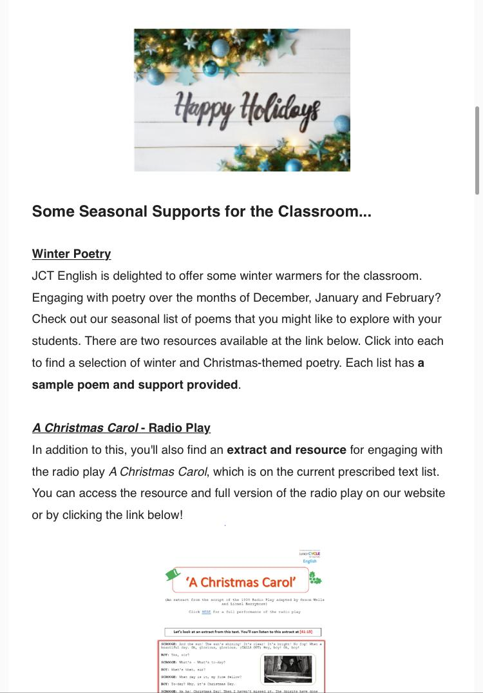
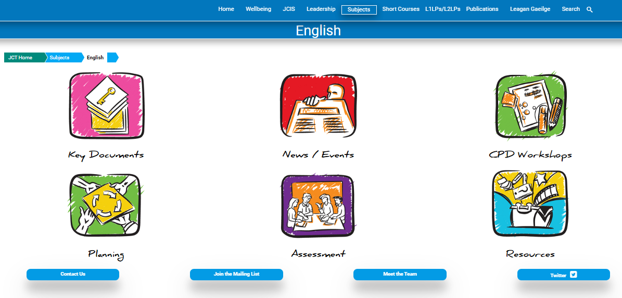
Join our Mailing List – www.jct.ie/english
We send one Mailshot each month
with news, supports and resources!
(Check your spam/other folder)
HERE

Slide 14
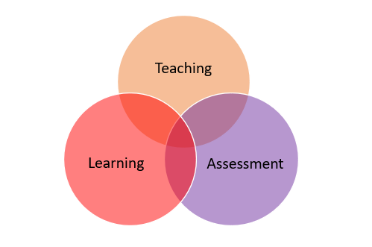
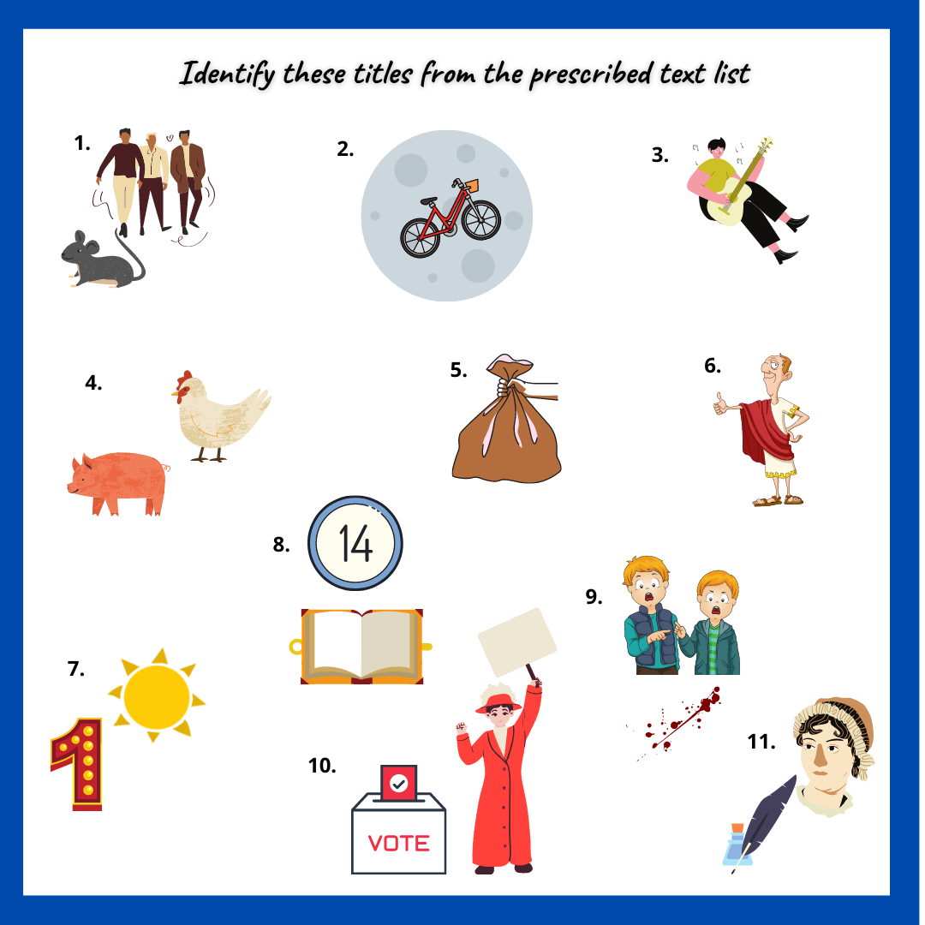
Focus:
To share recent experiences of teaching and learning in Junior Cycle English

Slide 15
Research on learning during the pandemic
“…the transition to remote instruction and the subsequent re-opening of schools had a profound impact on teachers’ work. The crisis required many of them to acquire new skills and prepare materials suited to virtual learning environments.
During school closures, digital resources became the lifeline for education and the pandemic pushed teachers and students to quickly adapt to teach and learn online.”
(OECD, The State of School Education: One year into the COVID Pandemic, 2021)
Rationale
4

Slide 16
Sharing our recent learning experiences
Focus: To share recent experiences of teaching and learning in Junior Cycle English
Jennifer Browne
Griffeen Community College,
Lucan, Dublin
6
Click here to listen to the clip

Slide 17
Activity 2 – Breakout Room (10 mins)
In the Breakout Room:
Nominate one person to share screen and audio
Choose one video to watch on the Google site
Share your thoughts on the clip. Chat about one thing that worked for you and your students in light of the pandemic

Slide 18
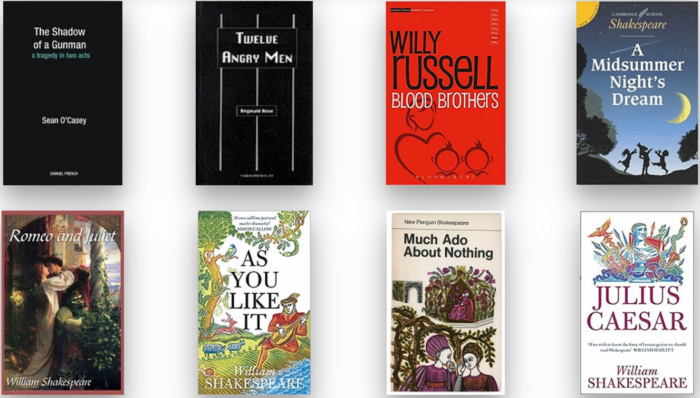
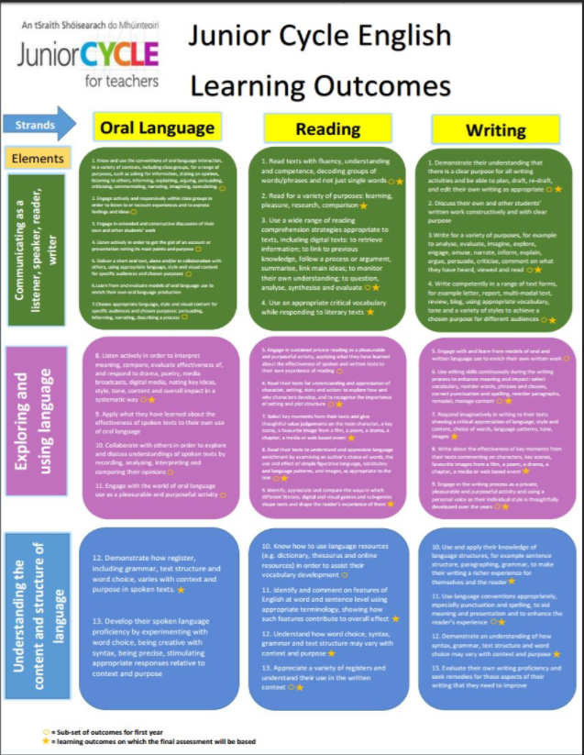
Junior Cycle English since 2014

Slide 19
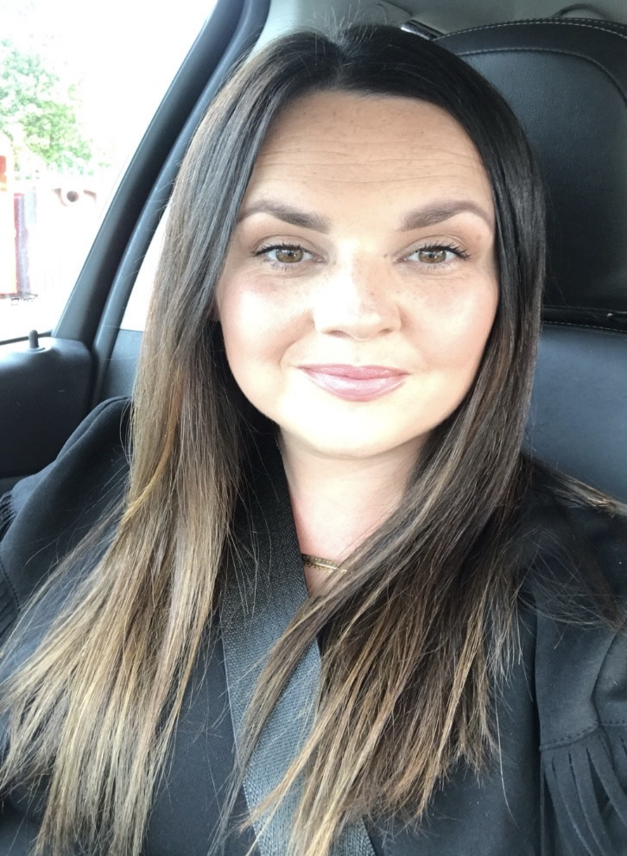
Identifying learning experiences in our classrooms
As you listen, reflect on student learning in your own classroom
Nadine Butler
Trinity Comprehensive School, Ballymun, Dublin

Slide 20
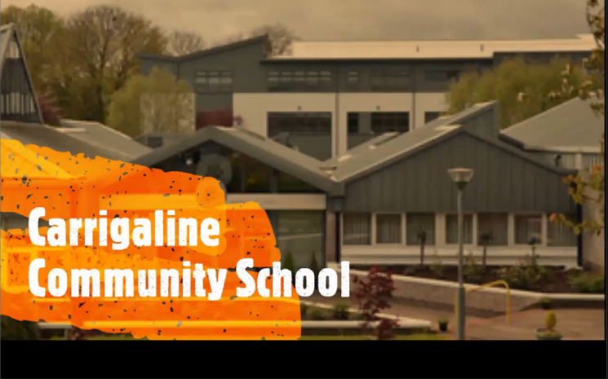
Looking at student learning experiences
Learning Experience
Students teach each other skills
As you watch, reflect on student learning in your own classroom.
Carrigaline Community School,
Cork
6/7

Slide 21
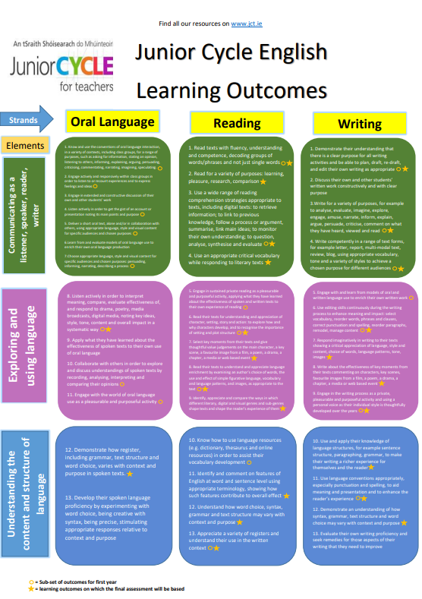
Learning Outcomes in action for CBA 1 and CBA 2
CBA 1
Oral Communication
Oral Language
1, 5, 7, 9, 13
Reading
3
Writing
3, 5
CBA 2
Collection of Student’s Texts
Oral Language
1
Reading
2,6,8
Writing
1, 2, 3, 4, 6, 9, 11
7/8

Slide 22
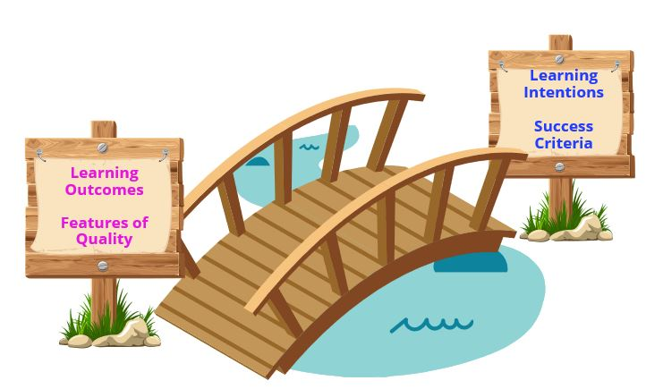
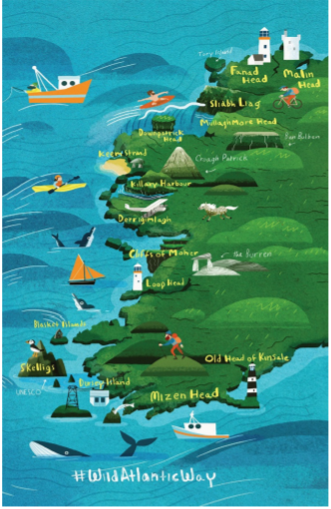
Focus:
To explore planning for assessment

Slide 23
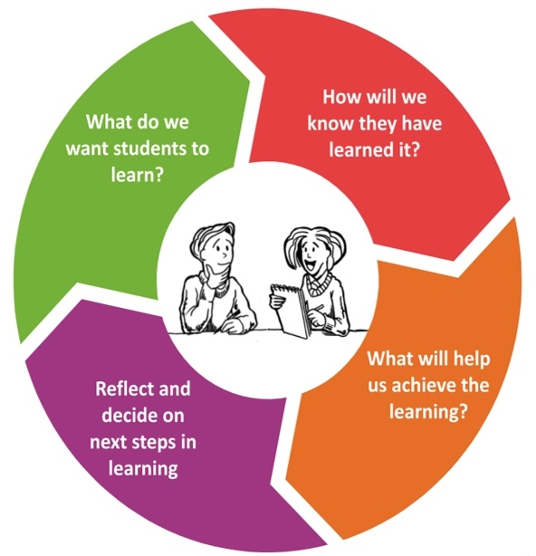
What factors do we consider when we create an assessment?
The student’s prior knowledge
Differentiation
Choice of response formats
Scaffolds, exemplars, models
Link learning intentions to the assessment
Success criteria
10

Slide 24
Personal Writing in First Year
Assessment in Junior Cycle English… rests upon the provision for learners of opportunities to negotiate success criteria against which the quality of their work can be judged by peer, self, and teacher assessment; and upon the quality of the focused feedback, they get in support of their learning.
(English Specification, p.16)
First Years
Coláiste Cholmcille,
Ballyshannon, Donegal
11

Slide 25
Assessment to support student learning
First Year
Second Year
Third Year
Focus: To explore planning for assessment

Slide 26
2017 Higher Level English Final Assessment Section D - Engaging in the Writing Process
Study the Word Cloud.
Complete the task that follows.
Using one or more of the words or phrases from the Word Cloud above, write the dialogue for a scene in a TV drama where an adult confronts a teenager, or a teenager confronts an adult.
Your dialogue may be serious or humorous or both. You may refer to location, the use of special effects and make suggestions for movement in your script. Indicate each speaker on the left‐hand side of the page.
What in the question itself supports students to answer it?
12

Slide 27
2018 Ordinary Level English Final Assessment Section C – Writing for a Variety of Purposes
You and your classmates are going to travel along part of The Wild Atlantic Way next weekend. You all meet at break time to try to decide whether to camp or to stay in hotels. You know what you would prefer to do.
Write out the talk you would give to persuade your classmates to agree with you.
13
What in the question itself supports students to answer it?

Slide 28
Looking at Quality or Success Criteria in the Final Assessment
General Indicators of Quality from the Marking Scheme
14

Slide 29
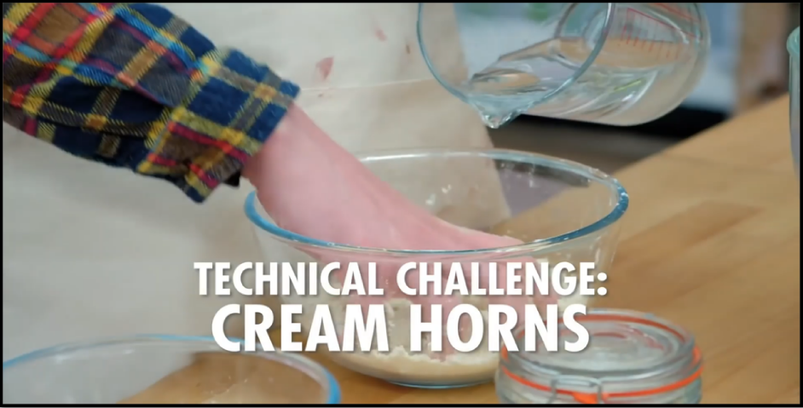
The 'Technical Challenge’
Click here to watch the video

Slide 30
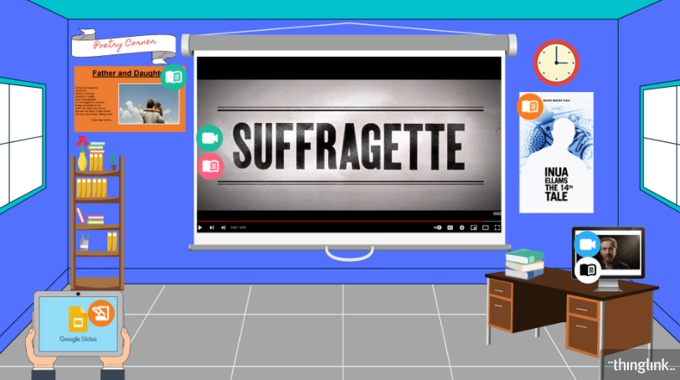
Tour of ThingLink and 4 Texts
Individual Task – Tour of ThingLink
15

Slide 31
How we manage break-times
Don’t leave the meeting!
Do mute your mic
Do turn off your camera
We’ll continue at 11.20am

Slide 32
Focus:
To collaboratively create a sample assessment focusing
on personal writing
10

Slide 33
Aspects of selected Learning Outcomes
OL1 Know and use the conventions of oral language interaction in a variety of contexts
R8 Read their texts to understand and appreciate language enrichment
W2 Discuss their own and other students’ written work
constructively and with clear purpose
W9 Engage in the writing process as their individual style is thoughtfully developed
W11 Use language conventions appropriately, especially
punctuation and spelling
15

Slide 34
Learning Intentions
2nd
Year
We are learning to:
Focus on personal writing and create texts in a range of formats
Develop our own style and consider word choice, punctuation and spelling
Consider:
How can these learning intentions link to the assessment and to the success criteria that your group will create?
15

Slide 35
A reminder of linking Learning Intentions and Success Criteria
We are learning to:
Create an informational or instructional script
Teach each other skills
Share our instruction, with others, in a clear, step-by-step format
Use an appropriate media format, tone and keep our audience in mind
Success Criteria
The information or instructions are presented in a clear, step-by-step format
The words and vocabulary used are specific to the task
An appropriate format and tone is used
An awareness of the audience is shown
6-7

Slide 36
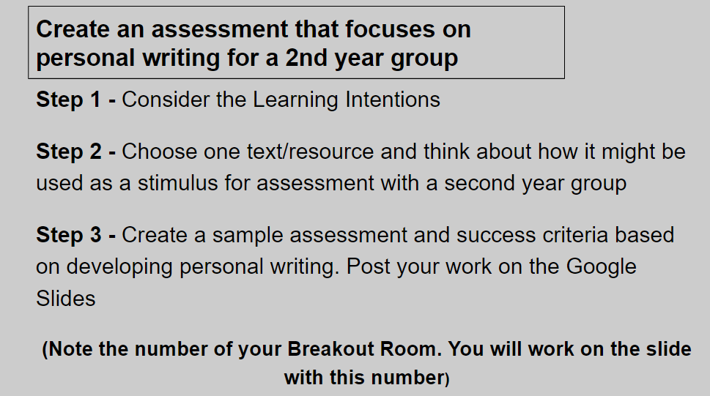
Activity 3 – Collaboratively Create an Assessment (20 mins)
Department Task
Step 1 - Consider the Learning Intentions
Step 2 - Choose 1 text/resource to use as a stimulus for assessment with a 2nd year group
Step 3 - Create an assessment and success criteria. Post your work on the Google slides
15
Please NOTE the breakout room number that you are in

Slide 37
Feedback
Future Considerations
How do we approach assessment as an English department?
What is working well?
What might be changed?
To save this exercise as a PDF, screenshot your slide or simply download from the Google site. Please note these slides serve as a springboard for ideas only.
These slides will not be available after today, so please save now if you wish to keep a copy.

Slide 38
A flavour of the elective workshops on offer today...
16
Click here to watch the video

Slide 39
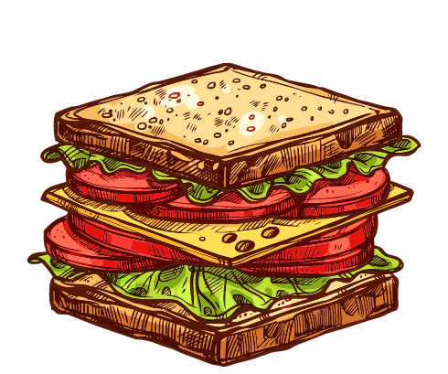
How we manage break-times
Don’t leave the meeting!
Do mute your mic
Do turn off your camera
We’ll continue at 2pm

