Slide 1



Slide 2

THE POWER OF
INDEX ANNUITIES

Slide 3


Slide 4


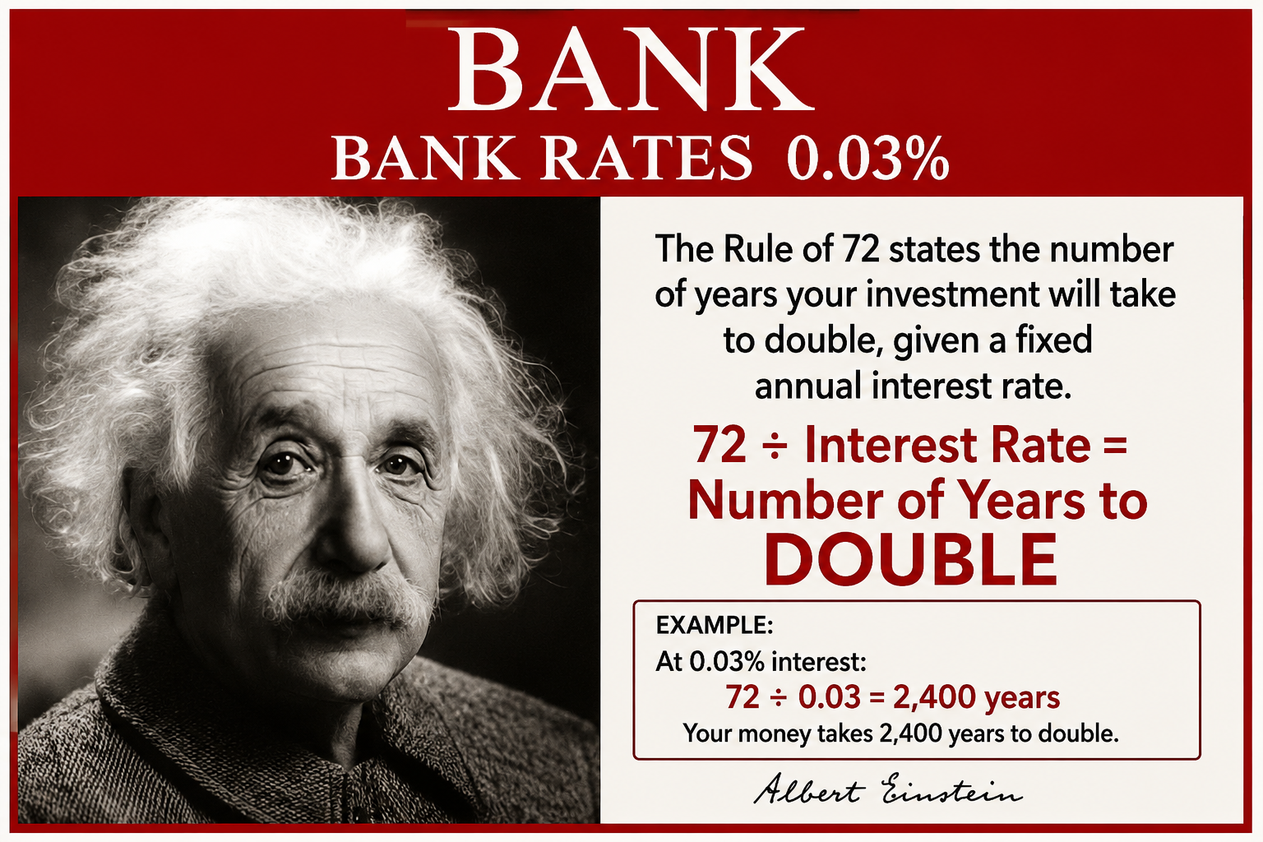
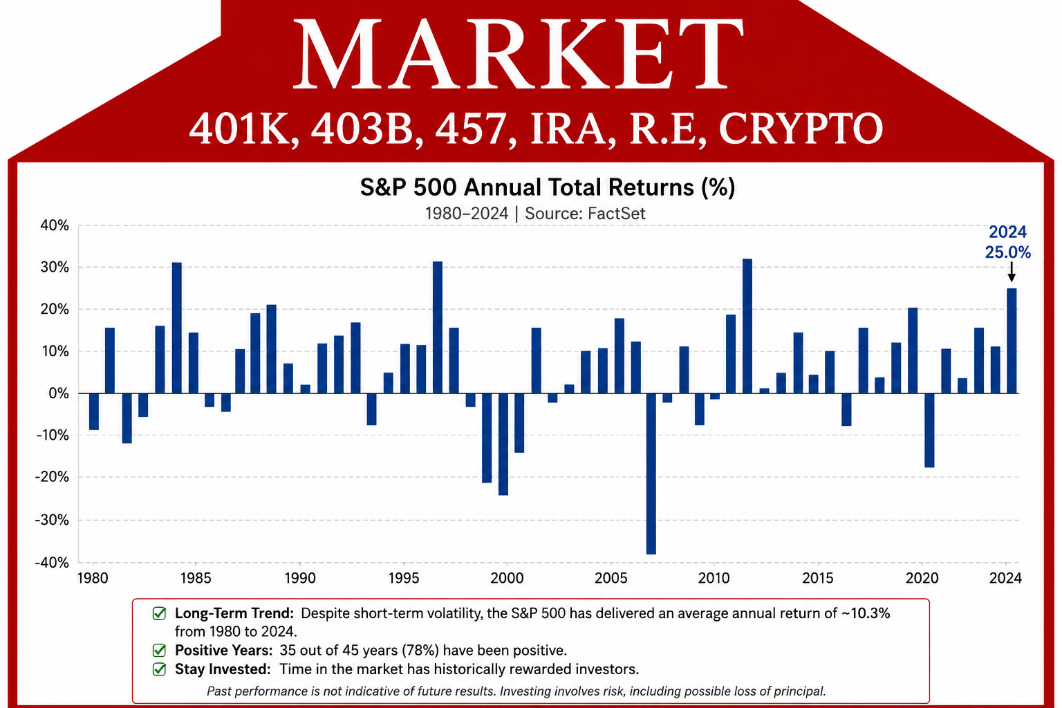
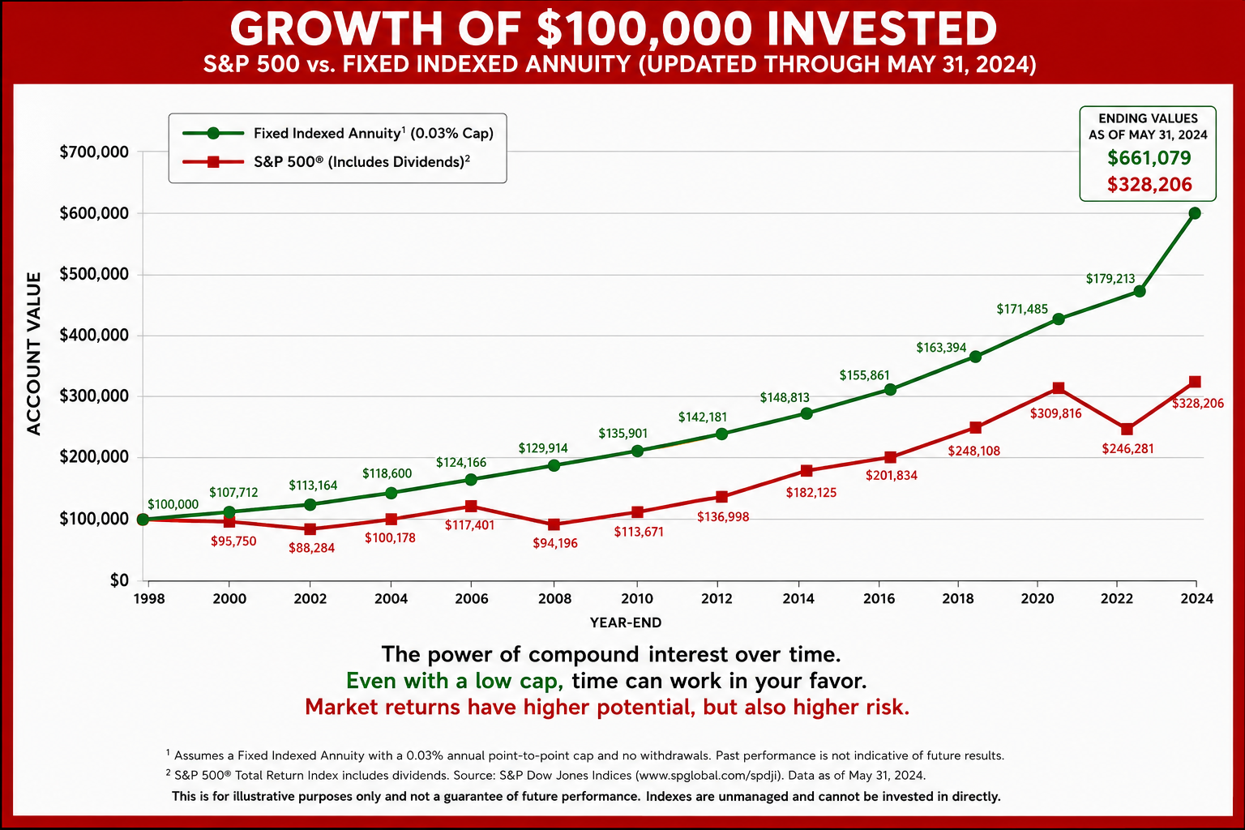
THREE HOMES OF MONEY
FIXED ACCOUNT
SAFE, ACCESSIBLE
FEES, LOW INTEREST RATES
VARIABLE ACCOUNT
HIGH REWARD
HIGH RISK
INDEX ACCOUNT
SAFETY OF THE BANK (NO RISK)
PORTION OF THE MARKET’S UPSIDE
BANK
BANK RATES 0.03%
MARKET
401K, 403B, 457, IRA, R.E, CRYPTO
INDEX
(HYBRID)

Slide 5
EMPLOYEE ALTERNATIVES
Opt 1: LEAVE IT Opt 2: CASH OUT Opt 3: CASH OUT A PORTION Opt 4: IRA ROLLOVER
401(K)
IRA
INDEX
ANNUITY
RISKY
RISKY
SAFE

Slide 6
BENEFITS OF INDEX ANNUITIES
SAFETY OF PRINCIPLE
TAX-DEFERRED GROWTH
LIFETIME INCOME
LTD ACCOUNT ACCESS
DESIGNATED BENEFICIARIES
*INCOME RIDER!

Slide 7
ANNUITIES SIMPLIFIED
PENSION
INDEX ANNUITY
EMPLOYER
EMPLOYER
$$$$$$
$$$$$, 401(K), 403(b), 457, IRA, TSP...
LIFE INSURANCE CO
LIFE INSURANCE CO
INDEX ANNUITY
ANNUITY
INCOME FOR LIFE
INCOME FOR LIFE
*INCOME RIDER*
ANNUITIZED
NO ANNUITIZATION
ACCOUNT ACCESS
GROWTH & SAFETY
LEAVE A LEGACY FOR BENEFICIARIES

Slide 8
WHAT HAPPENS WHEN YOU LOSE?
THE
BIGGEST
MYTH
IS
THAT
YOU
WILL
CATCH
UP!
$100,000
0%
$100,000
+5% (+5,000)
$105,000
+5% (+5,250)
$110,250
+5% (+5,512)
$115,762
+5% (+5,788)
$121,550
+5% (+6,077)
$127,627
$100,000
-20%
$80,000
+8% ($6,400)
$86,400
+8% ($6,912)
$93,312
+8% (+7,464)
$100,776
+8% (+8,062)
$108,838
+8% (+8,707)
$117,545

Slide 9
SECURE YOUR RETIREMENT INCOME!
IRA INCOME
$500,000
4%
$20,000/YR
WHAT IF THE
MARKET LOSES 30%?
$350,000
4%
$14,000/YR
INCOME MAY CHANGE!
INDEX ANNUITY INCOME
$500,000
5%
$25,000/YR!
WHAT IF THE MARKET LOSES 30%?
$500,000
5%
$25,000/YR!
INCOME IS LOCKED IN!

Slide 10
ANY QUESTIONS?

Slide 11
1. HOW MUCH INCOME DO YOU WANT TO HAVE COMING IN EVERY MONTH? ANNUALLY?
_______________/_______________
2. AT WHAT AGE DO YOU WANT TO RETIRE? __________
3. FACTOR AVERAGE LIFE EXPECTANCY _________
4. SUBTRACT YOUR RETIREMENT AGE FROM AVG. LIFE EXPECTANCY TO GET THE NUMBER YEARS THAT YOU WILL NEED INCOME ______
5. MULTIPLY YOUR DESIRED ANNUAL RETIREMENT INCOME TIMES THE NUMBER OF YEARS OF INCOME NEEDED TO GET YOUR FIN# _____
WHAT IS YOUR FIN#?
FINANCIAL INDEPENDENCE NUMBER
ANY QUESTIONS??

Slide 12
LICENSED AGENT NEXT STEPS:
GET A FULL STATEMENT(either email or picture of it)
PICTURE OF DRIVERS LIC OR GOVERNMENT ID
Set up call with client and transferring company to see which forms they need to release funds. Their own form? the receiving company’s form?or just verbal authorization?
ANY QUESTIONS??

