Slide 1

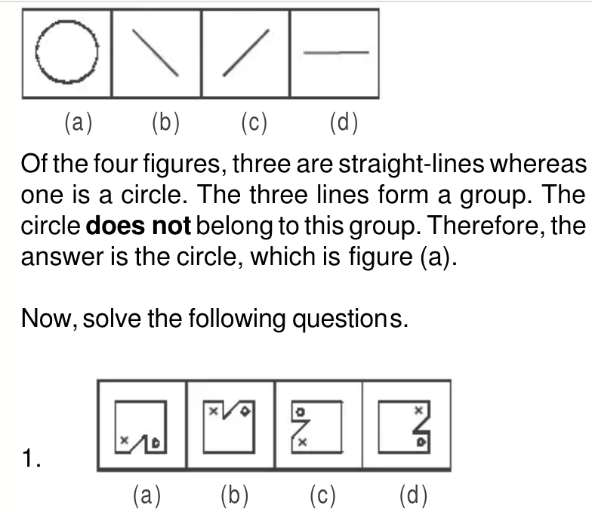
Neuro-Symbolic Visual Reasoning 🧠
"How many red balls are next to the cube but not behind the slide?"
Are we really teaching our children's spatial and visual reasoning?
PS: We are asking for sure.
Guided by:
Ravi Kiran Sarvadevabhatla,
Makarand Tapaswi,
Mohd Hozaifa Khan
By Aditya & Nikhil
2024204012, 2024201067

Slide 2

Story of Ishan
Ishan, a seventh-grader with a knack for storytelling and creative writing, thrived in subjects like English and history. But geometry felt like an alien world. While his classmates breezed through lessons, Ishan stumbled over tasks like:
Mental Rotation: Struggling to recognize how a folded net transformed into a 3D shape.
Spatial Scaling: Misjudging real-world distances from map scales (e.g., thinking 1:100 meant “steps,” not meters).
Perspective-Taking: Unable to predict how a building would look from above or the side.
Traditional worksheets and textbook diagrams left him lost. “It’s like everyone else sees a puzzle, and I just see scribbles,” he confided in his teacher, Ms. Patel. His confidence plummeted, and he dodged STEM clubs—a pattern seen in 34% of students with underdeveloped spatial reasoning.

Slide 3


The Problem: Complex Visual Queries
For students like Ishan, spatial reasoning isn’t about talent—it’s about tools. Spatial Quest bridged the gap between frustration and mastery, proving that with the right support, every student can decode the world’s hidden geometry.
Challenging Queries
Current Limitations
"How many red cubes are to the left of the green sphere?”
Systems fail on nested queries (e.g., “Find a red cube smaller than the sphere to the right of the cylinder”).
“Is there a weapon in the scene?”
Symbolic engines break with noisy inputs
Needed Skills
Understand objects, attributes, and relationships.

Slide 4
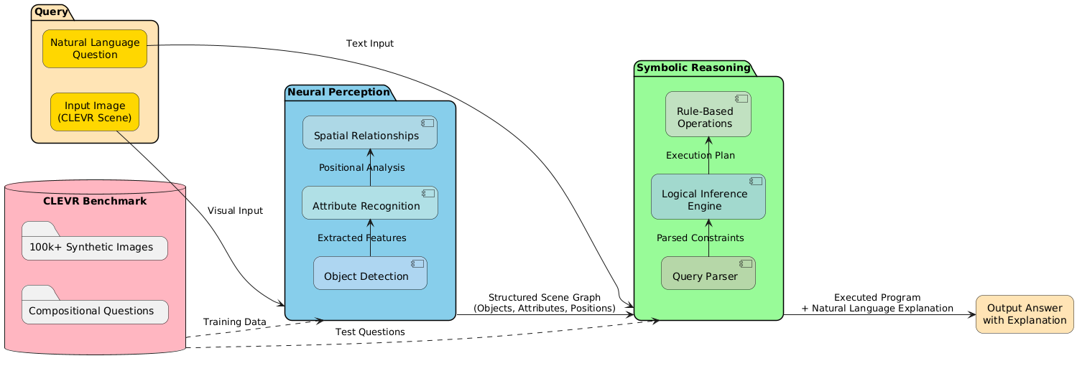
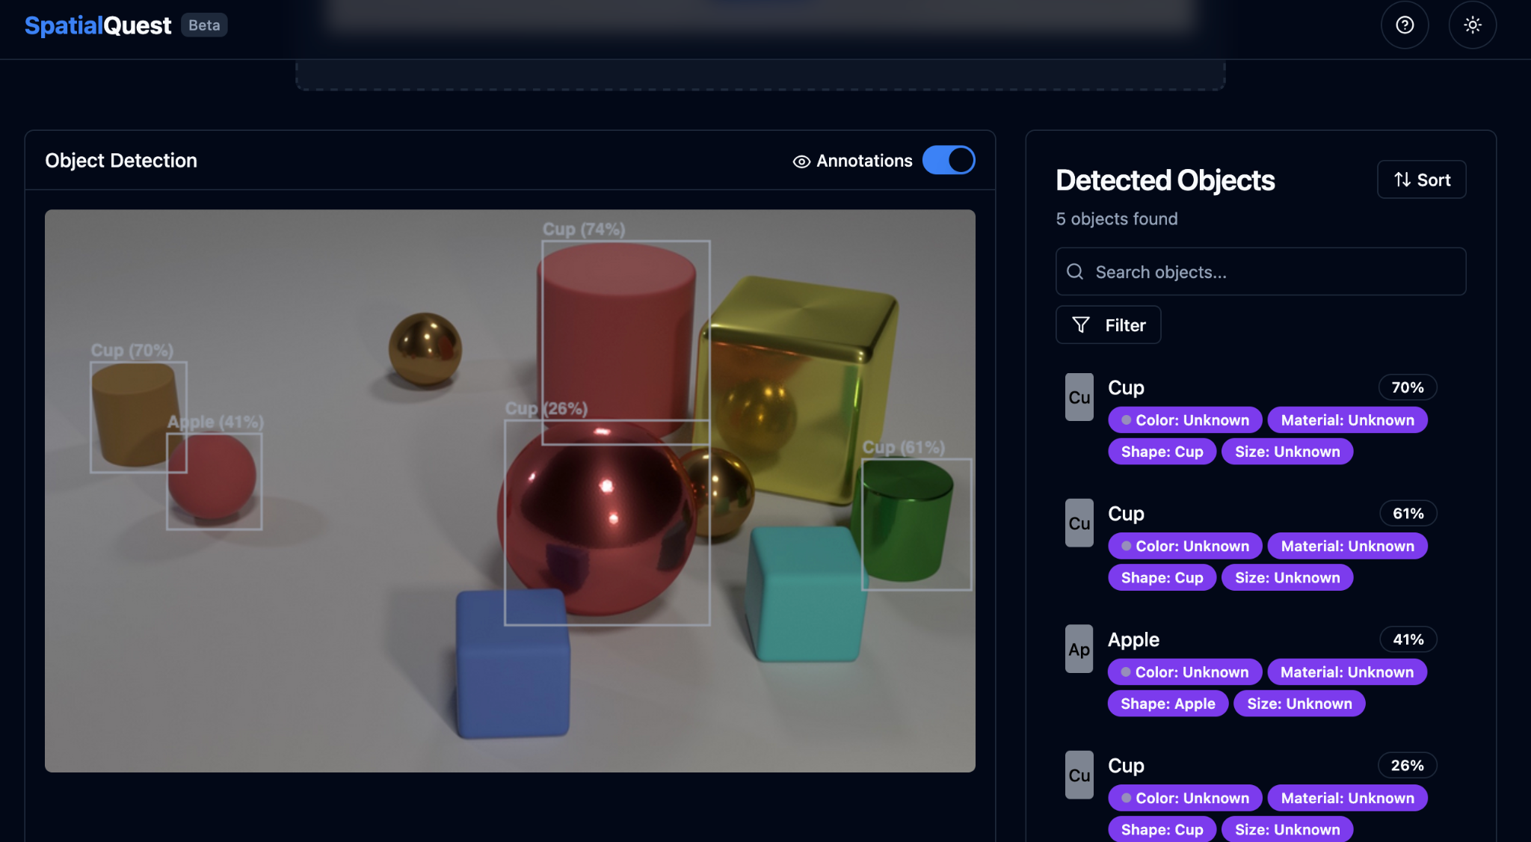
Our Solution: Spatial quest - A Neuro-Symbolic Visual Reasoning
Neural Perception
Symbolic Reasoning
Detects objects and recognizes attributes.
Applies logical inference and rules.
CLEVR Dataset
Benchmark for complex visual queries.

Slide 5

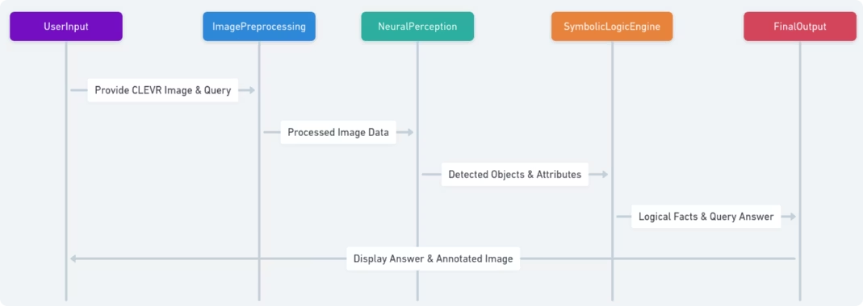
System Workflow: Detect → Reason → Answer 🧩
1
Input
Visual scene and user query.
2
Detect
Neural network identifies objects and attributes.
3
Reason
Symbolic engine applies logic rules.
4
Answer
System delivers the final result.

Slide 6
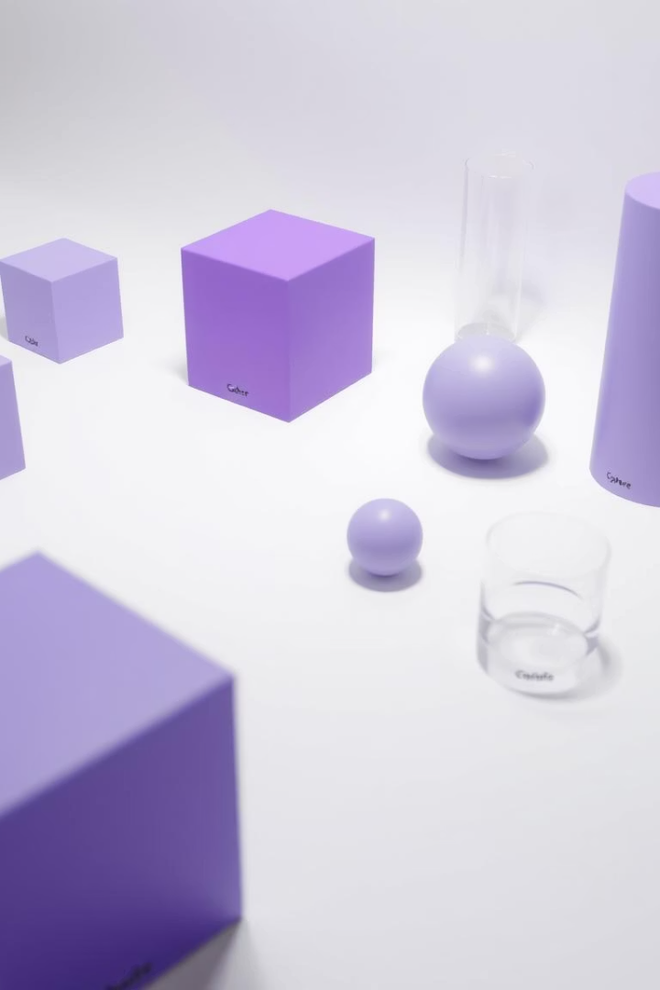
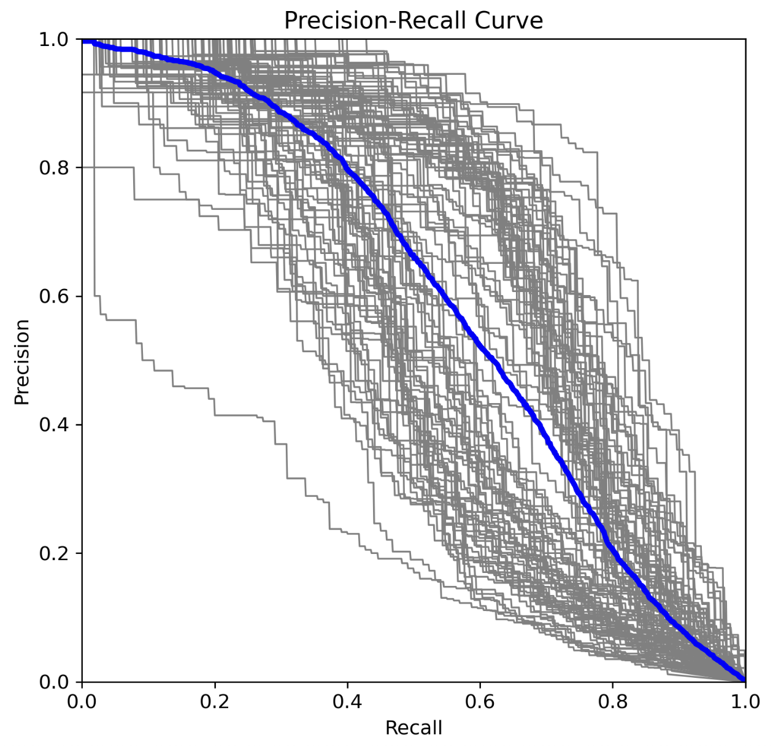
Neural Object Detection & Attribute Recognition 🧠
🚂
Training
🎁
Objects
On sub-sampled CLEVR dataset with 98.7% detection accuracy.
Cubes, spheres, cylinders detected precisely.
📲
Attributes
Color, size, and material recognized effectively.

Slide 7
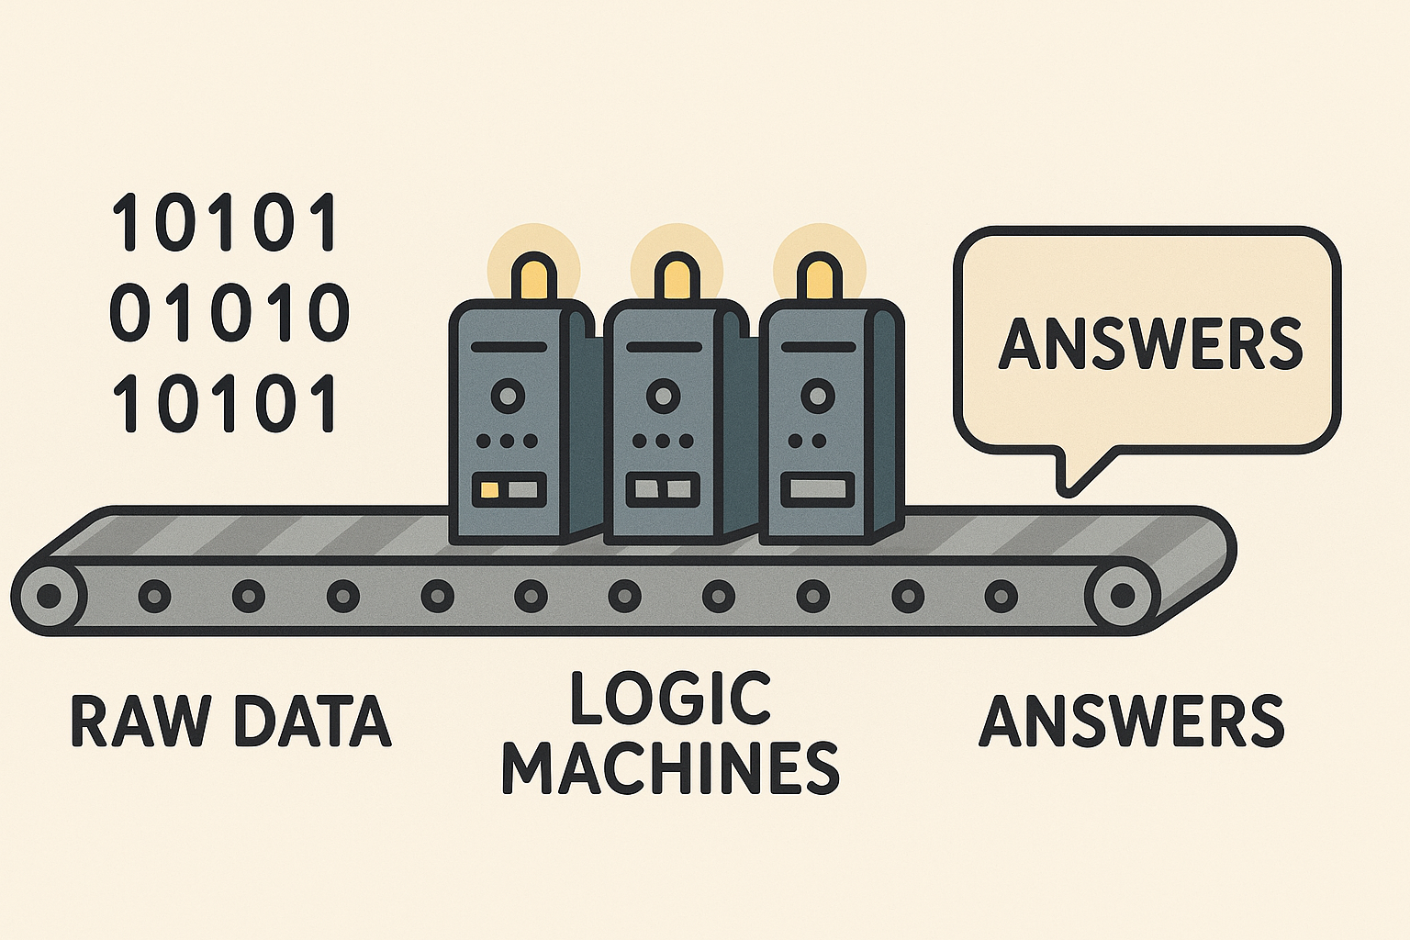
Symbolic Reasoning:
Spatial Rules
Encoded relations: left, right, above, below.
Logical Rules
Propositional logic (AND/OR/NOT)
First-order predicates (∀, ∃ quantifiers)
Domain-specific constraints like physics
Compositional Queries
Handles multiple conditions logically.
Example Rule
"If A left of B and B left of C, then A left of C."
Nested conditions: "Find objects that are (red AND metallic) OR (small BUT NOT spherical)"

Slide 8
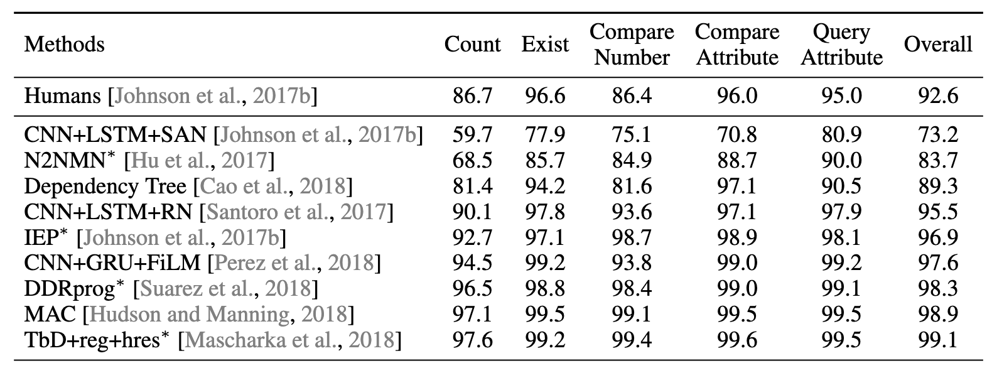
Metrics: Accuracy & Speed ⚡️
Accuracy
Speed
Reasoning Time
Achieved 95.2% on complex CLEVR queries.
3x faster than end-to-end neural models.
Average of 0.7 seconds per query.

Slide 9
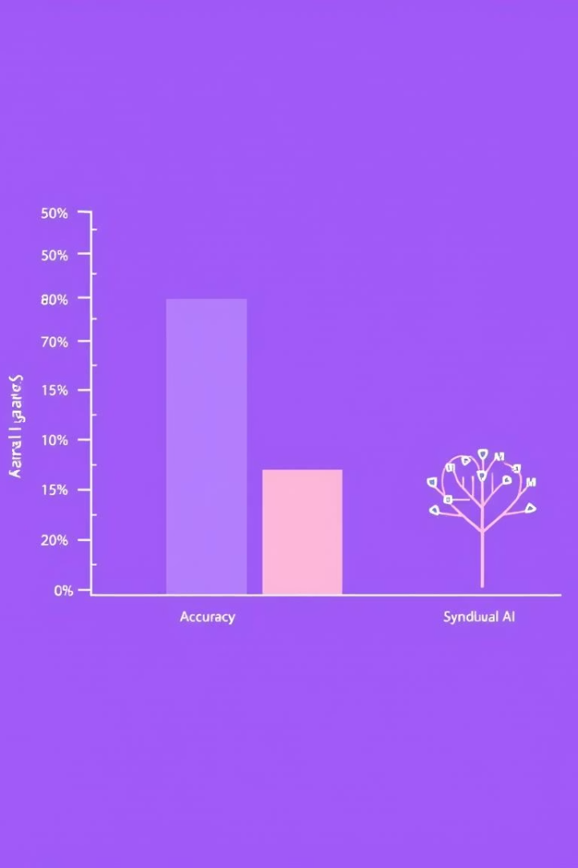



Ablations: Neural vs. Hybrid ⚙️
Neural-Only
Symbolic-Only
Neuro-Symbolic
78% accuracy, struggles with complex queries.
Depends on perfect object detection.
95.2% accuracy, robust to noise.

Slide 10
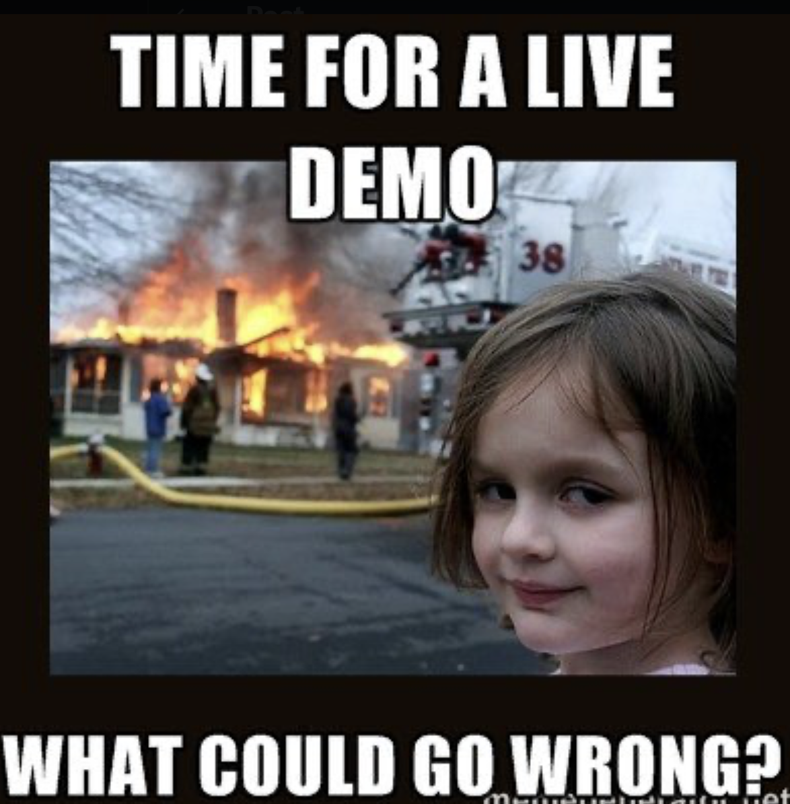
Demo: Interactive Web UI 💻
Explore Visual Reasoning
Children create scenes and test queries interactively.
Drag-and-Drop
Easy scene building with intuitive controls.
Explainability
Visual explanations of the reasoning process.
Demo link: https://youtu.be/TwZfHC4935Q

Slide 11

Conclusion & Next Steps 🚀
Powerful Tool
Enhances visual reasoning skills in kids.
Future Work
Expand to real-world images beyond CLEVR.
Integration
Embed into educational games and learning platforms.
Positive Impact
Supports cognitive development and interactive learning.

Slide 12

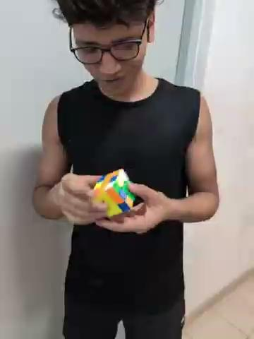
Here it all started
Thanks to all 🙏
Aditya AKA ProdMan
Nikhil singh AKA 5* Dev

