Slide 1
Designing a Culture: From Walden II to Classroom Consultation
Ronnie Detrich
Wing Institute
Wing Institute Summit, 2014

Slide 2
The Consulting Project
Public school consulting service for students in special education.
Operated for 13 years (1990-2003).
First year: started with one consultant
experience as classroom teacher but no consulting experience
part way through the year added a clinical supervisor .10 FTE
Final year: 20 consultants
serving 300 students in 300 different classrooms
across 50 school districts
provided 11,365 hours of consultation (10,431 direct, 948 indirect).
Notes:
Goal to support students in public schools so that placement in private special education schools was not necessary.
Encouraged by Marty C.
Teri Lewis was part of the group pretty early on.

Slide 3
Staff Characteristics
Diverse backgrounds
Education, psychology, school psychology, behavior analysis, social work, counseling
Most had MA, a few PhD.
Three skill sets required
Technical skills
Behavior analysis
Educational instructional practices
Social influence-ability to gain agreement from teacher, parent, district administrators.
Working assumption: technical skills more easily developed than social influence skills.
Without social influence, technical skills relatively useless.

Slide 4
Our Challenge
Design a system that supports effective behavior of a diverse group of consultants (approximately 100 different consultants over the years)
Working in 300 distinctly different classroom cultures.
Inspired by the code in Walden II we developed a set of guiding principles.
“The code acts as a memory aid until good behavior becomes habitual.” Frazier-Walden II.

Slide 5
Core Principles
Our task is to come alongside the teacher and solve problems with the teacher rather than for the teacher.
It is only support when the teacher says it is.
Notes:
Teacher and student were the location for action. If we were not perceived as support by the teacher then we were likely to fail.
Ultimately, we were providing relief so our “solutions” had to solve the problem as the teacher defined it.

Slide 6
Method of Analysis
We apply the operant paradigm (context-behavior-function) across all practices and services. The relationship between context and function is bi-directional and non-linear.
Notes:
This was shared with staff and potential staff. We wanted to be very clear what we were about and what folks were signing up for if we hired them.

Slide 7
Interventions
Our goal is individual skill development which may involve teaching both functionally equivalent skills and compensatory skills that allow an individual to be effective across settings and across time.
Our interventions must always include positive and proactive procedures.
The design and implementation of suggested interventions and teaching strategies is guided by data-based information.
Notes:
This was the early 90s when the aversives controversy was raging. We wanted to make sure that consultants maintained a focus on skill development rather than behavior management.

Slide 8
Relationship to Consumers
As consultants our role is temporary; we practice a mediated model and systematically promote independence.
Our service model is collaborative and focuses on demonstrating and encouraging a problem-solving process.
Our support services are individualized to accommodate consumer interests, needs, and preferences. Throughout service we solicit feedback and adjust our practices to promote satisfaction.
Our interactions must include an evolving sensitivity to diversity.
Notes:
We wanted to emphasize that a particular case was not the basis for a career. Also, all of our contracts expired at the end of the fiscal year

Slide 9
Evaluating Services
Service outcomes are assessed through periodic and systematic sampling using the following criteria:
Data-based demonstration of student skill acquisition through a staff mediated model.
district willingness to use our services again.
the degree to which parents speak well of us.
Notes:
Three clients: student, school personnel, families.
District-two measures-number of contracts and satisfaction surveys.

Slide 10
Business Operations
We never say no to requests for services.
Service goals are developed within the context of contract hours.
Notes:
We were part of the IEP process. Every student has right to free and appropriate education. Service could not be delayed-not appropriate.
Negotiated with district about the scope of the goals given contract limitations.

Slide 11
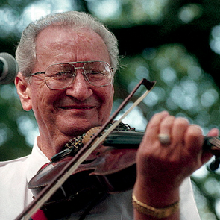
Building Sustainable Cultures
“A culture is preserved one generation at a time.”
Dewey Balfa
Notes:
Many consultants came through had to find a way to make sure they were effectively integrated into the culture-it could not be left to chance-had to be done everytime.
Screening process became legendary-not everyone could join the culture and it wasn’t easy. Teri had to come to participate in at least two interviews.

Slide 12
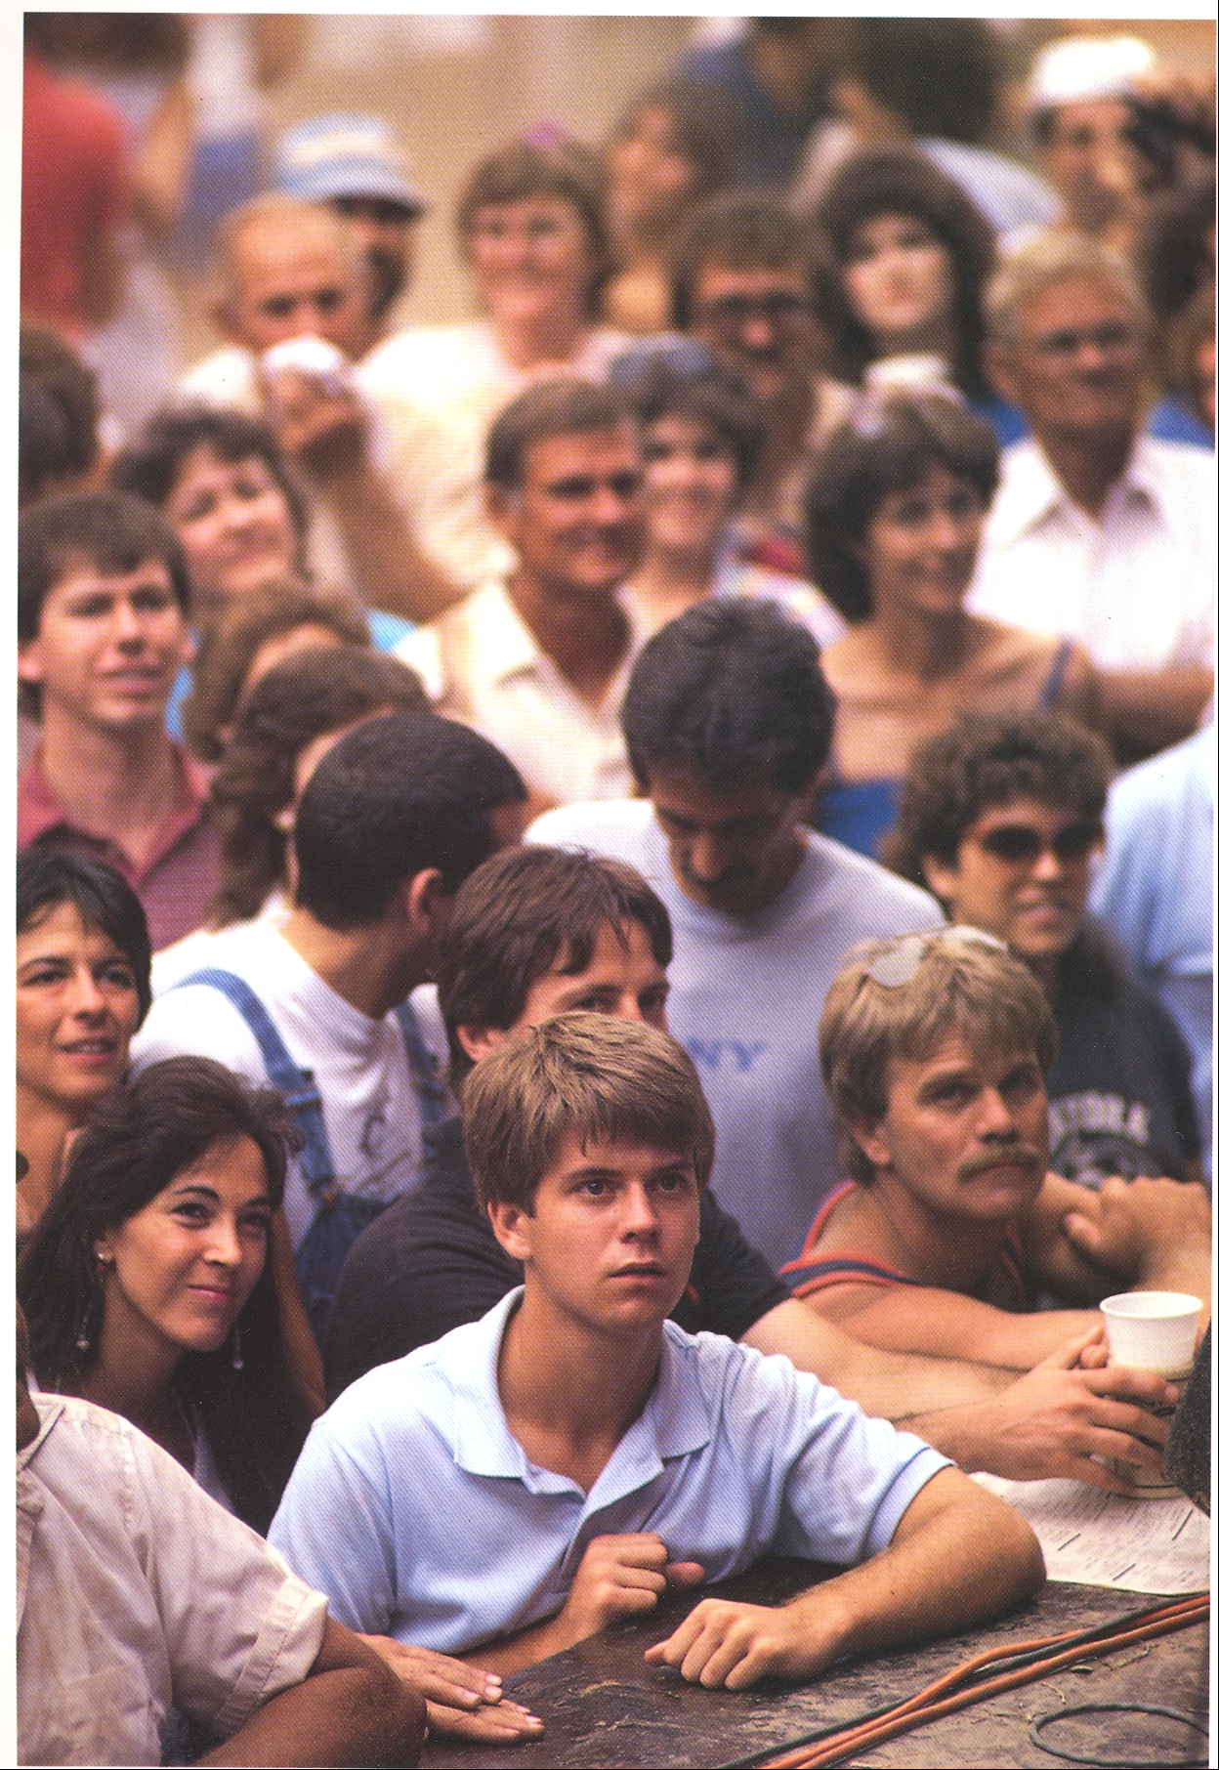

Slide 13
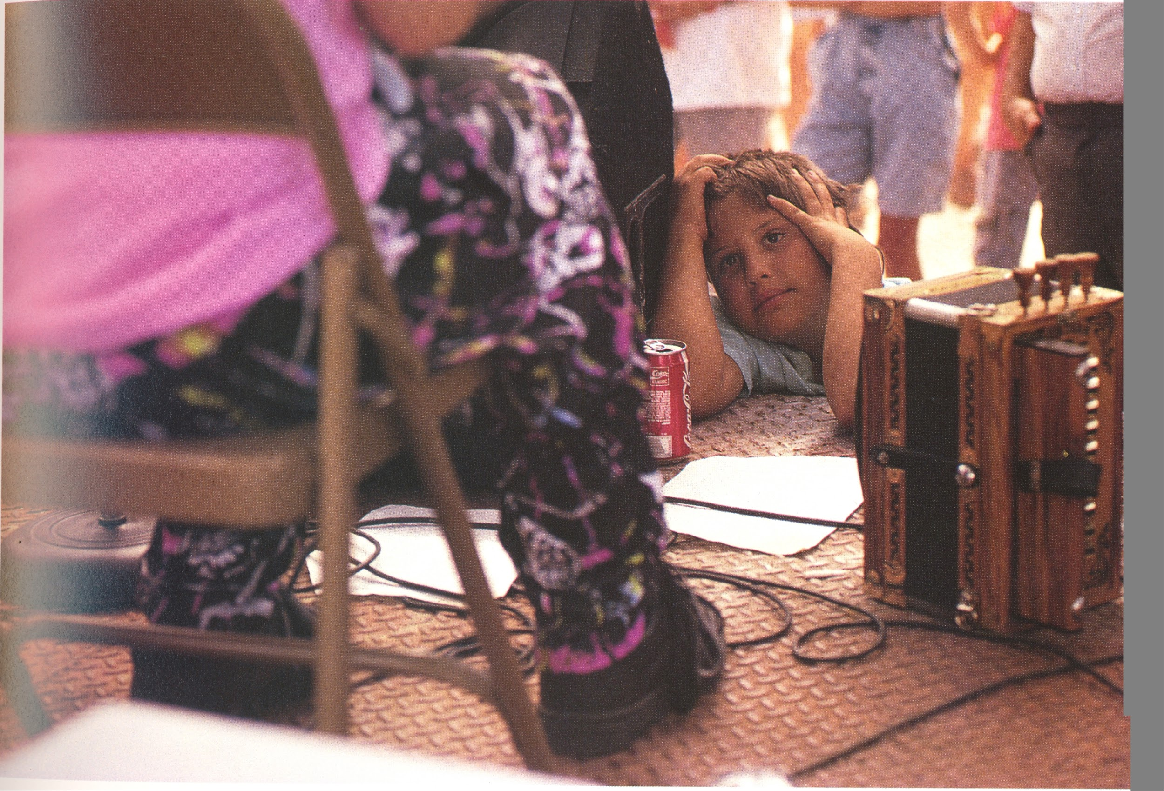

Slide 14
How We Did It
Principles established by the group.
Principles routinely reviewed and discussed within the group.
Principles informed supervision of consultants.
Infrastructure developed to support following principles:
Frequent supervision including peer-peer.
Many data-based feedback systems.

Slide 15
Conclusion
Attempt to explicitly establish a culture.
Provided a common framework for addressing issues.
Evolved over time.

