Slide 1
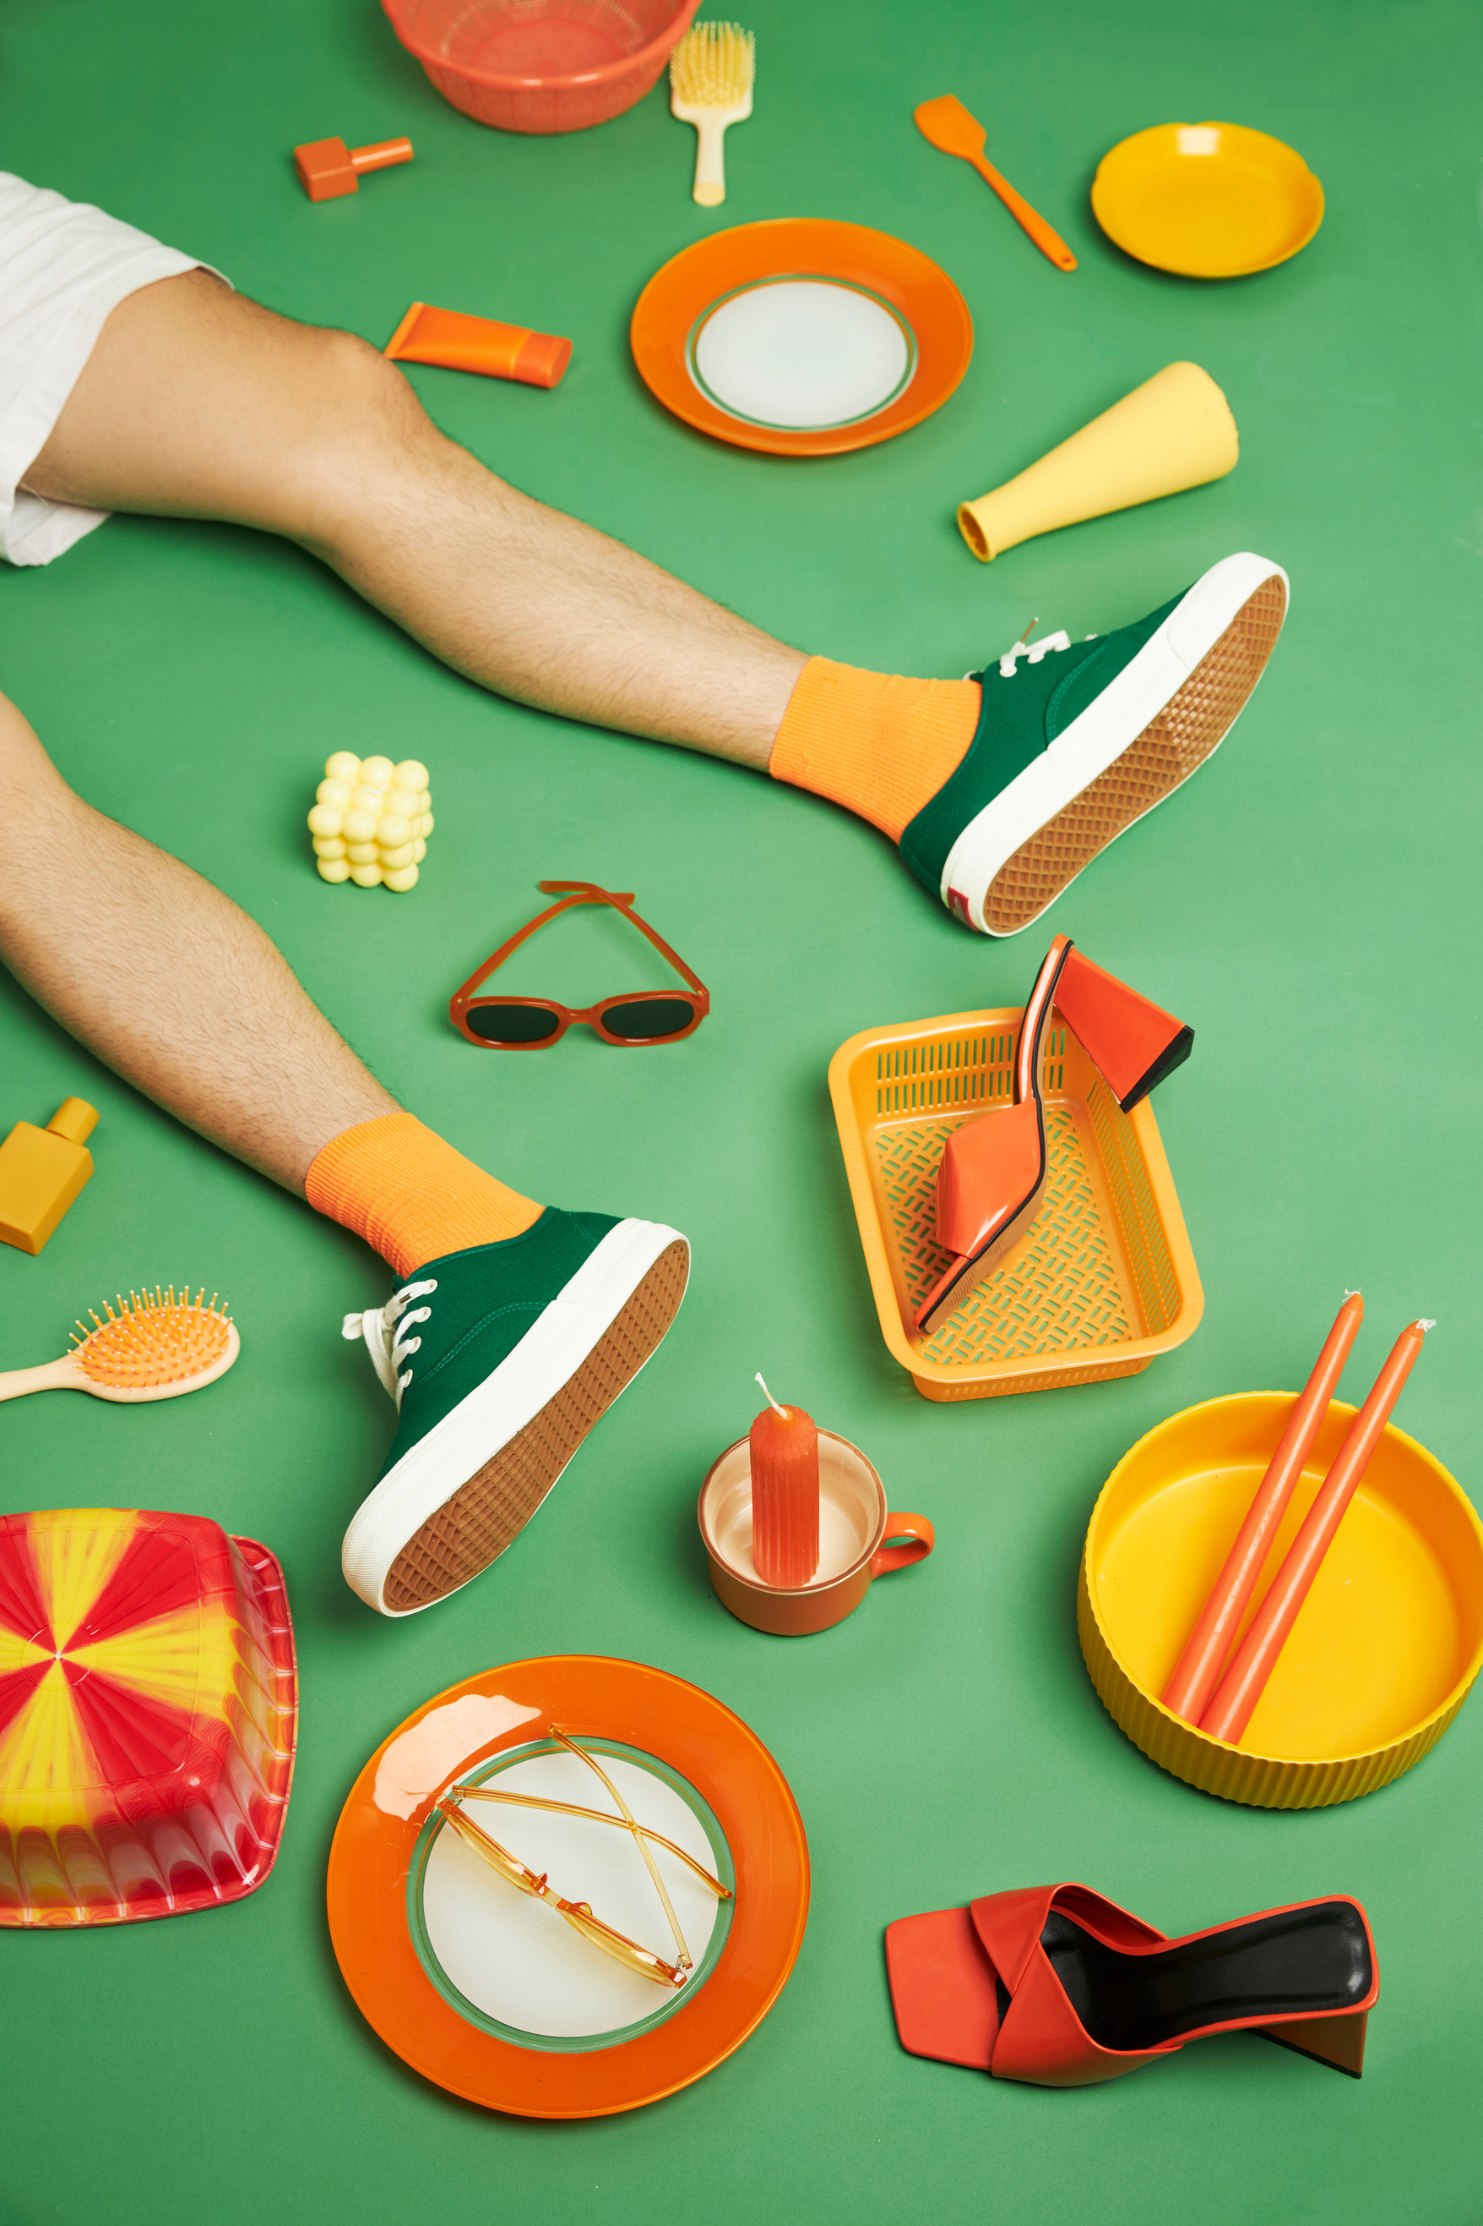


Liceria & Co.
Pitch Deck Presentation
Redefining Fashion Experience
Style • Innovation • Sustainability
Presented By:
Helene Paquet
@reallygreatsite

Slide 2
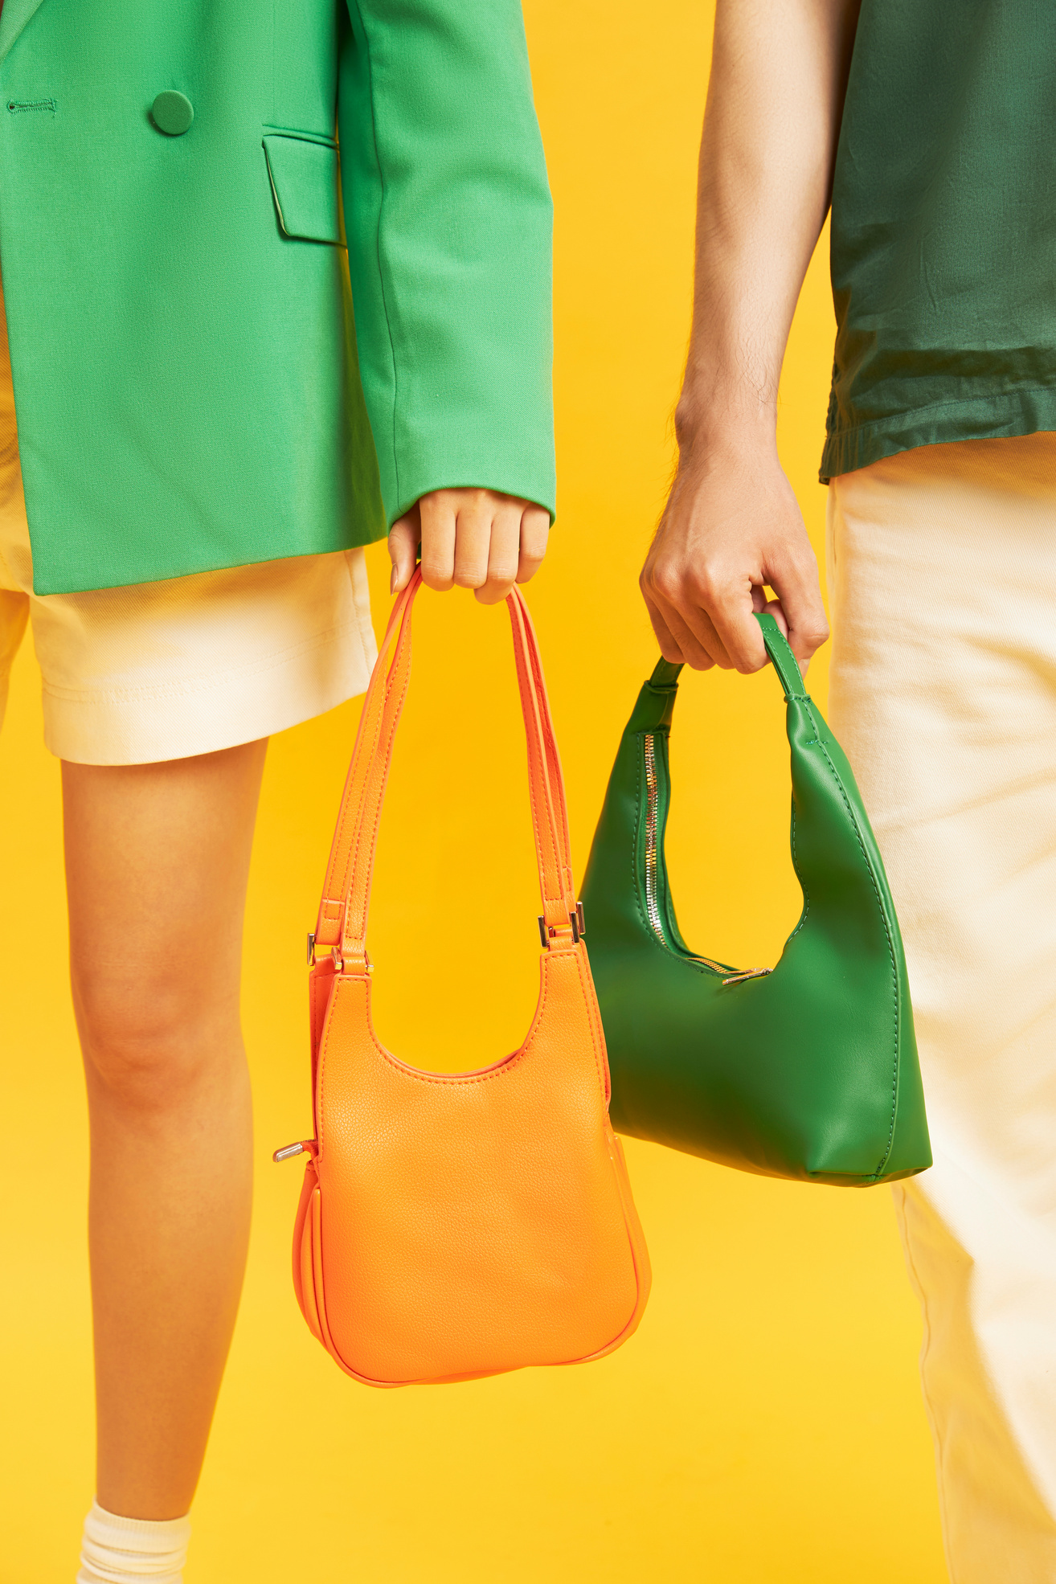


The Current Challenge
The fashion industry is driven by fast trends, overproduction, and environmental impact. Shoppers feel overwhelmed by choices yet underwhelmed by personalization.

Slide 3
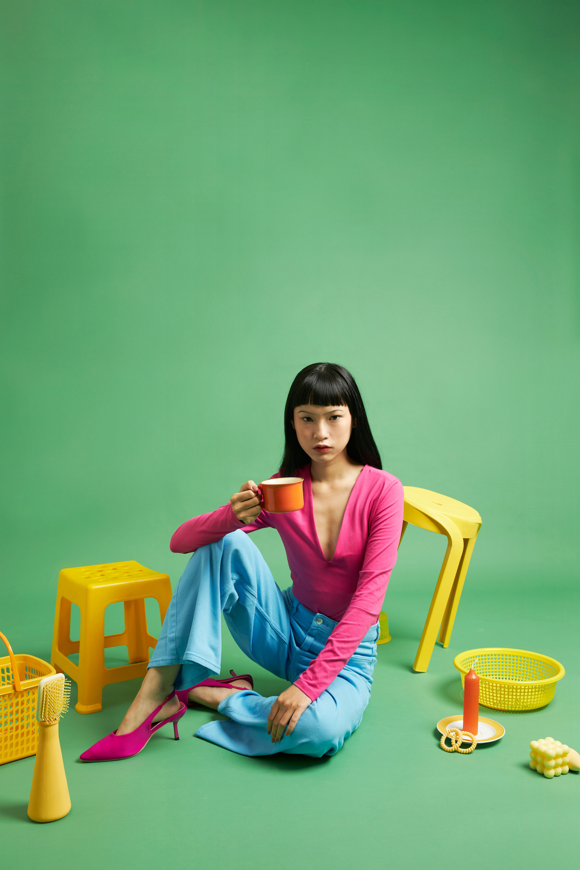


Our Big Idea
We are building a smarter fashion ecosystem that delivers personalization, transparency, and sustainable style—all in one seamless experience.

Slide 4
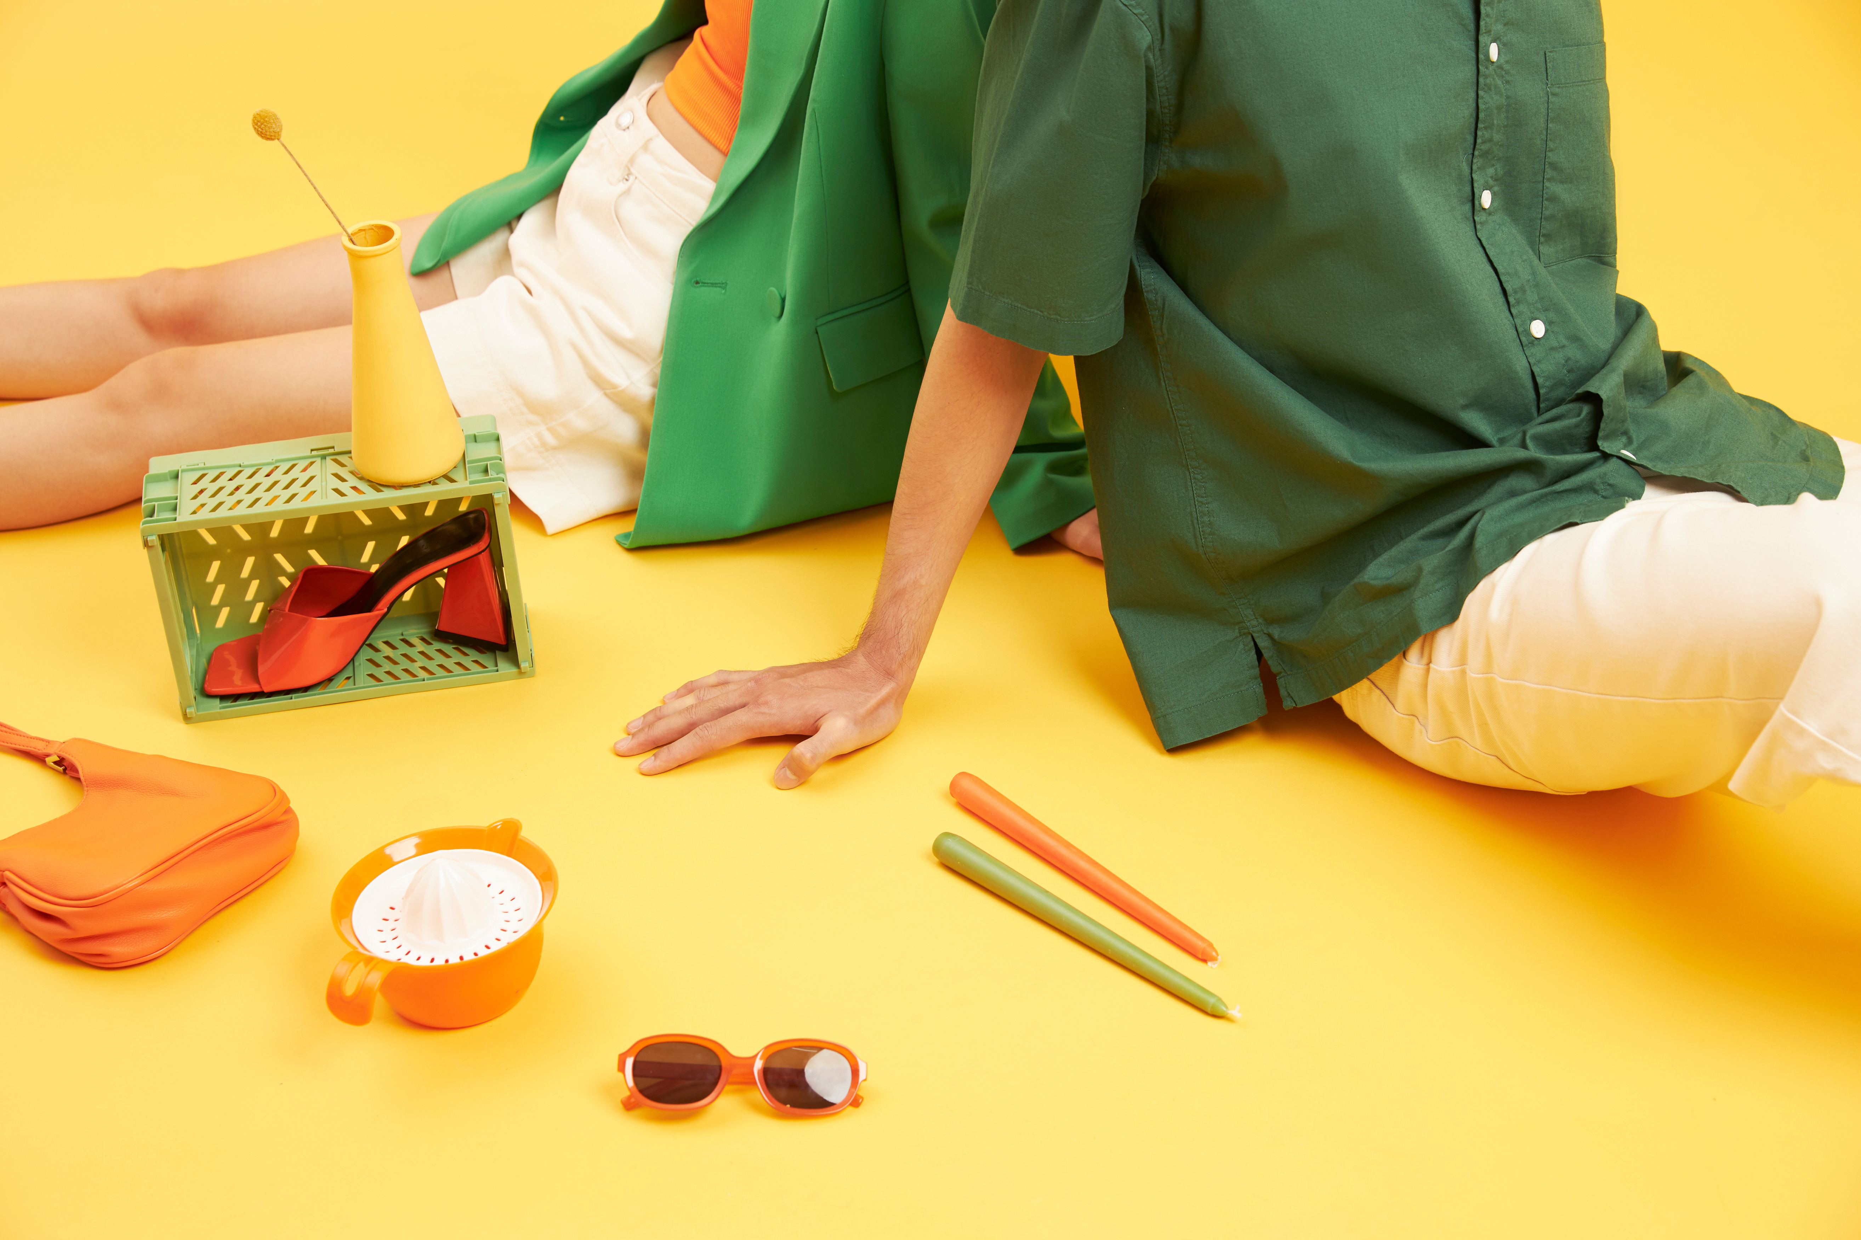


Market Potential
The global fashion market is valued at $2.5 trillion.
Demand for sustainable and digital-first fashion is rapidly growing, especially among Millennials and Gen Z.

Slide 5
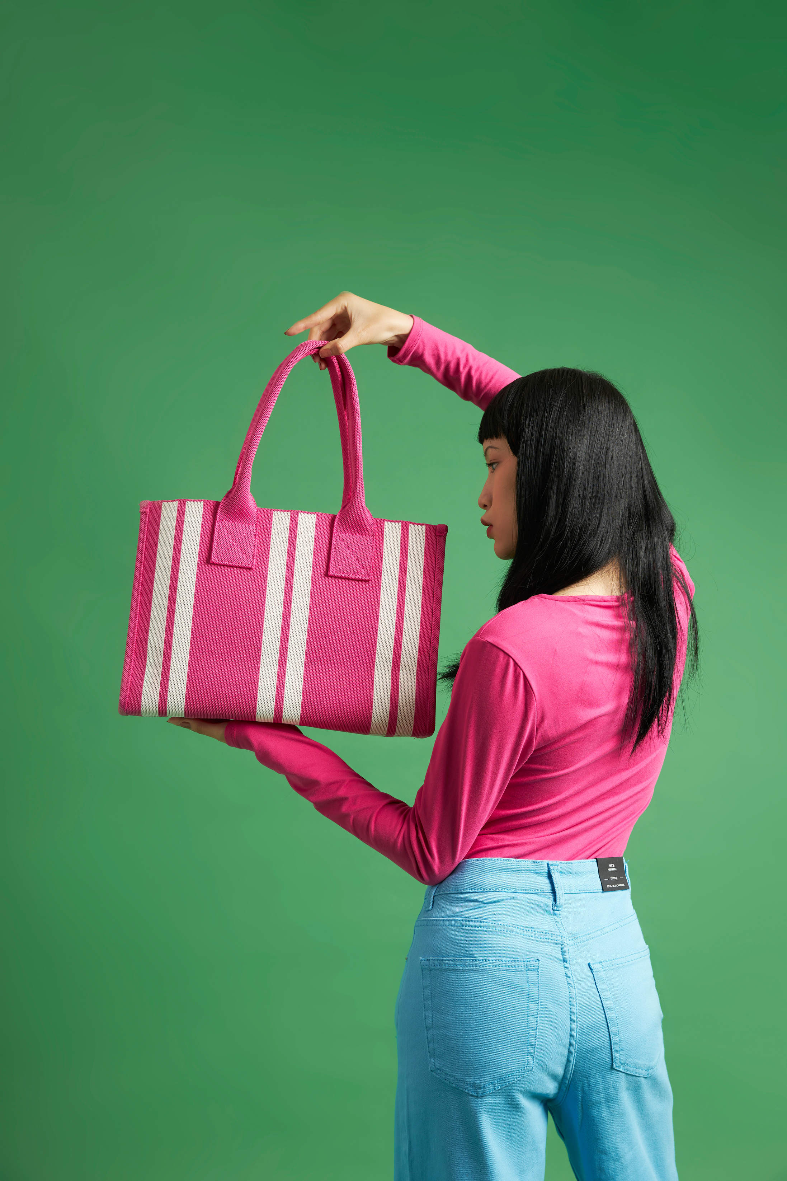


@reallygreatsite
What Sets
Us Apart
Personalized style powered by data
Digital-first experiences like virtual try-on
Sustainable collections with ethical sourcing
Exclusive designer collaborations

Slide 6

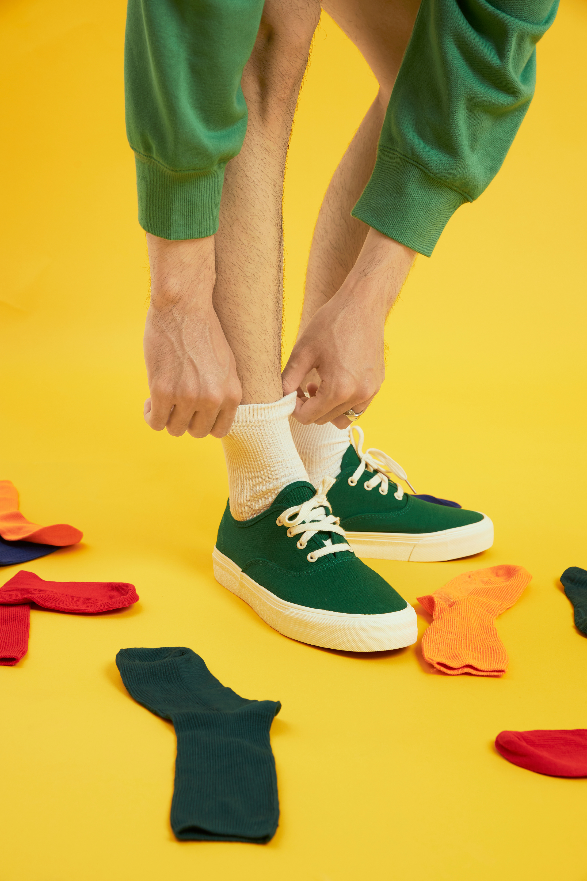

Direct-to-consumer sales
Membership and subscription models
Partnerships with designers and brands
How We Operate
Digital fashion for the virtual economy

Slide 7
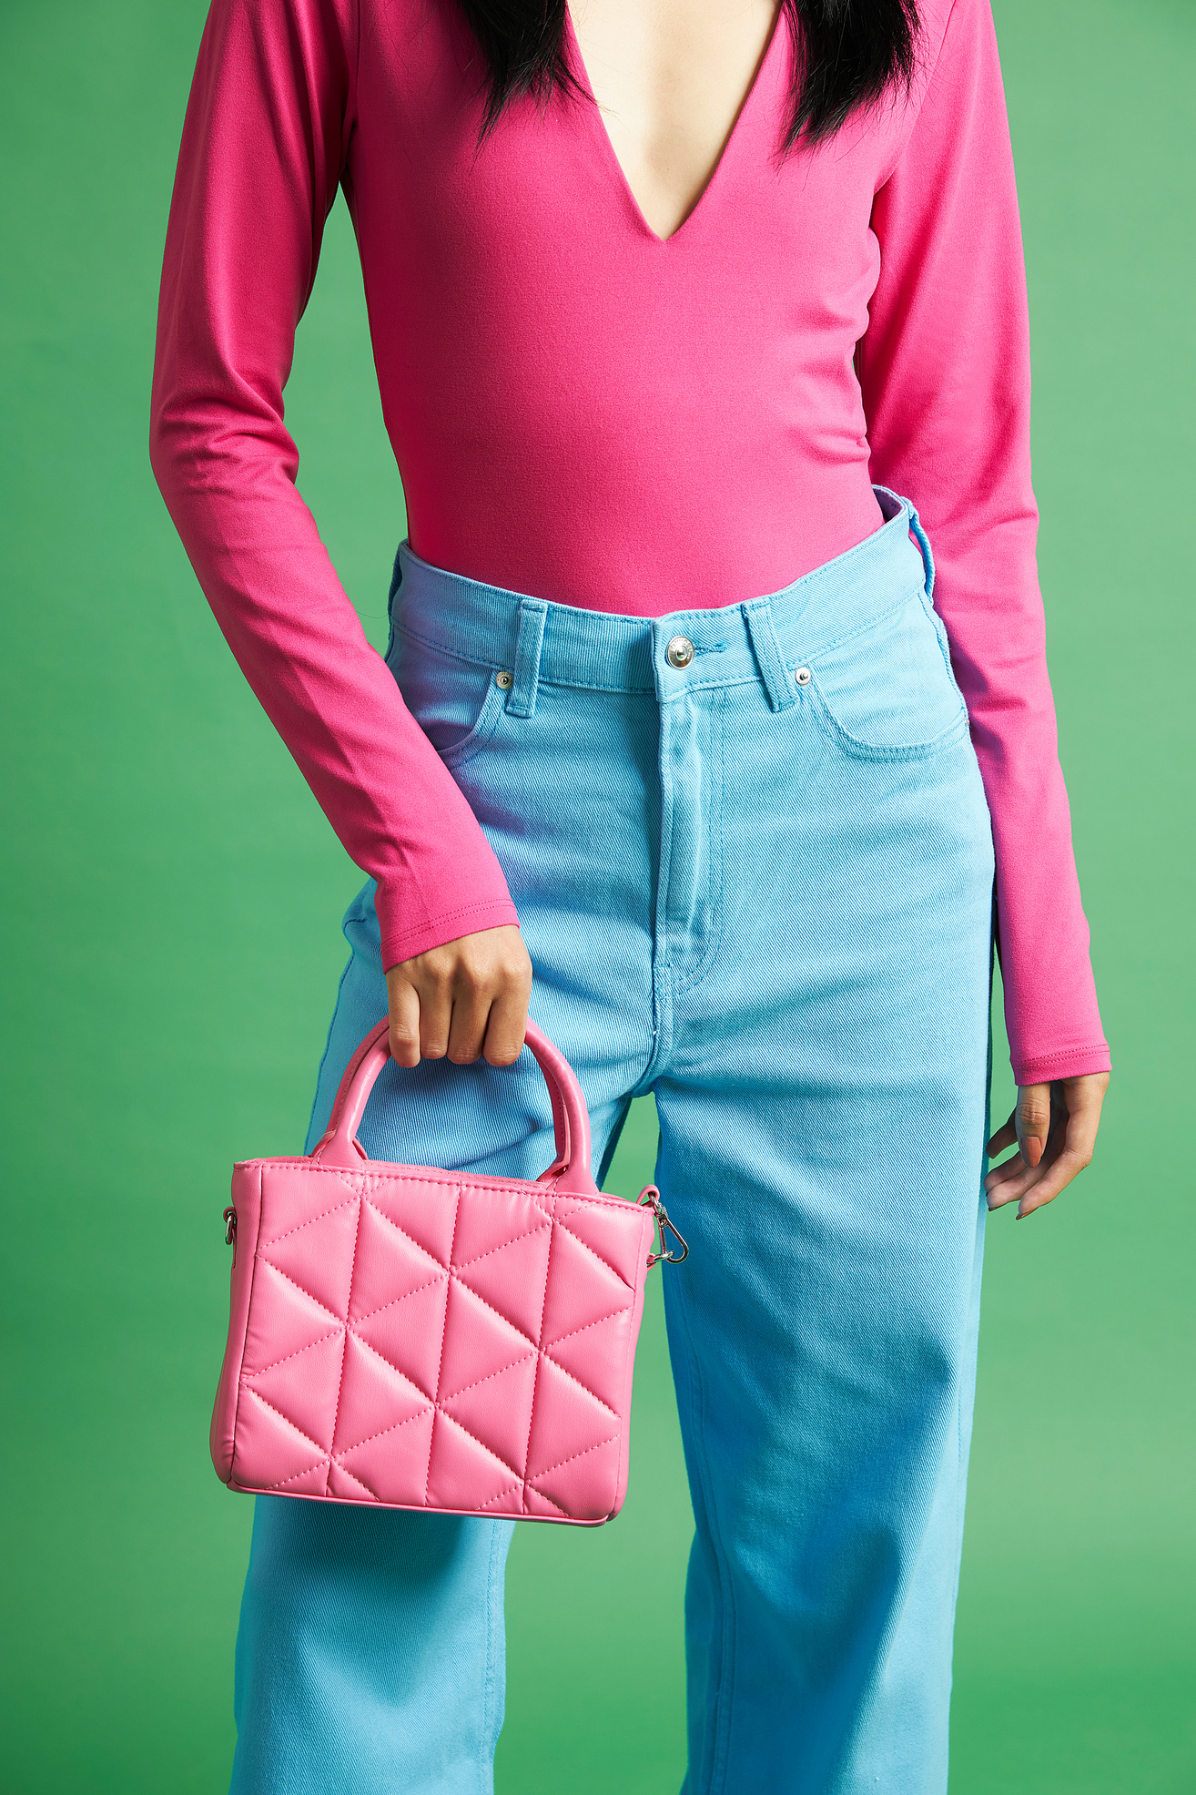
Shoppers already love our curated collections. Engagement and retention are strong, and early partnerships prove demand for a new fashion experience.
Early Results

Slide 8
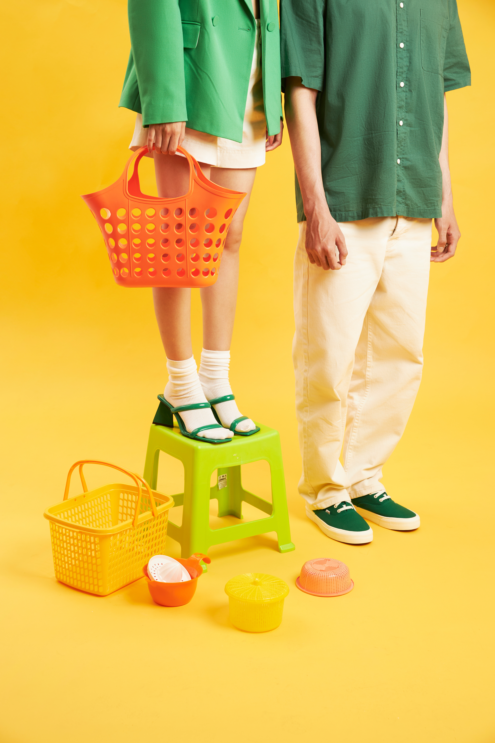


Competitive Advantage
Traditional fashion retailers chase trends. Digital platforms lack sustainability. Our edge is combining personalization, sustainability, and innovation in one ecosystem.

Slide 9
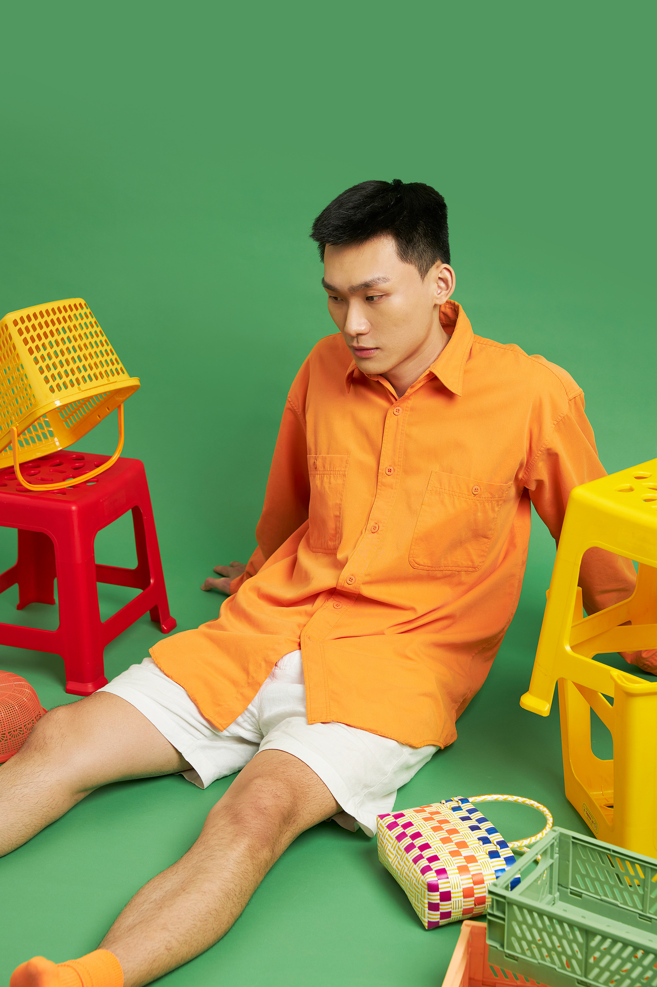
Growth Strategy
We aim to scale by leveraging influencer partnerships, digital campaigns, and exclusive launches. Expansion will target key fashion hubs worldwide.

Slide 10
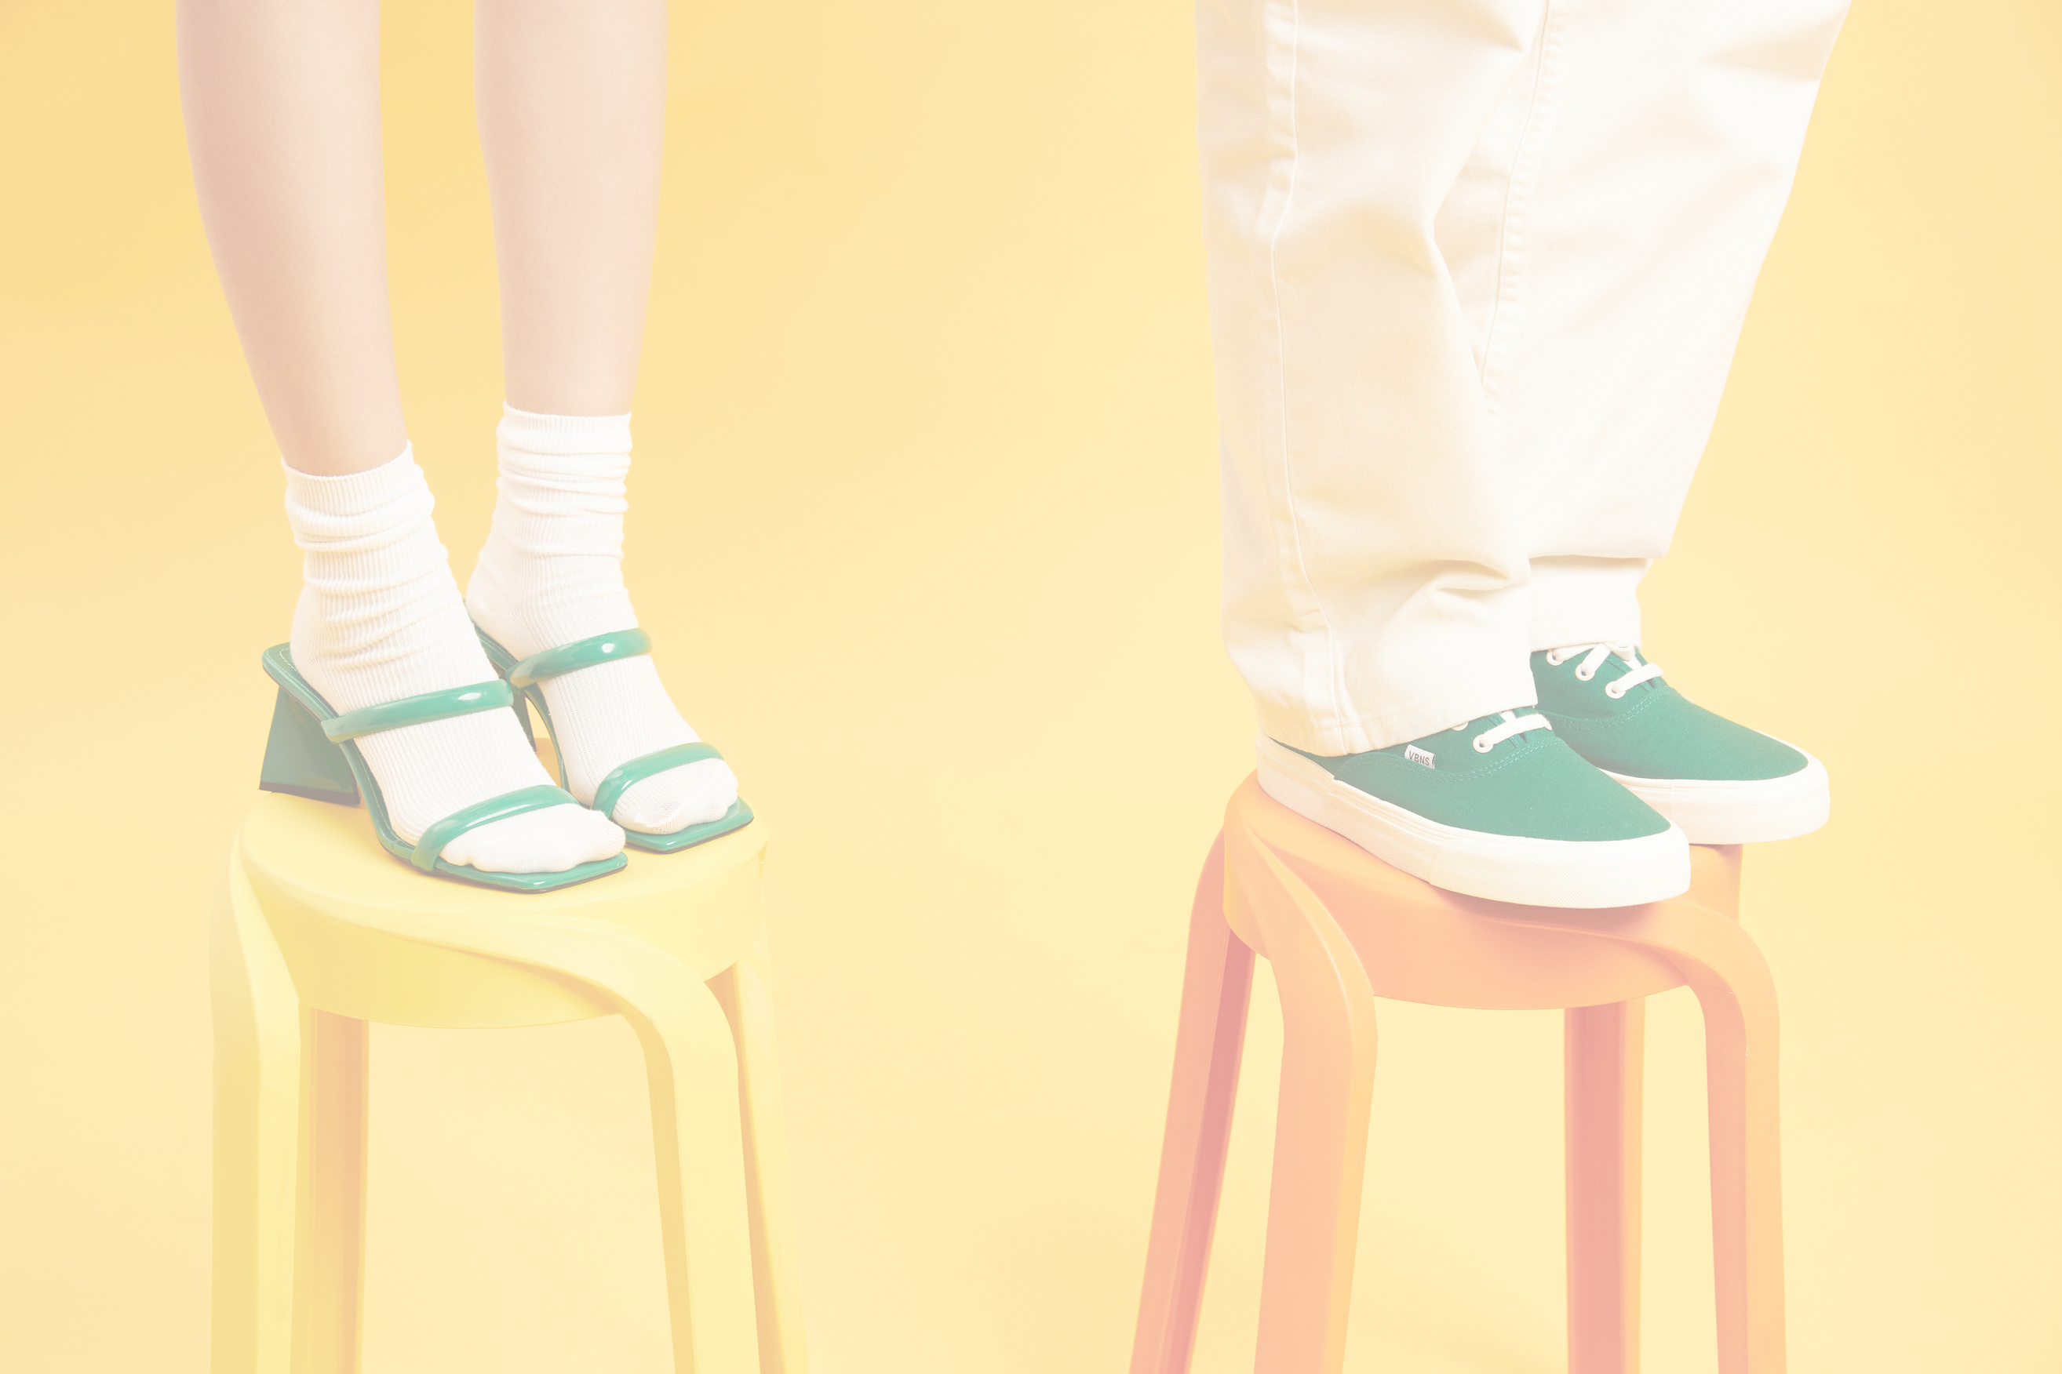



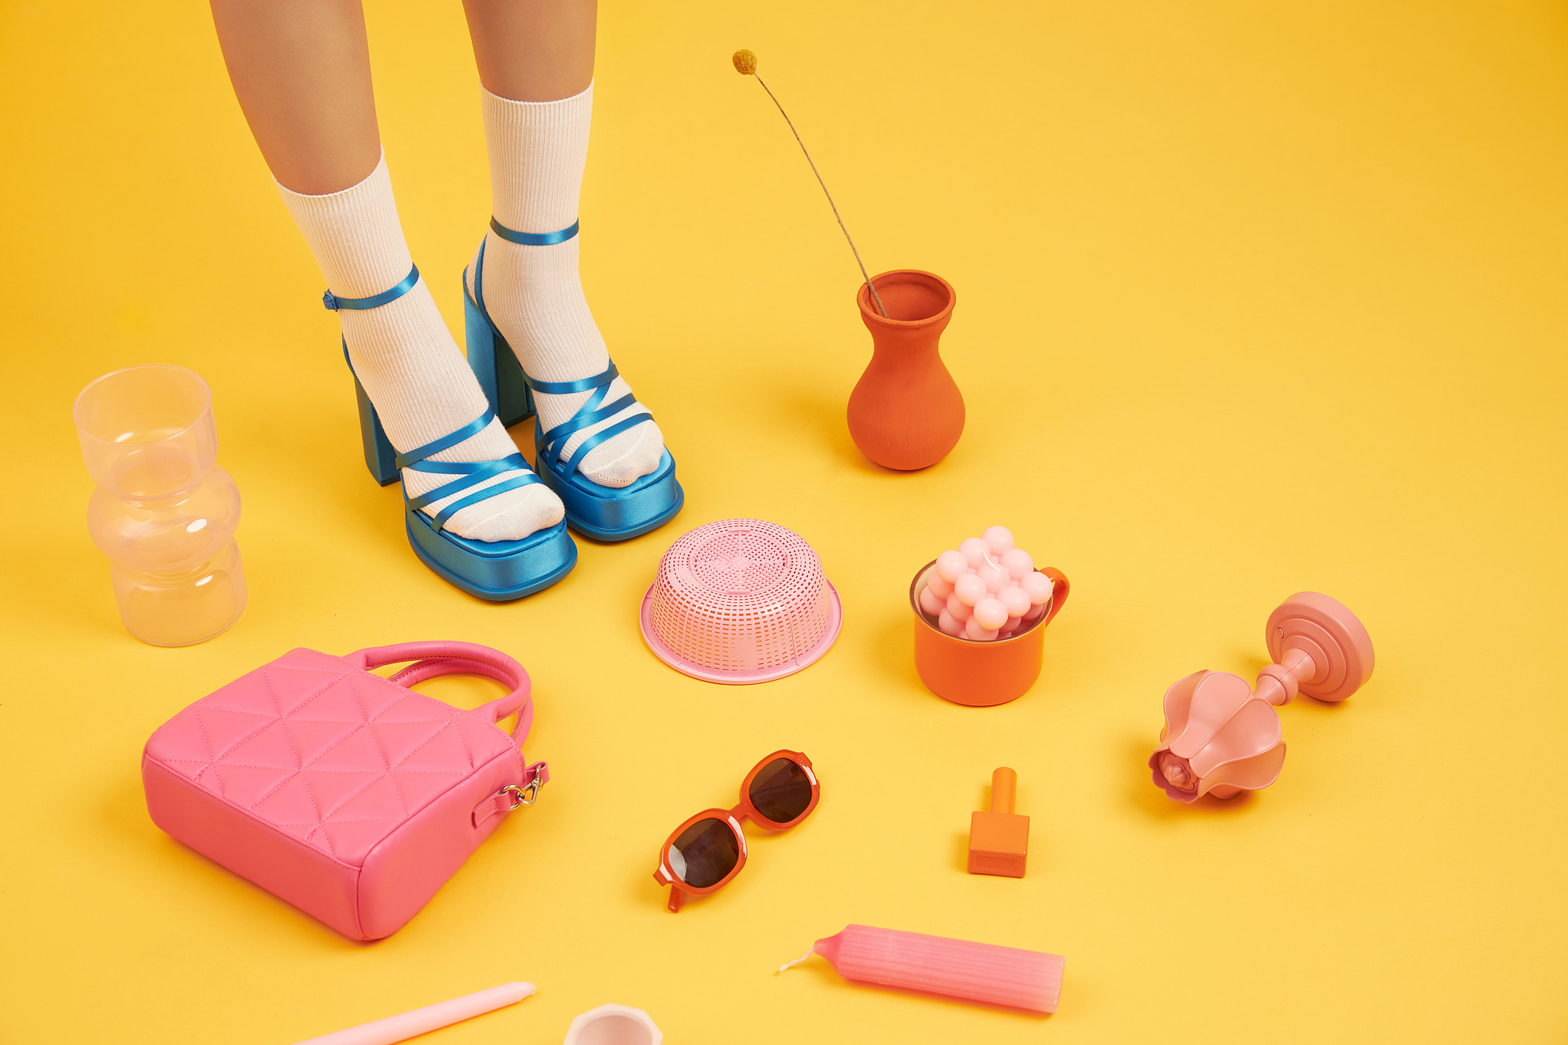
Liceria & Co.
Contact Us
Thank You
Very Much!
  +123-456-7890
  123 Anywhere St., Any City
  @reallygreatsite
Fashion is more than clothing—it is identity and culture. We envision a future where fashion is sustainable, digital, and deeply personal.
Join us in shaping the future of fashion.

