Slide 1
https://docs.google.com/presentation/d/16fo1SXoWy5GTVRtWqMgbCfxa0DSAPYUF/edit?usp=drivesdk&ouid=100310403716016927669&rtpof=true&sd=true

Slide 2
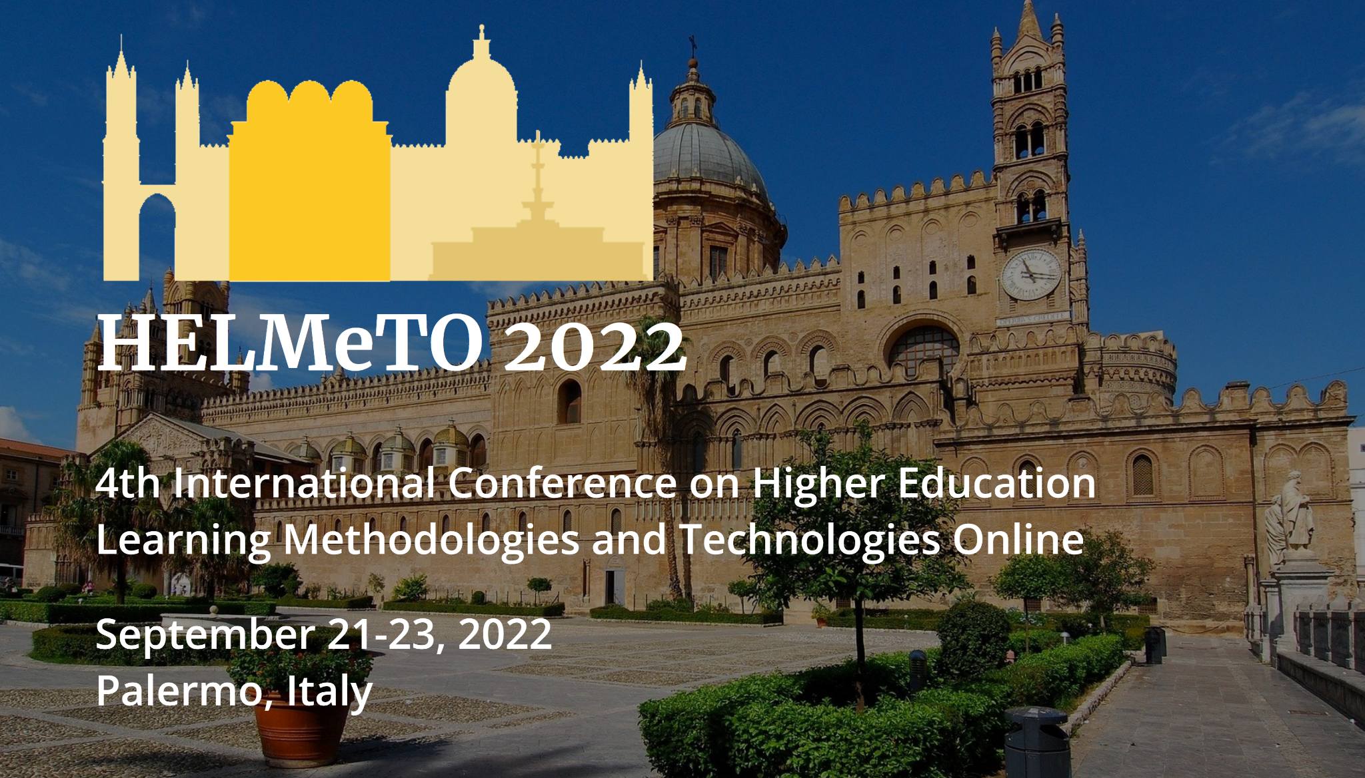

Slide 3





University of Pisa
DICI
¹Department of Civil and Industrial Engineering
CAFRE
²Interdepartmental Center for Lifelong Learning,
Training and Education Research
MAESTRO
Manufacturing Education for a Sustainable fourth Industrial Revolution
Additive Manufacturing for Sustainability
Francesco Lupi¹ and Michele LANZETTA^{1,2}
Follow/download this presentation: www.lanzetta.unipi.it/research/am
Notes:
https://www.aitem.org/convegno2019/programma/

Slide 4
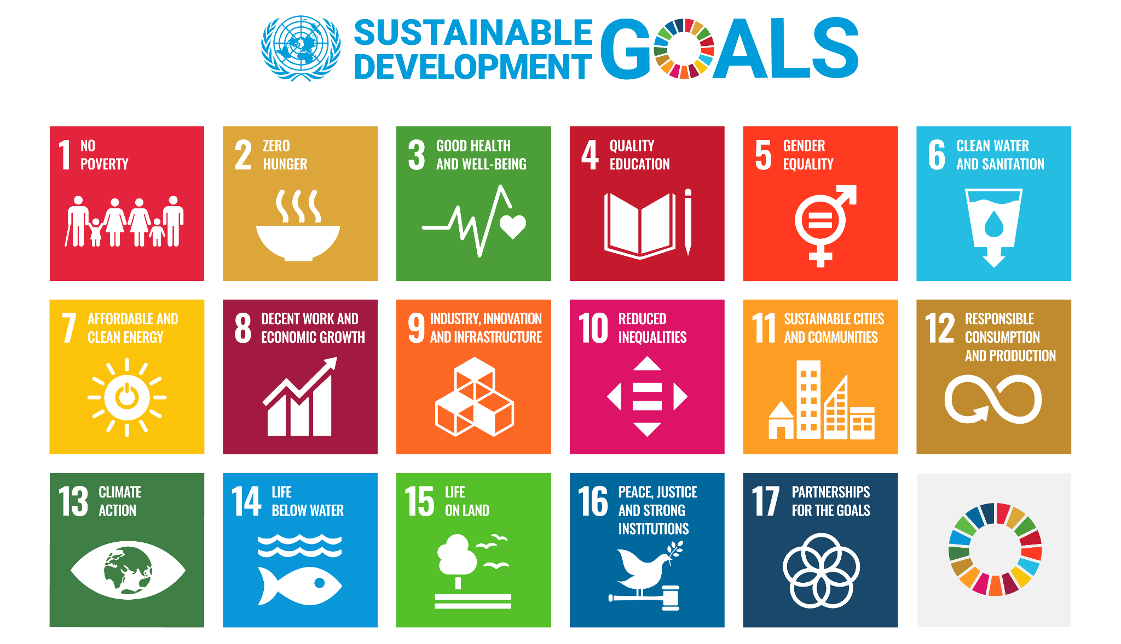
un.org/sustainabledevelopment
Notes:
There are various ways of clustering the goals: essentially from an industrial or business perspective, we are now aware that economic aspects are not enough, environment and social aspects are all more and more relevant. Nothing new under the sky, just standardization/modelling from an accredited source

Slide 5
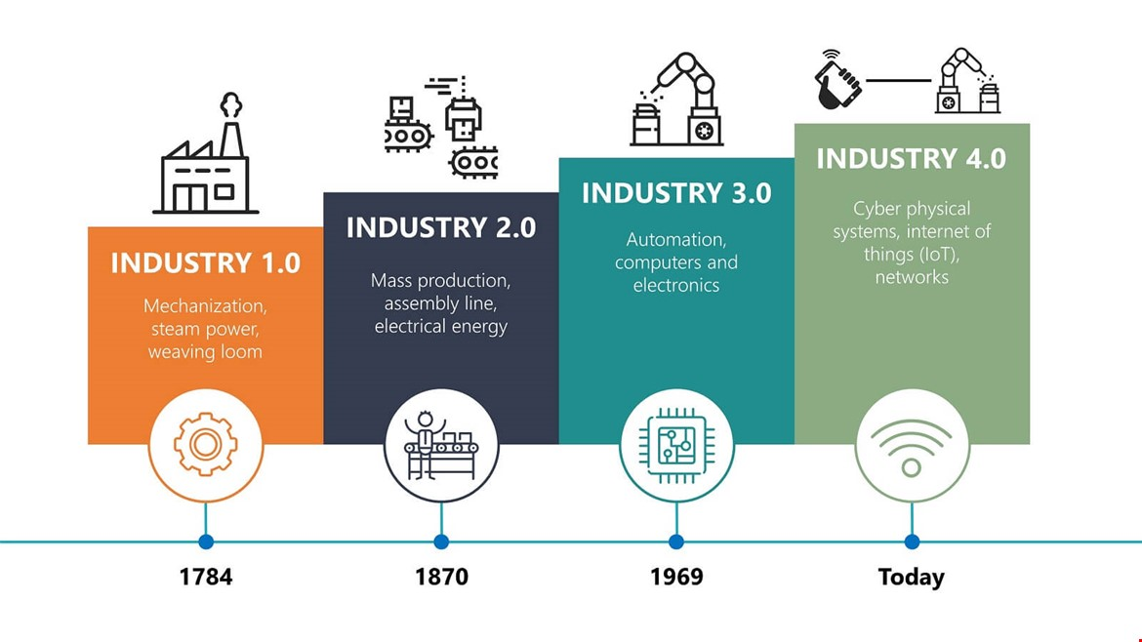
A fourth “announced/provoked” industrial revolution

Slide 6
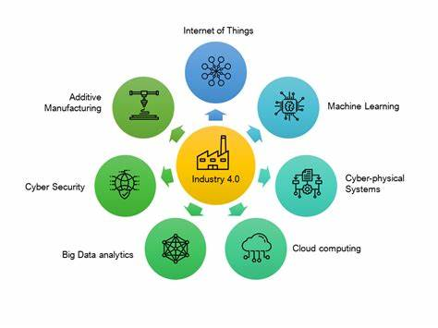

Slide 7
Push/pull strategy in education?
SKILLS
SYLLABUS
JOB

Slide 8
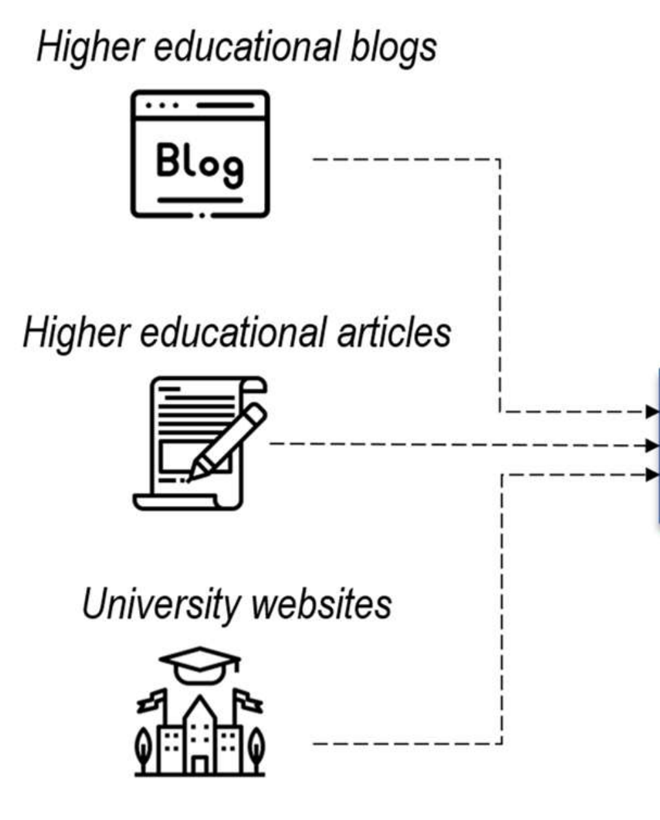
Typical push strategy in education
SKILLS
Notes:
We do what our colleagues are doing

Slide 9




Misalignment risk
GAP
≠

Slide 10
Push/pull/virtuous loop strategy in education
ACADEMIA
SYLLABUS
ARCHETYPE
JOB
MARKET/INDUSTRY

Slide 11
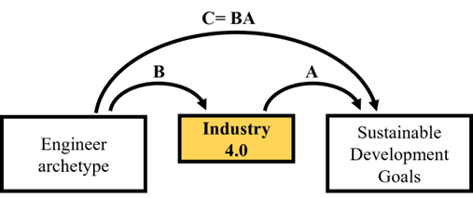
Defining skills
Lupi, F., Mabkhot, M. M., Finžgar, M., Minetola, P., Stadnicka, D., Maffei, A., ... & Lanzetta, M. (2022).
Toward a sustainable educational engineer archetype through Industry 4.0. Computers in Industry, 134, 103543.

Slide 12



MAESTRO- MAnufacturing Education for a Sustainable fourth industrial RevOlution
Erasmus + KA203 - Strategic Partnerships for higher education

Slide 13
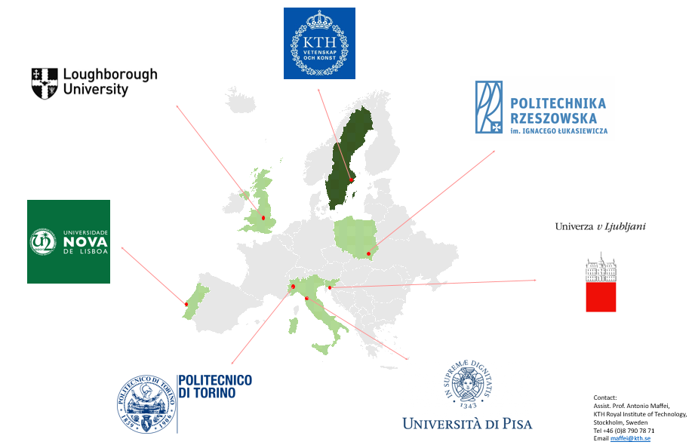

MAnufacturing Education for a Sustainable fourth industrial RevOlution
maestro.w.prz.edu.pl

Slide 14
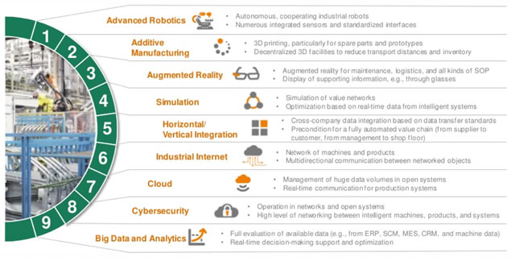
Enabling technologies for a fourth industrial revolution

Slide 15
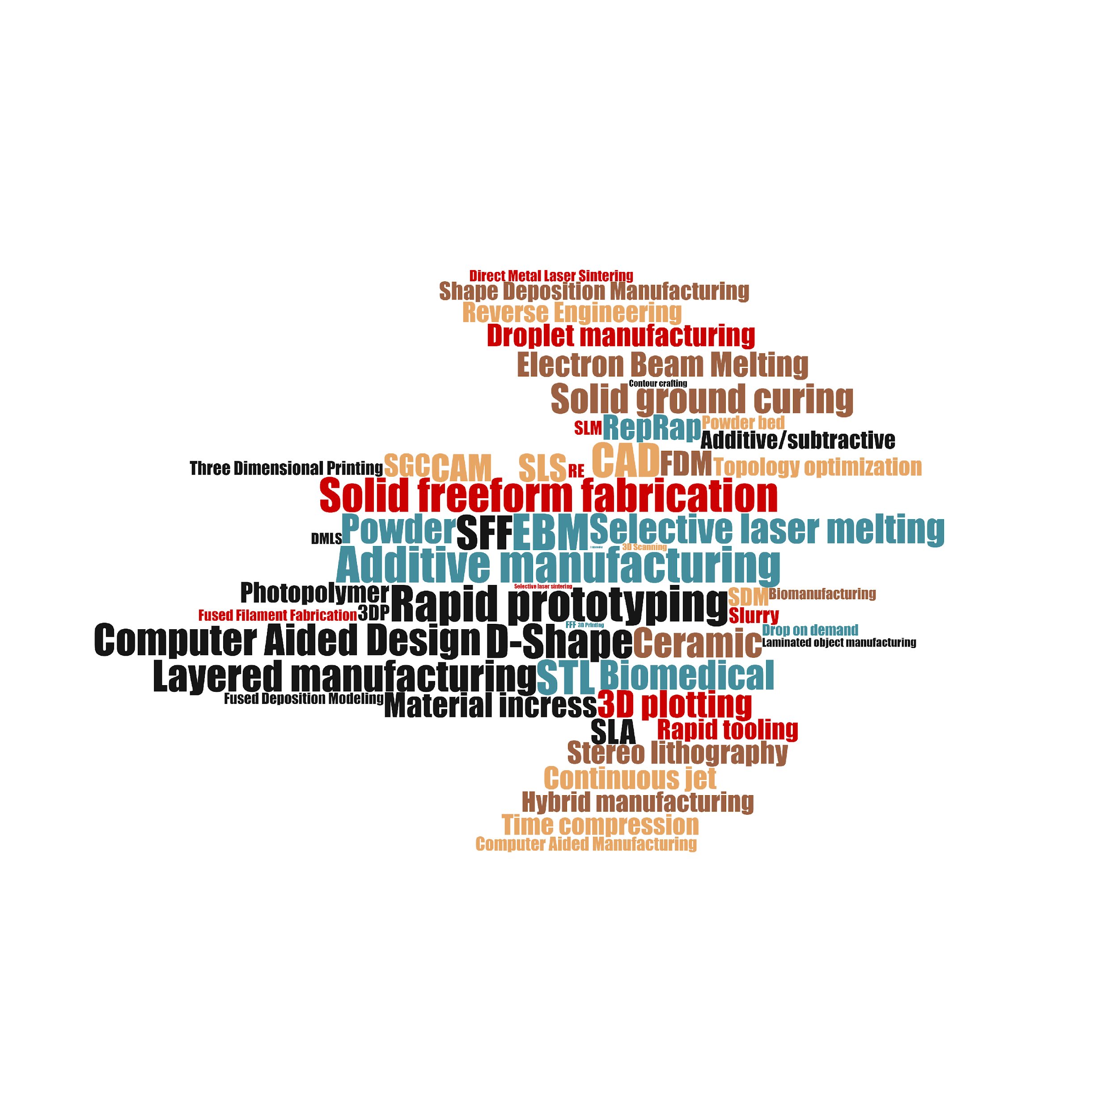
Additive manufacturing
Notes:
Some keywords more examples will follow

Slide 16
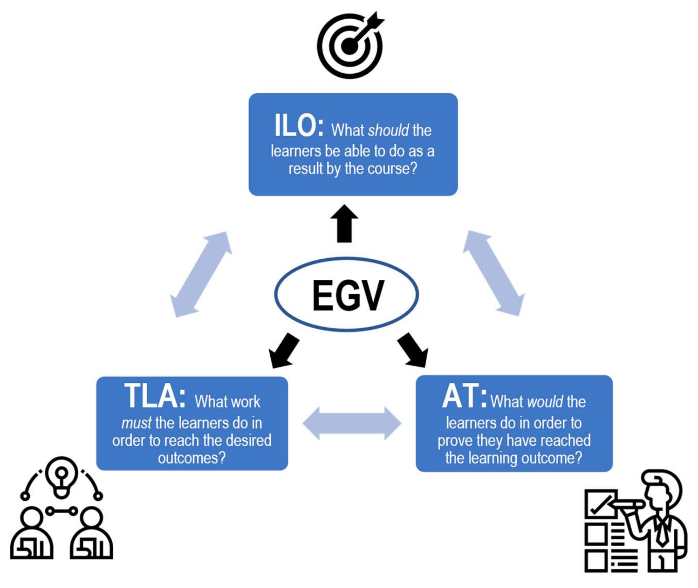
Constructive alignment course design
LEGENDA
EGV Educational Goal Verb
ILO Intended Learning Outcome
TA Teaching Activities
LA Learning Activities
AT Assessment Task
Maffei, A., Boffa, E., Lupi, F., & Lanzetta, M. (2022). On the Design of Constructively Aligned Educational Unit. Education Sciences, 12(7), 438.

Slide 17
Method implementation, Teaching Activities
TA 1.1: Present and explain energy analysis for rapid prototyping approaches, design methodology, pros/cons, environmental impact frameworks and standards
TA 1.2: Provide updated case studies through seminars on medicine and AM prosthesis by a sustainable perspective
TA 1.3: Set brief and provide ongoing feedback on project work. Organise students into groups of three or four and provided with a real case study project
TA 1.4: Provide prompt feedback to each group during the project development

Slide 18
Method implementation, Learning Activities
LA 2.1: Listen, query, discuss with peers and produce an infographic to explain, describe, and visualise the information at the end of each lecture
LA 2.2: Listen, query, discuss with peers and seminar guests experts as well
LA 2.3: Discuss within the group members and provide/share ideas by a 30 minute final presentation. Check understandings with one another. Take back to the group and improve the project in a second round based on peers and teacher review
LA 2.4: Provide 1 hour final presentation to the whole class

Slide 19
Method implementation, Assessment Task
AT 3.1: Each project group presents a final written report of the project to the professor. The group is assessed on the main standard attributes of the project: Problem presentation, CAD design, AM software and implemented solution, practical prototype realization and sustainability assessment

Slide 20
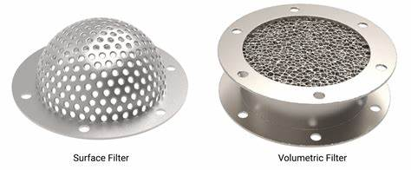

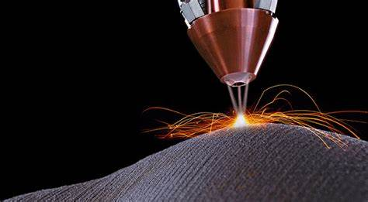
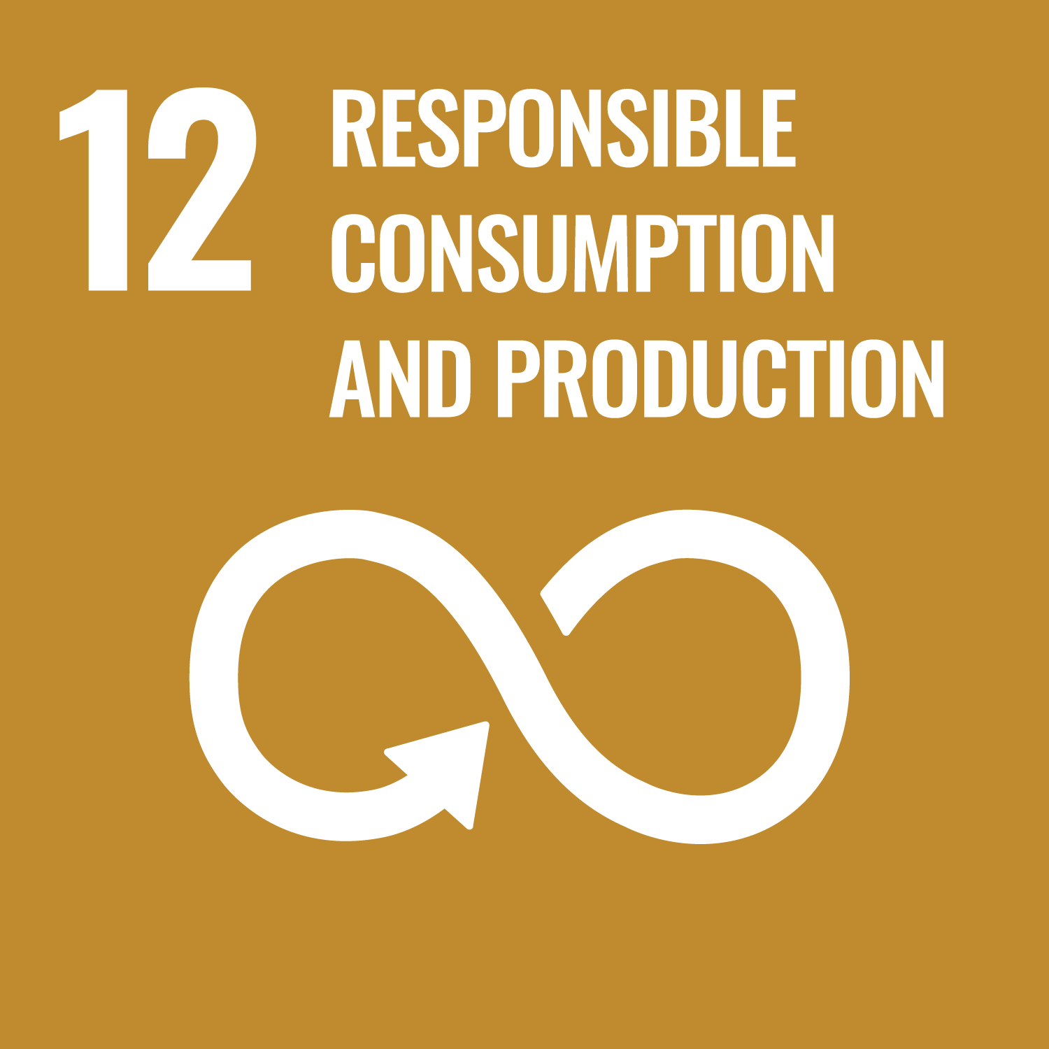
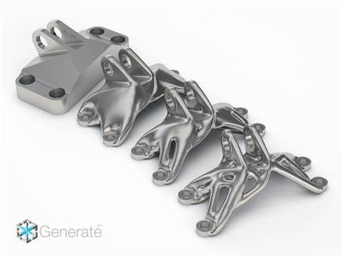
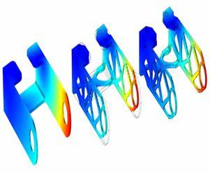
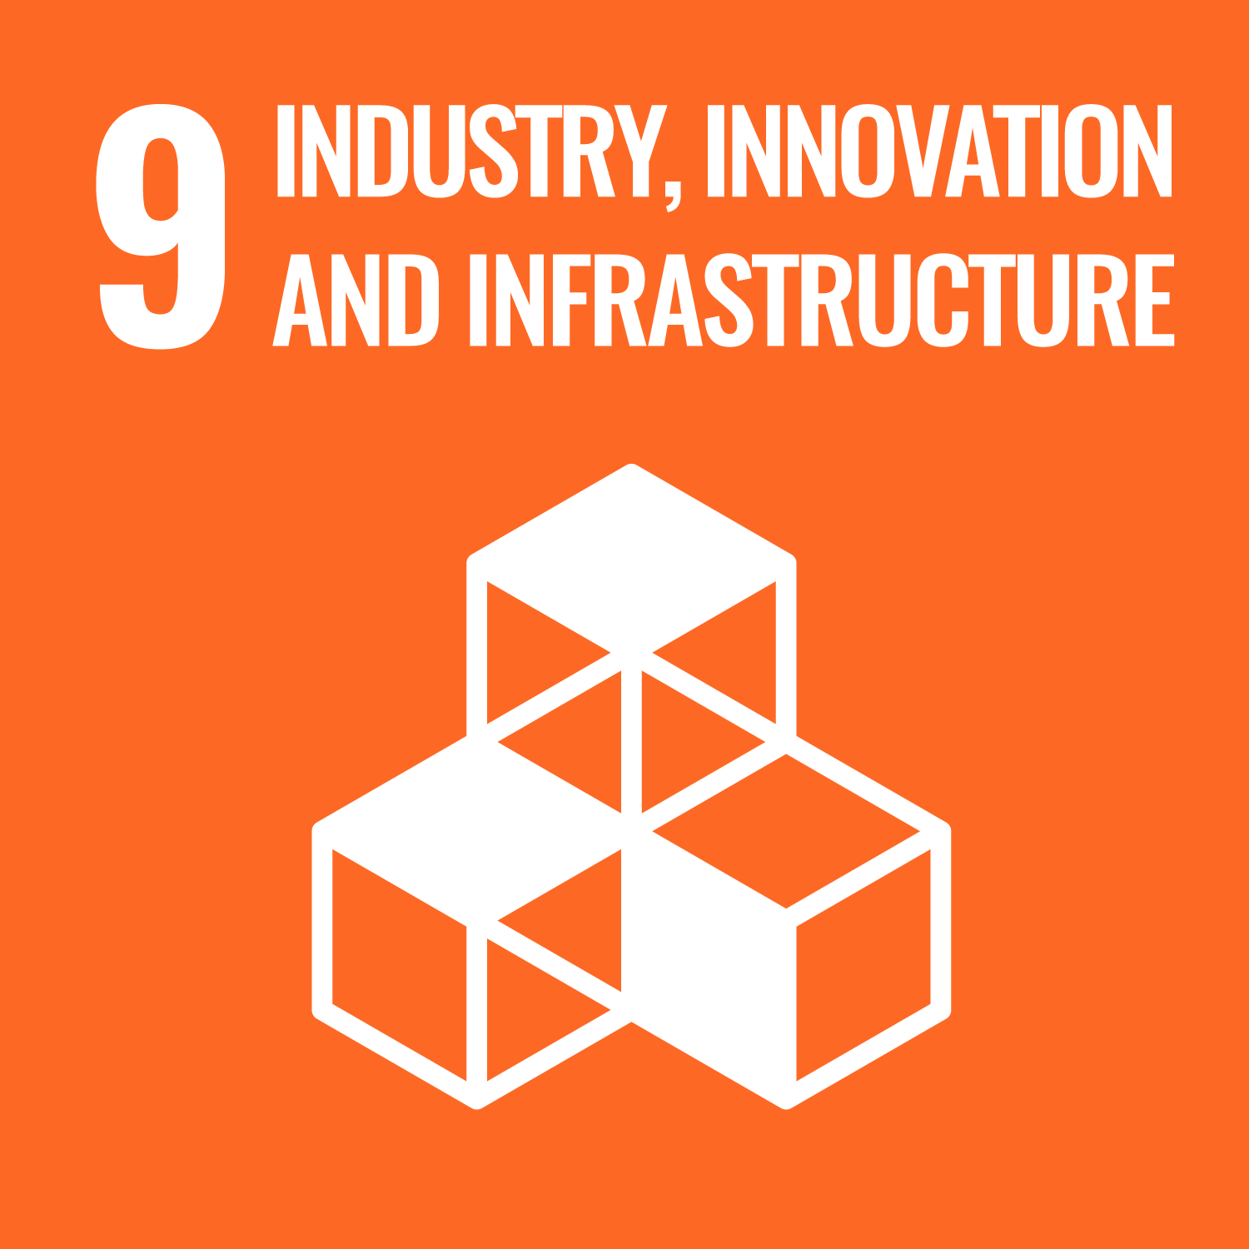
Case studies
weight reduction, materials
and energy saving
topological optimization

Slide 21
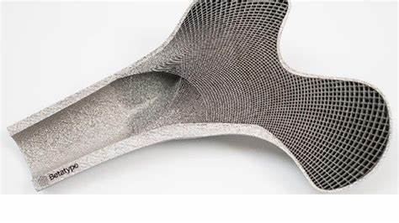

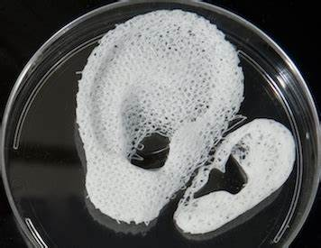
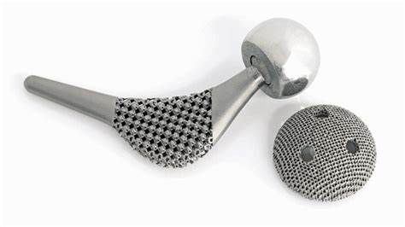

Case studies, Medical
trabecular structures
scaffolds for cell culture
dental
prothesis (hip joint)

Slide 22
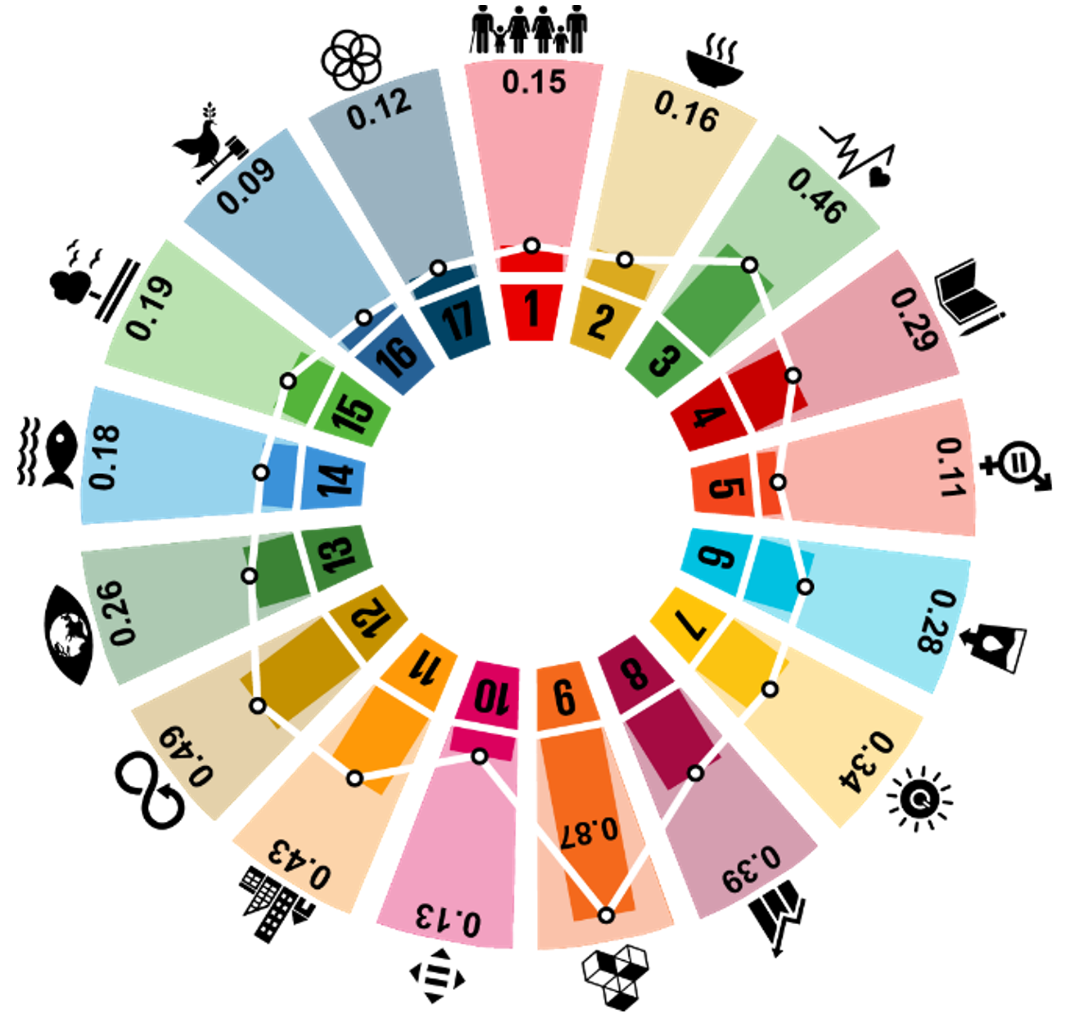
Results from survey
Affected SDGs are NOT only
SDG 9: Industry, Innovation, and Infrastructure
Build resilient infrastructure, promote inclusive and eco-friendly industrialisation and foster innovation
SDG 3: Good Health and Well-being
Ensure healthy live and promote well-being for all at all ages
Instructors/experts (4) vs students (20) advice

Slide 23
University of Pisa
DICI
¹Department of Civil and Industrial Engineering
CAFRE
²Interdepartmental Center for Lifelong Learning,
Training and Education Research
MAESTRO
Manufacturing Education for a Sustainable fourth Industrial Revolution
Additive Manufacturing for Sustainability
Francesco Lupi¹ and Michele LANZETTA^{1,2}
Follow/download this presentation: www.lanzetta.unipi.it/research/am
Notes:
https://www.aitem.org/convegno2019/programma/

