Slide 1



Spotting hate: creating an algorithm
Go back home, nobody likes you...
Is this hate speech?
NO
YES
Are my people really using hate speech? > Media Production > Spotting hate: creating an algorithm

Slide 2
A reminder...
Algorithm:
a process or set of rules to be followed in calculations or other problem-solving operations, especially by a computer.
Online Hate Speech:
every form of online content targeting an individual or group of people based on a core characteristic of them, in particular on their gender or gender identity, race or ethnic origin, sexual orientation, religious affiliation or belief, disability, with the intention to spread hate, harass, threaten and provoke directly or indirectly violence against the specific individuals or members of groups within the societies.

Slide 3
Main features of an algorithm
Start/Finish (Input/Output)
Process or step in instructions
NO
Decision or question
YES

Slide 4
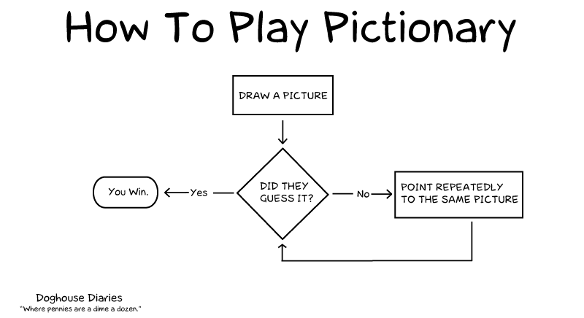
Example of a simple algorithm

Slide 5
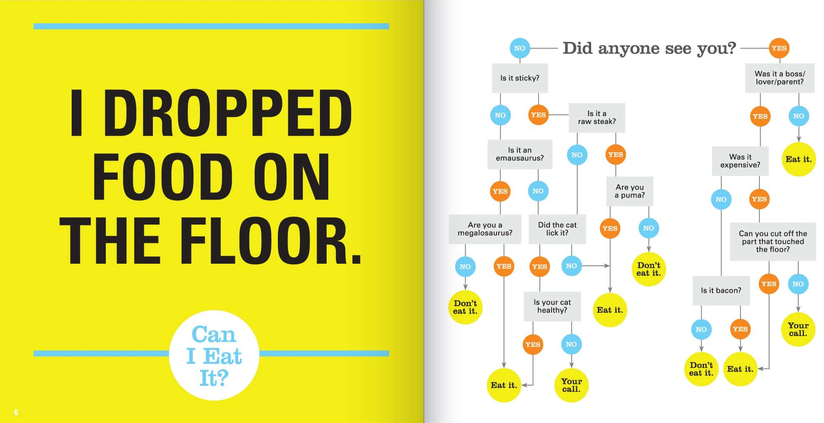
Example of a more complex algorithm
http://welldonestuff.com/inconsequential-dilemmas-funny-flow-charts

Slide 6
Sample Hate Speech Statements
You’re here but you can’t even speak our *%$@£!^! language, make an effort
Why don’t you STICK TO YOUR OWN KIND?
~%$£*- I’m gonna @$%£& you up.
WHY DO XENOVIANS ALWAYS COME TO OUR COUNTRY - %$£*&@~£ GO HOME!
If there is ONE MORE act of Xenan terrorism, then it is time for Alaranians to start killing Xenovians in the street! All of them.
These people are SCUM! Shoot them all here and now.
#NoOffence, but a xenovian is not a human being, it’s an animal.
You’re women are all hores.
Waking up and remembering you’re a Xenovian must be a *%$@£!^! bad start to the day.
Women deserve equal rights and lefts.

Slide 7
Your challenge
Produce an algorithm to identify hate speech using a series of tests. The purpose of the algorithm is to identify if a statement is, or is not, hate speech.
For example: Does the statement include bad language?
You should repeatedly test your algorithm with the sample set of statements provided to make sure it works.
Once you have completed and tested your statements there will be a new, final set provided to see how effective your algorithm is.

Slide 8





Sample Hate Speech Statements 2
No jobs, no prospects, no %$£*&@~£ hope #BlameXenovians
Ah, beautiful Xenovian, I look forward to removing your head from your body!
~%$£ you, ~%$£ them, ~%$£ everyone.
I believe that Xenovians have as much right to be here as humans #onlyjoking
When will you Xenovians crawl back to the slimy rock you came from?
These people are SCUM! all of them now.
All Xenovians are %$£*&@~£
You and your kind are all a bunch of &$!^*-&$%@!
Xenovians are dogs! This is what I do to dogs: burn-them-all.gif
Meme - The best kind of Xenovian is a dead one.

Slide 9








www.hackinghate.eu
#SELMA_eu

