Slide 1
Treatment Integrity as a Focus for Feedback
Ronnie Detrich
Wing Institute
Wing Institute Summit, 2011

Slide 2
Everybody’s Talking
Teacher accountability is often offered as solution for education troubles.
Numerous proposals to pay and evaluate teachers based on student performance.
Proposals usually linked to performance on high stakes tests.
Very weak means of influencing teacher behavior.

Slide 3
Difficulties with High Stakes Tests as Basis for Feedback
Low frequency
Once per year
Long delay between behavior and feedback
Test in spring, feedback following fall
No direct link between teacher behavior and feedback
Feedback is about student performance
Does not specify what teachers do to influence student scores

Slide 4
Function of Feedback Systems
Assure that all students are benefitting from educational services.
Student performance primary source of feedback to educators.

Slide 5
What Should be Targets for Feedback?
Logistically it is difficult to provide feedback on all aspects of teacher behavior.
Student performance influenced by variables not under teacher control:
Curriculum is usually selected at another level.
If curriculum is ineffective then inappropriate to hold teacher accountable.
Effectiveness of curriculum can be measured by student performance but only if implemented with integrity.
How well educators implement an intervention should be primary target for feedback.

Slide 6
Training is Necessary but Not Sufficient
OUTCOMES
(% of Participants who demonstrate knowledge, demonstrate new skills in a training setting,
and use new skills in the classroom)
TRAINING
COMPONENTS
Knowledge
Skill
Demonstration
Use in the Classroom
Theory and Discussion
10%
5%
0%
..+Demonstration in Training
30%
20%
0%
…+ Practice & Feedback in Training
60%
60%
5%
…+ Coaching in Classroom
95%
95%
95%
Joyce and Showers, 2002

Slide 7
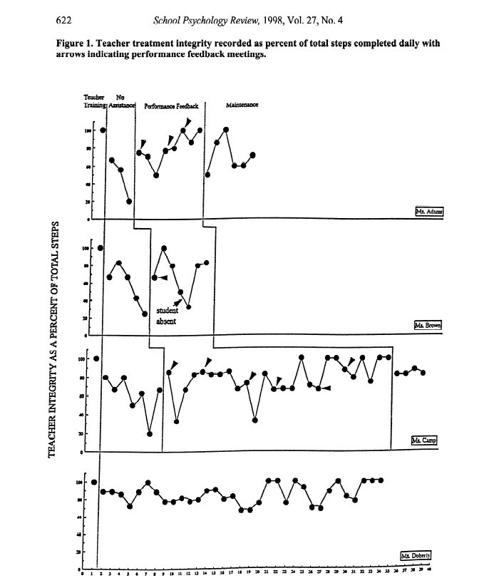
Mortenson & Witt, 1998

Slide 8
What We Know About Treatment Integrity
It is estimated that drug prevention programs are implemented with integrity only 19% of the time. (Hallfors & Godette, 2002)
Programs have extensive research base as being effective.
This may be a generous estimate.
No reason to assume that other programs are immune to poor implementation.

Slide 9
What We Know About Treatment Integrity
Teacher ratings tend to overestimate accuracy of implementation ( Wickstrom, Jones, Lafleaur, & Witt, 1998).
Teachers rated integrity at 54% accurate.
Direct observation= 4%.

Slide 10
Importance of Treatment Integrity
Students cannot benefit from interventions they do not experience.
Unless educators knows what they are supposed to be doing they cannot do more of it.

Slide 11
The Role of Student Data?
Student data provides feedback about progress.
If we know about adequacy of treatment integrity then can make decisions:
Adequacy of intervention
Adequacy of implementation
If implementation is inadequate then focus should be on improving educator behavior.
If implementation is adequate then focus should be on changing intervention.
Decisions can be made about increasing or decreasing intensity of intervention.

Slide 12
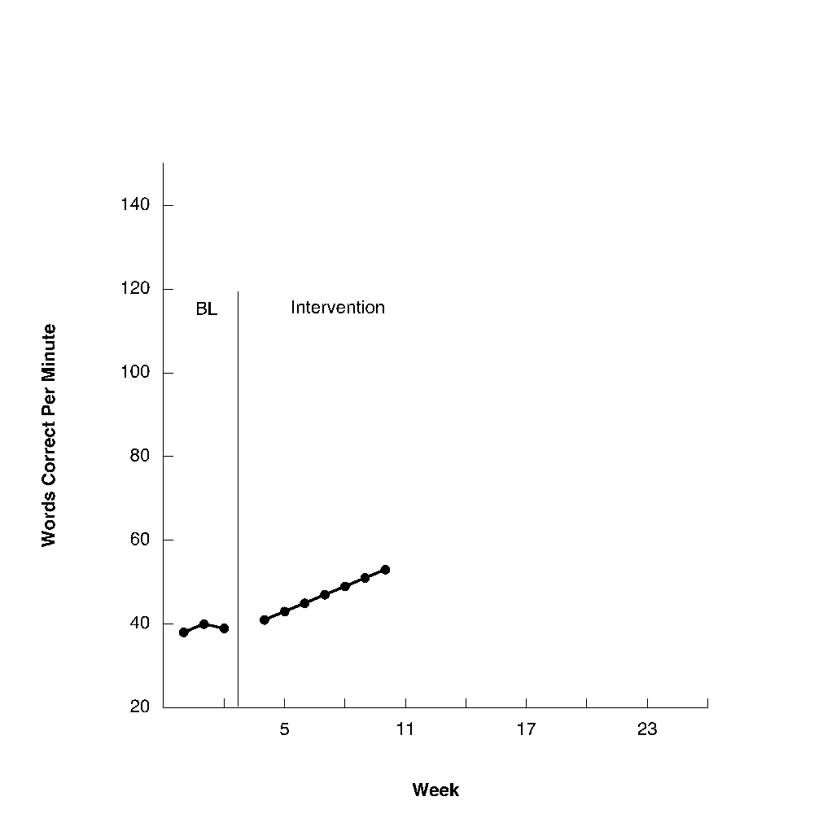
Visual Aids Can Enhance Data Interpretation
Grade Level Standard
Aim Line
Trend Line

Slide 13
Taking Treatment Integrity Measurement to Scale
Insufficient resources to frequently observe all educators to determine adequacy of implementation.
One solution: Measure student behavior and analyze at different units of analysis:
School
Classroom
Individual student
If there is a gap between obtained and expected performance at any level assess adequacy of treatment integrity.

Slide 14
Taking Treatment Integrity Measurement to Scale
Requires that data are routinely collected across all levels.
RtI:
CBM on all students 3/year.
PBS:
Continuous measurement of Office Discipline Referrals.
School-wide Evaluation Tool (SET) measures treatment integrity at the school level.
Schools with scores higher than 80% have greater impact on social behavior than schools that do not.

Slide 15
Implications of Providing Feedback to Educators
Moves primary responsibility for student outcomes from teachers to broader system.
If teachers are to effectively implement:
System must select effective interventions for teachers to implement.
Assure that implementers are actually trained.
Assure that resources are present to implement effectively.
System must monitor teachers’ implementation of intervention.

