Slide 1
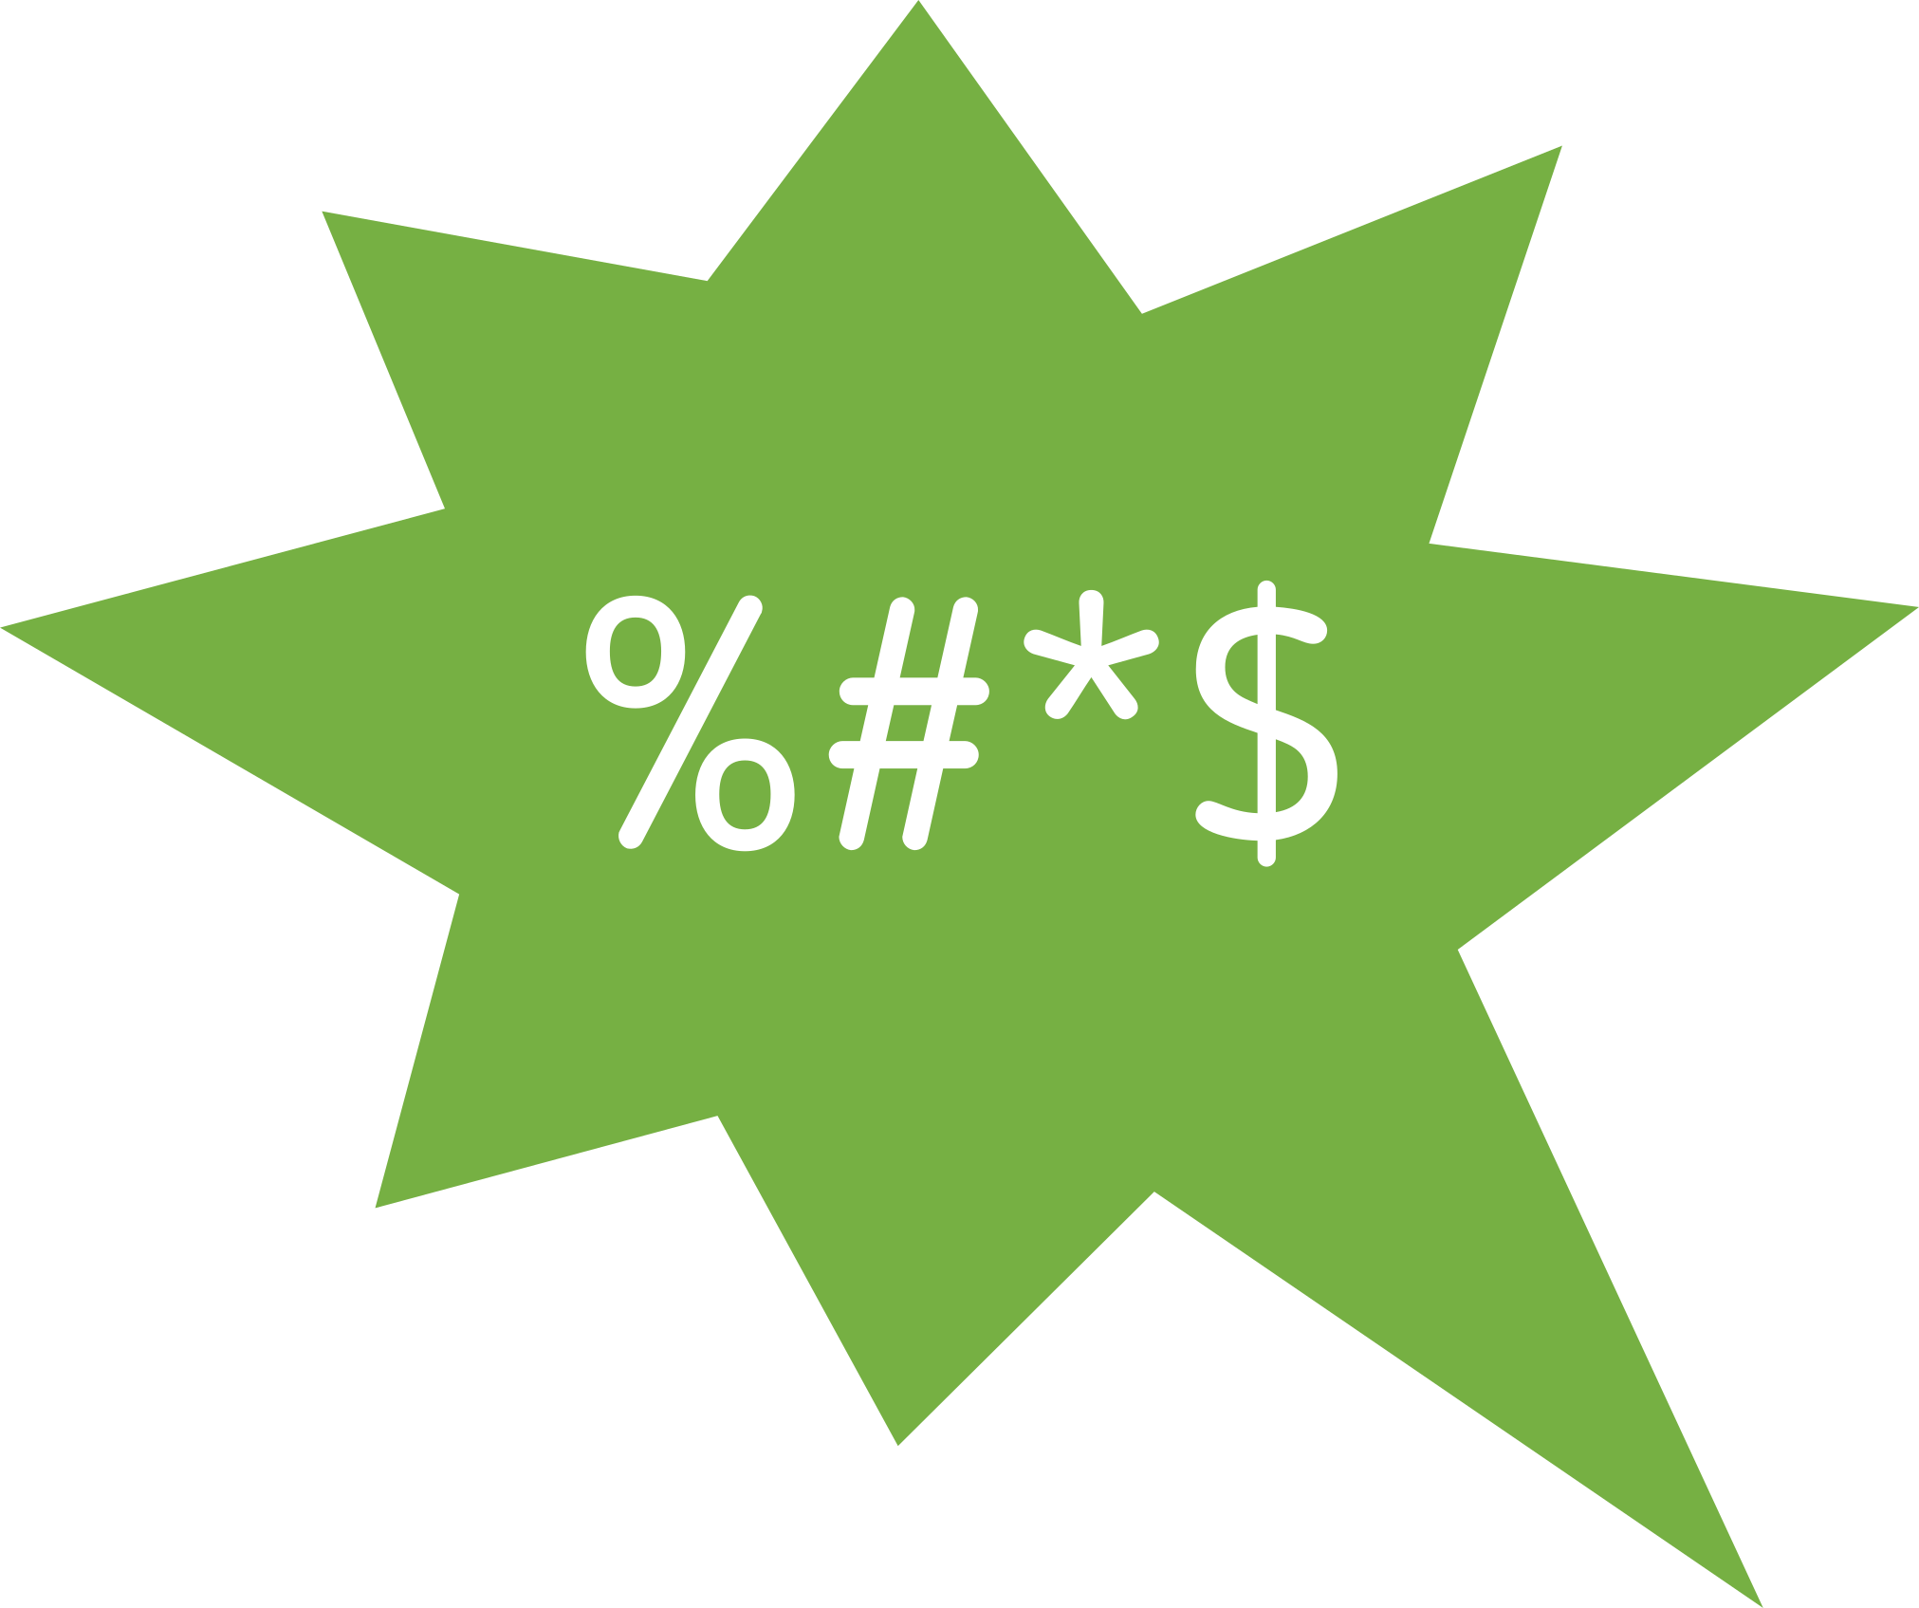



What is hate speech? > SEL > Naming and sorting emotions
Naming and sorting emotions
Finding words that describe how hate speech makes you feel

Slide 2
What things online make you happy/feel positive?
What things online make you feel upset/worried/sad/negative?
What things online would you consider hateful?
Why?
What do you think hate speech is?
Who is it targeted at?
How does it make you feel?
How does it make the person/people targeted feel?
How might it make the perpetrator feel?
Do some forms of hate speech affect you more than others?
Why?
Is something still considered hate speech if the intended target isn’t affected by it?
Why/why not?
Is there a difference between being hateful/hurtful and hate speech online?
Why?
Is there content online that can be misunderstood? E.g. satire, parodies, irony, sarcasm, in-jokes, etc.
How do you decide if this type of content is hate speech?
Can you always tell?

Slide 3
High
Energy
Low
© RULER Programme. Yale Centre for Emotional Intelligence
Unpleasant
Pleasant
Feelings

Slide 4
High
Red emotions are unpleasant and high in energy, like anger, frustration and anxiety
Yellow emotions are pleasant and high in energy, like excitement, joy and elation
Energy
Blue emotions are unpleasant and low in energy, like boredom, sadness and despair
Green emotions are pleasant and low in energy, like tranquility, serenity and satisfaction
Low
© RULER Programme. Yale Centre for Emotional Intelligence
Unpleasant
Pleasant
Feelings

Slide 5
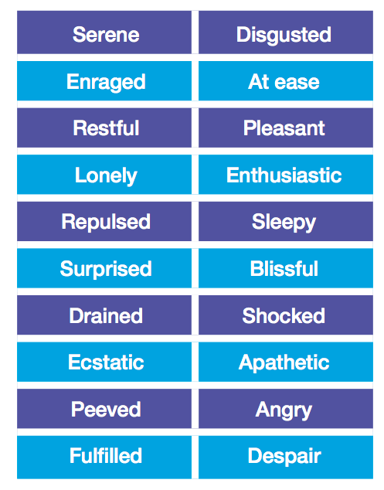
© RULER Programme. Yale Centre for Emotional Intelligence

Slide 6















© RULER Programme. Yale Centre for Emotional Intelligence

Slide 7
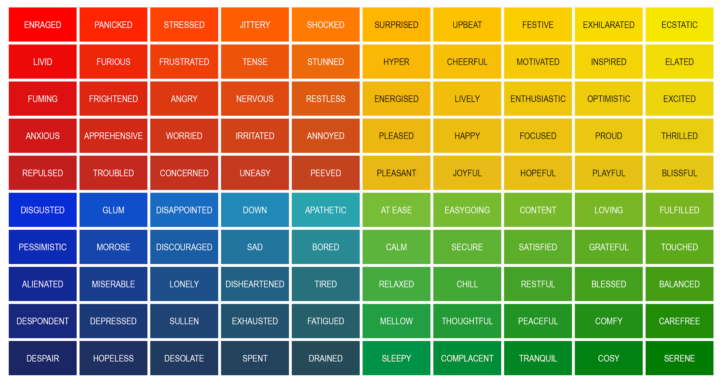
How are you feeling?

Slide 8








www.hackinghate.eu
#SELMA_eu

