Slide 1
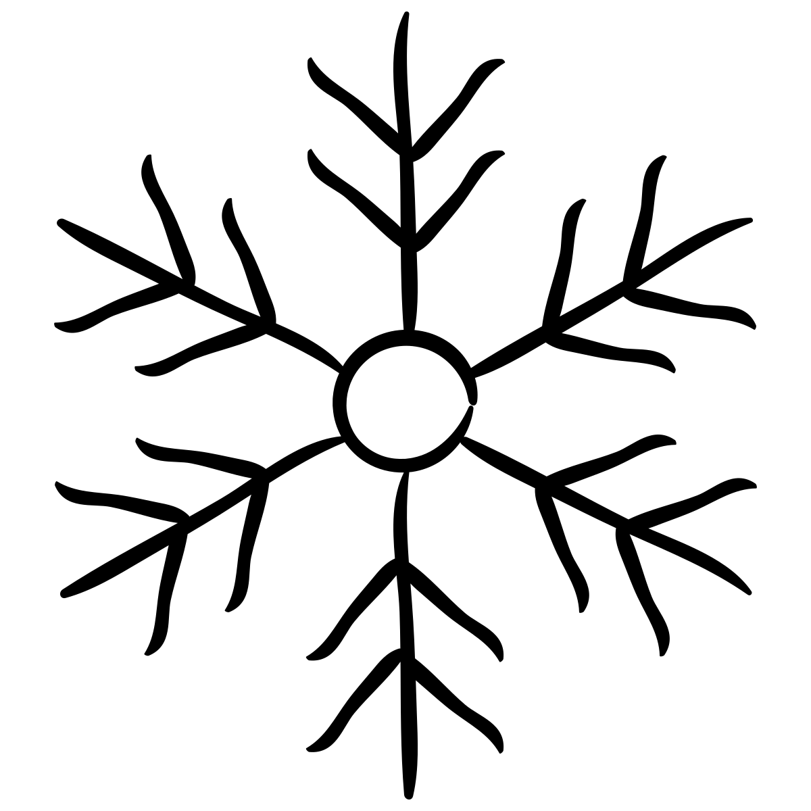


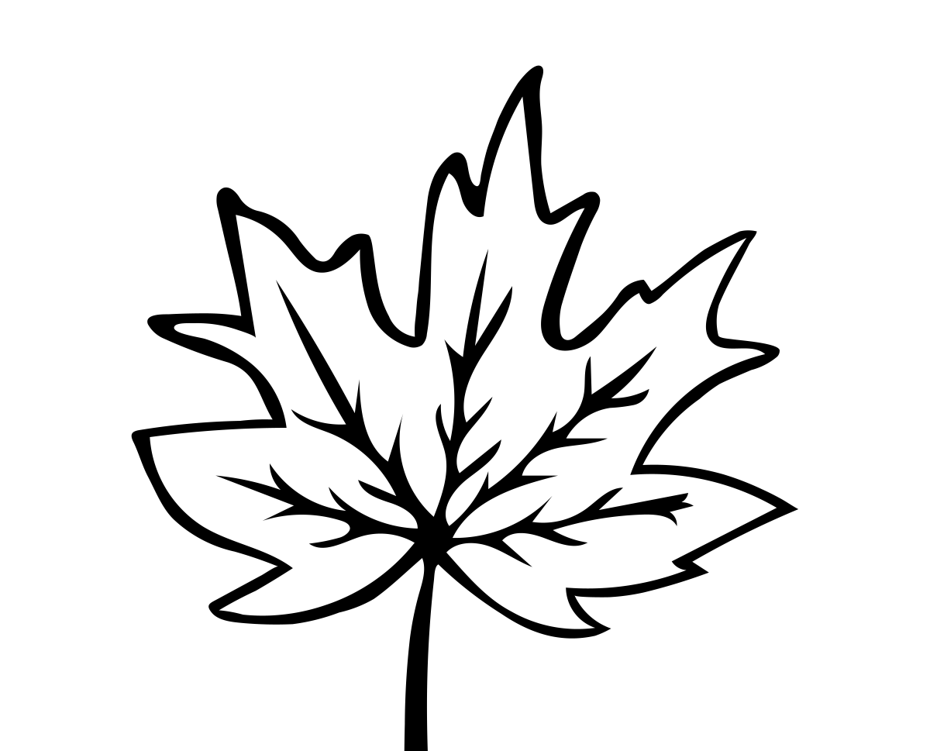


Name _____________________
Does any place not have fall?
Have you ever seen symbols
like these before?
These symbols represent the seasons.
There’s a snowflake for the cold winter. There’s a flower for spring, when new plants grow. There’s a sun for the hot summer. And there’s a leaf for fall, when leaves change color.
Snowy winter in Wisconsin, sunny winter in Florida
Seasons are changes in nature that repeat year after year. For example, in the U.S. state of Wisconsin, snow falls around the same time each year. That change in weather is part of the winter season there.
But not every place gets snow each winter. In the U.S. state of Florida, a winter day can feel as warm as summer in Wisconsin! It almost never snows in most of the state. The seasons in Florida don’t look like those four season symbols. But Florida does have seasons. The changes that show fall has arrived in Florida are just DIFFERENT from Wisconsin.
Wisconsin winter
Florida winter
Rainy season in the rainforest
In fact, lots of places on Earth don’t match the classic four season symbols. Like, how about the Amazon rainforest? The Amazon rainforest stays green and warm pretty much all year. Instead, this place has OTHER big changes from season to season. Around the Amazon, there’s WET weather for about half the year, and DRY weather for the other half. It goes from wet…to dry…and back, year after year.
Wet
Dry
Sunny season in the South Pole
Seasons look different in really COLD places, too, like in Earth’s South Pole. There, a big change from season to season is SUNLIGHT. Winter near the South Pole is DARK. The Sun doesn’t appear in the sky for weeks, or even months! And it’s the opposite in summer. In summer, the Sun stays up for most of the day and night. Some people say that the South Pole has TWO seasons: sun-filled summer and dark winter.
Dark winter
Sun-filled summer
Summary
Every place on Earth has changes in nature that repeat year after year. To keep track of those changes, we divide the year into SEASONS. Winter, spring, summer, and fall is one way of dividing the year into seasons, based on big changes in temperature. But, it’s not the ONLY way.
For example, near the Amazon rainforest, you can divide the year into WET and DRY seasons. And near the South Pole, big changes in SUNLIGHT divide up the year. How do the seasons change near where you live?
Weather & Climate

