Slide 1

Here’s The Best Way To
Participate Over These Two Days
WELCOME
www.BetweenMenAndWomen.com

Slide 2
1) We have blind spots that get in our way.
2) We don’t practice “squeaky clean” communication.
3) We don’t practice the things that could make the biggest difference. (Ex. Listen to one another, Honor one another’s requests, Practice equal give & take, Honesty, Willingness to “take care” of your partner’s well being
4) We don’t make room for the natural “Polarity” that creates a “spark” between us.
Why Do We Struggle?
www.BetweenMenAndWomen.com

Slide 3

Let’s use the Pareto Principle… …or the 80/20 Rule.
www.BetweenMenAndWomen.com

Slide 4
What should come out?
What should go in?
www.BetweenMenAndWomen.com

Slide 5

A Perspective That Works
You need a new way to look at things.
www.BetweenMenAndWomen.com

Slide 6

A Perspective That Works
Where are you now?
www.BetweenMenAndWomen.com

Slide 7
A Perspective That Works
Get a ceiling view- “Go Drone”
www.BetweenMenAndWomen.com

Slide 8
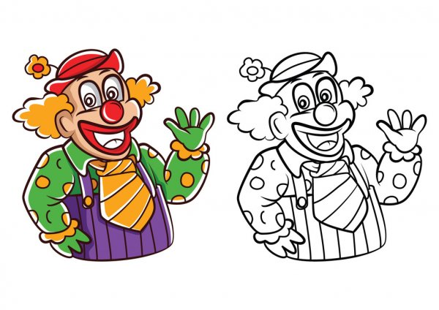
A Perspective That Works
Separate one thing from the other “things” … otherwise everything gets “coloured with the same crayon”.
Ex: Separate facts from
interpretation/embellishment
www.BetweenMenAndWomen.com

Slide 9

A Perspective That Works
WE - not “you” and “me”.
www.BetweenMenAndWomen.com

Slide 10

THE ISSUE IS NOT THE “ISSUE”
- things are not “one way” and there are many variables that affect HOW we each see things
www.BetweenMenAndWomen.com

Slide 11
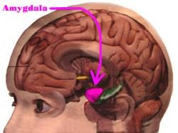
Physiology
We are wired to scan for threat
www.BetweenMenAndWomen.com

Slide 12
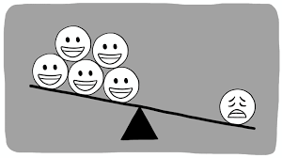
- “the bad” gets our attention
- holds a LOT of weight with us
Negative Bias: We ALL Have It
www.BetweenMenAndWomen.com

Slide 13
Three ways of being that will get us into trouble in our communication.
“Terrible Trio”
www.BetweenMenAndWomen.com

Slide 14
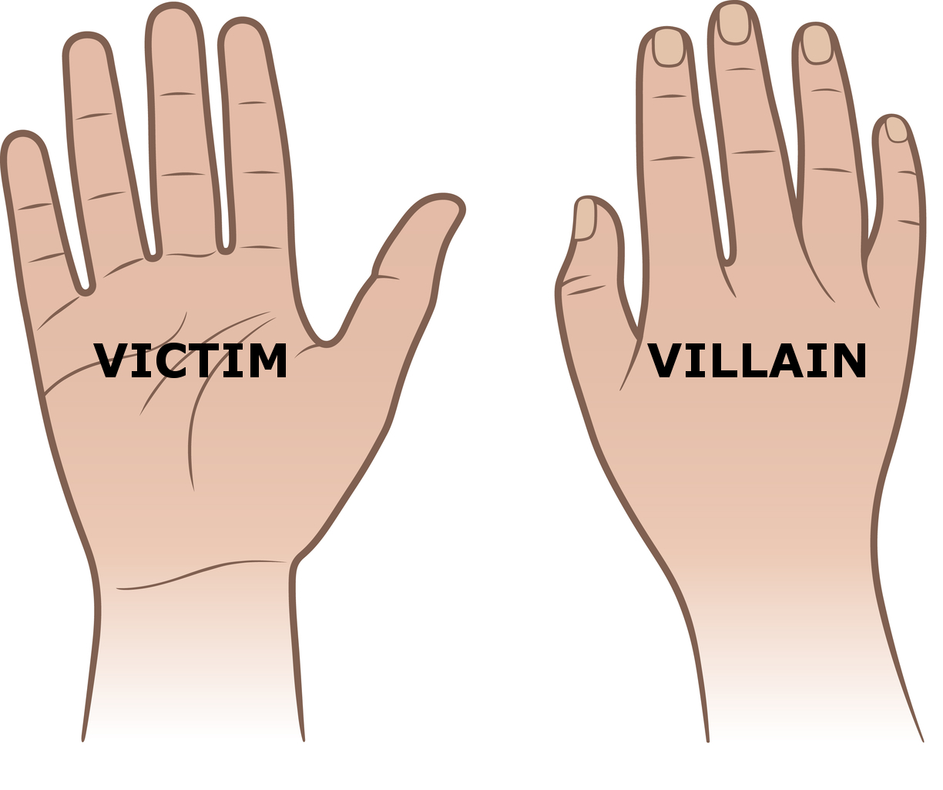
Victim/Villain
- you can’t have one without the other
Victim/Villain
www.BetweenMenAndWomen.com

Slide 15

Characteristics
- unwillingness
- little accommodation for partner
- “you can’t make me”
- I don’t really care how it is for you
- I refuse to apologize and/or see my part
- I won’t listen to anyone around me… I’ll only listen to myself
Stubborn
www.BetweenMenAndWomen.com

Slide 16
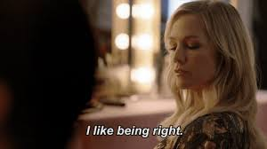
Characteristics
- I’m right and you’re wrong
- I know everything/you don’t know anything
- I’m superior/better than you
- you need to be “fixed”
Being Right
www.BetweenMenAndWomen.com

Slide 17
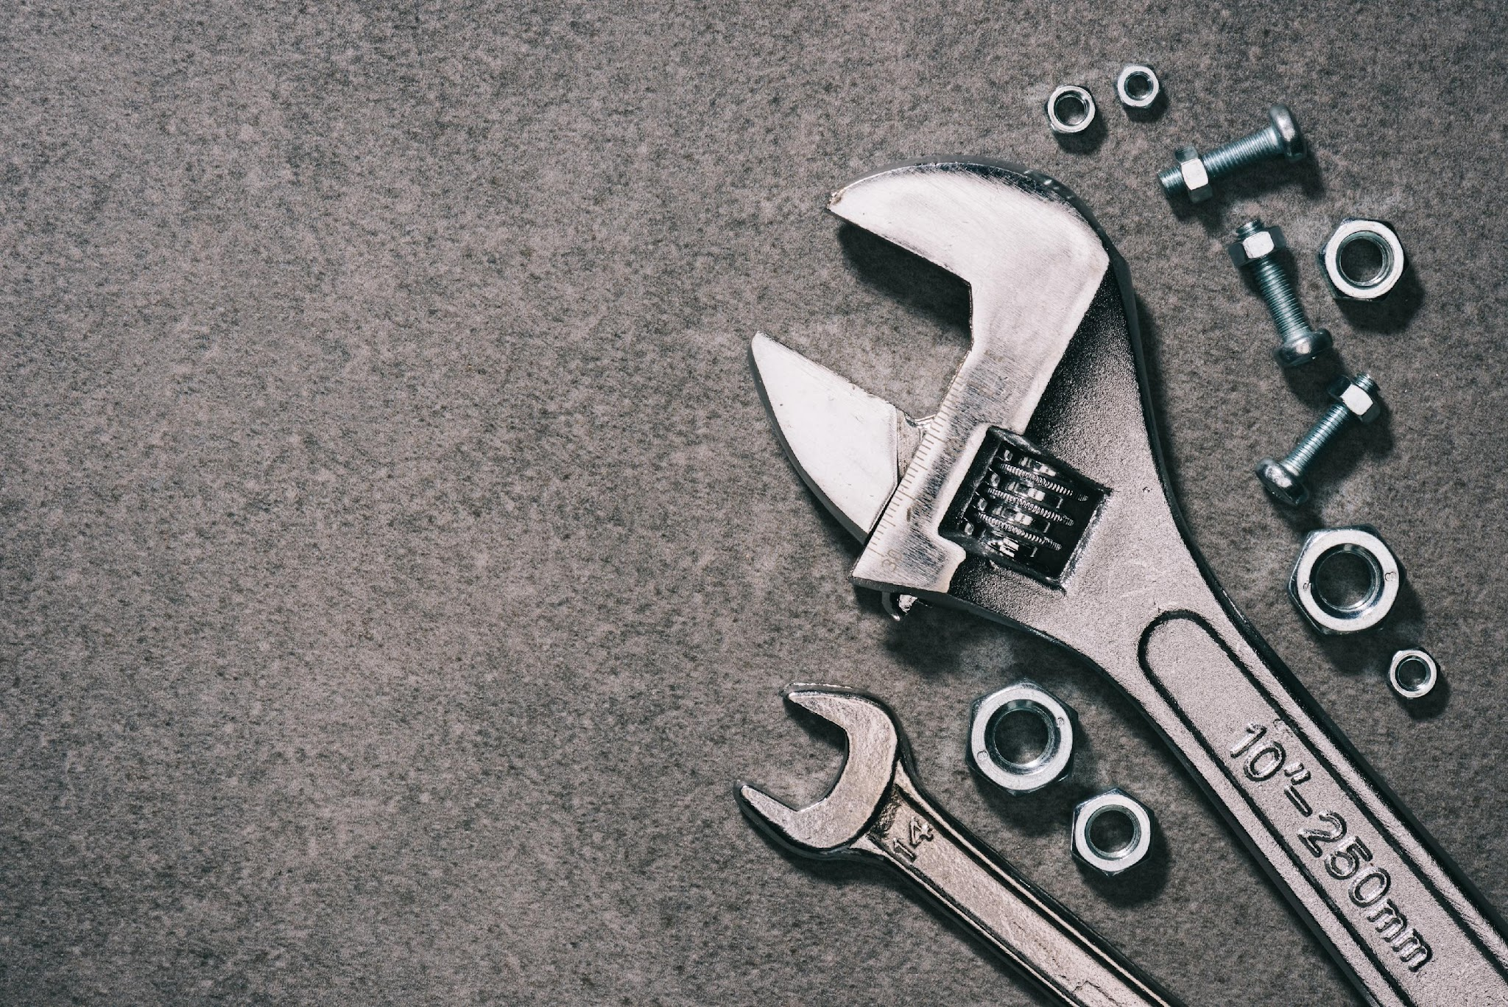
- must happen QUICKLY
- must happen OFTEN
- make sure you BOTH do it
“I was being stubborn”
“We need to take a break”
“I’m getting a little scared here”
- acknowledge your part
Repair That Works
www.BetweenMenAndWomen.com

Slide 18
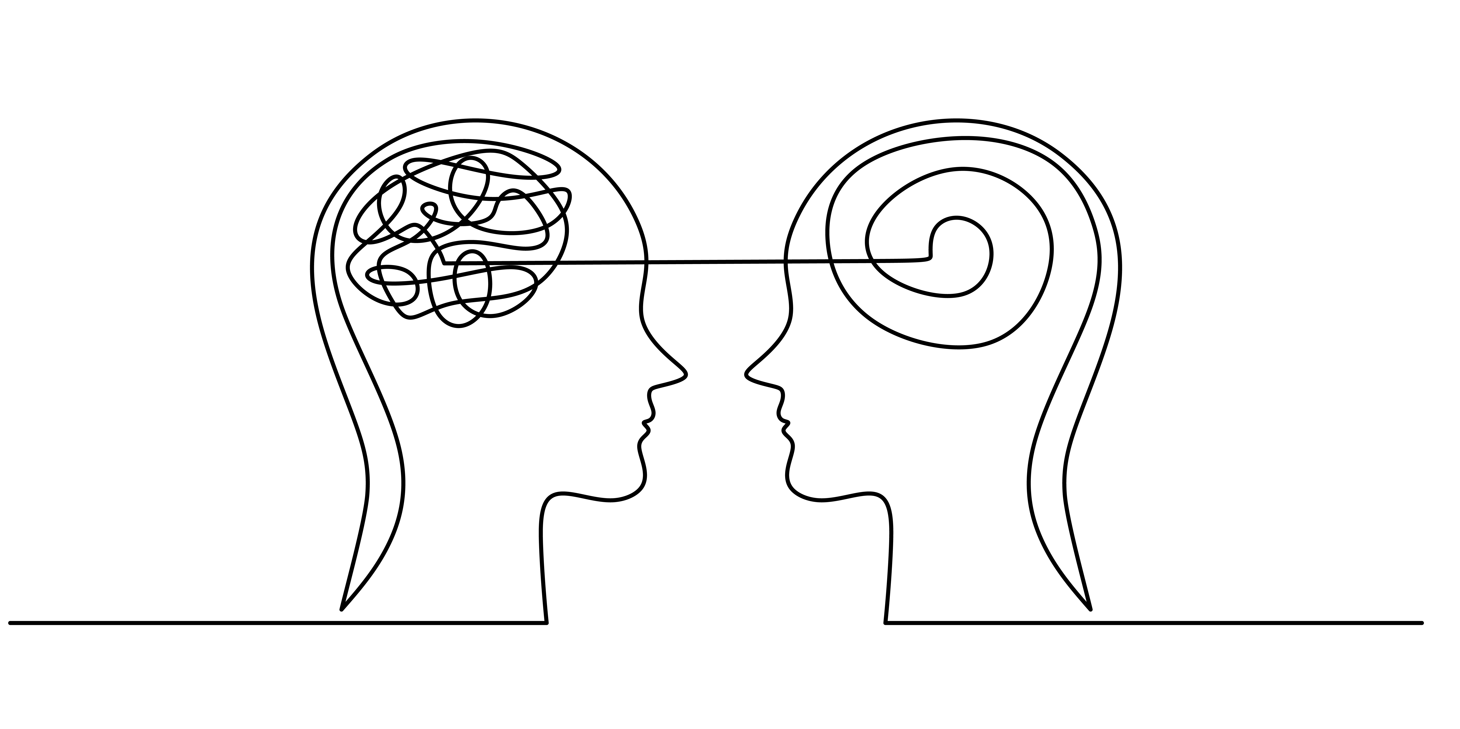
We Think Differently

Slide 19


Linear / Sequential
Left Brained
Thinking Process
Diffuse / Weblike
Right Brained
Thinking Process

Slide 20

Faulty Assumption: That it’s BEST to look for commonalities
linear
diffuse
www.BetweenMenAndWomen.com

Slide 21

Thought Process/Logic
One “Contains” The Other
diffuse
linear

Slide 22
Our Thought Process
Reflects The Essence Of Who We Are
And How We Communicate
Desire
Production
www.BetweenMenAndWomen.com

Slide 23
Talk For
Different Reasons
Linear
- Report talk (information)
Likes to be clear about the purpose of the conversation BEFORE talking
Looking for the point of each conversation
Focuses on the solution to move forward
Talking about “problems” increases stress – just wants to “fix it” to move on to the next thing
Diffuse
- Rapport talk (connection)
Gets clear about thoughts and feelings WHILE talking
Most conversations are to get connected
Focuses on the problem as ALL the data is expressed (tends to lead with “troubles talk” and doubt)
Talking about “problems” reduces stress because talking is the “fix”
diffuse
linear

Slide 24
Production Desire
Convergent Thinking Process
Determines How
Likes Predictability/Decisions
Closes Cycles
Completes
Makes Things Happen
Orderly/Stability
Provides Form
Analytical
Targets The Issue (To Fix)
Wants Clarity From Partner
Focused on Goal/Result
Focused on How
Divergent Thinking Process
Determines What
Will Explore All Options
Opens Cycles
Expands
Imagines What Could Happen
Occurs Random/Chaotic/Movement
Provides Impulse
Experiential
Connects Multiple Factors
Wants To Be Understood/Gotten
Focused On Experience
Focused On What
www.BetweenMenAndWomen.com

Slide 25
We Have To Marry Production
With Desire To Keep Polarity
Between The Partners
Desire
Production
www.BetweenMenAndWomen.com

Slide 26
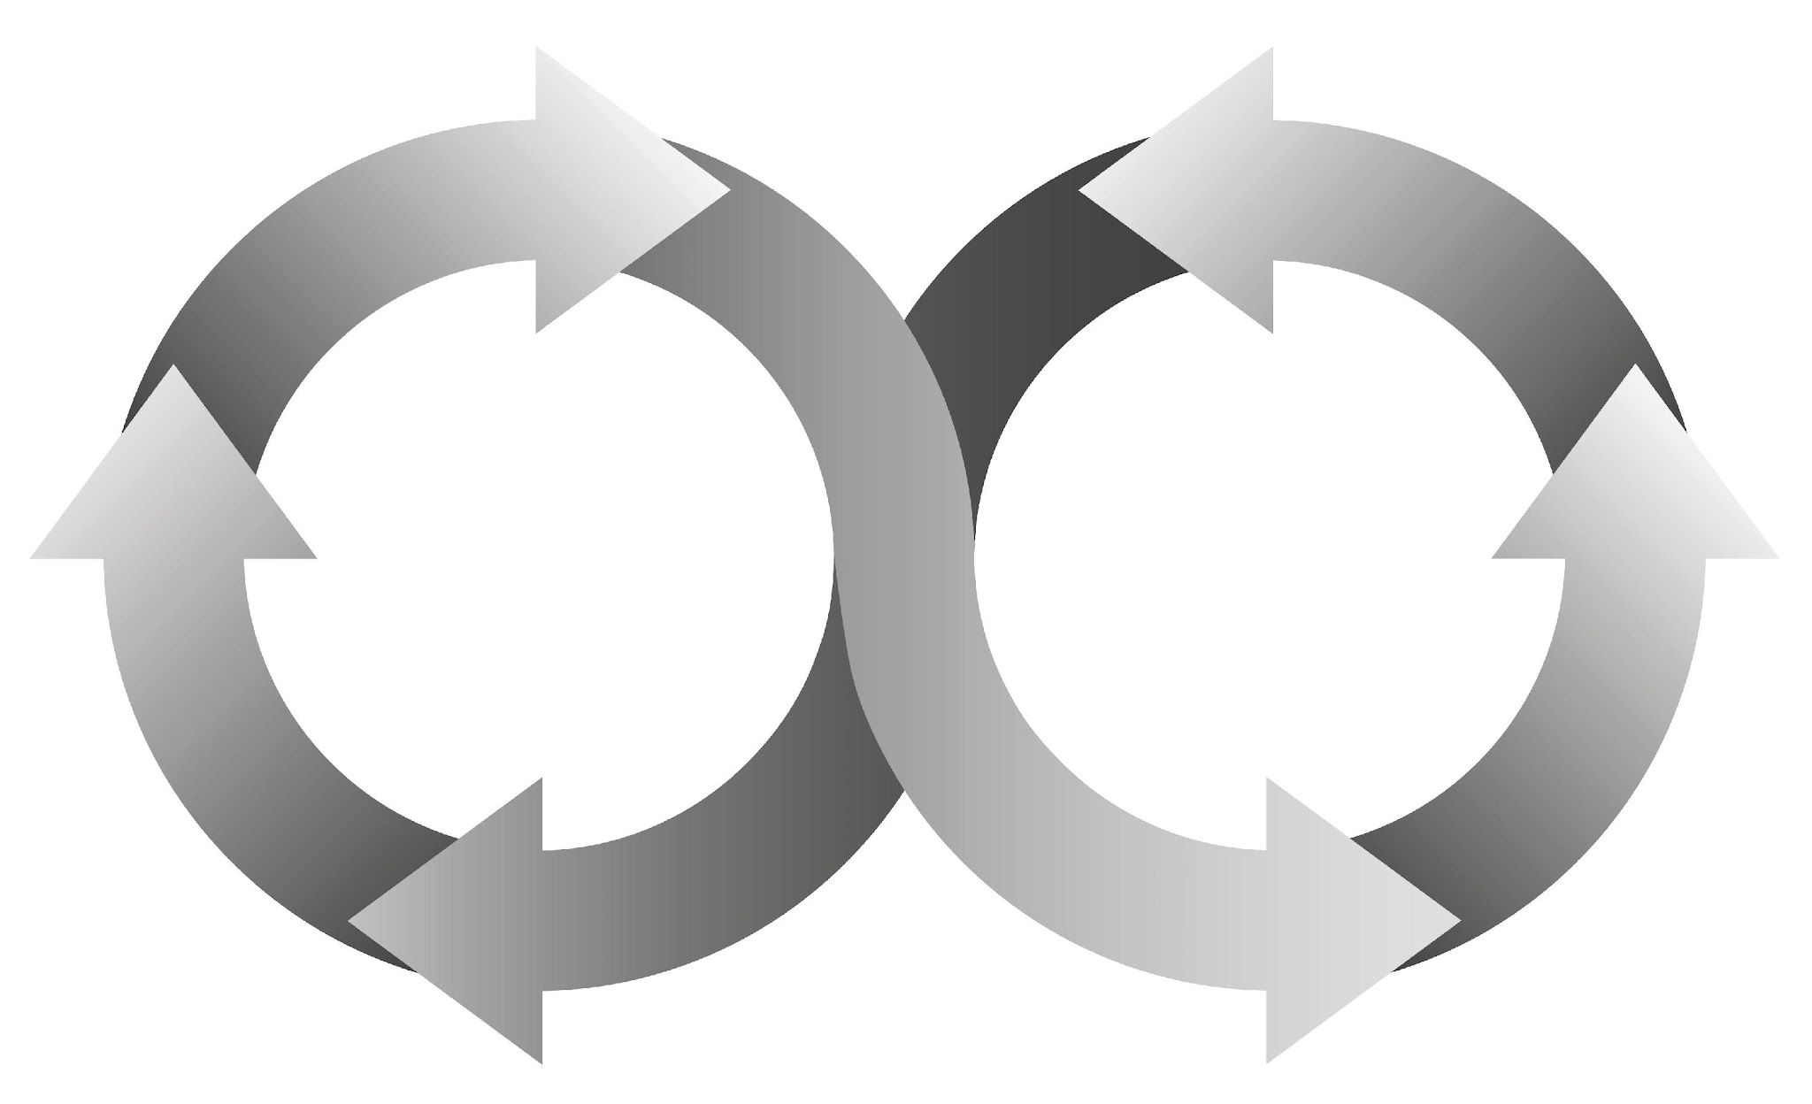
The Sacred Circuit: A Way to Get Connected
and Move Forward
Production
Desire
www.BetweenMenAndWomen.com

Slide 27
The Sacred Circuit: A Way to Get Connected
and Move Forward
Producer gives
presence/attention
(and partner receives that)
2. Desire/Dreamer gives
clean, clear desire (and
partner receives that)
3. Production directly
into Desire/Dreamer
(and partner receives
that)
4. Desire/Dreamer appreciates
& approves of production and
the value provided (and
partner receives that).
NOTE: The Dreamer’s pleasure attracts
more presence and production.
www.BetweenMenAndWomen.com

Slide 28

Dreamer is “Moving All The Time”
- will show you one side in any given moment
-what presents can change very rapidly from moment to moment
- judgment/assessment leads to withdrawal
There are many “Sides”
to the Dreamer
www.BetweenMenAndWomen.com

Slide 29
What Do “Dreamers” Want?
W = wants
A = attention
N = necessities
T = treasures
S = safety/security
** Safety is HUGE
www.BetweenMenAndWomen.com

Slide 30
What Do Producers Want?
To win/succeed at everything they take on
To successfully produce
Appreciation/approval for the value they
bring
To make their partner happy (succeed)
A peaceful place to come to after the
production of the day

Slide 31

(Glaser – Keicolt at Ohio State University)
- wounds of hostile couples healed
60% slower than low hostile couples
A 30 minute argument delayed healing
of a minor wound on the forearm
by one day
Couple’s Stress & Health
www.BetweenMenAndWomen.com

Slide 32

Spinning Girl
People will look at the same thing at the same
time and see the same thing differently.
Especially with your partner, you have to let that
be okay.
Why? BECAUSE THAT’S THE WAY IT IS
https://upload.wikimedia.org/wikipedia/commons/2/21/Spinning_Dancer.gif
www.BetweenMenAndWomen.com

Slide 33
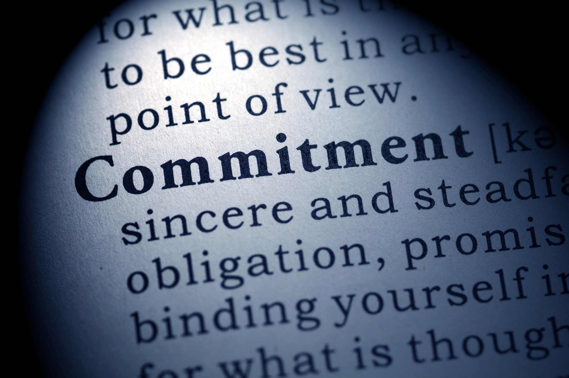
What Are You Committed To ?
What are you committed to
that is “bigger” than both of
you?
What inspires you?
www.BetweenMenAndWomen.com

Slide 34

Research Shows 3 Basic Ways We Communicate
Note: Two of them threaten us and
cause trauma.
www.BetweenMenAndWomen.com

Slide 35
3 Basic Ways We Communicate
Turning toward.
Turning against.
Turning away.
www.BetweenMenAndWomen.com

Slide 36

Still Face Experiment
No response or
turning away is most
stressful.
https://www.youtube.com/watch?v=apzXGEbZht0
www.BetweenMenAndWomen.com

Slide 37
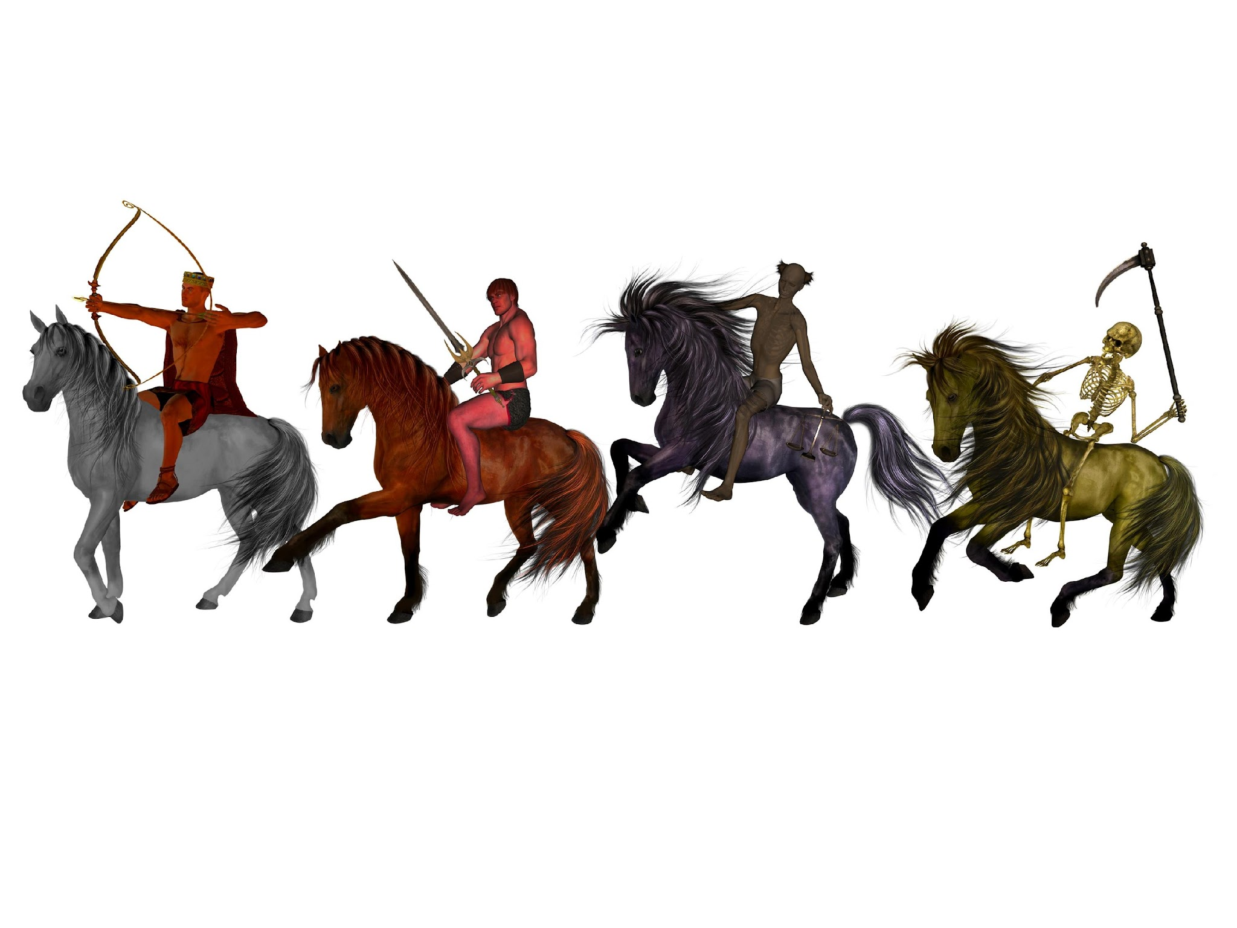
1. Criticism - Make a clean, clear request
2. Contempt - “Get The Good”, Admiration
3. Defensiveness - Acknowledge your part
4. Stonewalling – Learn how to self regulate
Antidotes To The 4 Horseman Of The Apocalypse
www.BetweenMenAndWomen.com

Slide 38
6 Steps
1. Separate the Person from the Problem.
2. State the facts.
3. Feelings – emotion, not assessment or
interpretation
4. Why is this a problem/concern for you.
5. Actionable Request – operative word is action
6. Is there anything I can do to make it easier for
you to fulfil on my request?
. NOTE:Keep “hard no’s” to a minimum & try a counter
offer.
Transform Criticism To Clean Clear Requests

Slide 39

What you bring to the table matters!
Smiling Baby
www.BetweenMenAndWomen.com

Slide 40

Notice how she relaxes as soon as
partner “gets” her experience. Notice
listener doesn’t have to feel it themselves,
doesn’t have to agree with it, just has to understand/get
the “quality” of the experience.
Don’t fix, don’t exercise logic, don’t
dismiss…. just let the other person know that you “get” the
experience. THIS is going with the flow instead of resisting it.
https://www.youtube.com/watch?v=-4EDhdAHrOg
“It’s Not About The Nail”
www.BetweenMenAndWomen.com

Slide 41

1. Show up, be present, be
interested
2. Eye contact
3. Let them talk
4. “Get” their feeling experience
5. Reflect their experience back to them
6. Ask a question or make a statement.
7. Keep asking questions or making
statements until the other is finished.
8. Tip: Nod your head, sprinkle in “oh yeah”…”uh huh”.
“Be The Bowl” – How To Listen
www.BetweenMenAndWomen.com

Slide 42

Step 1. Listen for WHAT HAPPENED (facts)
Step 2. How did the other feel? What was it
like for the other?
Step 3. Validate be saying …”that makes
sense because ….”
Reflect all of this back to the other.
Reflective Listening – 3 Basic Steps
www.BetweenMenAndWomen.com

Slide 43
Reflective Listening – 3 Basic Steps
Step 1. Listen for WHAT HAPPENED (facts)
Step 2. How did the other feel? What do you think
the experience was like?
Step 3. Validate by saying …”that makes
sense because ….”
Reflect all of this back to the other. And when it’s about you:
Step 4. Ask, “Did I get that right?”
Step 5. Ask “Is there more?”
www.BetweenMenAndWomen.com

Slide 44

1. Be consistent & frequent.
2. Don’t assume you know what
the other wants.
Sacred Circuit – Attention/Presence
www.BetweenMenAndWomen.com

Slide 45

1. Double edged sword (neediness,
attachment, addiction, obsession)
2. Get clear.
3. Focus on what you want, not on what
you don’t want.
4. Watch out for Doubt.
5. Stay out of Production.
6. Savour the wait.
7. Pay with your pleasure.
Sacred Circuit - Desire
www.BetweenMenAndWomen.com

Slide 46

1. Take cue from Desire
2. One cycle at a time.
3. The “Producers Protest”
4. No isn’t forever. (reassurance)
5. “Is there anything I can do for you?
Sacred Circuit - Production
www.BetweenMenAndWomen.com

Slide 47

1. Must be genuine
2. Put ENERGY behind your “thank-you’s”
3. Don’t be cheap with appreciation
4. There is ALWAYS something to be
appreciative and approving of.
Appreciation/Approval
www.BetweenMenAndWomen.com

Slide 48
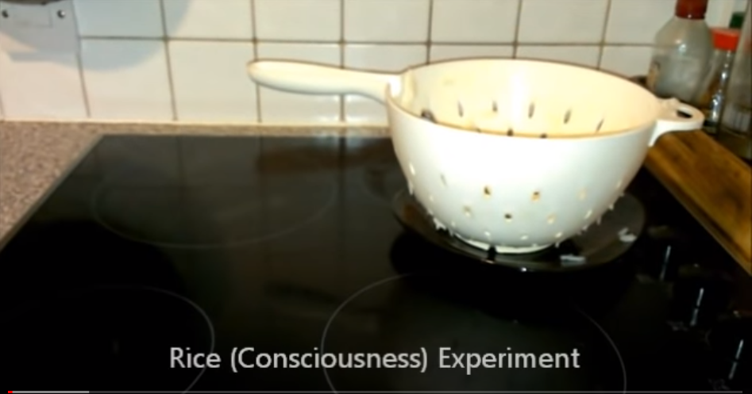
VIDEOS
Masaru Emoto’s Rice Experiment
https://www.youtube.com/watch?v=Ehlw-9PJkIE
Rice Consciousness Experiment
https://www.youtube.com/watch?v=31shlv5Z71A
Take-Aways
1. What you think and feel about your partner
matters.
2. The words you use matter.
www.BetweenMenAndWomen.com

Slide 49

Participant’s
“Take Aways”
Donna Tosky
www.BetweenAndMenWomen.com

Slide 50

Success Strategy
For You:
1. Be consistent.
2. Keep it simple.
3. Be willing & stay open.
4. Call in your HAWK regularly.
5. Know that yours is not the only
way to see things.
6. Be curious.
7. Practice self regulation.
8. Be willing to co-regulate (help your partner).
9. Hold your “person” & their well being in highest regard.
10. Please Please Please stop putting your rel’p last.
11. STOP BEING A VICTIM & generate a different result.
www.BetweenMenAndWomen.com

