Slide 1

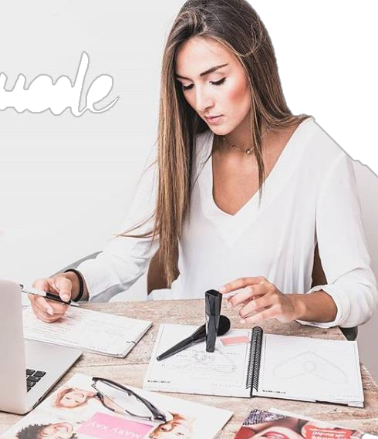




Slide 2

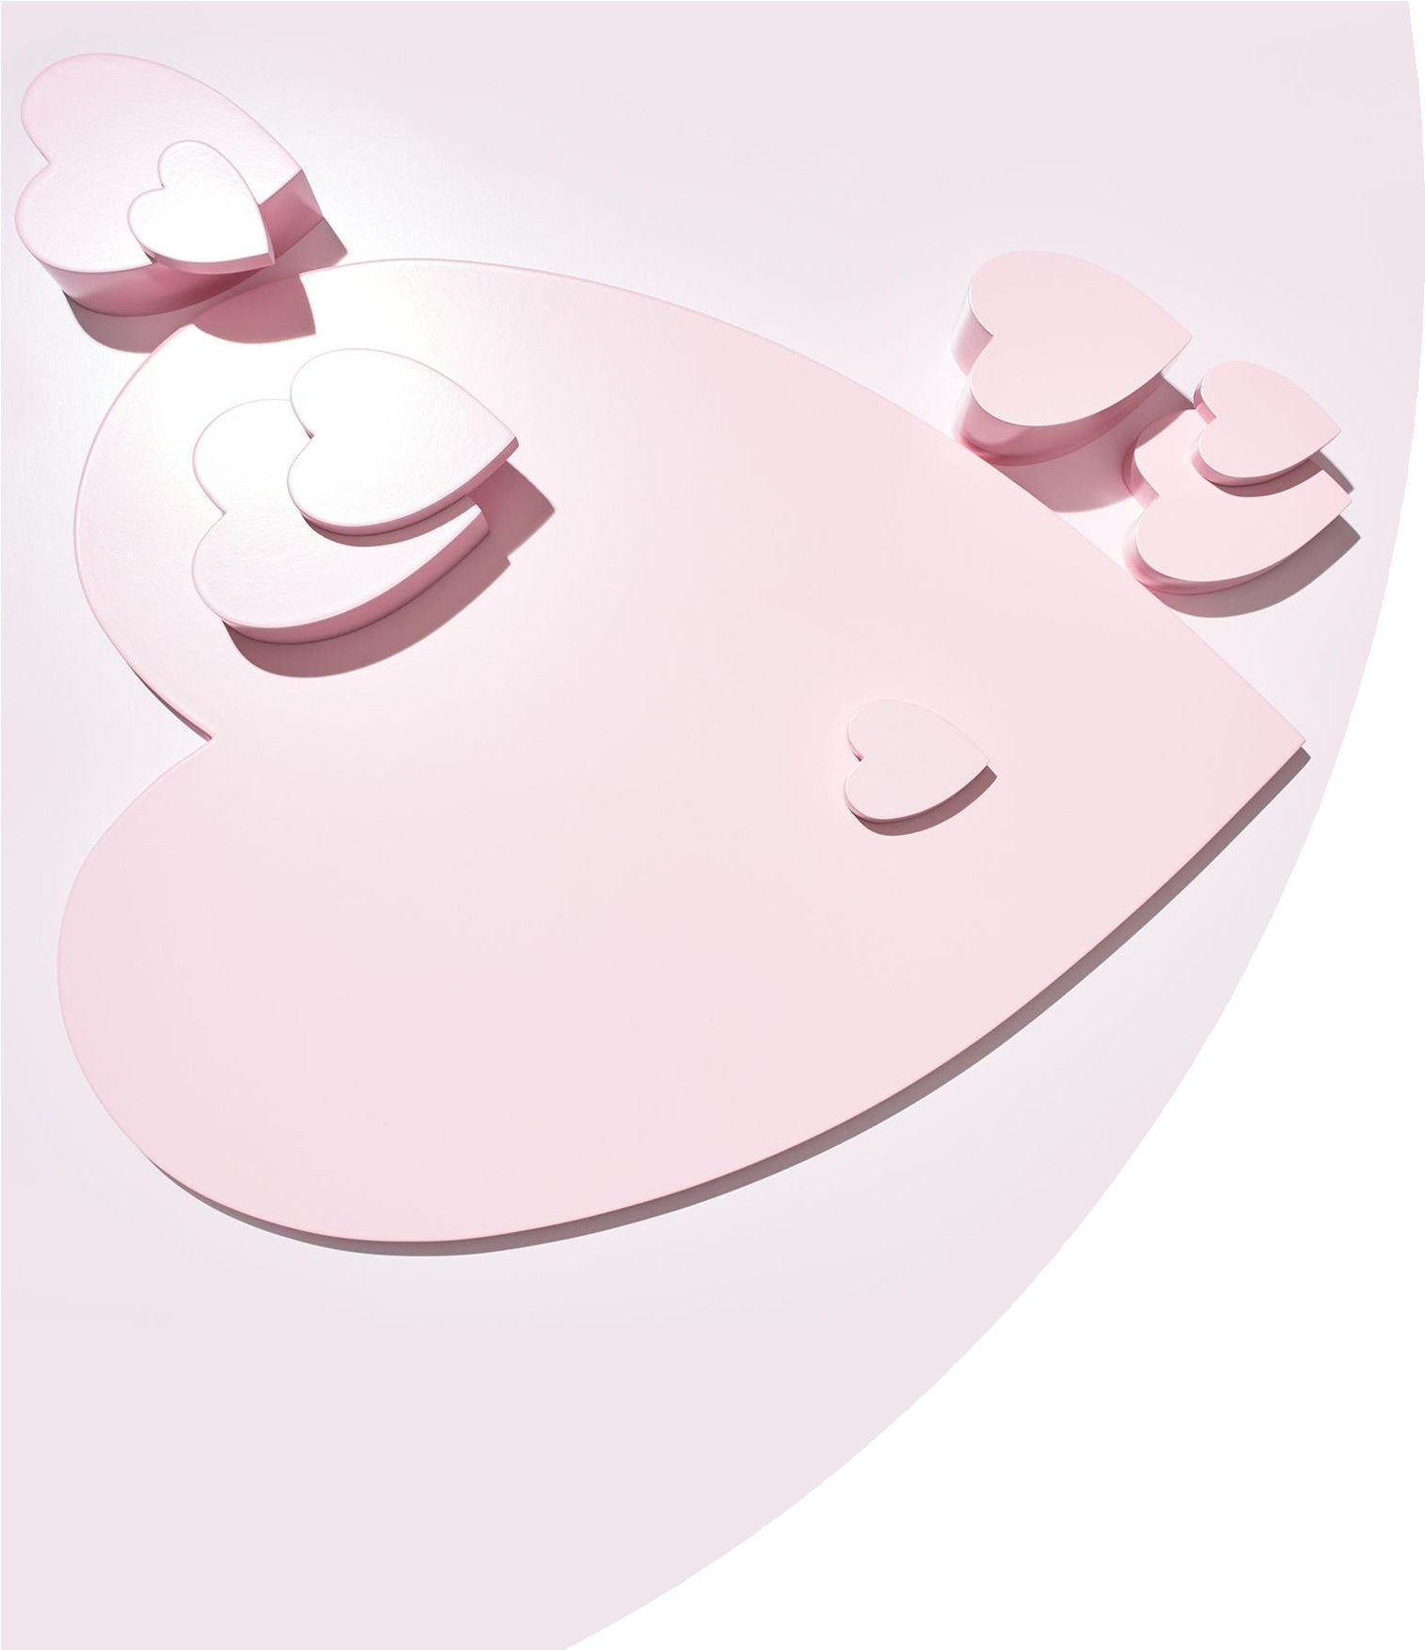







Slide 3


Slide 4



Slide 5


Slide 6









Slide 7

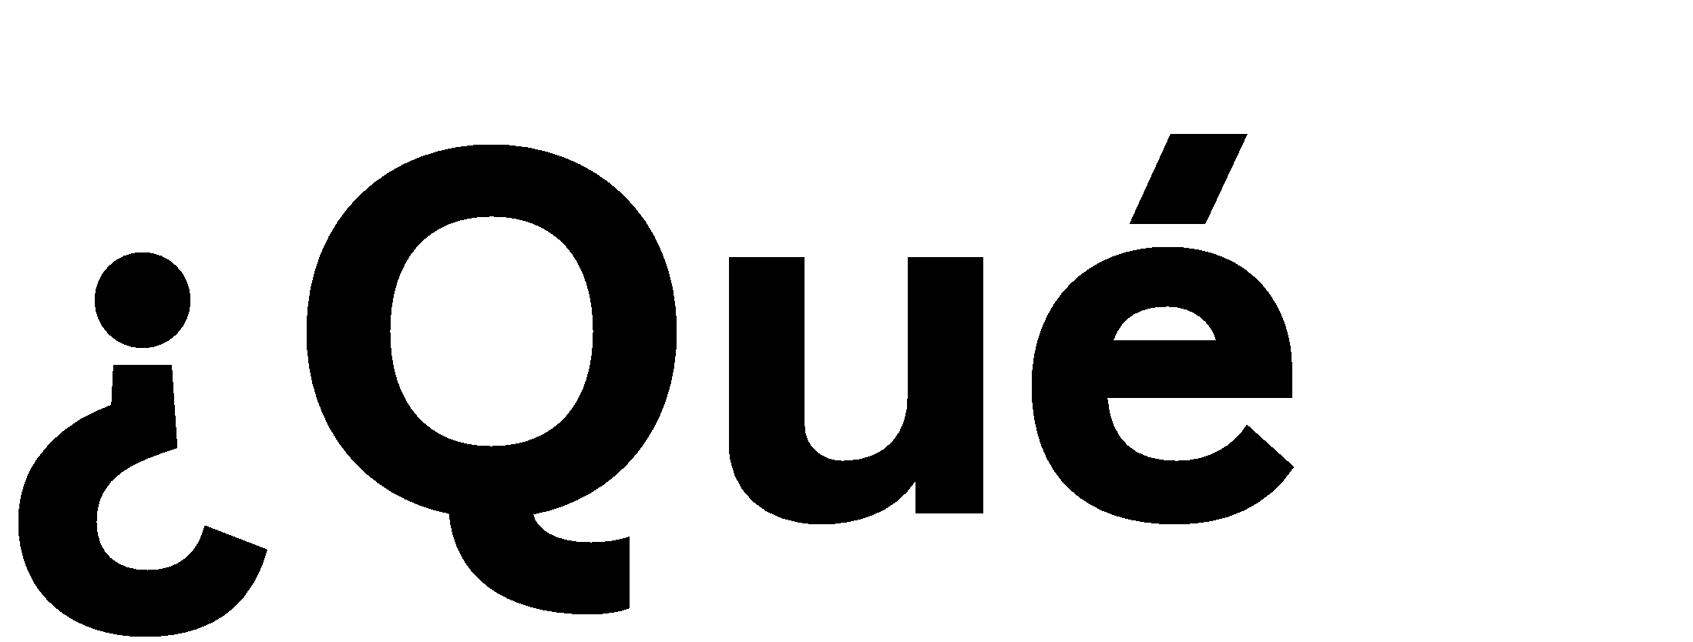





Slide 8







Slide 9










Slide 10










Slide 11







Slide 12



Slide 13





Slide 14


Slide 15





Slide 17


Slide 18




Slide 19
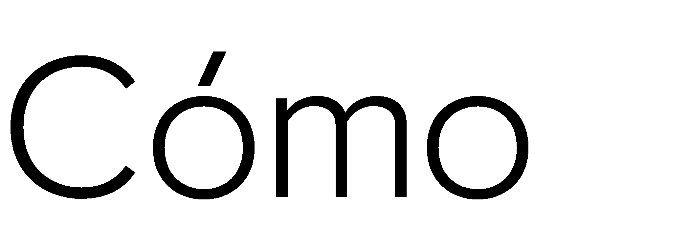






Slide 20



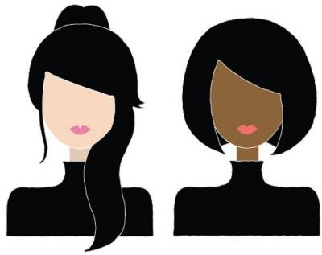



Slide 21











•

Slide 22



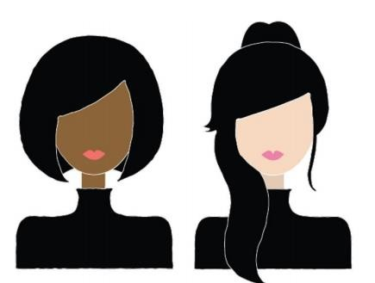

Slide 23



Slide 24



Slide 25



Slide 26











Slide 27







Slide 28






Slide 29









Slide 30








Slide 31

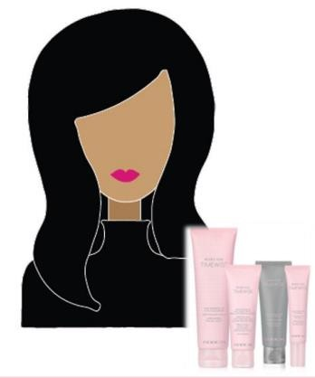




Slide 32


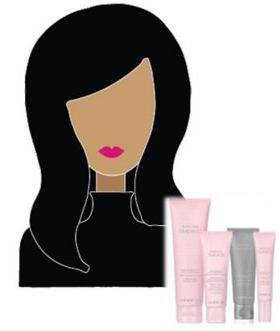









Slide 33







Slide 34






Slide 35



Slide 36



Slide 37



Slide 38









Slide 39








Slide 40







Slide 41










Slide 42








Slide 43










Slide 44





Slide 45


Slide 46






Slide 47




Slide 48





Slide 49
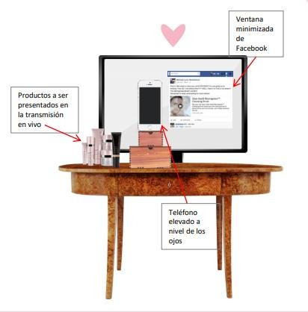



❑
❑
❑

Slide 50



❑
❑

Slide 51



❑
❑

Slide 52


❑
❑

Slide 53









Slide 54



