Slide 1


Freshdesk Integration
Document Version - 23 December 2020

Slide 2
What’s in it for me?
This product document will cover:
Introduction to Freshdesk
Integration Scope
Virtual Line
BizPhone
Setup Guidelines
Access Freshworks Developer Console
Create New Custom Application
Update New Version of the Application

Slide 3
Who should attend this training session?
This product document is catered for anyone that is keen on understanding how Freshdesk can be integrated into the B3Networks Cloud Communication Apps and what it can value-add to the telephony solutions.

Slide 4
Introduction

Slide 5
What is Freshdesk?
Freshdesk is an online cloud-based customer service platform to keep track of conversations, collaborate with colleagues, and improve team efficiency with accurate metrics. It serves organizations by providing helpdesk support with all smart automations to get things done faster.
The following B3Networks Apps allow users to instantly connect/integrate Freshdesk into their cloud communication solution to automate daily operations and enhance productivity.
Virtual Line
BizPhone

Slide 6
Objective:
To automate the process of customers using Freshdesk ticketing system and B3Networks cloud apps.
To synchronize call data storage between two systems.

Slide 7
Integration Scope

Slide 8
Virtual Line

Slide 9
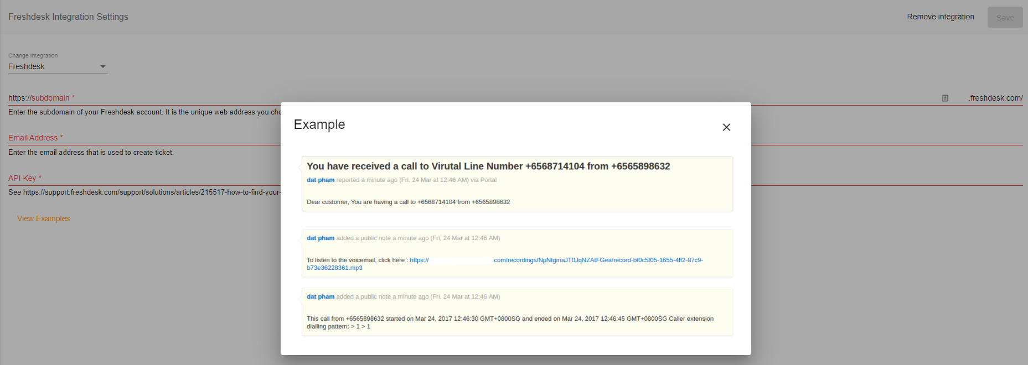
Aside from the main features of the Virtual Line App, it can also be engineered to integrate with third-party CRMs such as Freshdesk

Slide 10
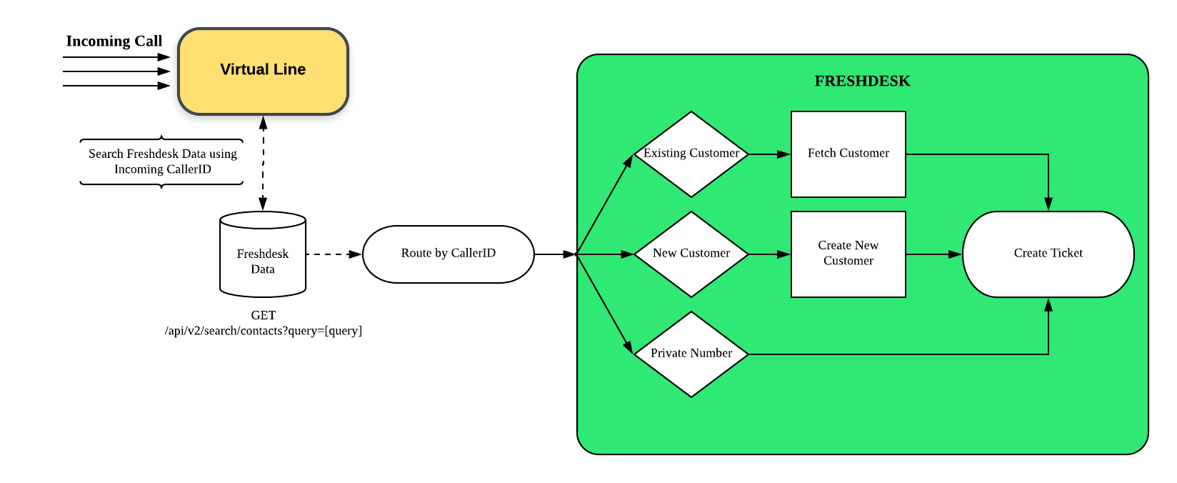
Following this diagram, by using the CallerID of the caller when an incoming call is received, the system can perform a query against the integrated Freshdesk database and proceed with the desired flow of creating a ticket into the customer’s system:
If the caller’s number is already registered in the database as an existing customer, a ticket will be created using their information, and will be tagged to them automatically.
If the caller’s number is not yet registered, a new account will be created and recorded in Freshdesk before opening a ticket.
If the caller is using a Private number, a ticket will be created with no other information gathered.

Slide 11
BizPhone

Slide 12
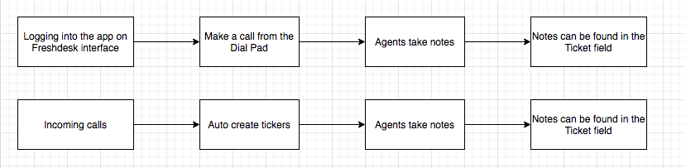
Designed Workflow:

Slide 13
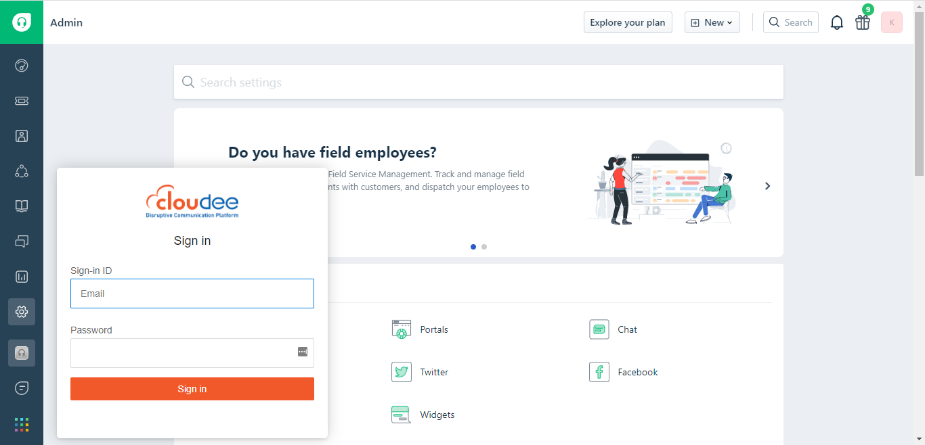
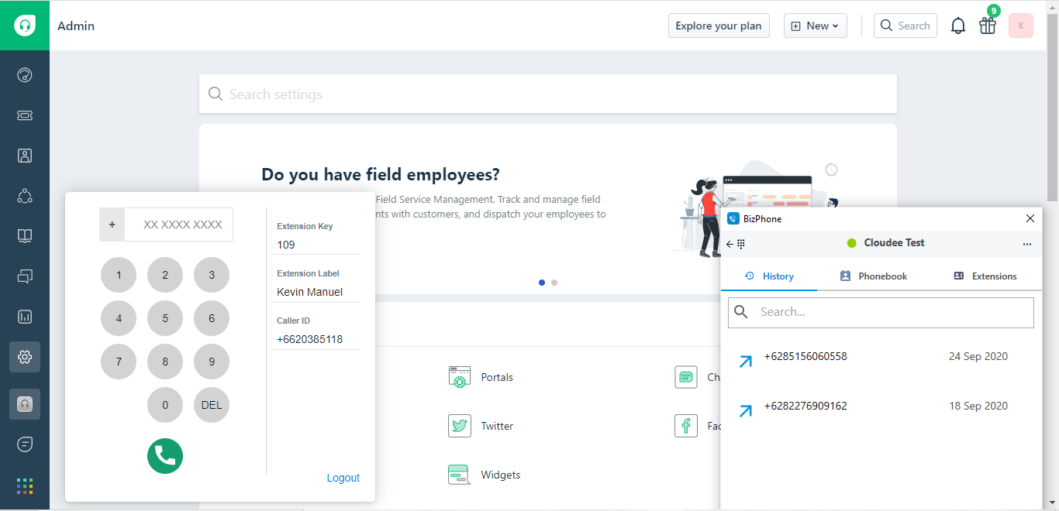
Integration Scope
Outbound call from Freshdesk using Bizphone Desktop Apps/Mobile Apps.

Slide 14
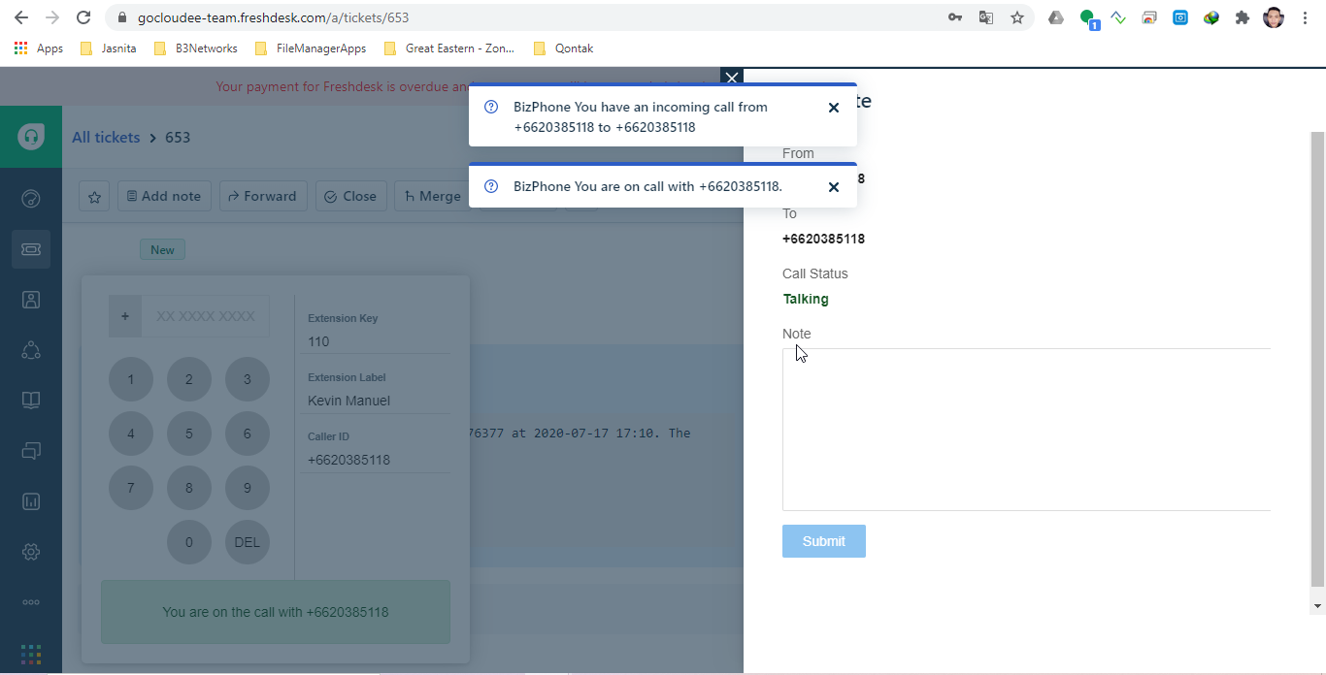
2. Incoming pop-ups and Note taking fields:

Slide 15
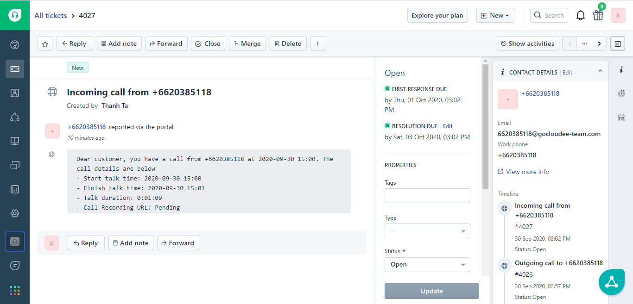
3. Ticket auto-creation for all incoming calls.
4. Data sync between B3Networks Call Center and Freshdesk.

Slide 16
Setup Guidelines

Slide 17
Requirements:
You must have a Freshdesk/Freshsales account
Freshdesk and Freshsales account is separate from each other
You still can use the same email for both Freshdesk/Freshsales account registration
To prevent collision if you are using the same email for both account, log out action is recommended
Your Freshdesk/Freshsales account must have administrator privileges so you can access Freshwork Developer Console

Slide 18
Access Freshworks Developer Console

Slide 19
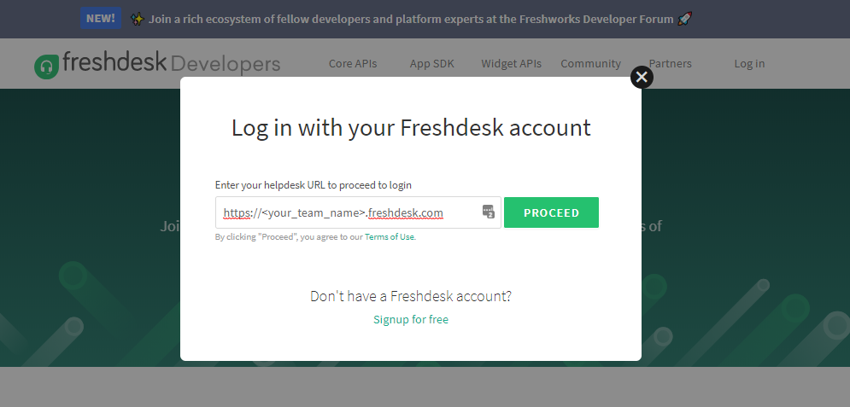
With Freshdesk
Go to https://developers.freshdesk.com/
Input your Freshdesk domain when login
Login with your Freshdesk account

Slide 20
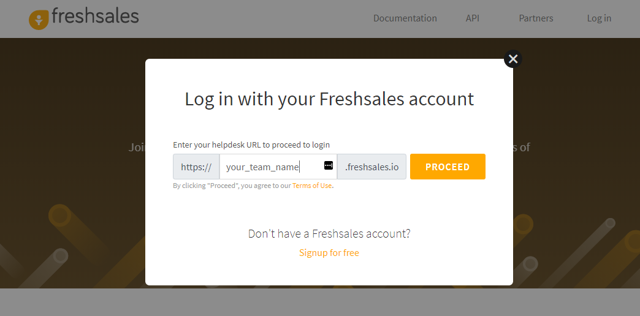
With Freshsales
Go to https://developers.freshsales.io/
Input your Freshsales domain when login
Login with your Freshsales account

Slide 21
2. Create New Custom Application

Slide 22
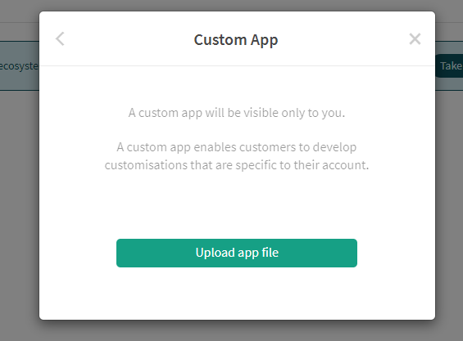
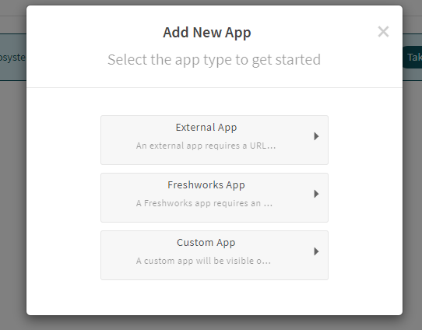
After logging in, the process of creating the new Custom App for Freshdesk and Freshsales is same, you just need to remember which account you are logging in
Remember to choose Custom App type at step 1
Upload the packed application file

Slide 23
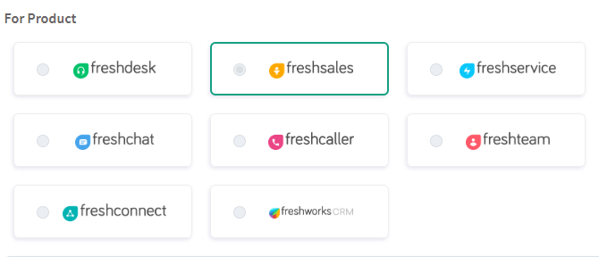
In the App Details screen, Choose the right product corresponding to you logging account. As in this guideline, the product here refers to be either Freshdesk or Freshsales
Fill up other the required fields in the App Details section
Publish the application. It may take up to 30 minutes before the application is available in the app store

Slide 24
3. Update New Version of the Application

Slide 25
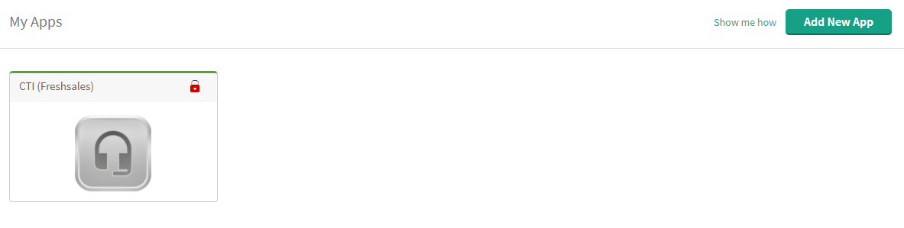
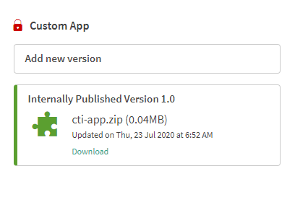
In My Apps page, select the custom application
On the right side of App Details page, click Add new version button

Slide 26
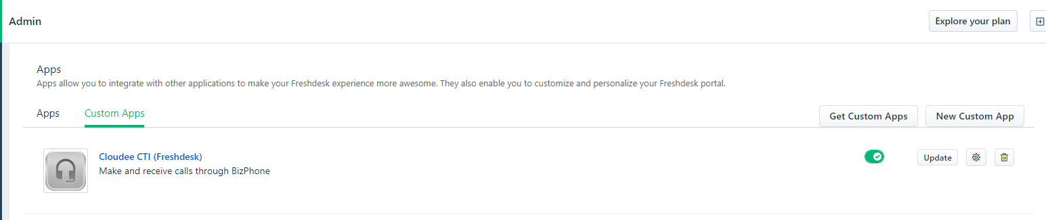
Upload new version and then Publish
After a new version of the custom application is published, Freshdesk/Freshsales organizations who are using the custom application will need to update the new version in their Admin page. Below is a sample in Freshdesk.

Slide 27
Important Notes:
Freshdesk and Freshsales will require separate packed application
Each domain or customer may require different portal domain configuration and repack the application is needed. Reuse the same packed application may lead to unexpected UI and behaviors of the custom application

Slide 28
Thank You
For comments and feedbacks please contact academy@b3networks.com.

