Slide 1




FREE PRESENTATION TEMPLATE BY EATEMP

Slide 2
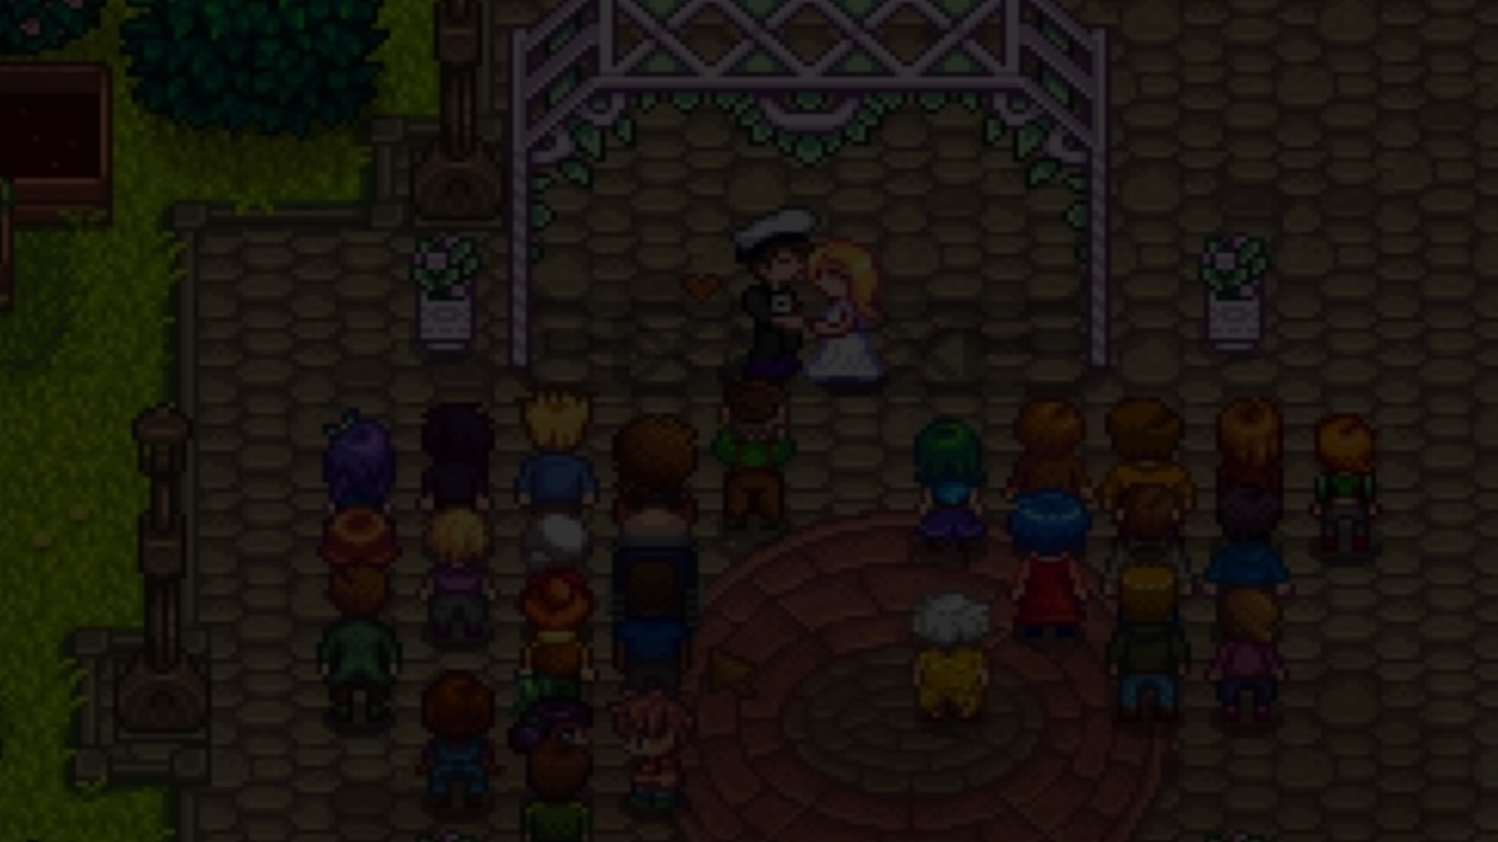
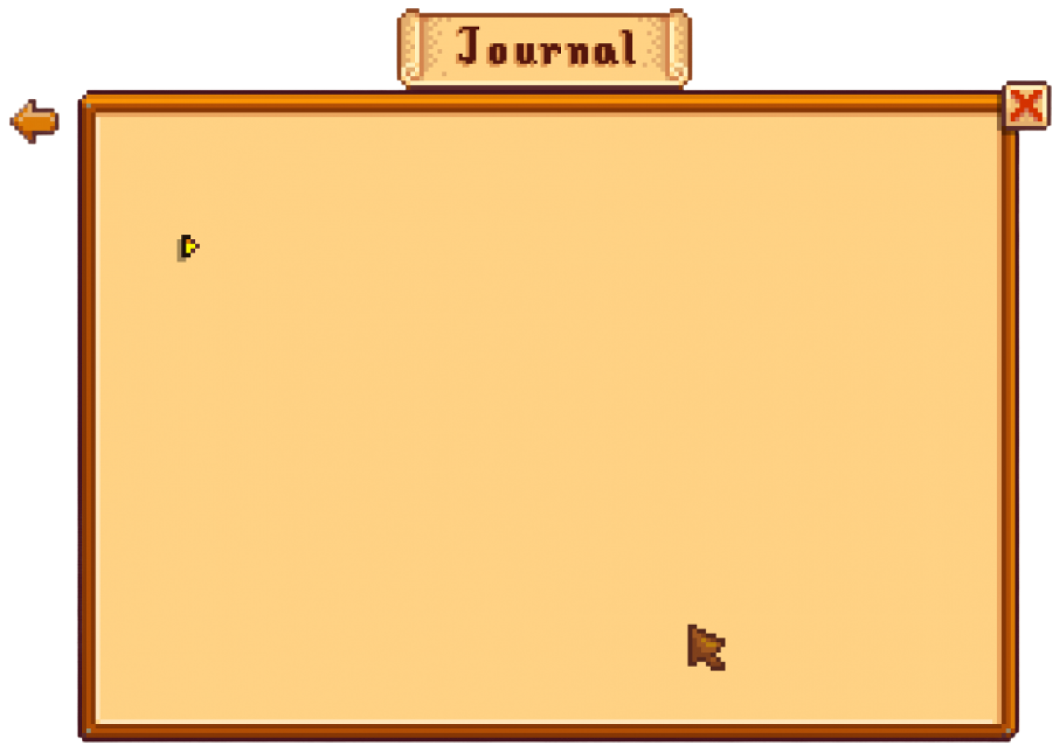
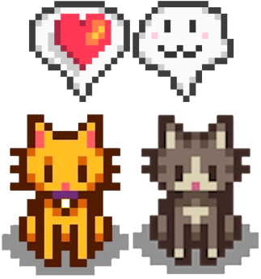

Welcome
Welcome to the world of fantasy! Join us on a journey to explore the mystical creatures, enchanted lands, and magical wonders that exist beyond our reality. Discover the wonders and secrets of this exciting realm and unlock the power of imagination.

Slide 3
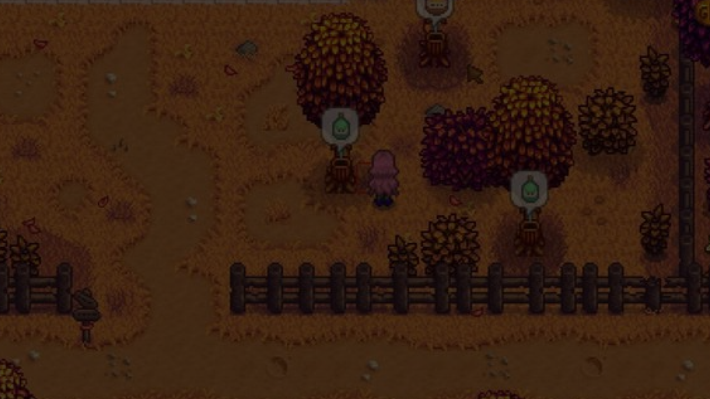

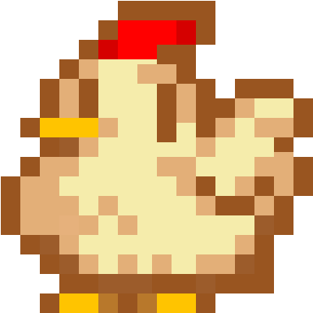

Contents
Introduction
Encounters Unicorn Sightings
Wonders Wishes Granted
Magic Spellcasting
Happily Ever After
Embrace the Fantasy

Slide 4



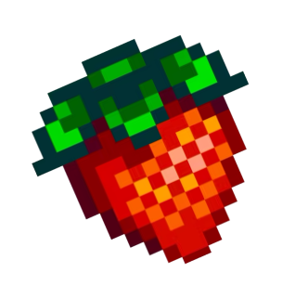
The Realm of the Extraordinary
Welcome to the Fantasy World, a realm of wonder and enchantment where anything is possible. Here, dragons breathe fire, unicorns prance through meadows, and rainbows shine brightly. This world is a place where wishes come true, where potions can be cursed and spells are cast. It's a place of treasure and adventure, where the impossible becomes possible. But the greatest treasure of all is the one that lies within.
The world of fantasy is a reflection of our deepest desires, our fondest dreams, and our wildest imaginations. It's a place where we can let go of the constraints of reality and explore the boundless possibilities of the human mind. In this introduction, we will delve into the mysteries of this realm, uncovering the magic and wonder that lies within. So come with us and let's embark on a journey through the Fantasy World.

Slide 5
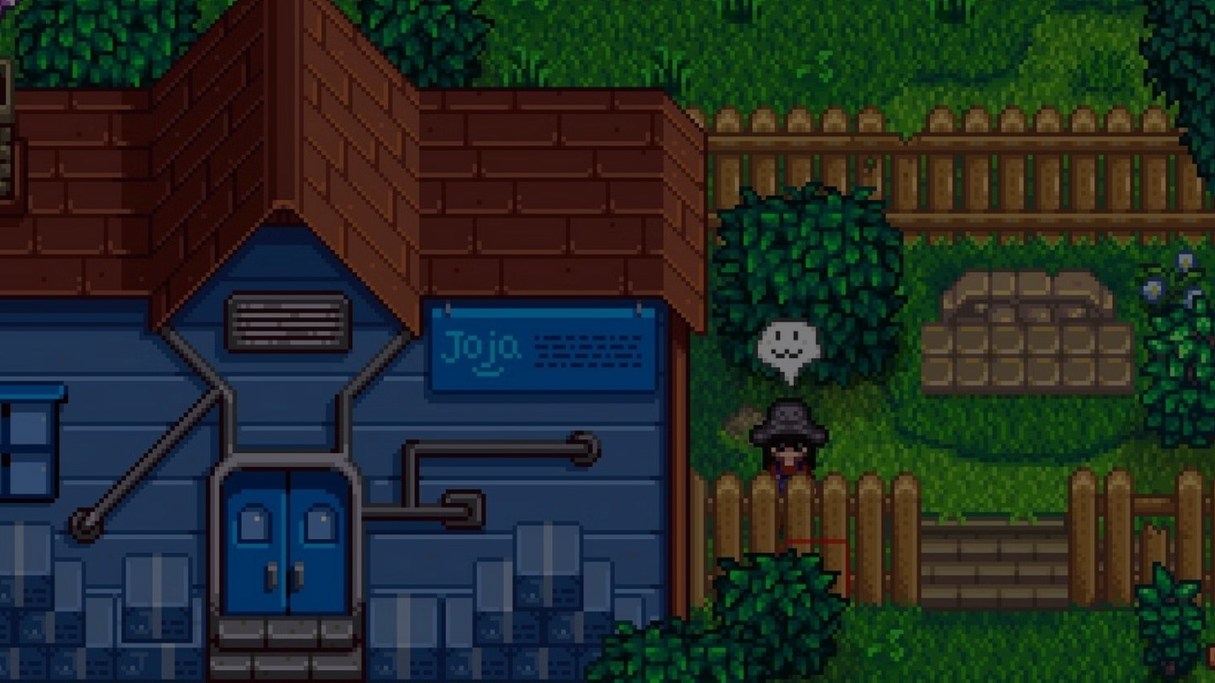


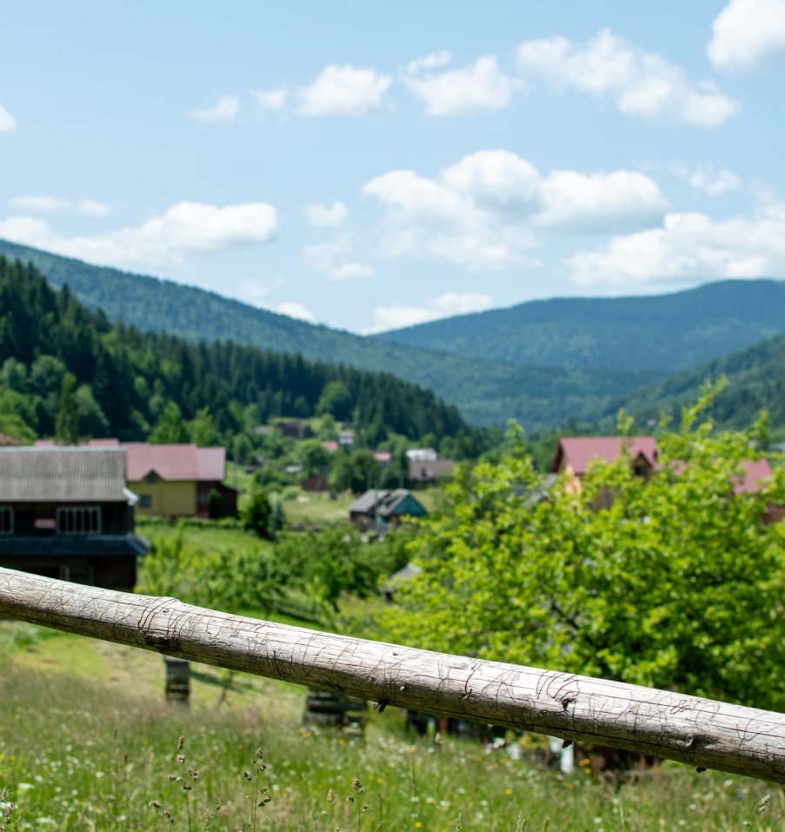



Unicorn Sightings
A record of the number of unicorns spotted in the fantasy realm and the beauty and mystery that surrounds these enchanting creatures.
Dragon Taming
A closer look at the art of taming dragons and the brave adventurers who dare to take on these fearsome creatures.

Slide 6
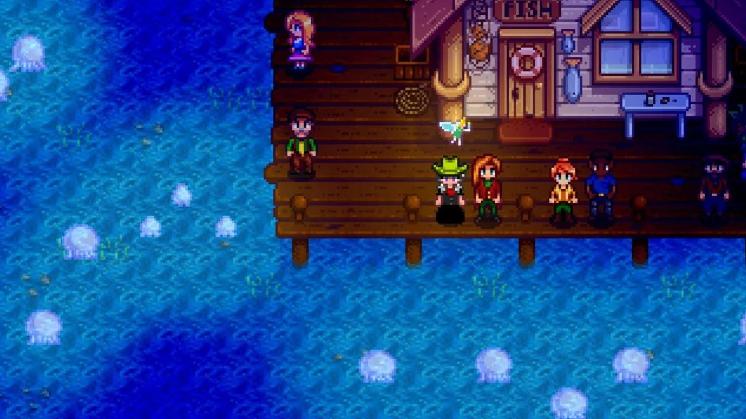

Unicorn Sightings
A record of the number of unicorns spotted
Dragon Taming
A closer look at the art of taming dragons

Slide 7
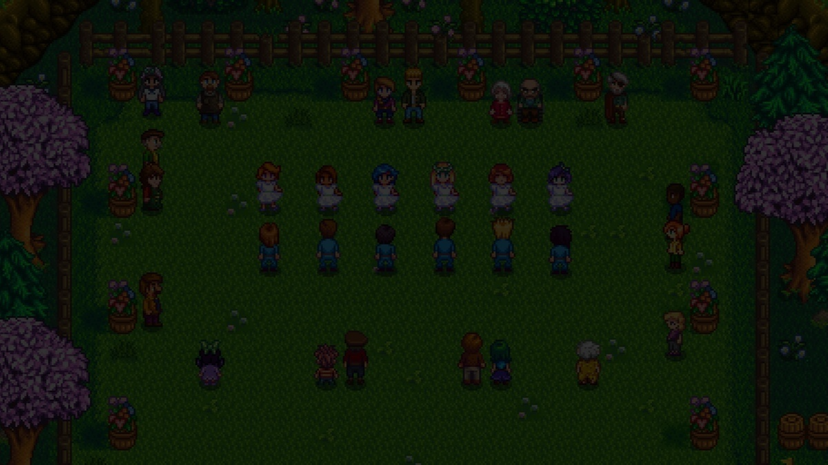
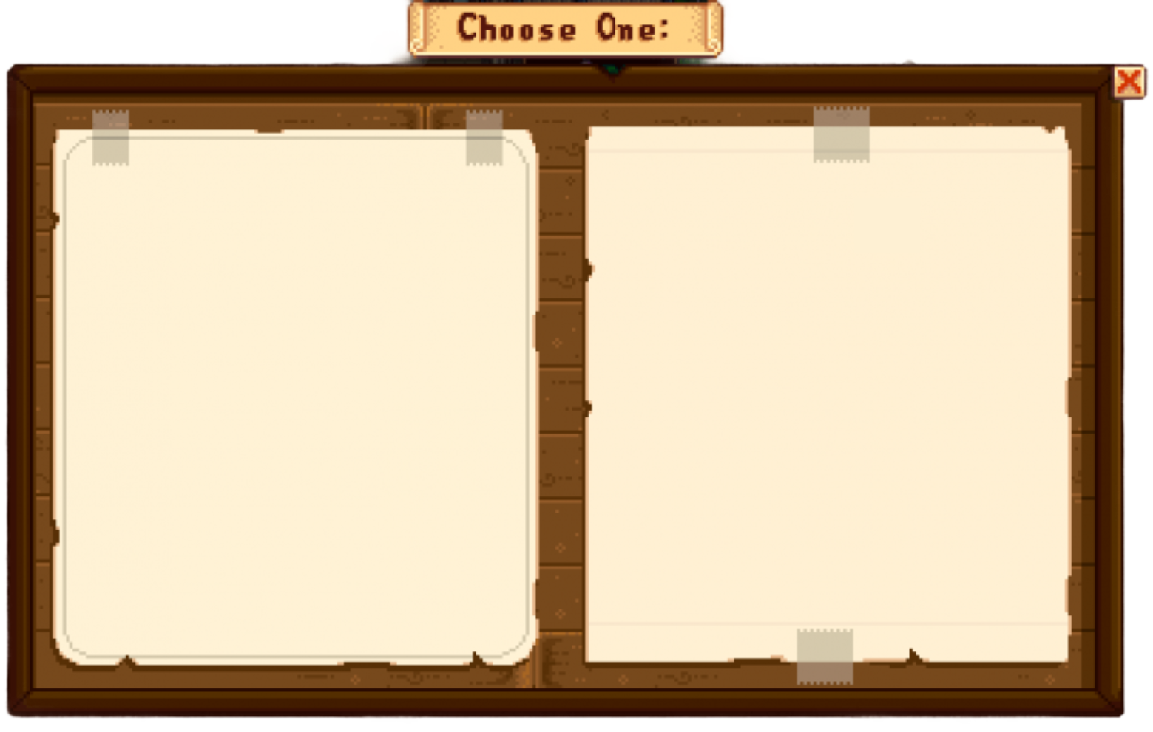
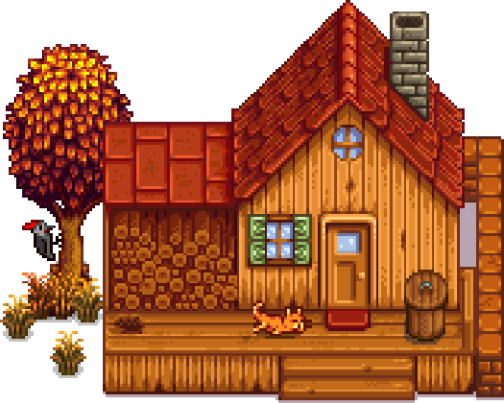
Dragon Taming Technique
The Art of Unicorn Sighting
A guide to taming and caring for dragons in the realm of magic.
Tips and tricks for spotting the unicorns in natural habitat.

Slide 8
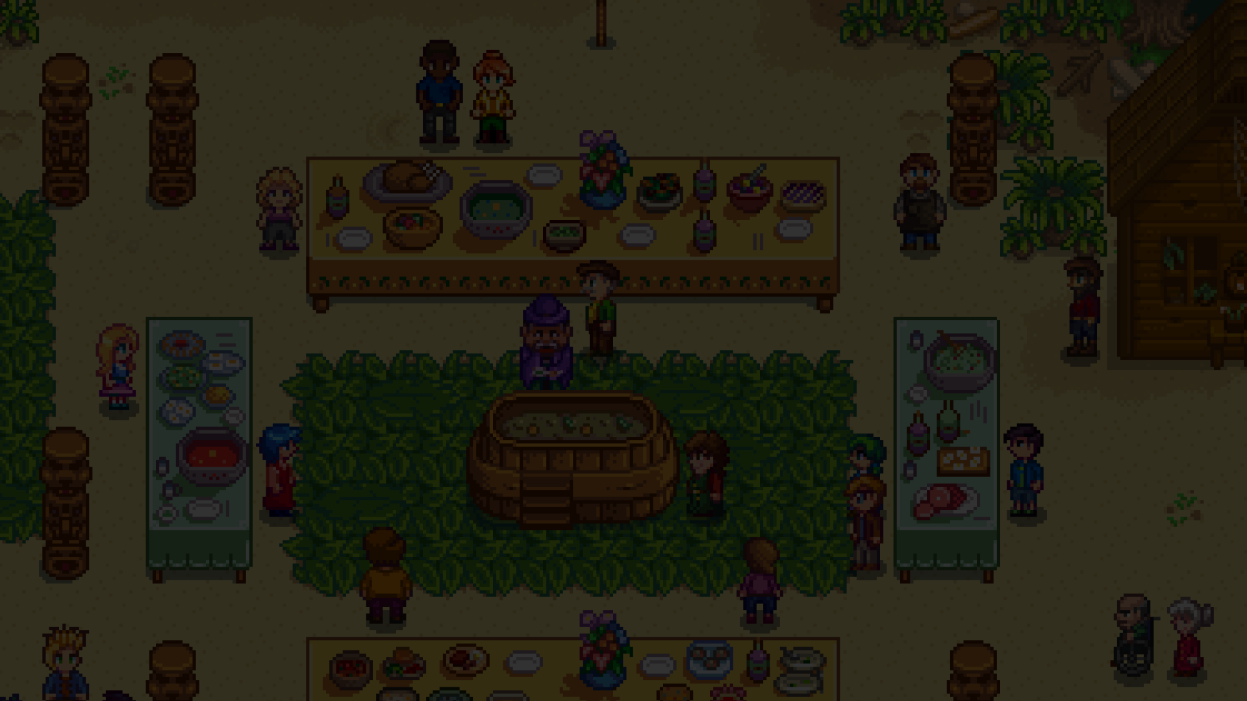

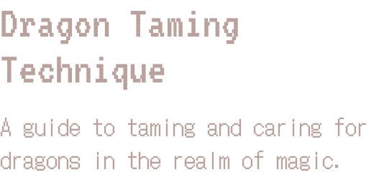
The Art of Unicorn Sighting
Tips and tricks for spotting the unicorns in natural habitat.

Slide 9
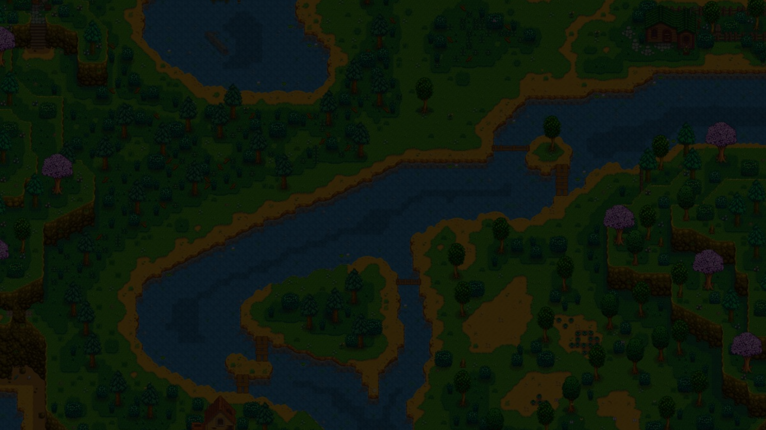
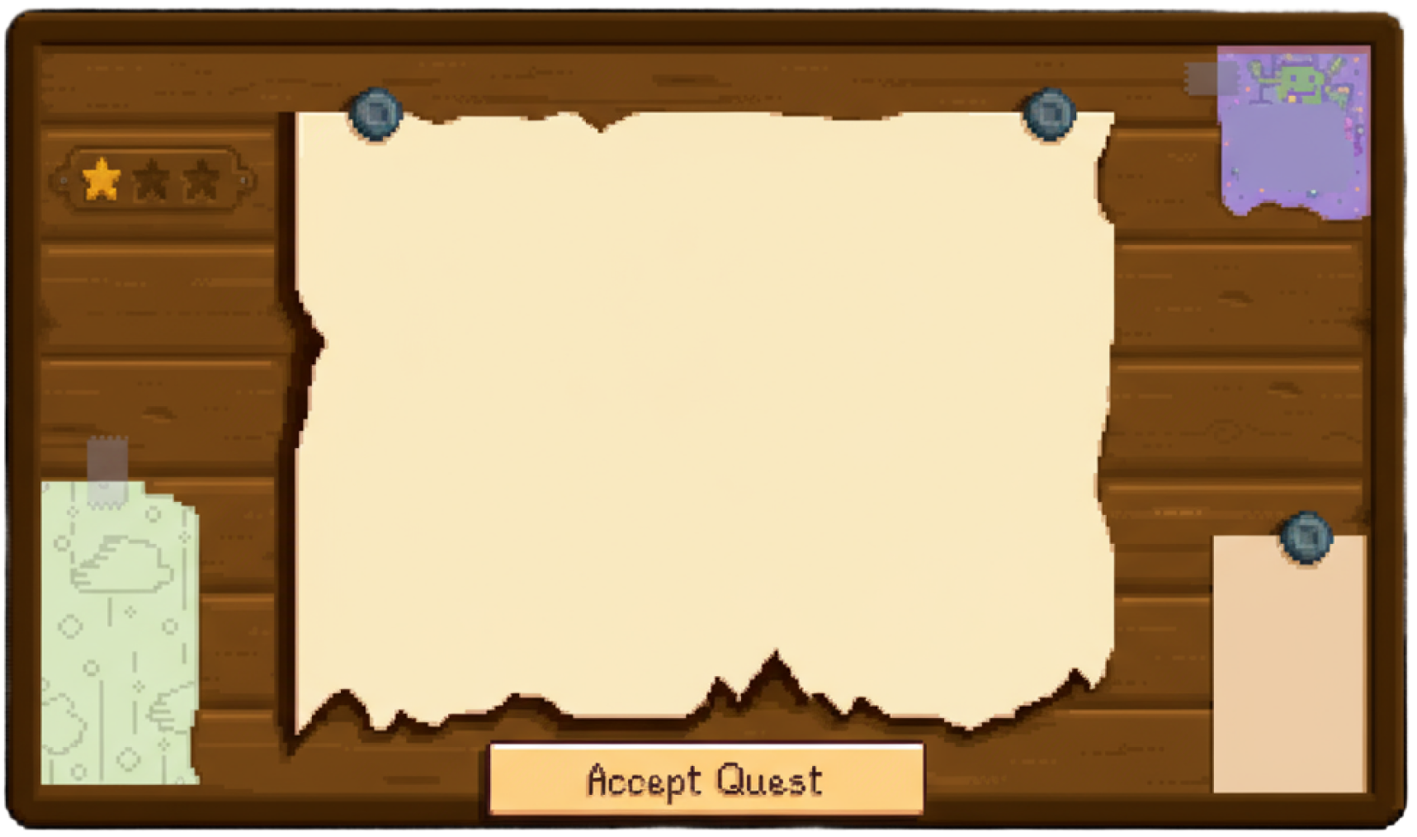
The Magic of Dragons
  Access to the intermediate and advanced dungeons.
  A greater number of quests and battles
  Ability to form larger parties with fellow adventurers.

Slide 10
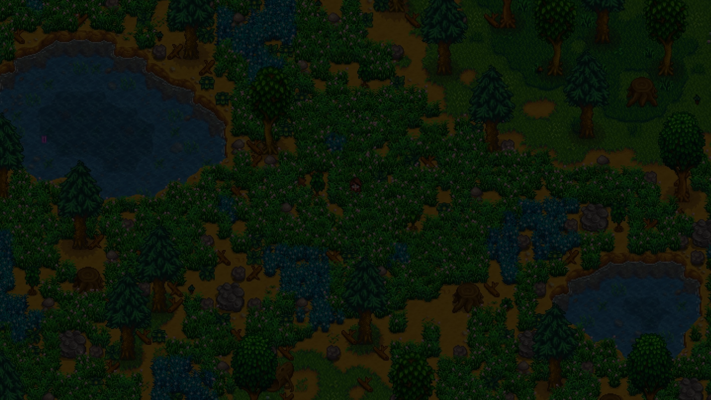




• Yes, you can use this for both personal and commercial projects.
• No, you don't have to credit us.
• No, you can't resell or redistribute it, including uploading this template online.
• And you can support us by sharing our site, EaTemp.com, with others.
Thank you for choosing EaTemp

